Slide 1

Calling attention to childhood lead exposure through data
Alyssa Sylvaria
The Providence Plan

Slide 2
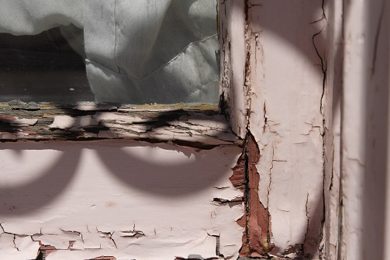
Costs of Lead
Health
Intellect
Special education
Lifetime earnings
Criminal activity and behavior

Slide 3
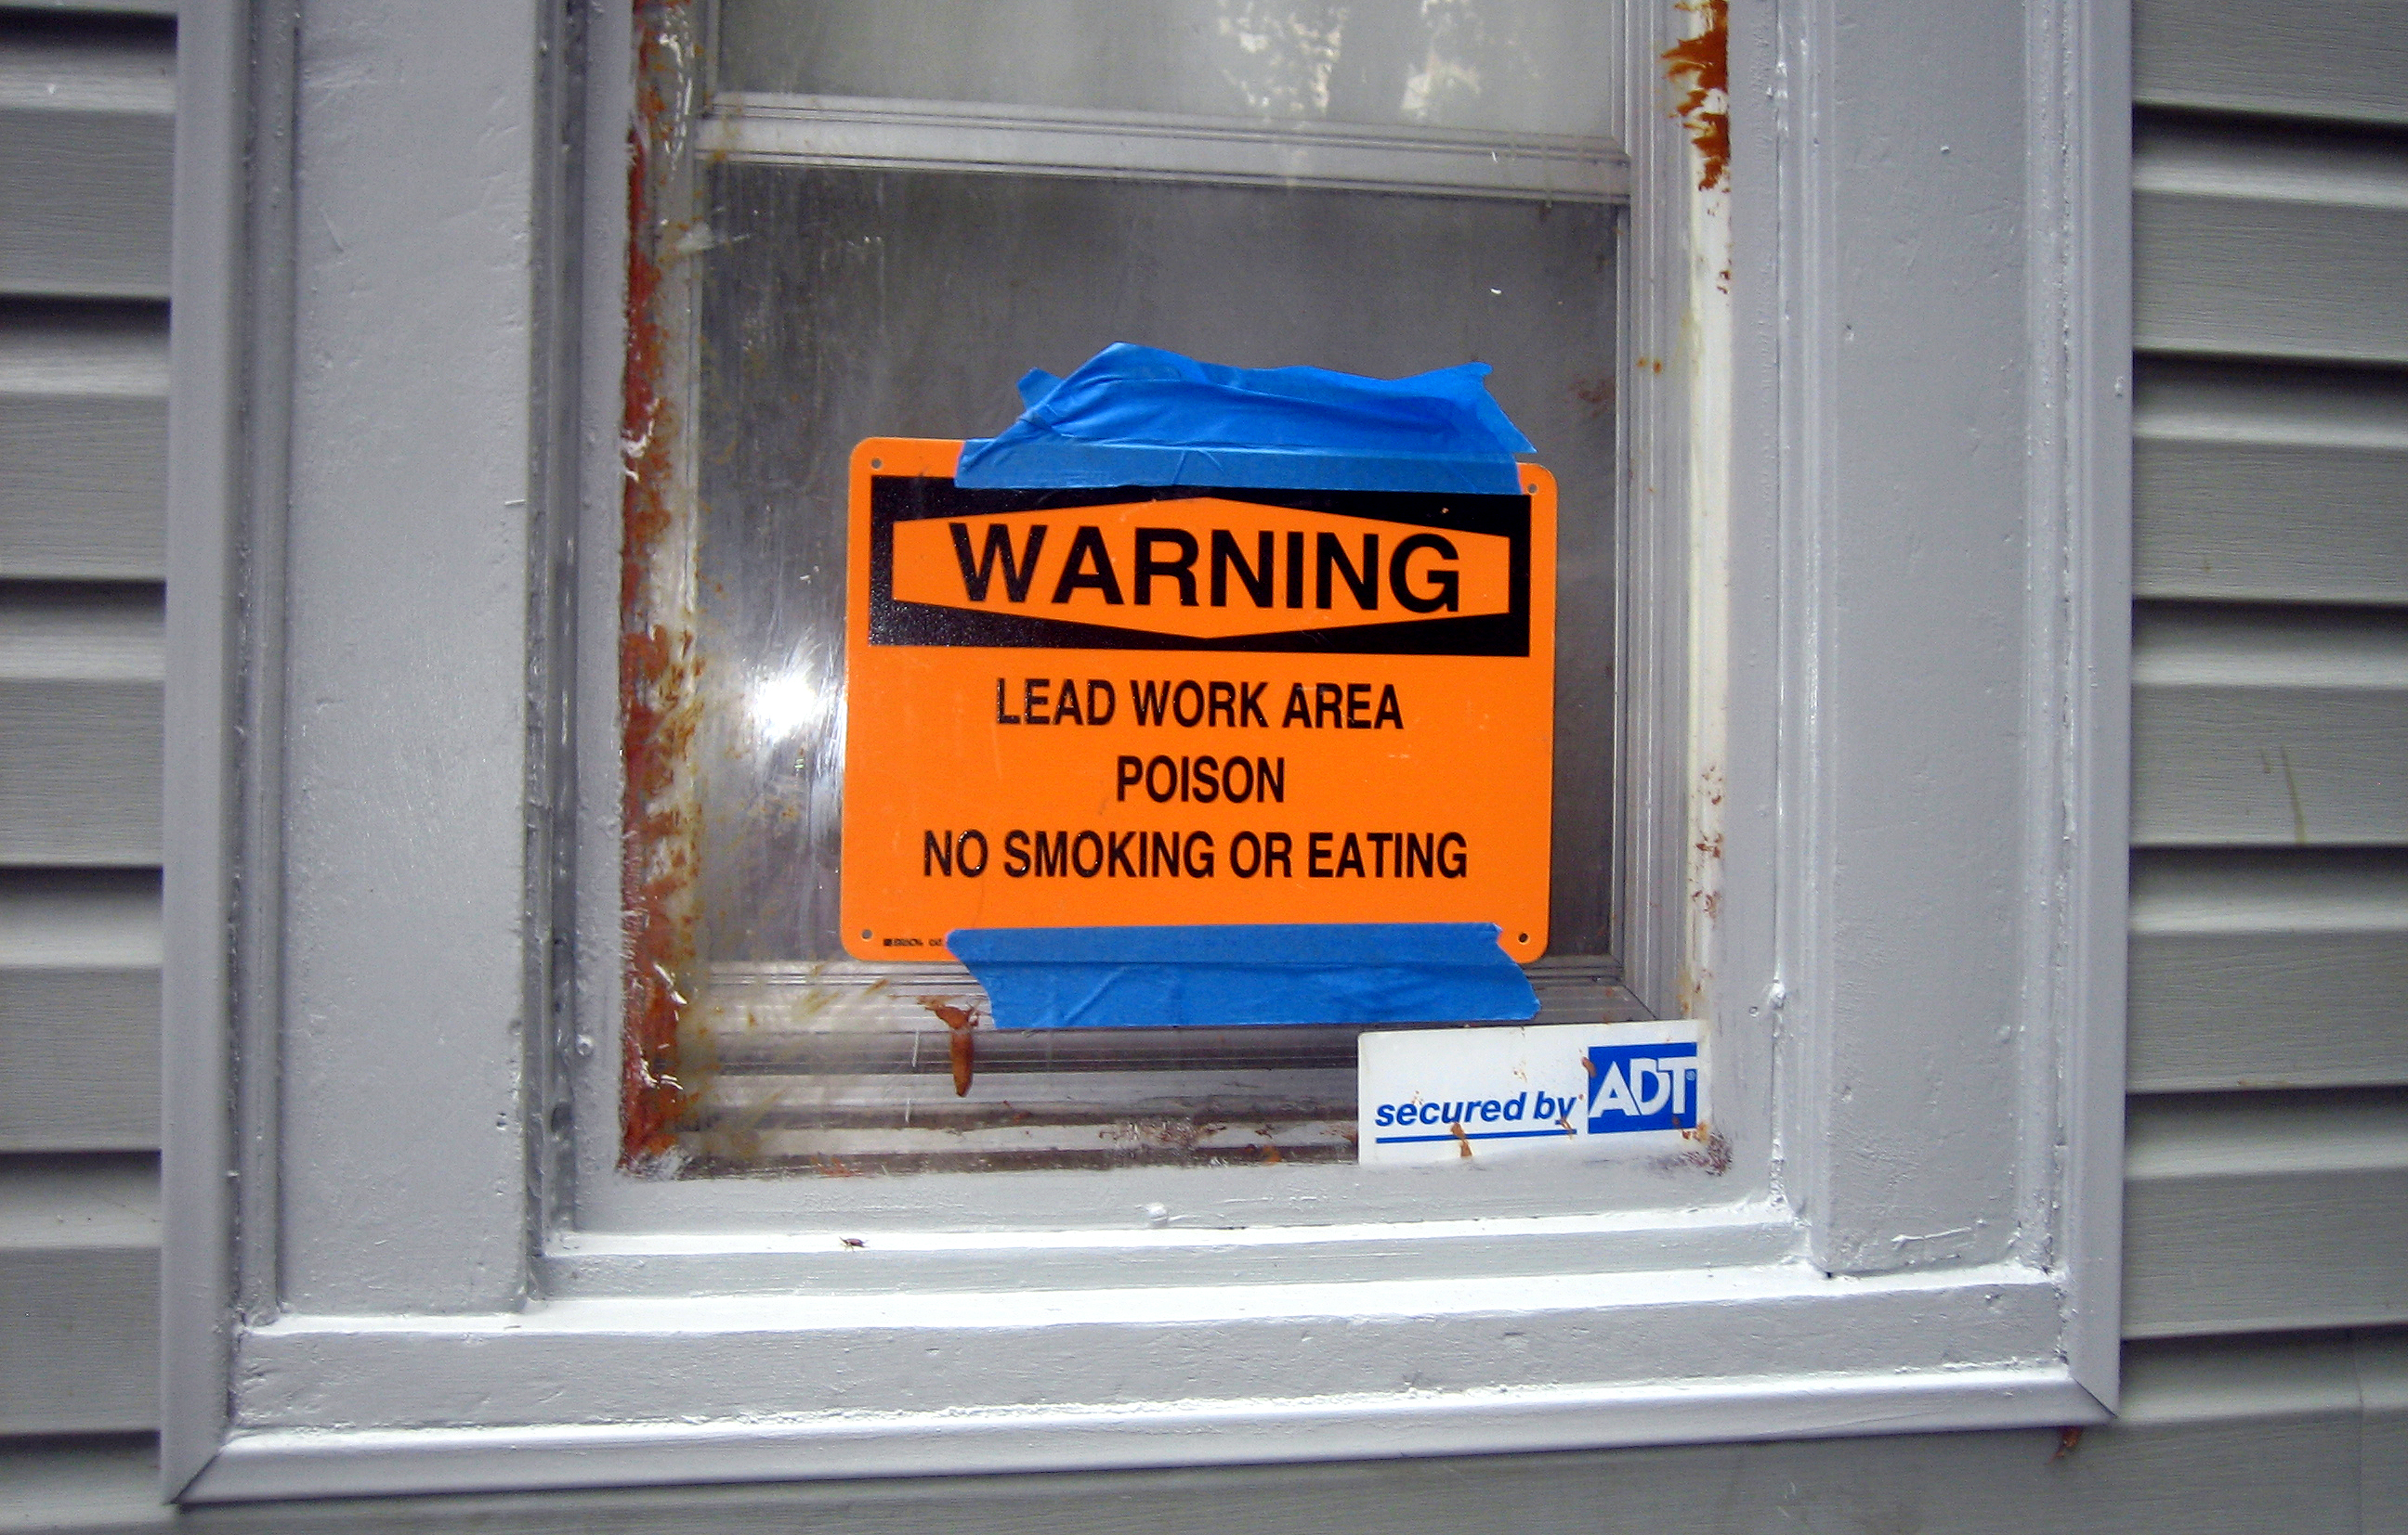
Lead exposure is preventable

Slide 4
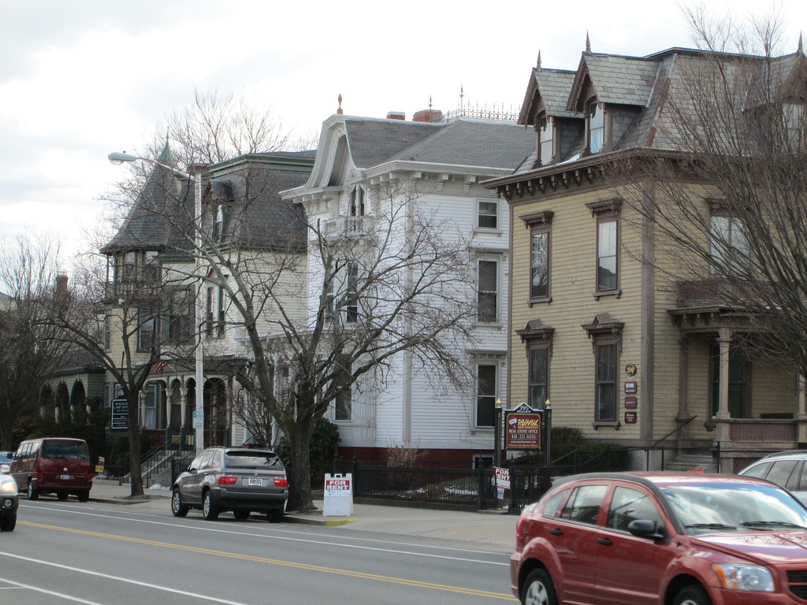

Housing & lead in RI

Slide 5




Notes:
History of working to prevent lead and promote healthy housing

Slide 6
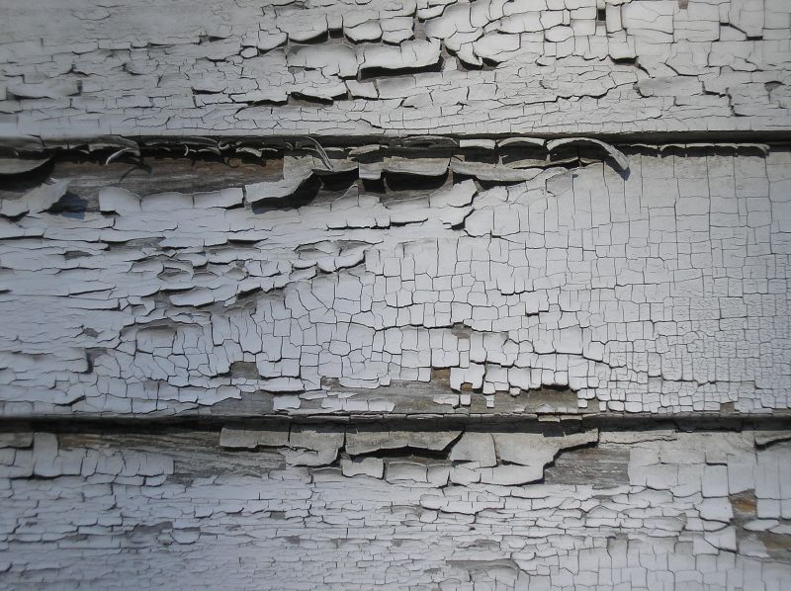
Lead-related data in RI
Lead screening
  About 760,000 records for about 338,000 individuals (all ages)
  1994 to 2013
Property compliance with lead laws
  Four “core cities”
  2005 to 2012

Slide 7



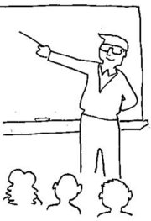
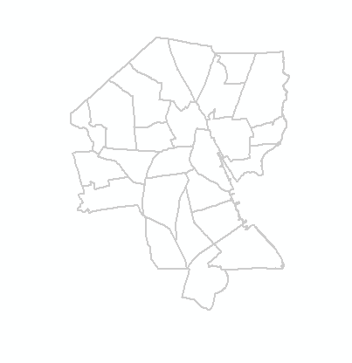
What we know about children
Lead test results
Property attributes
Neighborhood characteristics
Schools attended and educational outcomes

Slide 8



Where we publish data online
RI Data HUB ridatahub.org
Custom graphs, maps, charts
In-depth analysis of data across state agencies
RI Community Profiles profiles.provplan.org
Comprehensive maps at census tract, municipality, and state levels
Providence Healthy Housing Mapper
mapper.provplan.org/healthyhousing
Interactive map exploring childhood lead exposure, asthma, and property information in Providence.
Notes:
How we share the data publicly

Slide 9
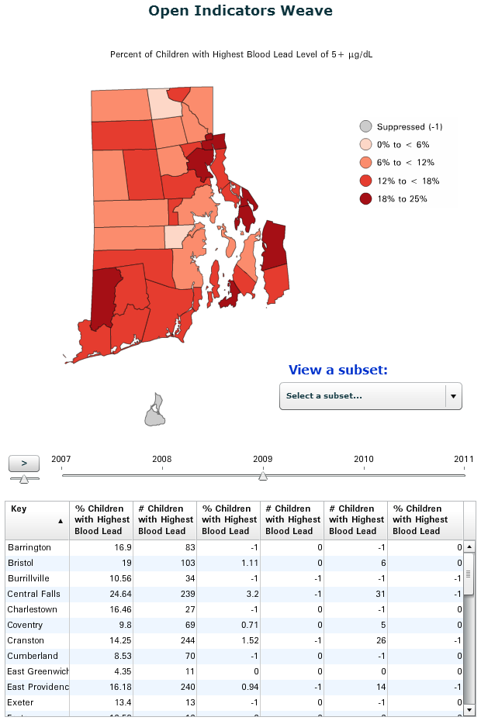
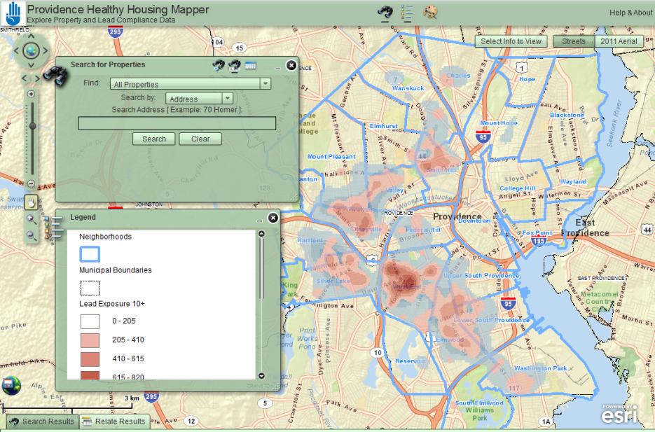
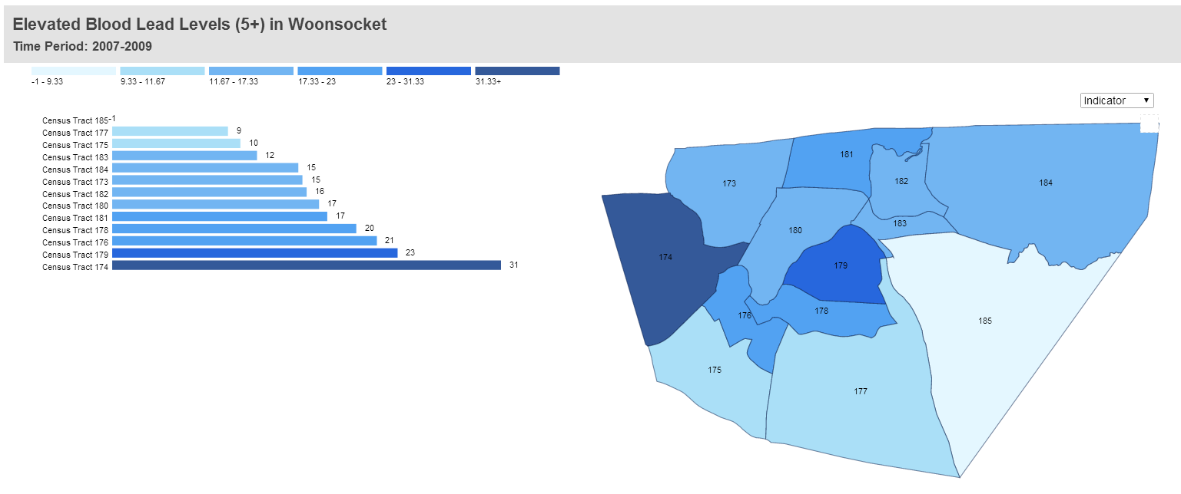
Map Childhood Lead Exposure
Notes:
Choropleth and hotspot maps help identify

Slide 10
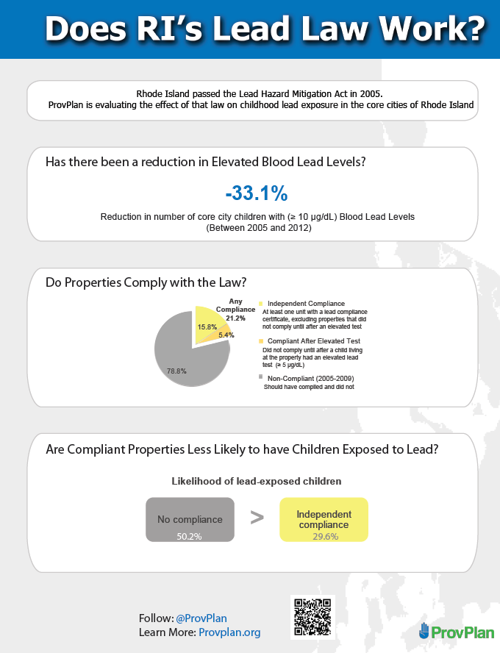
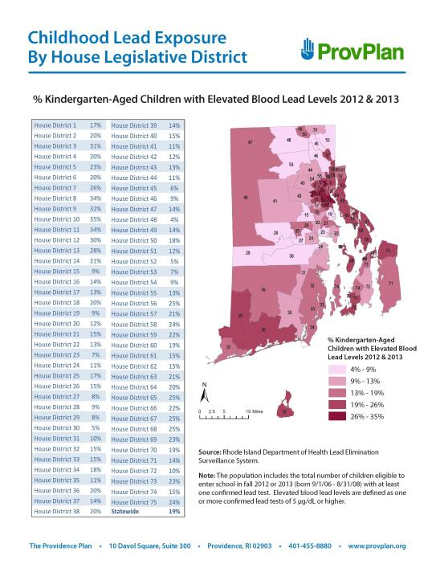
Provide
Visualization
Tools for
Advocates

Slide 11
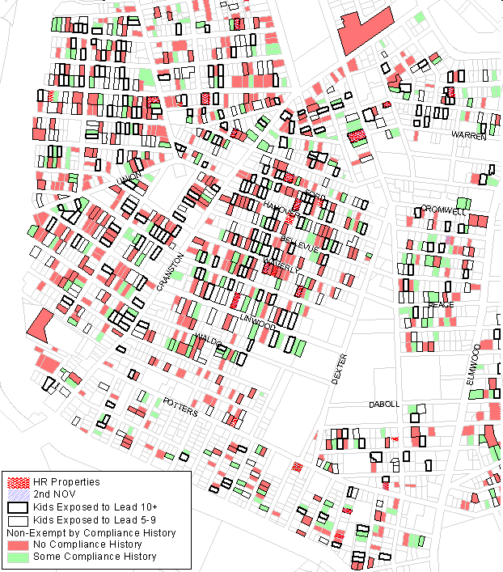
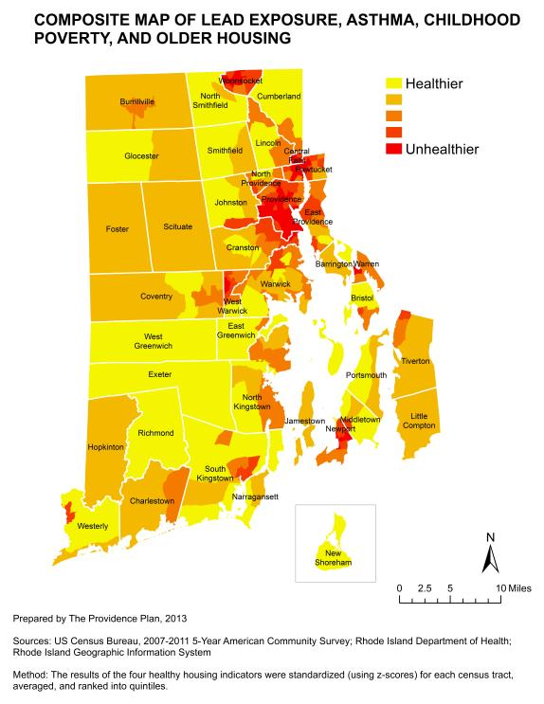
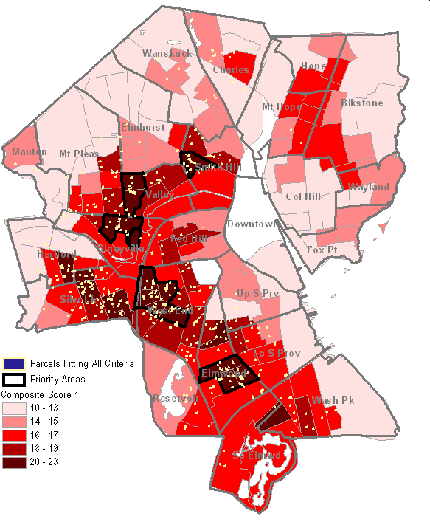
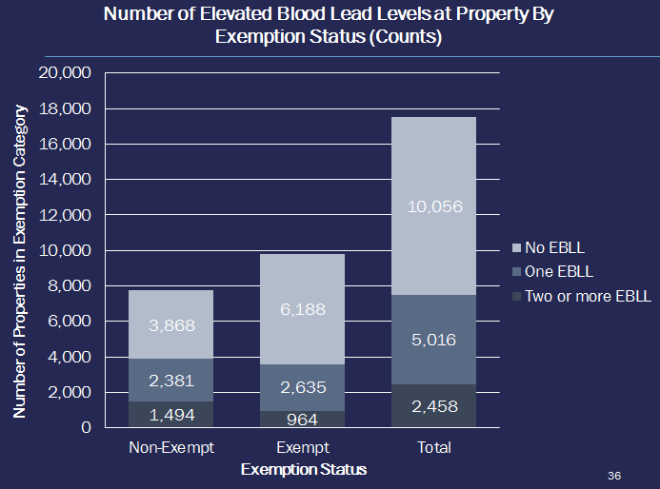
Put lead into the healthy housing context
Children Exposed to Lead by Compliance

Slide 12
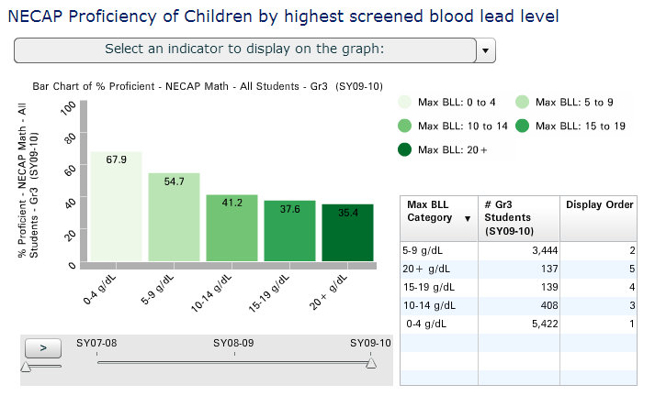
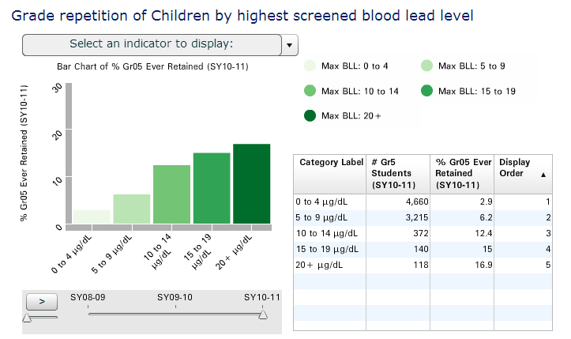
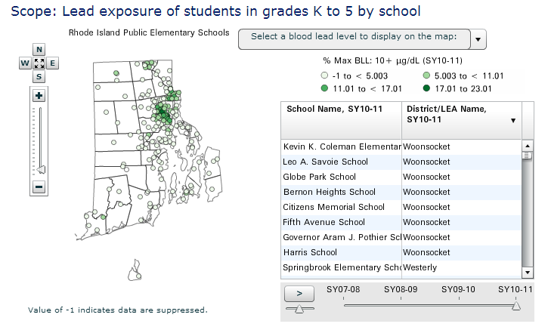
Connect lead and educational outcomes

Slide 13
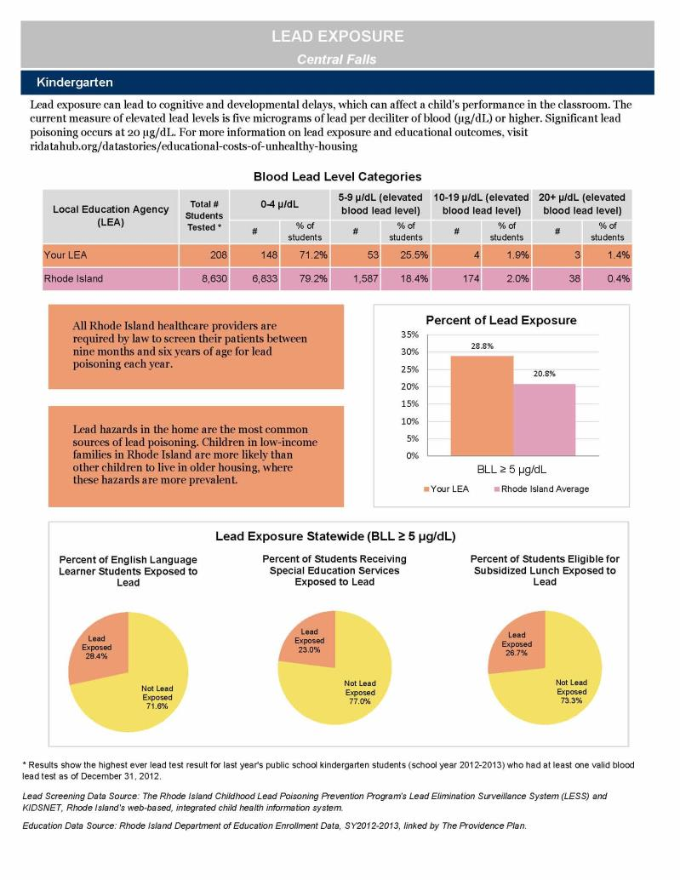
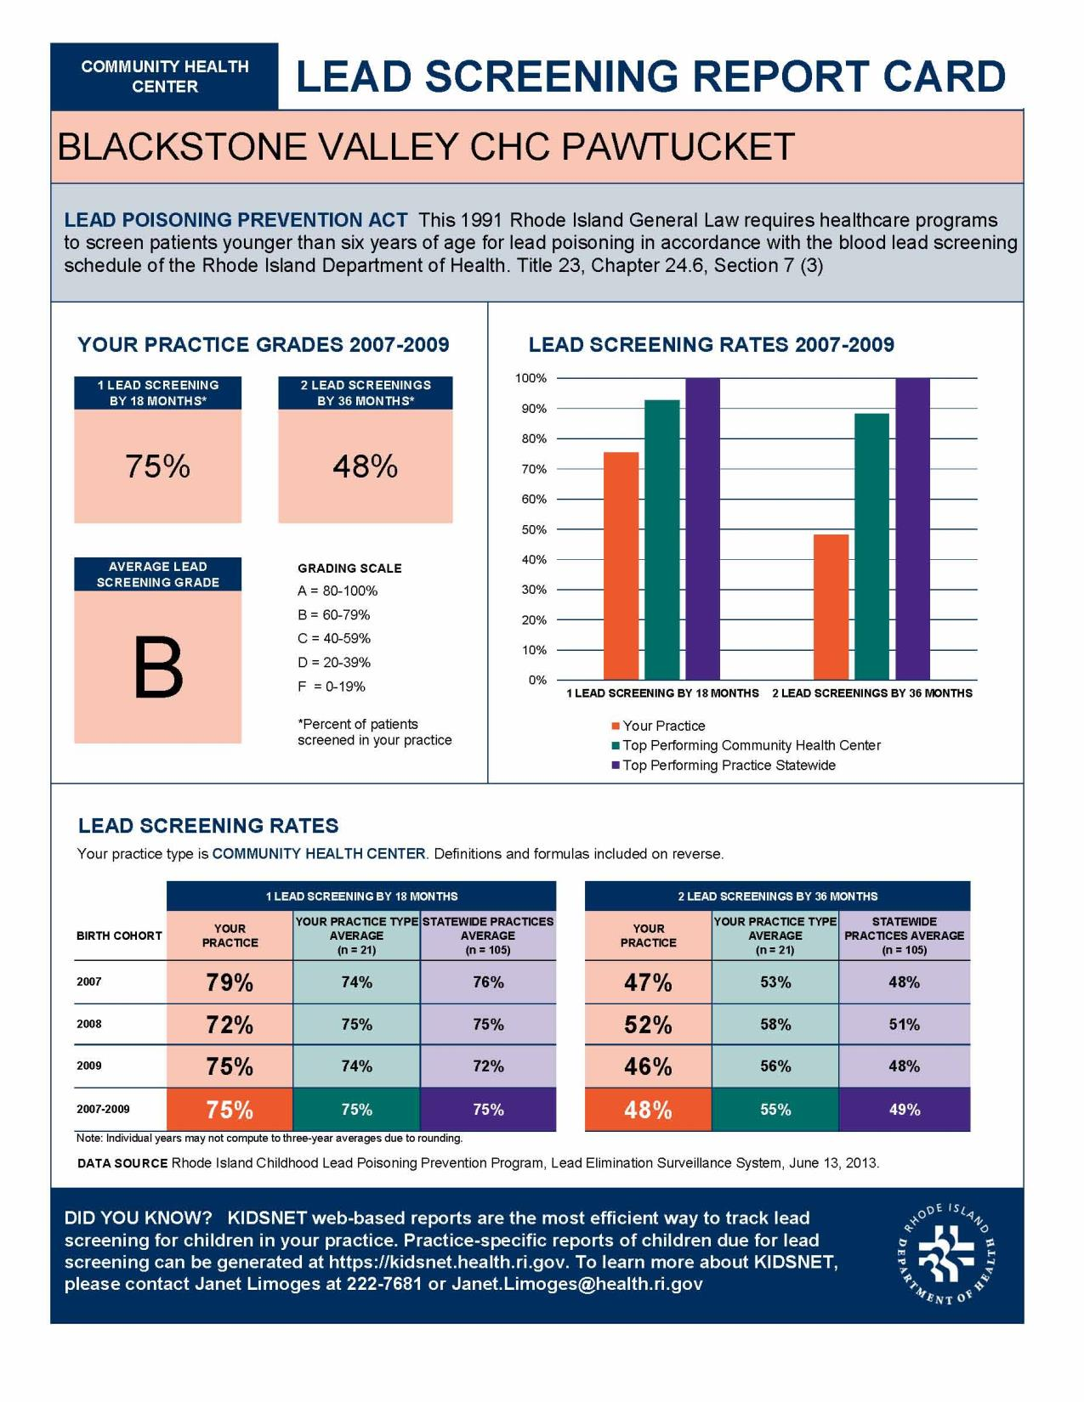
Create customized reports to mail

Slide 14
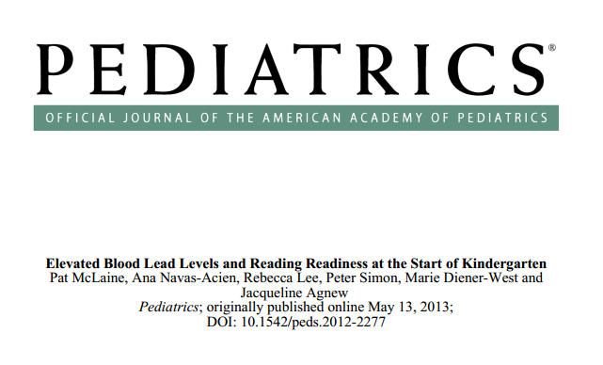


Publish

Slide 15
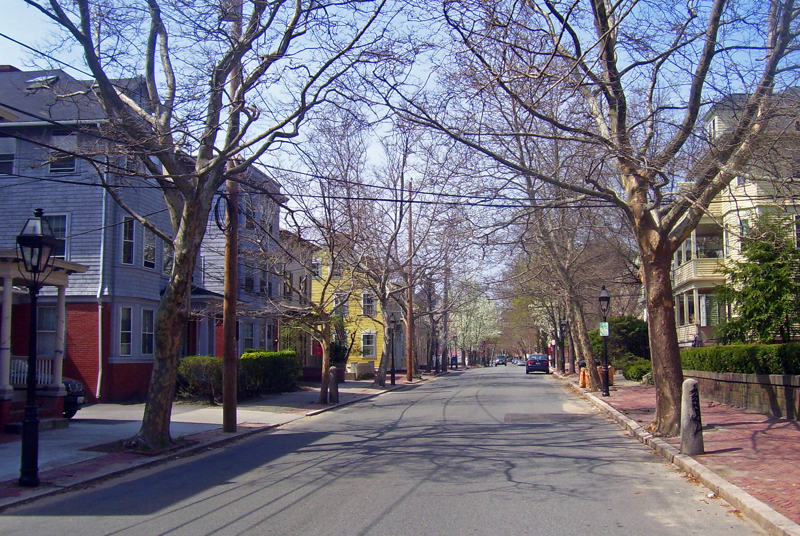
From here…
Update data
Emphasize connection with healthy housing
  Asthma data
  City inspections
  Energy usage
We’re open to suggestions

