Slide 1
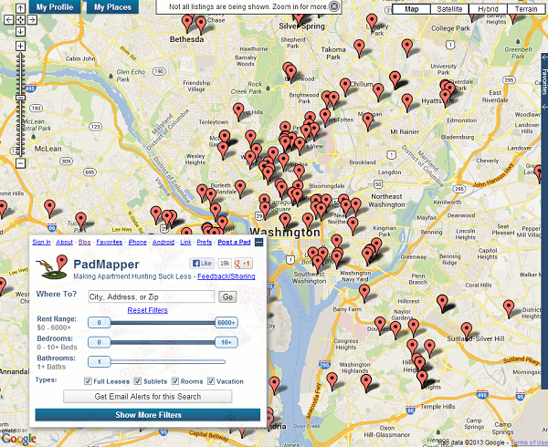
Rent Surveys
Web scraping to provide timely rental data
Created by: Graham MacDonald
Presented by: Rob Pitingolo
NNIP Partnership Meeting, June 2013

Slide 2
Why do this?
Survey every rental housing unit listed online (n =potentially thousands)
Collect valuable information about neighborhood rents
Precision allows for indicators at small-level geographies

Slide 3
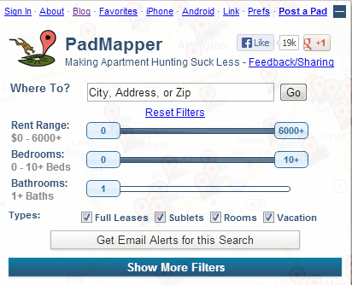
What is PadMapper?
A “Meta-site” that regularly draws rental data from top online listing services (and its own listing service)
Makes the search process easier through simple filters and a Google map interface

Slide 4
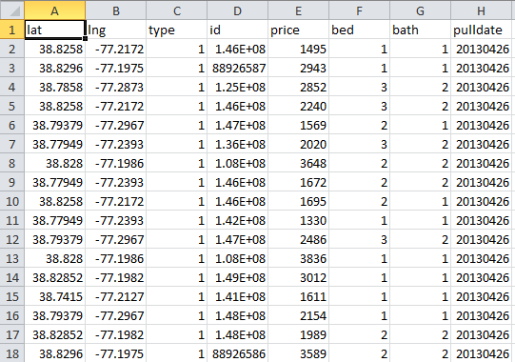
What is web scraping?
Web scraping is a program (often written in python) that extracts data from websites and puts it in a standard structured format. We scrape data weekly.

Slide 5
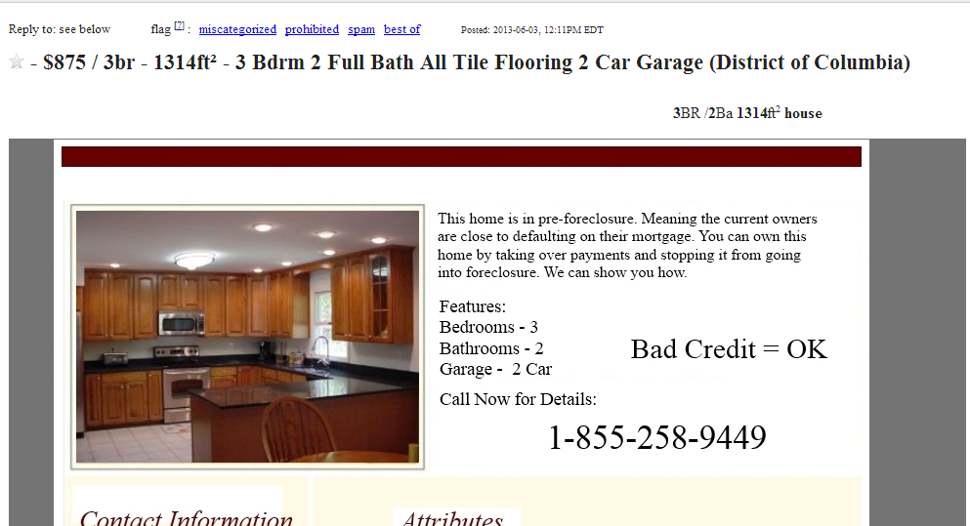
What can the data tell us?
List prices for apartments listed online…
…but not rentals that never make it to the web (or don’t get listed at all).

Slide 6
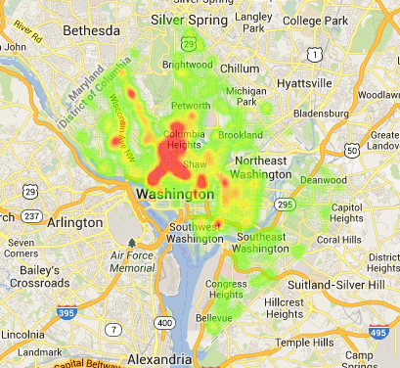
How Inclusive Is PadMapper?
Over a 12 week period from 3/14 to 5/31, there tended to be more listings in higher income areas with more adults.
Ward | Renter-Occupied Units | PadMapper Listings | Listings per 100 Renter-Occupied units | PctUnder18 | PctWhiteNH | PctBlackNH | PctPoorPersons | Pct16OverEmployed | AvgFamilyIncome
2 | 24,539 | 2263 | 9.2 | 4.8 | 70 | 9.8 | 15 | 67 | 205343
6 | 19,234 | 1610 | 8.4 | 14 | 47 | 43 | 18 | 67 | 115992
3 | 17,931 | 1486 | 8.3 | 13 | 78 | 5.6 | 7.1 | 67 | 257241
1 | 22,435 | 1491 | 6.6 | 12 | 40 | 33 | 16 | 71 | 94197
5 | 15,447 | 829 | 5.4 | 17 | 15 | 77 | 19 | 54 | 78559
4 | 11,843 | 634 | 5.4 | 20 | 20 | 59 | 9.9 | 61 | 116668
8 | 20,071 | 413 | 2.1 | 30 | 3.2 | 94 | 34 | 48 | 44341
7 | 17,255 | 249 | 1.4 | 24 | 1.5 | 95 | 27 | 47 | 54809

Slide 7
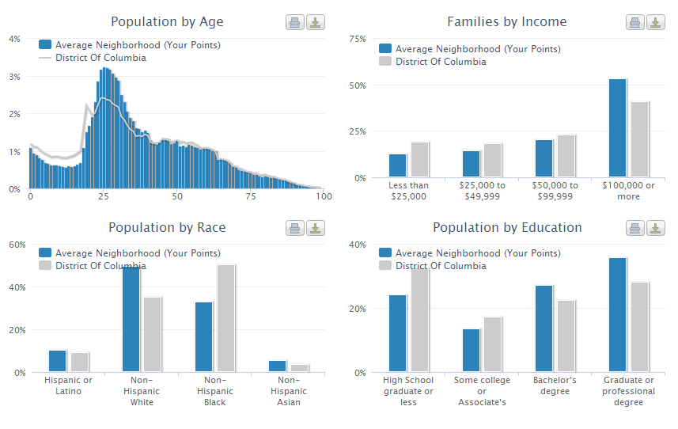
How Inclusive Is PadMapper?
(Weighted average, based on the number of points in each tract.)

Slide 8
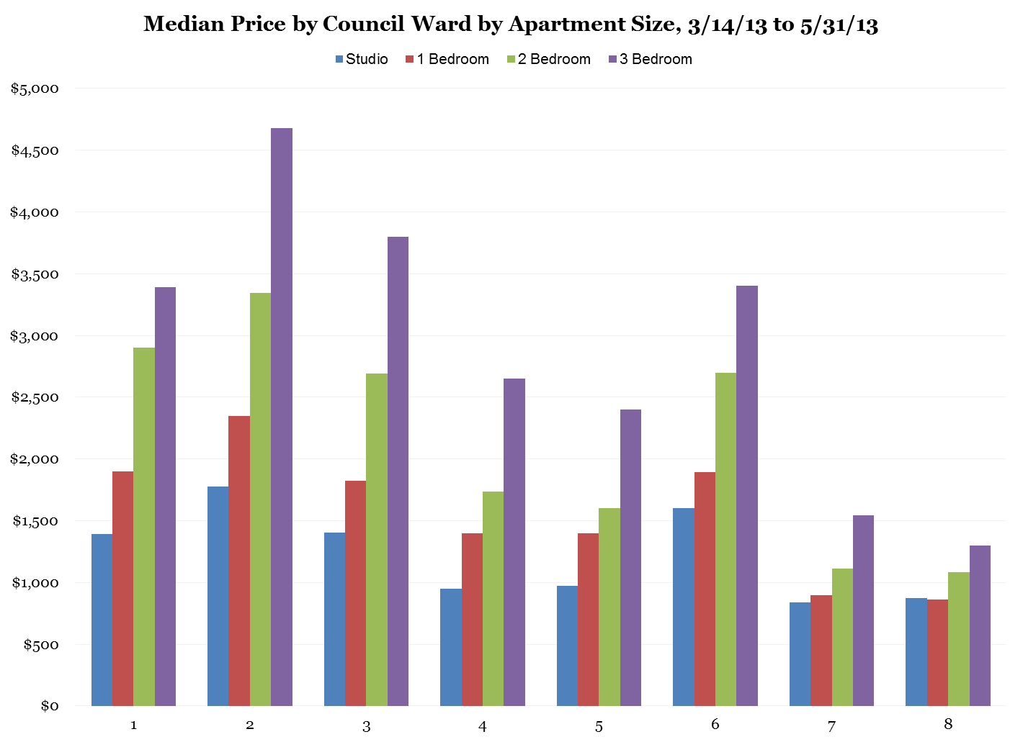
What did we find so far?
General Council Ward-level price trends

Slide 9
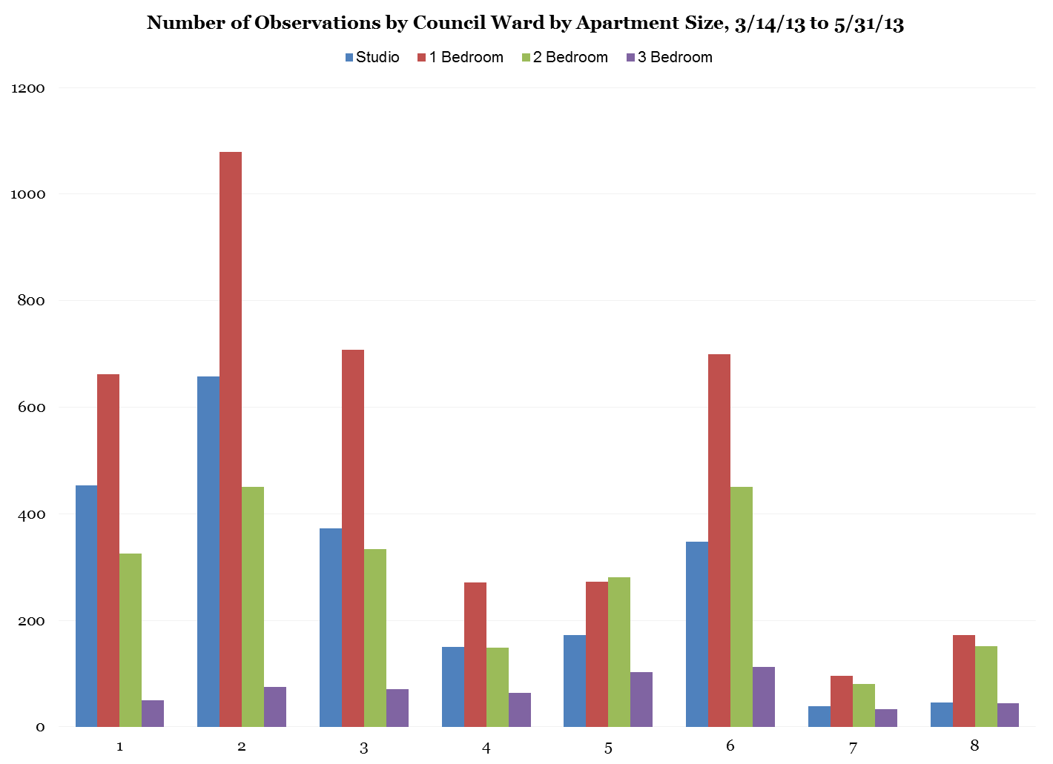
What did we find so far?
It is difficult to get enough observations for 3 bedroom apartments.

Slide 10
Goals for the future
Use larger time periods for smaller geographies. Currently, we still need more data for the D.C. Neighborhood Cluster level, especially for 3-bedroom units.

Slide 11
Goals for the future
Use larger time periods for smaller geographies. Currently, we still need more data for the D.C. Neighborhood Cluster level, especially for 3-bedroom units.

Slide 12
How does it actually work?
Step 1: Download data from web API to offline database
Step 2: Use ArcGIS to geocode lat/long data to local geographies
Step 3: Use statistical software to analyze your rent survey

Slide 13
I want to set this up. How?
Code available on request (Python + SAS). Contact Graham MacDonald.
You will need to know/have:
Python or another web-scraping scripting language.
A statistical software package or a database system:
SAS, Stata, etc.
MySQL, PostgreSQL
Server-side scripting language
PHP, Ruby, Python

Slide 14
Wait, is this legal?
It appears to be legal.
Sites like Craiglist do not have any exclusive content language in their Terms of Use.
Currently, PadMapper is involved in a lawsuit brought by Craigslist, but the judge only allowed evidence from posts made in a three week period between July 16 and August 8, 2012, when Craigslist required that users provide the site with exclusive content rights, before they ended up dropping that language as a result of criticism.
We do not use data from that time period.
PadMapper is not involved in any other ongoing litigation.
PROCEED AT YOUR OWN RISK

Slide 15
Resources:
Padmapper www.padmapper.com
NeighborhoodInfo DC www.neighborhoodinfo.org
Graham MacDonald: GMacDonald@urban.org
Rob Pitingolo Rpitingolo@urban.org

