Slide 1
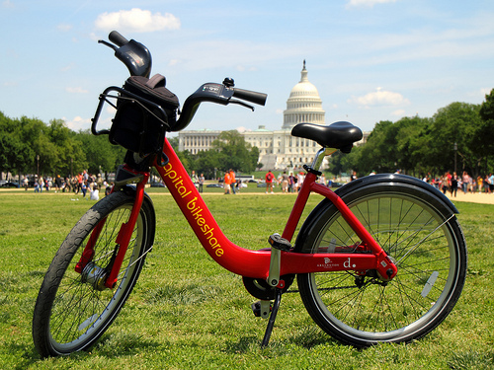
Capital bikeshare: An “Open Data” Success Story
Rob Pitingolo, The Urban Institute
NNIP Partnership Meeting, September 2012

Slide 2
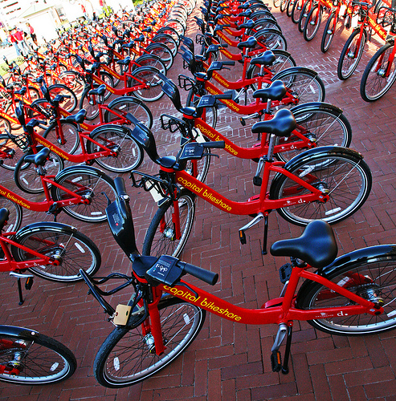
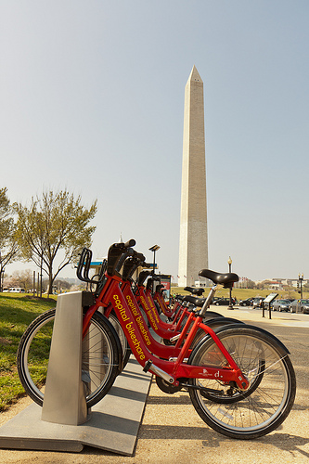
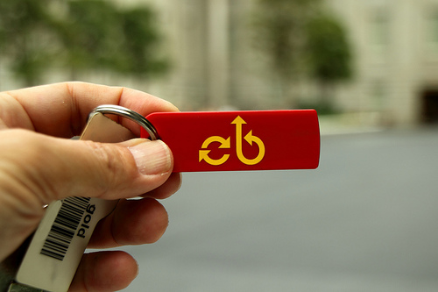
What is Capital Bikeshare?
1,200 Bikes
400 Stations
19,200 Annual Members
100,000+ Daily Members

Slide 3
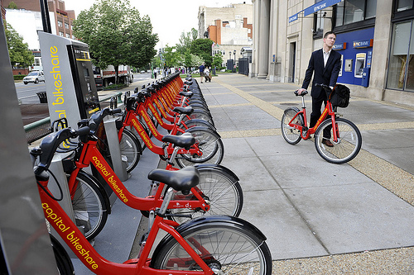
How Does It Work?
Sign Up
Take a Bicycle
Ride Away!

Slide 4
The Path to Open Data
September 2010: Capital Bikeshare Launched
Summer 2011: Big Push for Bikeshare to Release Data
January 2012: Open Data Released
Trip-Level Origin-Destination Data
Users Have Taken Over 2 million Capital Bikeshare Trips!
Example Data:

Slide 5
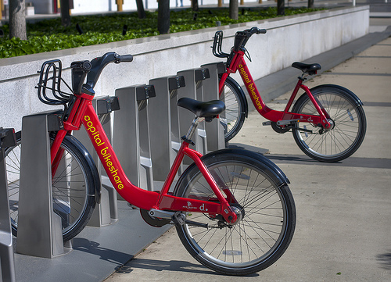
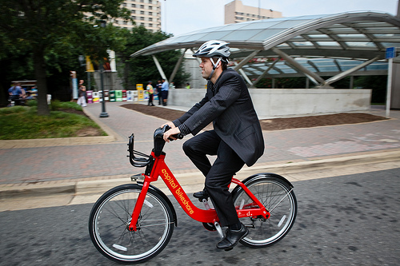
Research Questions
Does the System Operate Efficiently?
Who Uses Bikeshare? How Do They Behave?

Slide 6
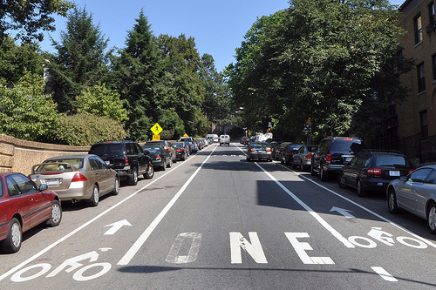
Q: Do Users Only Ride Downhill?

Slide 7
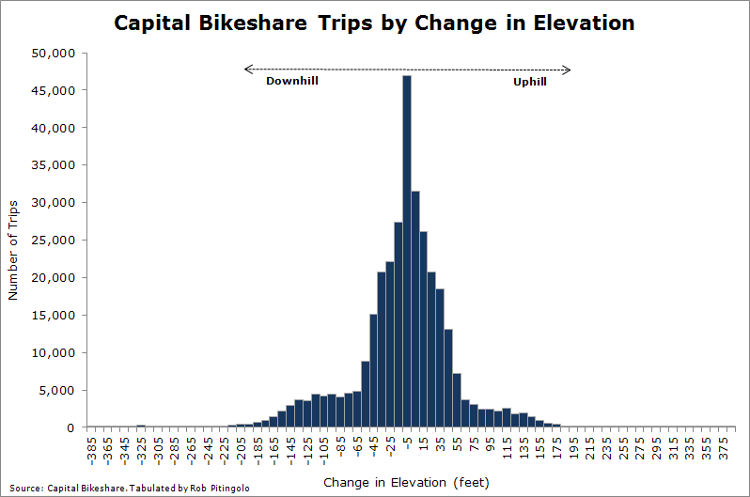
Answer: No!
80% of Trips Taken on Flat Ground
Median Trip:
3 feet downhill

Slide 8
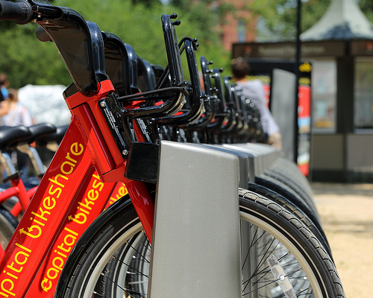
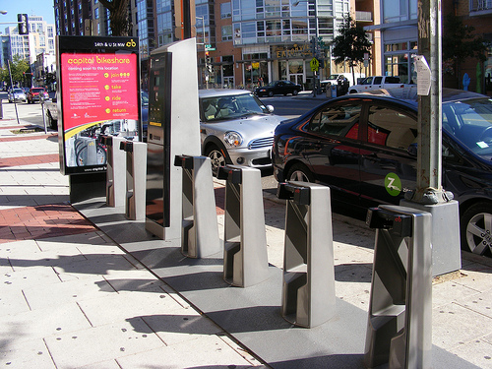
Q: Do Stations Downtown Fill Up in the Morning, Empty Out in the Afternoon?
Afternoon?
Morning?

Slide 9
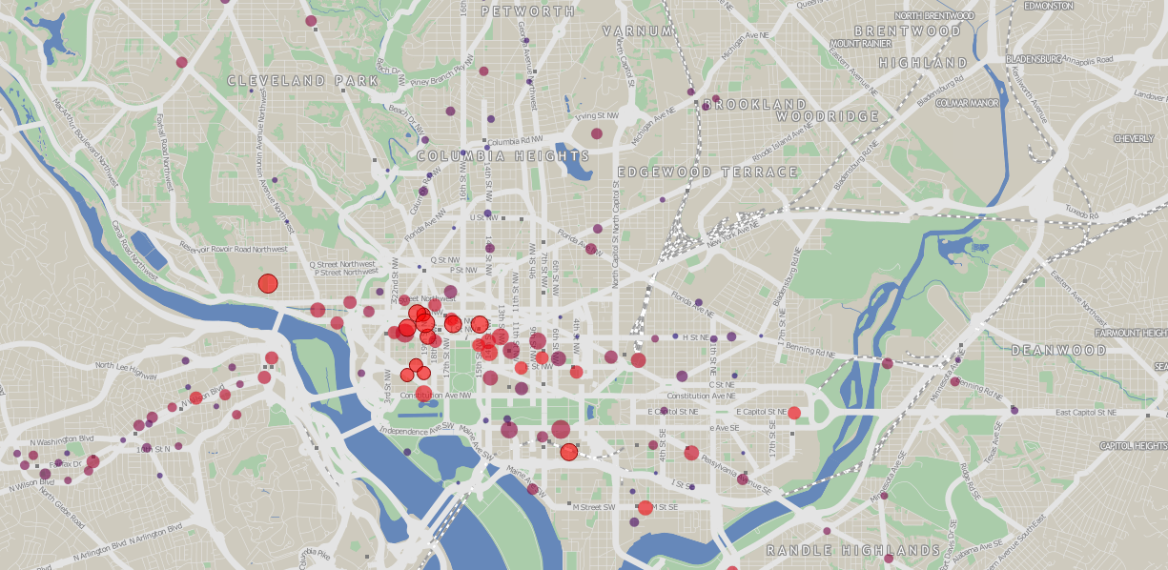
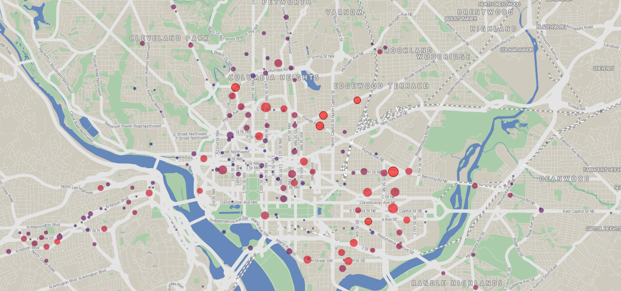
Answer: Yes!
9:30 am
6:30 pm

Slide 10
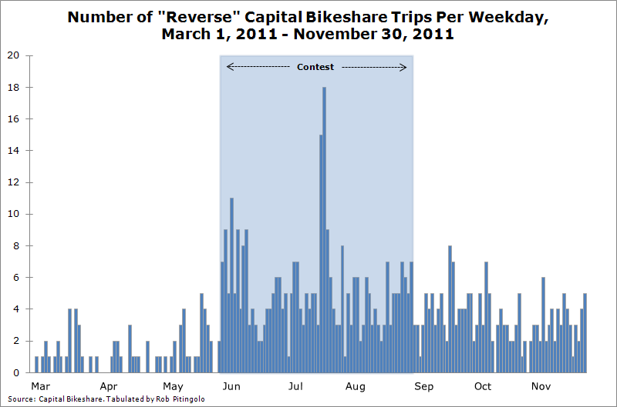
Q: Does Incentivizing “Reverse” Trips Work?

Slide 11
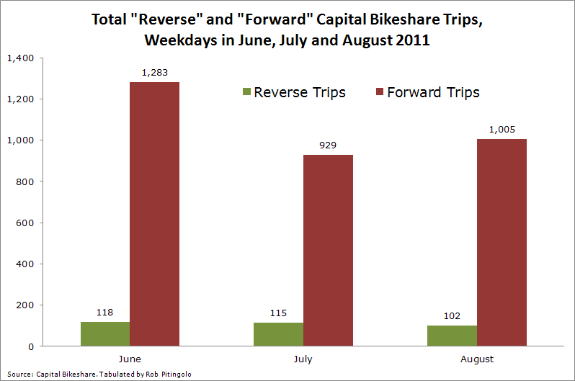
Answer: Not Really…

Slide 12
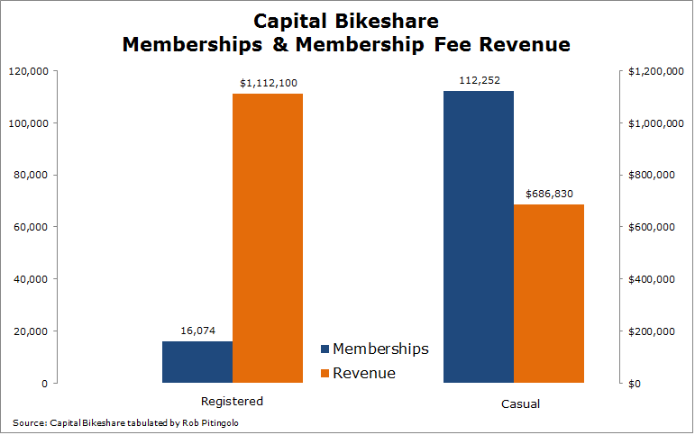
Q: Who Uses Capital Bikeshare?

Slide 13
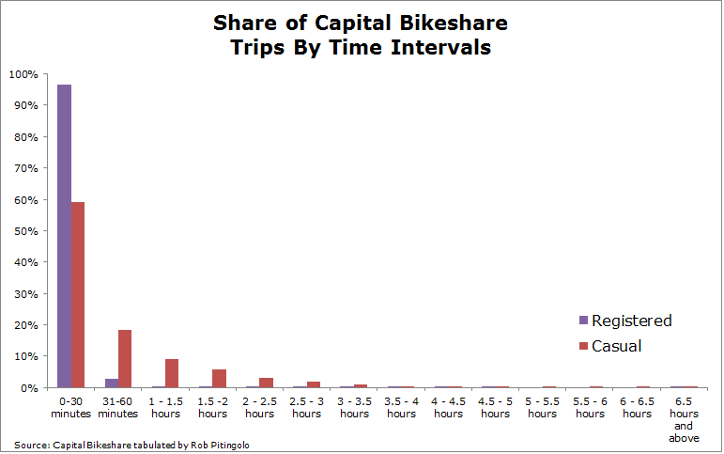
Registered Users Take Short Rides

Slide 14
Casual Users Are More Profitable

Slide 15
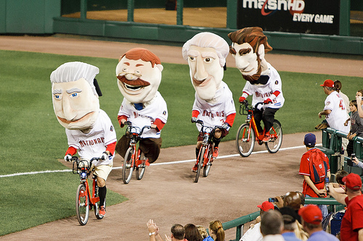
The Benefits of Open Data Extend Well Beyond Capital Bikeshare
For More:
http://tinyurl.com/cabi-opendata
rpitingolo@urban.org

