Slide 1

STRATEGIES FOR COMMUNITY SUCCESS
JUVENILE WELFARE BOARD
Children’s Services Council
PINELLAS COUNTY
FLORIDA
NATIONAL NEIGHBORHOOD INDICATORS PARTNERSHIP
JUNE 19, 2013
COLUMBUS, OH

Slide 2
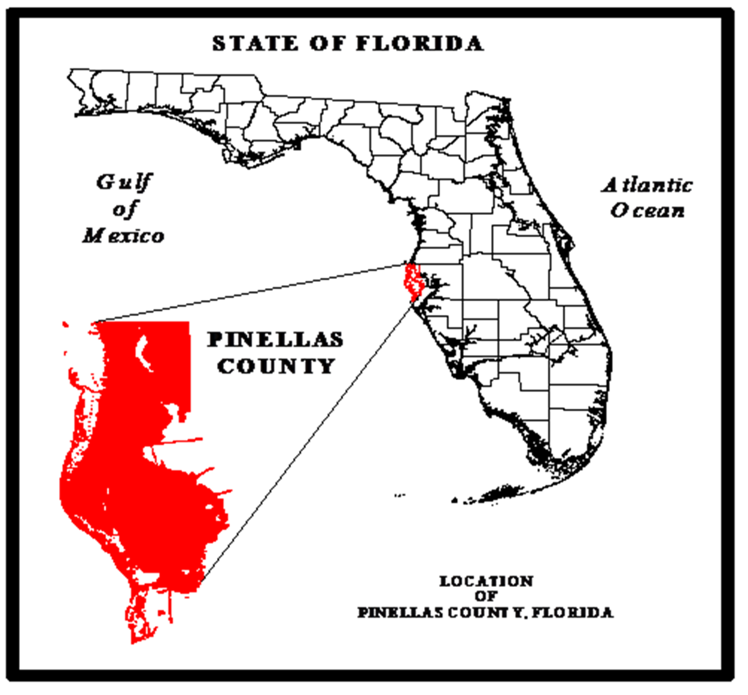
Juvenile Welfare Board (JWB)
Who are we?
Where are we?
.
An independent special taxing district whose mission is to: invest in partnerships, innovation and advocacy to strengthen Pinellas County children and families (est. 1946).
Notes:
Define independent taxing district. It is important to emphasize that the JWB was funded by a grass-roots effort.

Slide 3
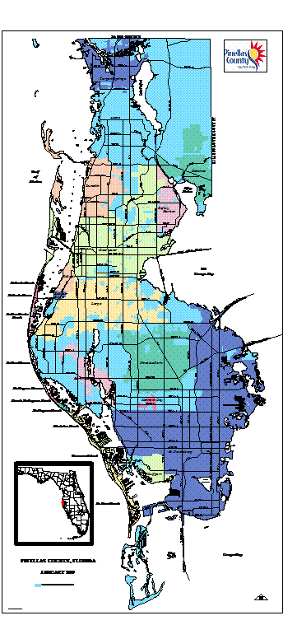
Pinellas County Fast Facts
Population = 916,542
Land Area = 279.92 square miles
Population Density = 3,274/square mile
82.1% White
12.6% at or below FPL
25 Governmental Bodies
Need for Close Intergovernmental Collaboration
Notes:
Here are some fast facts about Pinellas County. Clearwater and St. Petersburg are perhaps the best know municipalities in Pinellas.

Slide 4
What Do We Do?
Focus on services to children and families, with an emphasis on prevention and early intervention
Fund promising practices and evidence-based initiatives
Employ data-driven decision making
Support a network of neighborhood family centers in distressed areas & community councils
Foster partnerships and collaboration in data sharing, research, funding, and policy initiatives to improve quality-of-life conditions
Data
Plan
Action

Slide 5
  Research & Analyses
Examples of evaluation, planning and research:
Carrera Integrated School Model – school-based teen pregnancy prevention
21 Century Community Learning Center
Longitudinal evaluation of social and academic outcomes in partnership with Pinellas County Schools
Status of Pinellas Children
Homeless Point-In-Time
Place-based analyses and planning
Notes:
Carrera Integrated School Model - The program has seven integrated, scientifically accurate, and age appropriate components offered daily or weekly which work in concert to build developmental competency, identity formation and other positive youth development outcomes for participants, ultimately leading to the desire to avoid parenthood and risky sexual behaviors. All participants, regardless of program location, receive the following full seven components from youth development professionals, educators, and other specialists trained by national CAS-Carrera staff:
21 Century Community Learning Center - This program supports the creation of community learning centers that provide academic enrichment opportunities during non-school hours for children, particularly students who attend high-poverty and low-performing schools. The program helps students meet state and local student standards in core academic subjects, such as reading and math; offers students a broad array of enrichment activities that can complement their regular academic programs; and offers literacy and other educational services to the families of participating children. – US Dept. of Education

Slide 6

JWB Promotes
Collective Impact
Common Agenda
Shared Measurement System
Mutually Reinforcing Activities
Continuous Communications
Backbone Organization

Slide 7
FY 2013-2014 Investments
Desired Result | Allocation
Every child is ready to learn and succeed | $17.2 million
Every child has a stable and nurturing family | $21.4 million
Every child lives in a safe and supportive community | $5.7 million
Every child is healthy | $5.7 million
Notes:
This does not include admin costs for research etc. so we probably want to mention the total budget. These are desired outcomes developed by the Florida Children and Youth Cabinet – Office of the Governor. A crosswalk was made with the Desired Results for Pinellas County which are:
Every person has the opportunity to learn and succeed. All people in Pinellas County have the opportunity to acquire the skills, training and education needed to be economically self-sufficient, productive contributors to society.
Every person is physically and mentally healthy. All people in Pinellas County have the means and ability to achieve a state of physical and mental well being.
Every person lives in a safe and sustainable community. All people in Pinellas County live in a socially supportive, crime-free neighborhood that is part of an economically vibrant community.
Every person has stable and affordable housing. All people in Pinellas County have an affordable, sturdy home that is free of hazards.

Slide 8

  Impact Through Partnerships
Partial List of Community Partners:
Pinellas County Government
Florida Department of Health for Pinellas County
Pinellas County Schools
St. Petersburg College/USF
Cities of Clearwater, St. Petersburg
Wealth Building Coalition
Early Learning Coalition
All Children’s Hospital
Homeless Leadership Board
Community Councils
Neighborhood Family Centers
Notes:
Denise finishes here

Slide 9
  Functions & Technologies Supporting Objectives
Data Intermediary
Community Indicators
Research and Analyses
BI
Synergy
IT/BI
RAD
Notes:
Joe Starts Here

Slide 10
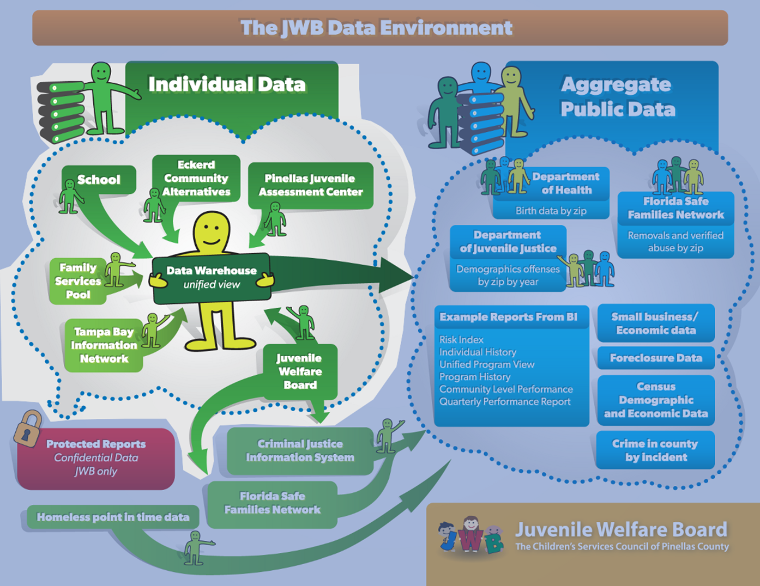
  JWB Data Environment
Notes:
Quickly view and analyze up-to-the-minute company reports and data in an innovative application designed specifically for mobile. Individually tailored insights give you the details you need for smart decision making and impromptu presentations.

Slide 11
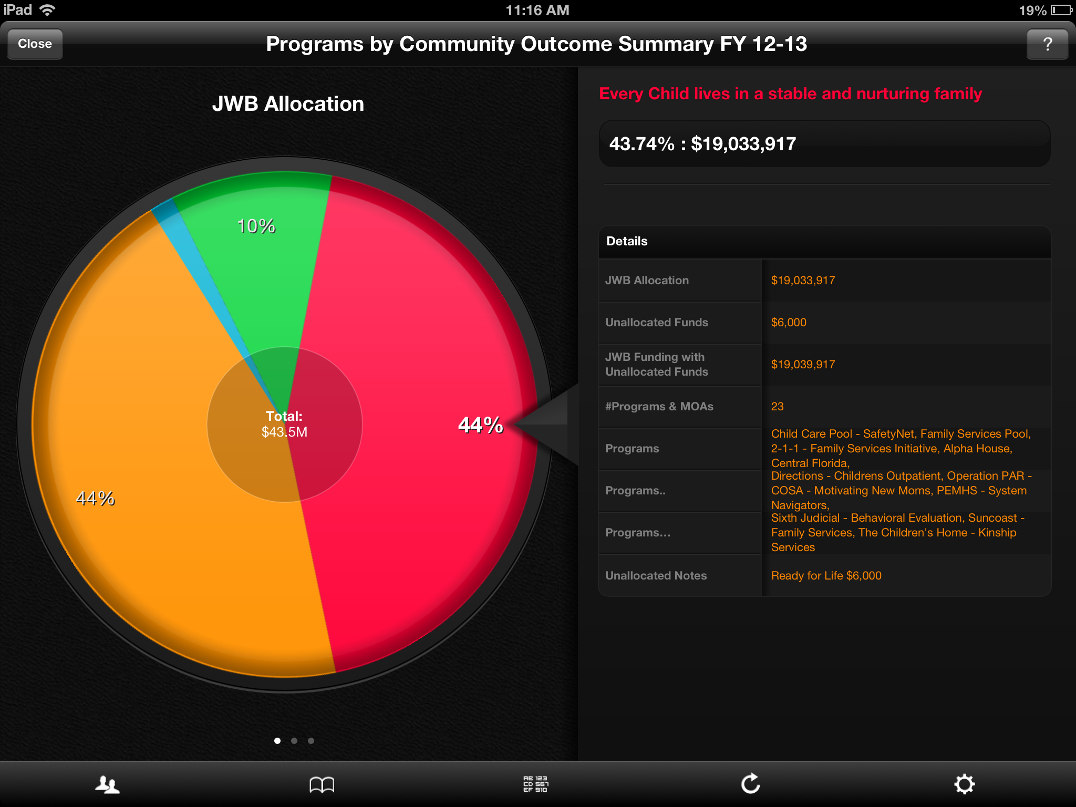
  ROAMBI Reports
Notes:
JWB has a service and activities management system, reports on performance objectives and finances are presented in a variety of formats including Roambi.

Slide 12
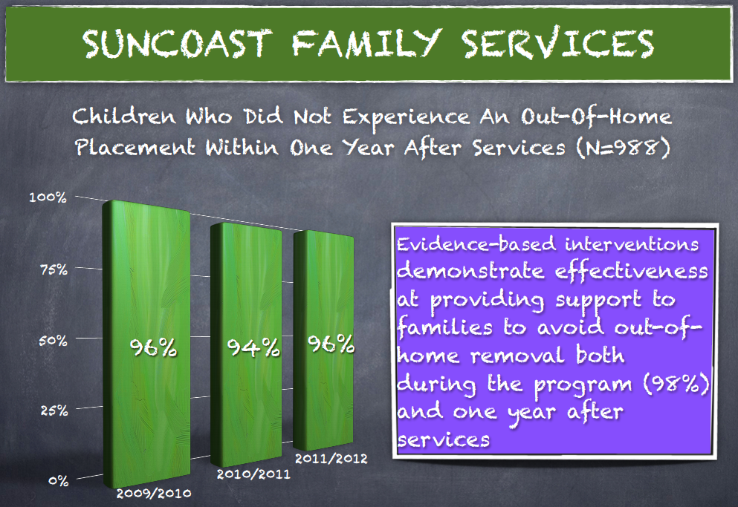
  Performance Management
Notes:
Program performance is monitored closely and shared with providers and the community.

Slide 13
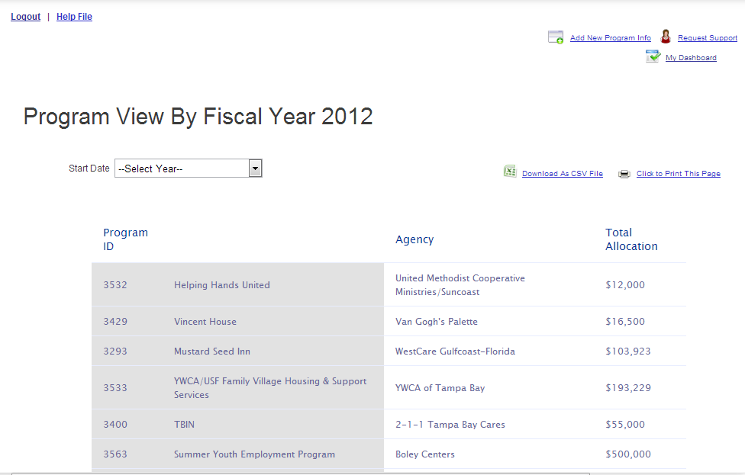
  Community Investment Profile
Notes:
Program performance is monitored closely and shared with providers and the community.

Slide 14

  Community-Level Data Utilization
Annual Paper Indicators Reports
Community Indicators pinellasindicators.org
Community Impact
Focus on Communities of Need
Robust data visualization capabilities
Integrated data system
Information on key areas of child well-being
Web-based, flexible
Promotes shared policy and funding decisions
Geographically referenced data
On Track for full CI-PM integration
Data available for download
2013
2006
1978

Slide 15
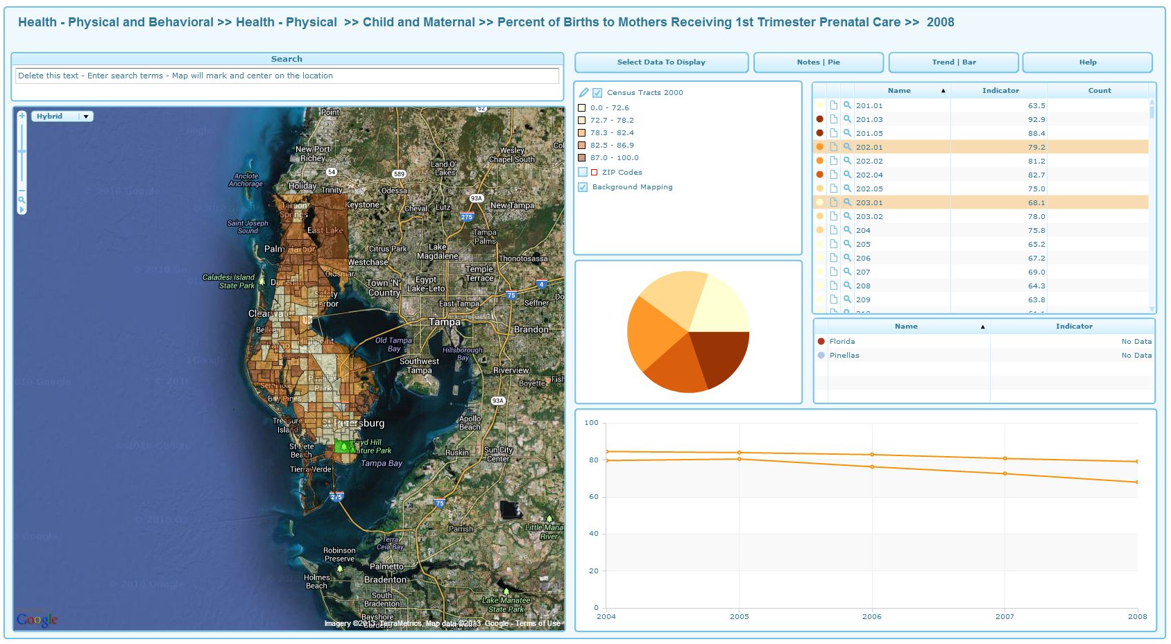
  Public-Facing Dynamic Reports
http://www.pinellasindicators.org/dataviews/report?reportId=321&viewId=525&geoReportId=2749&geoId=1&geoSubsetId=
Notes:
We have deployed GeoWise server-based InstantAtlas, managed via an administrative console. It can consume data in a variety of formats in including XML; we are working to implement a direct feed from the data warehouse.

Slide 16
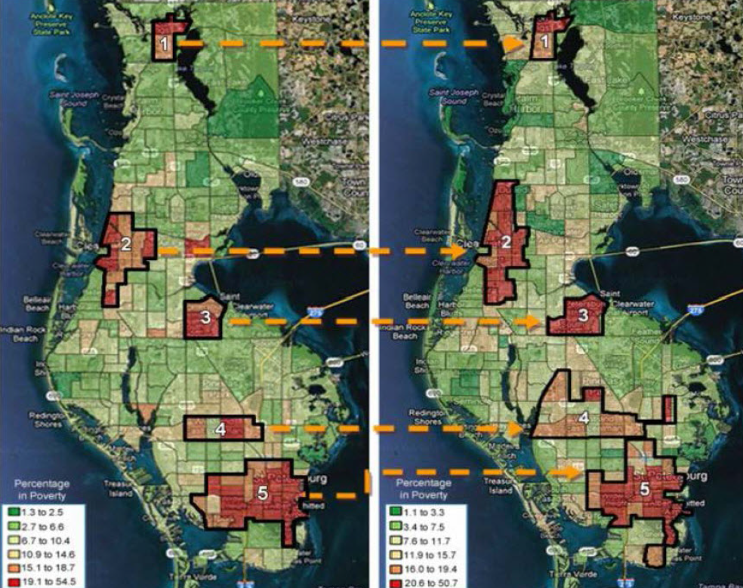
Healthy Communities
2000
2005-09
Source: US Census Bureau ACS (estimates)
Notes:
This study of Lealman Corridor builds on previous research and discussions around Healthy Communities, coming out of HHS’s Economic Impact of Poverty report. RAD was heavily in the analysis

Slide 17
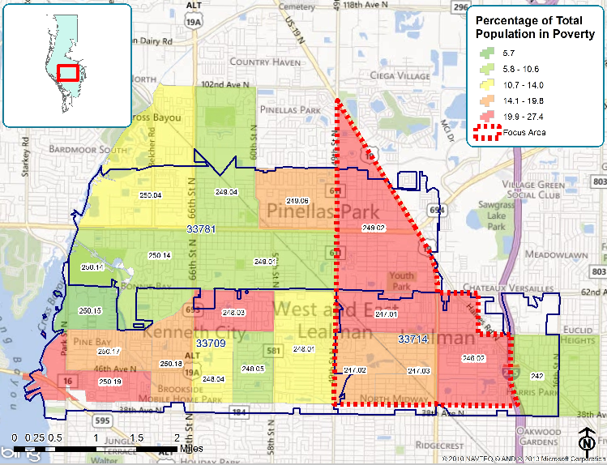
Lealman Focus Area
Source: US Census Bureau ACS 2007-11 (estimates)
Notes:
The Lealman Corridor was examined in detail at the census tract level. After analyzing and mapping numerous indicators, many at the client level, it was determined that the Eastern portion of the Lealman Corridor is the area of greatest need. The area is indicated by the dashed red line on the map.
This Focus Area is outlined in red; and it is bounded by US 19, 62nd Ave N, I-275 on the East, 62 Ave, N on the South, and 49th Street N on the West.

Slide 18
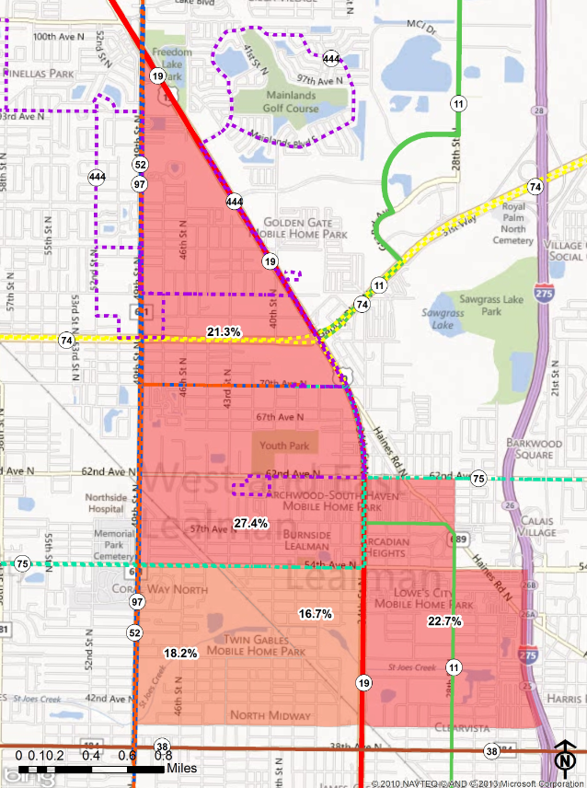
Demographics
Fast Facts
Poverty
County-wide 12.6%
Range in zone 16.7% to 27.4%
Population Compared to County
Focus Area County
Total: 19,911 916,542
Under 5: 6.2% 4.6%
5 to 17: 14.0% 13.2%
18 and over: 79.8% 82.2%
65 and over: 15.0% 21.2%
Race/Ethnicity
White: 75.8%
Black or African American: 8.8%
Asian: 7.8%
Other: 7.6%
Hispanic: 12.9%
Percentage of People Living Below Federal Poverty Level. Source US Census Bureau 2007-11 ACS
Source: U.S Census Bureau 2010; ACS 2007-11 (estimates)
Notes:
Here are some fast facts about the people living in the proposed focus area.
The population of the entire Lealman Corridor (i.e., 33709, 33714 and 33781) is approximately 70,476; and, it accounts for approximately 8% of the total population of Pinellas County. Mirroring the County, there are slightly more women (51%) than men (49%) in the Corridor. The median age is about 43 years old, slightly younger than the county overall (46.3). About 20% of the population is under 18 and about 19% of the population is 65 or over. Racial breakdown of the Corridor is as follows: 83.4% White, 7.4% Black or African American, 7% Asian, with the remainder characterized as other. About 10.6% of the population is Hispanic or Latino (2010 Census).
The total number of households in the Corridor is 30,477 and this accounts for 7% of the County total. 17,056 (56%) of these are family households (i.e., 1 or more other people related to the householder by birth, marriage, or adoption). 39.6% of the family households have at least one related child under 18 (U.S Census Bureau 2010).
The map depicts the percentage of individuals living below Federal Poverty Level. Most of the maps we will review will be zoomed to the Focus Area. The colored lines (indicate with laser) show PSTA bus routes (indicate bus route numbers).
Definition: Family Households i.e., 1 or more other people related to the householder by birth, marriage, or adoption).
COUNTY COMPARISON (RACE/ETHNICITY)ETC – Have Spreadsheet will add numbers later

Slide 19
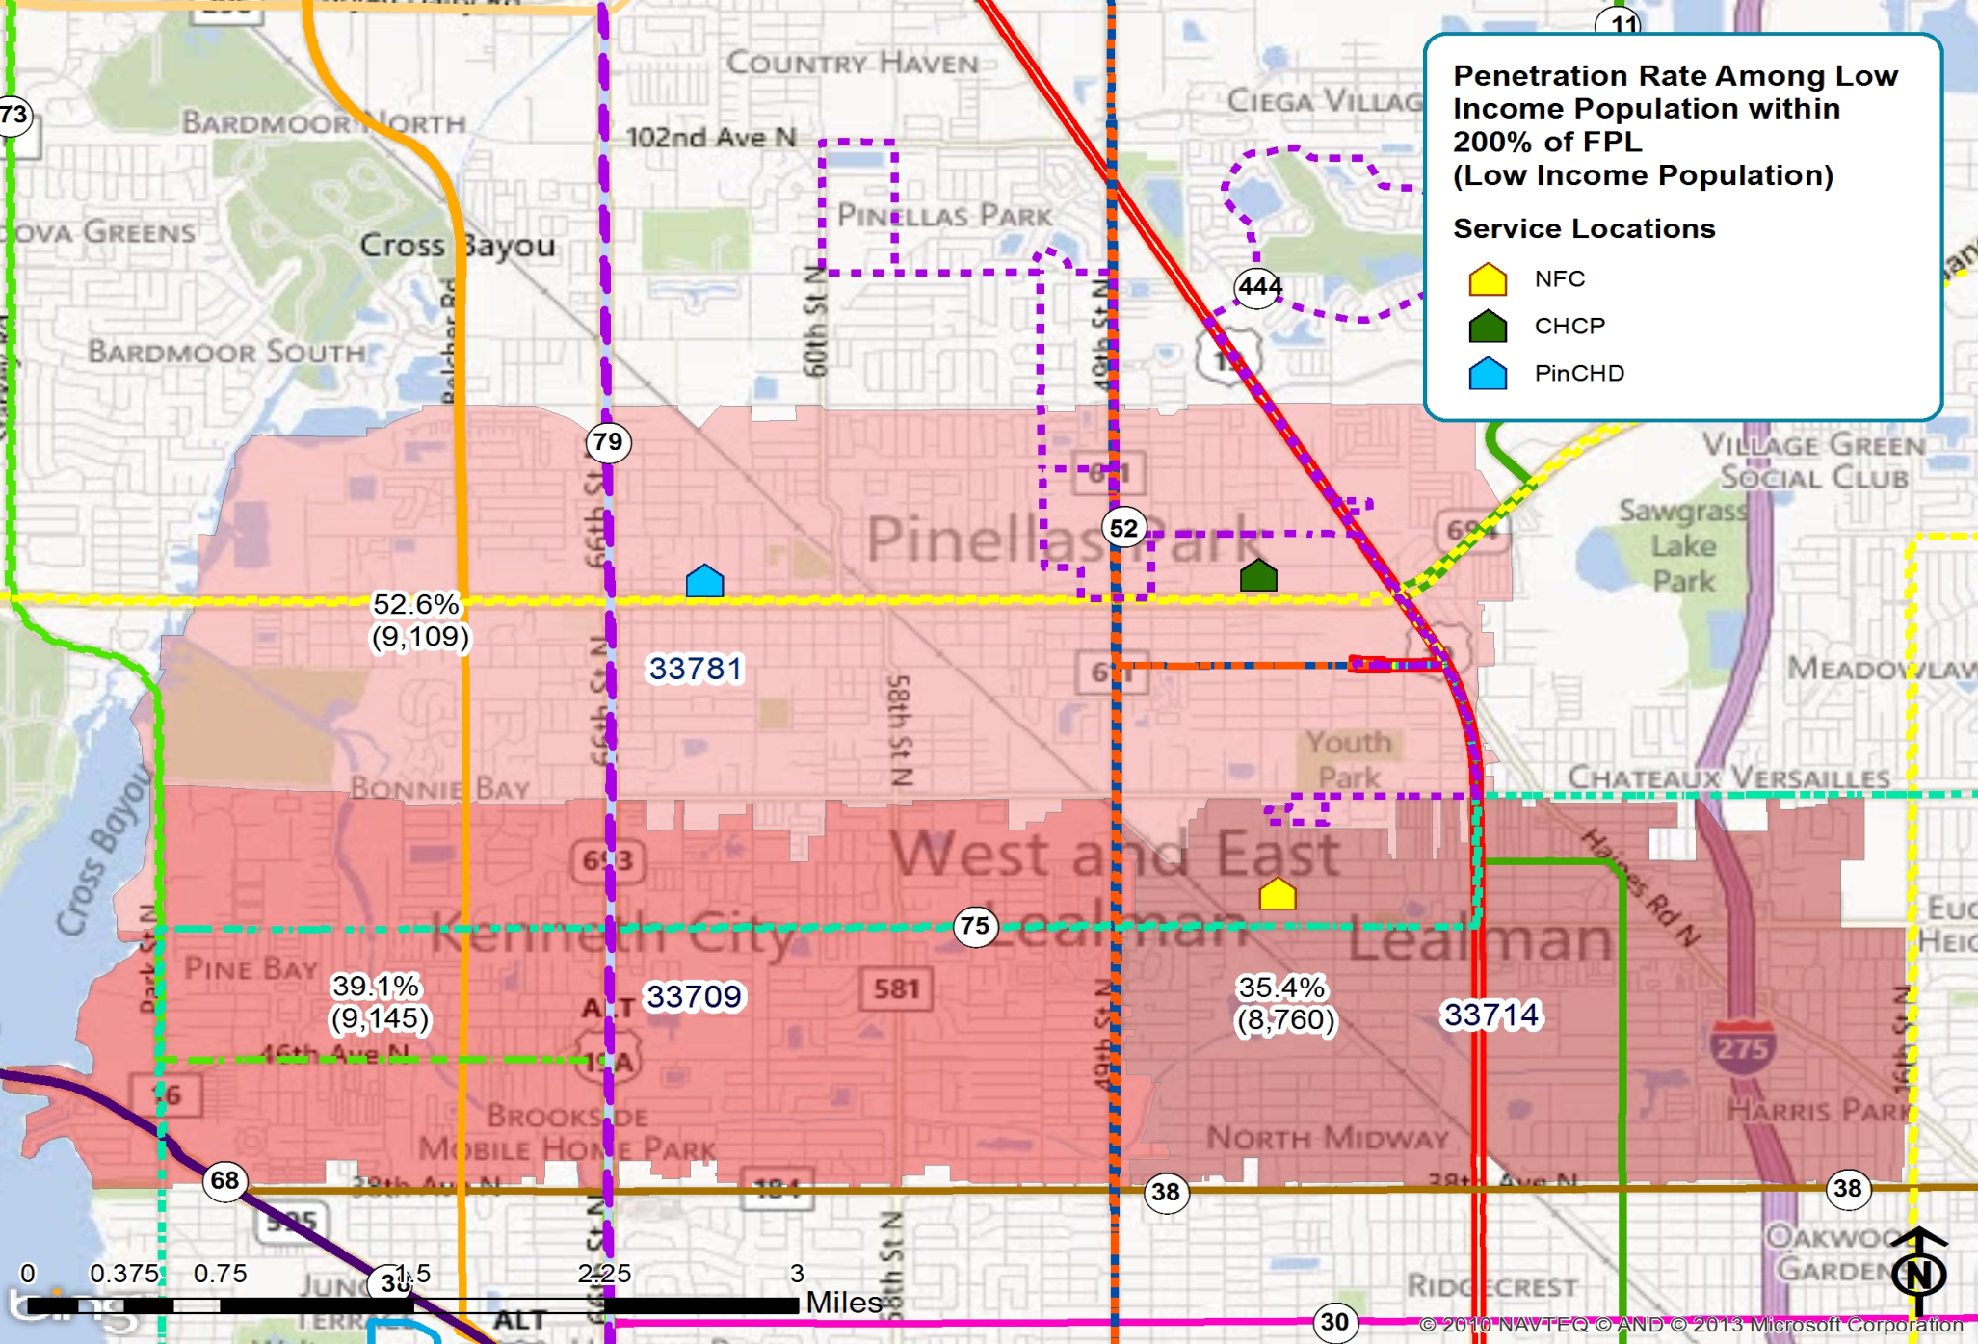
Health
Source: PCHD; UDS Mapper
Notes:
There is inadequate access to health care in the Target ZIP Codes with the worst access (35.4%) in ZIP Code 33714.
Despite the distance to the PCHD clinic the area between Rte. 19 and 275 (EAST LEALMAN) has one of the two highest concentrations of Health Department clients.
CHC relocated their Pinellas Park clinic to a new building at the beginning of this year, tripling their original capacity. The location on the map is the new site.
Note: Penetration rate calculated using data for CHC from UDS Mapper and data from client counts at PCHD

Slide 20
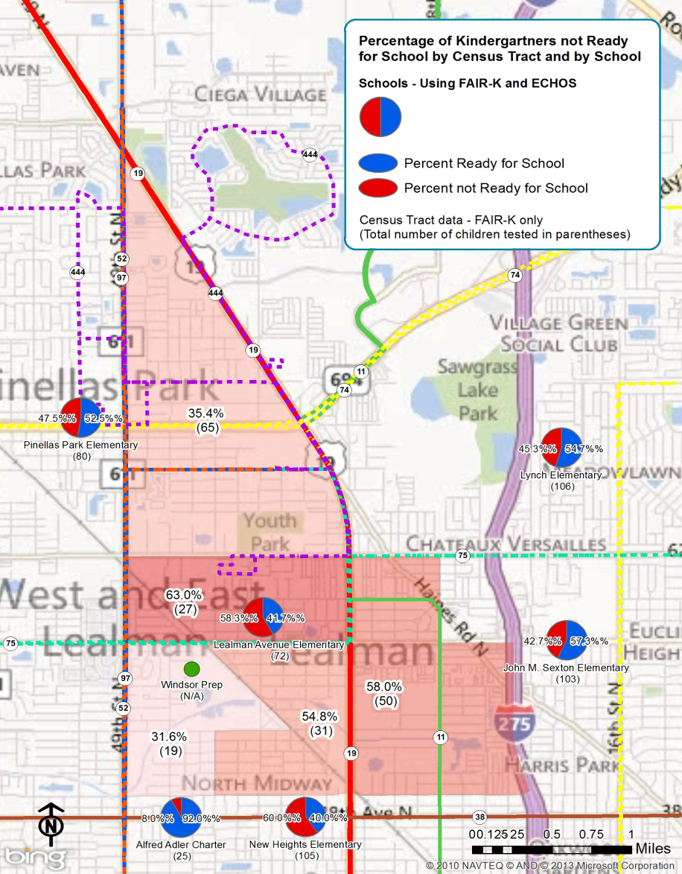
Education
Fast Facts
County-wide, 34% of children are not ready for school
Overall, 48% of children in the focus area are not ready for school when they enter kindergarten
45.5% of children in family day care homes are not ready for school at kindergarten entry
Source: Pinellas County Schools 2010-11; FL DOE 2010-11
Notes:
Not ready for school: 92 of 192 children (48%) in the focus area are not ready for school based on address of students living in the focus area. Source: data sharing agreement with school system for 2010-2011 School Year.
Sources for kindergarten readiness:
By school: FLKRS (FL Kindergarten Readiness Screener) measures listening comprehension and vocabulary. Administered to all public school kindergarten students. Data from Florida DOE website (2010-11).
By census tract: FAIR-K only (Florida Assessments for Instruction in Reading). All students entering public or private school kindergarten are tested in the first 30 days of entry into school. Measures ability to name letters of the alphabet and putting together the sound a letter makes with the rest of the word (the teacher asks “what would the word be if I say “l” and “ake” [a correct response from the child is the word, “lake.”]. These 2 skills predict the likelihood the child will be a successful reader. Data are from data sharing agreement with school system (2010-11)
Demand for child care: ELC report on 9/21/12 of # on waiting list by zip code.
Only 1 child care center east of US 19 in Zone

Slide 21
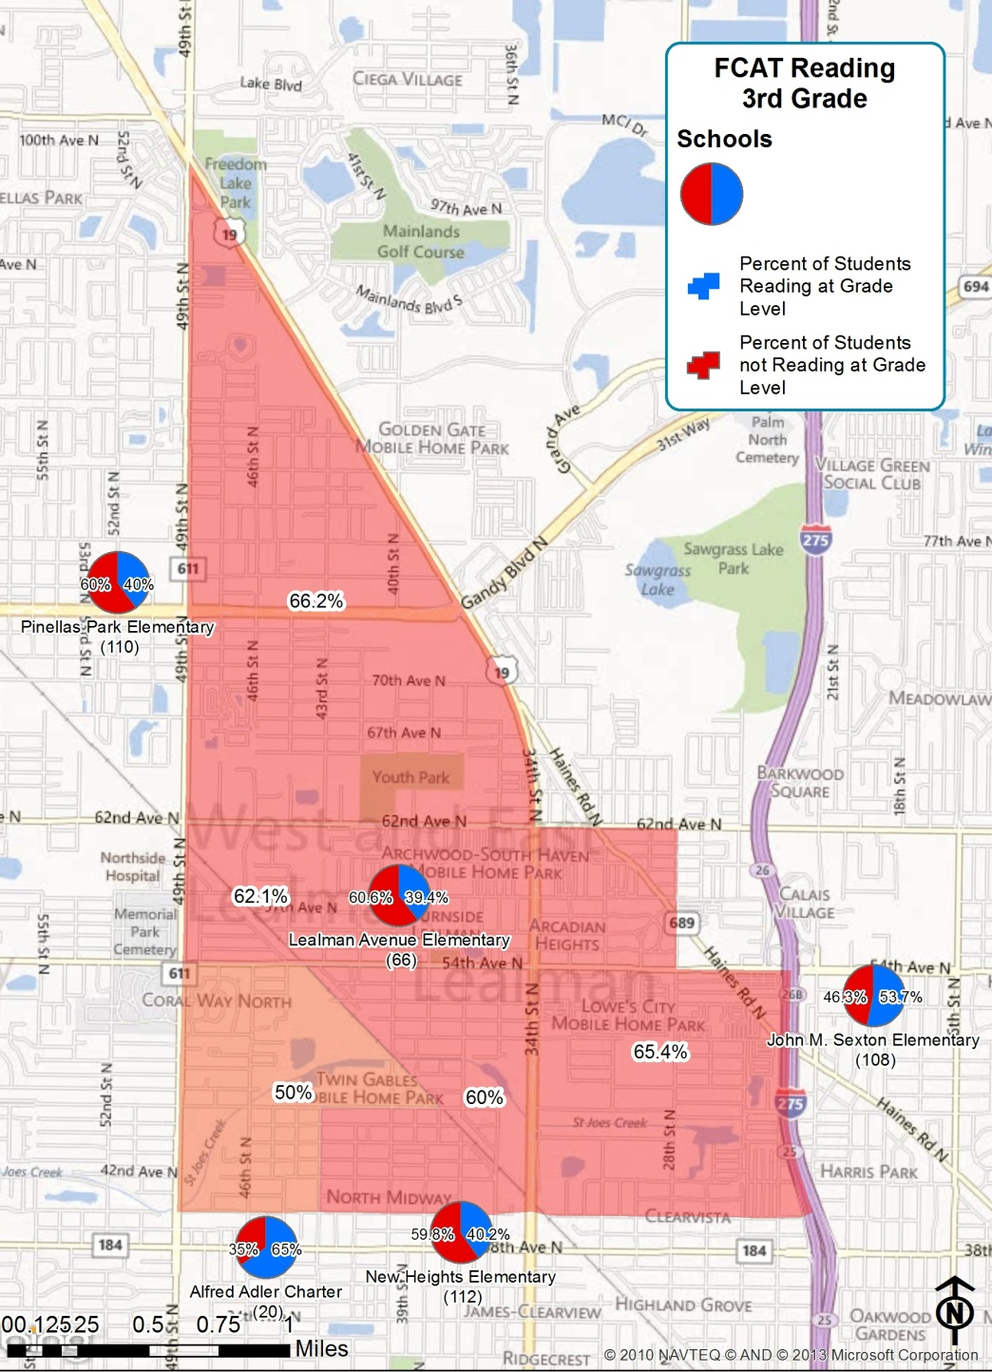
Education
Fast Facts
64% of third-grade students are reading below grade level compared to 26% county-wide
In the Focus Area, 22.4% of middle and 34.2% of high school students were absent 21+ days in School Year 2010-2011
County-wide, 14.5% of middle and 21.7% of high school students were absent 21+ days
14% of elementary school students are enrolled in English Speakers of Other Languages (ESOL) classes
Source: Pinellas County Schools 2010-11
Notes:
64% reading below grade level is based on FCAT Reading data JWB receives from the school system. We identified students who live in the focus area (based on home address) and then calculated the percentage of 3rd graders reading below grade level.
The 64% figure is independent of the particular school the child attends. In contrast, the blue & red circles show the % of students at each nearby school who are reading below grade level (again, based on FCAT).
Reading below grade level means students are reading at Level 1 or 2 (Level 3 is at grade level; Levels 4 & 5 are above grade level). Data is from FL Dept. of Education (FLDOE) website for 2011-2012, Grade 3.
Absenteeism rates for schools in the focus area are based on Lealman Intermediate (middle school) and Dixie M. Hollins high school. The most recent data available are from School Year 2010-2011. This is from FLDOE website.
% English Speakers of Other Languages (ESOL) based on data from New Heights, Lealman, and Pinellas Park elementary schools. Data was received from Dr. William (Bill) Lawrence, Pinellas County Schools Associate Superintendent, Teaching and Learning Services.
BREAKDOWN OF LANGUAGES. From the American Community Survey (5-year estimate 2007-2011): Nine percent of the population over age 5 in the focus area do not speak English very well. The most common languages among these folks: Spanish or Spanish Creole (N = 809), Vietnamese (N = 567), Thai (125), Laotian (N = 103), and Serbo-Croatian (N = 89).

Slide 22
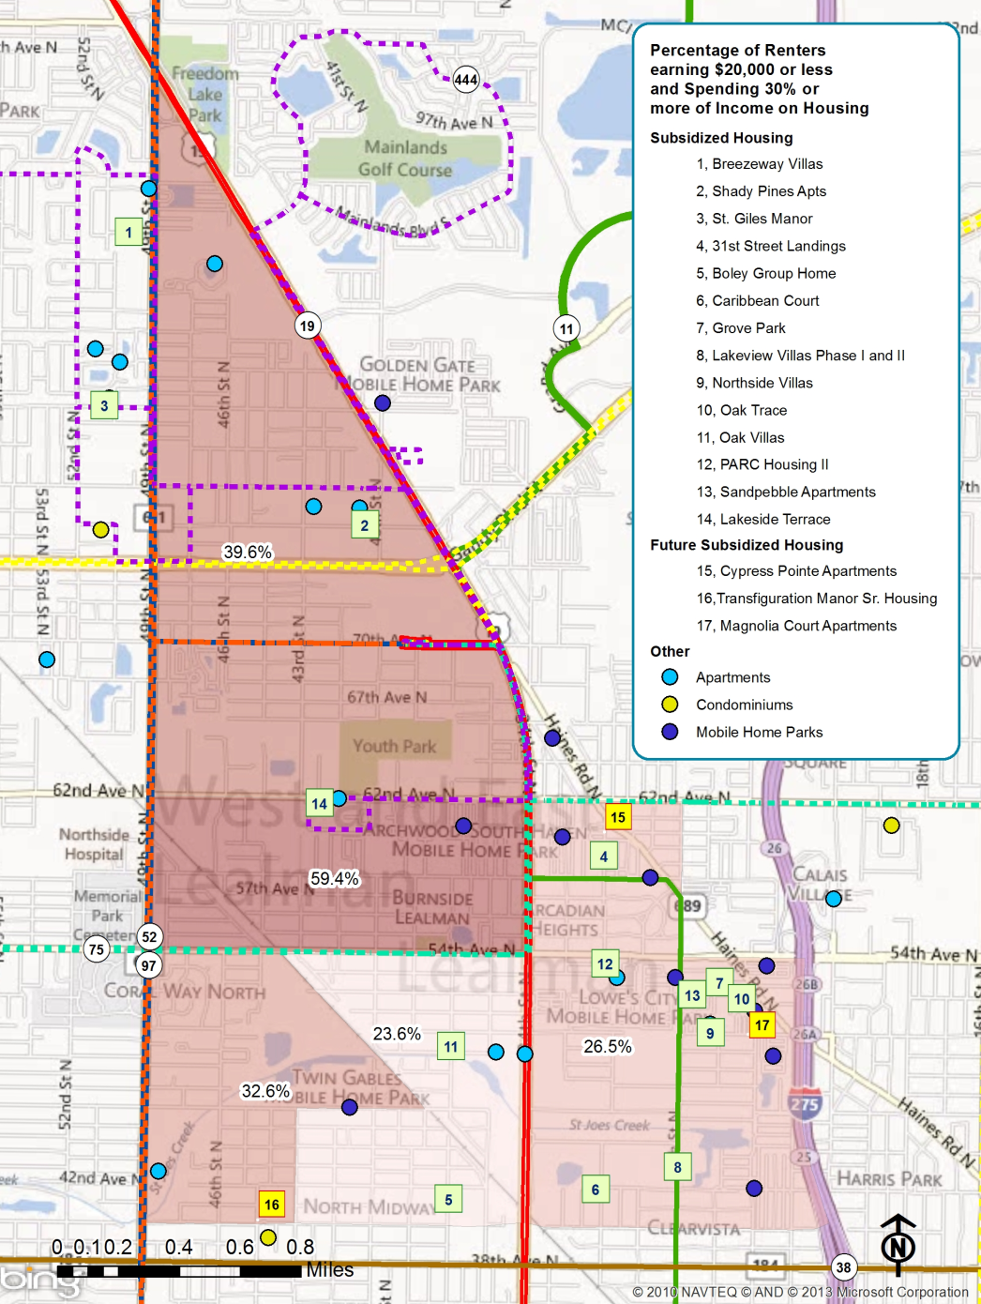
Housing
Fast Facts
Household Characteristics
Total Households: 8,468
Owners: 56.7%
Renters: 43.3%
Household Families with Own Children
Number: 1,940
Percent of total: 22.8%
Male - No Wife Households: 2.9%
Female - No Husband: 9.2%
High percentage of cost burdened
households (26.5% - 59.4% of renters earning $20,000 or less are spending 30% or more of income on housing)
Quality of housing
  Build year ranges from 1960-71
  Average 24.8% Mobile homes ; CT 246.02 = 51.8%
Source: US Census Bureau ACS 2007-11 (estimates) ; Florida Housing Data Clearinghouse ; PCCD
Notes:
Tool in toolbox is that a some industrial sites in Lealman are considered a Brownfield. Brownfield is defined by Pinellas County Community Development as an area where the expansion, redevelopment, or reuse is complicated by actual or perceived environmental issues.
Median build year for county is 1975

Slide 23
Housing
Desired Results
Recommendations
Increased availability of affordable housing stock at all income levels
Urban regeneration with mixed use and mixed income development
Poor quality owner-occupied and investor-owned housing stock is upgraded
The community is healthy and livable
Involve the community in no cost/low cost community improvement activities
Prioritize work based on available funds and cost-benefit analysis to:
  Produce at least 145 additional affordable housing units
  Rehab at least 36 housing units
  Complete at least two Livable/Healthy Communities Initiatives
Notes:
Note subordinate desired results or objectives.

Slide 24
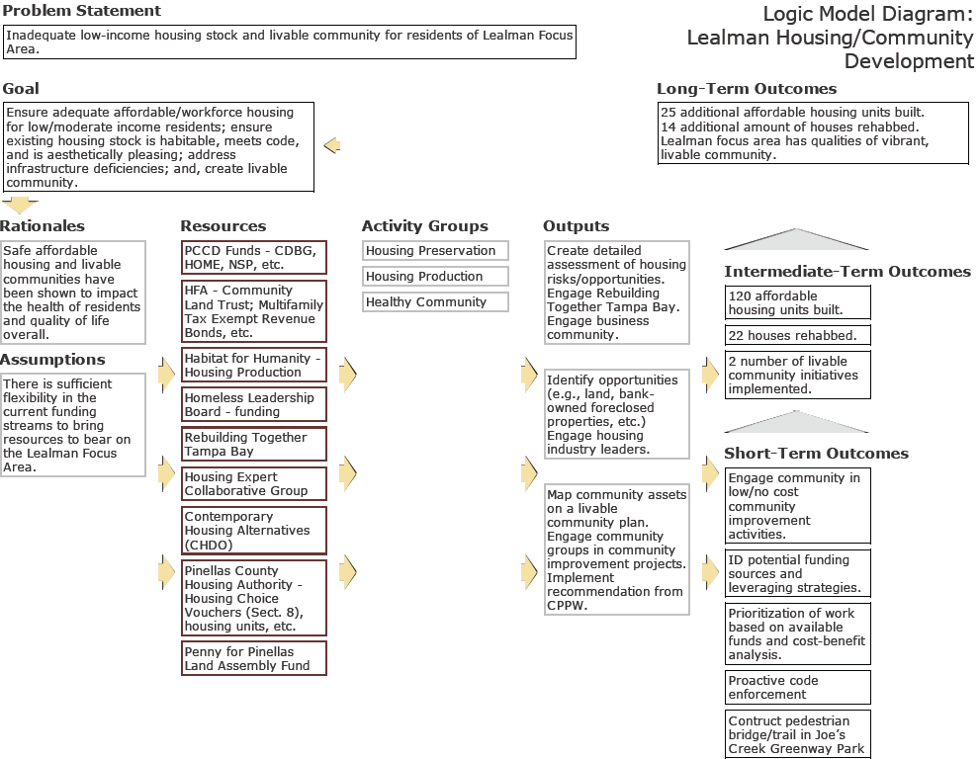

Slide 25

JWB uses data to build consensus and monitor progress toward a shared vision and desired outcomes for Pinellas County

Slide 26

Thank You!
Denise Groesbeck, Director
Research and Analytics Department
Juvenile Welfare Board
dgroesbeck@jwbpinellas.org
Joe Baldwin
Senior Researcher/Planner
Research and Analytics Department
Juvenile Welfare Board
jbaldwin@jwbpinellas.org

Slide 28

Tracks
Housing and Community Development: How indicators can be used to identify and address impacts to community health such as sprawl, urban blight, affordable housing, smart growth.
Health: Presentations and case studies on the challenges and successes of local health innovators – community residents, public and private agencies, and foundations.
Sustainability: Case studies and tools on how indicators can serve the challenges of setting and moving toward sustainability, climate neutrality, happiness and enhanced quality of life, and other holistic goals in our communities..
Equity and Ethics: Presentations explore ethical issues related to data ownership and how the relative disparity in income distribution and access to resources and data in communities affect progress on many levels.
Tools for Impact: Review and description of the most appropriate and effective tools to develop and maintain successful indicator projects; collect, organize and report data; identify the scale and impact of a project; engage the public and stakeholders; move from data to action.
Notes:
Shameless plug.

