Slide 1
Strengthening Capacity For Data-Driven Decisionmaking
Kathy Pettit
December 9, 2014
Moving the Needle: Using Data to
Improve Population Outcomes
Notes:
Introduce myself – thank you for inviting me

Slide 2
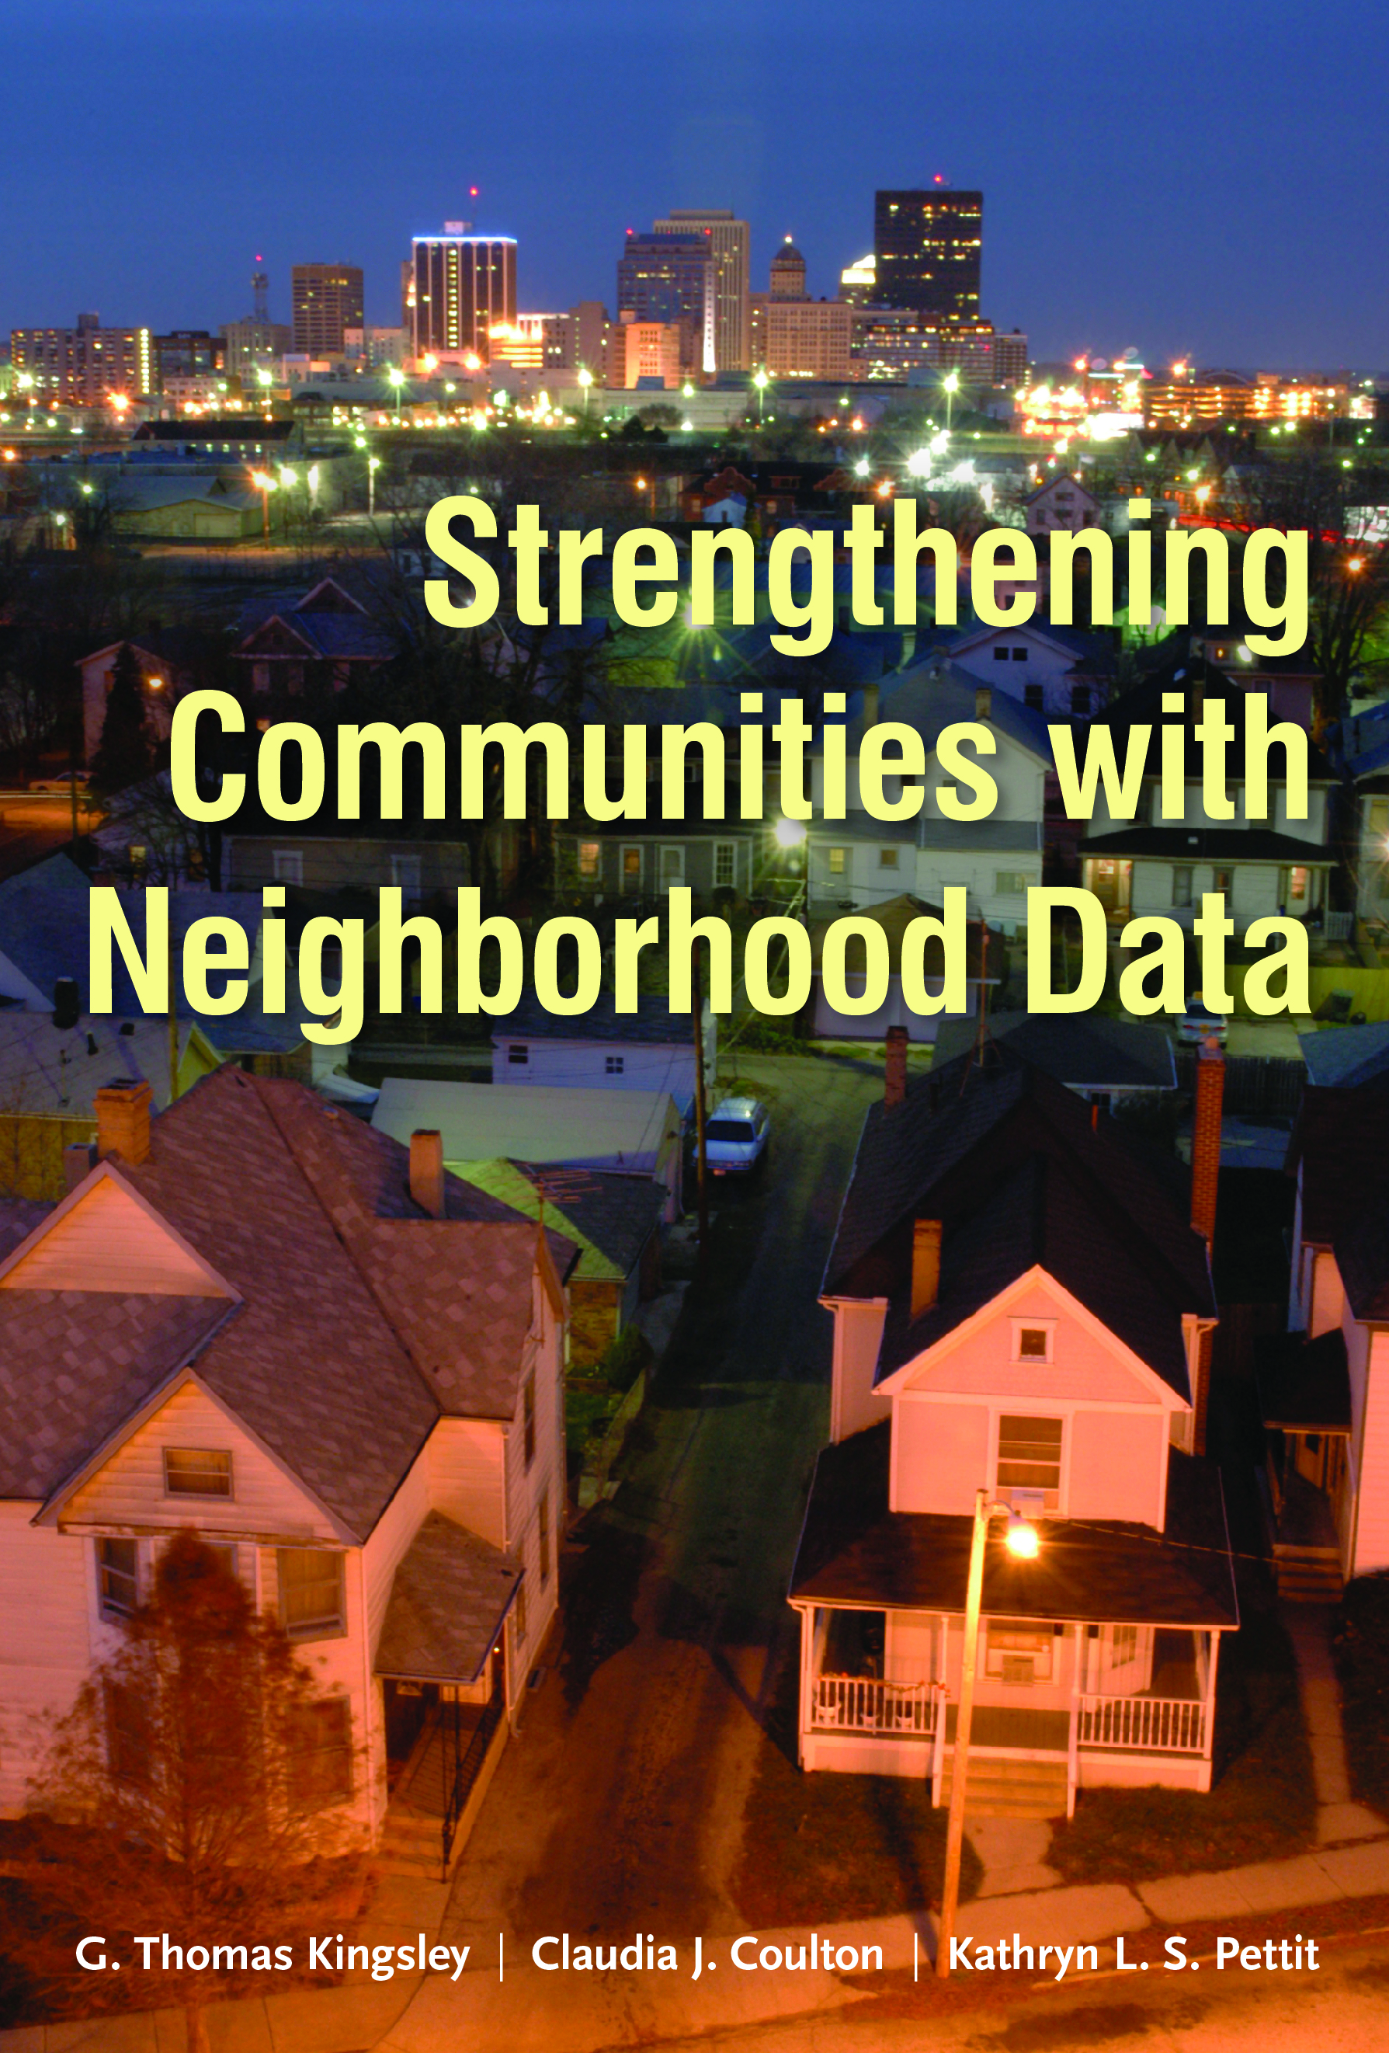
New Books On Data And Community Action
Notes:
Not only about NNIP – free ebook
Webcast
Strengthening Communities with Neighborhood Data(11/12 webcast)
MacArthur supported – covers progress comm field - Essays on Cleveland, Twin Cities, Portland
Case studies and examples from Austin, Camden, Dallas, and many more
What Counts: Harnessing Data for America’s Communities (12/4 event/webcast)
Edited volume with San Francisco Federal Reserve and RWJ support - looked toward community and health

Slide 3
Community Information Infrastructure
Administrative Data
Open Data
Integrated Data Systems
Repackaging / Interpretation
Cleaning/
Aggregation
Analysis
Visualization
Storytelling
Training/Technical Assistance
Goal: Broadest Base of Users & Purposes
Notes:
Lots of other types of data we can talk about, start with the administrative data
State and Local level
- This is partial – other types of data like surveys, social media, qualitative
- other sectors – private, and nonprofit

Slide 4
Community Information Infrastructure
Administrative Data
Open Data
Integrated Data Systems
Repackaging / Interpretation
Cleaning/
Aggregation
Analysis
Visualization
Storytelling
Training/Technical Assistance
Goal: Broadest Base of Users & Purposes
Notes:
Start with this first level – pieces that have gotten a lot of buzz

Slide 5
Open Data
Notes:
Describe some of the inputs - raw material – data is the new oil?

Slide 6
What is Open Data?
Principles
Increase transparency to help citizens hold government accountable and promote engagement
Enable access to a public good funded by taxpayers
Practices
Portals (mostly government examples so far)
Re-packaging of data (value-added data, apps, etc.)
Data standards (Transit, Open 311)
Policies: formal adoption of open data
Notes:
Policies could be at the local, state, or federal levels - exec/legislative - See Sunlight

Slide 7
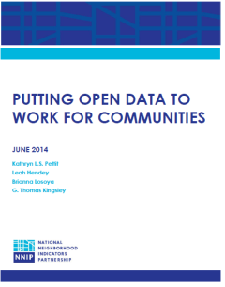
Open Data Grows Up
San Francisco’s Open Data Strategic Plan
Notes:
Title from Joy Bonoguro’s blog – Chief Data Officer in SF
Going beyond measuring progress by only how many thousands of data sets you have published, or turnout of early 20-somethings at 1 day hackathons
A lot of progress has been made
– we published a white paper on how open data and traditional community improvement groups could connect
- Code for America volume on people’s thinking of the next generation of open data work
- San Franscisco’s strategic plan -
From NNIP, Cura: Tech – new program in the Twin Cities – technologists and community groups team up to propose ideas that would help residents and groups in low-income neighborhoods. They provide rounds of seed funding to get started. Examples (should be verified): web site/app to facilitate local shopping (Somali scarf shop) or idea about simplifying the application to become a credentialed small and minority owned business.

Slide 8
Benefits of Open Data
Effective public policy
Effective planning/programs outside of government
Efficient delivery of government services
Transparency and accountability
Informed public engagement
Business development
Notes:
In the beginning, primarily driven by the last three goals…
the first three goals are as important outcomes of open data and should be used in judging its success.
Example: In DC, our open data portal helps to populate our PerformanceStat system, Track DC (also public)
Example: Hartford’s GIS manager Brett Flodine had been working on publishing to their new open data portal for 6 months driven by the goals of good government practices. But when it came time for the city to apply for a federal Promise Zone grant, his job in supplying information was much easier because the data was already organized.

Slide 9
Integrated Data Systems (IDS)
Notes:
A second major trend – covered by several essays in the What Counts book.

Slide 10
Integrated Data Systems
IDS link records from multiple agencies to track inputs and outcomes for individuals
Built on data sharing agreements, strict privacy protection, & common interest in social benefit
Used for:
Case management
Plan for target populations and program innovations
Mobilize work toward joint outcomes
Capture cost benefit across systems
Notes:
Linking data across-sectors can bring stakeholders together and illuminate new policy solutions, that wouldn’t be found when operating with only one source of information.
Give examples

Slide 11
IDS Catalog and Resources
Visit our IDS catalog and resource page http://neighborhoodindicators.org/resources-integrated-data-systems-ids

Slide 12
Moving from information to action
Notes:
Now have all this raw material – how to put it all together to get work done in better ways

Slide 13
Community Information Infrastructure
Administrative Data
Open Data
Integrated Data Systems
Repackaging / Interpretation
Analysis
Cleaning/
Aggregation
Visualization
Training/Technical Assistance
Goal: Broadest Base of Users & Purposes
Notes:
Move to next level of processing – adding value to the data - and working alongside groups inside and outside of government on how to use them

Slide 14
National Neighborhood Indicators Partnership
Collaborative effort of Urban Institute and 35 local data intermediaries since 1995.
NNIP partners help local actors use neighborhood data to improve communities through policy, planning, and advocacy.
Success based on:
Trusted and engaged institutions
Relevant and high-quality data across topics
Mission to support use of data for local action
Notes:
MODEL is not the focus today, but happy to answer questions or talk after the session
Bullet 1: Started with 6 partners, now at 35
Institutions:
The partners are housed in various types of institutions – universities, independent nonprofits, local funders.
But whatever the home, they are all respected organizations with a long-term stake in their community. They are viewed as neutral and people believe the data and analysis that is published.
Data: at the core of the work…
Partners all agree to assemble and organize local government data that is
1) Ngh-level (conditions vary across a city or region, citywide data doesn’t help you to target efforts)
2) On a range of issues – housing, schools, crime, etc. (need to understand ngh issues and interventions holistically)
3) Over time (to understand trends and be responsive when issues arise).
There is an economy of scale to having one group provide the service for the community.
Mission:
NNIP partners’ values drive all the hard work of acquiring and organizing the data. The point is to get the information used - whether for policymaking, community building, program planning.
At the start, the founding NNIP partners recognized that not everyone had equal access to information. Focus began with and remains on low-income nghs that have traditionally not had access to data or training to use them.

Slide 15
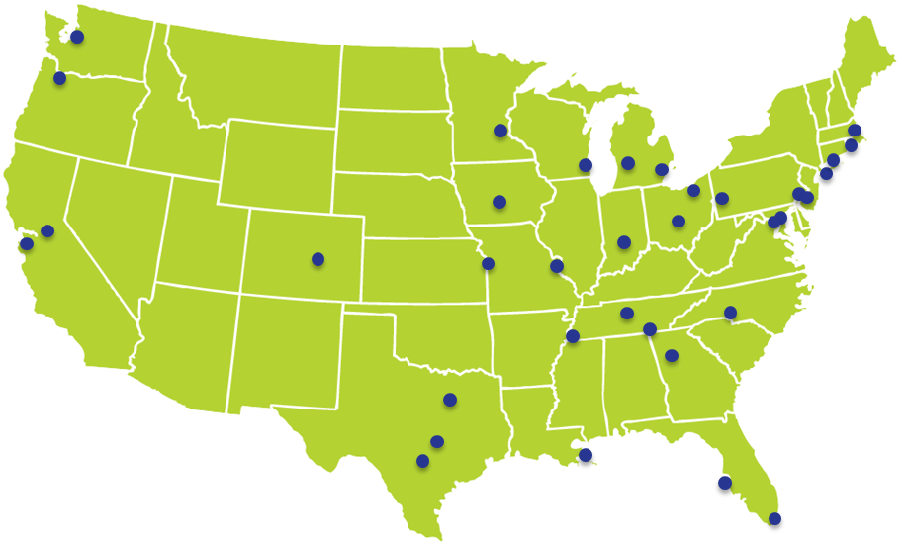
Translators, navigators, connectors
Notes:
To make this all happen, we need people who can cross disciplines and sectors.
Here are some of our NNIP partners that make it happen
Conversant with government operations, politics, community concerns, and the technical data side
Connect people locally and to national networks

Slide 16
NNIP Cross-site Project: Connecting People to Place
Project Goals:
Link data from IDS to local administrative data held by NNIP partners to address a local or neighborhood policy problem.
Build relationships between NNIP partners, IDS agencies and community partners.
Increase exchange of information.
Funded by the Annie E. Casey Foundation
Notes:
One example of tying data resources together to gain new insights and engage new actors
Improving Communities through Integrated Data Systems
Strengthen those connective arrows

Slide 17
NNIP Cross-site Project Connecting People to Place
Baltimore: Equity in access to energy assistance programs
New York City: Neighborhood and building effects on homeless episodes
Providence: Education and employment outcomes and civic engagement levels
Visit the Cross-site Project Page for more!

Slide 18
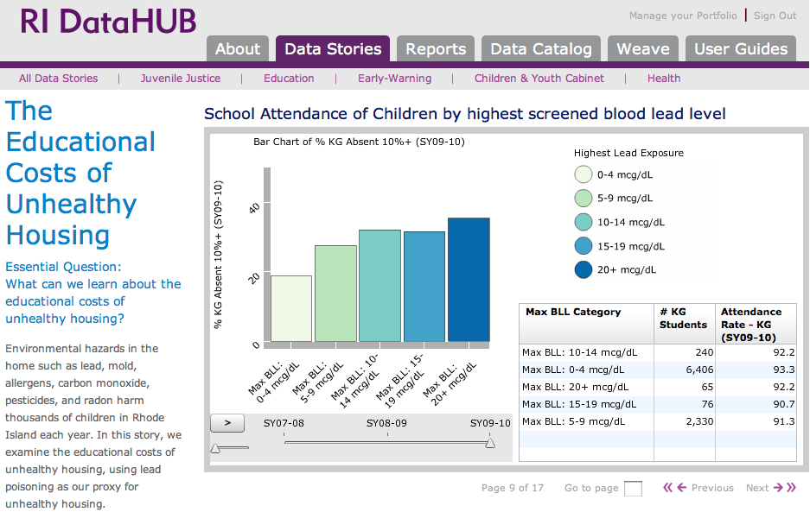
Source: Providence Plan
Notes:
Our partner, the Providence Plan has built an IDS called the Rhode Island DataHUB and worked with state and local agencies to bring together information about children in Rhode Island into one place. Combining the data allowed them to look beyond school-based factors for student absenteeism and begin to explore the Educational Costs of Unhealthy Housing.
Providence is the current leader in making the insights from IDS widely available and connecting them with policy actions – data stories are created in collaboration with the govt agencies and np stakeholders, so reflect the combined wisdom and experience.
For example, people look to principals and school district officials to address the problem of chronic absenteeism. But one of the big reasons kids miss school is because they are sick, often with chronic conditions like asthma. Lead exposure had been found to be a reliable proxy for unhealthy housing conditions that may exacerbate asthma.
This graph shows the percentage of kindergarteners that are chronically absent from school by the lead levels found in their blood stream during screenings. Those with the highest lead exposure are more likely to be chronically absent than children with lower levels. This graphic suggests that the school system cannot solve the problem of chronic absenteeism without working with community organizations and city officials to address social and environmental determinants of health.

Slide 19
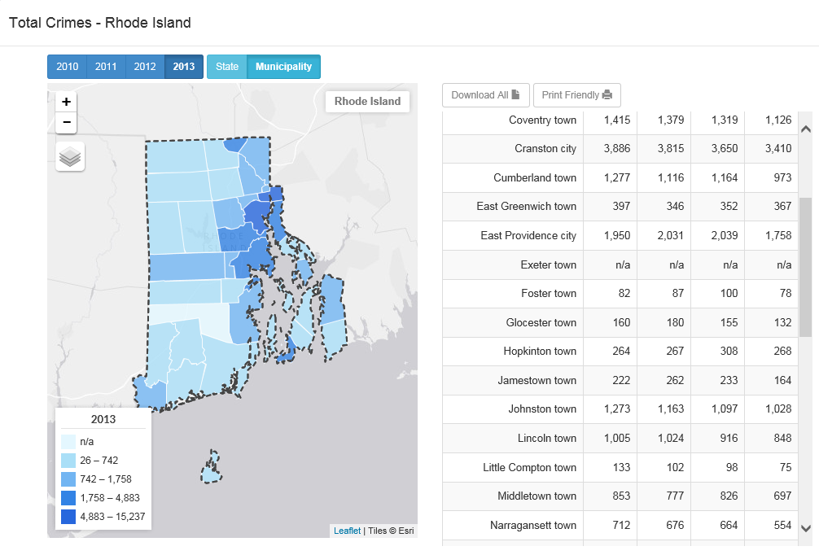
Insert comm profiles
Notes:
ProvPlan is also committed to opening up traditional administration data - these are there state Open source profiles – town is main area for decisionmaking – for some indic drill down to ngh level.
Education and employment outcomes and civic engagement levels

Slide 20
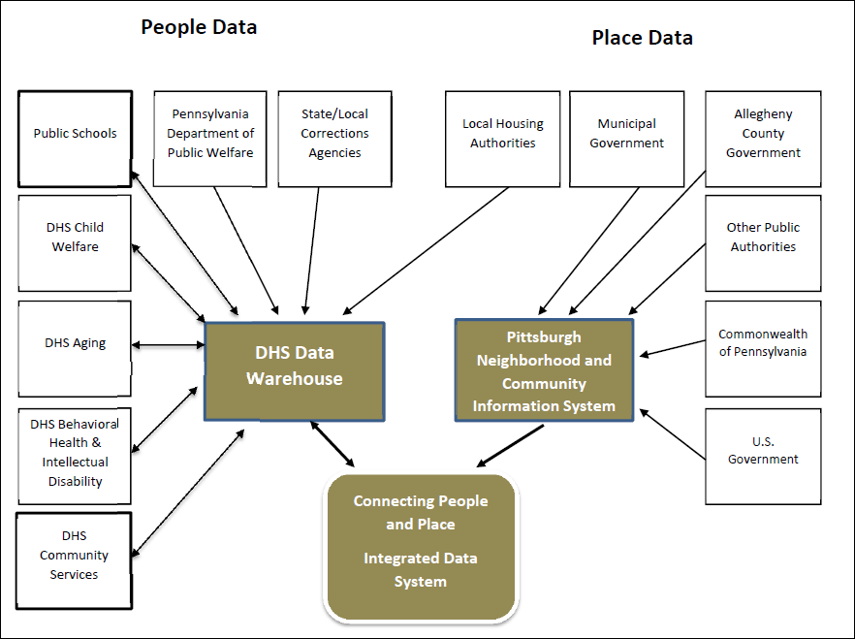
Data Sharing between Human Services and Neighborhood Data in Pittsburgh
Notes:
Pittsburgh also part of IDS project

Slide 21
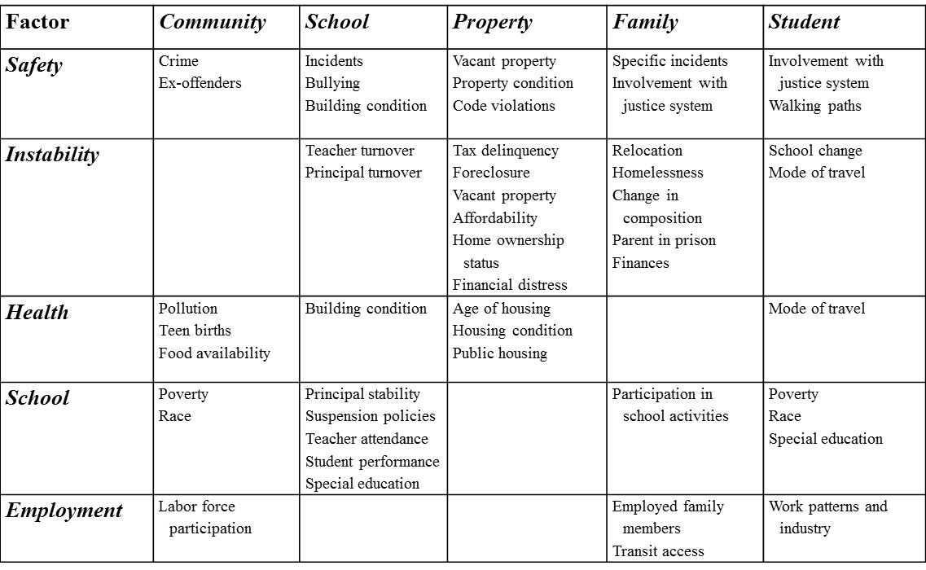
Pittsburgh: Neighborhood and place-based factors
influencing chronic absenteeism
Notes:
New ways to look at issues
Students with DHS involvement in 2012 were 41% - 85% more likely to have worse attendance than students who did not.
Students in 6th – 12th grades with juvenile justice involvement were 114% - 164% more likely to have worse attendance than those not involved in juvenile justice.

Slide 22
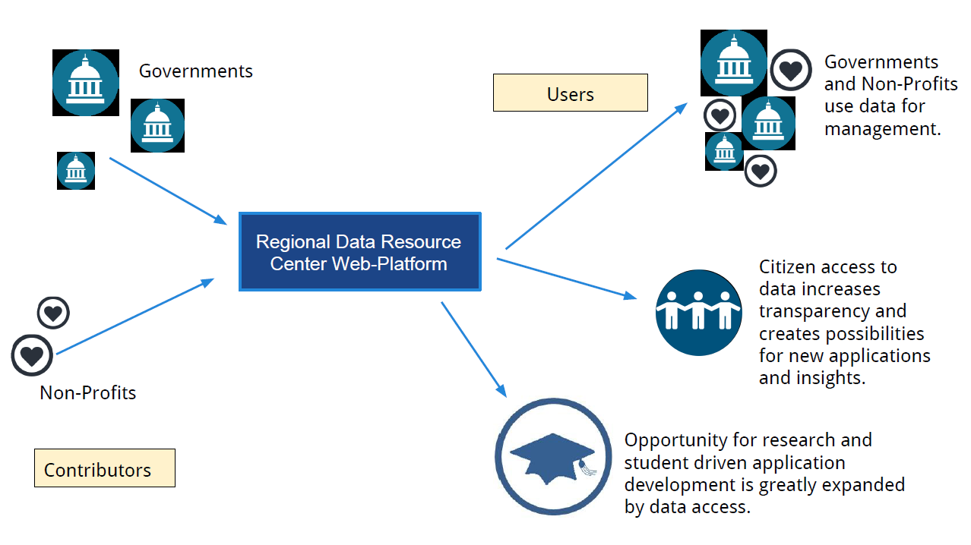
The Next Stage: Pittsburgh Data Ecosystem
Notes:
Bob Gradeck and Laura Meixall

Slide 23
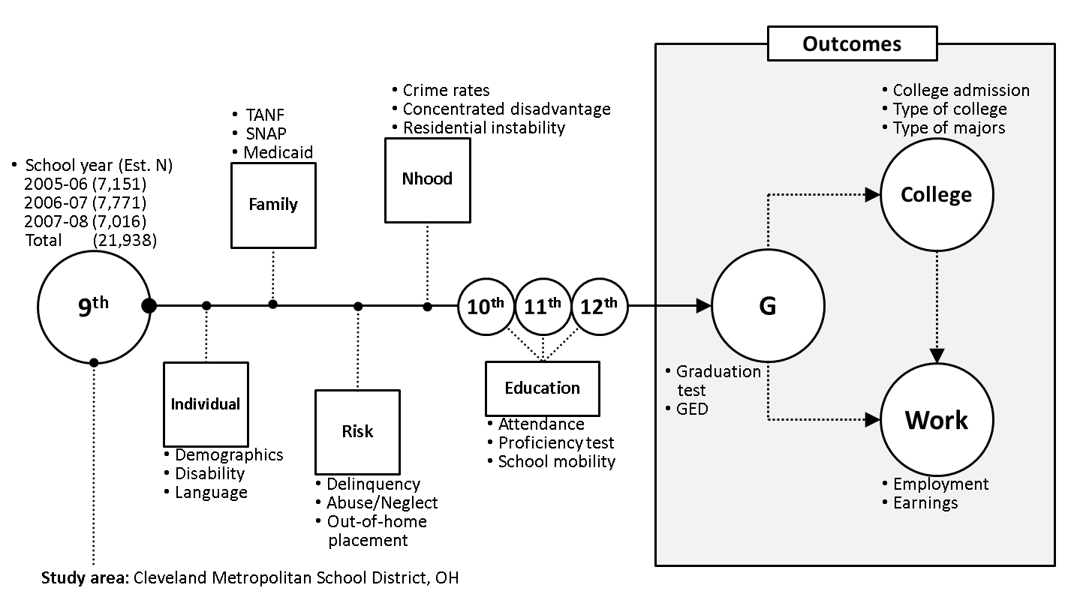
Cleveland: Long term outcomes for youth transitioning out of foster care
Notes:
Will study 4 cohorts of 9th graders (over 20,000) to compare foster care youth with neighborhood and school peers?
Long term outcomes for youth transitioning out of foster care

Slide 24
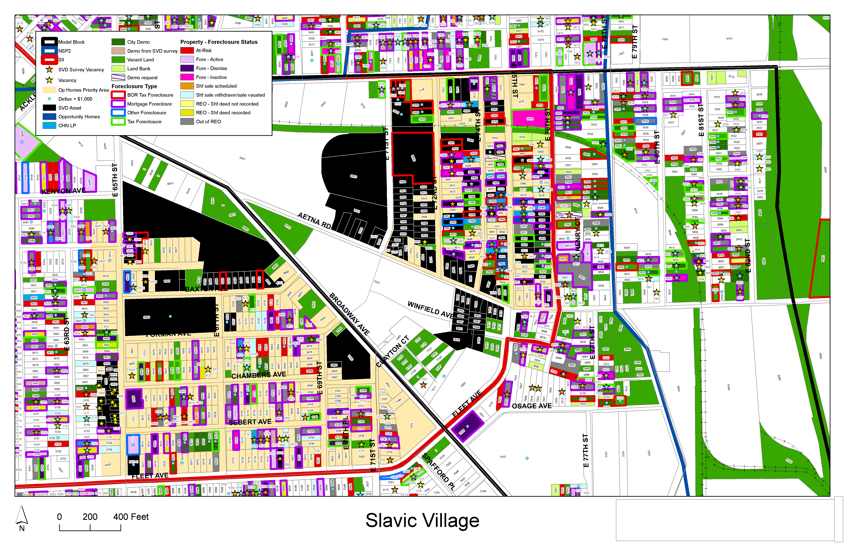
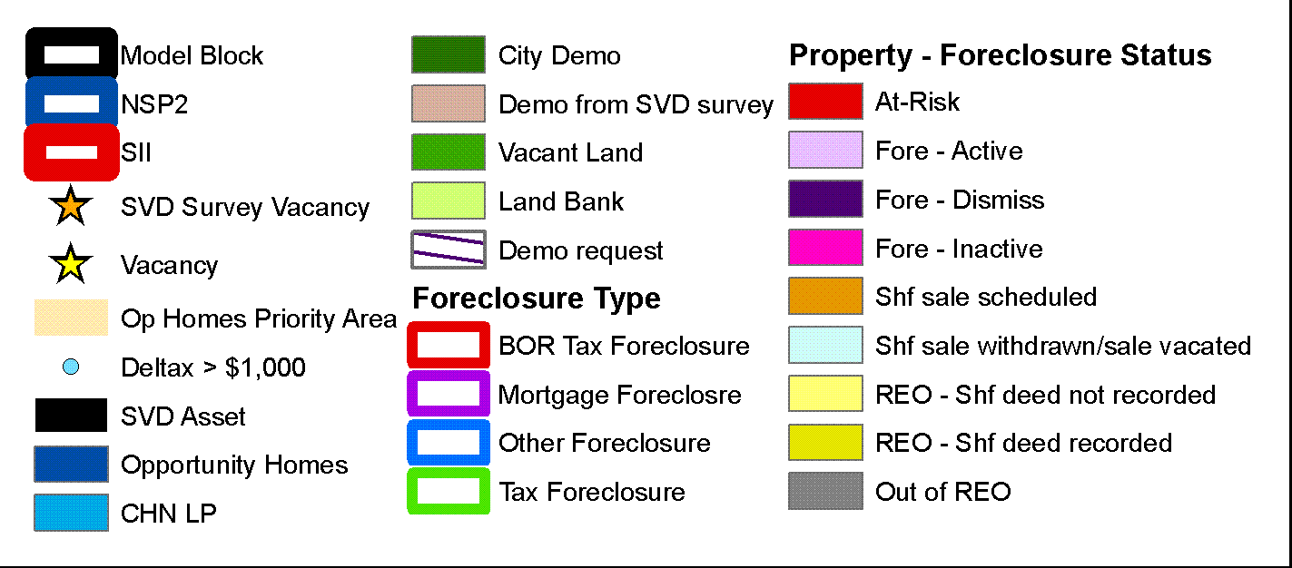
Source: Center on Urban Poverty and Community Development, Case Western Reserve University
Notes:
This example is from one of our founding partners in Cleveland, the Center on Urban Poverty and Community Development at Case Western Reserve University.
The Neighborhood Stabilization Team in Cleveland makes use of data from Case Western’s NEO CANDO – North East Ohio Community and Neighborhood Data for Organizing – System.
Pull together parcel level data from many different sources from the assessors office, the court system, vacancy data and blight surveys, neighborhood amenities, etc.
This data can zoom down to the block and to the parcel and zoom up to look at trends and the bigger picture.
It helps the team figure out which properties make for strategic interventions with their limited resources– whether helping homeowners to find foreclosure counseling or making sure vacant properties are maintained and boarded up to fight blight and cut down on spillover effects to other properties.

Slide 25
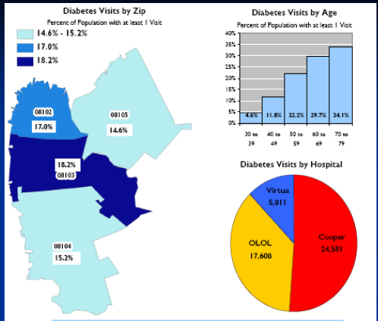
Camden: Understanding and Improving Health Care
Source:
CamConnect
Notes:
CamConnect, our Camden NNIP partner, had close relationship with hospitals from the beginning.
All 3 hospitals in the city wanted to understand their patients better and were concerned about rising costs of health care for uninsured people. After years of negotiation, they agreed to share their patient billing data with CamConnect, including both Emergency department visits and inpatient hospitalizations. Careful privacy protections and lots of work to harmonize the data.
Geocoded the data and did probabilistic matching to match patients who visited multiple hospitals. They found 38,000 Unique patients across institutions, found that approx one-half of the City population used the ER/hospital in one year. At the individual level, they ideitifed people who used the ER often, and assigned them a nurse practioner contact that could work with them one-on-one about their health issues (which likely crossed into housing, family situation, etc.).
Also helped with community-level interventions. They worked with the Camden Healthcare Coalition to dive into specific manageable diseases – here is 1 example of diabetes. These maps helped the Citywide Diabetes Collaborative focus their outreach efforts for classes on how to better manage the illness.
(now data is handled by Camden Healthcare Coalition who helps others interested in doing this work, still close partners with CamConnect).
25

Slide 26
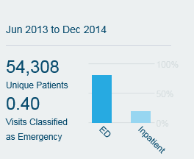
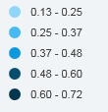
Notes:
The Camden Health Explorer (CHX) is a tool for thinking about the state of healthcare in Camden, NJ, through data. The CHX opens an unprecedented, nearly real-time window on the use of Camden’s health system — the barriers patients face and the improvements the Camden Coalition strives to make every day

Slide 27
Community Information Infrastructure
Administrative Data
Open Data
Integrated Data Systems
Repackaging / Interpretation
Cleaning/
Aggregation
Analysis
Visualization
Storytelling
Training/Technical Assistance
Goal: Broadest Base of Users & Purposes

Slide 28
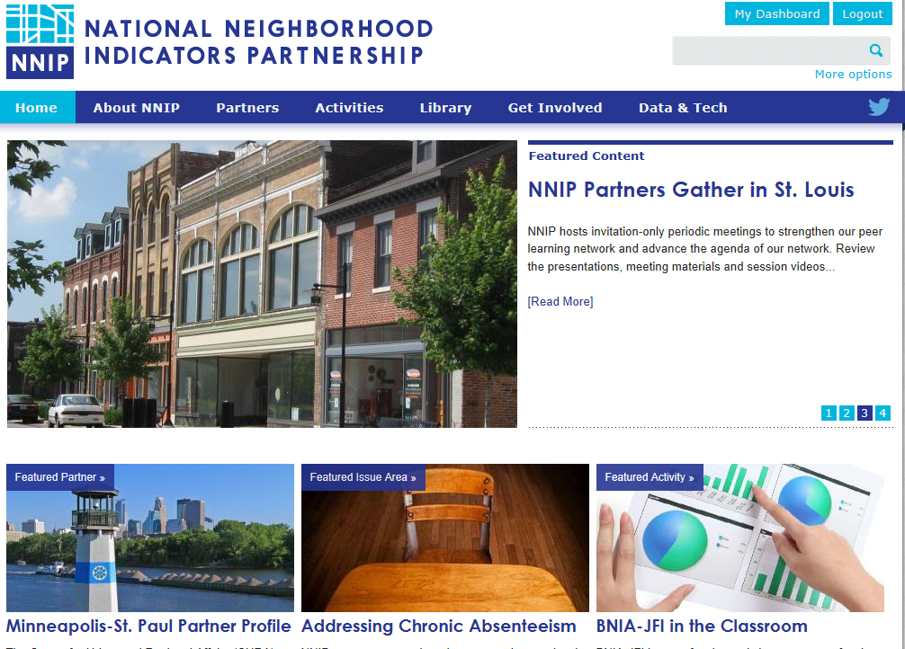
www.neighborhoodindicators.org
Notes:
Mention listserve and Twitter

Slide 29
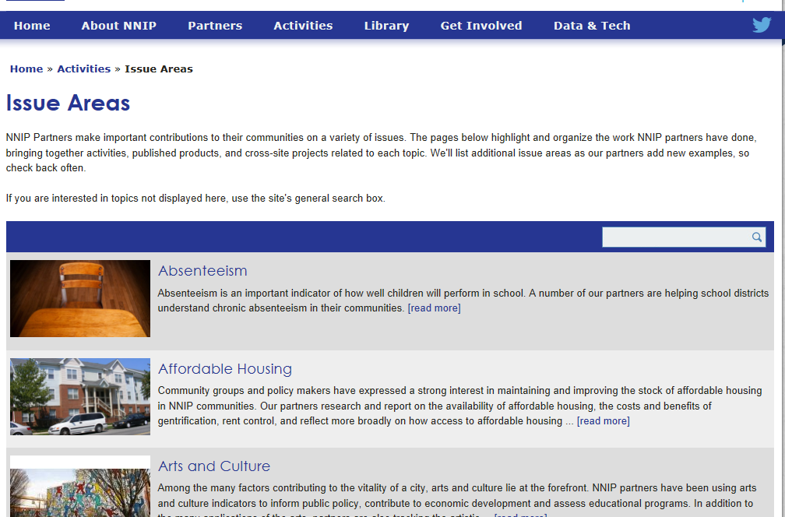

Slide 30
Follow us on Twitter @NNIPHQ
For more information about NNIP, visit www.neighborhoodindicators.org or
email Kathy Pettit at kpettit@urban.org

