Slide 1
Strengthening Capacity For Data-Driven Decisionmaking
Kathy Pettit
February 24, 2015
American Planning Association
Notes:
Introduce myself – thank you for inviting me
Show of hands – local govt, private sector?

Slide 2
Background
Notes:
Start with a little about my perspective and experience

Slide 3

Urban Institute
Urban is dedicated to elevating the debate
on social and economic policy through
rigorous research and engagement.
We believe in the power of evidence to improve lives by
  Reducing hardship amongst the most vulnerable
  Expanding opportunities for all people
  Strengthening the effectiveness of the public sector
Notes:
Urban was started in 1968 to be an outside evaluator for War on Poverty programs. Today, we do a broader array of research for governments and foundations - our work is grounded in our original research.
Motivations for getting our work into the public debate, particularly around helping low-income households and communities

Slide 4
National Neighborhood
Indicators Partnership
Collaborative effort of Urban Institute and 30+ local data intermediaries since 1995.
NNIP partners help local actors use neighborhood data to improve communities through policy, planning, and advocacy
  Trusted and engaged institutions
  Relevant and high-quality data across topics
Notes:
MODEL is not the focus today, but happy to answer questions or talk after the session
Mission:
NNIP partners’ values drive all the hard work of acquiring and organizing the data. The point is to get the information used - whether for policymaking, community building, program planning.
At the start, the founding NNIP partners recognized that not everyone had equal access to information. Focus began with and remains on low-income nghs that have traditionally not had access to data or training to use them.
Institutions:
The partners are housed in various types of institutions – universities, independent nonprofits, local funders.
But whatever the home, they are all respected organizations with a long-term stake in their community. People believe the data and analysis that is published.
Data: at the core of the work…
Partners all agree to assemble and organize local government data that is
1) Ngh-level
2) On a range of issues (need to understand ngh issues and interventions holistically)
3) Over time (to understand trends and be responsive when issues arise).

Slide 5




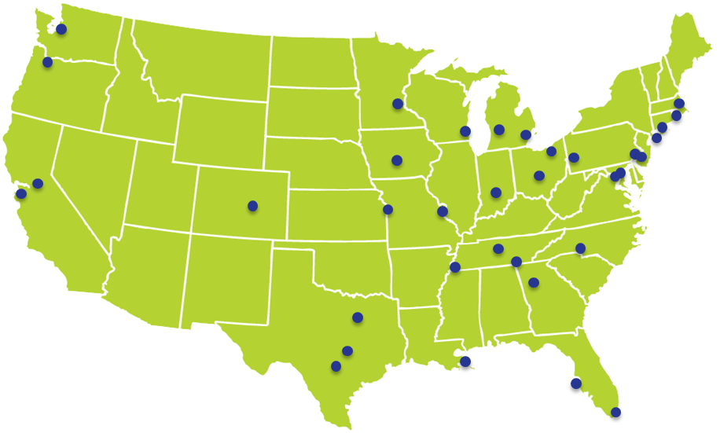




Translators, navigators, connectors
Notes:
Take a moment to acknowledge the amazing people behind the institutions – several of which helped with the examples I’ll share today
NNIP partner staff are the types of people who can cross disciplines and sectors.
Mix of skill sets: Conversant with government operations, politics, community concerns, and the technical data side

Slide 6
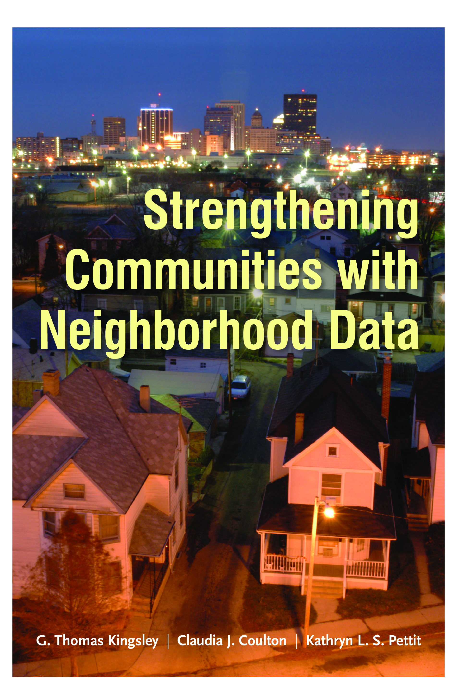

New Books On
Data And Community Action
Notes:
Also, before we get started, I’m going to touch the surface of a lot of topics today. I’ll point to other resources along the way, but there are also 2 related books published last fall – both free ebooks and the What Counts book can be ordered for free. Links on the handout.
Strengthening Communities with Neighborhood Data is a broad survey of the evolution of the community information field since the early 1990s funded by the MacArthur Foundation. It covers the institutional environment, the availability of neighborhood data, and innovations in the uses of these data for research and practice. It is meant for both practitioners and researchers.
What Counts: Harnessing Data for America’s Communities is collection of essays on using data for community improvement and health that was funded by the Robert Wood Johnson and looks more to the future of the field. The essays dive in more-depth on particular topics and is specifically oriented to practitioners. It is edited by a team from the San Francisco Fed (Naomi Citron and David Erickson) and Urban (myself, G. Thomas Kingsley, and Ellen Seidman).

Slide 7
From Data to Information to Action
Steps | Examples
Collecting Raw Data | Administrative Data Open Data Community Collected Data Survey Data
Enhancing Data | Integrated Data Systems Neighborhood Indicators
Interpreting and Communicating Data | Analysis Visualization Storytelling
Engaging Directly with Data | Training Technical Assistance Discussion, Organization, Action
Goal: Broadest Base of Users & Purposes
Notes:
Framework for my presentation today
Together we think a lot about what information infrastructure is needed to help a community gather and use data. Impt to understand all the steps that are needed to be able to get data used in your own issue area/work & see how you or your org might fit in
Activities needed to get data shared, understood, used in decisionmaking
Often too much focus on the first step
There is a mind-boggling amount of data available today – – but having the data in hand is not enough.
You all might have experience with the fact that it is still often hard to get the right indicators for the question you have, in the time you need.
For the rest of the presentation, I’ll walk through these steps and give highlights and examples

Slide 8
Collecting Raw Data
Notes:
Covering a few big topics – this may be the fun or boring part depending on your interests

Slide 9
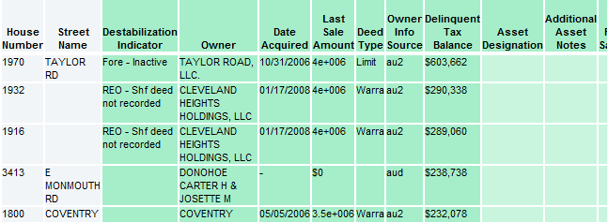
Administrative Data
Examples of Data
  Education
  Child care
  Births, deaths
  TANF, Food Stamps
  Health
  Crime
  Property sales, prices
  Foreclosures
Raw Home Mortgage Data
Transformed Property Data
(Cleveland)
Notes:
Most familiar to all of you – geography will vary - whether parcel or address.
Raw data with a range of quality and documentation
Increased focus on better use of the data for analysis and evaluation – featured in Obama’s budget and link on handout

Slide 10
What is Open Data?
Principles
  Increase transparency to help citizens hold government accountable and promote engagement
  Enable access to a public good funded by taxpayers
Practices
  Portals (mostly government examples so far)
  Re-packaging of data (value-added data, apps, etc.)
  Data standards (Transit, Open 311)
Policies: formal adoption of open data
Notes:
Just a little on open data since it is getting a lot of press
Depending on the context “open data” can mean a lot of things…

Slide 11
Benefits of Open Data
Effective public policy
Effective planning/programs outside of government
Efficient delivery of government services
Transparency and accountability
Informed public engagement
Business development
Notes:
In the beginning, primarily driven by the last three goals…
the first three goals are as important outcomes of open data and should be used in judging its success.
Example: In DC, our open data portal helps to populate our PerformanceStat system, Track DC (also public)
Example: Hartford’s GIS manager Brett Flodine had been working on publishing to their new open data portal for 6 months driven by the goals of good government practices. But when it came time for the city to apply for a federal Promise Zone grant, his job in supplying information was much easier because the data was already organized.

Slide 12
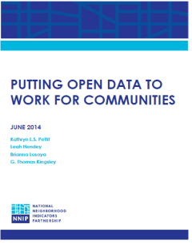

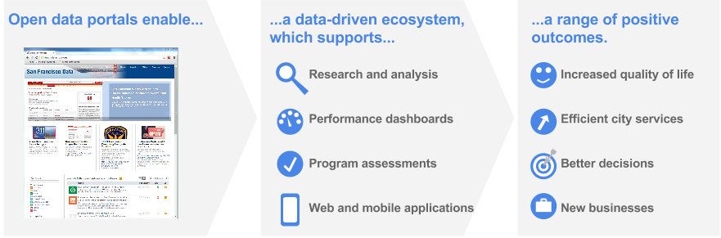
Recent Open Data Resources
San Francisco’s Open Data Strategic Plan
Notes:
Going beyond measuring progress by only how many thousands of data sets you have published, or turnout of early 20-somethings at 1 day hackathons
Here are some other resources for learning about open data
A lot of progress has been made
– we published a white paper on how open data and traditional community improvement groups could connect
- Code for America volume on people’s thinking of the next generation of open data work
- San Francisco’s strategic plan

Slide 13
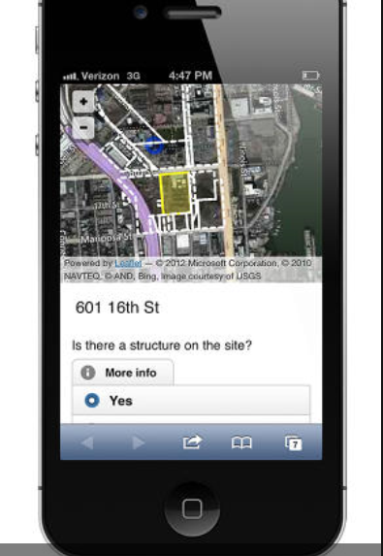
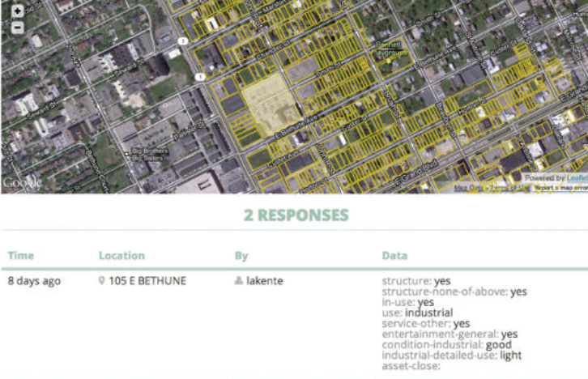
Community Collected Data
LocalData.com
Code for America Detroit, 2012
Notes:
While there’s been community collected data for a long time – maps done by Hull House of neighborhood characteristics – technology makes it a lot easier. More thinking about crowd-sourcing and how to combine more current or fine-grained citizen science data with “official” data sources.

Slide 14
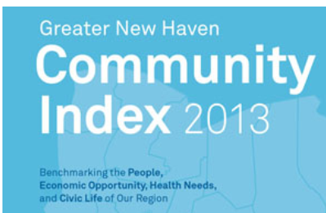

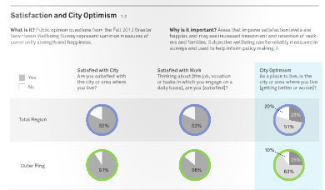
Survey Data
Notes:
Survey data
Large national ones – American Community Survey
Also – community surveys like this one from our partner in New Haven
Captures sentiment, opinions – city satisfaction.

Slide 15
Enhancing Data
Notes:
A second step – adding value to the raw data
Integrated Data System
Community Indicators

Slide 16
Integrated Data Systems (IDS)
IDS link records from multiple agencies to track inputs and outcomes for individuals
Built on data sharing agreements, strict privacy protection, & common interest in social benefit
Used for:
  Case management
  Plan for target populations and program innovations
  Mobilize work toward joint outcomes
  Capture cost benefit across systems
Notes:
Actionable Intelligence for Social Policy

Slide 17
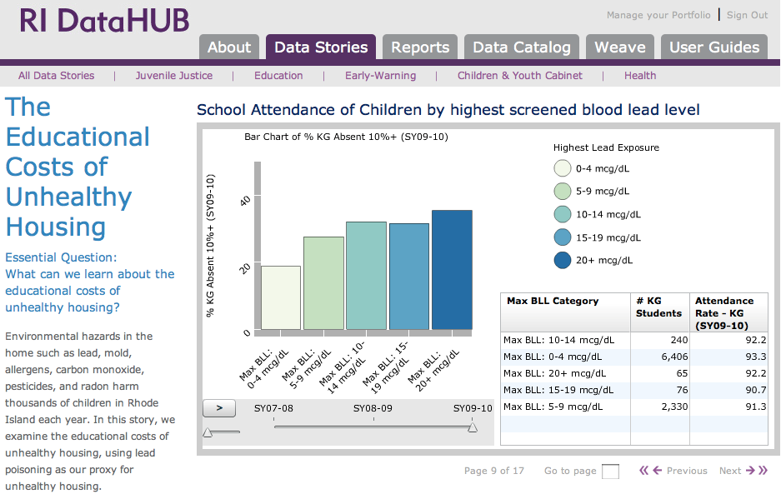
Source: Providence Plan
Notes:
Linking data across-sectors can bring stakeholders together and illuminate new policy solutions, that wouldn’t be found when operating with only one source of information. Providence is the current leader in making the insights from IDS widely available and connecting them with policy actions – data stories are created in collaboration with the govt agencies and np stakeholders, so reflect the combined wisdom and experience.
For example, people look to principals and school district officials to address the problem of chronic absenteeism. But one of the big reasons kids miss school is because they are sick, often with chronic conditions like asthma. Lead exposure had been found to be a reliable proxy for unhealthy housing conditions that may exacerbate asthma.
Our partner, the Providence Plan has built an IDS called the Rhode Island DataHUB and worked with state and local agencies to bring together information about children in Rhode Island into one place. Combining the data allowed them to look beyond school-based factors for student absenteeism
Graph – pct of kindergarteners that are chronically absent from school by the lead levels found in their blood stream during screenings.
- Those with the highest lead exposure are more likely to be chronically absent than children with lower levels.
- This graphic suggests that the school system cannot solve the problem of chronic absenteeism without working with community organizations and city officials to address social and environmental determinants of health.

Slide 18




IDS Catalog and Resources
Visit our IDS catalog and resource page http://neighborhoodindicators.org/resources-integrated-data-systems-ids

Slide 19
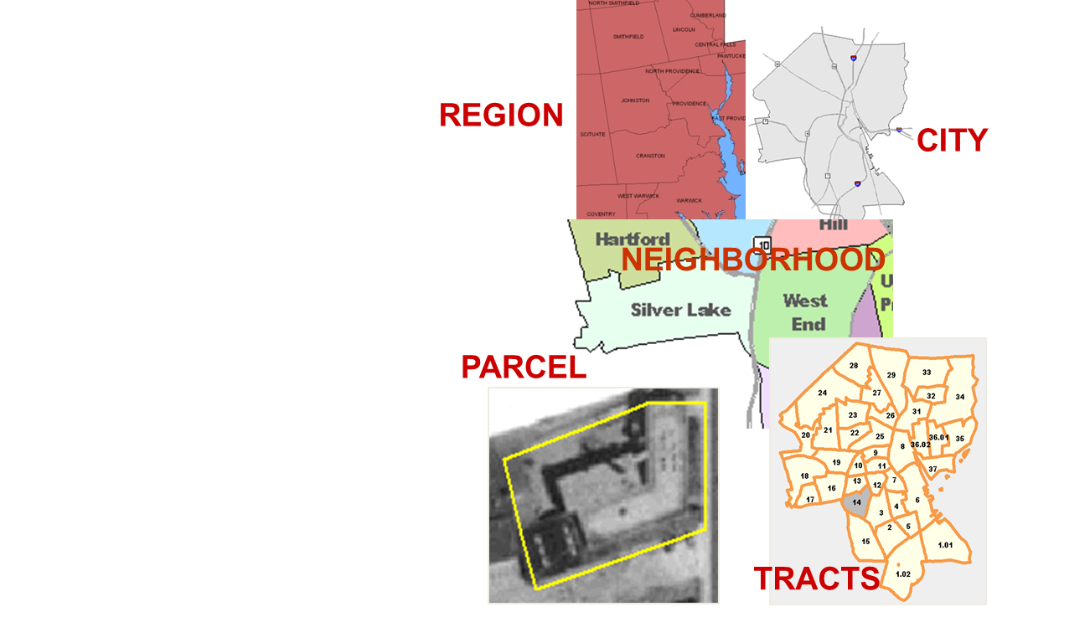
Neighborhood Indicators
  Problems are not evenly distributed across cities.
  Priority issues vary across neighborhoods.
  People can relate to data analysis at the neighborhood level.
Notes:
Sometimes just profiles – indicators around a variety of topics without formal selection or review process – more of a look-up resource

Slide 20

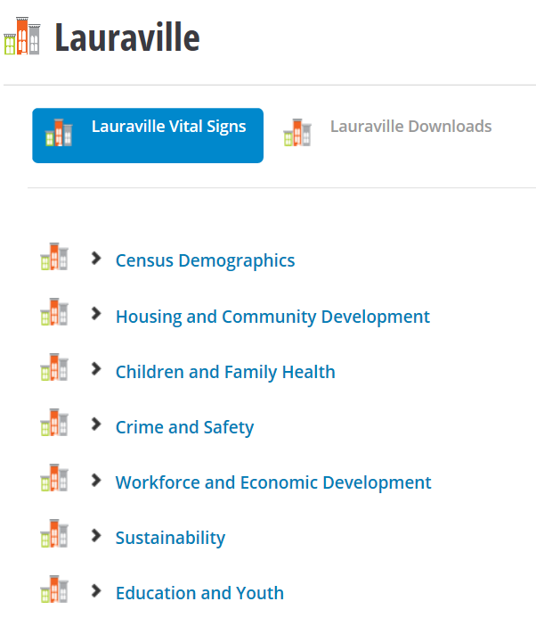
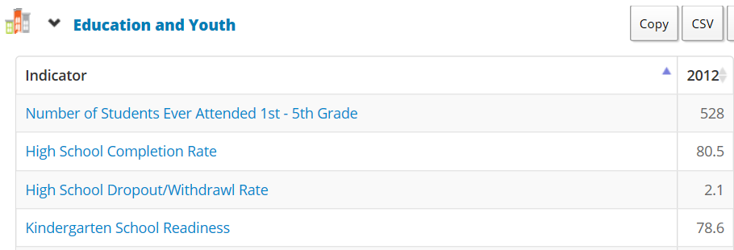
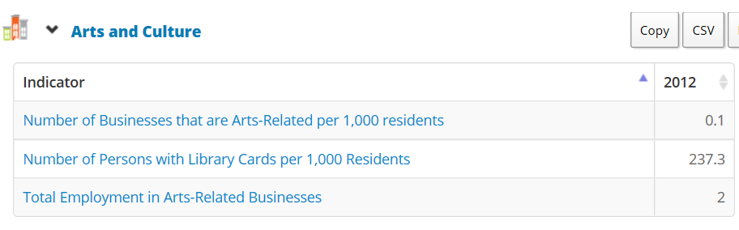
Baltimore Vital Signs
Notes:
Other times they are formal community indicators projects –
From our Baltimore partner – 15 years – standard set of data for their community areas – annual review of how neighborhoods are doing on a range of issues.
Start of a community conversation

Slide 21

Interpreting, Communicating, and Engaging with Data
Example from Detroit
Notes:
Combining the last 2 items
Interpreting and Communicating Data
Engaging Directly with Data
Now have all this raw material – how to put it all together to get work done in better ways

Slide 22

Detroit Blight Removal Task Force
To develop a straightforward and detailed implementation plan to remove every 'blighted' residential structure, commercial structure and public building, and clear every blighted vacant lot in the city of Detroit
Notes:
Included private, nonprofits, and public sector
Led by Dan Gilbert (private sector), Linda Smith (Non-Profit Housing Corporation), Glenda Price (Detroit Public Schools Foundation)

Slide 23
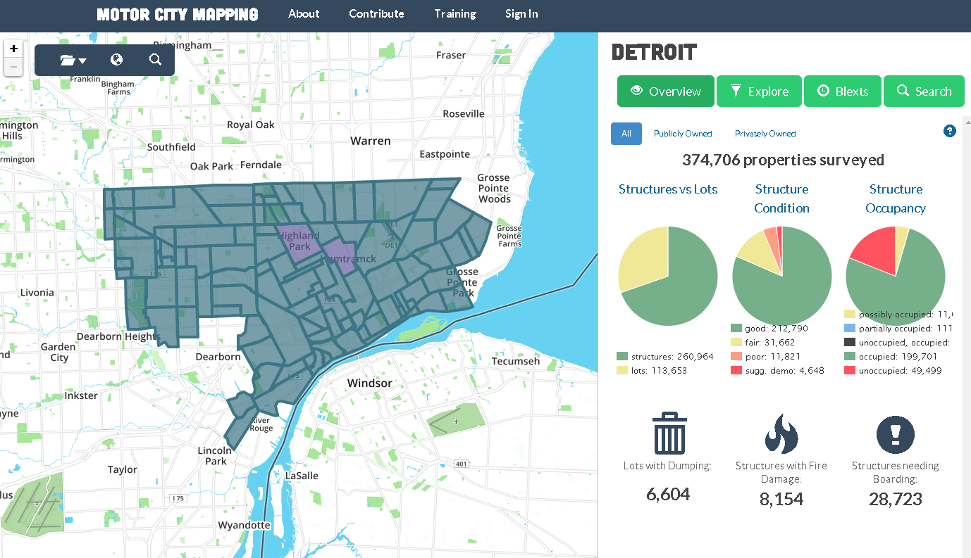
Motor City Mapping
Notes:
In November 2013, the Blight Removal Task Force, in partnership with Michigan Nonprofit Association, Data Driven Detroit, and Loveland Technologies, began a physical survey to gather property condition data for all 380,000 parcels in the city.
Goal to create a comprehensive database of detailed information including the condition of each and every property in Detroit.
Over 10 weeks, about 150 resident surveyors and volunteer drivers documented residential & commercial property conditions.
photos, checklist on housing/lot conditions (occupancy, lot vacancy, fire damage, dumping and property use etc.
Data was uploaded via a live-stream feed to ‘mission control’, where associates performed a quality control check on all data
Findings: 84,000 + structures and vacant lots in need of intervention:
40,000 blighted structures are recommended for immediate removal.
38,000 structures have “Blight Indicators” and need further evaluation.
6,000 vacant lots showed evidence of dumping and need immediate attention

Slide 24
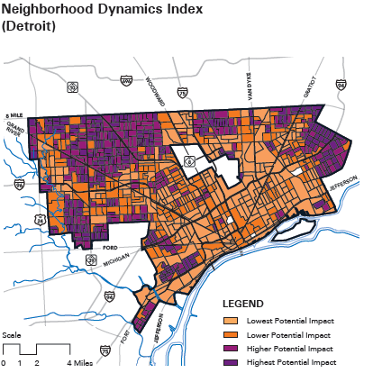
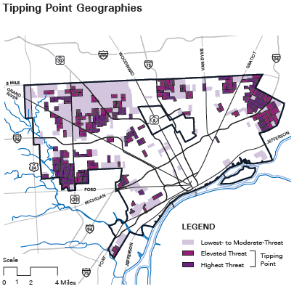
Maximizing Community Impact Tool:
Neighborhood Indices
Notes:
How to use the information for decisions was baked in from the start
Specifics on the Motor City Mapping website – combined several indicators into 1 index to measure impact
This one maps places where there would be the most impact – density of occ. structures and children
On the right - Neighborhood Threat Index – based on foreclosures and rate of decline in property conditions. Combine these two to overlay recommended target areas

Slide 25
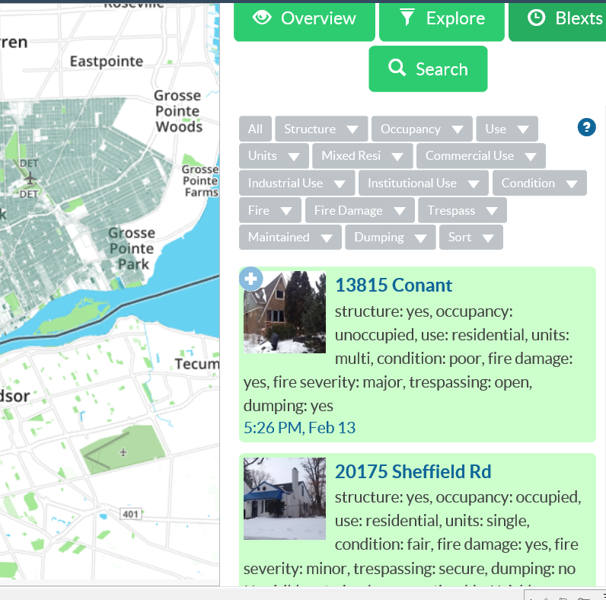
Updating the data with Blexting
Notes:
Property surveys have been done for decades with paper and pencil to handhelds
Difference here is that the process is designed to be scalable, repeatable, and real-time
Downfall has always been that the information is outdated quickly
Software app was designed to allow registered users to continue to feed information into the system – there is a training PPT with clear instructions. A neighborhood watch group, CDC, or just concerned ngh. Reviewed for quality.

Slide 26
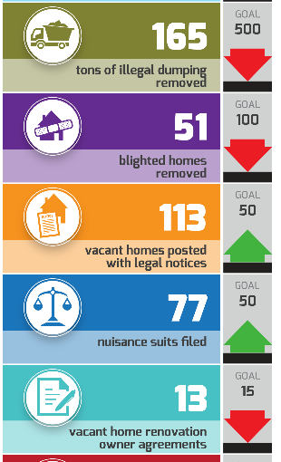

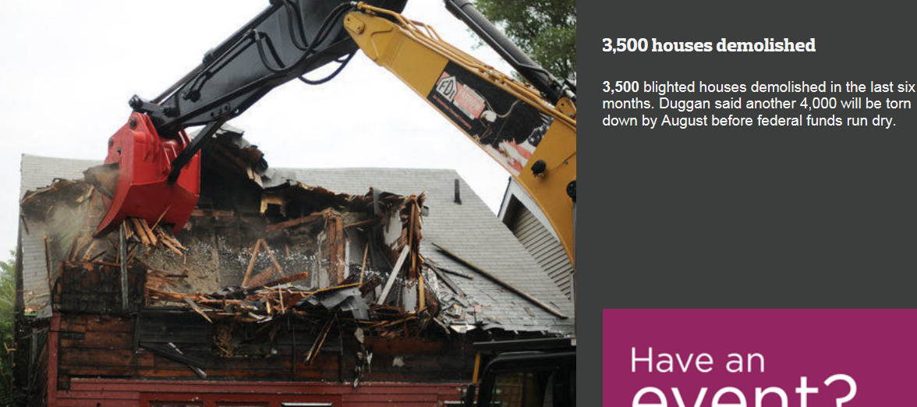

City Performance Management
Notes:
Also being used in city performance management
Officials said the new Detroit Dashboard will provide weekly updates on numbers of lights installed, lots mowed, vacant houses destroyed and other service-related statistics. The city has been trying to show strides in improving basic services since entering bankruptcy last year and putting a halt to
Storyboard of progress - http://www.mlive.com/news/detroit/index.ssf/2015/02/14_numbers_on_detroit_progress.html#6

Slide 27
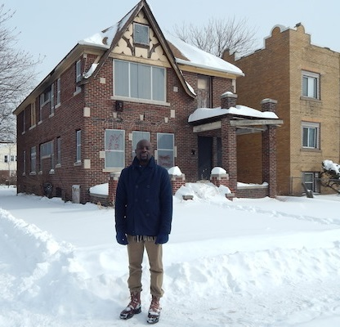
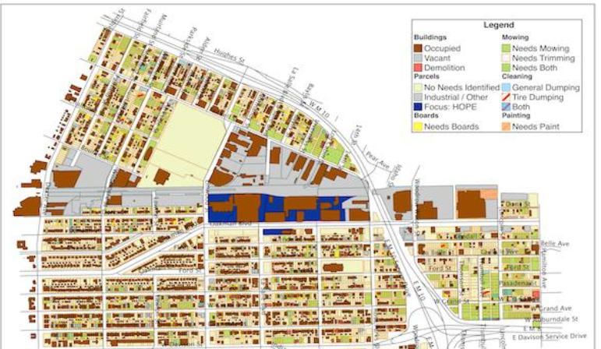
HOPE Village Neighborhood Action
Notes:
An example of using the data at a ngh level ...
Picture of Focus: HOPE’s placemaking and planning manager, Jerrell Harris. His work is largely focused within the 100-block HOPE Village Initiative area.
One of his major projects is redeveloping this old house: HOPE campus’s Detroit's first certified LEED Platinum residence.
The initiative will host a three-day anti-blight event in July, when volunteers will board up houses, clean up vacant lots and begin beautification efforts as part of what he calls "a transformative plan for the neighborhood" that is greatly informed by MCM data
http://www.modeldmedia.com/features/DRF4MotorCityMapping021315.aspx 2/13/15

Slide 28

Interpreting, Communicating, and Engaging with Data:
Example from Austin
Notes:
Now have all this raw material – how to put it all together to get work done in better ways

Slide 29
COH Approach to Presenting Data
Use multiple sources to understand the problem and potential solutions.
Include community needs and assets.
Admit imperfections and limitations.
Enlist participants to fill out the picture (including tangible and intangible).
Notes:
Use multiple sources – for obesity, they mapping the physical fitness scores, but also the parks, health food outlets, and fast food restaurants.
Balance negative indicators with recognition of assets - Examples depending on the topic, but include Playgrounds, Libraries, Faith Communities, but also individuals that serve as community leaders and supports.
Admit the administrative data are incomplete and imperfect – ask the participants to contribute to the data collection process.

Slide 30
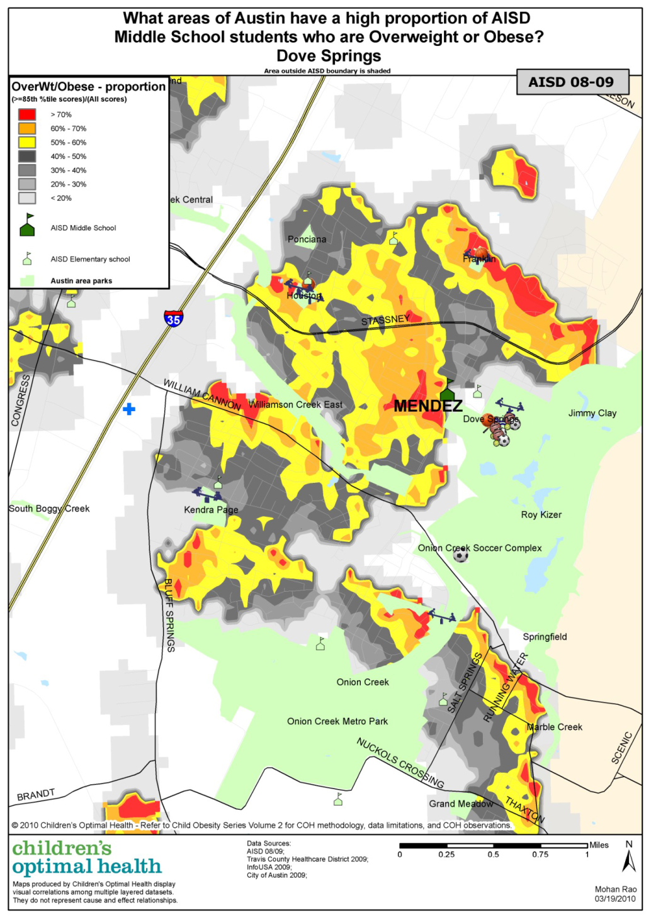
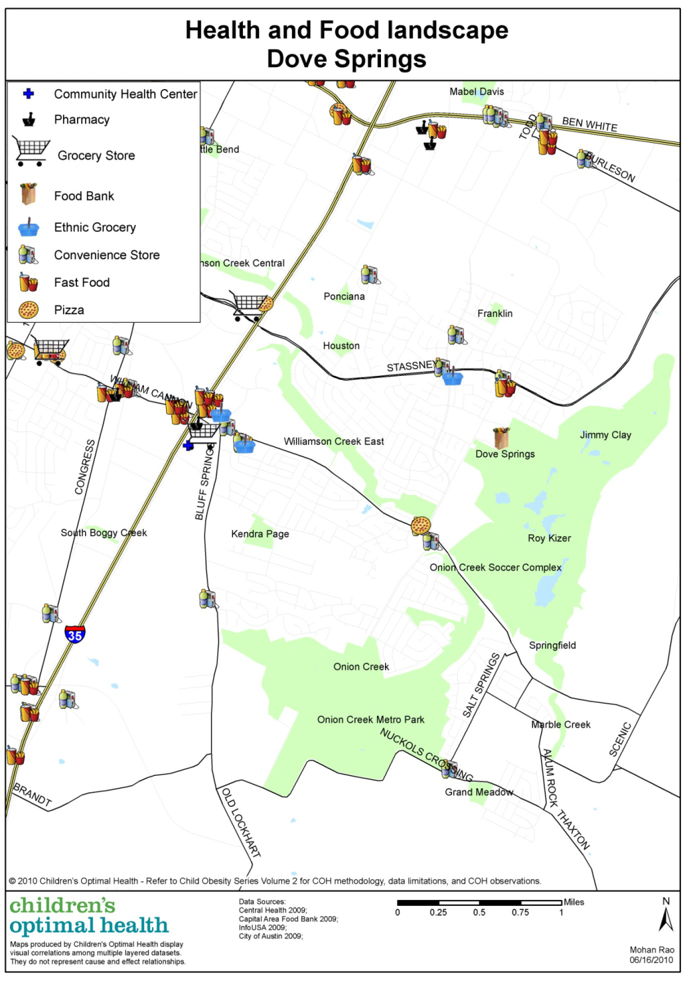
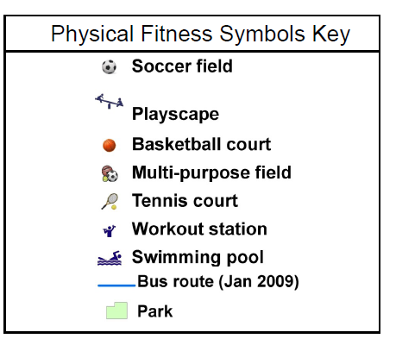
Understanding
the Problem
Notes:
[Taken from the Austin COH website]
COH also zoomed in on neighborhoods (this is Dove Springs) and looked at other related issues like cardiovascular health (proportion map on left) and the health and food landscape in the area (map on right).
1) There appear to be very few food outlets located close to where families live.
2) There are only a few food establishments in the Dove Springs area that supply both fresh meat and fresh fruits and vegetables.
3) There appears to be a large amount of green space in this area but not all of it may be accessible for recreational use and appropriate for children to play in.

Slide 31



COH Community Summit
Notes:
Format:
“Leave your title at the door.”
Guest speaker – experts like head of the trauma center
Presentation of analysis (primarily maps while I’ll discuss in a minute)
Panel that brings in different voices (juvenile justice people, advocacy and service groups). For example, in the session on maternal and infant health, an advocacy group help identify a panel of Hispanic and African-Amer. women who had bad experiences with the formal health care providers and talk about why they did not seek OB care. This also helps foster cultural sensitivity.
Small group discussion (4 to 8 people)
Breakout groups – also planned with thought – thematic tables (note “access to alcohol” tent in pic), neighborhood tables, etc. but always the ability to create your own group.
No assignment, but encourage mixing (EMS person in pic)

Slide 32
Operational & Policy Changes
Targeted allocation of resources by City and County to neighborhoods of highest need
City planning to include sidewalks and hike/bike trails in targeted neighborhoods
AISD School Board included student health as a core value
Improved physical education and health curriculum in schools
Improved awareness and advocacy around importance of school recess
Notes:
Coalition of organizations commitment to action and advocacy to achieve this shared goal
They meet monthly to look ahead a year to see which apt buildings have govt subsidies that are expiring and share information about landlords, tenant organizations.
Moving all this to open source website – 3 levels of access – public, network, indiv. org

Slide 33

Interpreting, Communicating, and Engaging with Data:
Affordable Housing in Washington, DC
Notes:
NeighborhoodInfo DC – housed at Urban – serves as our local NNIP partner under the leadership of Peter Tatian
Provides community-based organizations and residents in the District of Columbia with local data and analysis they can use to improve the quality of life in their neighborhoods

Slide 34
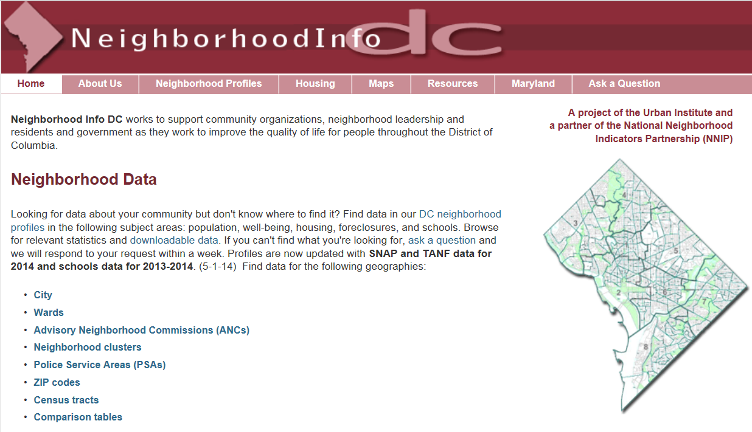
NeighborhoodInfoDC.org
Notes:
Older design, but good data and resources.

Slide 35

Commissioned by the Community Foundation for the National Capital Region with support from the Morris and Gwendolyn Cafritz Foundation
Notes:
We’ve done local housing analysis since the late 1990’s
Recent report –summer - aim to get a regional picture of housing issues

Slide 36
Purpose of the Study
For the region and local jurisdictions:
  Identify supply, demand, and gaps along housing continuum from homeless system to affordable homeownership
  Examine how housing patterns and policies to address needs vary across jurisdictions.
  Examine how housing policies and programs are funded by the public and philanthropic sectors

Slide 37
Regional look at affordable housing
Gap in Affordable Units for Extremely Low Income Renters, 2009-11
Total gap = 94,200 units
Notes:
Zoom in on DC – walk through graphic
Many households in DC spend much more than they can afford that on rent or mortgage payments, leaving less for food, health care, and other basic needs.
The US Department of Housing and Urban Development categorizes households by how they compare with the median income in an area. In 2011, the median income in the Washington region was $106,100 for a family of four. That means that a four-person family supported by, say, a paramedic earning $46,400 a year is considered very low income and can afford to pay up to $1,160 a month for rent. The same-sized family supported by a dental hygienist earning $90,460 is middle income and can afford $2,262 a month in rent.
From 2000 to 2011, the number of rentals that were affordable for low-income, very low-income, and extremely low-income households either fell or increased only slightly, while the number of rentals that only middle- or high-income households could afford rose rapidly, particularly for studio and one-bedroom apartments that would be suitable for one- or two-person households.

Slide 38
DC Preservation Network
Shared goal: Preserve federal and local assisted affordable housing
Multi-level strategies
  Create a Preservation Plan for DC
  Monitor projects that are at risk of losing their affordable status and work to preserve affordability
Notes:
Coalition of organizations commitment to action and advocacy to achieve this shared goal
They meet monthly to look ahead a year to see which apt buildings have govt subsidies that are expiring and share information about landlords, tenant organizations.
Moving all this to open source website – 3 levels of access – public, network, indiv. org

Slide 39
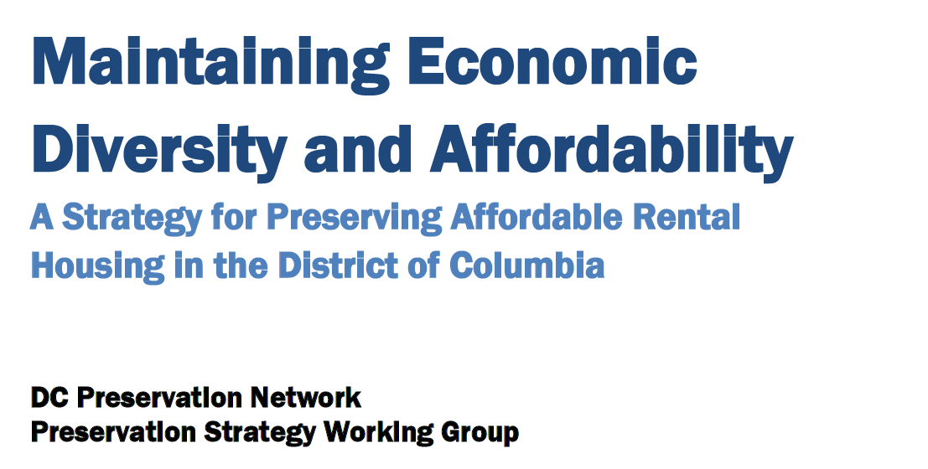
Strategy: Create a Preservation Plan
Coming
March 2
Notes:
Preservation Policy:
- Recognizes that to maintain and increase affordable housing options for residents it must preserve existing affordable housing in addition to creating more affordable units.
- Thus, it will strive to preserve wherever practicable the affordability and sustainability of its existing affordable housing stock.
- To do so it should dedicate substantial additional funding to preservation and adopt goals and criteria for allocating resources to achieve this objective.
Preservation Goals:
· Preserve existing District and federal subsidized housing, including public housing
· Prevent displacement of residents with low and moderate incomes
· Preserve housing that serves vulnerable populations such as persons who have disabilities, or
are formerly homeless, low income seniors or returning citizens
· Maintain diversity in neighborhoods
· Maintain the stock of market rate affordable rental housing
Preservation Criteria: for determining the types of affordable rental housing that should be preserved
Preservation Methods and Tools
Preservation Implementation:
· The District should create a Preservation Team made up of top officials from District’s many agencies that connect to housing and a representative from the DC Preservation Network to develop protocols for preserving affordable housing. An Action Team of operating staff from the above agencies and offices should be charged with implementation.

Slide 40
Strategy: Monitor at-risk projects
1: Compile and link relevant data
DC Preservation Catalog: Initially developed by the National Low Income Housing Coalition
Local and federal administrative data from several sources
  DC Assessors data, code enforcement actions
  HUD inspection scores
Informal knowledge of technical assistance providers
Notes:
Second strategy: monitoring subsidized properties that might be lost
The Network maintains a database of approximately 35,000 assisted affordable rental units through one or more federal or local housing subsidy programs and meets monthly to review those properties that may be at risk of losing affordability.
The DC Preservation Catalog is now being maintained by the Coalition for Nonprofit Housing and Economic Development and NeighborhoodInfo DC.
property name, location, owner, manager, and physical condition.
various subsidies that contribute to a property's affordability, including each subsidy's effective expiration dates, the number of income-restricted units, the income level at which the property is affordable

Slide 41
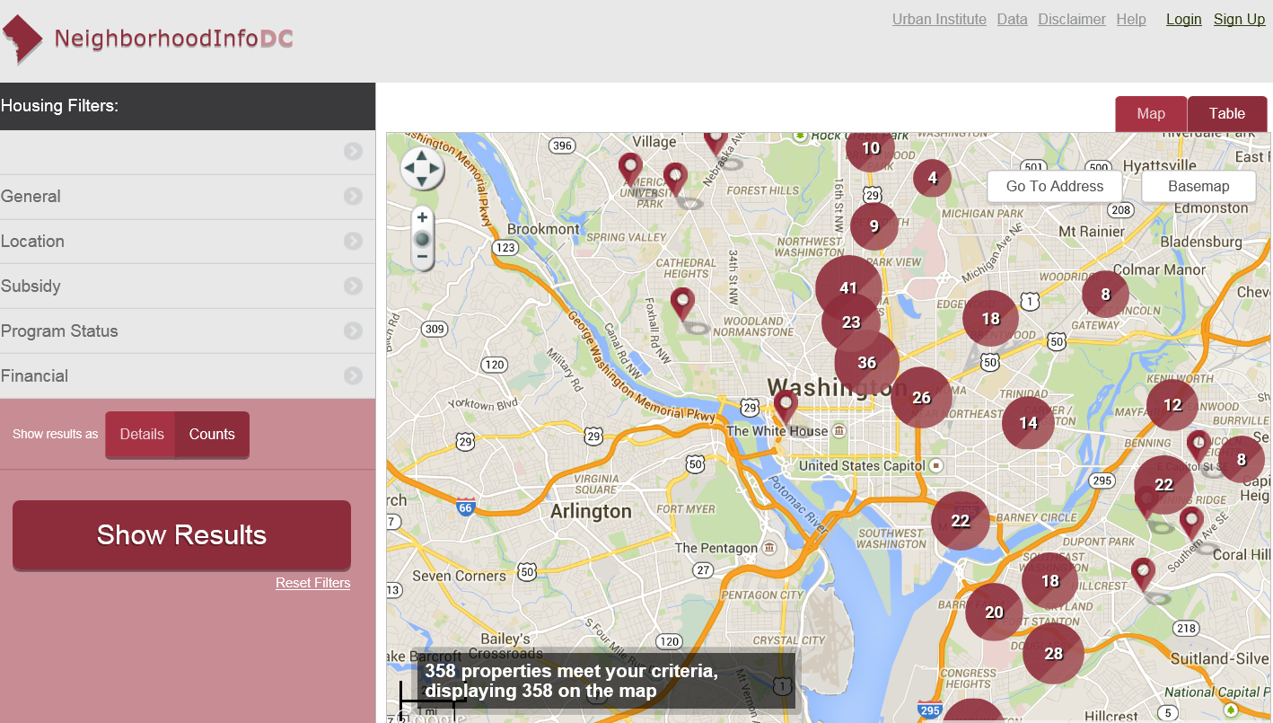
2: Share data: PDF report (before) and public portal (coming soon)
Notes:
Previously with a PDF

Slide 42
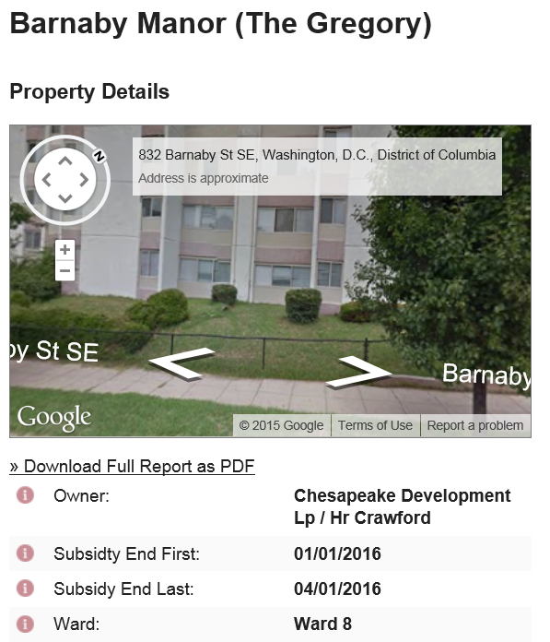
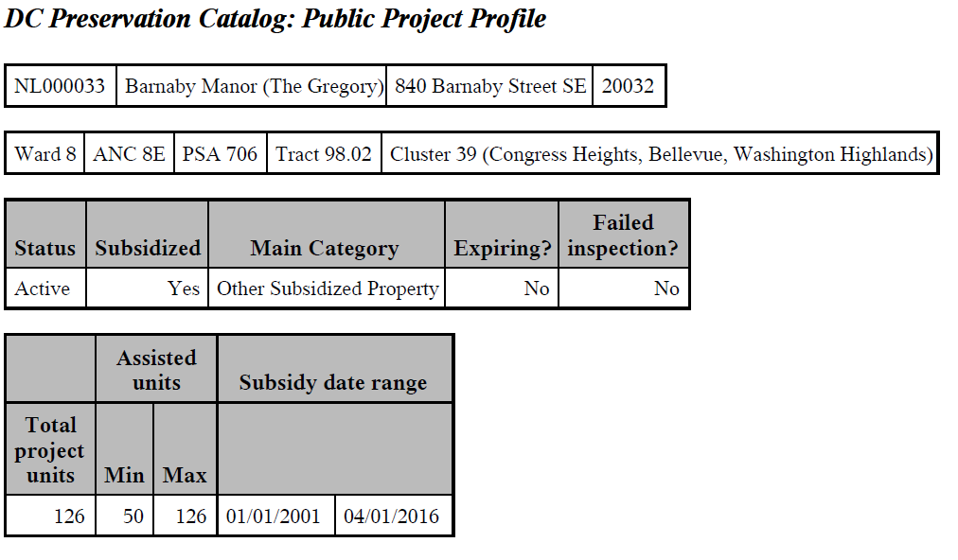
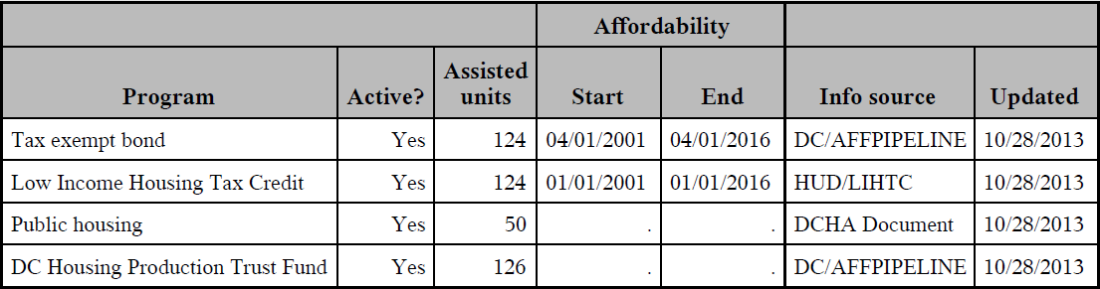

Slide 43
3. Convene cross-sector forum for action
Convenors: Coalition Nonprofit Housing and Economic Development (CNHED) and NeighborhoodInfoDC at the Urban Institute
Other Participants:
  Nonprofit and private housing developers
  Housing counseling and legal services providers
  U.S. Department of Housing and Urban Development
  District of Columbia housing agencies
Notes:
Participants in the Network include housing counseling organizations, legal services providers, affordable
housing developers, the U.S. Department of Housing and Urban Development, and DC government
agencies, including the Department of Housing and Community Development, DC Housing Finance
Agency, DC Housing Authority and the Office of Tenant Advocate.
Meets monthly to review those properties that may be at risk of losing affordability – review upcoming properties
Share information about and owner's intention to either continue or discontinue participation in the affordable housing program, how organized the tenants are, etc.
Portal has a separate password-protected section so that members can store and save this type of sensitive information within the network

Slide 44
4. Identify action strategies
Ensure tenants are informed of their rights
Identify high-priority buildings
  Expirations
    Convince landlords to stay in program
    Tenant, nonprofit, or city purchase of buildings
  Terminations
    Targeted code enforcement
    City discretionary building repair fund
Notes:
They make sure tenants are informed of their rights and identify high-priority buildings for the CDCs to assist in organizing and perhaps purchasing the building.
Prioritize properties – limited time and resources even with coalition – is it in a hot ngh? Are tenants organized and ready to buy the building?

Slide 45
Preservation Save:
The Gregory - 840 Barnaby Street, SE
In June 2010, the Network identified that the 124- unit property was at risk for loss.
Latino Economic Development Center began organizing the tenants.
With Network’s urging, DCHFA, DCHA, and DHCD coordinated to preserve the building.
  Hired new asset and property manager
  Addressed the poor living conditions
  Renovated the uninhabitable units for more income
Notes:
This story reflects how a collaborative and intentional effort by DC agencies working with
The Gregory provides 124 families an affordable place to live near the DC/Maryland border in southeast DC. However, the building was almost lost due to poor housing conditions, management issues, and lack of coordination among several DC agencies.
Many units were vacant and issues with the management of the building kept these problems from being addressed.
Failed inspections meant that the DC Housing Authority (DCHA) had to stop paying the landlord for the project-based vouchers that were connected with the building. DC Housing Finance Agency (HFA), DCHA and the Department of Housing and Community Development (DHCD) were all involved in the building, but all looking at different options for the building’s future.
The Latino Economic Development Center began organizing the tenants, some of whom were facing immediate displacement because the non-payment of vouchers due to failed inspections caused them to have overdue back rent. The efforts of the Preservation Network and the tenants organizing pressured DCHFA, DCHA, and DHCD to workout a coordinated plan to preserve the affordable building.

Slide 46
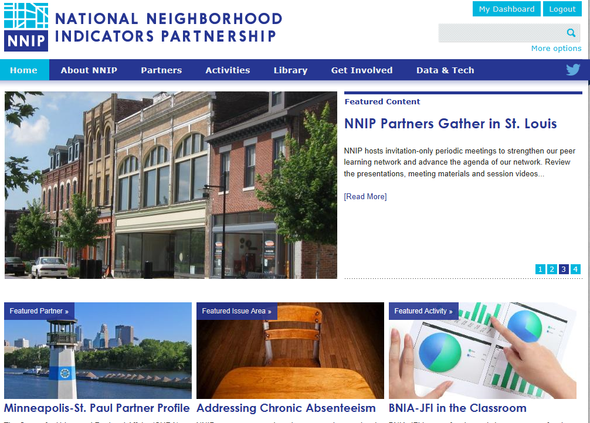
www.neighborhoodindicators.org
Notes:
Mention listserve and Twitter

Slide 47
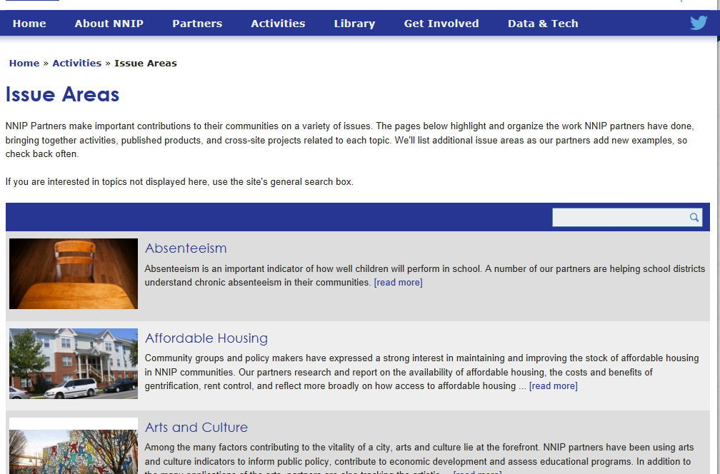

Slide 48
Follow us on Twitter @NNIPHQ
For more information about NNIP, visit www.neighborhoodindicators.org or
email Kathy Pettit at kpettit@urban.org

