Slide 1
USING INFORMATION FOR
COMMUNITY ACTION
National Neighborhood Indicators Partnership
Kathy Pettit, The Urban Institute
Unleashing the Power of Local Data Conference
October 13, 2011
Notes:
Introduce myself: urban researcher & Co-Director of the National Neighborhood Indicators Partnership (NNIP)
Today’s presentation: National trends around community use of data, a little about NNIP, and then examples of our how partners have used the data.

Slide 2
What’s Happening Nationally?
Great progress on Open Data
  Lots of energy from the private and public sector
Federal place-based initiatives survive budget pressures
  Promise and Choice Neighborhoods
  Sustainable Communities
More critical than ever to target neighborhood efforts
  Stagnating economy increases need for public programs
  But local, state, and federal funding is being cut back
Notes:
First, there is much good news…
Increased availability of localized information from many sources (online property info, NCLB reporting, live crime stats, etc.)
More usable technology and broader personal use of information (Google maps)
- tools like Policymap, Census bureau site that you’ll hear about later today
2. Federal programs have encouraged communities to use data to plan and monitor programs. In the case of Promise Ngh, I’ve seen just the process of doing the proposal have an effect, even for those that did not win federal grant. You probably have examples of local programs too.
3. Need to be smarter about how we spend limited resources. Hard choices to be made.

Slide 3
What Needs to Be Done Locally?
Identifying the right data to answer questions
Transforming raw data into information
Communicating findings and insights
Advocating for effective & informed policies
Implementing the right programs to help residents and neighborhoods
Notes:
All of that momentum is not enough…. Data is only a tool to accomplish the goals of our organizations This is why all of you are needed....
From the flood of data, Still hard work to figure out how to get the data you need for the area you care about
Giant spreadsheet of numbers or data file difficult to absorb without interpretation, creating of meaningful indicators
What does it mean? What’s behind the trends?
Next need to share what you have learned and assemble the political will and resources for programs.
Finally, you move to the action and will need to track progress or setbacks.

Slide 4
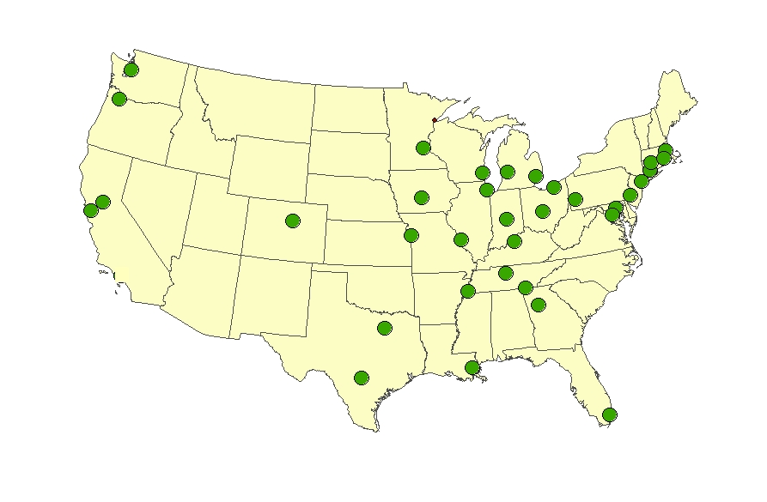
National Neighborhood Indicators Partners
Atlanta
Baltimore
Boston
Camden
Chattanooga
Chicago
Cleveland
Columbus
Dallas
Denver
Des Moines
Detroit
Grand Rapids
Hartford
Indianapolis
Kansas City
Louisville
Memphis
Miami
Milwaukee
Minneapolis-St. Paul
Nashville
New Haven
New Orleans
New York City
Oakland
Philadelphia Pittsburgh
Portland
Providence
Sacramento
St. Louis
San Antonio
Seattle
Washington, DC
Notes:
Collaborative effort since 1995
Urban Institute and local partners in 35 U.S. cities. And several more on the way.
All partners have built information systems with neighborhood level data on a variety of topics. This data is updated over time and saves each groups in their cities from having to go negotiate with the police to get crime data, the schools to get education data, etc.
All are local organizations with a long-term stake in their community. Data providers can be comfortable the data will be handled responsibly, and consumers can trust the information that comes from a neutral source.

Slide 5
NNIP Mission: Information for Change
Democratizing Information
  Facilitate the direct use of data by stakeholders
Work for many clients
  Helping Boys and Girls Club choose a new site
  Working in a cross-sector collaboration to reduce infant deaths
A central focus on strengthening, empowering low-income neighborhoods
Information as a bridge for collaboration among public agencies, nonprofits, businesses
Notes:
Lots of data sites, but the NNIP mission sets us apart. Partners are very different in many ways, but we share a set of key principles
1. Agreed to take on the role of facilitating and promoting the direct practical use of data by community and city leaders in community building and local policy making.
2. All partners have a wide variety of partners and audiences since systems on the shelf don’t sustain support. A colorful map will be, will not be enough unless it leads to greater understanding or new conversations. (These are short-term & long-term examples).
3. Giving emphasis to building the capacities of institutions and residents in distressed neighborhoods. Level the playing field by making sure everyone has access to the information
4. Importance of interacting with stakeholders around the data and ongoing relationships. In New Orleans, our partner hosted a meeting with the various state, city, and nonprofit agencies that own 14,000 vacant properties in the city. Having some initial analysis from our partner offered an opportunity for them to connect and begin to coordinate strategies.
UI coordinates the partnership and works nationally to build the field.

Slide 6
Lessons from NNIP
Design indicators for action—not just to passively monitor trends.
Develop indicators at the neighborhood level as well as the city or county as a whole.
Use available indicators but recognize their inadequacies – don’t discount local wisdom.
Place the numbers in the context of images and stories about the issues you care about.
Notes:
1. need to motivate the data collection and analysis to keep the effort going
2. Overall city trends in teen pregnancy won’t help identify where you need to target your efforts. Also, people relate to where they live, gets them engaged right away
3. I love data, but some of it is not so good… Be a critical user of data. For example, code enforcement in many cities is complaint-driven, so sometimes you see more violations in well-off areas that are more likely to demand city action. Doesn’t mean there are not problems with dangerous buildings or poorly maintained properties in lower-income parts of the city.
4. You all could probably teach us something about the last piece of advice. Most effective work combines the numbers analysis with stories of real people and real neighborhoods.

Slide 7
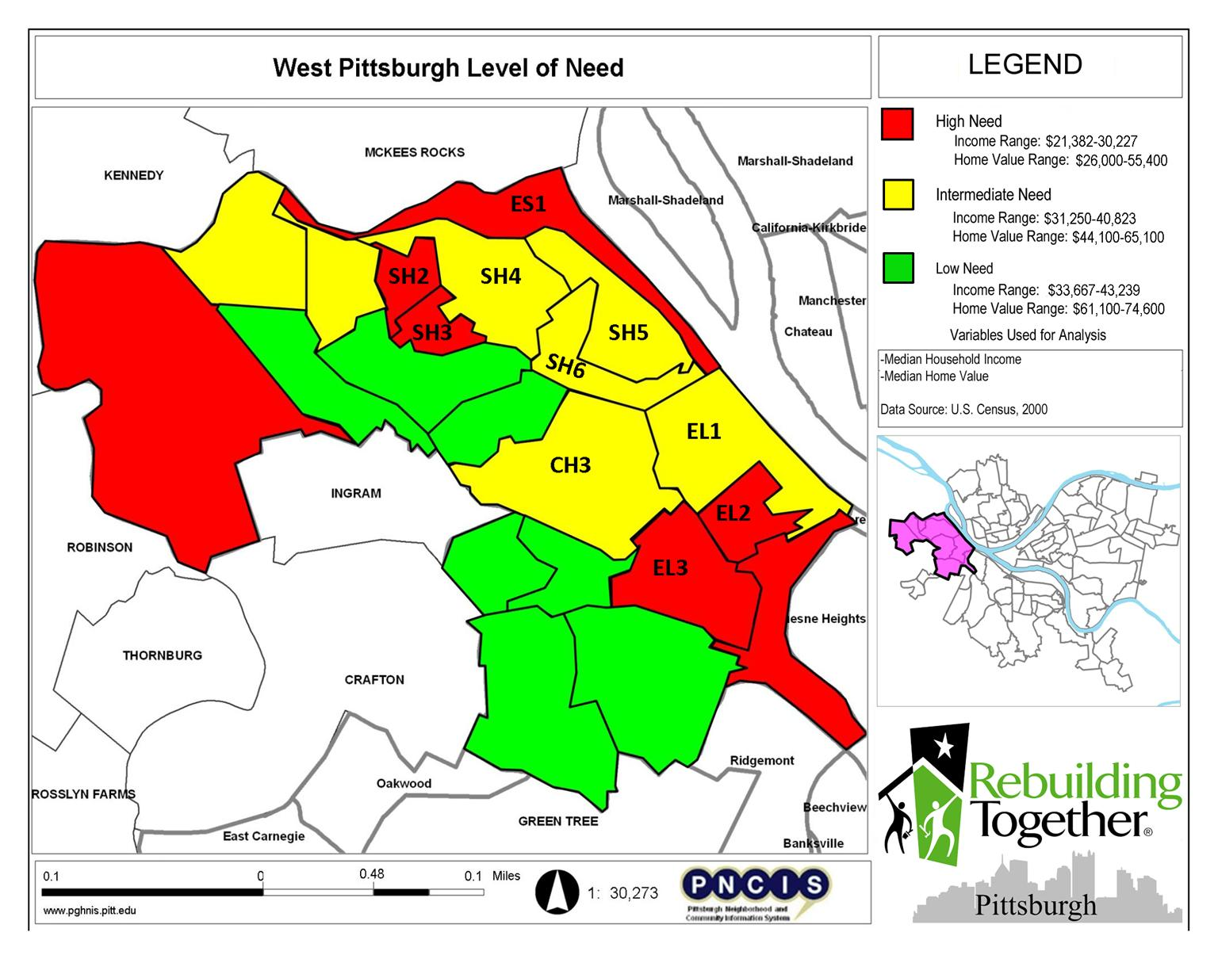
Select target
service areas
Notes:
Before we finish up, I’ll go over some quick examples from our partners
Credit the Pittsburgh Neighborhood and Community Information System
Alan Sisco at Rebuilding Together
Operation Urgent Care provides free home repair services to elderly homeowners in Allegheny County.
First used census data to decide which broad areas they would focus on (income and home value). One of the chosen areas was the Eliot neighborhood.

Slide 8
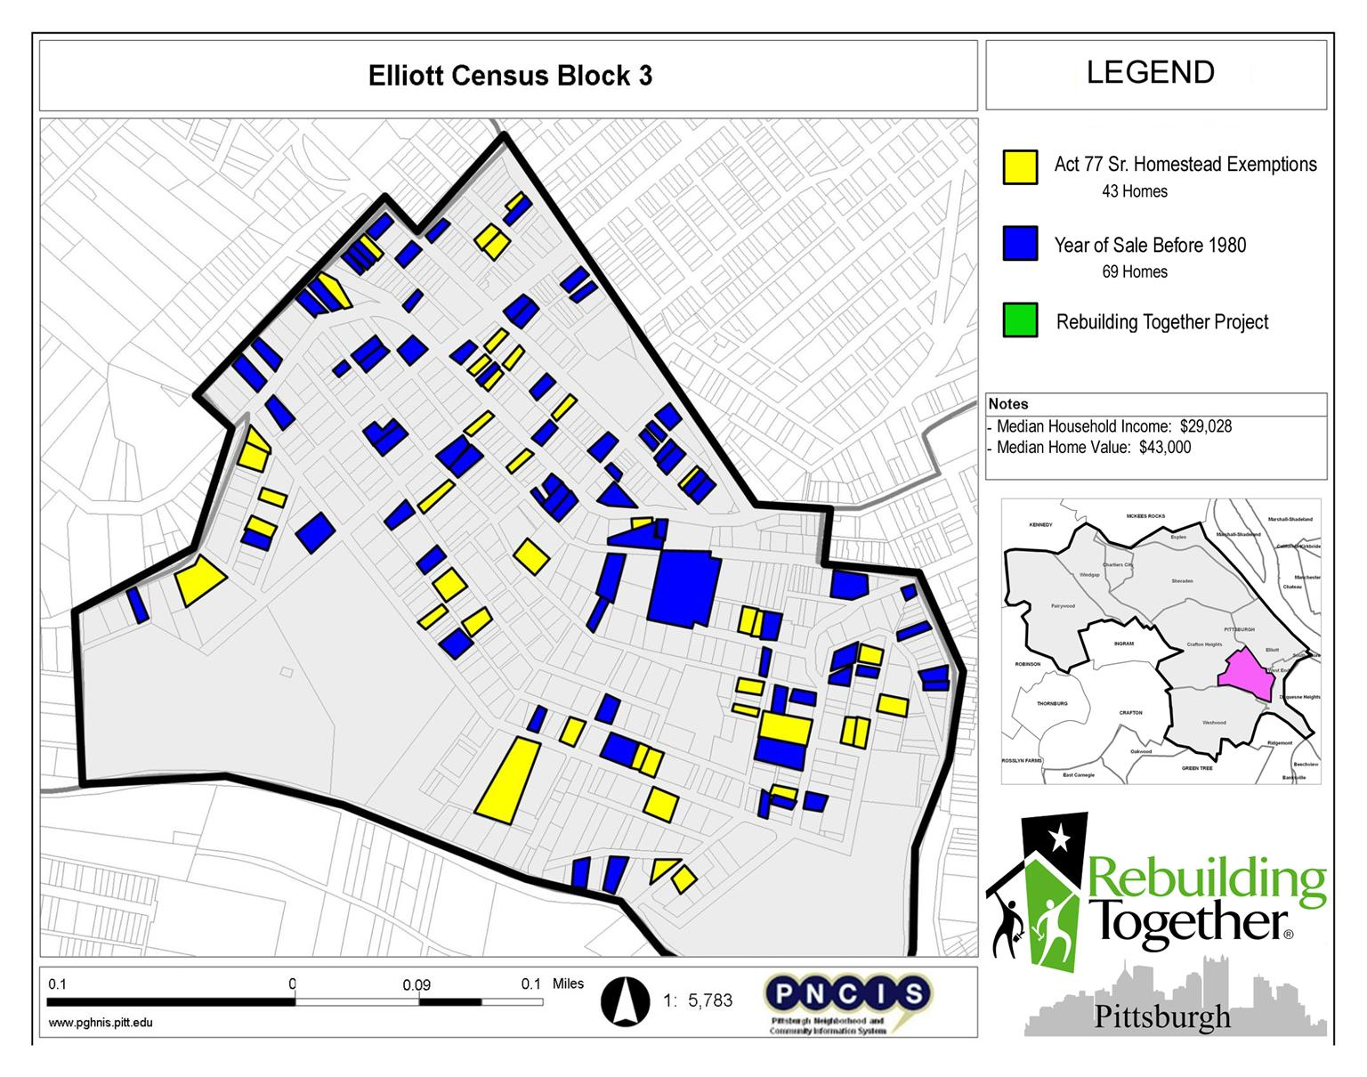
Identify potential clients
Notes:
Next they used property level data to compile a list of the homeowners who take Senior tax exemptions or who had owned their home for 30 years or more.
Year of Last Sale (A home last sold before 1980 indicates potential client.)
Act 77 Sr. Homestead Exempt (Eligibility for the exemption is similar to our eligibility guidelines. )
Owner’s Address (Tax Change Notice) (Indicates zoning type and possible homeowners.)
Created Map Reports indicating census blocks with high concentrations of seniors in our 3 target areas.
- spreadsheets listing names and addresses of potential clients.
- conducted targeted outreach in West Pittsburgh, sending out mailers to potential clients.

Slide 9
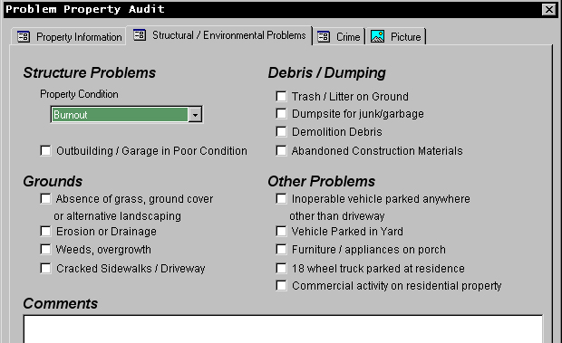
Inform community development decisions
Source: Center for Community Building and Neighborhood Action, University of Memphis
Notes:
Case of very hands-on work. Phyllis Betts from Memphis and her team launched the Neighborhood-by-Neighbor program, which was a citywide Residential Property Survey. This is a case where the existing data wasn’t enough - Using handheld devices, trained community members to rate the properties.

Slide 10
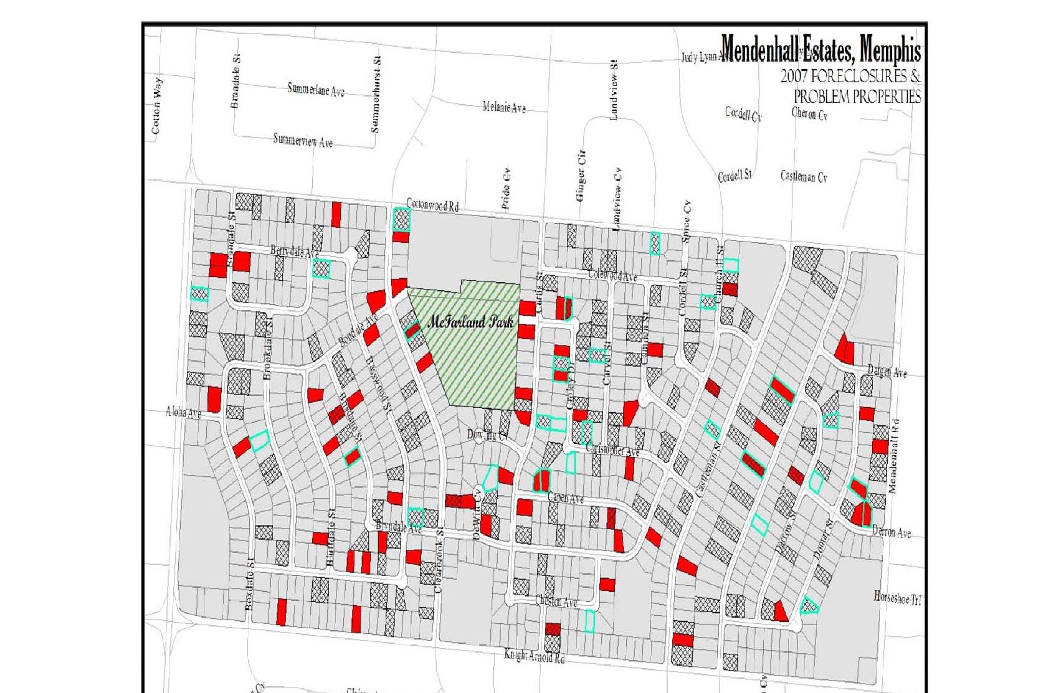
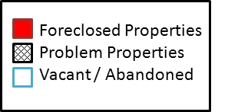
Source: Center for Community Building and Neighborhood Action, University of Memphis
Notes:
Here is a product of their work – able to tell where the homes were that were poorly maintained. They had initally thought most of the worst would be properties in foreclosures, but they found out that there were many problems with homes not in foreclosure –
Outcomes:
- Documentation for city-and private foundation-sponsored receivership actions against problem properties
- Selection of our new community development intermediary’s (Memphis LIFT) targeted neighborhood areas
- Background data for NSP acquisition strategies

Slide 11
Uncover disparities in access to basic services
Average miles
Average Distance to Nearest Grocery Store by Block in
Chattanooga
Source: Ochs Center for Metropolitan Studies
Notes:
Food access is perfect NNIP issue because it crosses so many topics (high cost of groceries in poor ngh, public health, economic development)
Community coalition in Chattanooga concerned about increasing obesity (national trend). Get date, title of report.
Partner mapped out grocery stores to calculate distance to grocery stores
(check on overlay with poverty).
Also did price survey (how much a given basket of food cost in different ngh)
Identifying marketing, strategies for attracting grocery stores.
(Several partners have done similar work with Social Compact)

Slide 12
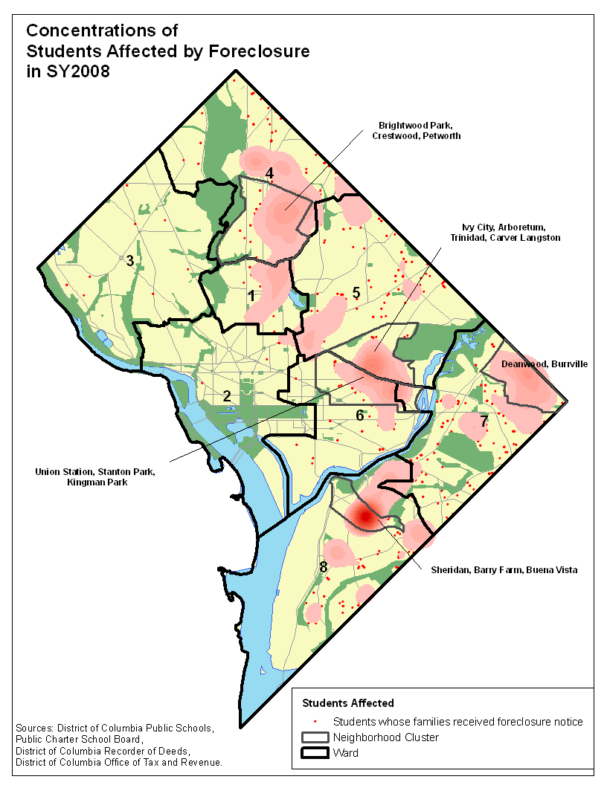
How Foreclosure Effects Kids
Forced mobility can put kids behind socially and academically
Foreclosure prevention counselors should connect families to student services
Schools need to understand the patterns and trends of students affected by foreclosure to design appropriate responses.
Bring a hidden issue to light, bridge silos.
Notes:
DRAFT - DO NOT CITE
12
We are wrapping up a cross-site project on the impact of foreclosures on children and schools funded by Open Society Foundation. Here is a map from DC of the kids in foreclosed homes. (Hot spot is 2 apt complexes accounting for 151 of the students affected.)
Connecting school system staff, housing counselors, homelessness prevention - working with the same families and can do a better job by coordinating their efforts.
Implications for schools
Understand the patterns and trends of students affected by foreclosure to design appropriate responses.
Review school policy and practice for requiring children who move out-of-boundary mid-year to change schools.
Improve identification of children who become homeless and qualify for McKinney-Vento benefits and protections.
Implications for housing counselors
Inform families who are forced to move about potential impacts on education and available support services.
Connect displaced families with housing search and rapid re-housing assistance.
Partner with highly-affected schools to do financial education outreach.

Slide 13
How You Can Get Started
Learn and network as much as you can today!
Think about concrete ways local and national data could help in your own advocacy or program work.
Reach out to NNIP partners, universities or research groups for help. (We also help new NNIP partners get started).
Think long-term – support open data and build your local data infrastructure.
Notes:
Motivate advocacy and improve programs.
Conferences like these are great at giving you a little space from day-to-day “to-do” lists and brainstorm new ideas of how data can move your mission forward. I’d encourage you in particular to think about bridging the silos in your worlds.
Make and share maps to show connections and spur new conversations.
Finally, beyond your immediate needs, think about the data infrastructure in your community. Where are there resources you could tap? Where are their gaps that need to be filled? Can your local governments be more open about sharing their data?

Slide 14
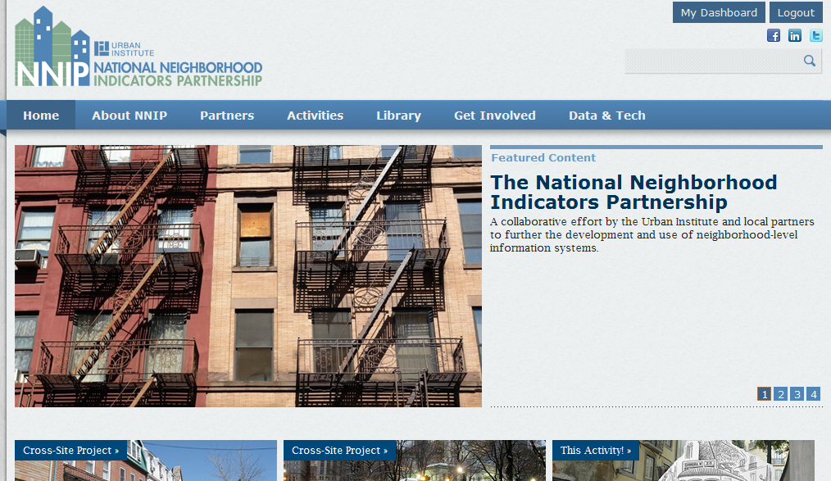
Visit our new website for more ideas...

Slide 15
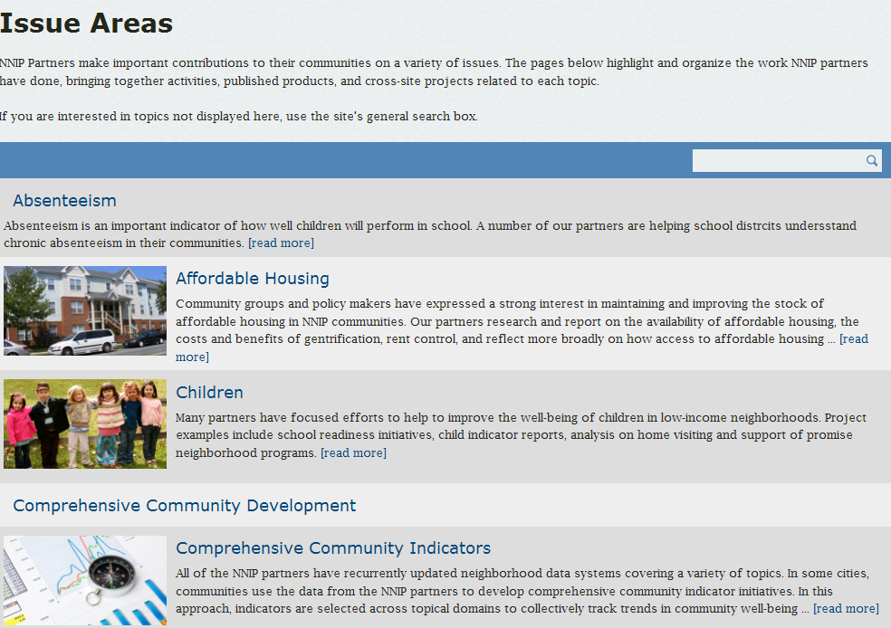


Slide 16
For more information
NNIP Web site: www.neighborhoodindicators.org
Email: Kathy Pettit, kpettit@urban.org
Notes:
I’ll be here all morning – happy to answer questions here or later & look forward to learning with you during this morning’s sessions.

