Slide 1
UTILIZING DATA FOR NEIGHBOHROOD CHANGE:
A NATIONAL PERSPECTIVE
National Neighborhood Indicators Partnership
Kathy Pettit, The Urban Institute
Utilizing Data to Manage Neighborhood Change Conference
October 28, 2011
Notes:
Introduce myself: urban researcher & Co-Director of the National Neighborhood Indicators Partnership (NNIP)
Today’s presentation: National trends around community use of data, a little about NNIP, and then examples of our how partners have used the data.

Slide 2
What’s Happening Nationally?
Great progress on Open Data
  Lots of energy from the private and public sector
Federal place-based initiatives survive budget pressures
  Neighborhood Stabilization Program 2
  Promise and Choice Neighborhoods
  Sustainable Communities
More critical than ever to target neighborhood efforts
  Stagnating economy increases need for public programs
  But local, state, and federal funding is being cut back
Notes:
First, there are a host of forces encouraging the use of data for community decision making
Increased availability of localized information from many sources (online property info, NCLB reporting, live crime stats, etc.)
More usable technology and broader personal use of information (Google maps)
- National tools like Policymap, Census bureau
2. Federal programs have encouraged communities to use data to plan and monitor programs. In the case of Promise Ngh, I’ve seen just the process of doing the proposal have an effect, even for those that did not win federal grant.
3. Need to be smarter about how we spend limited resources. Hard choices to be made.

Slide 3
What Needs to Be Done Locally?
Identifying the right data to answer questions
Transforming raw data into information
Communicating findings and insights
Advocating for effective & informed policies
Implementing the right programs to help residents and neighborhoods
Notes:
All of that momentum is not enough…. LOTS OF WORK TO BE DONE LOCALLY
This is why all of you are needed....
From the flood of data, Still hard work to figure out how to get the data you need for the area you care about
Giant spreadsheet of numbers or data file difficult to absorb without interpretation, creating of meaningful indicators
What does it mean? What’s behind the trends?
Data is only a tool to accomplish the goals of our organizations. Next need to share what you have learned and assemble the political will and resources for programs.
Finally, you move to the action and will need to track progress or setbacks.

Slide 4
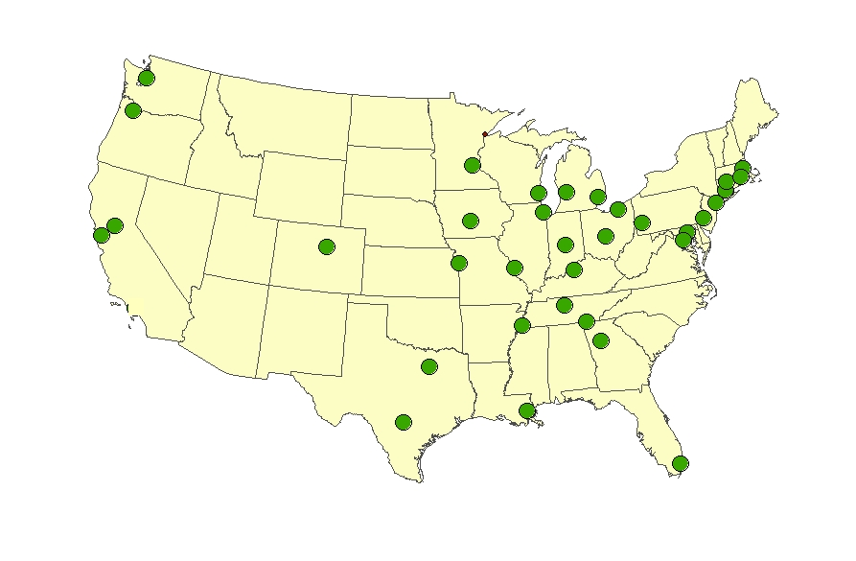
National Neighborhood Indicators Partners
Atlanta
Baltimore
Boston
Camden
Chattanooga
Chicago
Cleveland
Columbus
Dallas
Denver
Des Moines
Detroit
Grand Rapids
Hartford
Indianapolis
Kansas City
Louisville
Memphis
Miami
Milwaukee
Minneapolis-St. Paul
Nashville
New Haven
New Orleans
New York City
Oakland
Philadelphia Pittsburgh
Portland
Providence
Sacramento
St. Louis
San Antonio
Seattle
Washington, DC
Notes:
The importance of local capacity to move from data to action is the foundation of NNIP
Collaborative effort since 1995
Urban Institute and local partners in 35 U.S. cities. And several more on the way.
CURA has been our partner since 2007, work collaboratively with MetroGIS and Wilder
All partners have built information systems with neighborhood level data on a variety of topics. (People don’t experience their lives in silos and multiple topics allow you to see how things fit together). This data is updated over time and saves each groups in their cities from having to go negotiate with the police to get crime data, the schools to get education data, etc. Centralized resource is much more efficient.
All are local organizations (mostly nonprofits or university centers) with a long-term stake in their community. Data providers can be comfortable the data will be handled responsibly, and consumers can trust the information that comes from a neutral source.

Slide 5
NNIP Mission: Information for Change
Democratizing Information
  Facilitate the direct use of data by stakeholders
A central focus on strengthening, empowering low-income neighborhoods
Work for many clients
  Helping Boys and Girls Club choose a new site
  Working in a cross-sector collaboration to reduce infant deaths
Information as a bridge for collaboration among public agencies, nonprofits, businesses
Notes:
Lots of data sites, but the NNIP mission sets us apart. Partners are different in many ways, but we share a set of key principles
These will look familiar to you, but let you know that you are part of a national movement of local stakeholders using data to craft solutions for their communities.
1. Agreed to take on the role of facilitating and promoting the direct practical use of data by community and city leaders in community building and local policy making. Reaction to too much research done about ngh without any value coming back.
2. All partners have a wide variety of partners and audiences since systems on the shelf don’t sustain support. A colorful map will not be enough unless it leads to greater understanding or new conversations. (These are short-term & long-term examples).
3. Giving emphasis to building the capacities of institutions and residents in distressed neighborhoods. Level the playing field by making sure everyone has access to the information
4. Importance of interacting with stakeholders around the data and building ongoing relationships. In New Orleans, our partner hosted a meeting with the various state, city, and nonprofit agencies that own 14,000 vacant properties in the city. Having some initial analysis from our partner offered an opportunity for them to connect and begin to coordinate strategies. (other example of foreclosure counselors with school staff).
UI coordinates the partnership and works nationally to build the field.

Slide 6
Lessons from NNIP
Design indicators for action—not just to passively monitor trends.
Develop indicators at the neighborhood level as well as the city or county as a whole.
Use available indicators but recognize their inadequacies – don’t discount local wisdom.
Place the numbers in the context of images and stories about the issues you care about.
Notes:
1. need to motivate the data collection and analysis to keep the effort going. Embedding an audience and action agenda from the beginning will ensure a report/analysis doesn’t sit on the shelf.
2. Ccty trend in teen pregnancy could be going down, while the rate is rising in Latino neighborhoods. 1 overall number won’t help identify where you need to target your efforts. Also, people relate to where they live, gets them engaged right away
3. I love data, but some of it is not so good… Be a critical user of data. For example, code enforcement in many cities is complaint-driven, so sometimes you see more violations in well-off areas that are more likely to demand city action. Doesn’t mean there are fewer problems with dangerous buildings or poorly maintained properties in lower-income parts of the city. Be sure to vet findings with people on the ground.
4. You all could probably teach us something about the last piece of advice. Most effective work combines the numbers analysis with stories of real people and real neighborhoods.

Slide 7
INDICATORS IN ACTION:
Preserving Affordable Housing in Washington, D.C.
Notes:
Talk about 2 examples… First is from DC, where we at UI are the NNIP partner for the city.

Slide 8
Setting Community Goal
Housing Strategy Task Force (2006)
  Composed of city officials, advocates, and non-profit housing and for-profit producers.
Report recommended:
  2.1 Preserve at least 30,000 existing affordable units
    2.1a Preserve all project-based Section 8 and other federally-supported units
Outcome measure:
  Number of project-based Section 8 units preserved/lost
Notes:
How we got started. At the top of the market, we came together to try to be more intentional and have overarching housing policy – a blueprint for where we wanted to go.
Explain Section 8 project based housing and expirations.

Slide 9
Understanding the Problem
Notes:
We started with some summary analysis. Good for overall view (see cluster up the center of the city which was gentrifying). But wasn’t detailed enough to act upon.

Slide 10
Collective Action:
DC Preservation Network
Collaboration between NeighborhoodInfoDC (NIDC) and Coalition for Nonprofit Housing and Economic Development
NIDC compiles full list of federally or locally subsidized rental housing from various sources
NIDC meets monthly with city staff and housing nonprofits to review the list
Each group takes on responsibility to follow-up with individual properties
Notes:
To move from abstract goals to concrete tasks, we reached out to CDCs in the city.
Most CDCs have major emphasis on preserving affordable housing
But challenge to respond to rapid changes in the market
Obtaining and applying current information is difficult
Distorted trends based on anecdotes
Current efforts ad hoc – who happened to find them
Need to get ahead of the curve: Accurate and frequent data needed to target limited resources and not duplicate efforts
NIDC partnered with the CNHED to create the DC preservation network - Monthly meeting
We maintain the DC Preservation Catalog, a database of rental properties with units affordable to low-income households (at or below 80% area median income) through one or more federal or local housing subsidy programs.

Slide 11
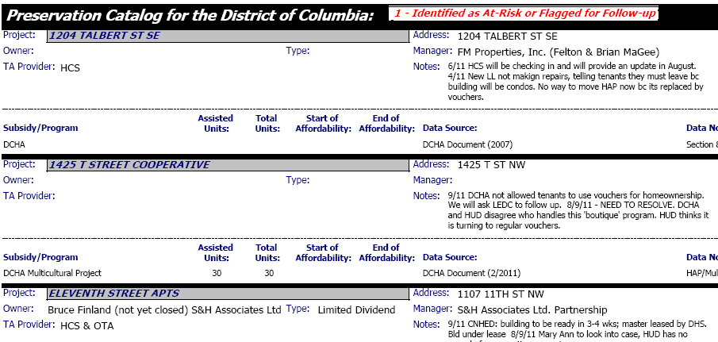
Extract from October 2011 Report
Notes:
Document from October – 328 subsidized rental projects with about 38500 units and limited equity cooperatives operating in the District with about 35K units.
Blends data from various federal and local administrative sources, plus notes on personal knowledge, actions to date.
Details not critical, but note field for “TA” provider – promotes accountability and prevents duplication

Slide 12
Categories of Properties
At Risk or Flagged for Follow-up
Expiring Subsidy
Recent Failing REAC Score
More Info Needed
Other Subsidized Property
Notes:
Categories allow group to scan and prioritize their work. Things to consider
large buildings; those in ngh with limited affordable housing, those in ngh where city has special efforts.
• Identified as At Risk or Flagged for Follow-up – projects identified as at-risk of leaving the affordable housing stock, and projects for which attendees at previous meetings have agreed to provide follow-up information
• Expiring Subsidy – projects for which the subsidy with the lowest income targeting is believed to be expired or is expected to expire before December 2011 (unless indicated otherwise at previous meetings)
• Recent Failing REAC Score – measure of housing quality from HUD - projects for which a recent numeric REAC score was below 60 and there is no indication of subsequent funding for rehabilitation (housing trust fund, tax credits, etc.) (unless indicated otherwise at previous meetings)
• More Info Needed – projects for which the development, occupancy, or tenure status is particularly unclear
• Other Subsidized Property

Slide 13
DC Preservation Strategies
Poor conditions
  Negotiate with owners/managers
  Bring HUD to the table
Terminations
  Targeted code enforcement
  City discretionary building repair fund
Expirations
  Convince landlords to stay in program
  Tenant, nonprofit, or city purchase of buildings
Notes:
Our part is the data work, need to do hand-off to the program-based organizations. 11q-9998-8-9 11
Congress Heights I – failed REAC. We found out through the Network. Latino Economic Development Corp. organized a tenant association and did an assessment. Through the Network we were able to get the tenant association pro bono legal representation (Washington Legal Clinic for the Homeless) and get a meeting with HUD and the association and a meeting with all these partners and the management / owner to make a plan between all to get the conditions resolved before the next inspection. REAC score went from a 29 to 92.
We would not have known about the failed REAC so quickly if we had not had the Preservation Network meeting which HUD was at. Since the scores are not posted regularly on-line, it’s very helpful to get a heads up from HUD.

Slide 14
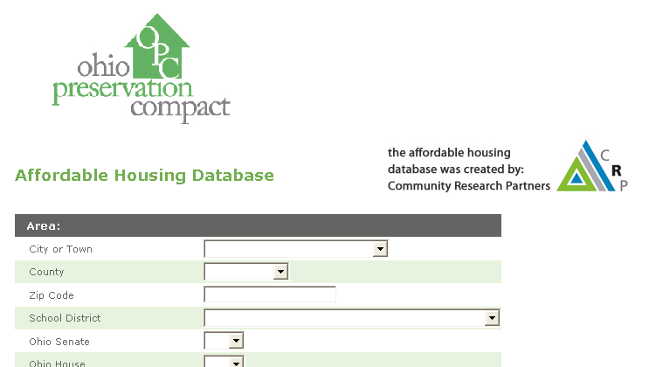
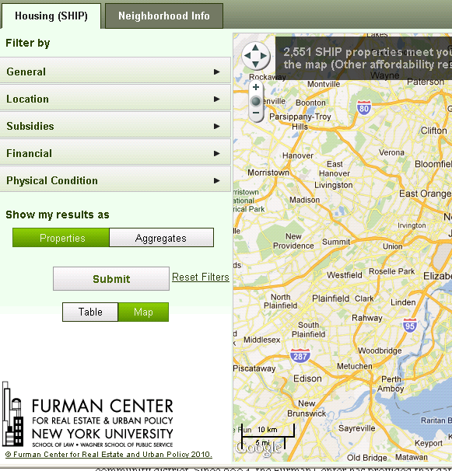
Similar data efforts by NNIP partners in Columbus and New York City

Slide 15

Data Driven Organizing in Pittsburgh’s Homewood Children’s village
Thanks to Samantha Teixeira & Dr. John Wallace, Jr.
and Bob Gradeck for slides and story

Slide 16

The Village
Adapting the Harlem Children’s Zone model
HCZ pillars
  Community building
  Evidence based programs
  Scale
  Evaluation
Property issues are a key aspect of Homewood’s challenges
Notes:
Homewood Promise ngh – comprehensive services for children pre-birth to young adulthood in defined neighborhood. Efforts to reach every child. When the organizers first went into the neighborhood, they had a focus on community building, asking neighbors and parents what the greatest concerns of the community were.
The neighborhood had a brand new school, but the parents were most concerned about blighted and abandoned buildings that the children had to pass as they walked to back and forth to school. Organizers respected community feedback, even though housing was not an original part of the Promise Ngh model.
Although connection may not be obvious, abandoned homes attract crime, crime and perception of safety affect how much time parents allow kids to engage in active outdoor play (evans)

Slide 17
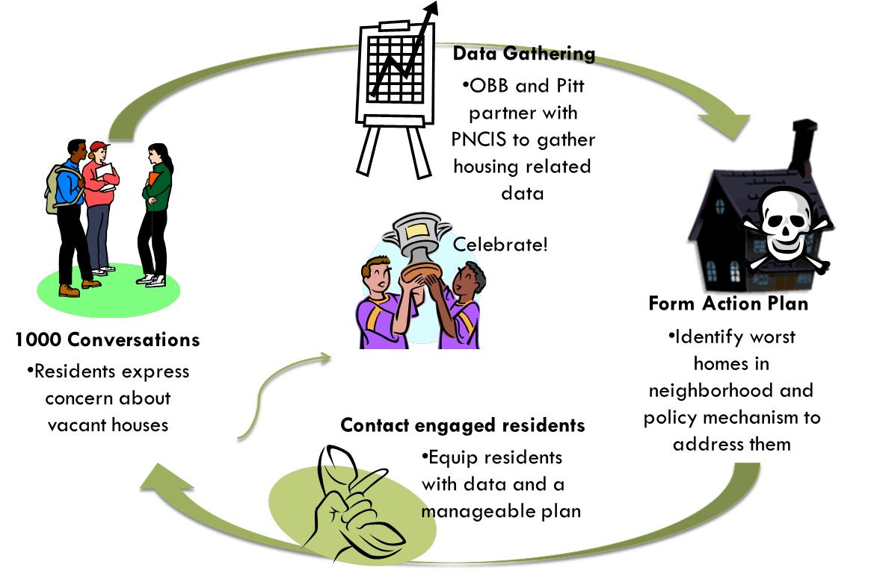
Notes:
1000 Conversations (from subjective)-vacant and abandoned properties raised as an issue
To data (to objective percentages)-empirically, how big a problem is it? (not just perception)
PNCIS illustrates how big a problem vacancy is.
Data driven organizing is a way to address it.
Note that PNCIS partnered with us throughout the process, starting at the data gathering step

Slide 18
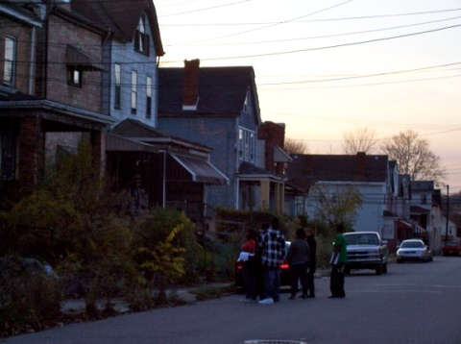
PNCIS Partnership in HCV Neighborhood Assessment
Research Review & Design
Data Integration
Data Visualization: MAPS!
Training
Policy Action
Notes:
Research Design: NNIP partner reviewed and IDed existing instruments from other NNIP partners including building inspection protocols and neighborhood assessment survey suggestions
Data Integration: data integration strategy (Setting data collection and entry process up so that it could easily be integrated into the PNCIS system), now we can create maps that integrate the data we collected in the neighborhood with other PNCIS data like crime info and BBI violations
Training: Trained students and community organizing staff to use the system, got into the data driven mindset. (important to ensure quality of information)
Data Analysis/Community Action: Key piece was the ability to integrate our two datasets to inform our community actions and identify policy mechanism to take action

Slide 19
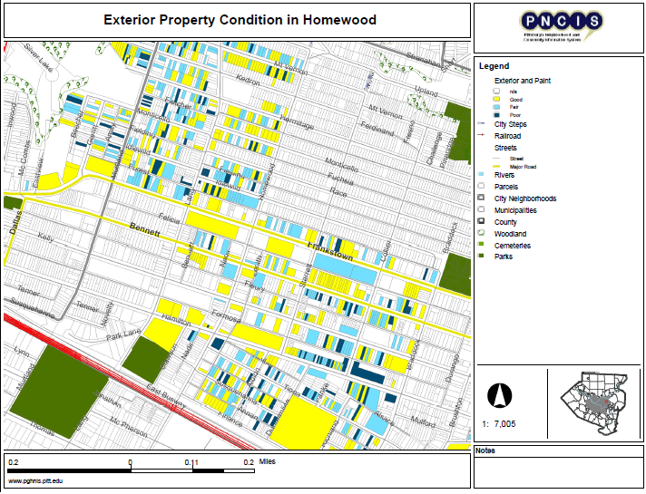
Notes:
Here is a resulting Map of exterior condition of properties, to be used for data driven organizing, block clubs. Before and after assessments (does a block club affect the physical condition of a block? etc. ) Yellow is good, light blue is fair, dark blue is poor.

Slide 20
Data Driven Organizing
Homewood’s Dirty Thirty:
  Used joint database to identify worst properties in the neighborhood
  Mobilized residents to call the 311 Response Line and advocate for boarding up the properties
  23 of 30 properties (77%) were boarded up, torn down, or otherwise improved within about a month
Notes:
Identified properties that were vacant and open to entry.
ID dangerous props, form action plan—called back people who had initial concern to form a task force (using data and existing policy mechanism 311)
Focused efforts to complain to the city
With data backbone in place they can monitor and update information about the problem properties
We can visualize our outreach efforts using maps and track ownership, Bureau of Building Inspection violations, and tax delinquency (using our joined database) for these properties to continue our advocacy efforts.

Slide 21
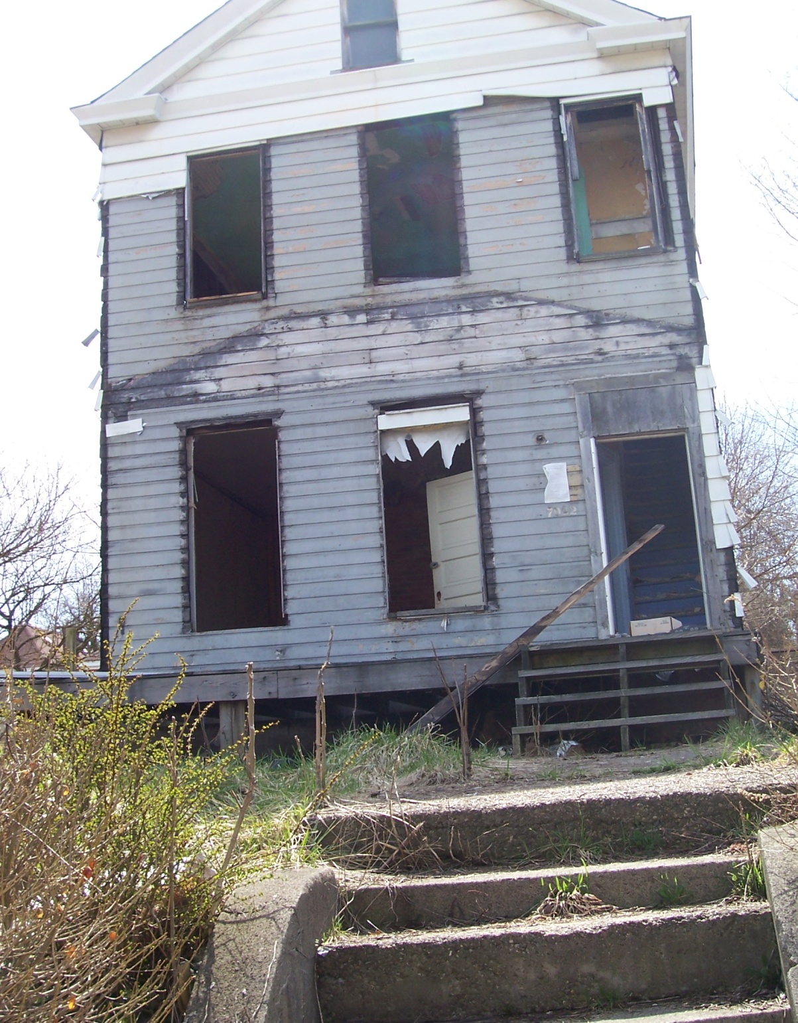
Before

Slide 22
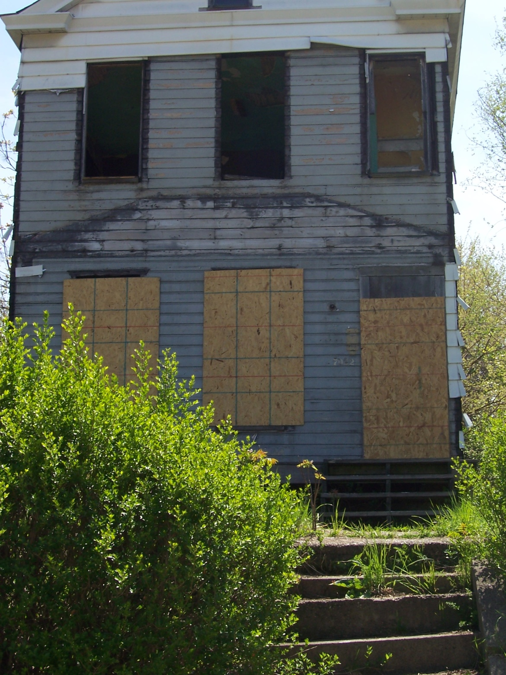
After

Slide 23
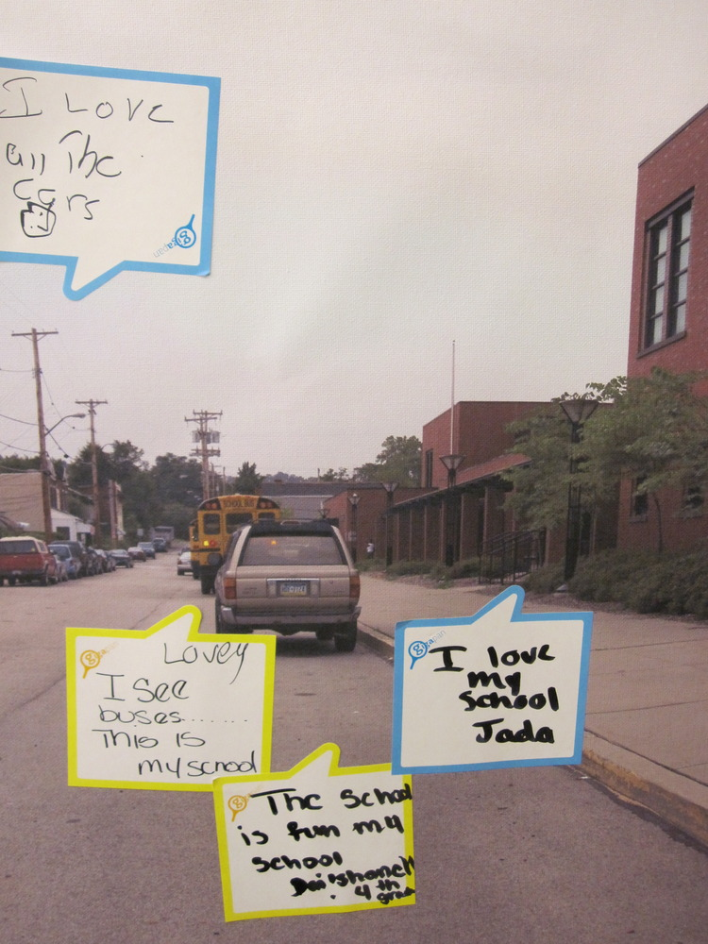
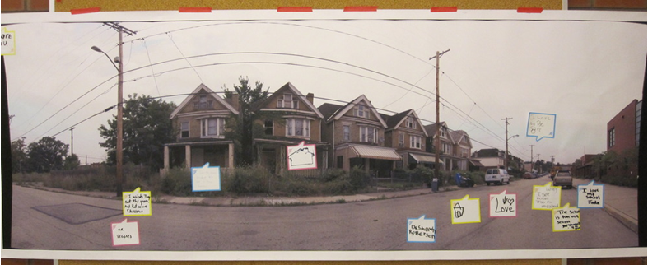
Gigapan
Document neighborhood conditions
Collect input from residents
Notes:
Use of periodic photos to track change in the neighborhood over time – use it to gauge resident input – including here comments from kids in the school.

Slide 24
Impact
Bringing resources back to the neighborhood to help children and families
Improving quality of built and physical environment
Strengthen residents’ capacity for action
Making the neighborhood a safer place for children
Notes:
Direct safety impact of boarding up these 30 buildings, but most important was the experience of the residents of identifying a problem, partnering with local organizations to document the issues, create an action plan, and see improvement in their neighborhood – solid foundation of working together will serve the Promise neighborhood activities as they proceed to educational and social goals.

Slide 25
Tips for Getting Started: Using Data
Learn and network as much as you can today!
Think about concrete ways local and national data could help in your own advocacy or program work
Reach out to NNIP partner, universities and research groups for help
Think long-term – support open data and your local data infrastructure
Notes:
Varied levels of experience in the room – hopefully you can add in your advice
Conferences like these are great at giving you a little space from day-to-day “to-do” lists and brainstorm new ideas of how data can move your mission forward.
Motivate advocacy and improve programs.
Make and share maps to show connections and spur new conversations.
Reach out – our model is not to have every nonprofit have to develop internal data capacity, but draw on shared expertise of NNIP and other research orgs.
Finally, beyond your immediate needs, think about the data infrastructure in your community. There are good ngh level analysis in every city, but many are lacking the broader framework of the information infrastructure. Where are there resources you could tap? Where are there gaps that need to be filled? Can your local governments be encouraged to be more open about sharing their data? Our partners are only able to respond to crisis because of early work and investment.

Slide 26
Tips for Getting Started: Sharing Data
Publish non-confidential data on-line
  Cities of DC, Vancouver, San Francisco as inspiration
Transform your data into indicators for neighborhoods and cities to inform others’ work
Think about how information might start new conversations and break down silos in your city
  New audiences for your data
  External data that would help your work
Notes:
Many cities are charging for data – tempting giving city budget constraints, but there will be a larger community payoff by having the data available to inform initiatives.

Slide 27
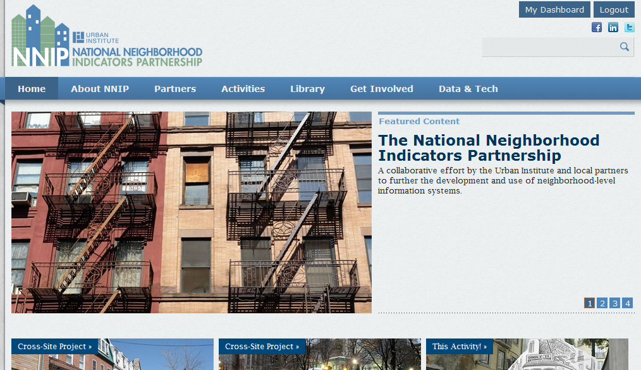
Visit our new website for more ideas...

Slide 28
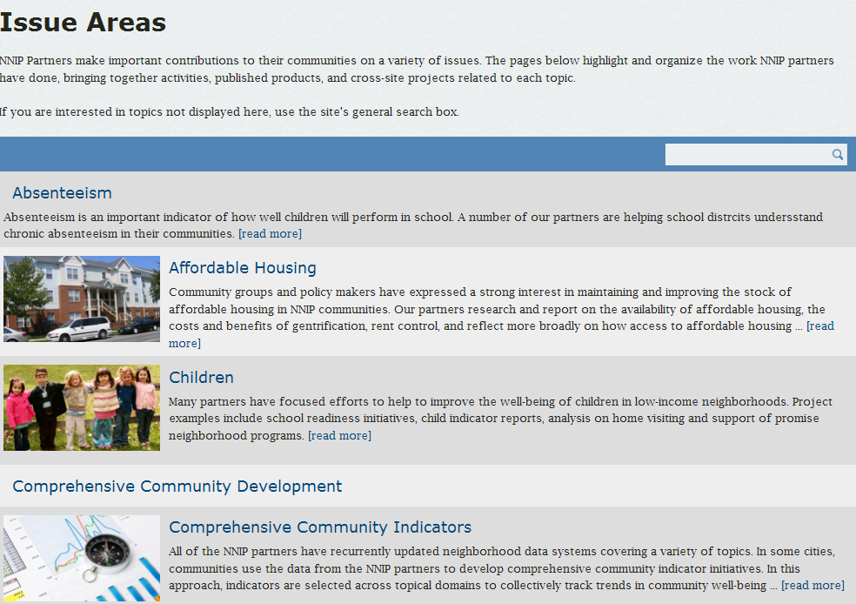


Slide 29
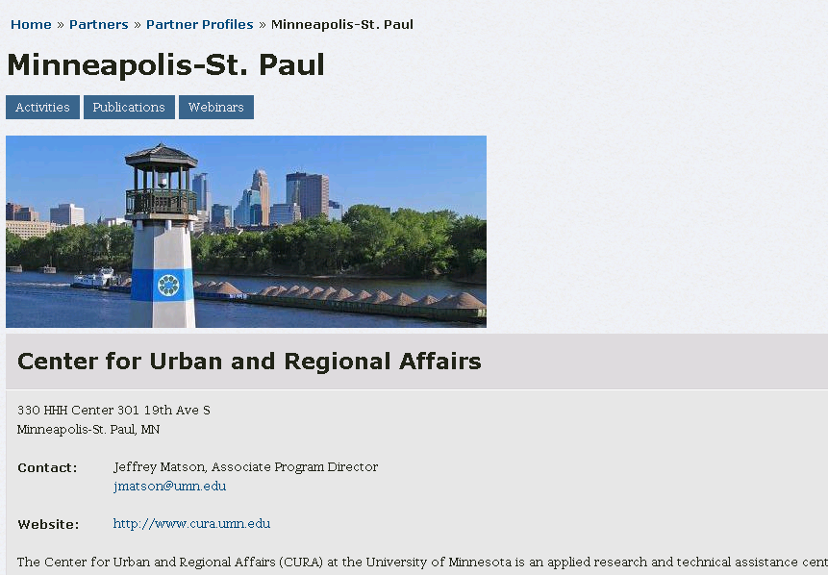
Notes:
Encourage you with Jeff to submit your stories.

Slide 30
For more information
NNIP Web site: www.neighborhoodindicators.org
Email: Kathy Pettit, kpettit@urban.org

