Slide 1
Allies in Advancing Transparency:
Indicator Projects & Open Data
Kathy Pettit, The Urban Institute
Community Indicators Consortium
October 17, 2013
Notes:
Introduce myself

Slide 2
Today’s Plan
Introduction to NNIP and to Open Data
Synergy between Indicators Projects and Open Data
Recommendations
  For Indicators Organizations
  For National Networks
Local Example
Discussion
Notes:
Note full hour and change in format
Share thoughts about what we’ve learned this year
How many people know about NNIP? Know about open data community in their local area?

Slide 3
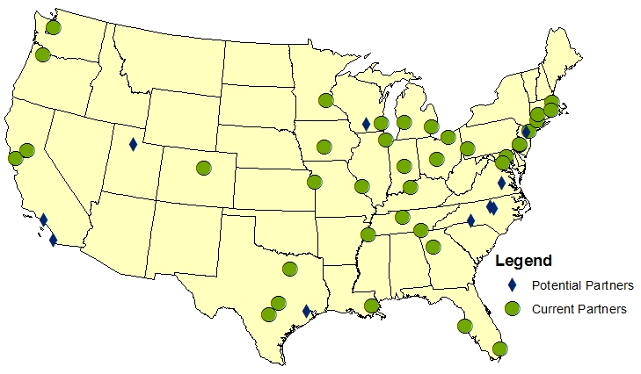
Notes:
Give some background so you understand my perspective
Direct NNIP – a network of local partners

Slide 4
NNIP Basics
Collaborative effort since 1995
  Urban Institute & local partners; now 37 cities
  All partners build and operate neighborhood level information systems using local data
  Success based on:
    Trusted and engaged institutions
    Relevant and high-quality data
    Mission to support use of data for local action
Notes:
Network is supported by the Annie E. Casey and the John D. and Catherine T MacArthur Foundations
Bullet 1: Started with 6 partners, now at 37
Three necessary components to success (e.g. three-legged stool)
Institutions:
The partners are housed in various types of institutions – universities, independent nonprofits, local funders.
But whatever the home, they are all respected organizations with a long-term stake in their community.
Data:
Partners all recurrently collect local government data at the address or small area-level on a range of issues – housing, schools, crime, etc.
They handle confidential data responsibly, summing up individual-level data to neighborhood indicators to share broadly.
There is an economy of scale to having one group provide the service for the community.
The systems are built incrementally, so partners have different sets of data depending on local context.
Mission:
NNIP partners’ values drive all the hard work of acquiring and organizing the data. The point is to get the information used - whether for policymaking, community building, program planning.
The founding NNIP partners recognized that not everyone had equal access to information. Focus began with and remains on low-income nghs that have traditionally not had access to data or training to use data. (democratizing information)
But partners serve wide range of clients - helping citywide nonprofits and even gov’t agencies find and use data in their decisions.
Network:
UI coordinates the network: organizes partner meetings, helps new partners get started, develops cross-site projects, and serves as a national advocate for the importance of local capacity to use data to inform community action.

Slide 5
What is Open Data?
A set of principles: open data will…
  Provide access to a public good funded by taxpayers
  Increase transparency so that citizens can hold governments accountable and engage in public discourse
  Add value to the private sector and society
A movement
  A community of “good government” advocates, civic developers, elected officials, government staff, and others advocating for open data principles
Notes:
FIRST – primer on open data (term thrown around a lot) (Exciting to see there are lots of examples in panels)
Open Data is an ideal
Not usually coming from issue-specific motivation
Note groups – Sunlight Fndn, Code for America, Open Knowledge Foundation, World Bank

Slide 6
What is Open Data? (cont.)
A set of policies
  Formal government statements adopting open data
  See http://sunlightfoundation.com/policy/opendata/
A set of practices
  Portals (mostly government examples so far)
  Re-packaging of government data (value-added data, apps, websites)
    Meet-ups, Code for America brigades, individuals
    Hackfests, code-a-thons, apps contests
  Data standards (Open 311, Transit, HouseFacts)
Notes:
Govt statements:
Could be at the local, state, or federal levels
Vary in breadth and strength of mandates
Sunlight project researching/promoting local open data, recent Utah legislation, Chicago and Cook County are leaders
Apps – mostly citizens as consumers of public services; individual decisions (bus apps, parking)

Slide 7
NNIP and Open Data
Special focus project funded by MacArthur Foundation
Network discussions and convenings
Conversations with open data community
Summary white paper
UI National Data Repository
Notes:
Introduction to NNIP partners and Open Data
Current state of Open Data in NNIP
Partner awareness and participation (survey results)
Practice of open data (from scan of partner websites)
Case studies of involvement
Chicago, Milwaukee, Oakland, Pittsburgh,
What Open Data offers to NNIP partners
What NNIP offers to Open Data
Recommendations for the network
***FIRST TIME TRYING IT OUT BEYOND NNIP – LET’S SEE HOW IT TRANSLATES***
Ask question – how many people know about open data activities in their local area?

Slide 8
Community Information Infrastructure
Many players – government, nonprofit, private
Many roles to play
  Assemble, transform and disseminate data
  Apply the data to achieve impact
  Use data to strengthen civic life and governance
Notes:
Through open data work and other experiences of our partners, we now have a more complex understanding of components needed for healthy community information system.
Walk through Slide.
We are interested in how prices interact, how they reinforce each other.

Slide 9
Open Data Benefits
Indicator Projects
Results in more easily accessible data
Helps indicators projects focus on the value that they add to the data
Increases visibility and demand for data and indicators
Reinforces culture of data sharing within governments
Notes:
Open Data and Indicators Projects mutually support each other even without interacting or deliberate coordination
Without doing anything…

Slide 10
Indicator Projects Benefit
Open Data
Assemble, transform and disseminate data
  Move from raw data to relevant information
Apply the data to achieve impact
  Demonstrate value of opening data
  Serve as bridge for policy and community action
Notes:
Open data portals most often share raw data - a series of point in time numbers – few denominators, few are indicators, no trends (example – crime)
Practical uses of open data help bolster argument for continuing sharing of open data (and perhaps even expanding it)

Slide 11
Recommendations for INDICATORS ORGANIZATIONS

Slide 12
Why get involved in Open Data?
Engage new audiences and allies to advance your mission
Extend your organization’s skills and capacity

Slide 13
Roles for Indicators Organizations in Open Data
Apply the data to achieve impact
  Advise developers on priority data sets and useful applications to benefit communities
  Act as liaison between community and issue-based groups and civic developers
  Co-host events, such as codeathons, CityCamps
Use data to strengthen civic capacity & governance
  Join coalitions to advocate for open data policies
Notes:
Not comprehensive

Slide 14
Roles for Indicators Organizations in Open Data
Use data to strengthen civic capacity & governance
  Join coalitions to advocate for open data policies
  Elevate issues of equity in the open data conversation; consider who is benefiting
Notes:
Not comprehensive

Slide 15
Recommendations for NATIONAL Networks
Notes:
What individual organizations can do
Like CIC

Slide 16
Roles for National Networks in Open Data
Encourage more involvement with the open data community
  Publicize relevant nationally available open data
  Encourage indicator projects to release data in developer-friendly formats with complete metadata
  Outline possible roles in open data for indicators projects; highlight local examples
  Encourage state-level coordination around open data
Notes:
CIC, NAPC, Kids Count, etc.
Networks can educate their members
Examples that show value in collaboration
Mechanisms: spread the stories about open data successes through its network
For NNIP, recognition that this is not a special project, but needs to be interwoven into all of our projects. Element like community engagement, political advocacy.

Slide 17
Roles for National Networks in Open Data (cont.)
Direct engagement and sharing with open data stakeholders
  Attend each other’s meetings
  Advocate together on the national level
  Build knowledge about the components needed for successful open data release and use
Notes:
Half the work is just showing up – hearing each other’s perspectives, understanding points of mutual interest, building relationships
Federal data agenda – mention APDU, threats to ACS, investments in data.gov, release of new data sets like USPS vacancy data
“ valley of disillusionment” - understand how the moving pieces work together – how to assess the health of various sections of the community information infrastructure and identify gaps.

Slide 18
LOCAl EXAMPLES
Notes:
You can hear about local examples in other Chicago panels.

Slide 19
Visualizing Neighborhoods in the Twin Cities
  Sponsors: Center for Urban and Regional Affairs (at University of Minnesota) and Open Twin Cities
  Goals: start conversations, build community, experiment, and prototype projects for neighborhoods
  Activities: Explore how data can be used for research, analysis, mapping, outreach, engagement, and communication
  Participants: neighborhood leaders, technologists, data visualizers, designers, artists, scientists, civil servants
Notes:
Several partners have collaborated on hackathons – Pittsburgh, Boston, Baltimore
This is Minneapolis
GET DATE
Focus on a theme (visualizing neighborhoods) or a particular data source (crime, education, etc.) (in talks with the MN Secretary of State to help with a hackathon specifically around their data -- voting and business licensing).
Goals – as the first time, more successful in the first two goals than the concrete outcomes so far

Slide 20

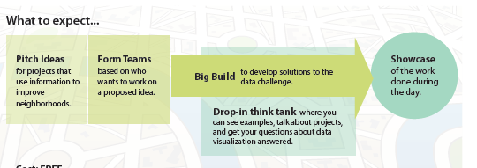
Notes:
the benefits were definitely more of the intangible kind -- relationship building and getting an audience that was new to hackathons involved, and we knew that going in.
Have pre-hack sessions (with food and/or happy hour) focused on idea generation and explaining to non-technical folks how these things work and the important role they play (concrete ideas for groups to focus on.)
What we heard time and time again from the tech community is that the coders, designers and web developers will come with nothing more than a date and location put to make it really successful, energized, etc. you need great (useful) project ideas.
Focus on a theme (visualizing neighborhoods) or a particular data source (crime, education, etc.) (in talks with the MN Secretary of State to help with a hackathon specifically around their data -- voting and business licensing).
(Sponsored) prizes are always good but it needn't be a competition. We had prize drawings for people who stuck around until the end.
GET an EXAMPLE OR TWO

Slide 21
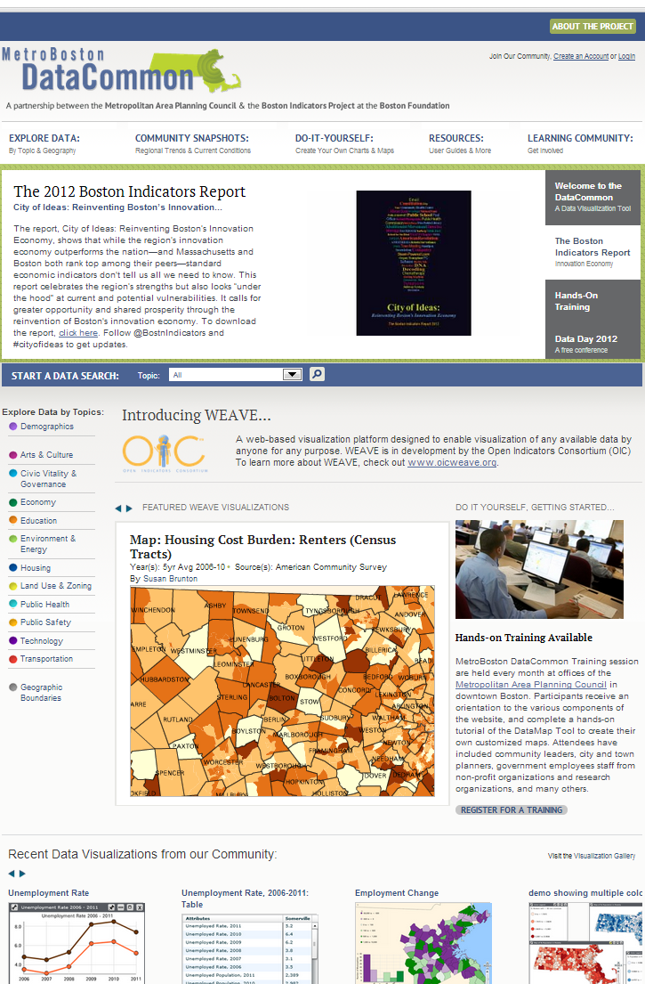
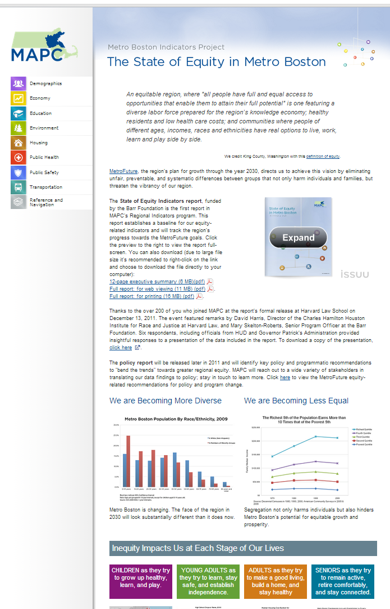
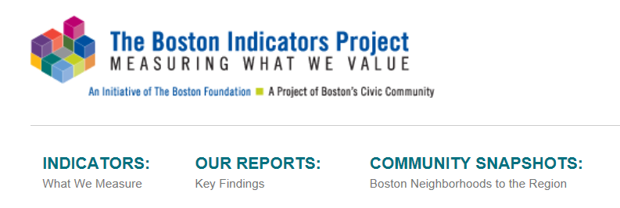
Metro Boston
DataCommon & Regional Indicators
Notes:
[LOOK AT HOLLY’S PPT to TIE THIS TO OPEN DATA]
Sust Comm
Initial divisions
Made economic argument
Rel with Boston indicators
Equity points in grantmaking

Slide 22
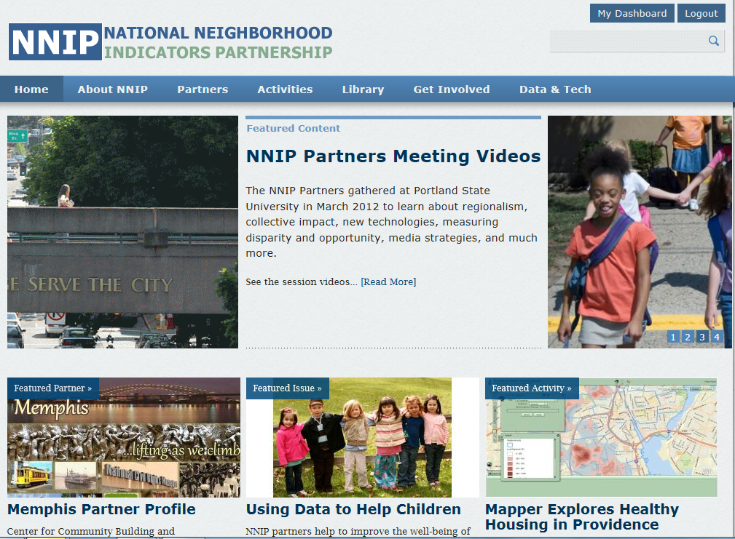
www.NeighborhoodIndicators.org
Notes:
Here’s our web site where you can find out more about NNIP and our partners
www.NeighborhoodIndicators.org

Slide 23
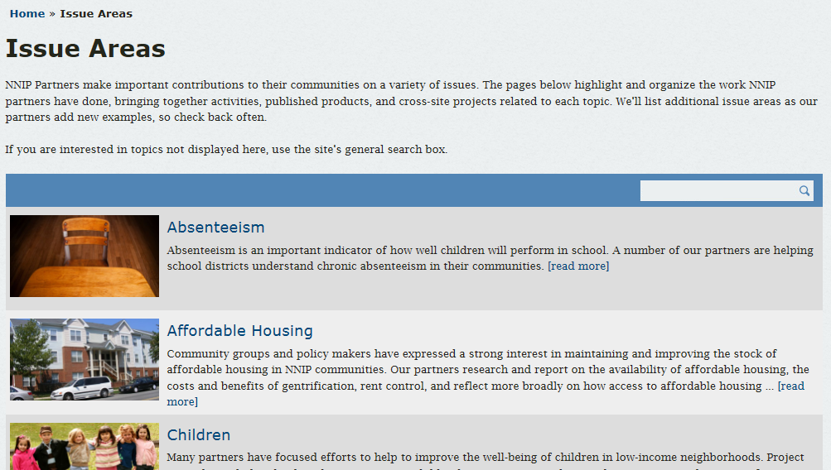
http://www.neighborhoodindicators.org/activities/issues
Notes:
In particular, there is an issue area page to help you connect directly with specific content areas in which our partners work.
Sections on promise Neighborhoods and Sustainable Communities

