Slide 1
Community Information Infrastructure
Kathy Pettit, The Urban Institute
Chicago Council on Global Affairs, Emerging Leaders
October 4, 2013
Notes:
Agenda today:
Big picture, a little NNIP and my perspective, walk through 3 categories of work that are needed for places to build and take advantage of community information

Slide 2
Community Information Goals
More successful communities through…
  Common understanding of conditions and trends
  Informed decisions and action by local stakeholders
  Using data throughout the cycle
    Issue identification
    Planning and design
    Implementation
    Evaluation
Notes:
Start with big picture

Slide 3
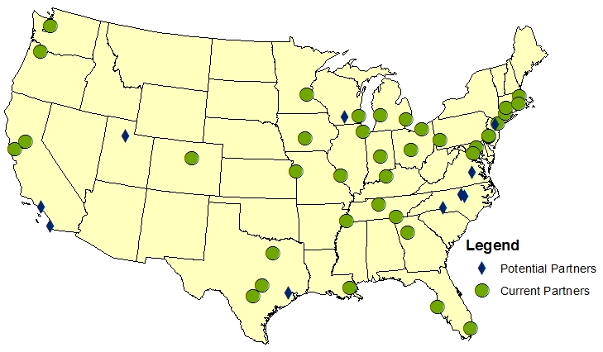
Notes:
Give some background so you understand my perspective
Direct NNIP – a network of local partners

Slide 4
NNIP Basics
Collaborative effort since 1995
  Urban Institute & local partners; now 37 cities
  All partners build and operate neighborhood level information systems using local data
  Success based on:
    Trusted and engaged institutions
    Relevant and high-quality data
    Mission to support use of data for local action
Notes:
Network is supported by the Annie E. Casey and the John D. and Catherine T MacArthur Foundations
Bullet 1: Started with 6 partners, now at 37
Three necessary components to success (e.g. three-legged stool)
Institutions:
The partners are housed in various types of institutions – universities, independent nonprofits, local funders.
But whatever the home, they are all respected organizations with a long-term stake in their community.
Data:
Partners all recurrently collect local government data at the address or small area-level on a range of issues – housing, schools, crime, etc.
They handle confidential data responsibly, summing up individual-level data to neighborhood indicators to share broadly.
There is an economy of scale to having one group provide the service for the community.
The systems are built incrementally, so partners have different sets of data depending on local context.
Mission:
NNIP partners’ values drive all the hard work of acquiring and organizing the data. The point is to get the information used - whether for policymaking, community building, program planning.
The founding NNIP partners recognized that not everyone had equal access to information. Focus began with and remains on low-income nghs that have traditionally not had access to data or training to use data. (democratizing information)
But partners serve wide range of clients - helping citywide nonprofits and even gov’t agencies find and use data in their decisions.
Network:
UI coordinates the network: organizes partner meetings, helps new partners get started, develops cross-site projects, and serves as a national advocate for the importance of local capacity to use data to inform community action.

Slide 5
Common values drive NNIP work
Recognizing diversity in neighborhood conditions
Collaborating across sectors and silos to address issues
Democratizing data
  Making data widely available
  Building capacity in distressed communities to participate in decisionmaking
Notes:
Citywide numbers mask differences across ngh, are not very helpful for crafting solutions. City indicator could be the same, while some ngh conditions get worse and others get better. Or the problem moves.
Many problems don’t have simple solutions.
Example: If there’s a high obesity rate, could be lack of access to healthy foods or too many unhelathy options. Or could be lack of open space or high crime in the parks. Or nutrition education, school PE policies
We can only make real progress by working together.
Data can spur collaboration.
Just access to data on a website is not enough – how to understand, question the data, ask for relevant data for their concerns.

Slide 6
Many players needed
Competent, accessible government agencies
Talented data analysts and translators
Effective nonprofit organizations
Engaged residents
Thoughtful philanthropic funders
Interested business community
Innovative civic developers
Notes:
Different mix of role for different sectors/organizations
Mix of strong/weak
In no order…..

Slide 7
Many roles to play
Assemble, transform and disseminate data
Apply the data to achieve impact
Use data to strengthen civic life and governance
Notes:
Our strategy paper laid out three main ways to advance the information environment
I’ll walk through them. This is my first attempt at describing the broader model (so I may slip back out of habit), but my examples will be from partners in the network. (other examples without data intermediary out there).

Slide 8
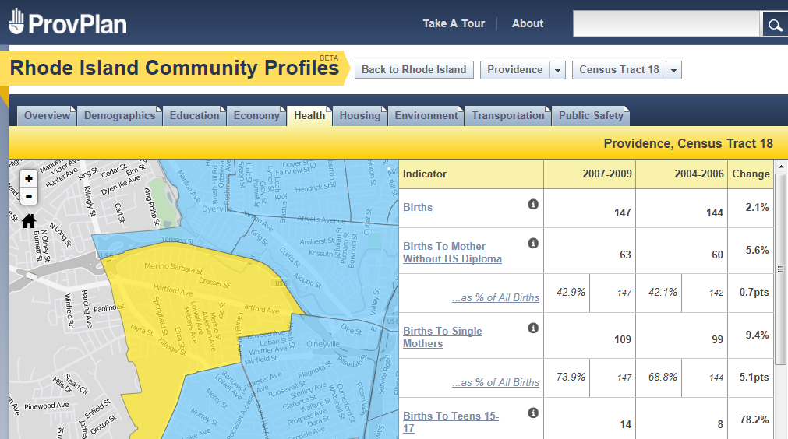
Assemble, transform & disseminate
Notes:
Assemble, transform and disseminate data. Accessing data from multiple agencies through open data portals or data sharing agreements is the first step.
Wide array of data:
Confidential data (schools, health)
Integrated Data Systems (identifiable linked data)
Community-generated data (vacancy surveys, asset mapping)
Program data (client characteristics, services provided)
Survey data (attitudes, perceptions, quality of life)
Example: Clean and aggregate raw data (including confidential sources) to create indicators
Others are more complex query systems or APIs targeted at developers

Slide 9
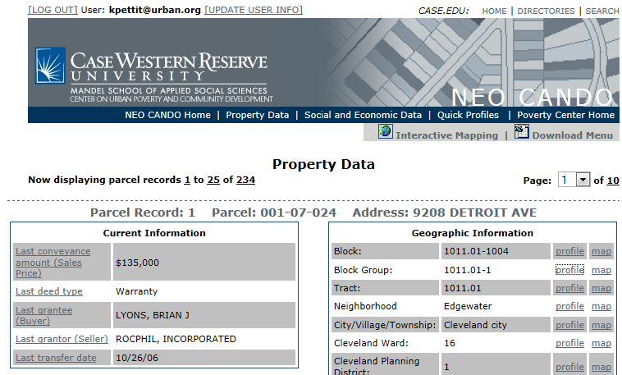
Assemble, transform & disseminate
Notes:
Combine different datasets or datasets over time for new insights – code violations, assessors, sales, permits, tax liens
Public and private section
Tailored for govt staff, comm dev, land bank, ngh groups
Updated daily

Slide 10
Achieving impact with data
Advocacy group gets new insight on local issue from public indicators
Nonprofit develops performance management system for its programs
Government agencies have decisionmaking tools tailoring the data for them to improve operations
Funders determine target neighborhoods or populations based on criteria
Community indicators project identifies new emerging issues
Issue-oriented action coalitions create strategies based on current data and trends
Many more…
Notes:
Not going to read through each one, but just shows the range (these are all collective action, not indiv decisions)
Apply the data to achieve impact. The most visible payoffs (tip of iceberg)
to be applying the data to address local policy problems
local stakeholders need data to identify emerging issues and target resources and investments efficiently.
Examples: issue-oriented action coalitions – affordable housing, obesity, school readiness

Slide 11
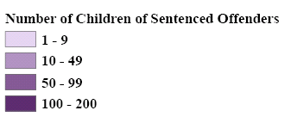
Advocate for
Legal Reform
Individuals convicted of selling drugs were permanently barred from receiving food stamps, making their transition more difficult and denying help to their children
Source: Providence Plan
Notes:
Part of reentry mapping network (DATES)
San Diego, CA: San Diego Association of Governments participated
There were 1,316 children in Providence who had a parent sentenced in 2008
50 parents were disqualified each month
In RI, individuals convicted of selling or distributing drugs were permanently barred from receiving cash assistance or Food Stamps.
*successful reentry, help at-risk children and families, & financial analysis about total cost
FIP and Food Stamps are a pivotal transitional support for ex-offenders returning to
Rhode Island’s communities. The pressures on ex-offenders are immense. Following release,
inmates must secure employment, housing, clothing, means of transportation, and food, among
other necessities. The pressures on parents are even more dramatic. FIP and Food Stamps
support they need to provide for their families.
Supporting ex-offenders during re-entry reduces future costs of incarceration by reducing
recidivism.

Slide 12
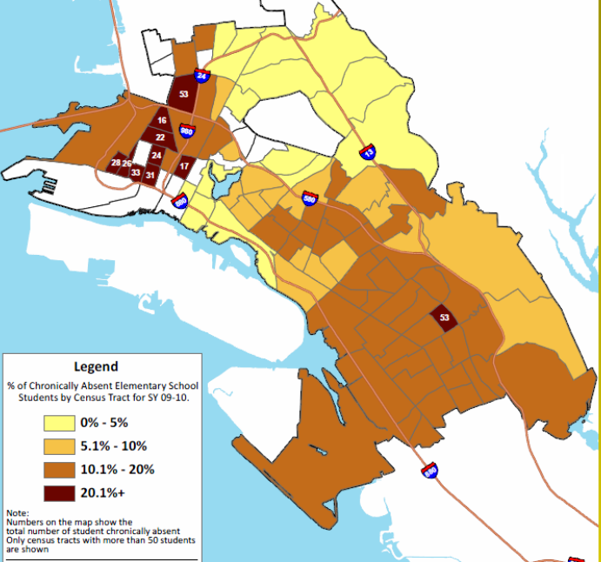

Share of Elementary Students who Were Chronically Absent
Highlight Effects of Foreclosure on Children
Forced mobility can put kids behind academically and socially.
Foreclosure prevention counselors should connect families to student services.
Schools need to understand the how their students are affected by foreclosure to design appropriate responses.
Assist school district with analysis
and operations
Source: NeighborhoodInfo DC
Notes:
12
Map of the share of chronically absent elementary school students by census tract of where the student lived – not by school location.
Darkest shade had 20% of more of their children chronically absent in this school year.
Impt b/c Root of the problem may differ ngh by ngh. By understanding the patterns, interventions can be tailored to fit the neighborhood context (transpotaion, childcare health)
Developed weekly tools
Action plan – parents, teachers, comm groups, service agencies

Slide 13
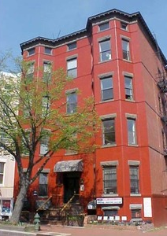
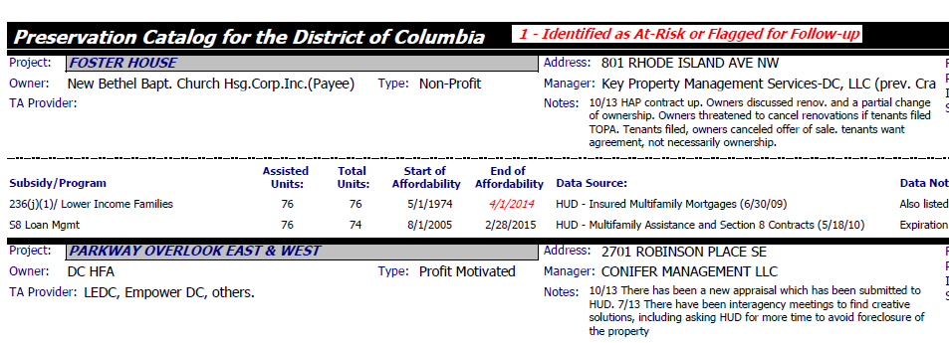
Coordinate Collective Planning and Action

Slide 14
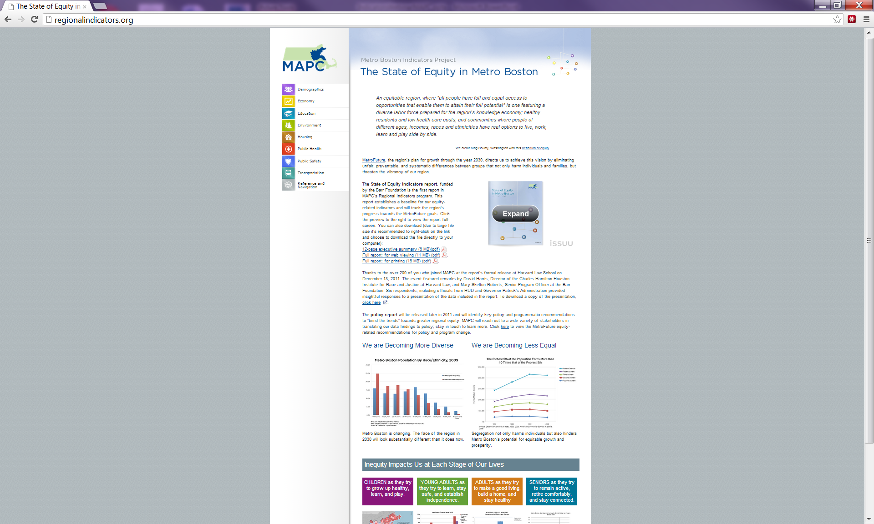
Frame, Choose,
and Track
Community Goals
Notes:
Sust Comm
Initial divisions
Made economic argument
Rel with Boston indicators
Equity points in grantmaking

Slide 15
Strengthen civic life & governance
Enhance the data capacities of local institutions and residents
Increase community expectations about availability of current, relevant data
Promote a culture of learning and collaboration
Notes:
Use data to strengthen civic capacity and governance.
NNIP partners also work to cultivate the overall local capacity for informed action. Improving systems, not just 1 program
This includes enhancing the data capacities of other local institutions and promoting a culture of learning and collaboration.
Training – more formal around certain topic (head start), or skill set (MetroPulse videos)

Slide 16

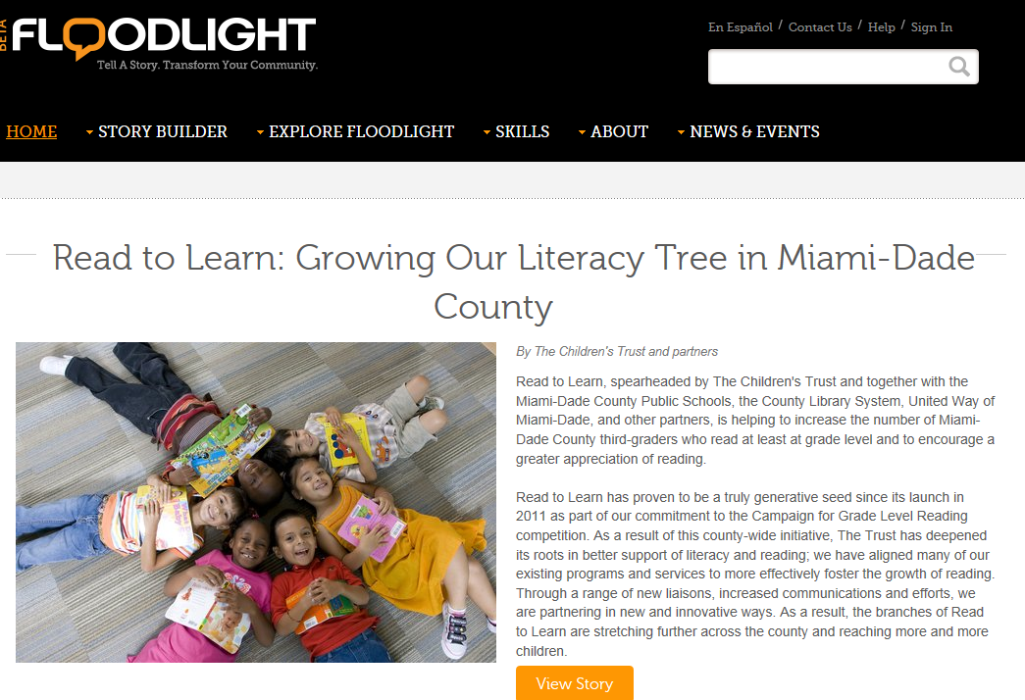

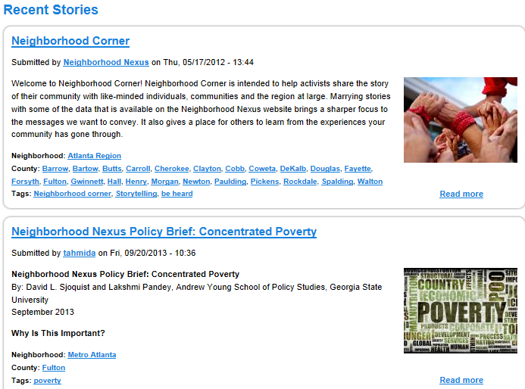
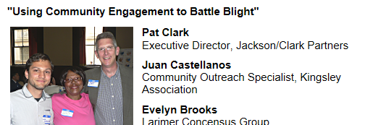

Strengthen civic life & governance
Notes:
Some of this is more amorphous, but there are specific actions/new tools
Training, Data Days, Online communication tools, community journalism
Citizen engagement

Slide 17
This is an exciting time!
Advances in data/technology
  Expanding and maturing open data systems
  New visualization/analysis tools
  New types of data – crowd-sourced, social media
  Integrated data systems
Advances in policy and practice
  Focus on cross-sector, data-driven collaborations (collective impact model, Promise Neighborhoods)
  New allies and collaborations (Code for America, Sunlight Foundation, Federal Reserve branches)
Notes:
See more than open data -
Opporutnies and challenges (reinforcing power structure)

Slide 18
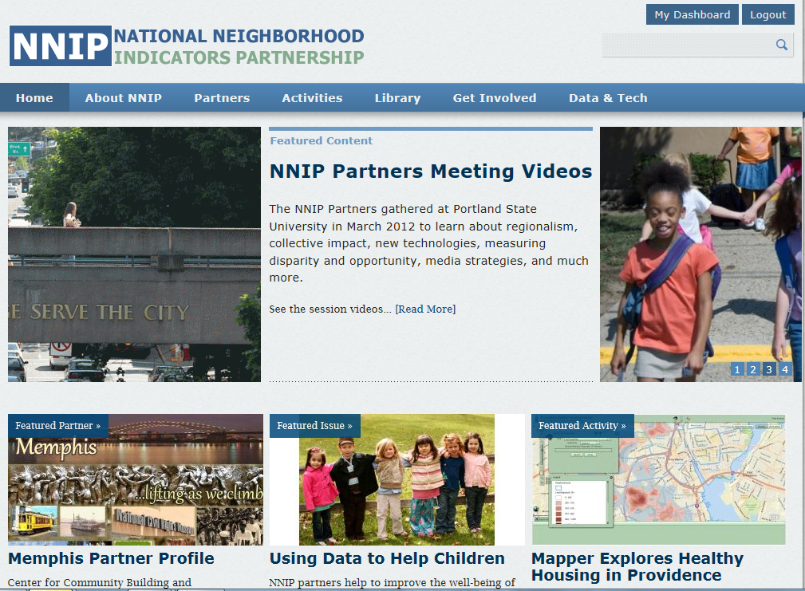
www.NeighborhoodIndicators.org
Notes:
Here’s our web site where you can find out more about NNIP and our partners
www.NeighborhoodIndicators.org

Slide 19
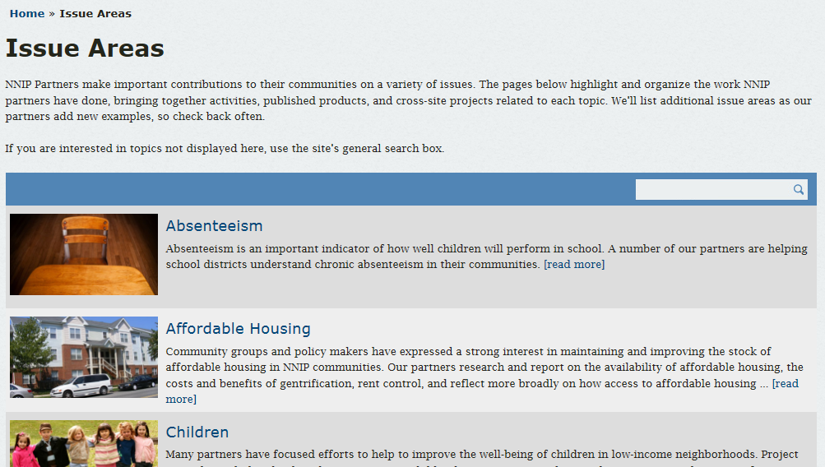
http://www.neighborhoodindicators.org/activities/issues
Notes:
In particular, there is an issue area page to help you connect directly with specific content areas in which our partners work.
Sections on promise Neighborhoods and Sustainable Communities

