Slide 1
Foreclosure Prevention Roundtable Support provided by Open Society Foundations Neighborhood Stabilization Initiative The Urban Institute September 25, 2012

Slide 2
Today’s Agenda
Objective: Present the thesis of GHHI’s impact on foreclosure mitigation and neighborhood stabilization and solicit feedback, input and recommendations of thought leaders on how best to establish the value proposition of GHHI as an effective augment to the national housing stability agenda.
I. Welcoming Remarks 10:00 – 10:15
Rolf Pendall, PhD, Director of the Metropolitan Housing and Communities Policy Center
Discuss what UI does, what their relationship is w/ GHHI and personal reflection of the crosswalk of GHHI, Foreclosure Prevention, Neighborhood Stabilization, and Family Economic Success.
II. Framing and Context 10:15 – 10:20
Solomon Greene, Senior Program Officer for Open Society Foundations
A brief overview of Open Society Foundations interest and investments in neighborhood stabilization
III. GHHI and Neighborhood Stabilization 10:20 – 11:00
Ruth Ann Norton, Executive Director of the Green and Healthy Homes Initiative
Overview of green, healthy and safe housing intervention investments and why a GHHI Standard may improve market value and long-term affordability of financially distressed housing. Provide a summary of the OSF-funded activities in Baltimore, Chicago, and Providence.
IV. Input and Discussion 11:00 – 12:15
Factors to consider regarding the endorsement of HUD for GHHI and the national scaling effort. Consideration regarding the advocacy for a national home repair standard. Discuss existing data and what additional data is needed in order to influence the market
V. Next Steps in Advancing the GHHI-Neighborhood Stabilization Nexus 12:15 – 1:00
Synthesize the conversation, recognize knowledge gaps and identify next steps.

Slide 3
Premise
That the application of Green & Healthy Homes Intervention Standards has the potential to provide a competitive advantage at post-foreclosure sale
Green & Healthy Homes interventions have the potential to stabilize neighborhoods by saving struggling homeowners the costs of home maintenance, utility bills, and lost work days due to illness
Initial Findings:
- First-year utility cost savings among Baltimore GHHI clients averages $403
- 55% of current Baltimore GHHI families report less missed work time as a result of child’s asthma
Notes:
Survey respondents stated “I would choose a house needing fewer repairs” if they could re-do their home purchase. 17% Baltimore; 24% Chicago

Slide 4
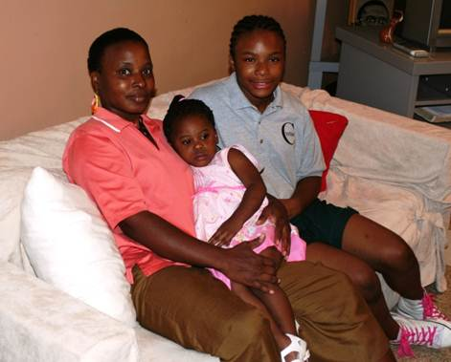
O’Bannon Family
Prior lead poisoned children in the home
History of asthma episodes resulting in 13 hospitalizations for youngest of two children
Triggers: Allergens (mice, pests, mold, dust mites); lead hazards
GHHI Intervention Cost: $15,444 Non-GHHI Estimate: $21,310
= Net estimated savings of $5,866
Results:
Allergens and lead hazards remediated & home weatherized
Daughter has not been hospitalized since the intervention resulting in avoided medical costs of $53,000
27% reduction in natural gas usage in 12 months post-intervention
Notes:
Programs Engaged: HUD OHHLHC, MEA, CDBG, CSBG, Foundations

Slide 5
What We Know
About Foreclosures, Housing and Health
Foreclosures Destabilize Neighborhoods & Negatively Impact Households
Decrease property values and increase crime rates (Alley 2011)
Increase the number of vacant and unhealthy homes (Alley 2011)
Cause psychological stress (Alley 2011 ) (Kingsley, Smith, Price 2009)
Displace families and disrupt social networks (Alley 2011)
Negatively affect school performance (Roy 2008)
Cause psychosocial affects related to the home as a site of security, well being, and perceptions of social status (Saegert & Evans 2003)

Slide 6
What We Know (slide 2)
The Foreclosure Crisis is a Public Health Crisis Many neighborhoods experiencing the highest rates of foreclosure already bear the burden of the poorest health outcomes (Phillips, Clark, Lee, Desautels 2010)
Foreclosures Exacerbate Existing Health Disparities Impacts Health Outcomes
Increase rates of hypertension and kidney disease (Pollack 2011) (Navas-Acien 2012)
Decrease in primary care physician visits in the six months prior to foreclosure (Pollack 2011)
Increases in symptoms of depression are directly linked to incidence and survival rates for major illnesses and heart attacks (Everson-Rose 2005) (Schulz 2000) (Mykletun 2007)
Impacts Health Care Utilization
Increase in emergency room visits and hospitalizations (Currie 2011)
Increases in emergency department and outpatient visits in 2 years prior to foreclosure (Pollack 2011)

Slide 7
What We Know (slide 3)
Poor Health and Health-Related Debt Place At-Risk Populations At Risk for Foreclosure “At Risk for Risk” Individuals that are “at risk for risk” are stacked highest in communities that are already struggling with other life and health consequences of low socioeconomic status (Link and Phelan 1995) and are at higher risk for mortgage default (Alley 2011) (Libman, Fields, Saegert 2012)
Poor health can be a key point of entry into mortgage delinquency and foreclosure Medical debt, illness and injury, lack of adequate health insurance, as well as caring for extended family are major contributing factor for mortgage delinquency and foreclosure (Alley 2011) (Libman 2012) (Robertson, Egelhof, Hoke 2008)

Slide 8
What We Know (slide 4)
Green, Healthy, and Safe Interventions Improve Health Conditions and Stabilize Neighborhoods Efforts to keep individuals in their homes stabilize neighborhoods and ameliorate financial distress among both those being foreclosed and their neighbors (Currie and Teckin 2011)
Decreases in energy and transit costs related to green and energy-efficient homes contributes to housing affordability and helps to sustain homeownership and stabilize neighborhoods (Sheldon, Bush, Kearsley, Gass 2009)
Prioritize accessibility and smart growth themes when setting goals for neighborhood stabilization (Kingsley, Pettit, Hendey 2009)
Interventions aimed at improving internal housing conditions improve the health of low-income groups, particularly those that are targeted at elderly or those with existing health conditions (Thompson, Thomas, Sellstrom, Petticrew 2009) The physical, social, and economic environments of local communities affect residents’ health. It is important to support cross-cutting strategies to reduce exposures harmful to health and to establish conditions that support healthful daily practices (Miller, Pollack, Williams 2011)

Slide 9
OSF NSI Sponsored Activities to Date
Surveys of GHHI clients to quantify housing burden (July-Sept 2012)
GHHI Baltimore: 107 conducted by the Coalition to End Childhood Lead Poisoning
GHHI Chicago: 100 conducted by Center for Neighborhood Technology and Delta Institute
Scans by Urban Institute NNIP Affiliates in Baltimore, Providence
Baltimore Neighborhood Indicator Alliance Jacob France Institute at University of Baltimore: Address-level analyses and contextual based on neighborhood characteristics
The Providence Plan: Neighborhood context analysis
Notes:
BNIA –JFI conducted in-depth data scan linking GHHI clients to administrative housing data sets
ProvPlan conducted a more cursory scan of the GHHI target area and in relation to GHHI housing interventions

Slide 10
Emerging Survey Findings
GHHI clients shared their challenges of homeownership.
Borrowing money to pay mortgage
Baltimore: 34%
Chicago: 16%
Experiencing energy burden simultaneously
Baltimore: 82% report “always” or “sometimes” have difficulty paying monthly utility bills
Chicago: 31% have overdue utility bills
Forgoing other expenses to pay mortgage
Baltimore: 58% had forgone food, prescriptions, health care services and/or utility bills in past 6 months
Notes:
We didn’t get any good response rates in any city as to HOW LATE on mortgage payments.
Some Baltimore clients revealed borrowing in excess of $1000 but this was, overall, poor response (14/107)
Families and friends are sources of funds, as are payday loan companies, credit cards, retirement savings.
Lack of response to questions could be as revealing as a response. Trust with GHHI staff, willingness to reveal the extent of hardship. All influence GHHI’s ability to successfully connect clients to appropriate resources.

Slide 11
Emerging Survey Findings (slide 2)
Tools for decreasing mortgage burden appear to be underutilized.
High mortgage interest rates among GHHI clients
Baltimore: 5.63%
Chicago: ~ 6.30%
Refinancing rates vary and show underutilization among some groups
Baltimore: 55% of households have refinanced
Chicago: 46% among CNT clients but 84% among Delta clients
Note: Variable mortgage interest rates among GHHI clients in Baltimore (10% of clients) and Chicago (17% of clients)
Notes:
Interest Rates as of 9/20/2012 per Freddie Mac Weekly Survey- 30 yr avg: 3.49%; 15 yr: 2.77%
Interest rates in Baltimore and Chicago (CNT) ranged from 3-12%;

Slide 12
Emerging Survey Findings (slide 3)
Homeownership Distress Continues into the Summer of 2012
 | Baltimore | Chicago
High Risk of Foreclosure | 37% | 24%
In Foreclosure | 9% | 6%
Among GHHI clients in Baltimore and Chicago In Foreclosure or at High Risk of Foreclosure, approximately 25% reported that they sought homeownership or credit counseling help.
Note: GHHI is defining high risk of foreclosure as having overdue mortgage payments.
Notes:
Foreclosure risk methods developed by CNT/GHHI staff – low risk = not behind on mortgage but are behind on taxes or insurance. Insignificant risk = mortgage paid or current on mortgage, taxes, insurance
1/3 of Baltimore respondents had borrowed money in past 6 months to pay mortgage (or rent). 58% had foregone food, prescription meds or medical services and/or utility payments to pay mortgage/rent.
Low / Insignificant risk of foreclosure: 65% Balt, 82% CNT, 76% Delta
Small sample sizes, but lack of accessing foreclosure prevention counseling point to strong role for GHHI to help connect people. To ask a few key questions at intake that could indicate risk. Trust with clients needed since response rates on some of the more sensitive questions in surveys were poor.

Slide 13
Emerging Survey Findings (slide 4)
Homeowners are confident that they can avoid foreclosure.
“Somewhat confident” or “Very confident” of avoiding foreclosure
Baltimore: 95%
Chicago: 83%
Generally, clients do not regret homeownership.
If [homeowner] could do everything over again, “I would not buy a house.”
Baltimore: 6%
Chicago: 6%
“…I would not change anything.”
Baltimore: 34%
Chicago: 39%
Notes:
“I would choose a house needing fewer repairs” 17% Baltimore; 24% Chicago

Slide 14
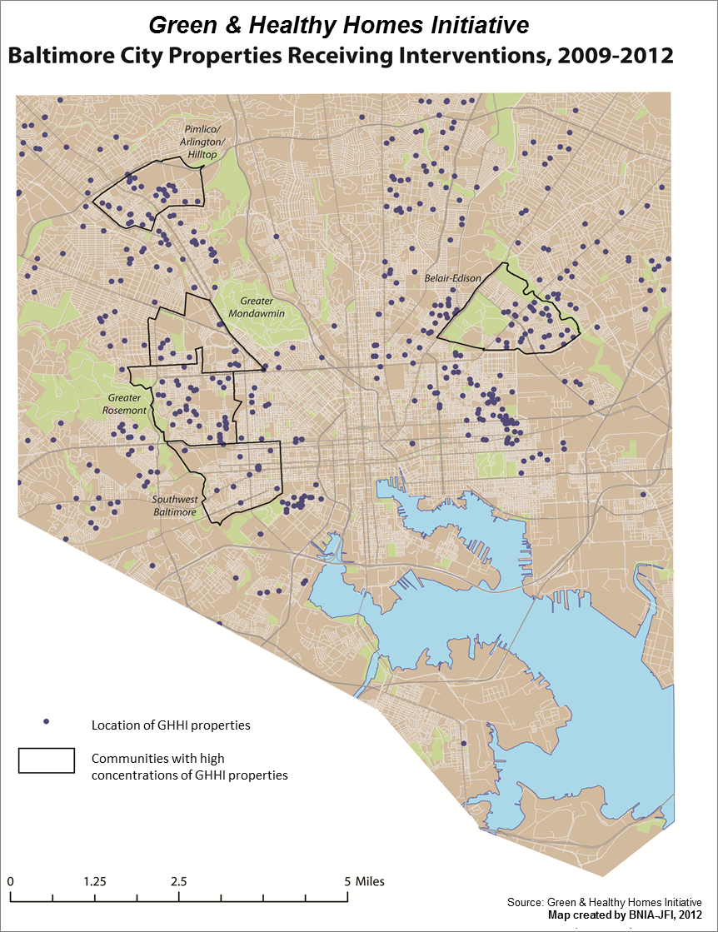
Preliminary Findings of BNIA-JFI Analyses
GHHI improved properties cluster in neighborhoods hardest hit by foreclosure crisis and at greatest risk
Same neighborhoods with housing distress above city average (pop. loss, vacant properties, low property values, low rehab permits) -evidence of effects of destabilization
GHHI properties post-intervention show positive indications of stability with low rates of foreclosure, REO sales, vacancies, and fewer code violations
Notes:
We need to longitudinally track

Slide 15
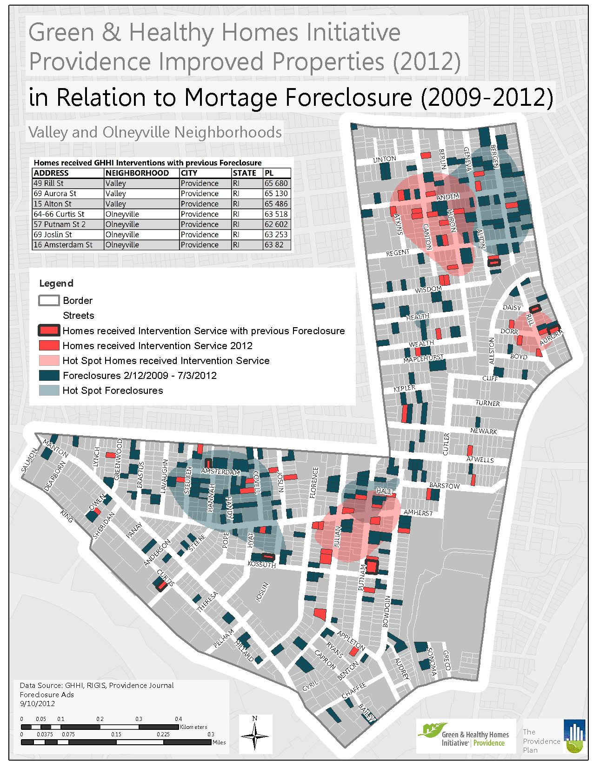
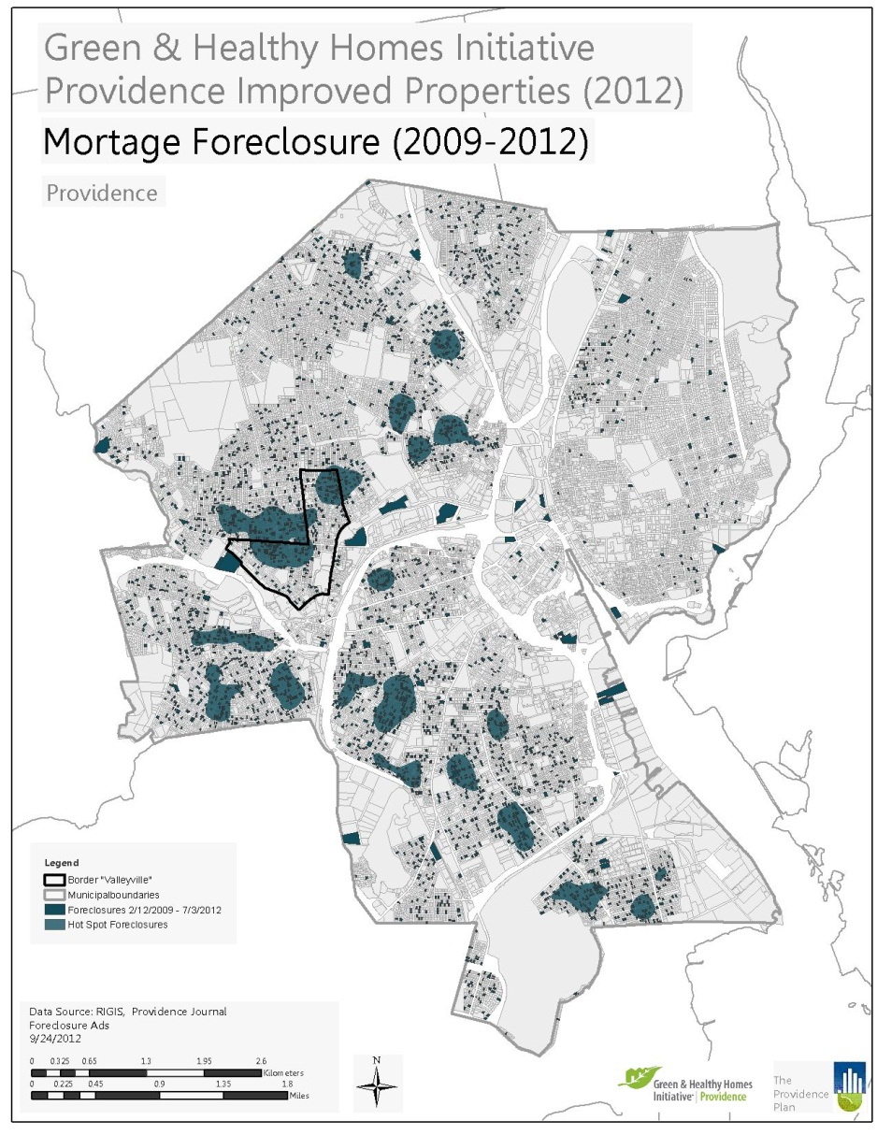
Providence Plan Contextual Scan
ProvPlan conducted initial mapping to help target GHHI Providence efforts in area of high distress (health, housing, poverty, crime)
Initial post-intervention analyses confirm distress of target area, need for longitudinal tracking
Notes:
Need for longitudinal mapping, tracking

Slide 16
References
Alley D, L. J. (2011 ). Mortgage Delinquency and Changes in Access to Health Resources and Depressive Symptoms in a Nationally Representative Cohort of Americans Older Than 50 Years. American Journal of Public Health, December; 101(12): 2293–2298. doi:10.2105/AJPH.2011.300245.
Apgar W, D. M. (2005). Municipal Cost of Foreclosures: AS Chicago Case Study. Minneapolis: Homeownership Preservation Foundation.
Currie J, T. E. (2011). Is the Foreclosure Crisis Making Us Sick? Cambridge, MA: National Bureau of Economic Research.
Everson-Rose SA, L. T. (2005). Psychosocial factors and cardiovascular diseases. Annual Review of Public Health, 26:469–500. [PubMed: 15760298].
Kingsley, T G., Pettit, K. L.S., Hendey, L. (2009). Addressing the Foreclosure Crisis: Action Oriented Research in Three Cities. The Urban Institute.
Kingsley, T.G, Smith, R.,Price, D. (2009). The Impacts of Foreclosures on Families and Communities. The Urban Institute.
Kuholski, K., Tohn, E., Morley, R. (2010). Healthy Energy-Efficient Housing: Using a One-Touch Approach to Maximize Public Health, Energy, and Housing Programs and Policies.Journal of Public Health Management & Practice. V 16, Issue 5: 68-74.
Libman K, Fields. D., and Saegert, S. (2012). Housing and Health: A Social Ecological Perspective on the US Foreclosure Crisis. Housing, Theory and Society, Vol 29, No. 1; 1-24.
Link, B G. and Phelan, J. (1995). Social Conditions As Fundamental Causes of Disease. Journal of Health and Social Behavior, Vol. 35, Extra Issue: Forty Years of Medial Sociology: The State of the Art and Directions for the Future: 80-94

Slide 17
References Continued
Miller, W.D., Pollack, C., Williams, D. (2011). Healthy Homes and Communities: Putting the Pieces Together. American Journal of Preventative Medicine. 40(1S1):S48 –S57
Mykletun A, B. O. (2007). Anxiety, depression, and cause-specific mortality: the HUNT study. Psychosomatic Medicine , 69(4):323–331.
Pollack C, S. K. (2011). A Case-Control Study of Home Foreclosure, Health Conditions, and Health Care Utilization. Journal of Urban Health: Bulletin of the New York Academy of Medicine, Vol 88, No3; pages 469-79.
Robertson, C.T., Egelhof, R., Hoke, M. (2008). Get Sick, Get Out: The Medical Causes of Home Mortgage Foreclosures. Health Matrix. Vol. 18:65.
Roy J, M. M. (2008). The Hidden Costs of the Housing Crisis: The Long term Impact of Housing Affordability and Quality on Young Children's Odds of Success. Washington, D.C.: The Partnership for America's Economic Success.
Saegert, Sand Evans, G W. (2003). Poverty, Housing Niches, and Health in the United States. Journal of Social Issues. 59:3, 569-589.
Schulz R, B. S. (2000). Association between depression and mortality in older adults: the Cardiovascular Health Study. Arch Intern Med., 160(12):1761–1768. [PubMed: 10871968].
Sheldon, A., Bush, P., Kearsley, Aaron, and Gass, Anne. (2009). The Challenge of Foreclosed Properties. Enterprise Community Partners, Inc.
Thompson, H., Thomas, S. Sellstrom, E., Petticrew M. (2009). The health impacts of housing improvement. American Journal of Public Health. 99:S681-692.

Slide 18
Key Discussion Questions
What benefits do you think that GHHI can have on distressed housing, foreclosed properties, and housing stability efforts?
How can financial institutions be engaged? Housing portfolios? CRA? Philanthropic arms?
What are the policy and program opportunities for government at the fed, state and local level?
How do we directly engage residents? Greater outreach, more education
How do we best use the non-profit community? Advocacy and influence? Philanthropy?
Is there market value in establishing a green, healthy and safe housing standard?
Would this be a valuable tool in addressing REO and vacant housing?
What would it take to establish this?
What data/evidence do you believe would be needed to advance this effort?
What are the compelling angles and to what audiences?
What evidence exists to support this?
What evidence is needed to drive it?
What are the key priorities in the existing effort of housing stabilization?
What is most urging?
How do we prioritize and segment, where needed?
What are the existing opportunities for aligning efforts and what are the appropriate access points?
What are the current trends in housing stability, foreclosure prevention and neighborhood stabilization?
Who are the partners we need to engage most?
How best to we engage partners?
What are key barriers to advancing an agenda on this nexus?
What are the needed next steps in advancing this effort in 3, 6 and 12 months?

Slide 19
Ruth Ann Norton
Executive Director
Green & Healthy Homes Initiative
Coalition to End Childhood Lead Poisoning
410-534-6447
ranorton@ghhi.org
www.ghhi.org
www.leadsafe.org

