Slide 1


Neighborhood Assessment & Regional Equity
Jeff Matson
jmatson@umn.edu
Neighborhood Revitalization Conference 7.25.14

Slide 2
Outline
Regional disparities
Neighborhood assessment
Contributions to regional disparity
Calculators and cost solutions

Slide 3
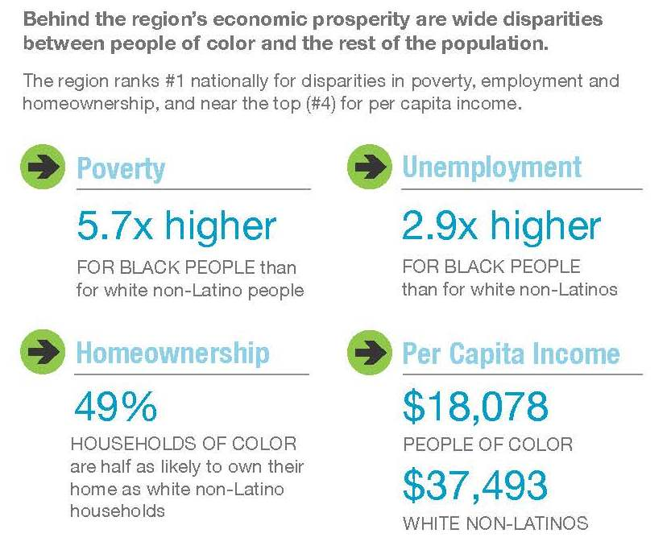
Fair Housing Equity Assessment
http://www.metrocouncil.org/Planning/Projects/Thrive-2040/Fair-Housing-Equity-Assessment-(FHEA)/FHEA/Fair-Housing-and-Equity-Assessment-(FHEA)-Report-S.aspx
Notes:
As a whole Twin Cities metro is doing very well
The Twin Cities metro had the fifth fastest-growing regional
economy among the nation’s 20 largest metropolitan areas
in 2012
The region has a relatively lower unemployment rate, ranking
143rd among the largest 150 metropolitan areas.
Look below the surface and you begin to see disparities
By race especial (white v. African American)
See MetC slides from
Some of the worst in the nation
Income inequality is growing in the region. The Twin Cities
ranks 34th among the largest 150 regions
Concentrated Geographically

Slide 4
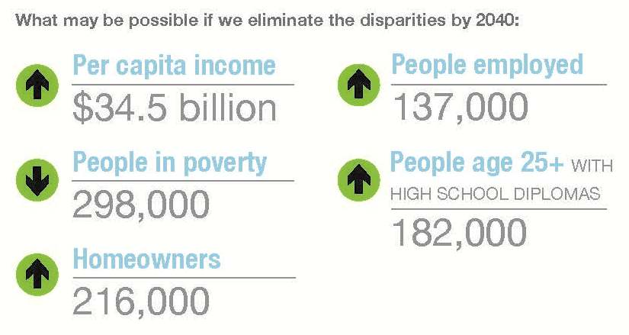
Fair Housing Equity Assessment
http://www.metrocouncil.org/Planning/Projects/Thrive-2040/Fair-Housing-Equity-Assessment-(FHEA)/FHEA/Fair-Housing-and-Equity-Assessment-(FHEA)-Report-S.aspx

Slide 5
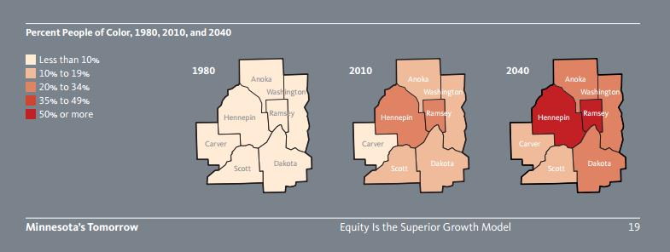
Changing Demographics
  Minnesota’s Tomorrow – PolicyLink, http://www.policylink.org/sites/default/files/MNT_032514.pdf
Notes:
Why Should this concern us?
This is the future of our region
Demographic Trends in the Twin Cities Metro
Percent people of color, 2010 24%
Growth in people of color, 2000 to 2010 52%
Projected percent people of color, 2040 41%
Percent foreign born, 2006–2010 10%
Share of growth attributable to people of color,
2000 to 2010 100%
College-educated workers of color in the metro earn $4.50/hour
less than their white counterparts.
Over the last 30 years, income for workers near the bottom
(the 10th percentile) in the Twin Cities declined by 4 percent,
while those near the top (the 90th percentile) experienced a
25 percent increase.

Slide 6
Overview
Contract with LISC and Building Sustainable Communities Partners
  Neighborhood Assessment
  Technical Assistance
Shared understanding of data
Illuminating gaps & racial disparity
Quantify the values in each critical category
How can community organizations best use this data?

Slide 7
Indicators
Poverty
Jobs and Economy
  Unemployment
  Labor Force Participation
Income
Housing
  Homeownership Rate
  Cost-Burdened Households
Crime and Safety

Slide 8
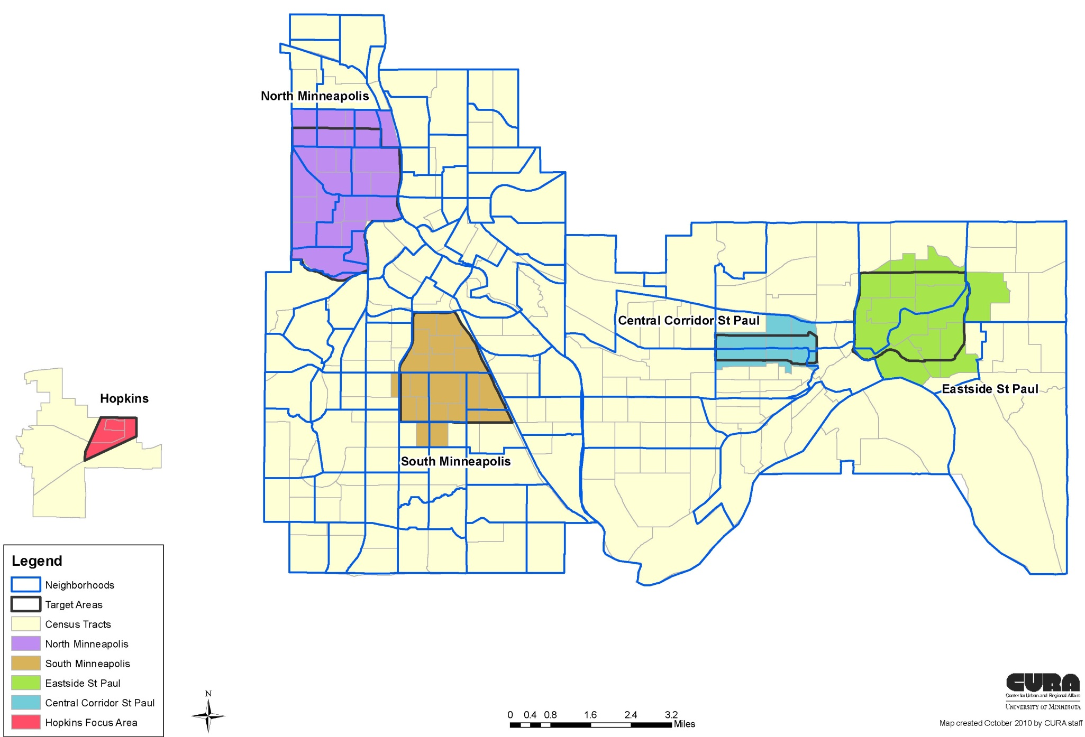
LISC Building Sustainable Communities Focus Areas

Slide 9
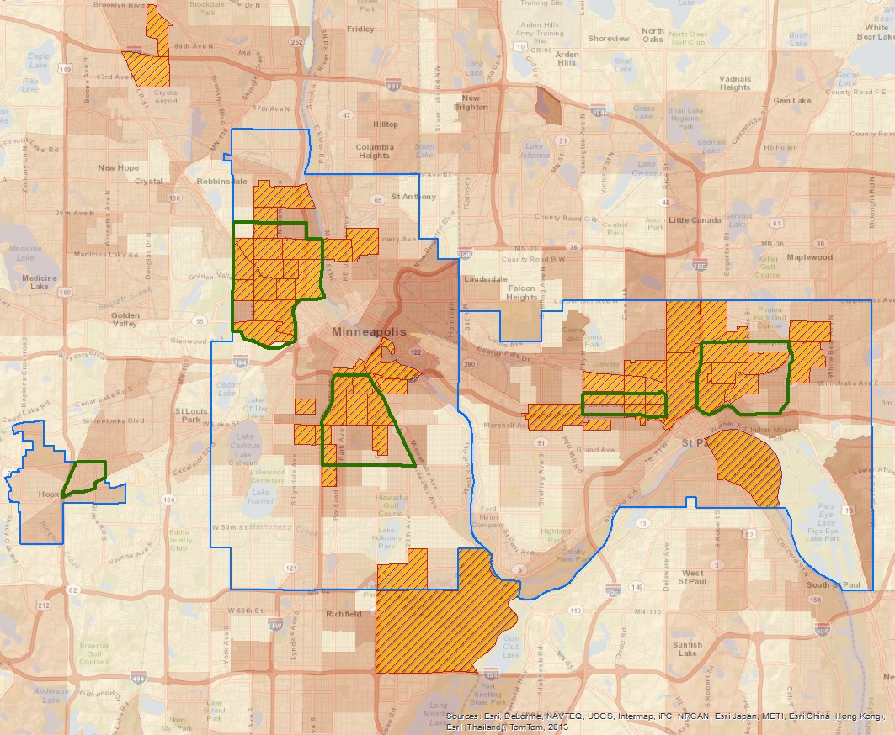
Racially Concentrated Areas of Poverty (RCAP) and LISC Focus Areas

Slide 10
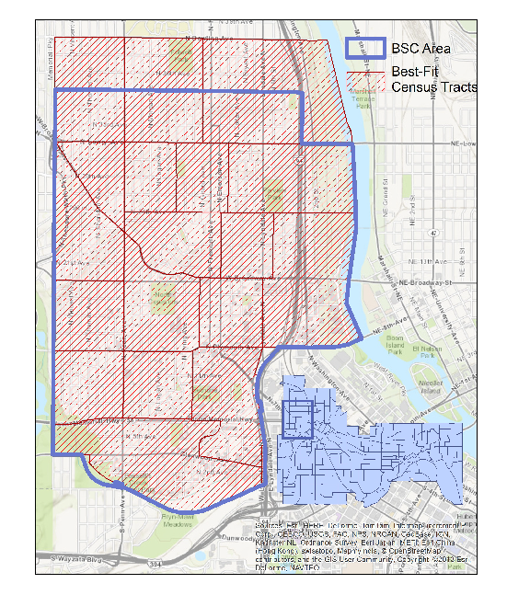
North Minneapolis
BSC Area

Slide 11
Poverty

Slide 12
Poverty
TO CLOSE THE GAP:

Slide 13
Contribution to Regional Inequity
African-American’s living in poverty in North Minneapolis makes up 3% of all Metro area residents living in poverty
North Minneapolis makes up 11% of regional African-American Poverty
Reducing the poverty rate to match the regional rate would reduce the regional value for African Americans from 34% to 31%

Slide 14
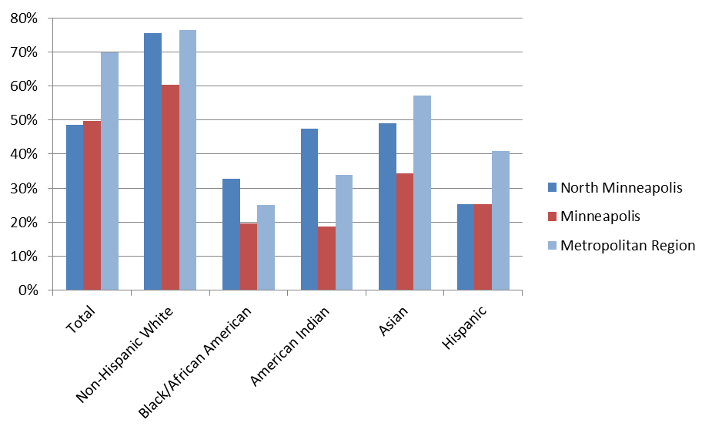
Housing (Homeownership)
Percent Owner-Occupied
Percent Cost-Burdened

Slide 15
Contribution to Regional Inequity
A total of 2,850 African American households would need to enter home ownership to close the gap
Increasing the Home Ownership Rate to 75% would improve the Regional rate from 25% to 28.5%

Slide 16
Unemployment
TO CLOSE THE GAP:

Slide 17
Unemployment

Slide 18
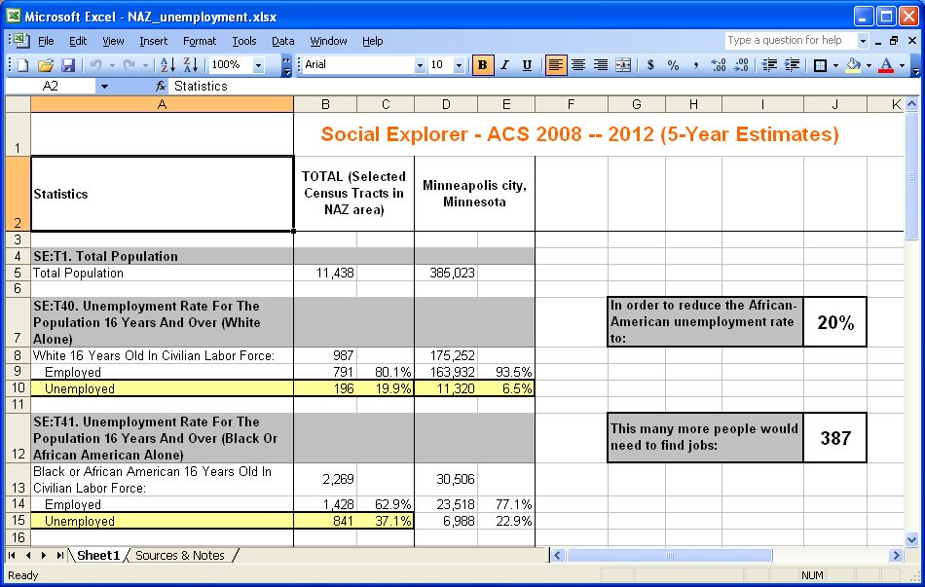

Slide 19


Slide 20
Summary
Consistent spatially concentrated and racially differentiated economic disparities North Minneapolis
  Poverty
  Jobs and Economy
  Income
  Housing
Moving Forward
  Recognition of the racial gaps and their spatial distribution
  How can this data best be utilized to inform practices going forward?
Notes:
Interrelatedness of indicators
Solve education you solve unemployment, you solve poverty and cost-burdened
What is the response?
Shared understanding of the data
Shared narrative of the solution
What would it take ($) to solve this?
Making the big ask
Big money follows big ideas

