Slide 1
Community Storytelling Efforts at The Piton Foundation
Part 1: Original Aurora Photo Voice Exhibit
Students + Cameras + Reflection = Magic
Part 2: “The Project Formerly Known as Citizen Atlas”
Storyboarding meeting – the power of process
Jordan Wirfs-Brock
April 4, 2012
jbrock@piton.org
@jordanwb

Slide 5
Sometimes, data strengthens a story.

Slide 9
Sometimes, a story is best told through emotions.

Slide 12
What did we learn?
Working on community storytelling projects often means working with a shifting target. Don’t fight this. Embrace it.
Knowing your audience will help you figure out what type of information and delivery is the most powerful. In some cases it’s data. In some cases it’s not. Be open.
Often, the process of storytelling is more important than the final product. Storytelling can be cathartic.

Slide 13
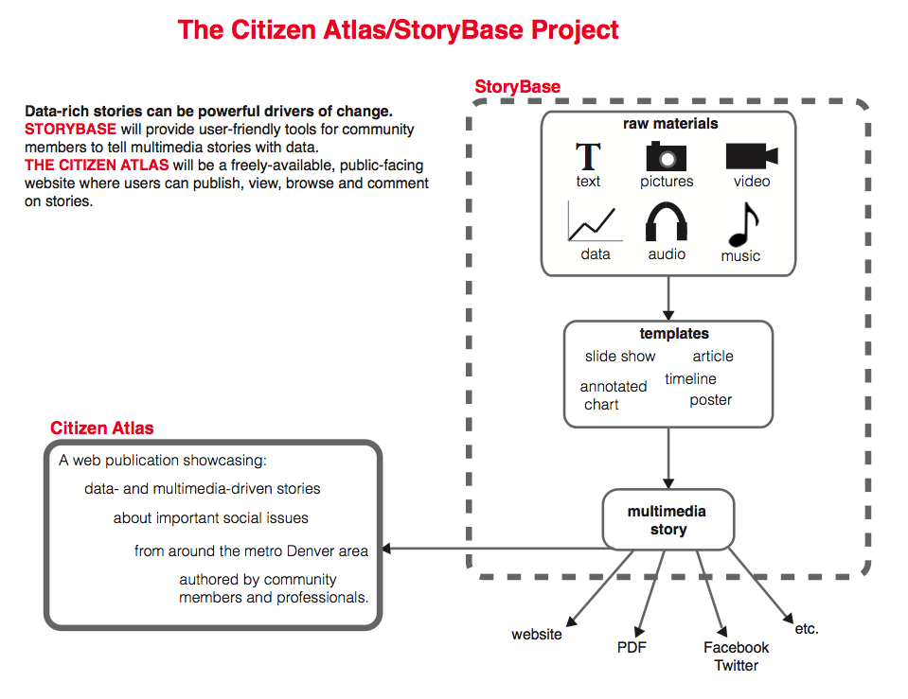
Name TBD

Slide 14
Story prototyping with Atlas contributors using the “Design Thinking for Storytelling” method.
Learn more: http://dschool.stanford.edu/
Full story prototyping process: http://bit.ly/Hf4mb2

Slide 15
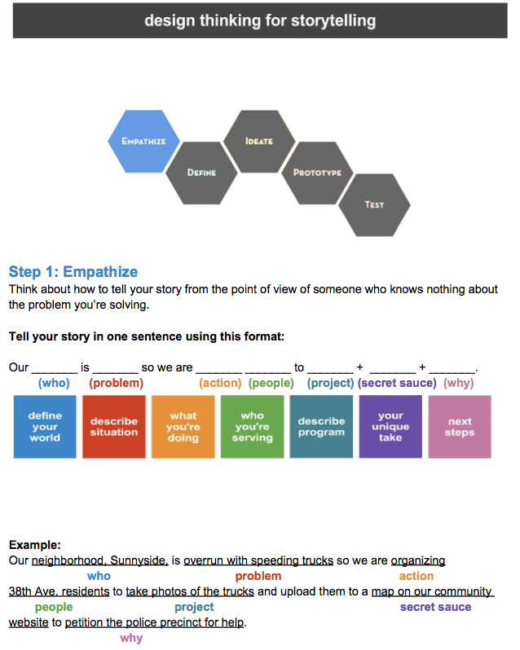

Slide 16
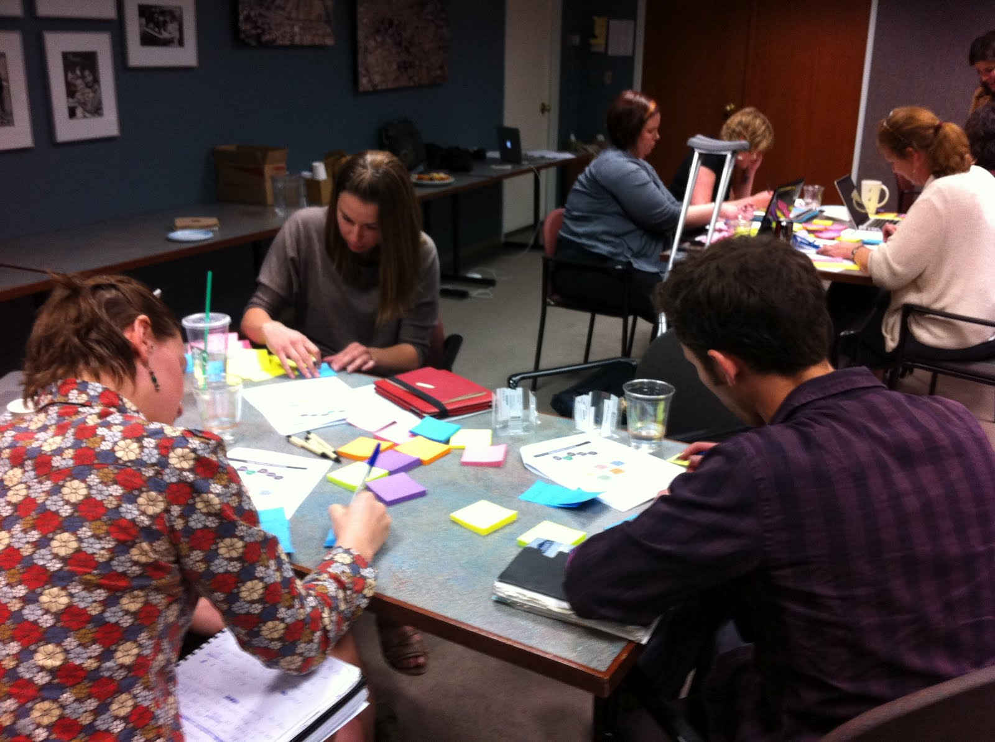

Slide 18
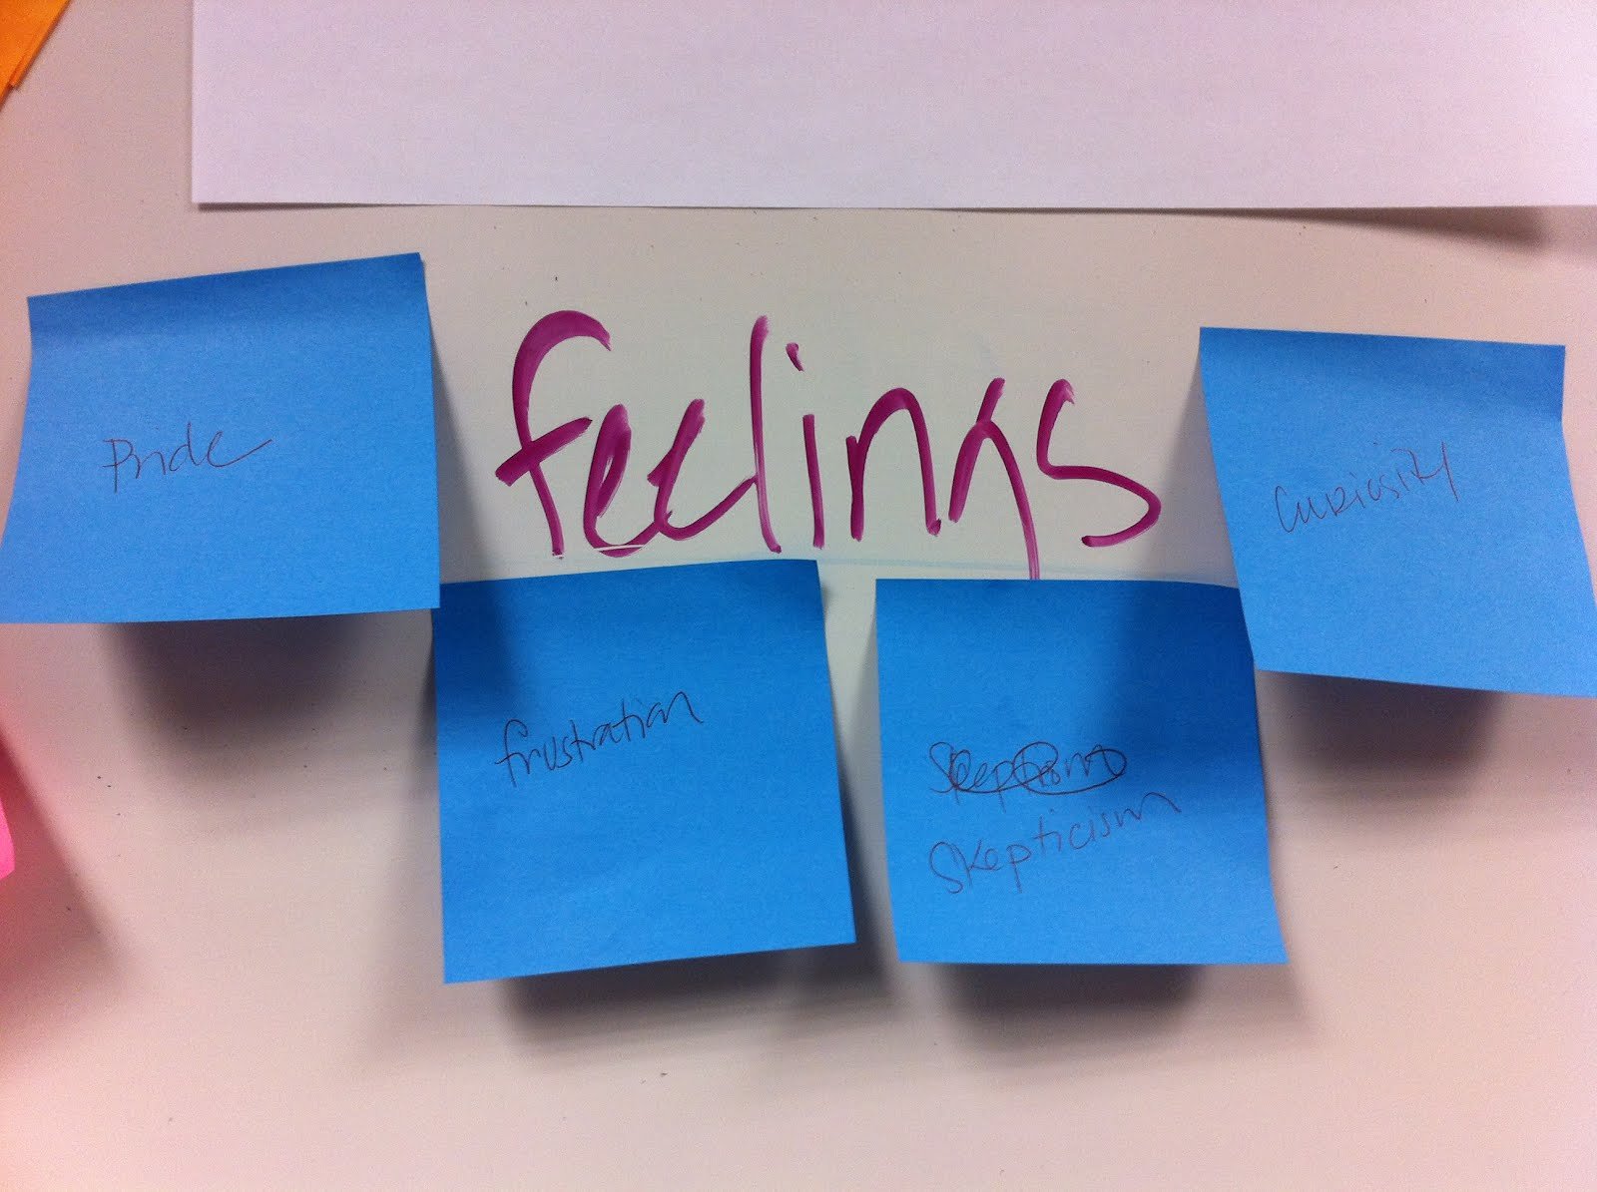

Slide 19
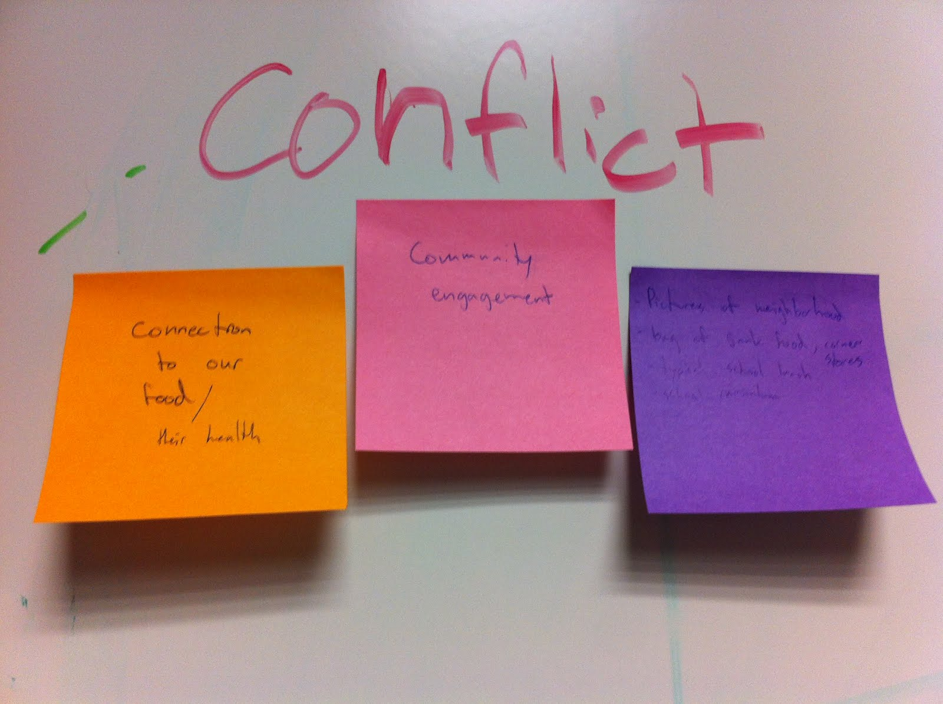

Slide 20
Following a process – even though it may seem formulaic – can reveal new ideas and spur creativity.

Slide 21
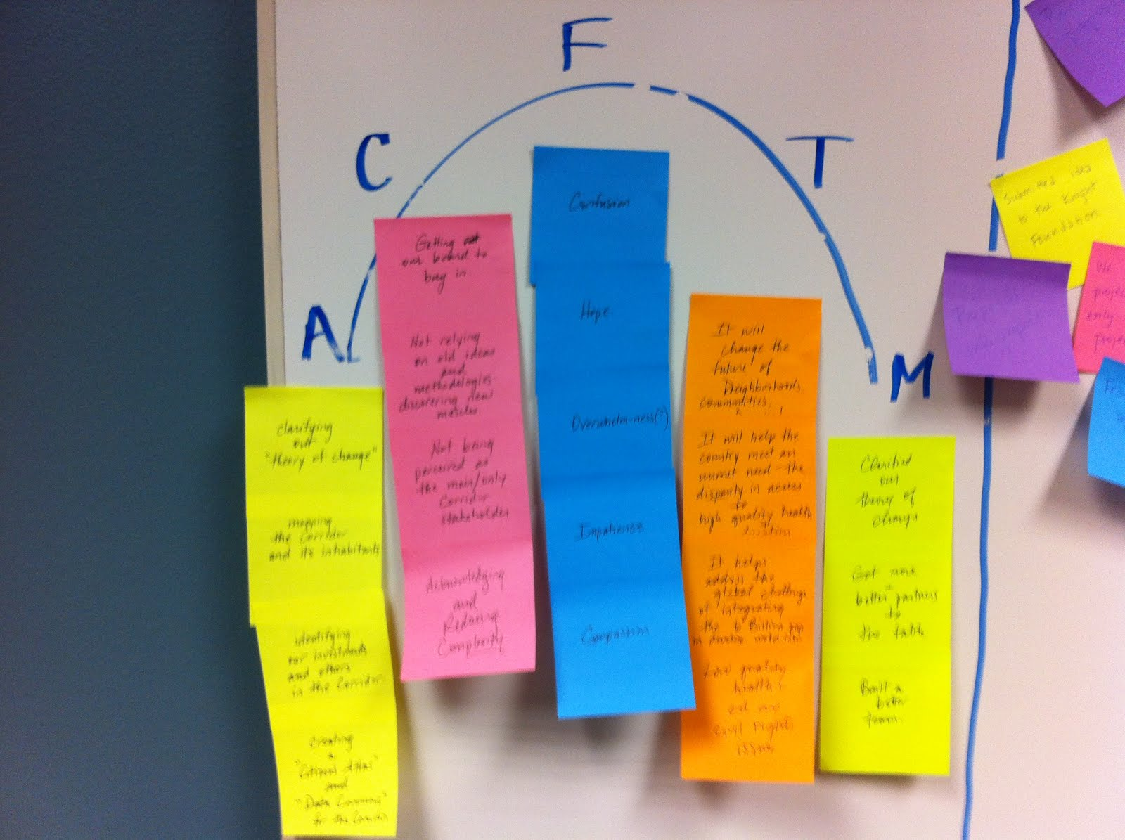

Slide 22
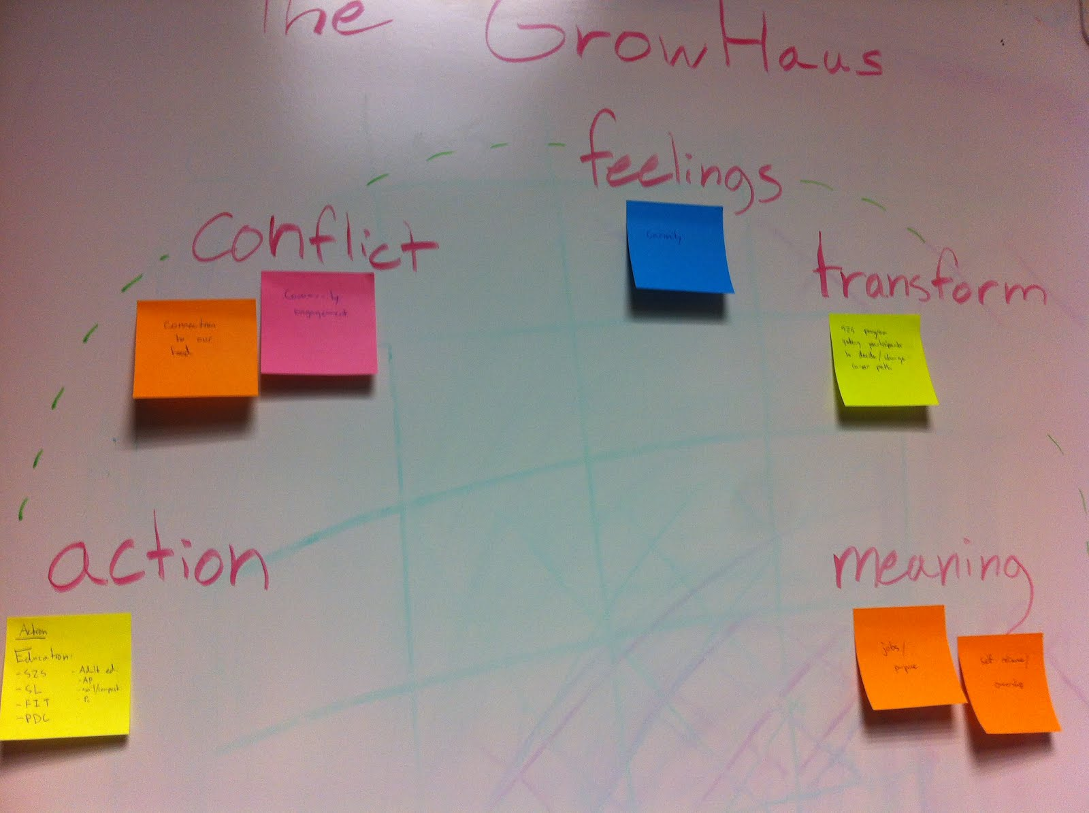

Slide 23
What did we learn?
We all have more stories to tell than we might think. Just because a project isn’t “finished” doesn’t mean it isn’t a great story.
For experienced storytellers, distribution is often the biggest challenge. Think about a story that’s sharable.
The hardest, and most useful, exercise was to describe your work into a single sentence. “I would have written a shorter letter, but I did not have the time.” – Mark Twain

Slide 24
Final Thoughts
Start small. But start somewhere.
Audience. Audience. Audience.
A storytelling project, just like any other project, is slippery and mercurial.
Sometimes, the word “storytelling” turns people off. But that doesn’t mean you have to stop doing it.
Appropriate technology storytelling technique.
Resource list: http://bit.ly/Hgw1JV

