Slide 1
From Information to Action: Introduction to NNIP for the Urban Waters Network
KATHY PETTIT
JULY 9, 2015

Slide 2
Urban Institute
Urban is dedicated to elevating the debate
on social and economic policy through
rigorous research and engagement.
We believe in the power of evidence to improve lives by
Reducing hardship amongst the most vulnerable
Expanding opportunities for all people
Strengthening the effectiveness of the public sector
Notes:
Urban was started in 1968 to be an outside evaluator for War on Poverty programs. Today, we do a broader array of research for governments and foundations - our work is grounded in our original research.

Slide 3
NATIONAL NEIGHBORHOOD INDICATORS PARTNERSHIP (NNIP)
Collaborative effort since 1995
Urban Institute & local partners; now 30 cities
All partners build and operate neighborhood level information systems using local data
Success based on:
Trusted and engaged institutions
Relevant and high-quality data
Mission to support use of data for local action
Notes:
Talk through slide
Three necessary components to success (e.g. three-legged stool)

Slide 4
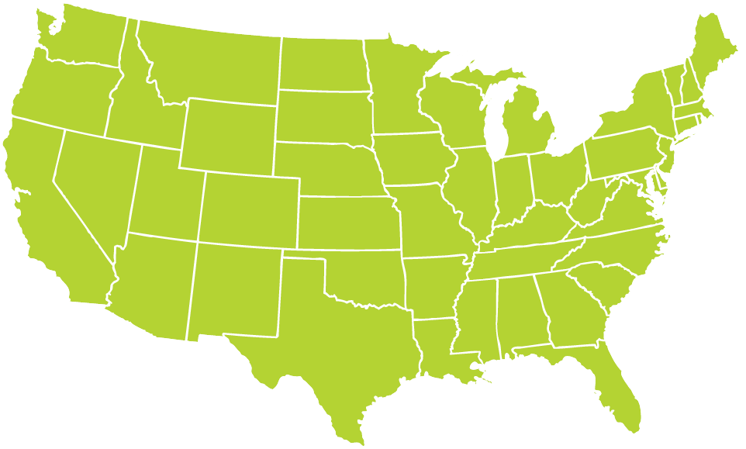
NNIP Partners
http://www.neighborhoodindicators.org/partners/profiles
Notes:
NNIP partner organizations in over 30 cities.
I’ve added a link to the partner organizations.

Slide 5
TRUSTED AND CONNECTED INSTITUTIONS
Notes:
Grown from 6 founding partners to more than 30, and more on the way
The partners are housed in various types of institutions –universities, independent nonprofits, local funders.
But whatever the home, they are all respected organizations with a long-term stake in their community.
They are viewed as neutral - not tied to any one political agenda or issue area.
Data providers are confident that confidential data will be handled properly, and audiences are confident of the rigor of the analysis.
Since they are on the ground, they can be responsive to community needs and emerging issues [give example]

Slide 6
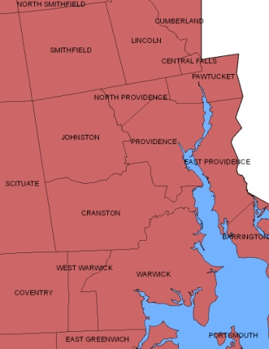
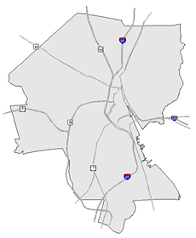
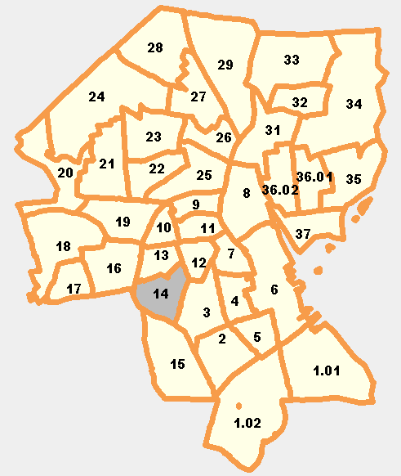
RELEVANT AND HIGH QUALITY DATA
Types of Data
Education
Child care
Births, deaths
TANF, Food Stamps
Health
Crime
Property sales, prices
Foreclosures
REGION
CITY
NEIGHBORHOOD
PARCEL
TRACTS
Notes:
Basic requirement for partners - Assemble, transform and disseminate data
NNIP would not be possible without access to local data. Local data is more impt than ever as the Census has switched from the long-form every 10 years to the 5-year averages and less precise American Community Survey.
And the ability to cover many issues is critical: residents don’t experience their community in silos and the solutions aren’t siloed either. (obesity example?)
Not just one-time project, but formal agreements to get the data recurrently to be ready when need for data arise
Neighborhood-level is key since problems are not evenly distributed across cities and priority issues vary across neighborhoods.
The partners collect data once from police, schools, health department; and add value by clean the data; and develop ngh-level indicators.
Result is a one-stop shop that is a flexible resource for the whole community – much more cost-effective than each nonprofit group trying to do it themselves. There is an economy of scale.
This part is hard work and the systems are built incrementally. Perspective of investment in infrastructure – which requires commitment from partner org and their funders to grow and support the systems over time.

Slide 7
MISSION: DATA FOR LOCAL ACTION
Democratize Information
Facilitate the direct use of data by stakeholders
Serve multiple audiences and purposes
But a central focus on strengthening and empowering low-income neighborhoods
Use information to promote collaboration
Acts as a bridge among public agencies, nonprofits, businesses, resident groups
Notes:
Principles and values: The motivation for all the hard work of compiling the data is to get it used - whether for policymaking, community building, program planning.
The founding NNIP partners recognized that not everyone had equal access to information.
Focus started on and still in on low-income nghs that have traditionally not had access to data or skills to use it.
but we found that as NNIP partners matured they were also needed to help citywide nonprofits and even gov’t agencies find and use the data in their work.
Some of the most compelling stories are where data has been used to break down silos – among agencies, sectors, geographies.
Data brings people to the table to develop a common understanding of the issues, and new solutions emerge.
Example: School Readiness project – health care providers , day care and early education providers, public school system, child advocates, family support services. Gather data and indicators about young children in the community and bring everyone to the same table to help improve outcomes for the kids.

Slide 8
NETWORK ACTIVITIES
Advance the state of practice
Inform local policy through cross-site projects
Share lessons through tools and guides
Build/strengthen local capacity
Support NNIP capacity in new communities
Cultivate the partners’ peer learning network
Influence national context/partnering
Provide leadership in building the field
Notes:
So that is how the local partners work – what do we do together and how does Urban Institute fit in?
The Urban Institute, a nonpartisan research organization, coordinates the NNIP network. The Institute brings decades of expertise in social and economic policy analysis. Data and evidence are at the heart of the organization’s mission.
Through the network, NNIP partners share what they know, learn from each other, and uncover new ways to revitalize neighborhoods and improve lives.
Together, the partners are an amazing network for peer learning. Rich base of knowledge to draw from - allows new partners or existing partners tackling new issues to get a jump start from others’ past experiences.
The network also advises other cities interested in the NNIP model and carries out multi-city action projects to dive into selected topics.
The Annie E. Casey Foundation and the John D. and Catherine T. MacArthur Foundation are the major foundation partners of the NNIP network.

Slide 9
Baltimore Data and Mapping Collaboration

Slide 10
Baltimore Green Registry http://water.bniajfi.org/
Collaboration of Baltimore Neighborhood Indicators Alliance (BNIA) and Baltimore Urban Waters Partnership
BNIA: interested in developing indicators of sustainability for Vital Signs community indicator project and policy tracking
Urban Waters: interested in help with assembling primary data and in neighborhood context
Notes:
Thanks to Mike Galvin for suggesting this and to Seema Iyer from BNIA for helping me plan this presentation
Mike can chime in with comments too ….
http://water.bniajfi.org/

Slide 11
Sustainability Topic Areas
Community-managed open space
Where are the locations of CMOS in the City?
Stormwater management sites
Where are stormwater management sites with potential for interventions?
Urban trees
Urban forest
Urban agriculture
Notes:
Open space – combined data from several community groups into 1 database
Check on website
Clean and Green
Mixed Greens
Neighborhood Park
Green Parking

Slide 12
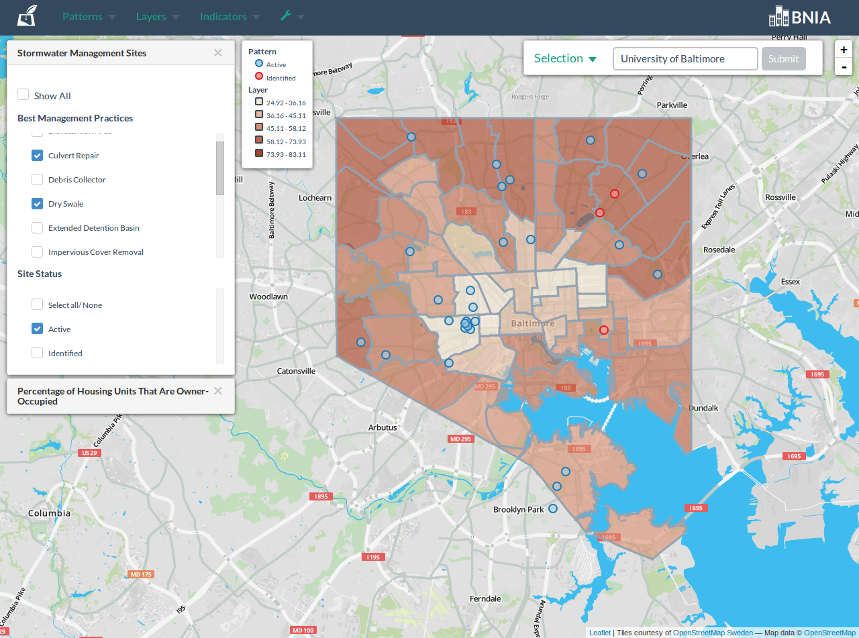
Baltimore Urban Waters
Notes:
Hot off the presses – shows interventions along a thematic map with a variety of ngh characteristics

Slide 13
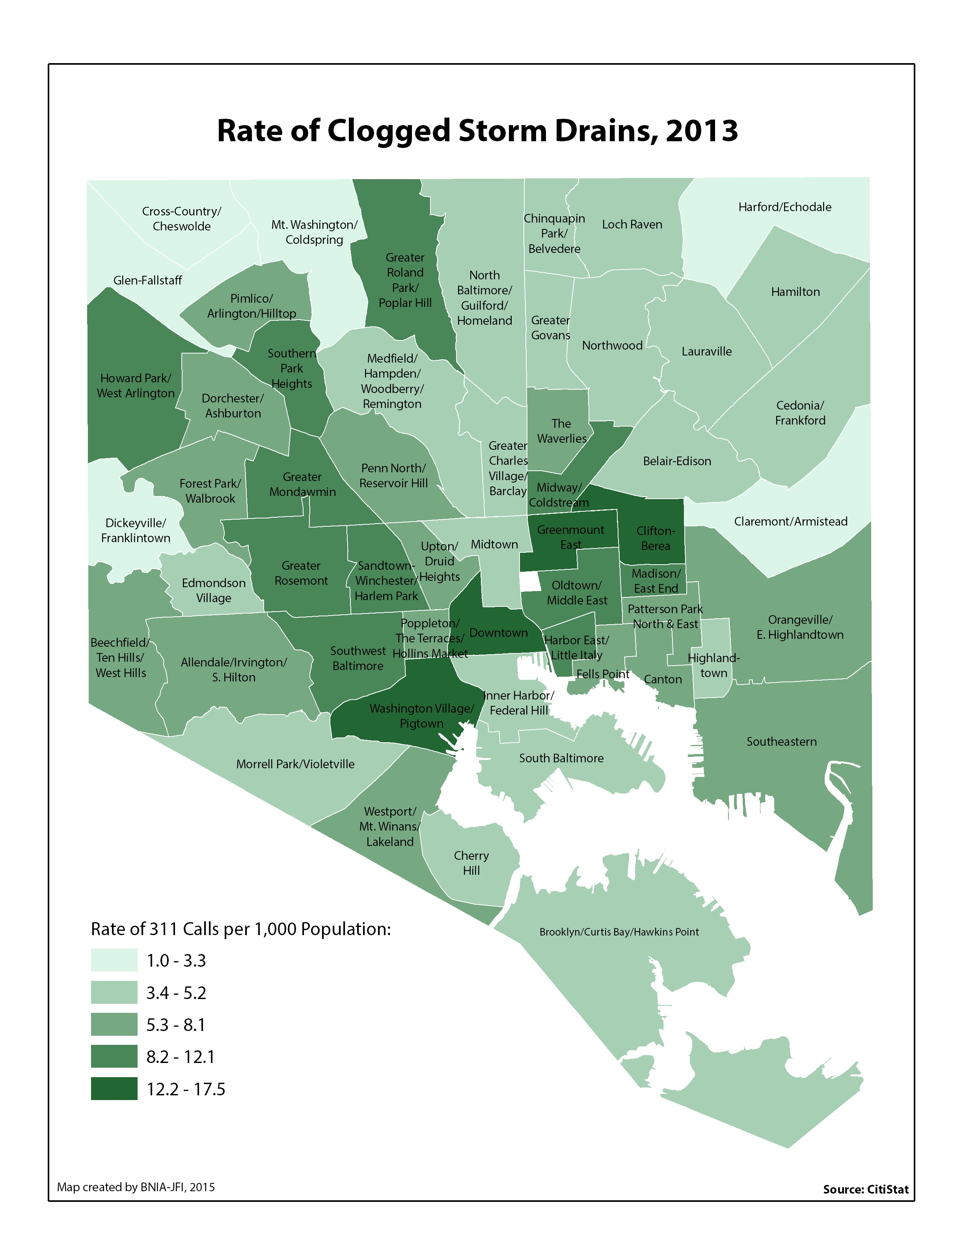
Baltimore Urban Waters
Notes:
From Vital Signs gallery
Vital Signs is a community Frame, Choose, and Track Community Goals
Ensures that environment is viewed as a key component of quality of life

Slide 14
Examples from other cities

Slide 15
Charlotte Quality of Life Explorer http://mcmap.org/qol/

Slide 16
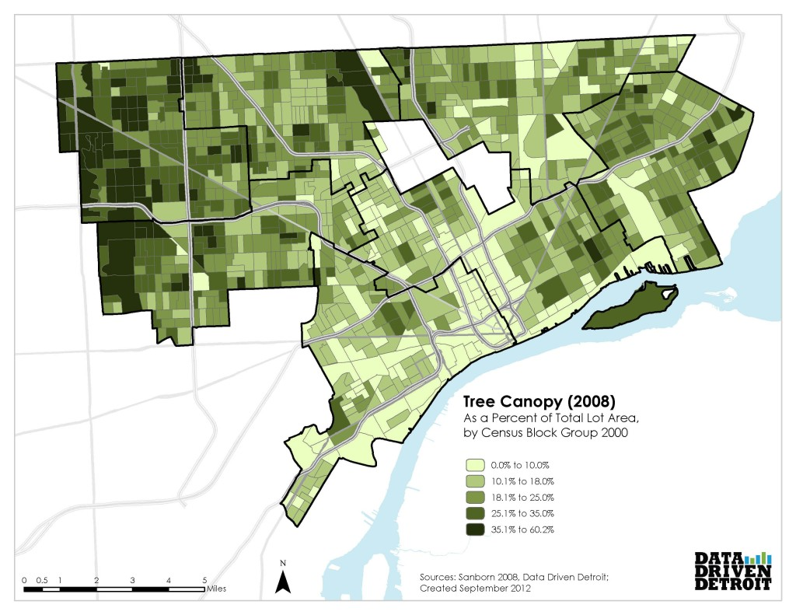
Baltimore Urban Waters
http://detroitenv.org/read-the-report/
Notes:
The Detroit Environmental Agenda is a bold environmental vision for the city of Detroit that captures both our challenges and our progress on key environmental issues. Data Driven Detroit has partnered with Detroiters Working for Environmental Justice, Great Lakes Bioneers Detroit, the Michigan Environmental Council, the Michigan Trails & Greenways Alliance, Recycle Here, Southwest Detroit Environmental Vision, WARM Training Center, and Zero Waste Detroit to provide data and technical support to the outreach and engagement process occurring through the end of 2012. The data, maps, and links below begin to paint a picture of how a safe, clean, and prosperous Detroit requires a healthy environment. As the outreach process moves forward, Data Driven Detroit will work with the Environmental Agenda to develop a list and “dashboard” of environmental indicators to help set a baseline, measure, and track progress for the state of Detroit’s environment

Slide 17
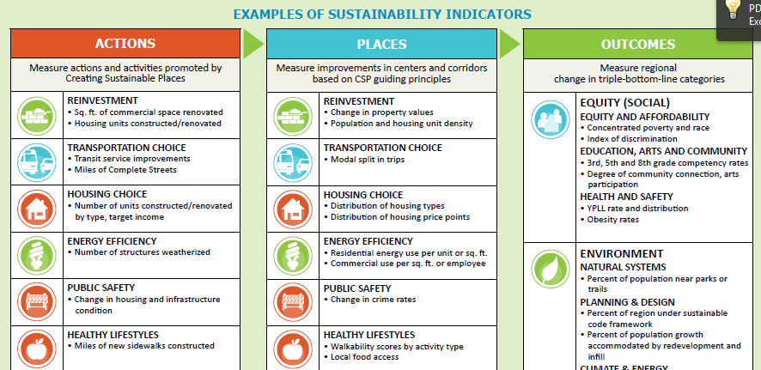
Identify & Measure Program Outcomes
Source: Mid-America Regional Council
Notes:
Example from one of our Kansas City partners – MARC (Mid-America Regional Council)
HUD-DoT Sustainable Communities grantee unusual in that the partner themselves are developing the program as well as the data/analysis in-house
Chose 6 commercial corridors; tied to transit improvements. Integrating regional and local perspective.
This is from Implementation Guidebook, which identifying indicators and outcomes for their initiaative – reflects a broader trend of emphasis on outcomes.

Slide 18
Select target service areas
Notes:
Credit the Pittsburgh Neighborhood and Community Information System
Alan Sisco at Rebuilding Together
Operation Urgent Care provides free home repair services to elderly homeowners in Allegheny County.
First used census data to decide which broad areas they would focus on (income and home value). One of the chosen areas was the Eliot neighborhood.

Slide 19
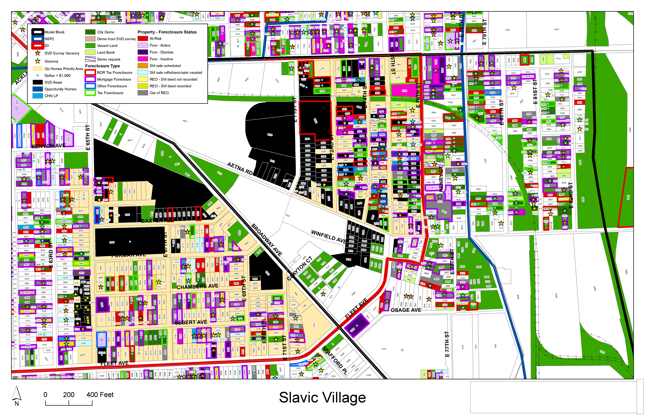
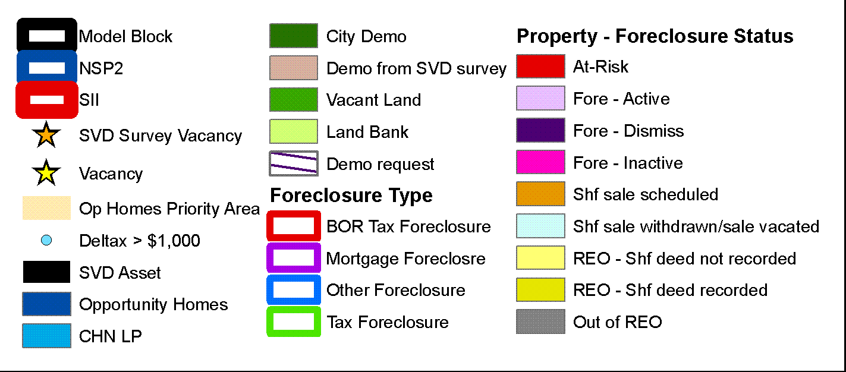
Inform community development decisions
Source: Center on Urban Poverty and Community Development, Case Western Reserve University
Notes:
This example is from one of our founding partners in Cleveland, the Center on Urban Poverty and Community Development at Case Western Reserve University.
The Neighborhood Stabilization Team in Cleveland makes use of data from Case Western’s NEO CANDO – North East Ohio Community and Neighborhood Data for Organizing – System.
Pull together parcel level data from many different sources from the assessors office, the court system, vacancy data and original data collection, neighborhood amenities, etc.
This data can zoom down to the block and to the parcel and zoom up to look at trends and the bigger picture.
It helps the team figure out which properties make for strategic interventions with their limited resources– whether helping homeowners to find foreclosure counseling or making sure vacant properties are maintained and boarded up to fight blight and cut down on spillover effects to other properties.

Slide 20
POTENTIAL WAYS OUR NETWORKS CAN HELP EACH OTHER
NNIP can highlight the importance of environment in neighborhood quality of life
Urban Waters can highlight the benefits of examining neighborhood context
Help disseminate events and local examples across networks
Connect existing partners locally
Recruitment of new partner cities
Notes:
Principles – bullets 1 and 2
Note – just like in your network – partners have different strengths and interests, but connecting to learn more about each other is a good idea
Common sites: Atlanta, Baltimore, Boston, Denver, Grand Rapids, Kansas City, New Orleans, New York, Philadelphia, San Antonio, Seattle, Washington, DC

Slide 21
OTHER RESOURCES
National websites
PolicyMap: www.policymap.com
Community Commons: http://www.communitycommons.org
Tackle the data yourself or with your local research partners
Small-Area Data List: http://www.neighborhoodindicators.org/library/catalog/list-national-data-sets-small-area-data
Notes:
Either way,
Encourage you to get started in whatever way is appropriate for your organization.

Slide 22
CONNECT WITH NNIP
Follow us on Twitter @NNIPHQ
Join NNIPNews
Public listserve about neighborhood revitalization and data
Visit the NNIP Website
www.neighborhoodindicators.org

Slide 23
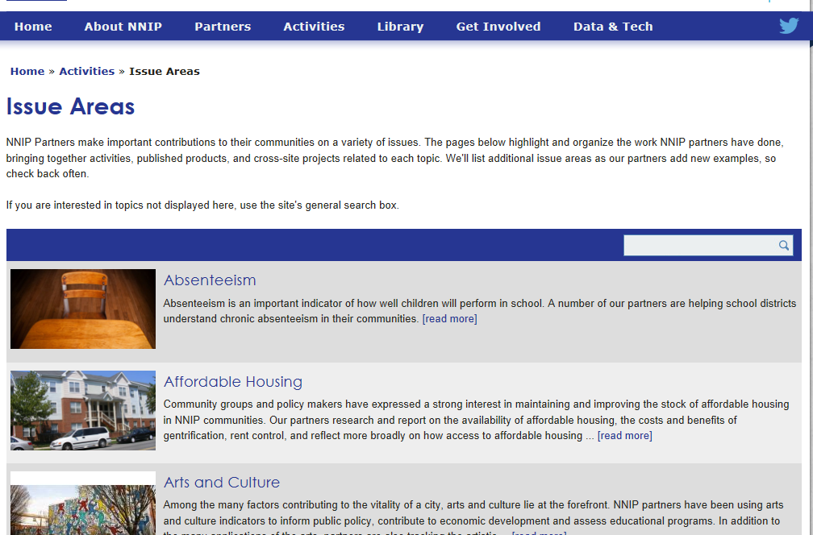

Slide 24
For more information about NNIP, visit www.neighborhoodindicators.org or
email Kathy Pettit at kpettit@urban.org

