Slide 1
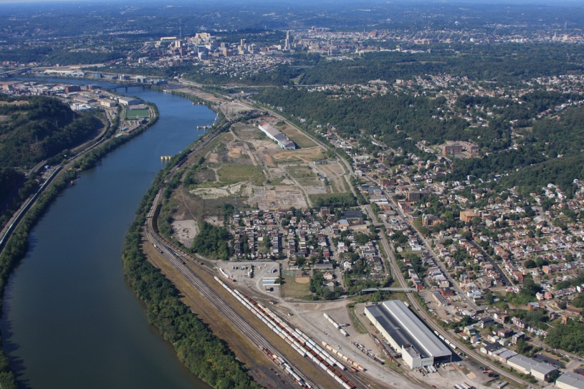
Pittsburgh Neighborhood and Community Information System
Sabina Deitrick, PhD
University Center for Social and Urban Research
University of Pittsburgh
Urban Affairs Association
April 4, 2013

Slide 2
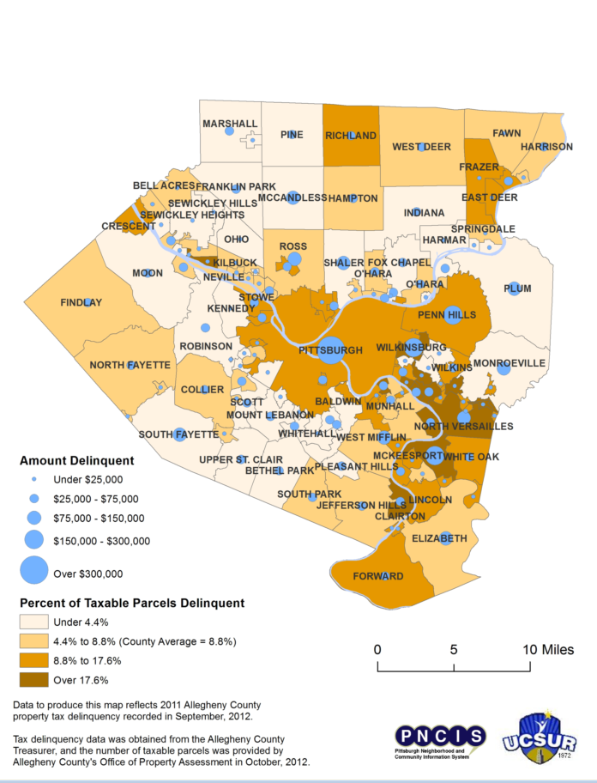
New directions
Expand geography
Move to suburbs of Allegheny County
Common issues across municipalities with blight, foreclosures, tax delinquency
Better coordinated information through community profiles and community surveys
Expand open data

Slide 3
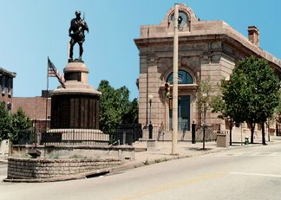
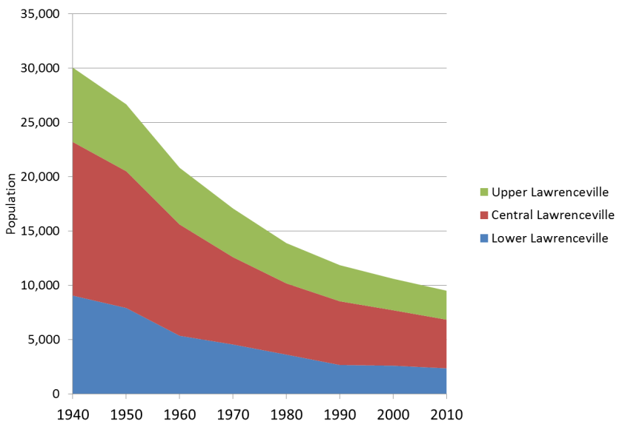
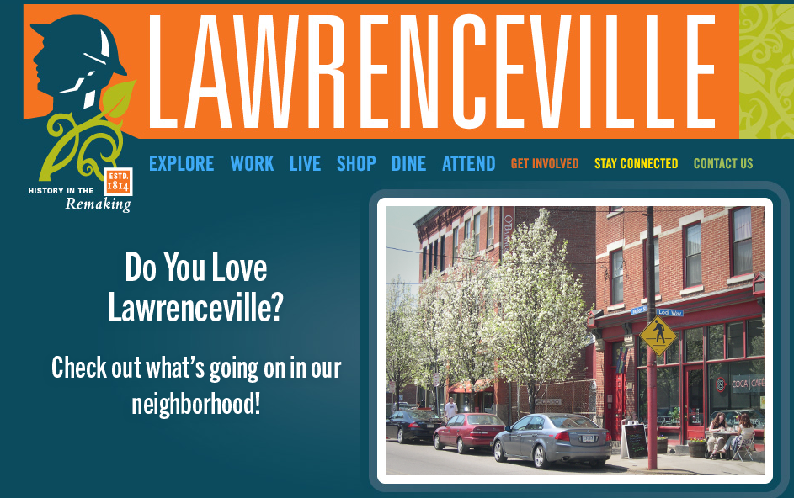
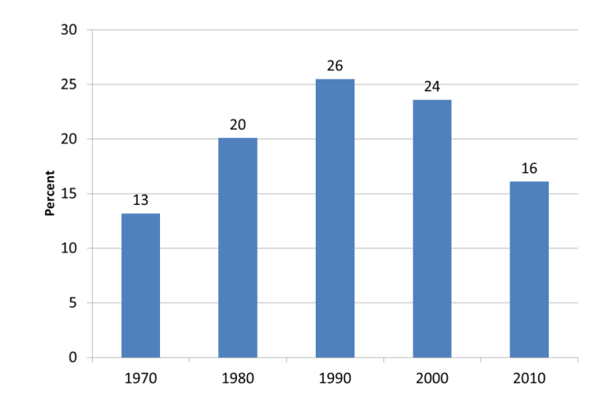
Lawrenceville Population 1940-2010
Community profiles –
The Lawrenceville neighborhood: Population loss, aging in place
and community development
Upper
Central
Lower
Percent of Population Age 65+, 1970-2010

Slide 4
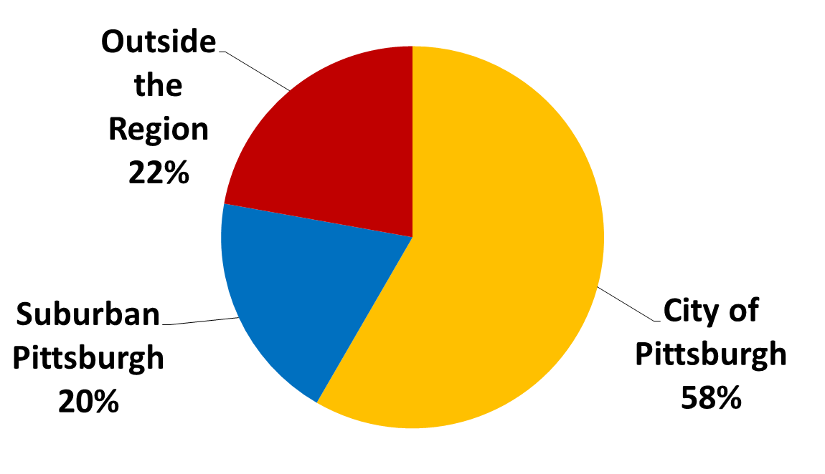
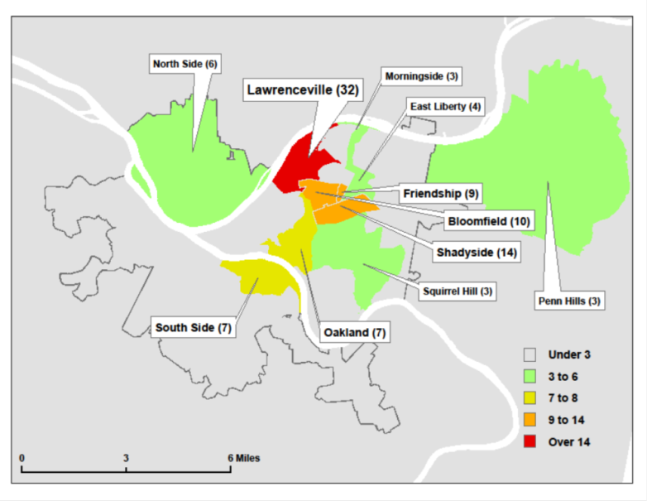
Neighborhood surveys -- Lawrenceville

Slide 5
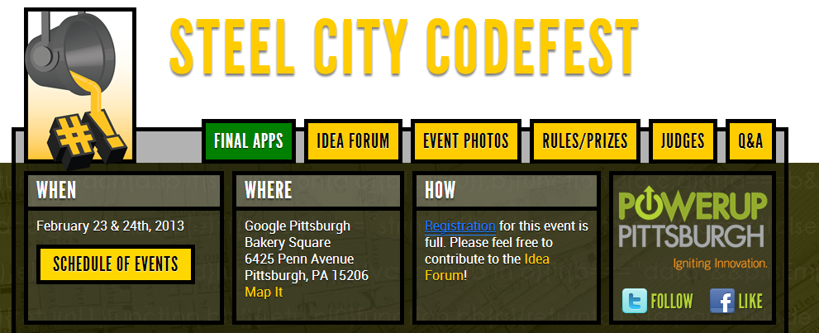
Steel City Codefest – February 24 – 25, 2013
Community development issues of residents
City of Pittsburgh, Google, University of Pittsburgh, Carnegie Mellon University and others
Lots of interest and lots of involvement
Next steps

