Slide 1
Building Community Capacity: Emory’s Place-Based Approach to Community Engagement
Meetings of the National Neighborhood Indicators Partnership October 20-22, 2010 – Oakland, CA
Michael J. Rich Emory University Associate Professor of Political Science and Director, Office of University-Community Partnerships Phone: (404) 712-9691 Email: mrich@emory.edu

Slide 2
Functions of NNIP Partners
To become an NNIP Partner, an institution must demonstrate that the following are central to its mission: (1) building and operating an advanced information system with integrated and recurrently updated information on neighborhood conditions in its city; (2) facilitating and promoting the direct practical use of data by community and city leaders in community building and local policymaking; and (3) giving emphasis to using information to build the capacities of institutions and residents in distressed neighborhoods.

Slide 3
Capacity Building
Community capacity is the interaction of human capital, organizational resources, and social capital existing in a given community that can be leveraged to solve collective problems and improve or maintain the well-being of that community. It may operate through informal social processes and/or organized efforts by individuals, organizations, and social networks that exist among them and between them and the larger systems of which the community is a part.
Chaskin, Brown, Venkatesh and Vidal, Building Community Capacity, p. 7.

Slide 4
Dimensions of Capacity Building Community capacity is dynamic and multidimensional
Chaskin et al, Building Community Capacity, p. 12.

Slide 5
Building Capacity through Information
“Neighborhood leaders need to learn how they can use information to make more effective decisions in most of their activities.”
Understanding their neighborhood(s) dynamics
Preparing comprehensive neighborhood plans
Developing strategic plans for their organizations
Designing specific projects or initiatives
Making the case to funders and/or collaborators
Monitoring their activities
Program assessment
The Role of NNIP in Building Community Capacity, Draft, October 2010

Slide 6
NNIP Strategies for Building Capacity
Traditional training—illustrate use of data in curricula
Direct “hands on” work with neighborhood stakeholders
Help create NEW data to make informed decisions

Slide 7
Panel Overview
Two presentations to illustrate approaches
Michael Rich, Emory University, Atlanta
Peter Eaton, University of Missouri at Kansas City
Plenary Discussion
Comments, suggestions on draft concepts
Ideas about promising approaches and tools
Next steps/working group interest

Slide 8
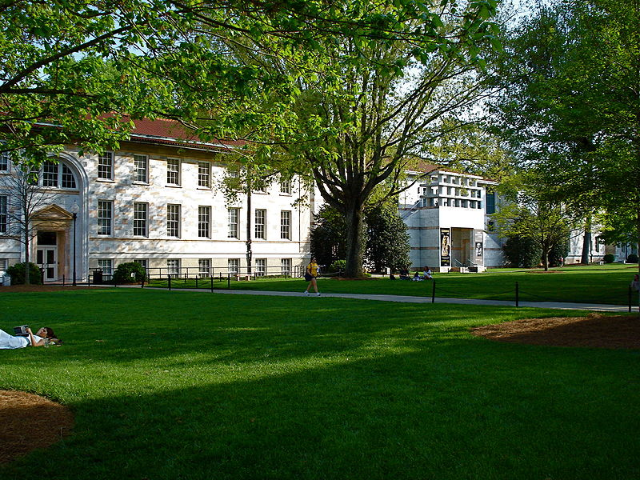
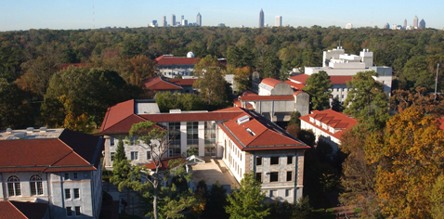
Nine Academic Units
Emory College
Oxford College
Graduate School of Arts & Sciences
Theology
Business
Law
Medicine
Nursing
Public Health
11,600 students
6,285 undergraduate
5,315 graduate and professional
19,300 employees
2,700 faculty
Economic impact
$1.3 billion spent each year in Atlanta--$3.4 billion impact

Slide 9
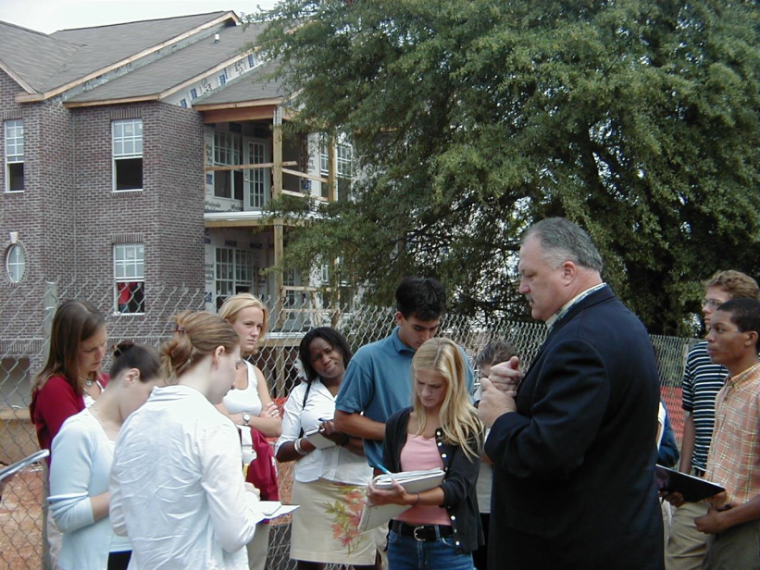
“Communities have problems. Universities have departments.”

Slide 10
Emory’s Foundational Principles for Community Engagement
Integration of teaching, research, and service
Continuum of engagement opportunities
Community is a meaningful partner
Provide a more navigable point of entry
Place-based approach to community engagement

Slide 11
Continuum of Engaged Scholarship
Service for Learning
Volunteerism
Introductory
Exposure
Immediate
Time-Action
EXPERIENCE
Connecting Classroom to Community
Service for Course Credit
Learning
Reflection
Application
UNDERSTAND
Intensive
Scholar-Service
Academic Programs
Structured
Applied Learning
Sustained
Outcomes
ADDRESS
Transformative Community Scholarship
Original Research
Knowledge Creation
Collaborative Process
Impact
TRANSFORM

Slide 12
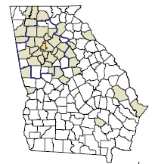
School Partnerships
42 school districts
38 counties
300 + schools

Slide 13
Place-Based Approach to Community Engagement
Engagement is scattered, ad hoc, and disconnected
Engagement is geographically-focused, strategic, collaborative, and cross-disciplinary

Slide 14
Place-Based Strategy Communities

Slide 15
Fostering Coherence and Alignment
Notes:
This is an example of how we leverage the continuum of engagement to address a specific set of issues: preservation of natural resources and sustainable development. This work is made possible by a $1 million grant from The Coca-Cola Foundation

Slide 16
Strategies and Programs
For Community
Training, technical assistance, & capacity building
Neighborhood assessment, strategic planning, program design & evaluation
For Faculty
Training: community-based learning and research
Support: financial assistance for projects
Logistics: matchmaking, transportation, information
For Students
Engaged learning courses
Research opportunities
Fellowships and research support

Slide 17
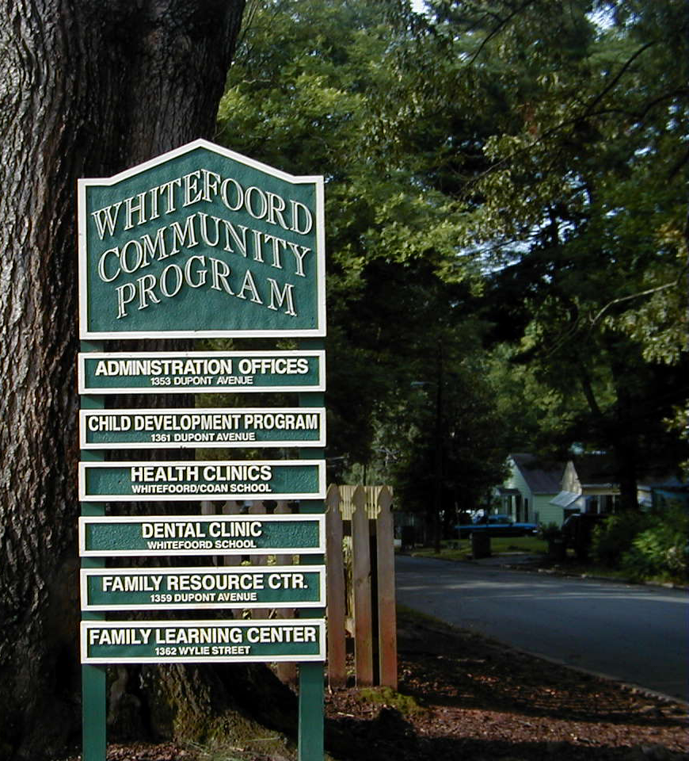
Edgewood Neighborhood Census 2000 Population: 5,224 African American: 92% Owner-Occupied: 39% High School grad+: 58% Poverty: 30%
Capacity Building Illustrations

Slide 18
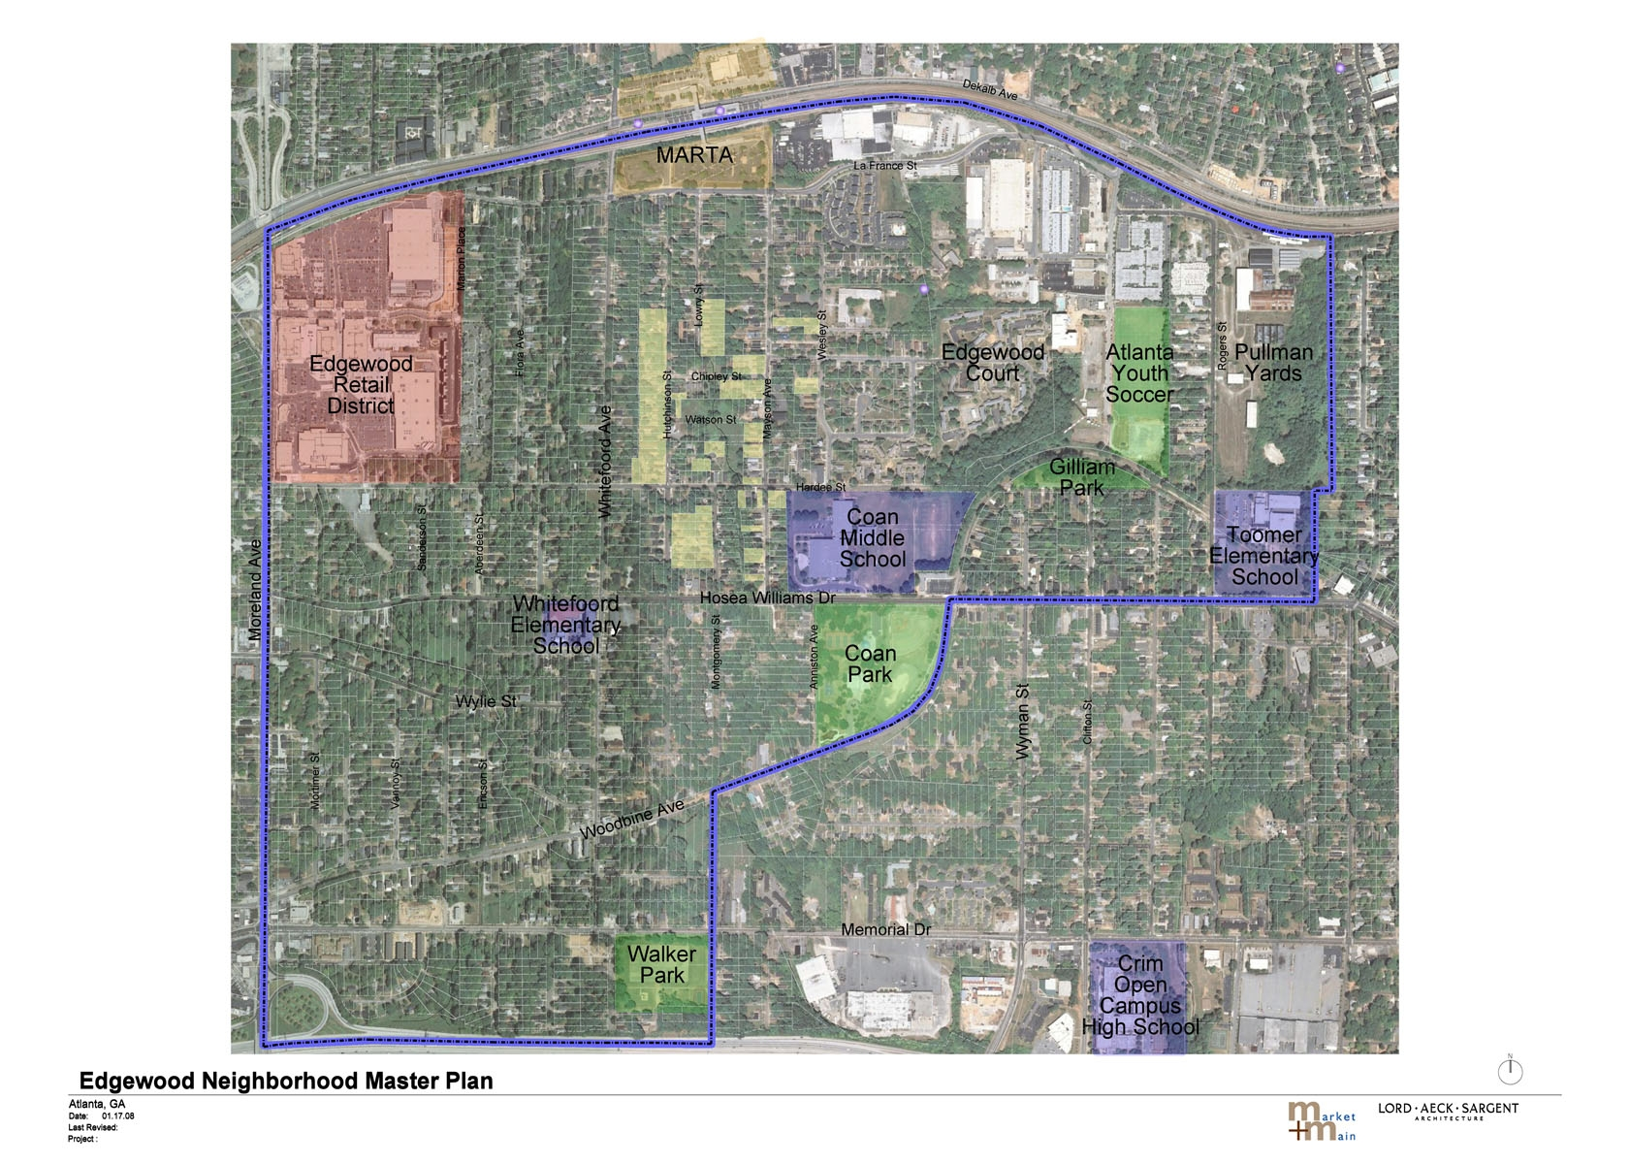

Slide 19
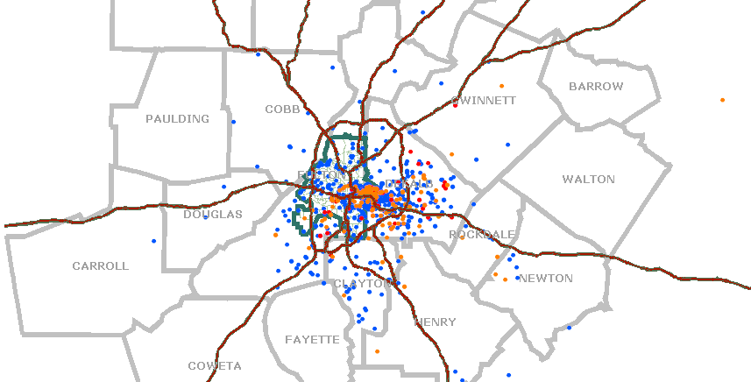
1. Whitefoord Community Program Understanding Service Distribution

Slide 20
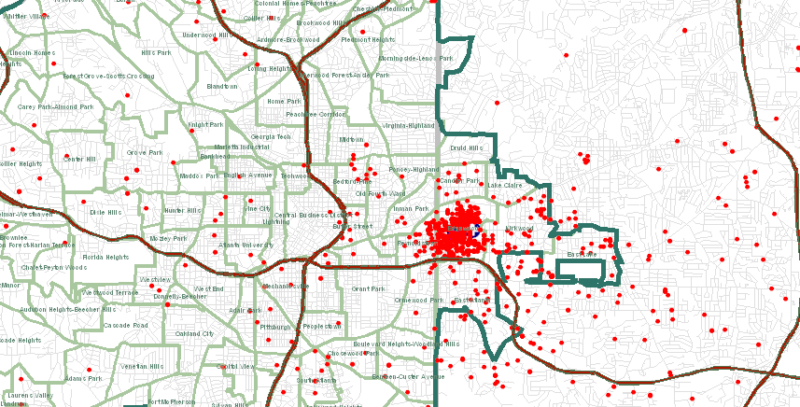
Whitefoord Clinic
N=2,057 64.3% within one mile of site

Slide 21
Whitefoord Clinic Geographic Trends, 2005 - 2007
 | LT 1 mile | 1 – 5 miles | 5 – 10 miles | GT 10 miles
2003 | 76 | 12 | 8 | 4
2004 | 75 | 13 | 7 | 5
2005 | 72 | 15 | 8 | 6
2006 | 65 | 17 | 10 | 8
2007 | 56 | 20 | 16 | 8
2003-2007 | 64 | 17 | 10 | 8

Slide 22
2. Edgewood Neighborhood Survey Understanding the Neighborhood
August – October 2007
Edgewood, Kirkwood, Reynoldstown
Topics included:
Assessment of Edgewood neighborhood
Problems, adequacy of services
Awareness of WCP and programs
Assessment of neighborhood schools

Slide 23
Awareness of programs and services Respondents who had heard of WCP

Slide 24
Awareness of programs and services Respondents who had heard of WCP by distance from WCP

Slide 25
Q6. How adequate is the availability of the following social services in the Edgewood neighborhood?
 | Need for Additional Service
 | None | Low | Moderate | High
Services for the Elderly | 7.9 | 11.4 | 19.6 | 61.1
After School Programs | 11.4 | 10.6 | 21.2 | 56.8
Safe Houses & Shelters for Youth | 8.8 | 13.0 | 22.1 | 56.1
Children and Youth Mentoring | 9.5 | 12.8 | 22.3 | 55.3
Computer Literacy Training | 10.5 | 14.6 | 21.3 | 53.6
Fatherhood Programs | 11.3 | 12.6 | 23.0 | 53.1
Parenting Classes | 11.5 | 13.9 | 23.0 | 51.6
Job Training and Job Placement | 11.7 | 15.2 | 21.9 | 51.2
GED & Adult Literacy Instruction | 12.2 | 13.7 | 25.5 | 48.6
Neighborhood Watch Groups | 10.4 | 17.0 | 25.0 | 47.6
Child Care | 12.1 | 15.7 | 27.4 | 44.8
Mental Health Services | 16.9 | 16.5 | 23.6 | 43.0
Healthcare Services for Children | 13.8 | 18.7 | 25.6 | 41.9
Parks, Bike Paths, Playgrounds | 17.1 | 21.4 | 23.1 | 38.5
Dental Services | 14.5 | 19.2 | 27.8 | 38.4

Slide 26
3. Program Evaluation and Design Mayson Avenue Cooperative
Provide Support for Relocated Residents:
-How would residents rate MAC’s relocation services?
-How are families adjusting to their new neighborhoods?
-Do families want to return to Edgewood?
Ensure Voucher Re-certification:
-Are residents employed or enrolled in job training?
-Are residents using MAC’s service providers?
-Are families becoming more self-sufficient?

Slide 27
Highlights of survey findings
Vast majority were satisfied with relocation experience
55% rated very good
33% good
Perceived choices and services received were most strongly associated with satisfaction with relocation process
Vast majority want to return to neighborhood
73% reported they would like to return to Edgewood

Slide 28
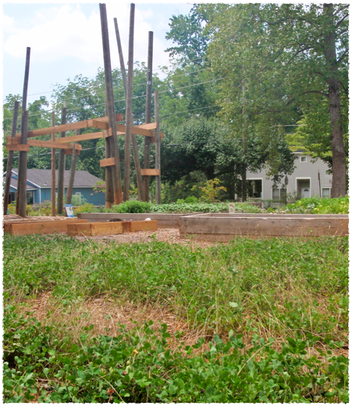
4. Edgewood Community Learning Garden Mid-course Correction and Fostering Collaboration
Issues to Address
Lack of resident awareness and participation in the garden
Widespread environmental knowledge base
Lack of centralized location for garden resources specific to schools
Notes:
Dale
2009 GRANT - FISKARS - BEDS, TOOLS, VOLUNTEERS
MOST GARDENS GET COMMUNITY SUPPORT BEFORE BUILDING
LOTS OF INFO ON THE WEB - HARD TO NAVIGATE IF PUSHED FOR TIME

Slide 29
Project Activities
Listening to residents
Focus groups (residents and stakeholders)
Surveys
Interviews
School administrators
School garden contacts
Teachers
Parents
Community volunteers
Best practices review of school/community gardens
Synthesis and recommendations
Notes:
Keesee

Slide 30
Highlights of Findings
86% of schools have gardens in SRT3; 83% of schools in City Schools of Decatur have gardens
In SRT3, 67% of school gardens were started within the last 2 years
Requests for material to include in the resource guide:
Funding
Programming
Curriculum
Maintenance
Notes:
Dale
NEED FURTHER RESEARCH FOR IT, BUT RESOURCES BECOMING MORE AVAILALBE

Slide 31
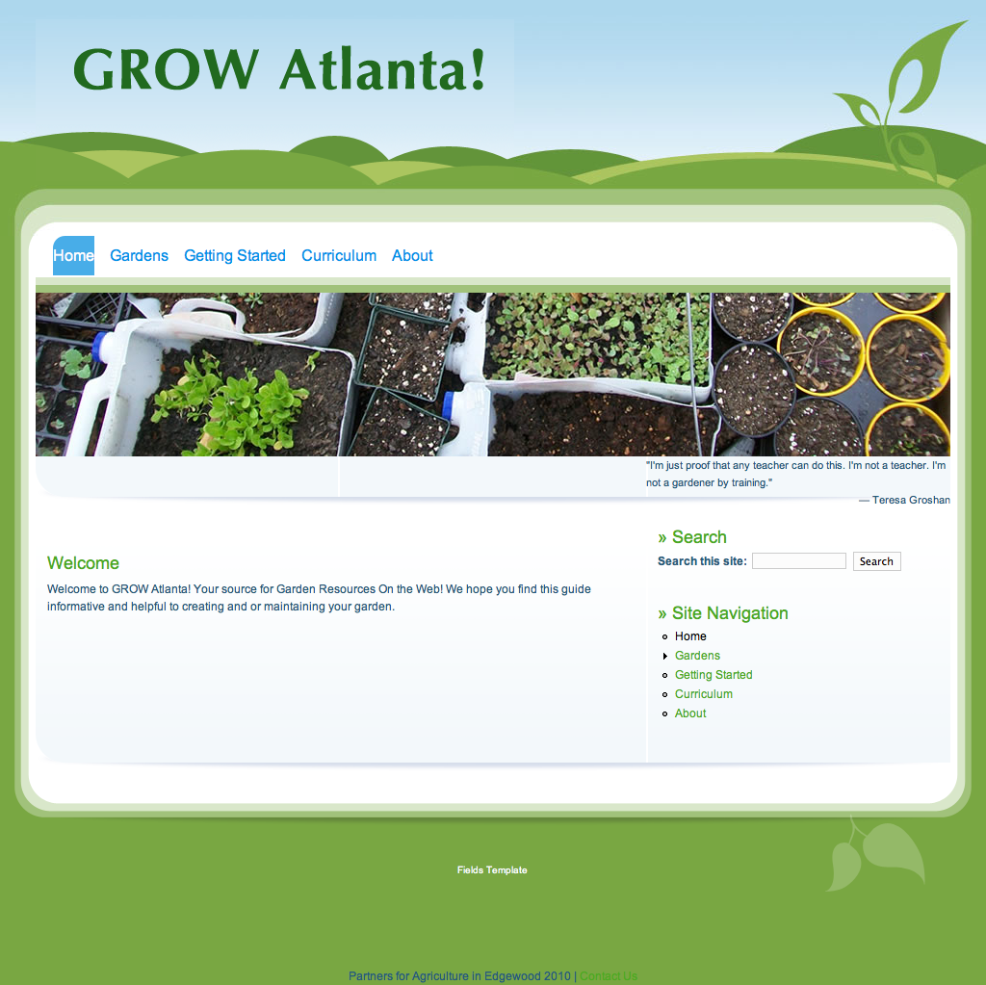

Slide 32
5. Graduation Generation Working Better Together

Slide 33
Overview
School-Family-Community-University Partnership
Foster collaborative, cross-sector, community-based approach to better align resources and efforts in a place-based strategy
Connect school reform and community building
Start in the middle—Coan Middle School
Compliment with APS Middle School Transformation

Slide 34
Evolution
History
Donor interest in school drop-out/high school graduation
Comprehensive effort, inside and outside school
Pilot project to leverage university, CIS
Community input, interest
Proposal/grant agreement
Do and Plan
Emory University Role
“Part of the team and coach”
Neigh assessment/ asset mapping
Process facilitation
Investor/leverage
Tracking and analysis

Slide 35
Community Building
Characteristics of the Community
Characteristics of the Community Building Process
Characteristics of the Community Builders

Slide 36
Collaboration

Slide 37
Summary
The Capacity Building Cube
Roles
evaluation
program design
planning
neigh profile
data access
data making
metro
hands-on work
Geography
city
training
districts
neighborhood
Functions
a capacity building engagement
Place
NNIP Partner
Role
CB function

