Slide 1
Using 2-1-1 data for Community Analysis
December 11th, 2014
Planning Council Presentation Title Here

Slide 2
Bob Waite, Program Director
bwaite@impactinc.org
Virginia Carlson, Data Strategist
vcarlson@impactinc.org
Charts in this presentation were taken from “Leading Indicators, Leading Change,”
which can be found on IMPACT’s website
www.impactinc.org

Slide 3
IMPACT’s mission is to change lives, for good.
helps restore the health and productivity of individuals, organizations and workplaces leading to an improved quality of life for our entire community
has served the community for more than 50 years
Is a regional service provider headquartered in Southeastern Wisconsin

Slide 4
IMPACT’s Family of Services
IMPACT 2-1-1
is a central access point during times of personal crisis or community disaster to get connected to information and assistance.
IMPACT Planning Council
conducts research, evaluates data and convenes stakeholders
to advance community health and human services
Other departments of IMPACT:
IMPACT Workplace Services
IMPACT Alcohol and Drug Abuse Services
IMPACT Awareness

Slide 6
AIRS – Alliance of Information and Referral Systems
AIRS is:
… a professional association of more than 5000 individuals and organizations, supporting 28 state and regional affiliates (chapters)
… the international voice of Information and Referral (I&R)
... the driving force behind the delivery of high quality I&R services
... the sole source for standards, accreditations and certifications for the community information and referral sector
… a leader in the development of the 2-1-1 movement that has transformed access for human services, in partnership with 211US and United Way Worldwide
… a national leader in human services that participates in critical partnerships with the United Way Worldwide, the National Association of States United for Aging and Disabilities, the National Association of Area Agencies on Aging, the National Emergency Number Association, the American Association of Suicidology and InformCanada
... a non-profit organization as determined under section 501(c)(3) of the Internal Revenue Code.
www.airs.org

Slide 7
AIRS - Alliance of Information and Referral Systems
AIRS Standards:
The standards serve as an important foundation for both new and existing I&R services and, from the beginning (1973), have formed the basis of two very important credentialing programs: individual certification and agency accreditation.
www.airs.org

Slide 8
Roles of a 2-1-1 program in the community: Information and Referral –
Bringing people and services together
Information giving
Referral giving
Advocacy
Crisis intervention
Follow-up
Resource Database
Data collection, analysis and reporting
Cooperative program development
Community outreach
Emergency preparedness and disaster response

Slide 9
Touching clients through IMPACT 2-1-1 platform:
State-of-the-art call center- this is where demand data is collected
Staffed by 24 Community Resource Specialists to answer calls in person, plus as many as 12 college interns and several volunteers
Staffing during peak hours (9:00am to 2:00pm) 15 to 25 CRS (including interns and volunteers)
Call-back option
Ability to apply skill-based routing of calls (“queue’s”)
Ability to change “on-the-fly” how calls are routed based call flow
Use of continuous data to make smart decisions for staffing
Scheduling staff with resource expertise
Routing calls

Slide 10
Data collection, analysis and reporting:
Caller Data and Statistics – “Demand”
Demographics:
Age; Gender (Male, Female, Transgender); Ethnicity; Primary Language
ZIP Code (often the basis)
Municipality
County
State
Other items as needed and required
AIRS Standard 13:
Inquirer(caller) data collection and reporting activities facilitate the analyses needed to support:
The human service needs of inquirers
Community needs assessment
Community planning
Allocation of funding
Research
From: AIRS Standards, Version 7.0 – Revised March 2013

Slide 11
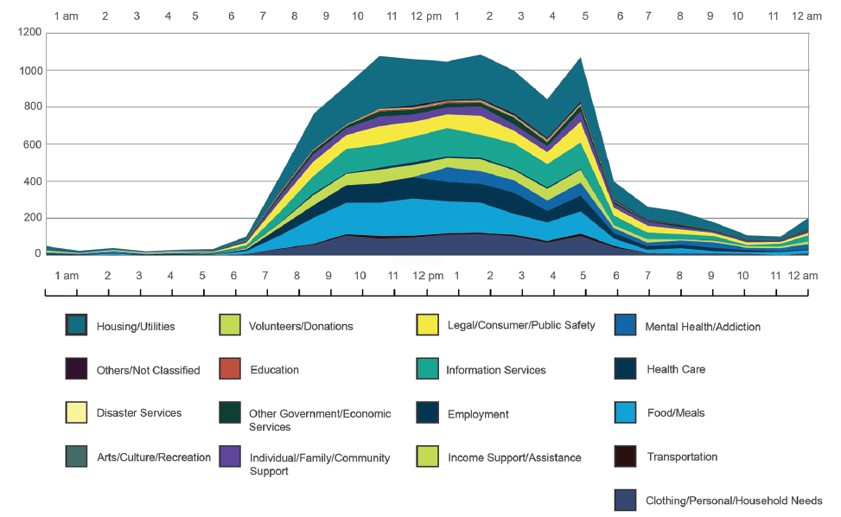
Twenty-Four Hours of IMPACT 2-1-1 Calls:
This chart was generated from data covering the time period from February 17 to March 16 of 2013.
See http://www.impactinc.org/news-reports/reports/impact-2-1-1-reports/ for IMPACT 211 Ten-Year Report

Slide 12
Demand data collected by IMPACT 2-1-1, 2003- 2012, shows that calls for “Basic Needs” are on the rise

Slide 13
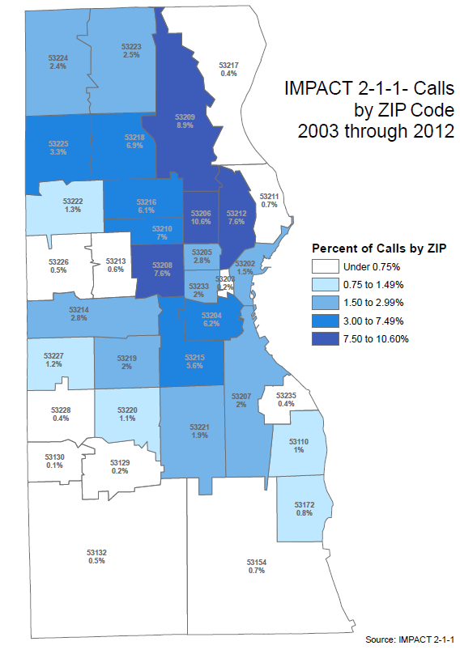
Where were the calls coming from?
This map of Milwaukee County shows the location of “high-need” ZIP codes over a decade.

Slide 14
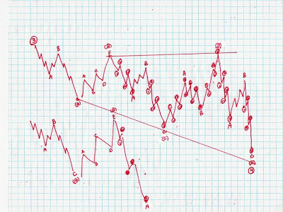
What we are able to do with the data:
Track basic rises and falls for service needs
Track unmet needs and gaps in service
Create special reports for foundations, university research, government, collaborative partners, etc.

Slide 15
Call Volume: 2002 to 2014
Call volume fluxes with number of employees taking calls in the call center
Year | Number
2002 | 58,106
2003 | 79,182
2004 | 89,741
2005 | 111,798
2006 | 122,640
2007 | 120,192
2008 | 130,083
2009 | 141,625
2010 | 137,388
2011 | 119,891
2012 | 143,731
2013 | 145,141
2014, so far | 141,317
Total | 1,540,835
Notes:
Bob: talking points: gradual uptick, then back down; why big slump in 2011?

Slide 16
Contacts:
January to November 2014
Total Calls for Year | 141,317
Online Database contacts | 92,546
Total Contacts | 233,863
Notes:
Question for Bob- How is an online database contact measured? Is it a search, or is it a page view on the refernet page?

Slide 17
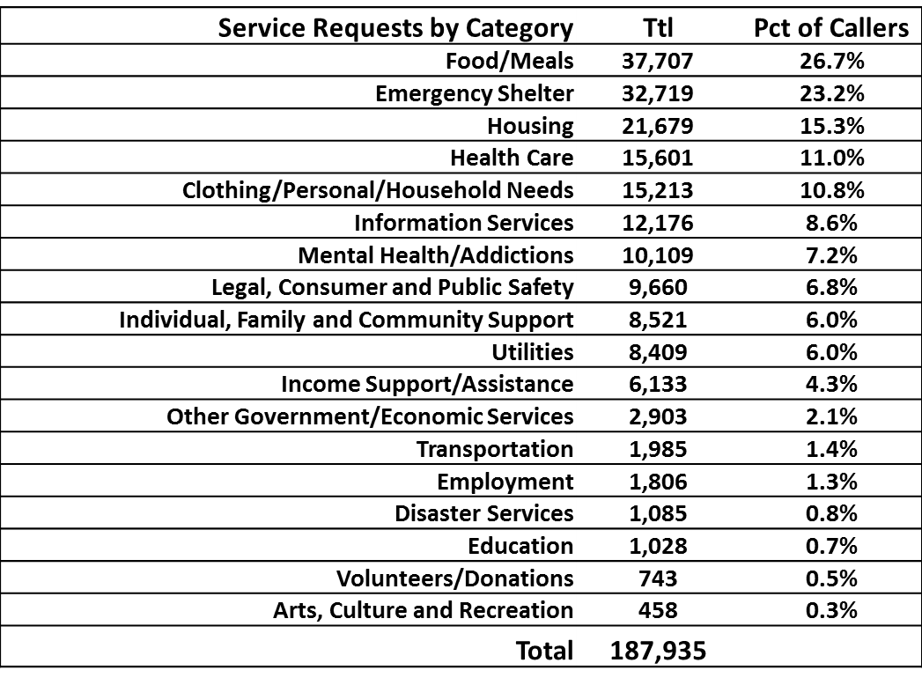
What are our customers calling about?
January – November 2014
Notes:
Question for Bob- which of these categories fit into “basic needs?”

Slide 18
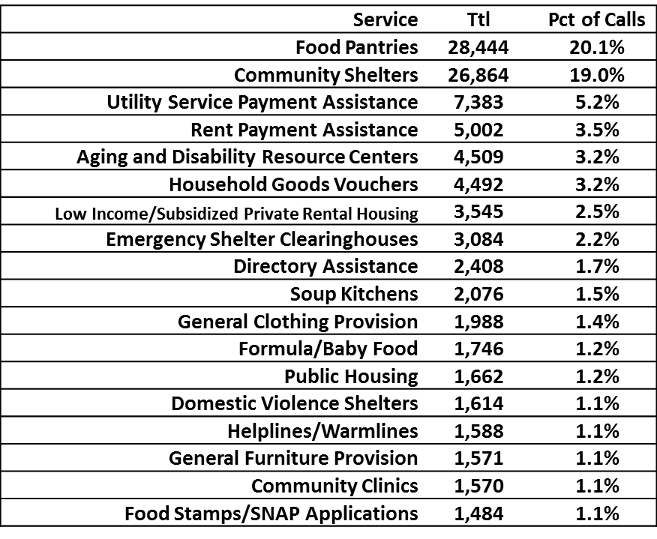
What are our customers calling about?
January – November 2014 (subcategories)

Slide 19
Milwaukee County ZIP Codes
 | January - November
 | Yr 2008 | Yr 2009
ZIP | Calls | Calls | Pct Chg
53217 - Whitefish Bay, Fox Point, Bayside | 354 | 551 | 55.6%
53132 - Franklin | 459 | 702 | 52.9%
53154 - Oak Creek | 716 | 1,045 | 45.9%
53129 - Greendale | 248 | 357 | 44.0%
53226 - Wauwatosa | 482 | 668 | 38.6%
53219 - West Allis | 1,991 | 2,748 | 38.0%
53130 - Hales Corners | 134 | 184 | 37.3%
53172 - So. Milwaukee | 827 | 1,093 | 32.2%
53110 - Cudahy | 1,149 | 1,457 | 26.8%
53211 (East Side/Shorewood) | 710 | 897 | 26.3%
53220 | 1,134 | 1,406 | 24.0%
53222 | 1,340 | 1,608 | 20.0%
53228 - Greenfield | 412 | 488 | 18.4%
53207 | 2,212 | 2,608 | 17.9%
53223 | 2,636 | 3,079 | 16.8%
53221 | 2,180 | 2,502 | 14.8%
53227 - West Allis/Milwaukee | 1,211 | 1,387 | 14.5%
53214 - West Allis/West Milwaukee/Milwaukee | 3,330 | 3,799 | 14.1%
53215 | 6,392 | 7,074 | 10.7%
53204 | 7,039 | 7,670 | 9.0%
53202 | 1,578 | 1,693 | 7.3%
53203 | 207 | 220 | 6.3%
53235 - St. Francis | 476 | 495 | 4.0%
53218 | 7,719 | 8,024 | 4.0%
53224 | 2,732 | 2,834 | 3.7%
53225 | 3,741 | 3,850 | 2.9%
53216 | 6,883 | 7,042 | 2.3%
53208 | 8,045 | 8,191 | 1.8%
53210 | 7,658 | 7,765 | 1.4%
53213 - Wauwatosa | 738 | 748 | 1.4%
53212 | 8,360 | 8,451 | 1.1%
53209 - Milwaukee/Glendale/River Hills | 9,687 | 9,695 | 0.1%
53205 | 2,993 | 2,904 | -3.0%
53201 | 99 | 96 | -3.0%
53233 | 2,245 | 2,171 | -3.3%
53206 | 12,053 | 11,316 | -6.1%
53295 - Wood | 48 | 39 | -18.8%
Milwaukee County | 110,218 | 116,857 | 6.0%
Recognition of Trends and Changes
Effects of the Great Recession
Increased calls for services
All, but one, of the yellow lines are suburban ZIP Codes.

Slide 20
Unmet needs
An unmet need is:
Not being able to find a referral or resource for a someone needing help.
Not having information to answer a request for help.
Why are there unmet needs or gaps in service?
Type of Service: No service exists; A service is undependable; Funds run out frequently;
Service/organization has long waiting lists (such as with low-income housing); A service is seasonal only (need school supplies in February, but nothing in place until the fall)
Agency / Program Based: No program found to meet need; Program not accepting new applications; Program out of funds
Eligibility Restrictions based on: Age; Gender; Residency / Citizenship
“Reality” Barriers – Service is offered, but person in need can’t access the service because of: Hours/days of service; Inaccessible for disabled; Language barrier; Long waiting list; Transportation

Slide 21
Unmet needs
An unmet need is:
Not being able to find a referral or resource for a someone needing help.
Not having information to answer a question someone may have.
Why are there unmet needs or gaps in service?
Income / Financial Based: Income too high or low; Lack of insurance; Too expensive
Customer Based: “Value” conflict (religiosity, ethnicity, political, etc.); Customer refused referral / resource
Groups of clients needing a specific resource/service in a specific area: Neighborhood; ZIP Code; Group of ZIP Codes; Portion of the city (north side, south side, etc); Entire city/municipality/County; State; Region / Multi-state

Slide 22
Unmet needs
In Milwaukee County requests for certain basic needs services are particularly difficult to fulfill.
Service Request Category | Pct Unmet
Emergency Shelter | 51.1%
Transportation | 41.1%
Utilities | 18.8%
Period: January to November 2014

Slide 23
Unmet needs
One perspective - In 2013, 51.1% of requests for “Community Shelter” were unmet.
Unmet Need Reasons | Number
Agency full / waiting list | 15,756
Customer ineligible | 3,218
Customer refused referral | 997
Customer not ready for information | 580
Call was disconnected | 462
Information not available | 419
No program found to meet need | 129
No transportation | 118
Customer ineligible - sex offender status | 21

Slide 24
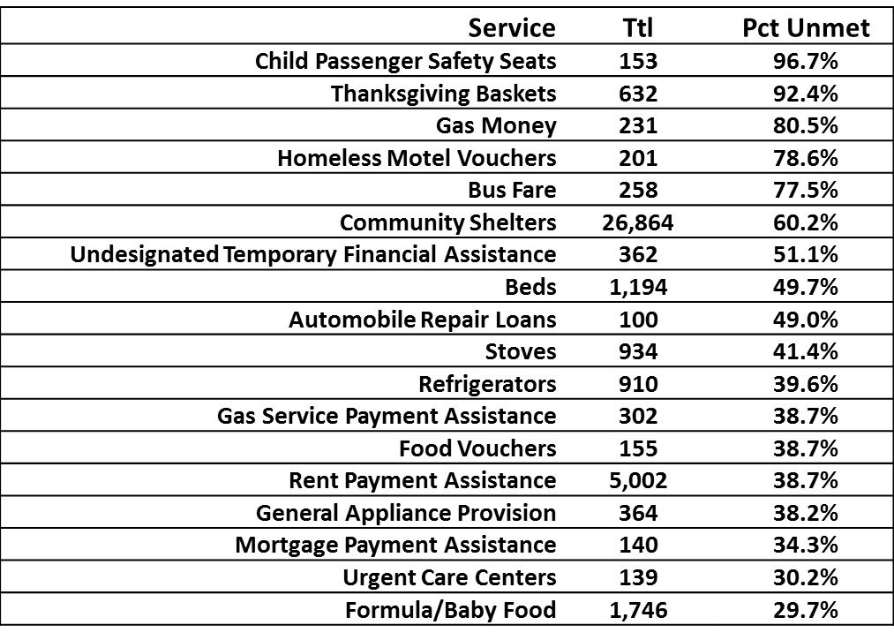
Unmet Service Requests and Needs
January – November 2014

Slide 25
Unmet needs
Why we have some services in Milwaukee (and not others)?
What are the limitations of the data in terms of tracking unmet needs.
We are only one “segment” of how measurements might be made.
No community wide effort or agreement on how/when to measure and when to tabulate results
Do funders ask for this data?
How much does the operation of 2-1-1 as a business affect the data? Do we have more accurate data from agencies we partner with?

Slide 26
Specific Case of Shelters’ unmet needs
Milwaukee County Continuum of Care: provide assessment for those in need of emergency shelter or prevent households from needing shelter. Provide Coordinated Entry for families and single women seeking emergency shelter. Will expand to all other groups later in 2015.
Created a vulnerability scale to screen families interested in emergency shelter.
92% of homeless families scored a 6 or higher on the Vulnerability Index Scale from October 1, 2013—March 31, 2014.

Slide 27
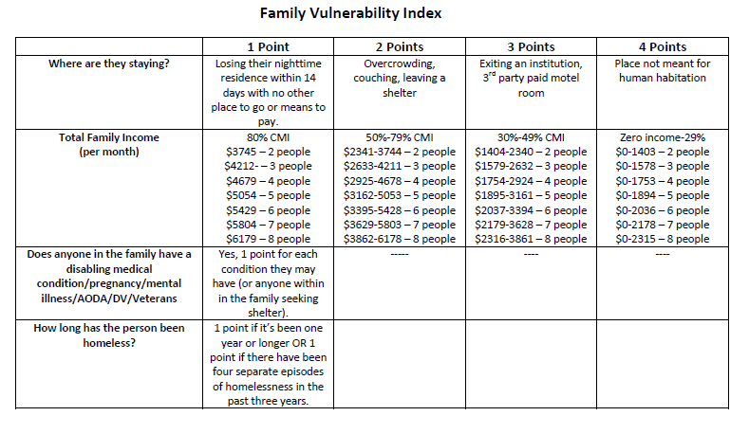
Emergency Shelter Assessment Tool

Slide 28
Data Limitations
It’s not a measurement of need for services- it’s a measure of need for information
Bias toward women
Broad categories- of age
How are both supply and demand data affected by business model?
Summer reading program example of need vs. information.
Notes:
Anecdote- calls for summer meal sites have gone down, because site locations have been stable over the past few years. Branding at the sites has gotten consistent. People know where they need to go. This may effect the “need data” as decreasing when it doesn’t

Slide 29
Resource Department:
2.5 full-time equivalent staff
Collects, maintains, and updates service data
Apply “Inclusion Policy” for what is collected and maintained
Indexed according to the AIRS/Infoline Taxonomy of Human Services
Push notification sent annually
Updates completed more often for organizations where a large number referrals are made
Some agencies update frequently, even daily
Research is ongoing
Data represents inventory of service provision in our service area

Slide 30
Resource Database
Classification System: AIRS/211 LA County Taxonomy
The AIRS/211 LA County Taxonomy sets a standard for defining services and for indexing and accessing the wide variety of human services available in communities across North America.
Six Level Example:
L | Health Care
LR | Rehabilitation/Habilitation Services
LR-8000 | Speech and Hearing
LR-8000.0500 | Audiology
LR-8000.0500-030 | Audiological Evaluations
LR-8000.0500-050 | Auditory Training
LR-8000.0500-050.05 | Auditory/Oral Training
Copyright © 2004-2014 Information and Referral Federation of Los Angeles County, doing business as 211 LA County. All rights reserved. Version 4.1.4.

Slide 31
Database Inclusion Policy:
Inclusion policy
The 2-1-1 Wisconsin/IMPACT 2-1-1 database includes non-profit and government health and human services, and for profit health and human service providers which provide a unique, hard-to-find or state-regulated service, free service, scholarships, reduced fees, sliding fee scale, or that accept Medical Assistance as payment. This would include organizations that fit this criteria that offer services to individuals residing or located in the 2-1-1 Wisconsin/IMPACT 2-1-1 service area or the service area of a local 2-1-1 Wisconsin provider.
See full policy: http://www.referweb.net/ipct/docs/inclusion.pdf

Slide 32
Find your 2-1-1!!
www.211us.org

Slide 33
Thank you!

