Slide 1
USING INTEGRATED DATA SYSTEMS TO CONNECT PEOPLE AND PLACE
September 30th, 2014
Community Indicators Consortium 2014 Impact Summit
Chris Kingsley, Data Quality Campaign
Alexandra Derian, Urban Institute
Joe Baldwin, Pinellas County Health and Community Services
Seema Iyer, Baltimore Neighborhood Indicators Alliance-Jacob France Institute

Slide 2
Cross-Site Project with the Annie E. Casey Foundation: Goals
Enhance access to IDS by NNIP partners and their communities
Create two-way exchange of info between NNIP & IDS and establish relationships
Demonstrate value of adding place info to people data
Apply to problems at the neighborhood level across different contexts
Improve IDS data quality and demand for IDS

Slide 3
Cross-Site Project with the Annie E. Casey Foundation: Sites
Baltimore: Equity of access in energy assistance programs
Cleveland: Outcomes for youth involved in the juvenile justice and child welfare systems
New York City: Neighborhood and building effects on homeless shelter entry
Pinellas County: Individual, home, family, school, and community-level factors impacting chronic absenteeism
Pittsburgh: Effects of neighborhood characteristics and human services involvement on chronic absenteeism
Providence: Education and employment outcomes and civic engagement levels

Slide 4



Integrated Data Systems : Pinellas County
J. Joseph (Joe) Baldwin, MA
HCS Planning Section Manager, NNIP Alumnus, CIC President
jbaldwin@pinellascounty.org
Denise Groesbeck, OTR MPA MSW
Starr Silver, PhD
Susan Rowden
Charles Dion, MA MPA
Diane Haynes, MA
Svetlana Yampolskaya, PhD

Slide 5
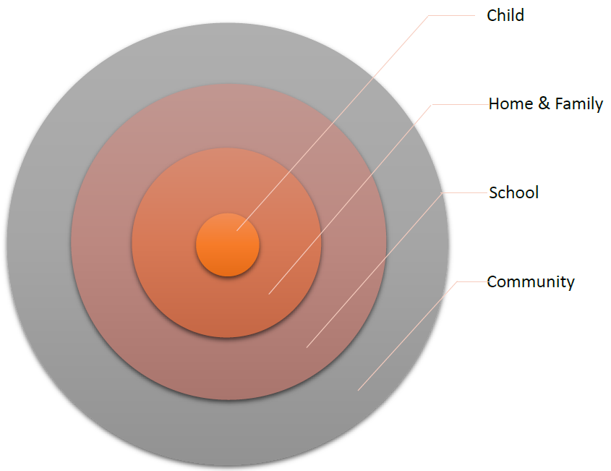
Integrated Data Systems : Pinellas County

Slide 6
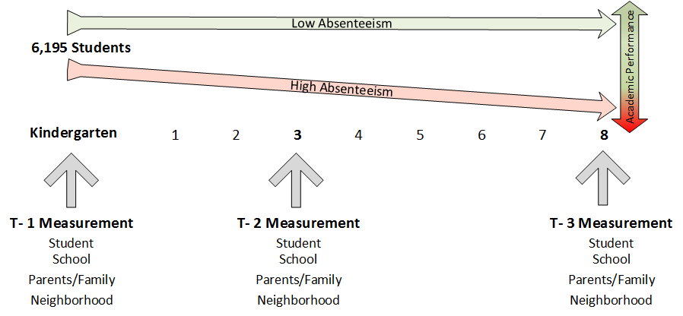
Integrated Data Systems : Pinellas County

Slide 7
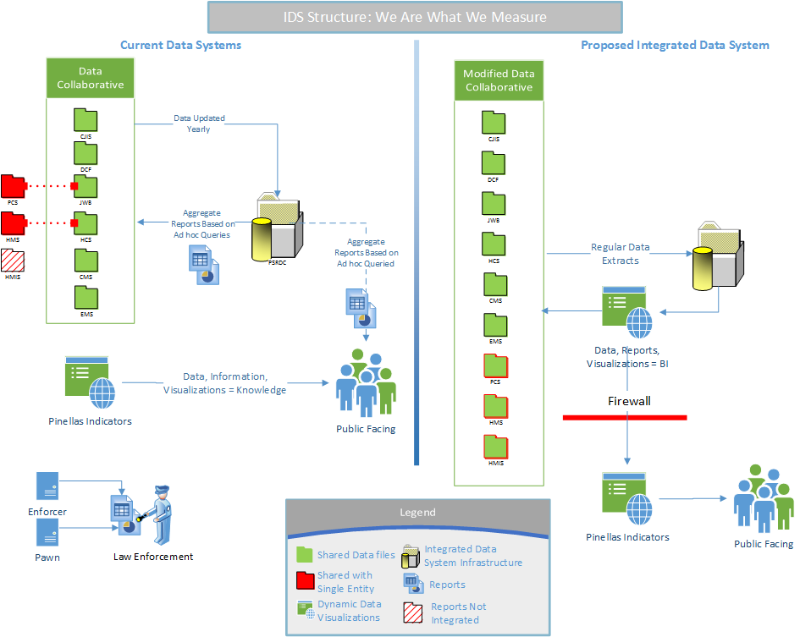

Slide 8

Integrated Data Systems: Baltimore Neighborhood Indicators Alliance-Jacob France Institute (BNIA-JFI)
postgreSQL
postGIS Geodatabase
Sales
Permits
Code Violations
Foreclosure Filings
Data allows us to track
Life cycle of housing
8

Slide 9


What about People?
Homeownership Counseling
Homeownership Preservation
Home Maintenance?

Slide 10
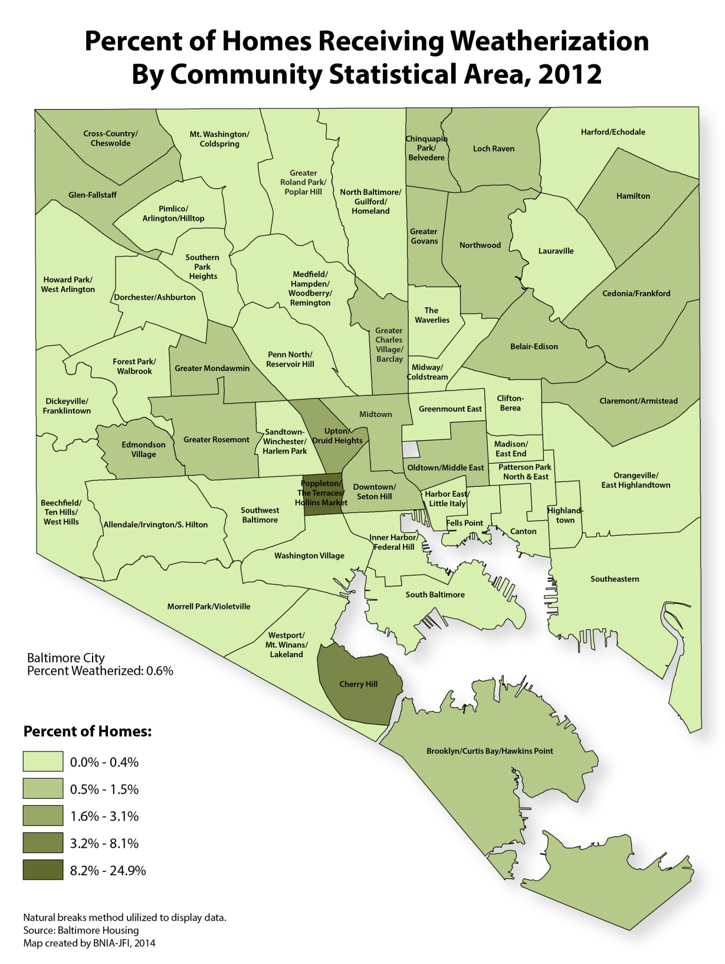
Weatherization
Budget increases in 2009 American Reinvestment and Recovery Act (ARRA)
Weatherization assistance programs (WAP) could be more than emergency services and part of housing policy in Baltimore

Slide 11
Technical Issues

Slide 12
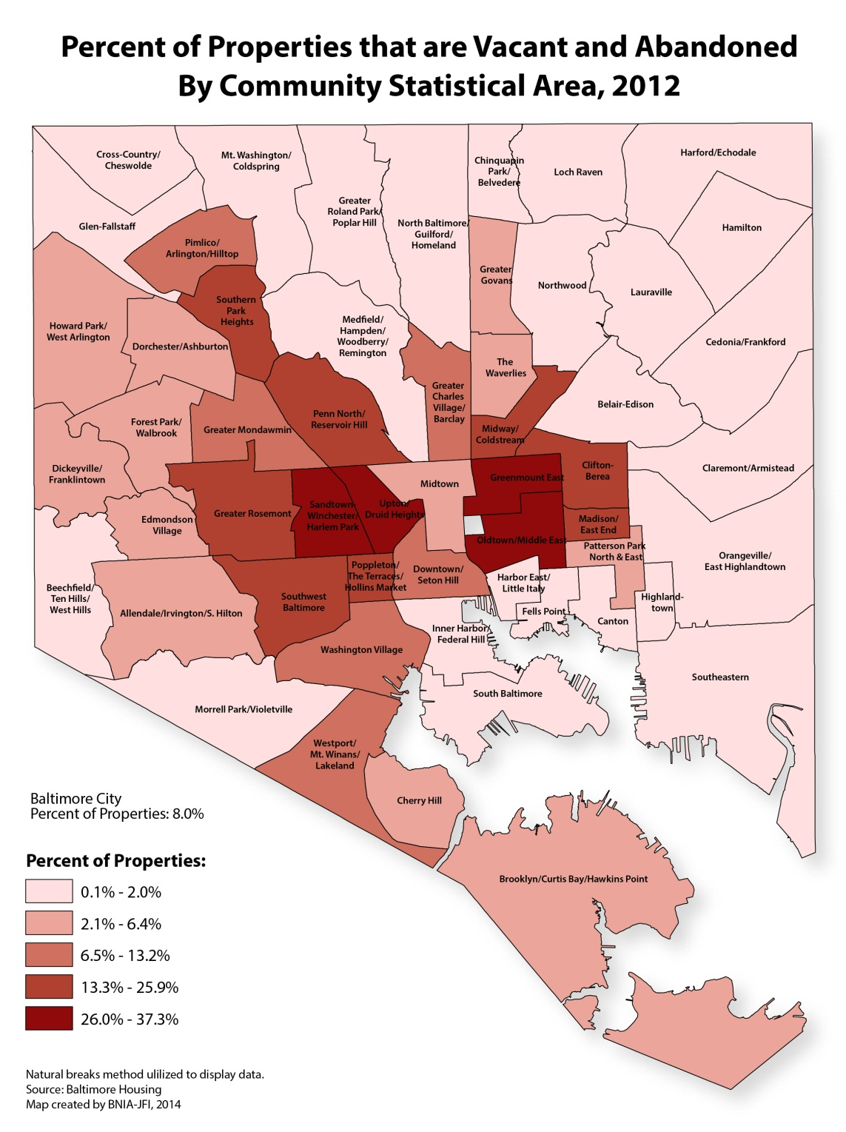
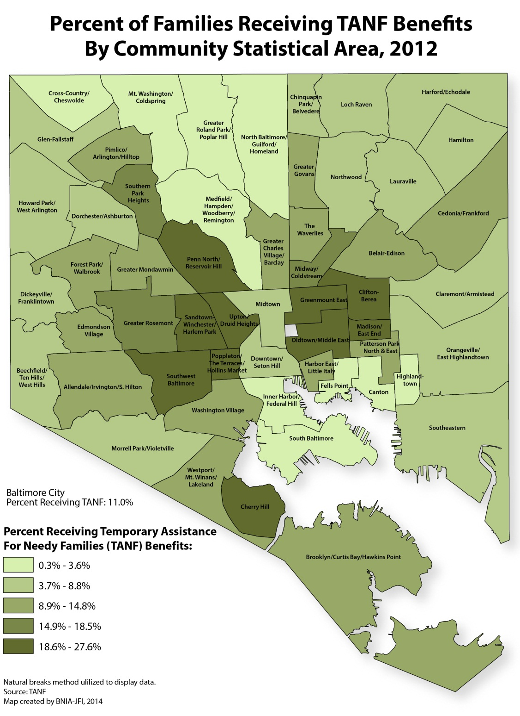

Slide 13




Resources for IDS
NNIP IDS catalog and resource page http://neighborhoodindicators.org/resources-integrated-data-systems-ids
Email: aderian@urban.org

