Slide 1

READY-TO-WEAR:
QUICK AND EASY MICROSITES
FOR DATA-DRIVEN REPORTS
Brian Karfunkel
Data Analyst
NYU Furman Center
NNIP Idea Showcase
July 16, 2015
1

Slide 2
Problem:
Many PDF reports
Lots of figures, lots of data
But: hard to make accessible to public

Slide 3
How to put top-line findings on the web with:
Limited technical resources
Quick turnaround
…and without oversaturating our main site

Slide 4
Solution: Microsites
Separate website, with different design and structure
Located at a subdomain
  http://rental-landscape.furmancenter.org
Doesn’t need to be dynamic
Does need to be concise, mobile-friendly, shareable at different levels
Notes:
Separate website, with different design and structure
Located at a subdomain
http://rental-landscape.furmancenter.org
Doesn’t need to be dynamic
Doesn’t need to have content updated frequently, like a blog would. Just do it once for each report.
Does need to be concise, mobile-friendly, shareable at different levels

Slide 5
But…
Can’t design new microsite from scratch for every report
Doesn’t need to be updated frequently, but does need to be created with rounds of writing, editing, tweaking
Want a consistent brand, but differing needs for individual reports
Needs to allow for static and interactive graphics and figures
Notes:
Can’t design new microsite from scratch for every report
Doesn’t need to be updated frequently, but does need to be created with rounds of writing, editing, tweaking
Want a consistent brand, but differing needs for individual reports
Needs to allow for static and interactive graphics and figures
Static figures are much easier to make, but interactive figures maximize the advantages of the web

Slide 6
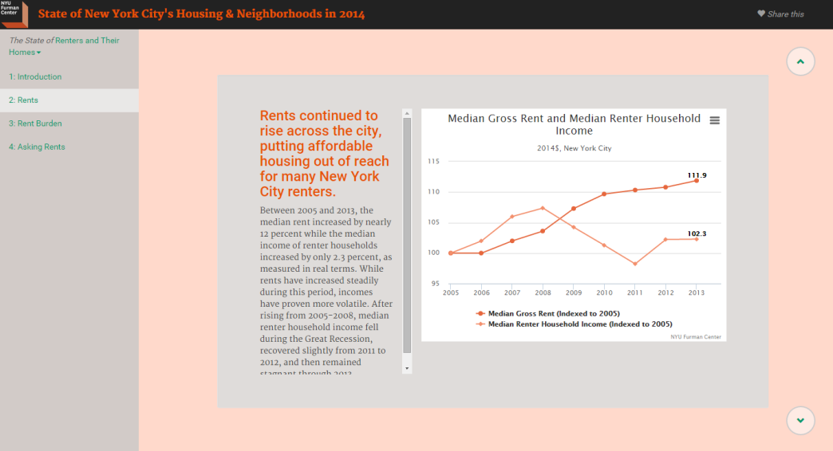
Static Site Generator
Text file with content
Figure saved as image (figure1.png)
title: In the past eight years, rent increases have far surpassed income growth.
figure: figure1.png
Between 2005 and 2013, median rent increased by nearly 12%, while median income of renter households increased by only 2.3% as measured in real terms.
Formatted Website (Static HTML Files)
Run Static Site Generator…
Notes:
Start off with text files that contain the actual content
Can use image files of figures directly from PDF/GIS/Excel
Run the static site generator…
And out pops a formated website, which you can copy and paste to your web server, and your microsite is live

Slide 7
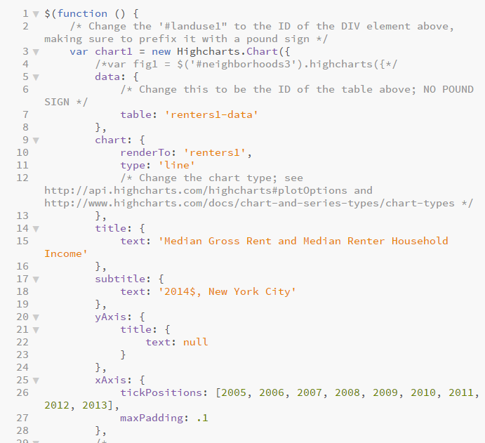
Static Site Generator: Interactive Figures
Text file with content
Javascript file specifying interactive figure
title: In the past eight years, rent increases have far surpassed income growth.
figure: figure1.js
Between 2005 and 2013, median rent increased by nearly 12%, while median income of renter households increased by only 2.3% as measured in real terms.
Formatted Website
Run Static Site Generator…
Notes:
To use interactive figures, just list, in that text file, the javascript file that will create the figure.
Then run the static site generator as before, and it will make a static HTML page with interactivity provided by Javascript

Slide 8
Still need someone who:
Can install and run programs from the command line
Is familiar with Python, HTML, and CSS
Knows basic Javascript for interactive figures
Can upload files to a web server (and create subdomains if necessary)

Slide 9
But many advantages:
Less-technical people can write and edit all text content, and tweak basic design
Static images for figures can be used directly in microsite (don’t need to go interactive)
Easily iterable: tweak the content or design, re-run the static site generator, and a new version pops out
Once you have staff trained to make one microsite, you can make many more

Slide 10
Site setup
Content is organized in slides, grouped into sections and chapters
  Each slide is a text document, with formatting in the Markdown language
    # Big Header
    ## Smaller Header
    __bold__
    *italic*
    [this is a link](http://url.to.link.com)
    More at http://daringfireball.net/projects/markdown/
Notes:
The final site is laid out as a column of slides you can scroll through
Markdown is an easy to learn, very basic way of specifying formatting in plain text files

Slide 11
Site setup
Figures can be simple image files
Can also be a Javascript file that creates an interactive graphic
  We use the Highcharts library to make creating figures and charts relatively easy.
  Only need basic Javascript, and easy to create templates that can be reused with different data

Slide 12
Technical Details
Uses Pelican, which is a static site generator written in Python
  Only need basic Python familiarity to set up, more advanced users can edit
Templates for individual pages are built using Jinja2, which uses Python-like syntax and HTML
Uses Bootstrap and JQuery for layout, basic styling, and interactive functionality

Slide 13
The Goal
Produce an open-source framework (hosted on GitHub) for making easy microsites
Clear instructions on how to download, build, and edit a microsite
Contributors can add new functionality as needed
First prototype should be released this summer
Alpha version (not for distribution!) viewable at www.furmancenter.org/soc2014/

Slide 14
Want to help out? Suggestions for features? Get in touch!
Brian Karfunkel
Data Analyst
NYU Furman Center
brian.karfunkel@nyu.edu

