Slide 1
NNIP Network Update and Idea Showcase
August 7, 2014

Slide 2
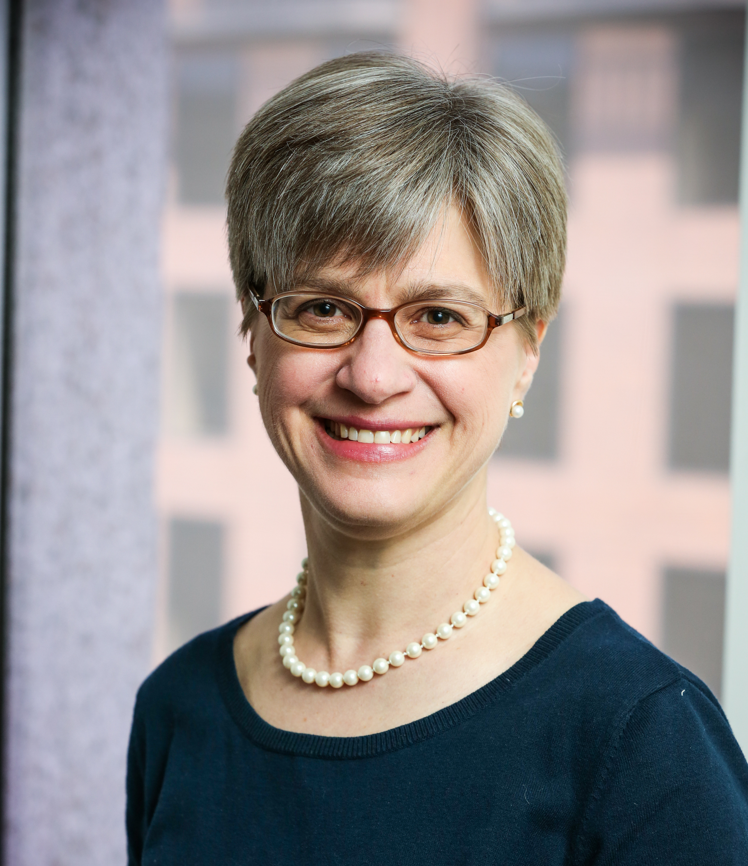
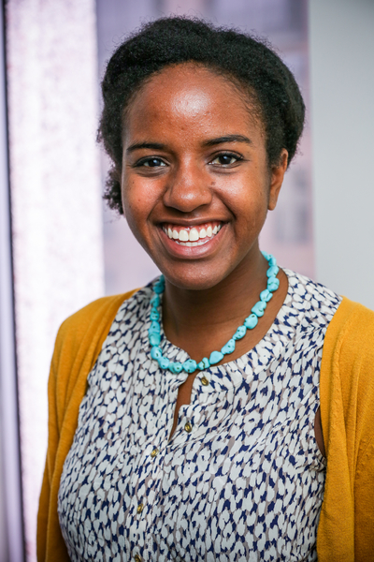
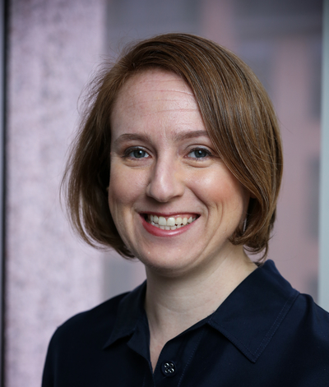
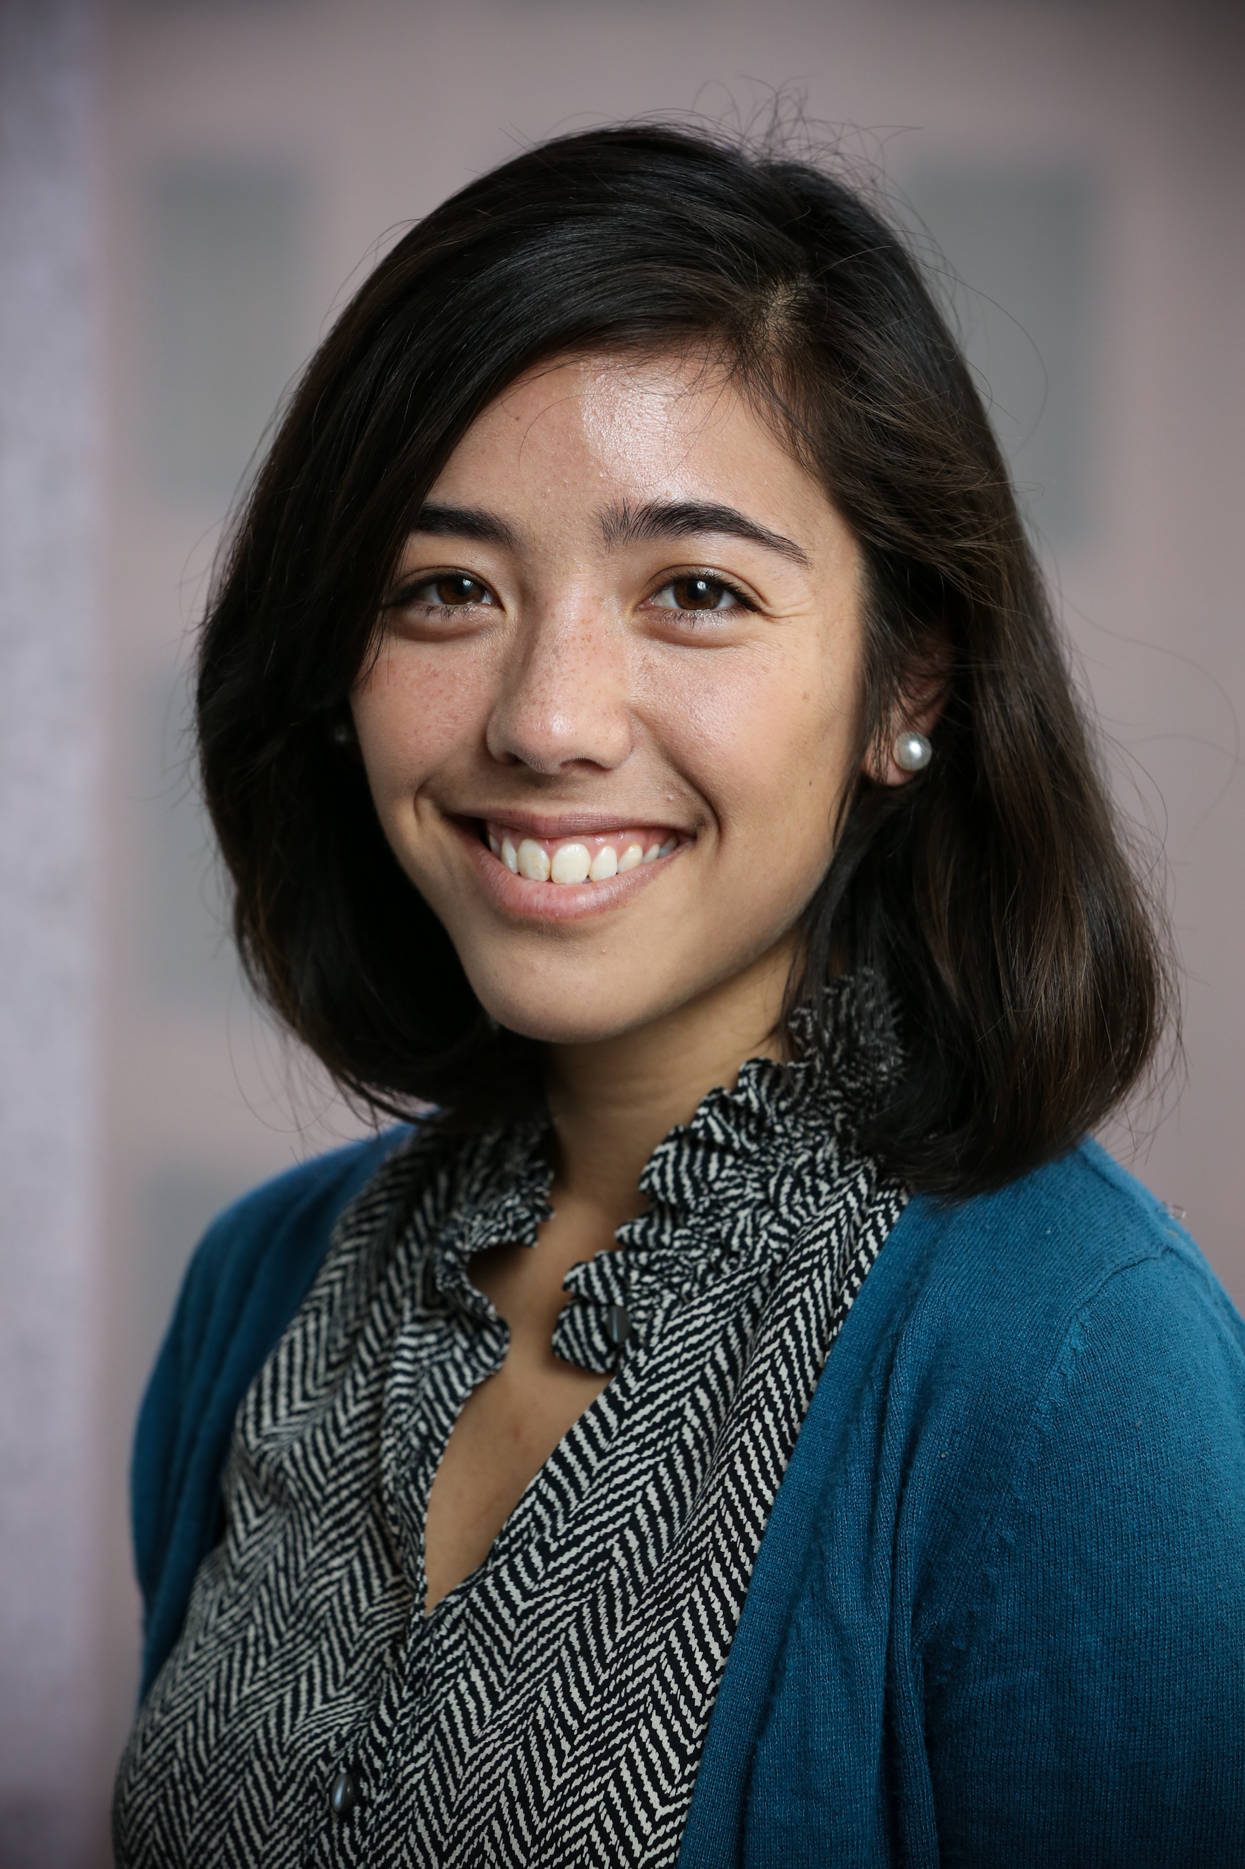
Urban Institute NNIP Staff
Rob Pitingolo
Kathy Pettit
Maia Woluchem
Leah Hendey
Kait Hildner
Tom Kingsley
Katya Abazajian
Notes:
Welcome Katya! Econ/Math major from Claremont McKenna – working on NeighborhoodInfo DC and NNIP teams

Slide 3
Denver Partners Meeting Update October 22-24th
Thanks to Piton team for all their help!
RSVP by August 15…
Still time to sign up for Tuesday’s Business Planning workshop
Working summary agenda posted on the NNIP home page and meeting page
Investigating the webcast options
Notes:
Agenda
- Piton work across the Denver region
- Engaging with suburban communities (Austin)
- NNIP assessment
- Performance management and report out

Slide 4
Communications Reminders
Please post that you are a NNIP member & the Partner Badge on your website.
Follow @NNIPHQ and use #NNIP for your own NNIP-related tweets
Promote NNIP in your presentations.

Slide 5
Fall/Winter Events
FOSS4G (9/8-9/13)
Local Employment Dynamics (9/9-9/10)
Association of Public Data Users (9/16-17)
Code for America Summit (9/23-9/25)
Community Indicators Consortium (9/30-10/1)
NNIP Denver Meeting (10/22-10/24)
Housing Solutions (11/18-11/20)
NNIP Idea Showcase (1/15/15)
Notes:
Let me know if anyone from your org is attending/presenting and we’ll compile lists.

Slide 6
Website Update
NEW – redesigned publications and activities forms to be demo-ed by Maia
At minimum – each partner should add four entries every six months, but hoping you will contribute more often.
Revived tracking - new report for NNIP/Urban staff on who has uploaded content.
Notes:
Haven’t been on the site in a while?
Generally, your login is your email, & you can request a forgotten password.
Editors at the organization can add new users if other staff need logons.
We have been doing the lion share of the entering. You can go to the All Partner Activities or the Library – Catalog and filter by your city to see what has been entered to date.
With three dozen – too many for us to keep up with.

Slide 7
Civic Tech and NNIP Partners
Notes:
Thanks to those who responded so quickly – I had some conversations with CfA about common interests and this information was very helpful

Slide 8
Upcoming Surveys (and Workgroups?)
Survey on data management practices (this week)
Developed with Executive Committee
Survey on organization finances this summer (late-August)
Supports Start-up guide, CIC presentation, answers questions from YOU!
Gauging interest in a technology workgroup?

Slide 9
Content In Progress
New Open Data case studies
Baltimore and Twin Cities
Two Books coming in October/November
Strengthening Communities with Neighborhood Data (Kingsley, Coulton, Pettit)
Using Data in Community Development (title TBD - Urban and SF Fed)
Performance Management Guide (Jake Cowan and Tom Kingsley)

Slide 10
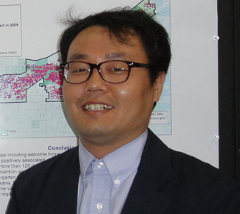
Thank you to our Showcase panelists!
Diana Gavarkavich
Charlotte
d.gavarkavich@uncc.edu
@UNCCUI
Jessie Partridge
Boston
jpartridge@mapc.org
@MAPCMetroBoston
Seok-Joo Kim
Cleveland
seok-joo.kim@case.edu
John Garvey
Oakland
garvey.john.p@gmail.com
@urbanstratoak

Slide 11
Send your ideas for other ways to stay in touch between meetings!
Notes:
Open to other webinars in November, December…

