Slide 1
NNIP Idea Showcase & Network Update
May 22, 2014

Slide 2
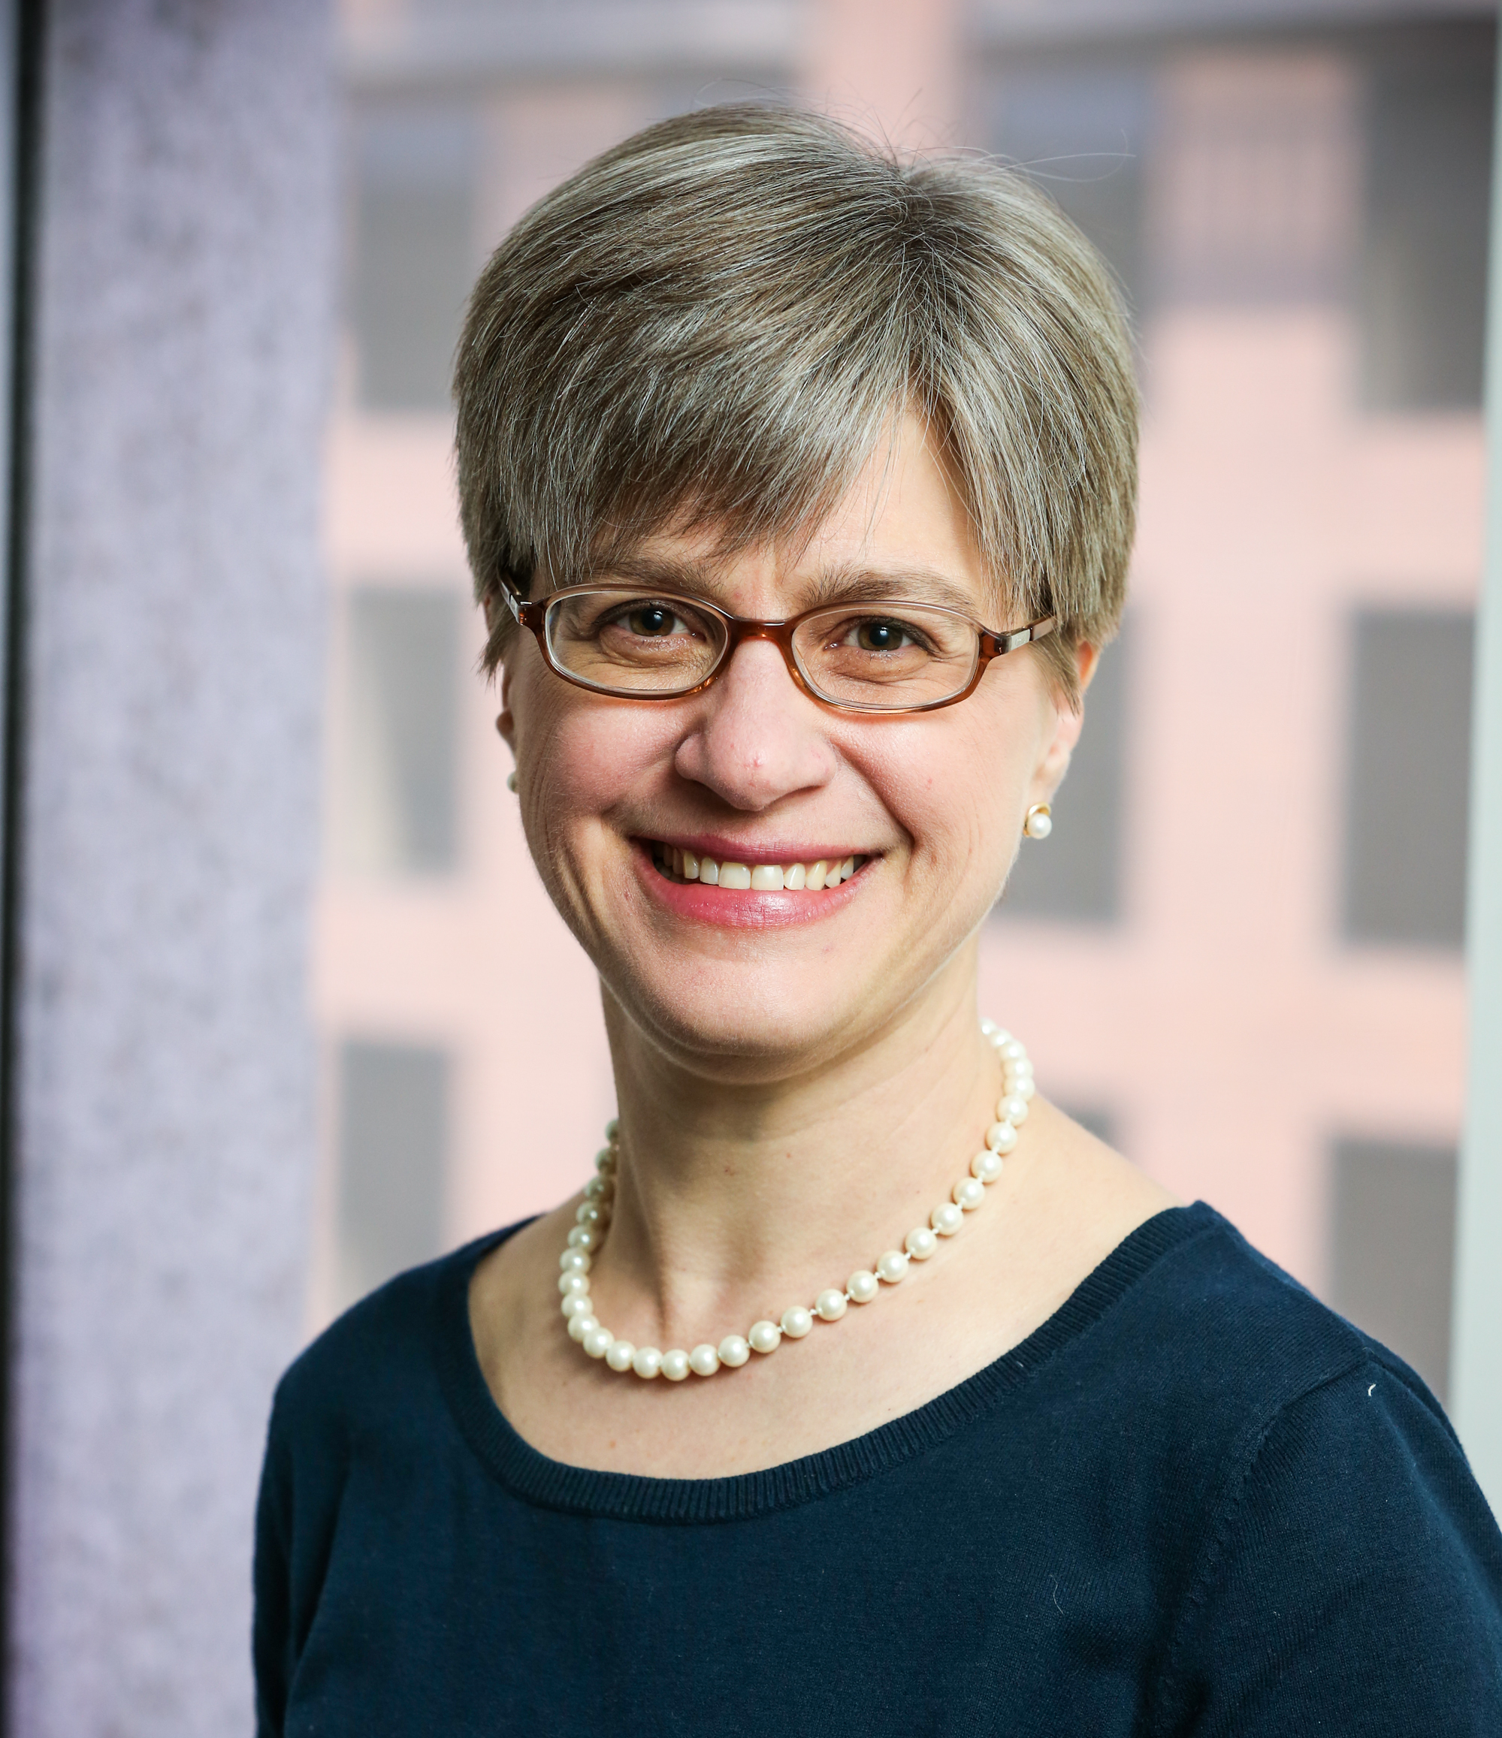
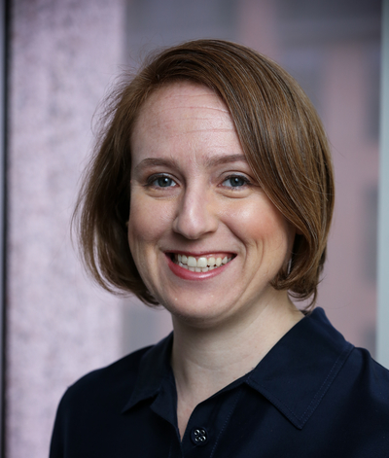
Urban Institute NNIP Staff
Kathy Pettit
Rob Pitingolo
Leah Hendey
Maia Woluchem
Tom Kingsley
Kait Hildner

Slide 3
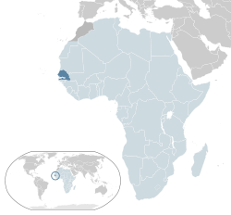
Congratulations and thanks to Brianna – off to Senegal!

Slide 4
Denver Partners Meeting Update October 22-24th, 2014
Same as April’s - mixed format on first 2 days. Please RSVP!
https://www.surveymonkey.com/s/NNIPOct14RSVP
Possible pre-meeting workshops on 10/21 if there is enough interest
See survey to google group and respond by 5/27!
Send Leah ideas for plenary meeting sessions (lhendey@urban.org)
Pittsburgh! Spring 2015.

Slide 5
Communications Update
New logo
New Partner Badge for your websites
Website branding updated soon
And…introducing @NNIPHQ with Rob as chief Tweeter

Slide 6
Website Update
NEW – redesigned publications and activities forms!
At minimum – each partner should update content every six months, but hoping sites will contribute more often.
Revived tracking - new report for UI/NNIP staff on who has uploaded content.
Notes:
Haven’t been on the site in a while?
Generally, your login is your email, & you can request a forgotten password.
Editors at the organization can add new users if other staff need logons.
We have been doing the lion share of the entering. You can go to the All Partner Activities or the Library – Catalog and filter by your city to see what has been entered to date.
With three dozen – too many for us to keep up with.

Slide 7
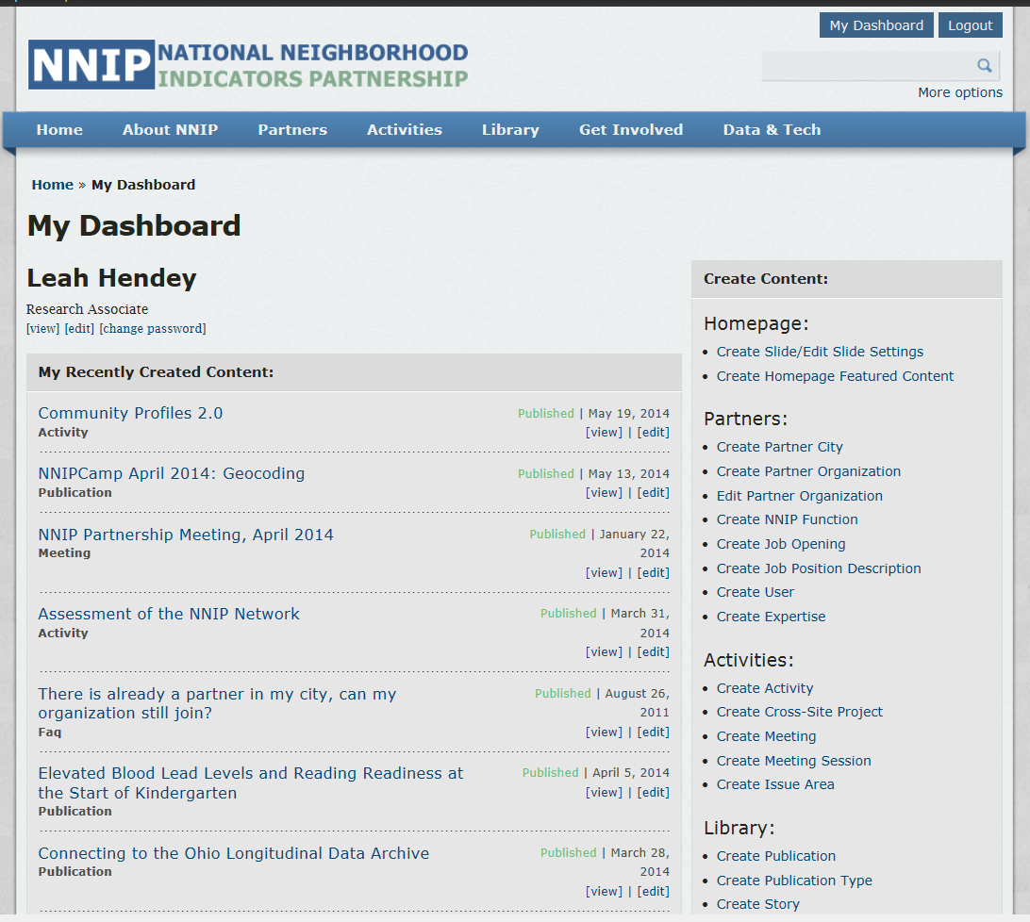
Notes:
After logging in, Click My Dashboard
The 2 you will use most are:

Slide 8
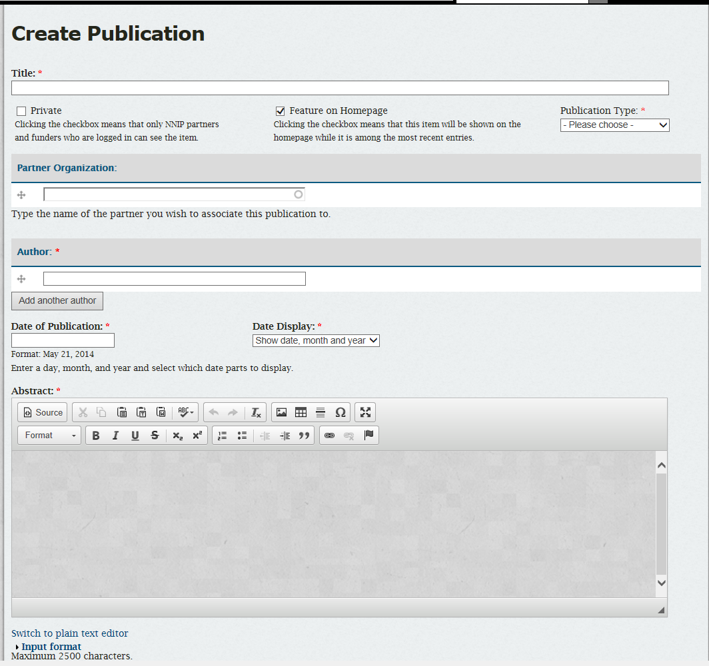
Notes:
Tried to reorganize fields in a logical way. Not shown here but a link to instructions (online guide) just above the title.

Slide 9
Notes:
Haven’t been able to figure out a great way on the tags, but you can see more of them at least
These are critical – main way to find items in an organized way.

Slide 11
Selected Content In Progress
NNIP assessment progressing
100% site participation – thank you!
New Tech and Tools items
Open Data paper and case studies (June)
Survey on data management practices (June)
Evaluation and start-up guides
Survey on organization finances this summer
Notes:
Just some of the items we are working on…
Reviving Tech and Tools
Questions for tech companies (for academic req coming soon)
Eric posted Smart Location DB
Consolidate info from Google group on geocoding
Open data - Various reasons for delay – about to go to layout
Exec Comm – data and metadata practices survey
NCDB - june

Slide 12
Thank you to our Showcase panelists!
Bob Gradeck
Pittsburgh
rmg44@pitt.edu
Aaron Schill
Columbus
aschill@researchpartners.org
Jeff Matson
Twin Cities
jmatson.@umn.edu
Eleanor Tutt
St. Louis
eleanor@risestl.org
Greg Sanders
Chicago (Alumni)
gregsanders101@gmail.com
Mingming Zhang
Denver
mzhang@piton.org

Slide 13
Webinar Schedule
Date | Topic
June 19 | Community Profiles: Providence & Pittsburgh
July 17 | Community Health Assessment (tentative)
August 7 | NNIP Idea Showcase & Network Update
December | Topic TBD – volunteers?
January 15 | NNIP Idea Showcase & Network Update

Slide 14
Send your ideas for other ways to stay in touch between meetings!
Notes:
See many of you next week!

