Slide 1
Development of SA2020’s Indicator Management System (IMS)
Clarissa Reneé Ozuna
CI:Now, Program Manager of Research
NNIP Idea Showcase
April 16, 2015

Slide 2
SA2020’s Data Need
11 Cause Areas
59 Identified Indicators
100+ Partially Identified
Sub-Indicators & “Distributions”

Slide 3
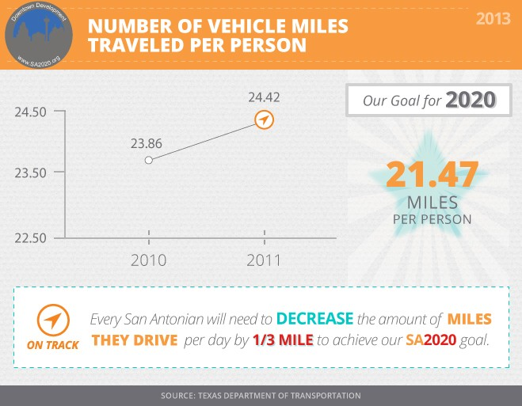
SA2020’s Existing Online Progress Report
TITLE.jpg
CHART.jpg
GOAL.jpg
PROGRESS.jpg
NOTE.jpg

Slide 4
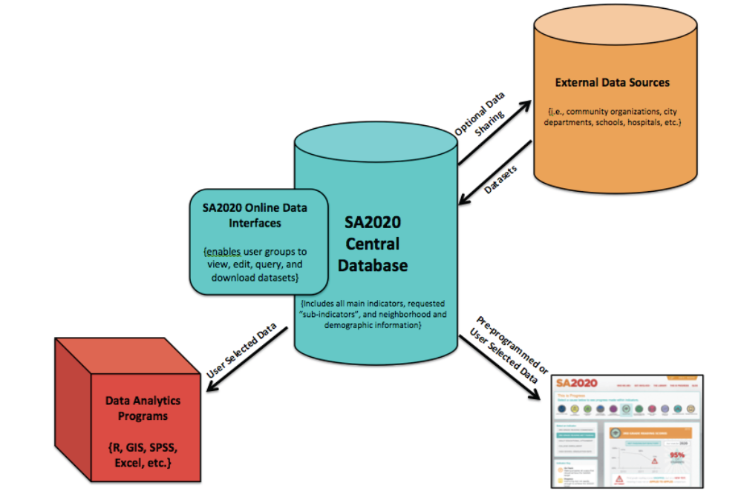
Proposed (and Realized) Solution

Slide 5
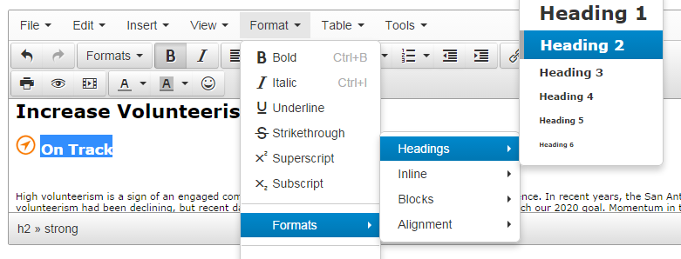
Indicator Management System (IMS)

Slide 6
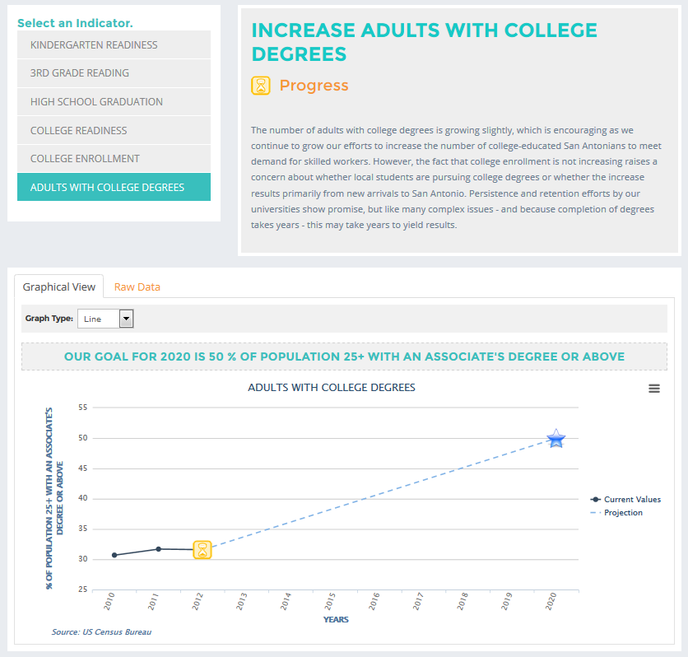
SA2020’s Updated Data Dashboard www.sa2020.org/progress/

