Slide 1
Data- Informed Advocacy NNIP Partners and Advocates Unite! Thursday, June 13, 2019
Notes:
We’re a 501 c 3 community data intermediary in Durham, North Carolina. Our work is for local neighborhoods, community organizers, local government, with a priority for empowering people historically excluded from processes of power…

Slide 2
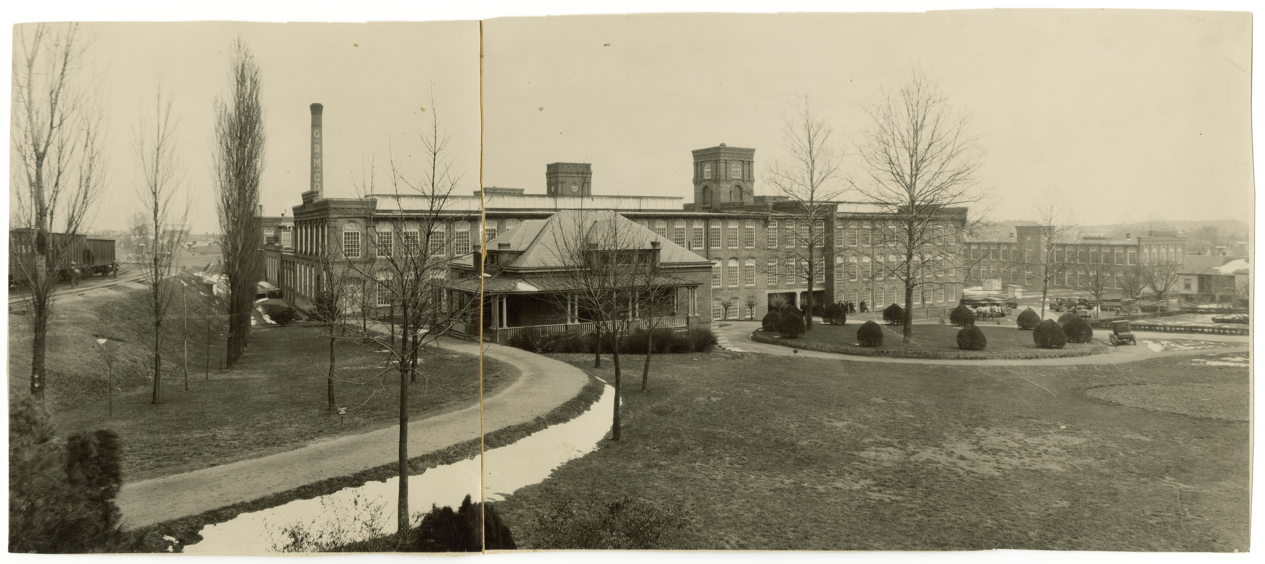
Image source: Digital Durham
Notes:
Referencing history is an essential element of our presentations. Neighborhood data are the product of neighborhood history. What is the appropriate way for you to make the connection in this presentation? Here’s an example from a recent presentation to Durham City Council:
The urban tier is the first urbanized area of Durham. It was the original cluster of mills and factories and the workers housed by them. Many of them renting from the companies.
This is the area most directly impacted by policies of redlining, highway construction, the urban renewal blight clearance efforts, racial covenants, the expansion of Duke University (Hickstown), and the movement of the textiles and tobacco industries to other places.

Slide 3
Traffic Pattern Map - Merrick Moore Community
Notes:
…they wanted to have us in the same meeting with city council member to hear about safety in their community; community conditions
Note: Orange lines are sidewalks and grocery stores are in the legend but there aren’t any on the map…

Slide 4
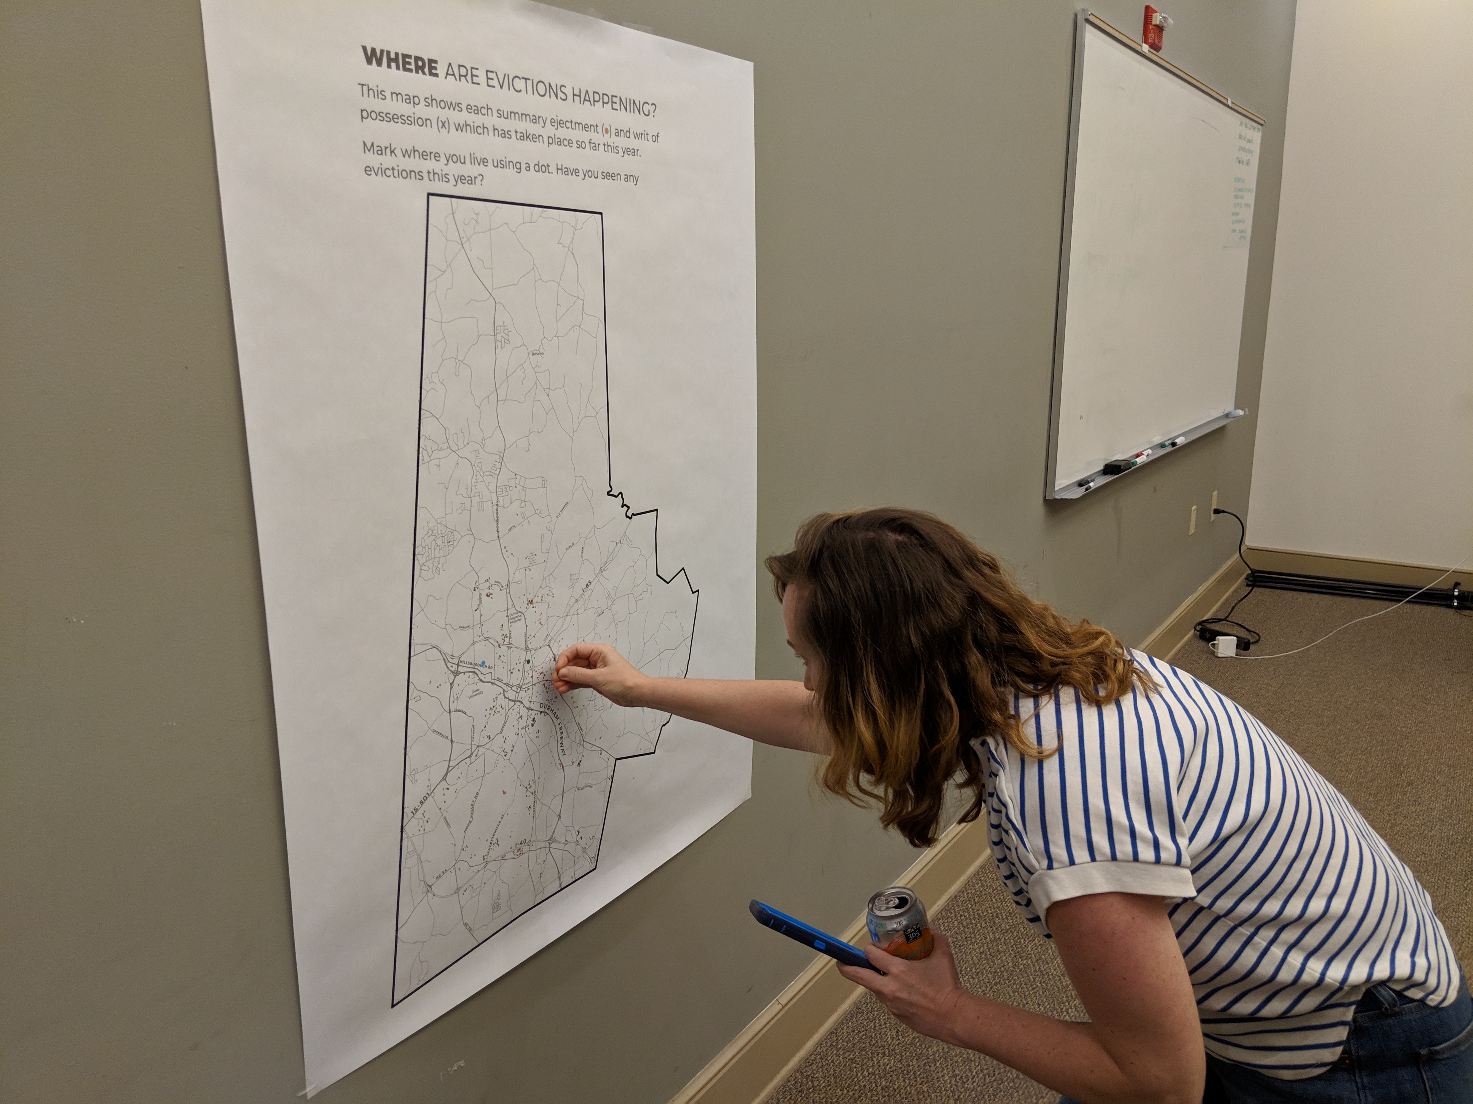
Who Owns Durham?
Notes:
How this came about -- DCLT’s interest in acquiring properties, Ekim’s work on gentrification
Giving people a platform to come up with strategies to prevent displacement
Members of city council attended, but we didn’t give them a platform by special introductions in order to keep from being politically-motivated

Slide 5
Contact
L’Tanya Durante
L’tanya@dataworks-nc.org
Libby McClure
libby@dataworks-nc.org
919.681.2063
https://dataworks-nc.org
Twitter @DataWorks_NC

