Slide 1
The National Neighborhood Indicators Partnership & the 5-Year ACS
Leah Hendey
June 28, 2011

Slide 2
What is NNIP?
Local data intermediaries in 35 cities
Goal: “democratize information”
3 driving principles:
Build/operate integrated neighborhood data systems.
Facilitate use of data by community & city leaders for policy making.
Use info to build capacities of organizations and residents in distressed neighborhoods.
UI organizes and operates the network.

Slide 3
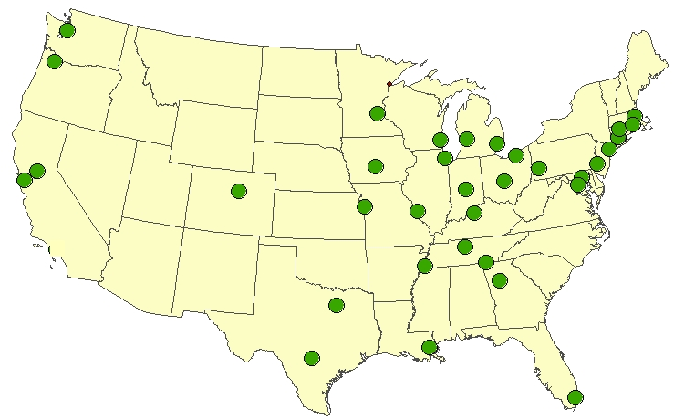
Location of NNIP Partners
Atlanta Baltimore
Boston
Camden
Chattanooga
Chicago
Cleveland
Columbus
Dallas
Denver
Des Moines
Detroit
Grand Rapids
Hartford
Indianapolis
Kansas City
Louisville
Memphis
Miami
Milwaukee
Minneapolis-St. Paul
Nashville
New Haven
New Orleans
New York City
Oakland
Philadelphia
Pittsburgh
Portland
Providence
Sacramento
Saint Louis
San Antonio
Seattle
Washington, D.C.
Notes:
Presentation maps.ppt
Links to all partners on NNIP web site
Others in the wings – Austin, Tampa, Jacksonville, Madison
We haven’t done active recruiting (people who find us)

Slide 4
NNIP Partner Audiences & Their Info Needs
Audiences:
Local nonprofits, government and funders
Audiences’ Information Needs:
Understand neighborhood context
Advocate around local policies
Demonstrate need for grant applications
Make decisions about:
Prioritizing issues within a community
Targeting services and program placement
Evaluate Programs
Notes:
Go over audiences and needs
Explain how the 5-year data works with these needs
Context – okay, especially when aggregated and using indicators with total population etc. - change over time is more difficult.
Advocacy & demonstrating need for grants – could be good depending on the purpose – poverty, housing costs? Threshold requirements
Decision-making – could be challenging -
Prioritizing one area over another with limited funds – may reach an area in need but may be difficult to justify decision.
If you need counts of people to provide services or build facilities (e.g. health clinics) – estimates +/- 300 or more are difficult to use
Program evaluation –– (difficult to detect often anyway) – very difficult to detect change in rolling 5-year samples (even if not advise NNIP partners audiences will probably want to see it).

Slide 5
Poll Results from NNIP Meeting
100% polled are using the ACS, nearly 3 out of 4 regularly.
Most have used the 5-Year Data, 80% using summary tables, & 25% calculating change from 2000 with SEs.
72% used in fact sheets, 30% in online mapping tools; 45% in analysis/reports
Use of Standard Errors in ACS Analysis:
31% always
25% in certain cases
34% want to, but don’t know how to explain to their audience
< 10% don’t use SEs
Notes:
Roughly 33-35 respondents to poll questions.

Slide 6
ACS 5-Year Data Strategies
Don’t give up – think about intended use Educate – community trainings
Almost 1 out 5 partners polled have held a training, plus 35% are planning to
People understand MOE concept – walk them through plausible scenarios
Provide cautions
Point out ways that misuse of data could backfire
Notes:
As I mentioned early - the intended use of the data is important – if a foundation comes to a partner and just wants to know if they are targeting a poor neighborhood, whether that neighborhood has 45%, 60% or 75% poverty it is really irrelevant.
Our partners need to educate the users of their data.
1 in 5 partners polled at our May session had held a training on the ACS. - another 35 % were planning to do so in the future either themselves or with a partner
Our partners report that because of things like polling people do generally understand the MOE concept – but its good to walk them through concrete examples of how it may affect their work.
To point out cautions, ways that the data could be misused

Slide 7
ACS 5-Year Data Strategies
Be creative and smart about indicator choices
Aggregate geography when possible
Identify indicators with higher reliability
Verify & backstop data with other sources
Consider how presentation of data could lead users astray
Rankings
Raw tables of estimates
Notes:
Not every indicator that we used in census 2000 is going to be appropriate for the ACS (and in some cases we may be pretending that it worked well in the census since we generally weren’t using the standard errors). E.g. 16-19 year old youth not in school and not employed.
Our NNIP partners often have very good sources of administrative data – this could be used to verify patterns in the ACS data and provide support for conclusions – food stamp or TANF receipt as proxies for poverty, or public data files like IRS for income change in neighborhoods
Our partners will need to be more cautious about the types of analysis that they produce and post on the web – raw tables of ACS estimates (especially single cells) without MOEs or more context maybe easily misused by local organizations. Rankings of neighborhoods may be misleading as well without MOEs.

Slide 8
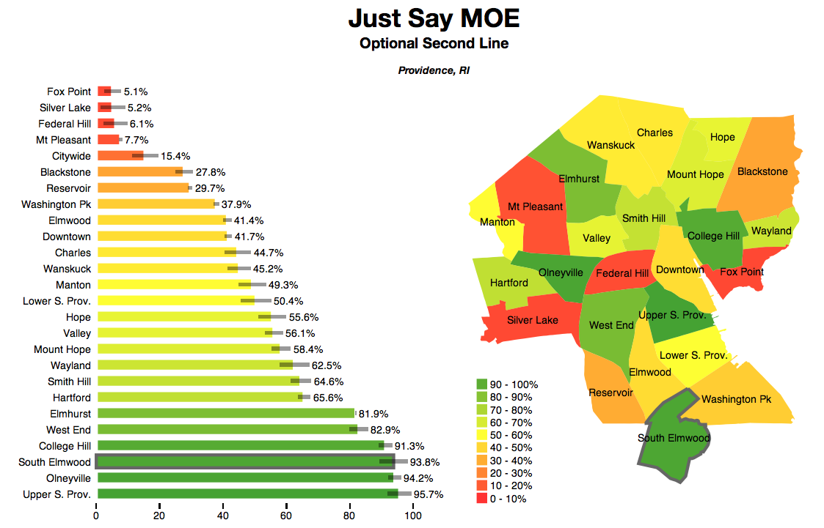
Notes:
Providence Plan – example of a visualization they are planning for the 2006-10 data using Protovis

Slide 9
Example - Portland
http://mkn.research.pdx.edu/2011/01/census-data-show-regional-disparities-in-educational-attainment/

Slide 10
UI Plans to Support the Partnership
ACS page on new NNIP website
Presentations, reports, examples
http://www2.urban.org/nnip/nnipacs.html
ACS sessions at future NNIP meetings
Webinars for NNIP partners
Census 2000 support materials
To aid in calculating SEs.
Publishing data (created indicators)
http://www.metrotrends.org/natdata/acs/index.cfm

Slide 11
What resources would be helpful?
Forum for ACS users
Collection of good examples of use
Guide on communication of meaning and limitation of data for various purposes
Parallel to COMPASS guides

