Slide 1
Neighborhood-Level Strategies, Regional Strength
STEPHEN ACREE
NNIP PARTNERSHIP MEETING
APRIL 2, 2014

Slide 2
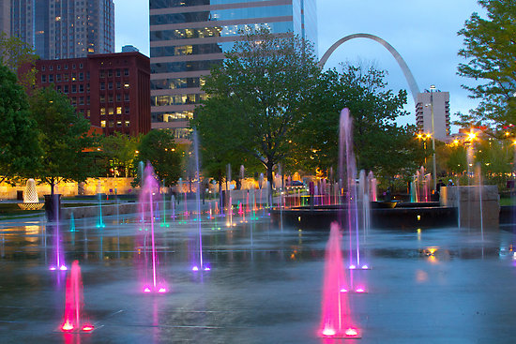
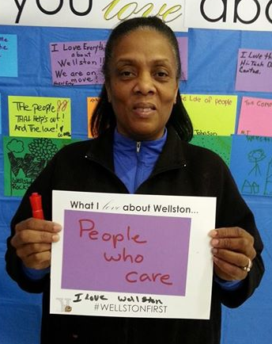
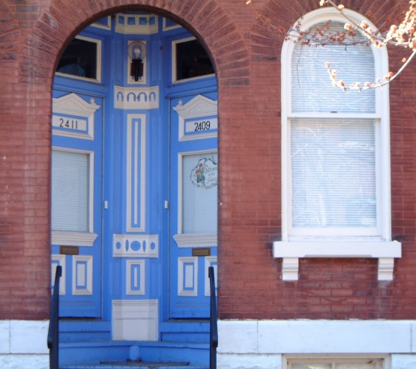
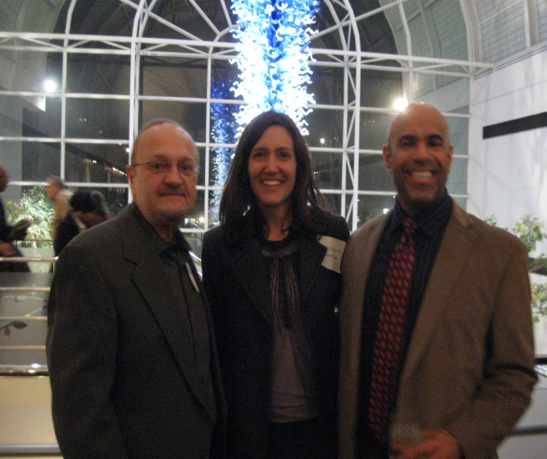
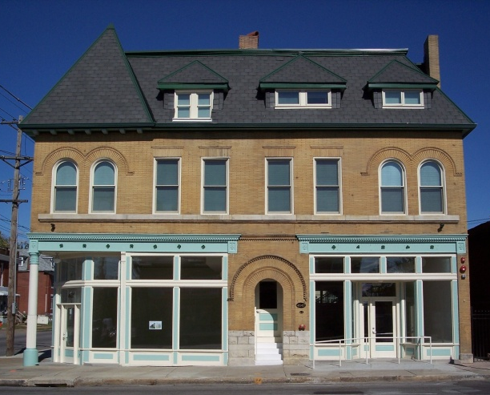
WELCOME TO ST. LOUIS!
photos credits: L2Photography (top left), St. Louis County (top right), Rise (bottom row)

Slide 3
ST LOUIS TOUR/RECEPTION SPONSORS

Slide 4
RISE CORE ACTIVITIES
1. Developing affordable and mixed-income housing and mixed-use communities that revitalize urban neighborhoods
2. Providing capacity building technical assistance and training to local governments, institutions and nonprofits engaged in community development in the St. Louis area
3. Making predevelopment loans to not-for-profit community development organizations

Slide 5
RISE CORE ACTIVITIES
4. Collecting, maintaining, analyzing and mapping neighborhood indicator and other data to measure the outcome of community development efforts and making data available as widely as possible to inform community-based decision-making
5. Engaging in housing and community development public policy education and advocacy

Slide 6
DATA DEMOCRATIZATION INITIATIVES
Sample of current activities

Slide 7
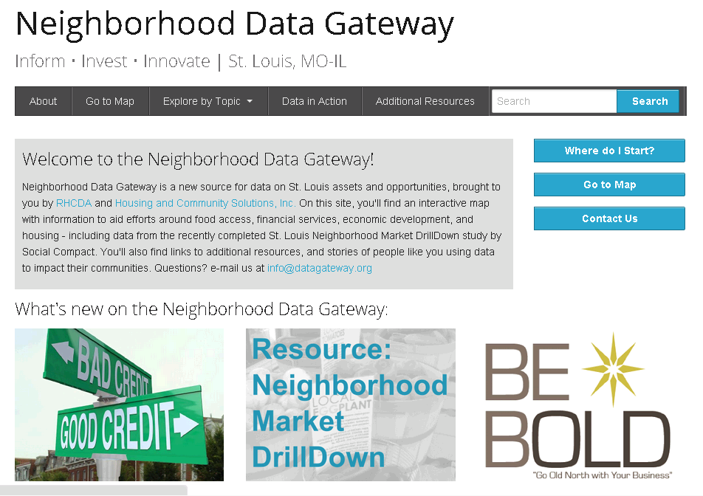
NEIGHBORHOOD DATA GATEWAY WWW.DATAGATEWAY.ORG
Currently updating retail leakage data with support from MidAmerica GIS Consortium and Washington University in St. Louis
Collaborating with St. Louis County to revise user interface & share additional data in user-friendly format

Slide 8
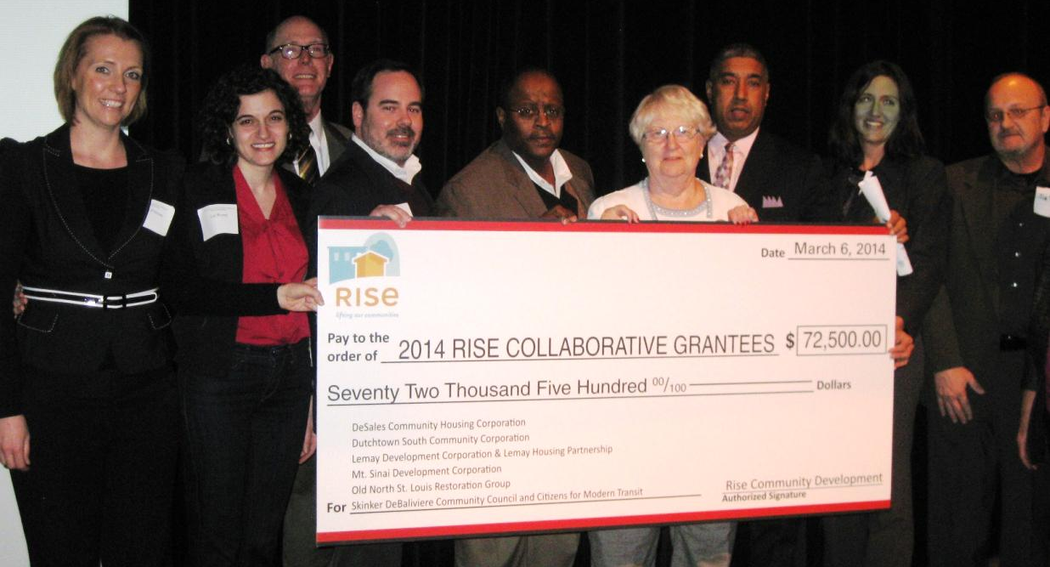
SUPPORTING AREA CDCs
Rise Collaborative Grants - $72,500 paired with Rise technical assistance provided to 6 CDCs. Several CDCs prioritizing data-informed decision making & evaluation.
Social Capital Working Group – partnership between Rise and three area CDCs to better measure & visualize social capital and networks

Slide 9
PARTICIPATION IN ONESTL REGIONAL PLAN WWW.ONESTL.ORG | WWW.STLOUISDATA.ORG
Staff served on Advisory, Community Engagement, and Data Portal committees
St. Louis Regional Data Exchange open data portal one of the key results of planning effort; created by the Applied Research Consortium, a collaboration between researchers at Saint Louis University, the University of Missouri - St. Louis, and Southern Illinois University at Edwardsville

Slide 10
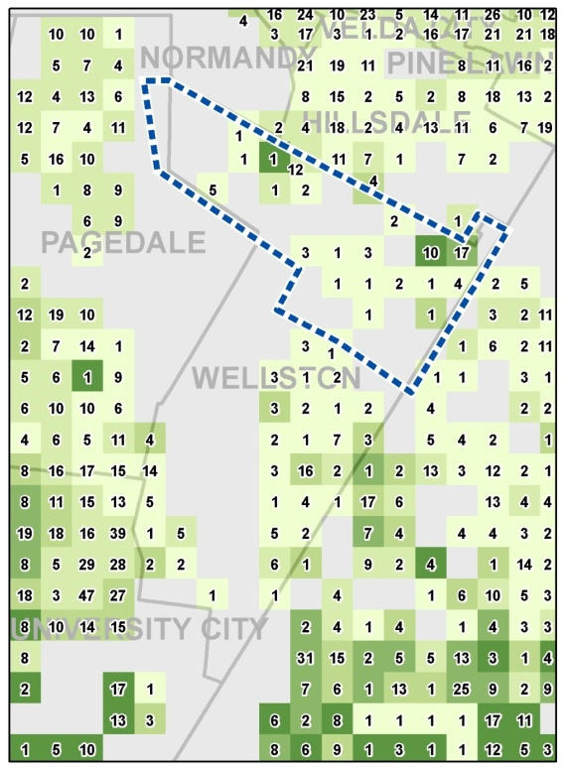
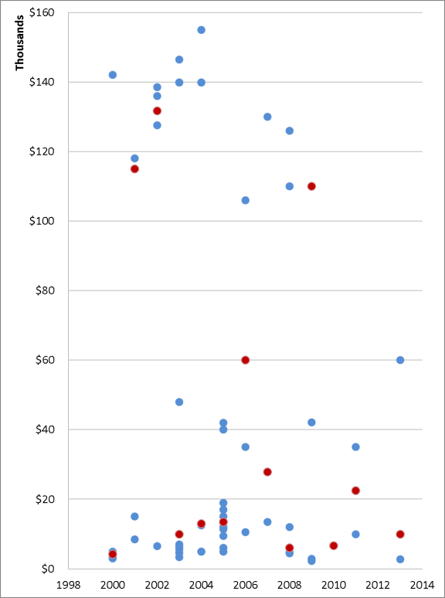
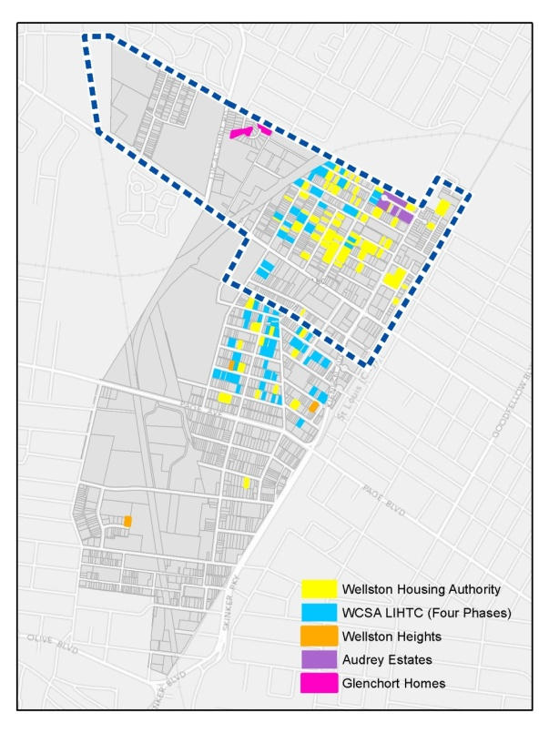
WELLSTON FIRST CHOICE NEIGHBORHOOD GRANT
Rise serving as Housing Coordinator on Wellston Choice Neighborhood Planning Grant
Ability to leverage past work in Wellston, including property condition data and housing market data

Slide 11
OPENDATASTL
Rise staff Eleanor Tutt one of the leaders of OpenDataSTL (launching as a Code for America brigade weekend of May 30, 2014)
Assisted with joint City of St. Louis/St. Louis County Code for America fellowship application

Slide 12
SESSION SPEAKERS
Hank Webber, Washington University in St. Louis
Todd Swanstrom, University of Missouri-St. Louis
Jennifer Allen, Trailnet
Tonya Dean, Dutchtown South Community Corporation

