Slide 1
From Information to Action: Lessons from NNIP for Place-based Initiatives
National Neighborhood Indicators Partnership
Better Data. Better Decisions. Better Communities.
Kathy Pettit, The Urban Institute
UNCA Neighborhood Revitalization Conference
June 27, 2013
Notes:
Introduce myself - director of NNIP and work on the Choice Neighborhoods Initiative assessment sponsored by HUD.
Agenda today:
-talk about the network and our partners, how they relate to place-based work and then share an examples from our Pittsburgh partner.

Slide 2
National Neighborhood
Indicators Partnership (NNIP)
Collaborative effort since 1995
  Urban Institute & local partners; now 37 cities
  All partners build and operate neighborhood level information systems using local data
  Success based on:
    Trusted and engaged institutions
    Relevant and high-quality data
    Mission to support use of data for local action
Notes:
Talk through slide
Network is supported by the Annie E. Casey and the John D. and Catherine T MacArthur Foundations
Three necessary components to success (e.g. three-legged stool)

Slide 3
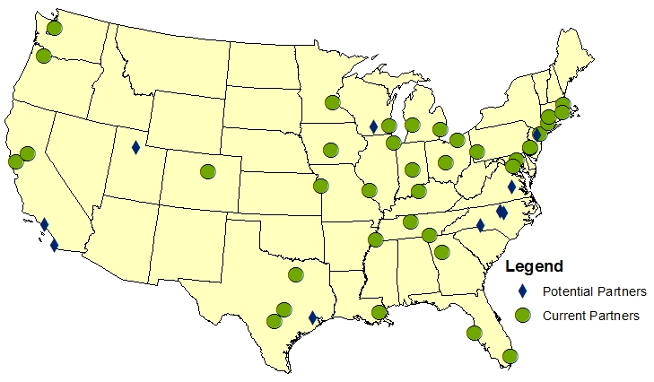
Trusted and Engaged Institutions
National Neighborhood Indicators Partners
Notes:
Grown from 6 founding partners to 37, and more on the way
The partners are housed in various types of institutions –universities, independent nonprofits, local funders.
But whatever the home, they are all respected organizations with a long-term stake in their community.
They are viewed as neutral - not tied to any one political agenda or issue area.
Data providers are secure that confidential data will be handled properly, and audiences trust of the rigor of the analysis.
Since they are on the ground, they can be responsive to community needs and emerging issues [give example if time]
Together, the partners are an amazing network for peer learning. Rich base of knowledge to draw from - allows new partners or existing partners tackling new issues to get a jump start from others’ past experiences.

Slide 4
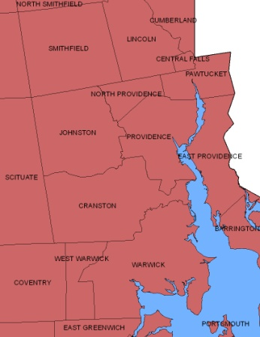
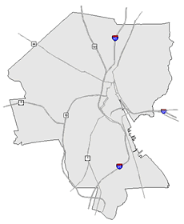
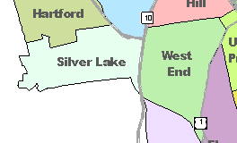
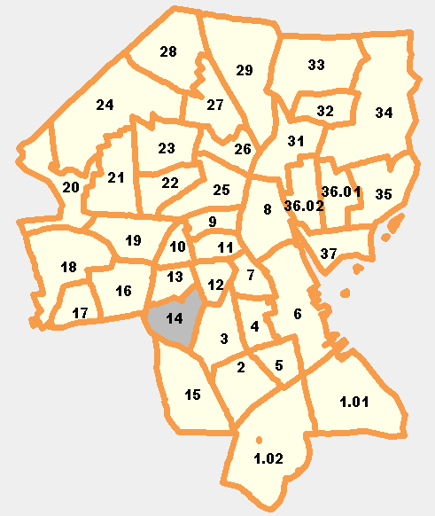
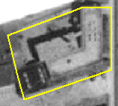
Relevant and High-Quality Data
Types of Data
  Crime
  Births, deaths
  Property sales, prices
  Education
  TANF, Food Stamps
  Child care
  Health
  Foreclosures
REGION
CITY
NEIGHBORHOOD
PARCEL
TRACTS
Notes:
NNIP would not be possible without access to local data. Local data is more impt than ever as the Census has switched from the long-form every 10 years to the 5-year averages and less precise American Community Survey.
The partners collect data from police, schools, health department; and add value by clean the data; and develop ngh-level indicators. This would be impossible for any one community based organization to do for a given project – it is more efficient to have 1 organization do it once for the community. There is an economy of scale.
Not just one-time project, but formal agreements to get the data recurrently to be ready when need for data arise
Neighborhood-level is key since problems are not evenly distributed across cities and priority issues vary across neighborhoods.
And the ability to cover many issues is critical: residents don’t experience their community in silos and the solutions aren’t siloed either. (obesity example?)
Result is a one-stop shop that is a flexible resource for the whole community.
This part is hard work and the systems are built incrementally. ?) The data holdings vary from city to city.
Perspective of investment in infrastructure – which requires commitment from partner org and their funders to grow and support the systems over time.

Slide 5
Mission: Data for Local Action
“Democratize Information”
  Facilitate the direct use of data by stakeholders
Serve multiple audiences and purposes
  But a central focus on strengthening and empowering low-income neighborhoods
Use information to promote collaboration
  Acts as a bridge among public agencies, nonprofits, businesses, resident groups
Notes:
Our principles and values drive our work all the hard work of compiling the data. The point is to get it used - whether for policymaking, community building, program planning.
The founding NNIP partners recognized that not everyone had equal access to information.
Focus started on and still in on low-income nghs that have traditionally not had access to data or skills to use it.
but we found that as NNIP partners matured they were also needed to help citywide nonprofits and even gov’t agencies find and use the data in their work.
Some of the most compelling stories are where data has been used to break down silos – among agencies, sectors, geographies.
Data brings people to the table to develop a common understanding of the issues, and new solutions emerge.
Example: School Readiness project – health care providers , day care and early education providers, public school system, child advocates, family support services. Gather data and indicators about young children in the community and bring everyone to the same table to help improve outcomes for the kids.

Slide 6
NNIP Partner Activities
Assemble, transform and disseminate data
Apply the data to achieve impact
  Assess and prioritize community needs
  Support place-based neighborhood initiatives with data collection, analysis, and evaluation
Use data to strengthen civic life and governance
  Enhance data capacity of local stakeholders
  Building a culture of data access and informed actions
Notes:
Three main roles…
Assemble: operate and maintain a one-stop shop for neighborhood level data on a variety of topics (housing, education, health, crime, etc.)
Applying : Getting the data out there is not enough, work side-by-side with others in the community to learn how the data can be used
Assess: Less $ and more need – importance of setting priorities and targeting programs
Place-based iniitiatives: Our partners have been very competitive in federal grants like Promise Neighborhoods and Sustainable Communities and many others. With the data infrastructure in place, a community can more easily show on a tight time frame of a grant application: 1) the need for the program; and 2) its ability to have a data-driven program and evaluate success of the programs.
Civic Life: Beyond any specific use of the data, there are broader goals
About improving the ability of all sectors of the community to access the data they need and know how to use it.
Raise expectations about access to quality information for the investment decisions that need to be made.

Slide 7
Advantages of NNIP partner support for place-based initiatives
Local data intermediaries bring:
  Knowledge of local context and players
  A strong reputation and network of pre-existing relationships
  Ability to connect initiative to other related efforts (either neighborhood-specific or city-wide)
  Knowledge of availability and quality of data sources
  Comprehensive approach to understanding neighborhoods, reflected in their multi-topic data collections
Efforts to assemble new data also contributes to system that can be re-used for other community needs.
Notes:
Advantage to using a locally-based intermediary – whether NNIP partner or trusted university or nonprofit evaluation partner
Knows who should be at the table, trajectories of neighborhoods
Standing in the community, “trusted broker”, pre-existing relationships
Being able to share information, in-the-know, connecting the dots
Data capacity is a given
Holistic perspective is most important – know that schools connected to housing connected to health connected to employment
***Following up on Tom’s point about infrastructure, any data work or organizational capacity built is sowed back into the community-wide resource and can be tapped for other purposes.

Slide 8

Data-Driven Organizing in Pittsburgh’s
Homewood Children’s Village
Thanks to Samantha Teixeira & Dr. John Wallace, Jr.
and Bob Gradeck for slides and story
Notes:
Story from our Pittsburgh partner – most of the work was in 2010 – give credit to PNCIS and individuals.
Dr. Wallace led the HCV at the time of this work in 2010.

Slide 9

The Village Approach
Follows the Promise Neighborhood model
Began with “1,000 conversations” to hear residents’ concerns
Learned that vacant and abandoned properties were one of Homewood’s key challenges.
Notes:
Homewood Children’s Village is modeled after the Harlem Children’s Zone, which inspired the Promise Neighborhood movement.
The model emphasizes: engage residents and build community, use proven programs, touch all the children in the neighborhood, and evaluate how things are going along the way.
[add background sometime how big, which section of town]
Began with listening to the parents about what they wanted to change in their community. Spoke with more than 1000 people to help prioritize their actions.
Housing conditions may not be the first thing that comes to mind for a child intervention, but the Village leaders recognized that their children and families need healthy neighborhoods to thrive.
For example, a brand new school had been built, but kids had to walk by unsecured homes or detour into the street when the sidewalk was overgrown.
On a neighborhood level, abandoned and problem properties attract crime and squatters. They also send an overall message that the neighborhood isn’t kept up.

Slide 10
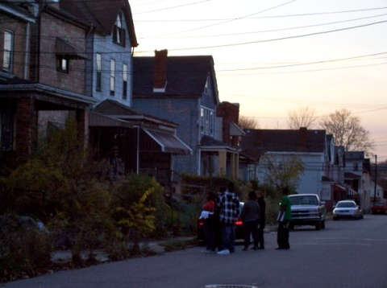
PNCIS Partnership in HCV Neighborhood Assessment
Research Review & Design
Data Collection & Integration
Data Visualization: MAPS!
Training
Analysis
Policy Action
Notes:
Once they identified the issue, the leaders reached out to our partner in Pittsburgh and came up with this plan.
Research Design: Contacted NNIP partners to review and ID existing property survey instruments including building inspection protocols and neighborhood assessment surveys
Data Integration: data integration strategy (Setting data collection and entry process up so that it could easily be integrated into the PNCIS system). They could them create maps that integrate the community-collected data with other PNCIS data like crime info and code violations
Training: Trained students and community organizing staff to use the results, got into the data driven mindset.
Data Analysis/Community Action: Look at patterns and identify policy mechanism to take action

Slide 11
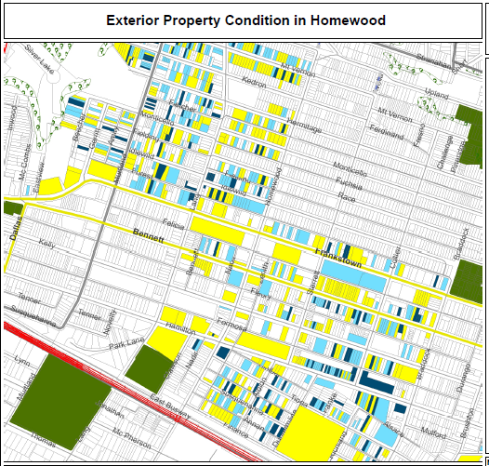
Legend
Exterior and Paint
Good
Fair
Poor
N/A
Notes:
They used the assessors file as the backbone of the system (with property ID, basic characteristics, ownership, and tax delinquency )
Student and residents implemented the property survey, noting the condition of each home.
Here is a map of the resulting data - Yellow is good, light blue is fair, dark blue is poor.
Map was shared and used for data driven organizing and presenting to block clubs.
[check with PNCIS – this is hypothetical or actual? Before and after assessments (does a block club affect the physical condition of a block? etc. ]

Slide 12
Data Driven Organizing
Homewood’s Dirty Thirty:
  Used joint database to identify worst properties in the neighborhood
  Mobilized residents to call the 311 Response Line and advocate for boarding up the properties
  23 of 30 properties were boarded up, torn down, or otherwise improved within about a month
Notes:
Together they came up with a collective action plan. Their data identified properties that were vacant and open to entry. They worked with residents to agree on the worst 30 properties in the area.
Residents in neighborhoods like Homewood have reasons to be skeptical about receiving good city services.
But as the group and armed with the data, they were willing to engage with the system. Within 1 month, more than ¾ of the properties had been attended too.

Slide 13
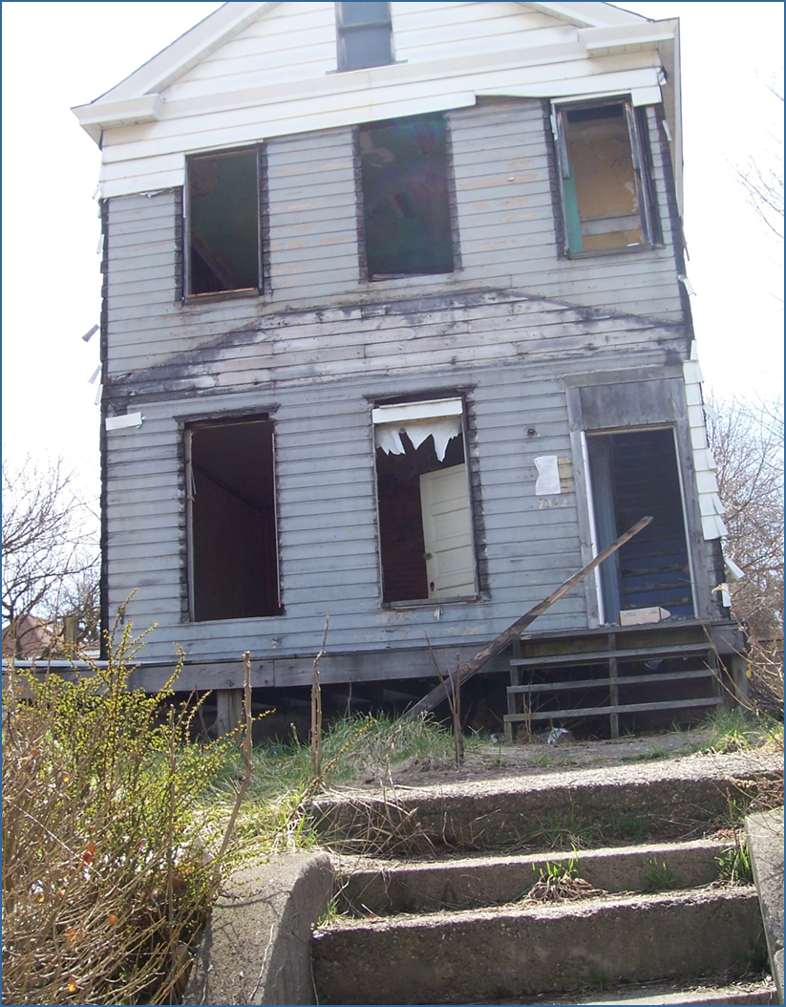
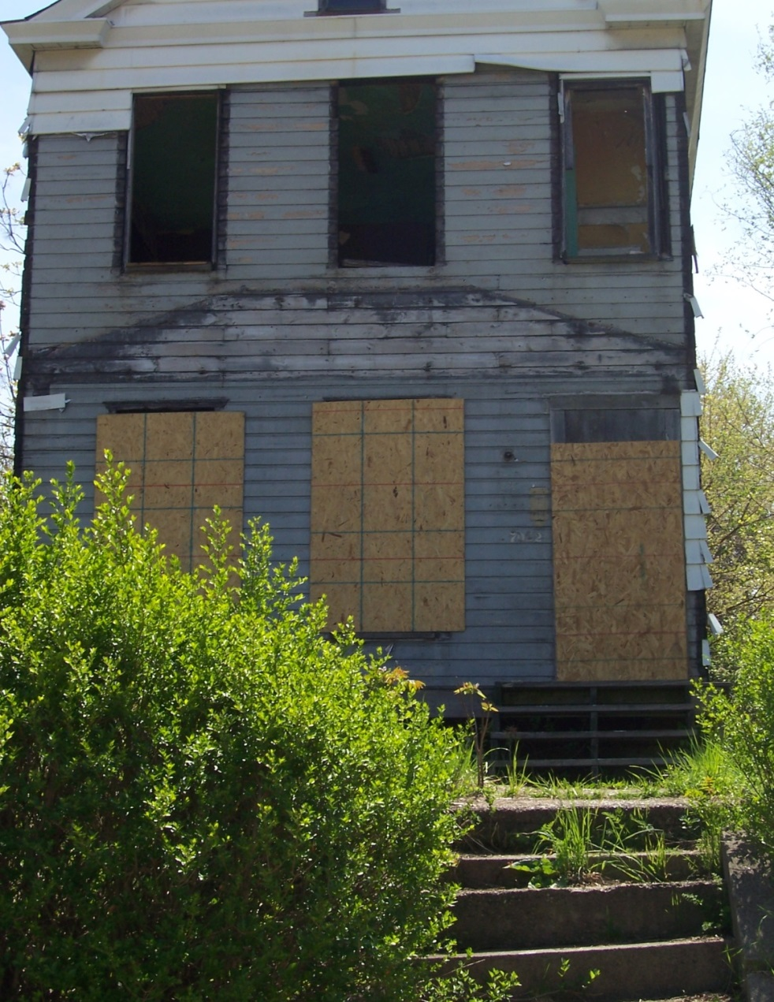
Before
After
Notes:
Here is an example of a property secured by the city

Slide 14
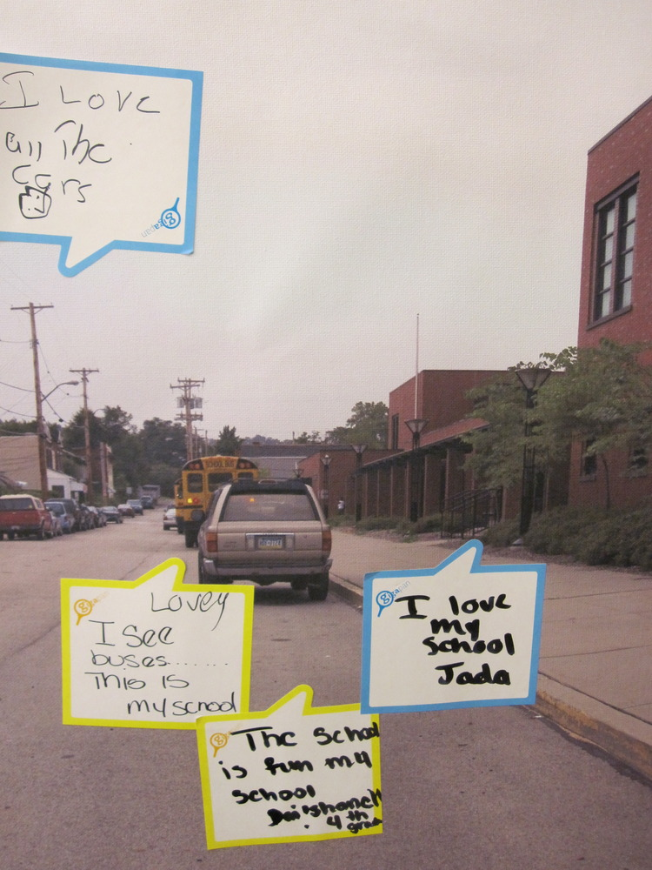
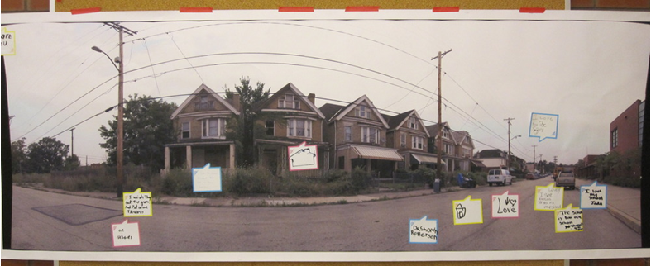
Gigapan
Document neighborhood conditions
Collect input from residents
Notes:
PNCIS recognizes that quantitative data does not capture everything that is important. They use photos to document baseline conditions and the neighborhood as it changes.
They engage school children to talk about what is good and bad about their neighborhood

Slide 15
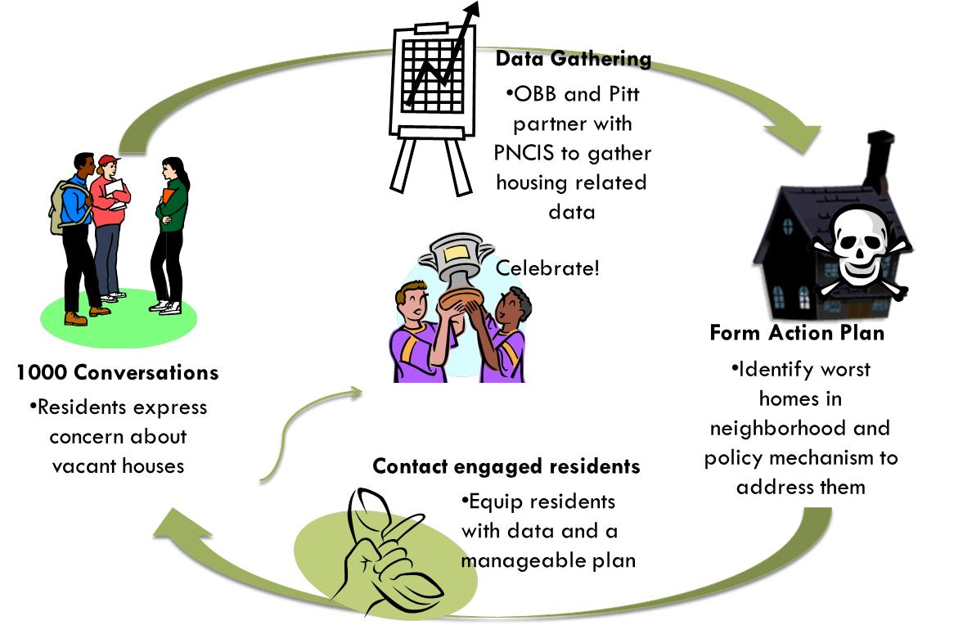
Notes:
So here’s a recap of their process
[walk through steps on slide]
PNCIS partnered with them in all the stages, but the data was nested in a change initiative and directly relevant to their work.

Slide 16
Impact
Bring resources back to the neighborhood to help children and families
Improve built and physical environment
Make the neighborhood a safer place for children
Strengthen residents’ capacity for action
Notes:
Short-term – bring city investment into the ngh and secure the individual properties so that its safer for children (both physical safety and less crime)
Just as important, residents learned they could take collective action to improve their neighborhood
Long-term - improving abandoned homes helps image and raises property values
This is not just a one-time project. Organizations in the community (Operation Better Block) are still accessing the data from the Website – they’re working on a neighborhood plan with the trained their staff
Update as of 6-2013 – PNCIS continues to work with the Children’s Village and provide information in support of property acquisition efforts. They are also discussing new work on a cross-disciplinary health project.
[Note: would be good to find out if the survey data has been/will be updated]

Slide 17
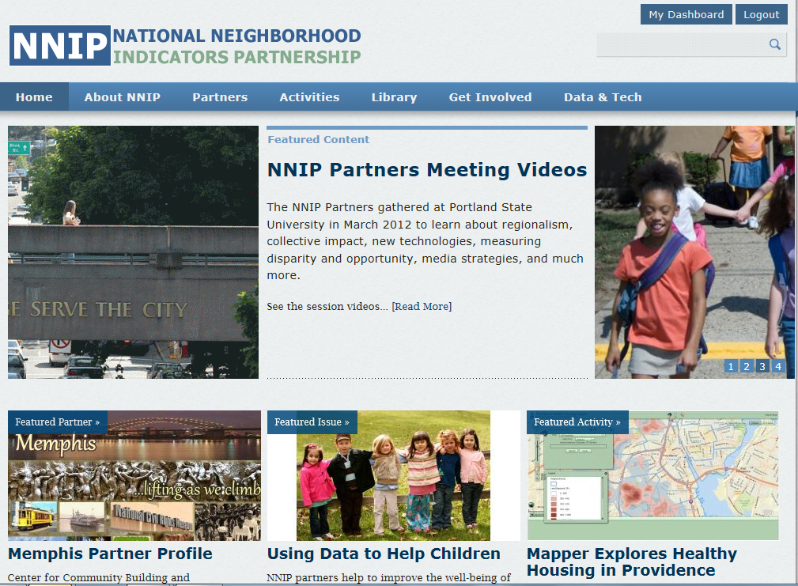
www.NeighborhoodIndicators.org
Notes:
Here’s our web site where you can find out more about NNIP and our partners
www.NeighborhoodIndicators.org

Slide 18
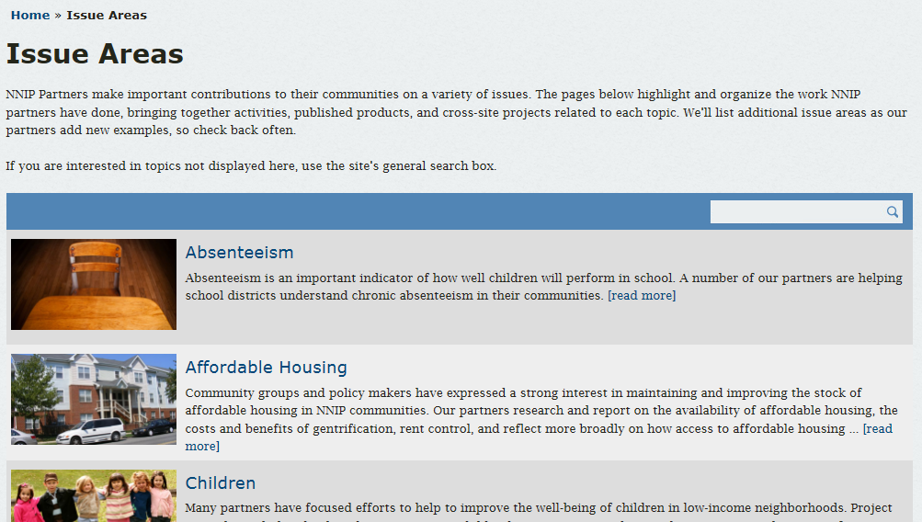
http://www.neighborhoodindicators.org/activities/issues
Notes:
In particular, there is an issue area page to help you connect directly with specific content areas in which our partners work.
Sections on promise Neighborhoods and Sustainable Communities

Slide 19
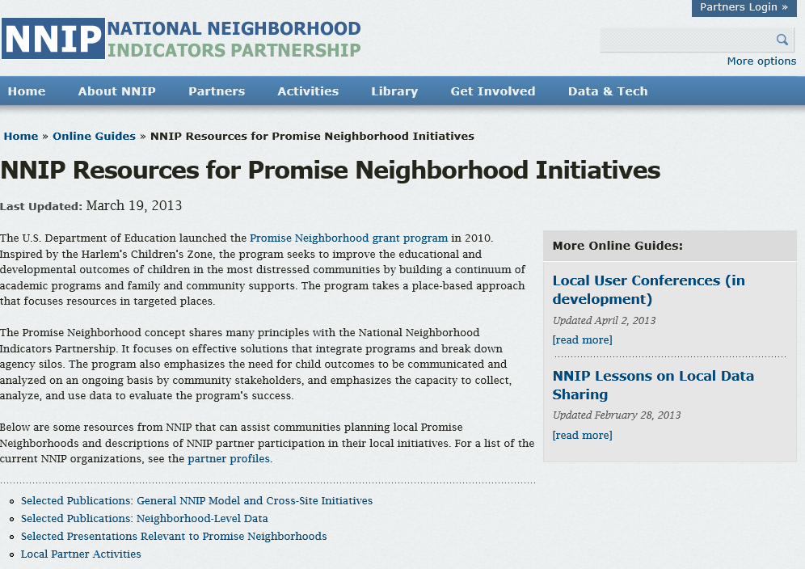
http://www.neighborhoodindicators.org/library/guides/nnip-resources-promise-neighborhood-initiatives
Notes:
In particular, there is an issue area page to help you connect directly with specific content areas in which our partners work.

Slide 20
From Information to Action: Lessons from NNIP
National Neighborhood Indicators Partnership
Better Data. Better Decisions. Better Communities.
Kathy Pettit, The Urban Institute
UNCA Neighborhood Revitalization Conference
June 27, 2013
Notes:
Thank you…

