Slide 1
USING DATA TO SPUR COMMUNITY PROBLEM-SOLVING
CASE STUDY OF AUSTIN’S COMMUNITY SUMMITS
KATHY PETTIT, THE URBAN INSTITUTE
JULY 24, 2014
NEIGHBORHOOD REVITALIZATION CONFERENCE
Notes:
Introduce myself – excited to be here

Slide 2
National Neighborhood Indicators Partnership
Collaborative effort of Urban Institute and local partners since 1995.
All partners regularly assemble, organize and transform neighborhood-level data to support local decisionmaking.
Success based on:
Trusted and engaged institutions
Relevant and high-quality data across topics
Mission to support use of data for local action
Notes:
MODEL is not the focus today, but happy to answer other questions.
Bullet 1: Started with 6 partners, now at 35
Institutions:
The partners are housed in various types of institutions – universities, independent nonprofits, local funders.
But whatever the home, they are all respected organizations with a long-term stake in their community.
Data:
Partners all recurrently collect local government data at the address or small area-level on a range of issues – housing, schools, crime, etc.
There is an economy of scale to having one group provide the service for the community.
Mission:
NNIP partners’ values drive all the hard work of acquiring and organizing the data. The point is to get the information used - whether for policymaking, community building, program planning.
The founding NNIP partners recognized that not everyone had equal access to information. Focus began with and remains on low-income nghs that have traditionally not had access to data or training to use data.
EXTRA
The systems are built incrementally, so partners have different sets of data depending on local context.
They handle confidential data responsibly, summing up individual-level data to neighborhood indicators to share broadly.
But partners serve wide range of clients - helping citywide nonprofits and even gov’t agencies find and use data in their decisions.
Network:
UI coordinates the network: organizes partner meetings, helps new partners get started, develops cross-site projects, and serves as a national advocate for the importance of local capacity to use data to inform community action.

Slide 3
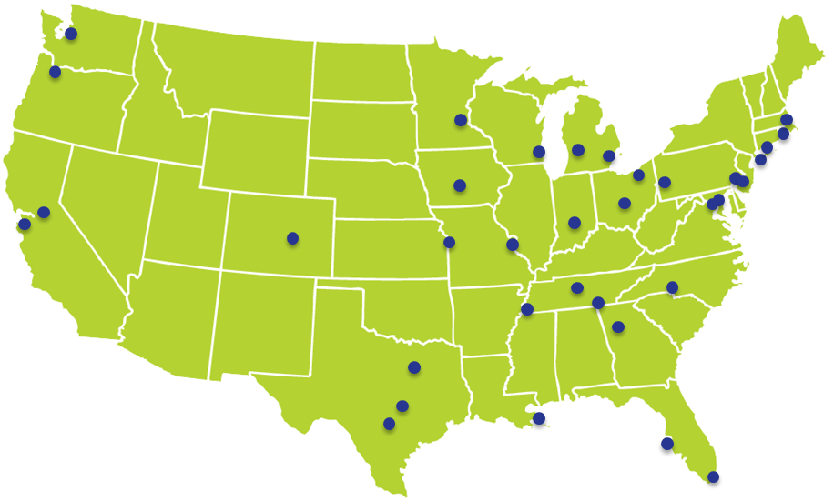
Better Data. Better Decisions. Better Communities.

Slide 4
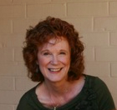
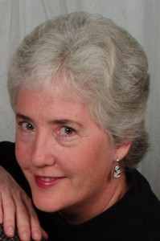
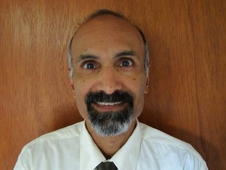
Thanks to Children’s Optimal Health for sharing their story!
www.childrensoptimalhealth.org
Maureen Britton
Executive Director
Susan Millea
Community GIS Facilitator
Mohan Rao
Spatial Analyst
Notes:
Mission: To enable communities through GIS mapping to visualize the health of their neighborhoods, identify assets and needs, and unearth opportunities for collaborative change.

Slide 5
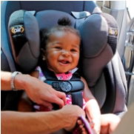
Community Summits
Summits are a focal point of a longer community problem-solving process.
Approach has been used for several topics.
Notes:
Introduce idea of the summit – my presentation focuses more on process than findings or issue areas to help you think about whether this would work for your community.
Summits are a focal point of a longer community problem-solving process - preparation, event, and follow-up
Topics: Child obesity
Transportation-relation child injury
Child and youth risky behavior
Afterschool programming

Slide 6
Operating Principles
Cross-sector and inclusive
Elected and administrative government officials
Teachers and principals
Staff from service and advocacy nonprofits
Health professionals and other specialists
Business leaders
Shared agenda-setting
Shared recognition
Actionable information
Notes:
Operating principles
Cross-sector and inclusive – need to understand an issue from all sides – list of types of participants.
Agenda-setting: consider partners’ missions and motivations as they develop the agenda.
Example (but not sure related to summit directly): When CoH first approached the Dell Valle (spelling correct) school district, obesity was not on the priority list of school officials because they were about to lose their federal grant that paid for all of their after-school programming. CoH could have walked away to find another district to work with, or tried to persuade Dell Valle to alter their own agenda. Instead, Susan and colleagues arranged for a meeting with the school district and relevant county officials. Through their discussions, the County agreed to make up the lost funding. CoH had a voice in including physical activity in the out of school time programming, but it’s folded into the school districts larger agenda.
Shared recognition: Child injury summit is co-sponsored with the trauma center at Dell Children's. The Center is required to work on prevention and publish research as part of their national accreditation process, so the Summit helps their institution too.

Slide 7
Preparation and Outreach
Data collection and analysis
Outreach
Who works in this space? Who needs to be connected?
Not just usual suspects – look for different voices and perspectives
Engage people up and down chains of command
Notes:
Preparing for a summit starts with thoughtful planning several months ahead of time.
Data are not the focus of this presentation, but happy to answer more questions about the topic in the Q&A or afterwards.
Outreach – walk through questions. For example, in the summit on youth substance abuse, they realized the health folks had never discussed the issue with the juvenile justice front line staff who worked with troubled youth every day.
They also share early data analysis, particularly with data providers/owners

Slide 8
Summit Planning and Logistics
Keep direct costs low by having space and catering donated by business partners.
Ask people about interests during registration process (Austin has hosted100 to 200 people).
Recommend a half-day session in the morning.
Reserve the room for additional time afterwards for networking and organizing.
Notes:
#4 They have gotten feedback that the un-structured networking time is very valued by the participants, so they build in the expectation for it. More conversations and planning can happen on the spot while people are energized about the topic.

Slide 9
Summit Ground Rules
“Leave your title at the door.”
Be prepared to listen – even though it might challenge your current understanding.
Gather everyone’s ideas and suggestions.
Sharing different perspectives is essential to developing a common understanding and vision.
Notes:
1. No status – from parents to front-line workers to business executives.
Focus on listening and learning new ideas (could move to “operating principles” slide)
3. Everyone matters, not just the people who feel comfortable speaking in a group. They gather participant feedback from everyone though answering questions on index card.
Throughout the Transportation-Related Child Injury Summit II attendees filled out index cards to help answer 3 questions:
1. Based on current initiatives, what kind of framework would allow for better collaboration?
2. What distinguishes child safety issues from those of adults?
3. How and where do we make changes?
4. Finally, the Summit is rooted in the value of different perspectives – people have different viewpoints on the causes of a problem and what can be done.

Slide 10
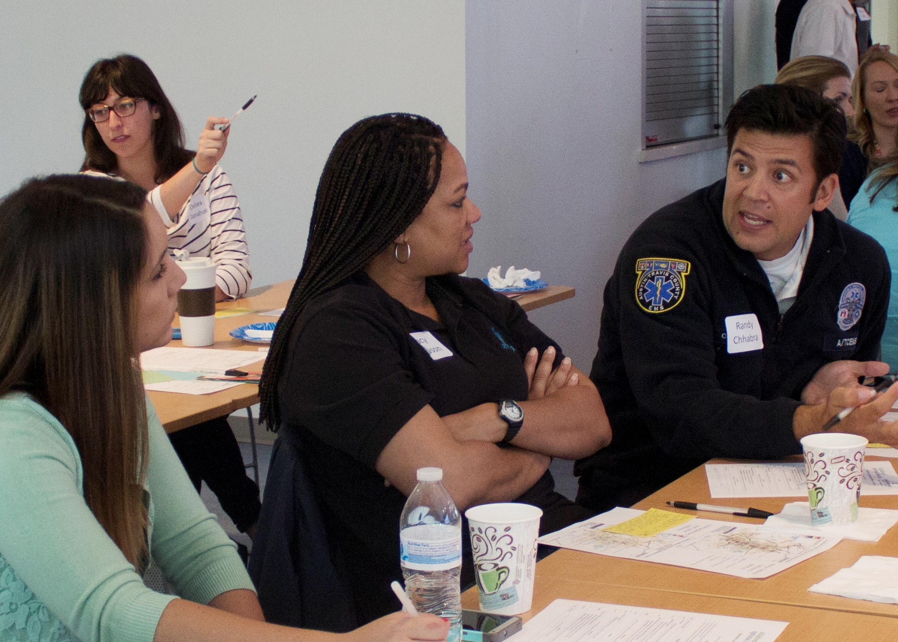
Summit Format
Notes:
Format:
Guest speaker – experts like head of the trauma center
Presentation of analysis (primarily maps while I’ll discuss in a minute)
Panel that brings in different voices (juvenile justice people, advocacy and service groups). For example, in the session on maternal and infant health, an advocacy group help identify a panel of Hispanic and African-Amer. women who had bad experiences with the formal health care providers and talk about why they did not seek OB care. This also helps foster cultural sensitivity.
Small group discussion (4 to 8 people)
Breakout groups – also planned with thought – thematic tables (note “access to alcohol” tent in pic), neighborhood tables, etc. but always the ability to create your own group.
No assignment, but encourage mixing (EMS person in pic)

Slide 11
Approach to Presenting the Data
Use multiple sources to understand the problem and potential solutions.
Include community needs and assets.
Admit imperfections and limitations.
Enlist participants to fill out the picture (including tangible and intangible).
Notes:
Use multiple sources – for obesity, they mapping the physical fitness scores, but also the parks, health food outlets, and fast food restaurants.
Balance negative indicators with recognition of assets - Examples depending on the topic, but include Playgrounds, Libraries, Faith Communities, but also individuals that serve as community leaders and supports.
Admit the administrative data are incomplete and imperfect – ask the participants to contribute to the data collection process.

Slide 12
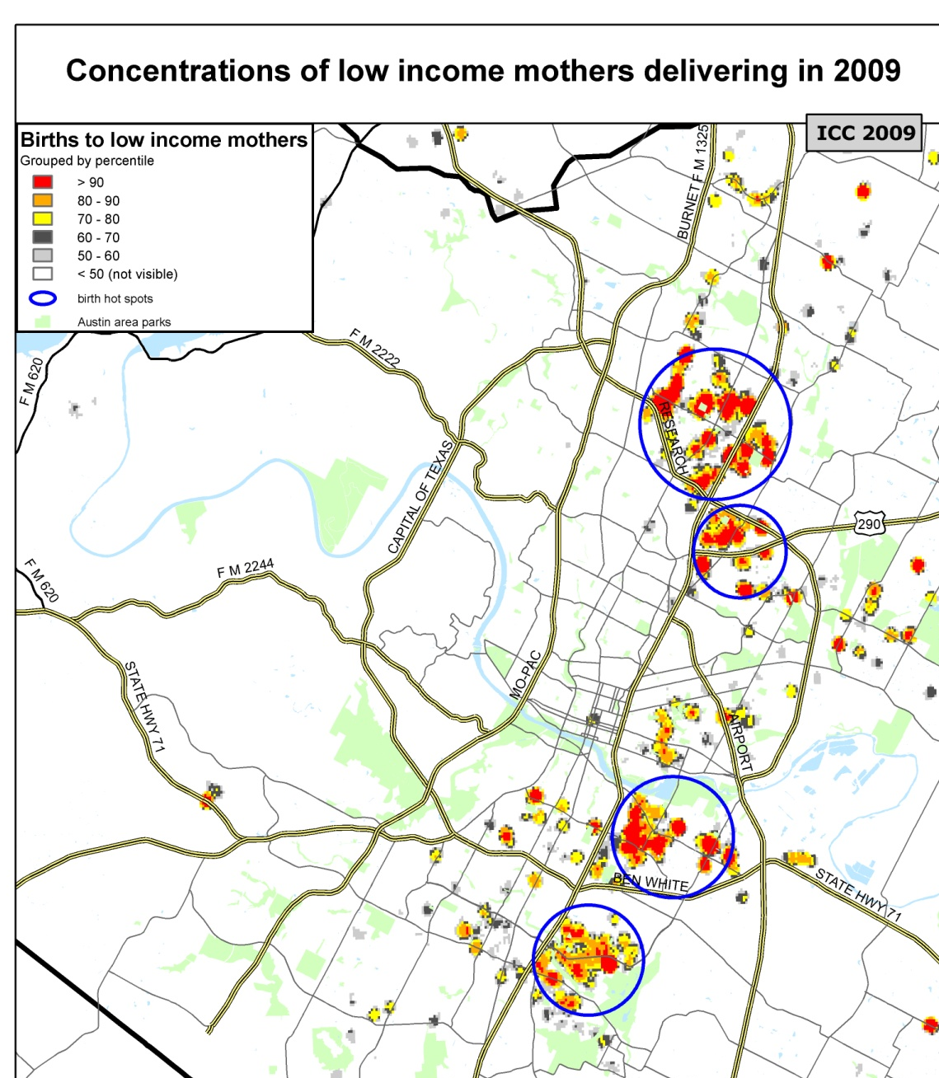
Benefits of Mapping
People naturally relate to their own neighborhood.
Maps transcend language and education barriers.
Encourages thinking about different causes and solutions for different areas.

Slide 13
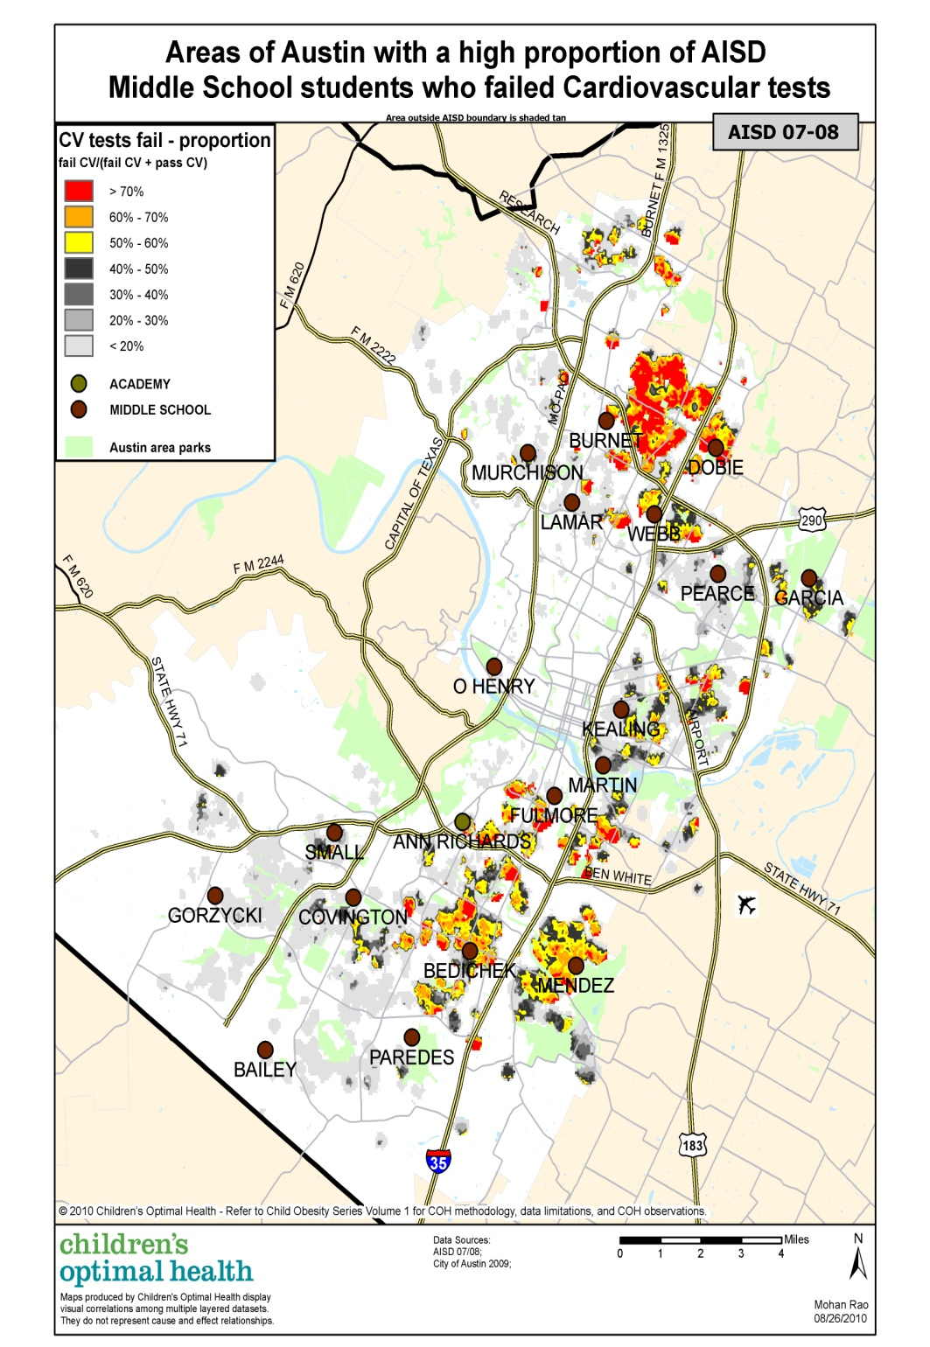
2007-08
Concentrations of middle school students who failed cardiovascular tests,
Austin School District
Notes:
Included some maps to give you a flavor and to show value of examining the data over time and how the data can surprise you.
Describe what map is showing - The red color indicates the highest concentration of students by residence by decile. Orange represents the second highest concentration.
At the beginning of the period, the more than 70 percent of the middle school children in the area had poor cardiovascular health in the NE area in the blue box.

Slide 14
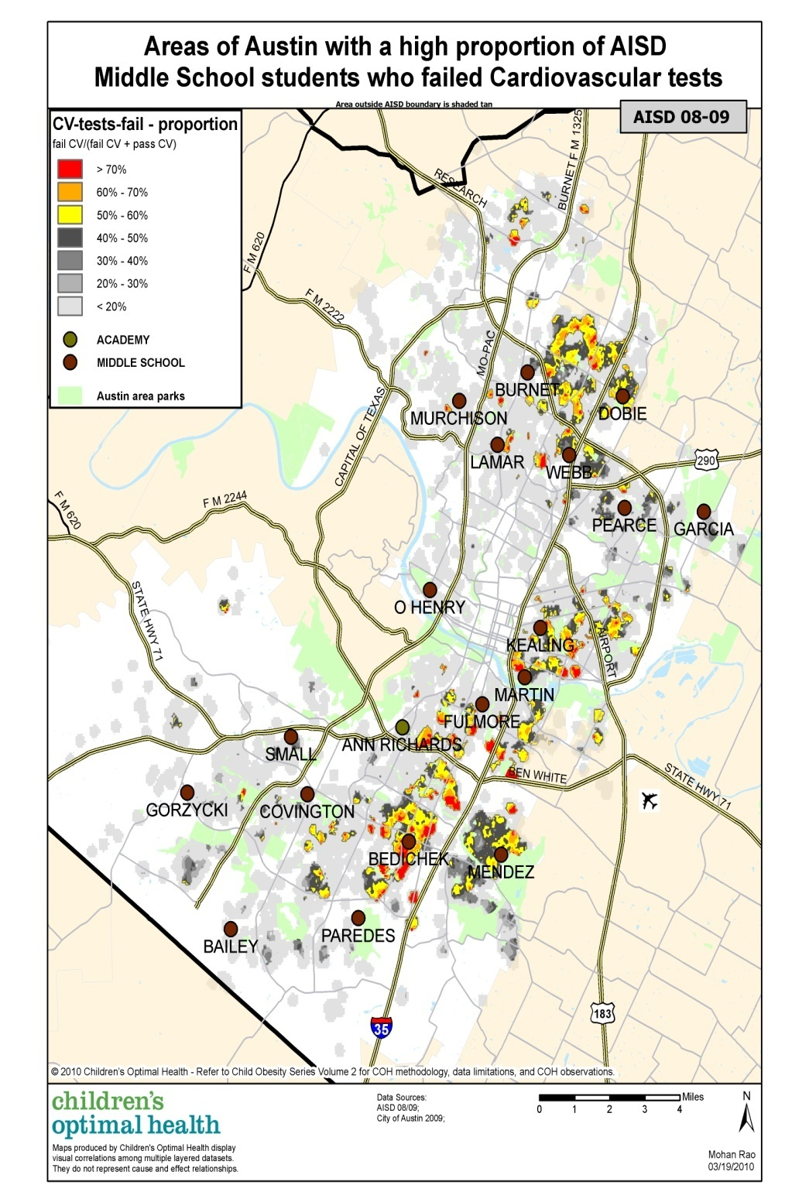
2008-09
Concentrations of middle school students who failed cardiovascular tests,
Austin School District

Slide 15
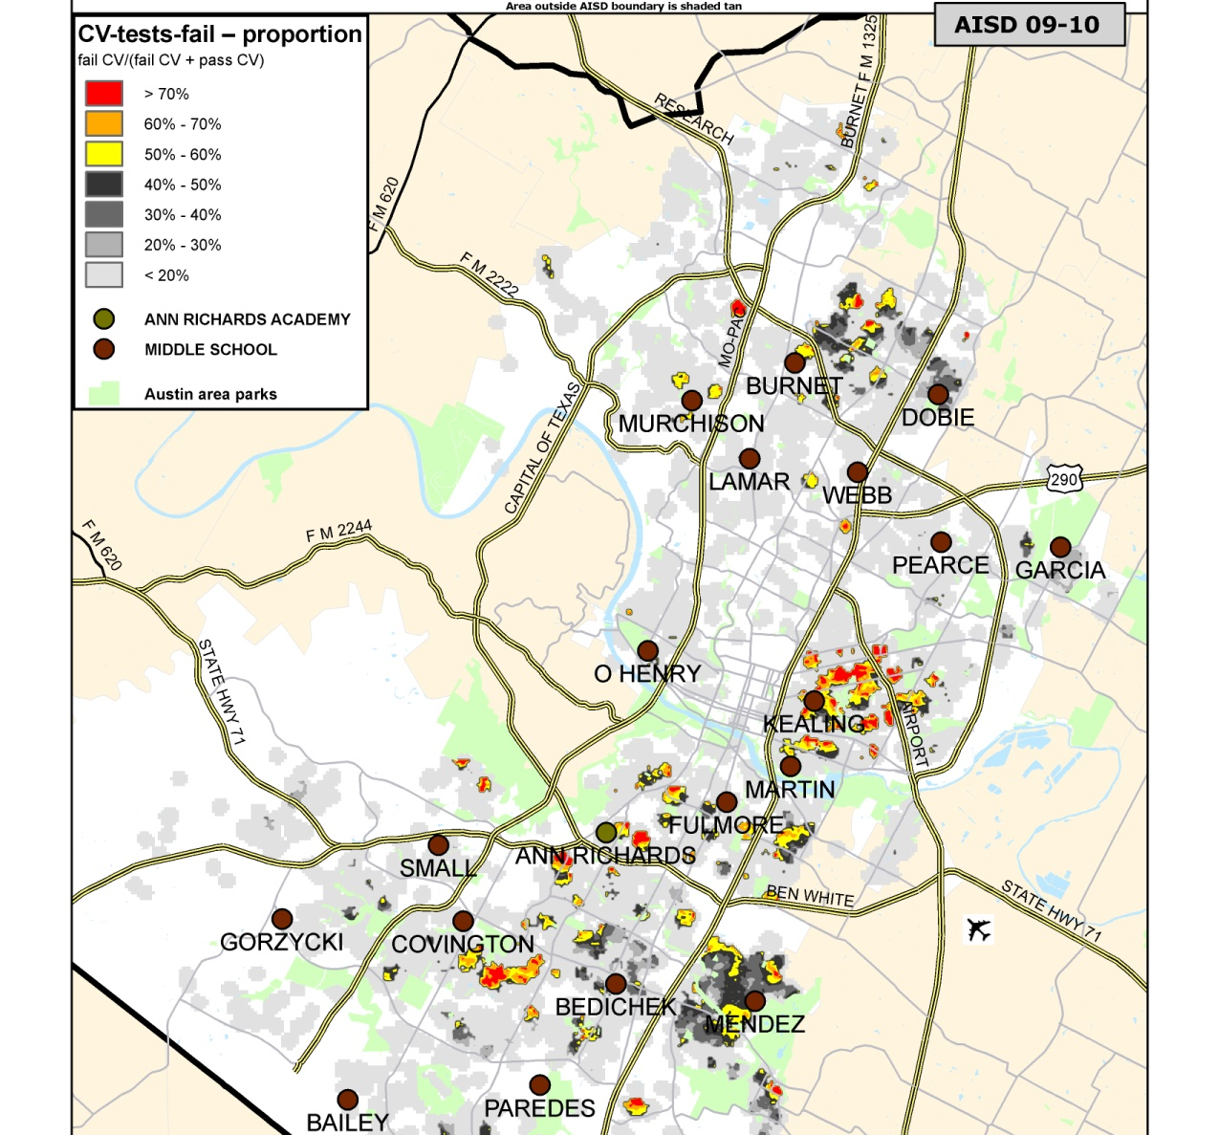
2009-10
Concentrations of middle school students who failed cardiovascular tests,
Austin School District
Notes:
By 2009/10, the rates had fallen to less than 50 percent for much of the area. After inquiring with the school district staff, they learned that the district had piloted a program called HopSports designed to increase physical activity at the three middle schools that served the neighborhood. COH presented this story and updated analysis for the whole district at a second AISD community summit in November 2010.
Problem is not solved – still many children, but is inspiration to the community that interventions can make a difference – this program was expanded to all of the middle schools through a foundation grant.

Slide 16
Beyond the Summit
Report out – summary of written answers and discussions.
Reflect on exchange and asking questions.
What are the barriers to action?
What needs to be changed?
Present to smaller/targeted groups (parents meetings, neighborhood groups, etc.)
Build coalitions for moving forward.
Continue data collection and analysis.
Notes:
CoH writes up all the ideas from the summit and makes them available on their website.
What usually comes out is an informal gap analysis – what is lacking and how to bridge gap. What change is needed?
Continue with presentations to smaller or more focused audiences
BUILD COALITIONS: They hold these summits to develop new connections and open lines of communication across sectors.
They have developed new coalitions out of the summits.
Travis County youth substance abuse prevention coalition - had fell apart for 10 years after fed. funding dropped).
City resolutions that direct city managers to do cross-sector group to tackle child injury issues.
And ask for commitments: for example, AISD School Board included student health as a core value.

Slide 17
Selected Accomplishments
Targeted allocation of resources by City and County to neighborhoods of highest need.
City planning to include sidewalks and hike/bike trails in targeted neighborhoods.
Improved physical education and health curriculum in schools.
School readiness action plan sponsored by United Way.
Child seat giveaways and trainings in neighborhoods with high levels of child injury.
Notes:
Long-term problems, so no one thinks things will be settled overnight
Other: Improved awareness and advocacy around importance of school recess

Slide 18
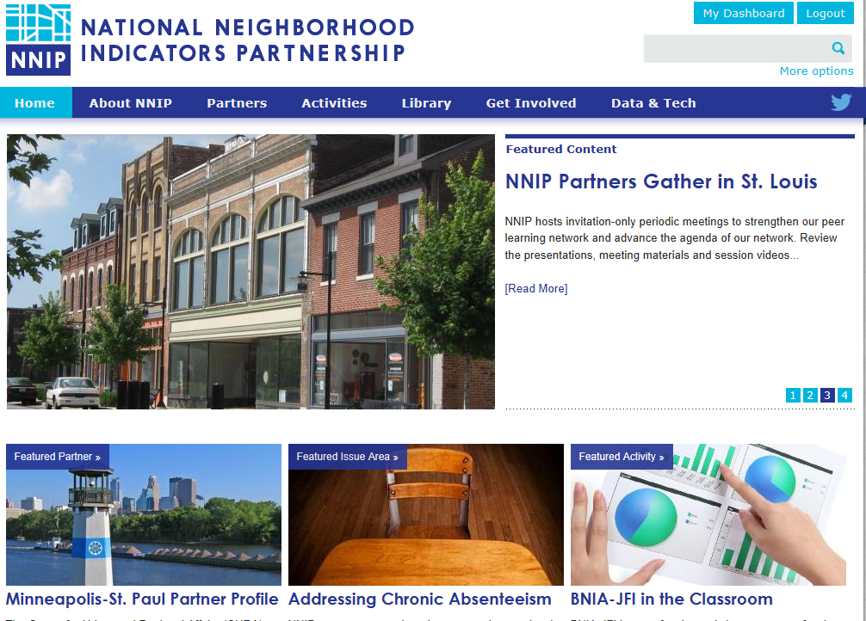
www.neighborhoodindicators.org
Notes:
Mention listserve and Twitter

Slide 19
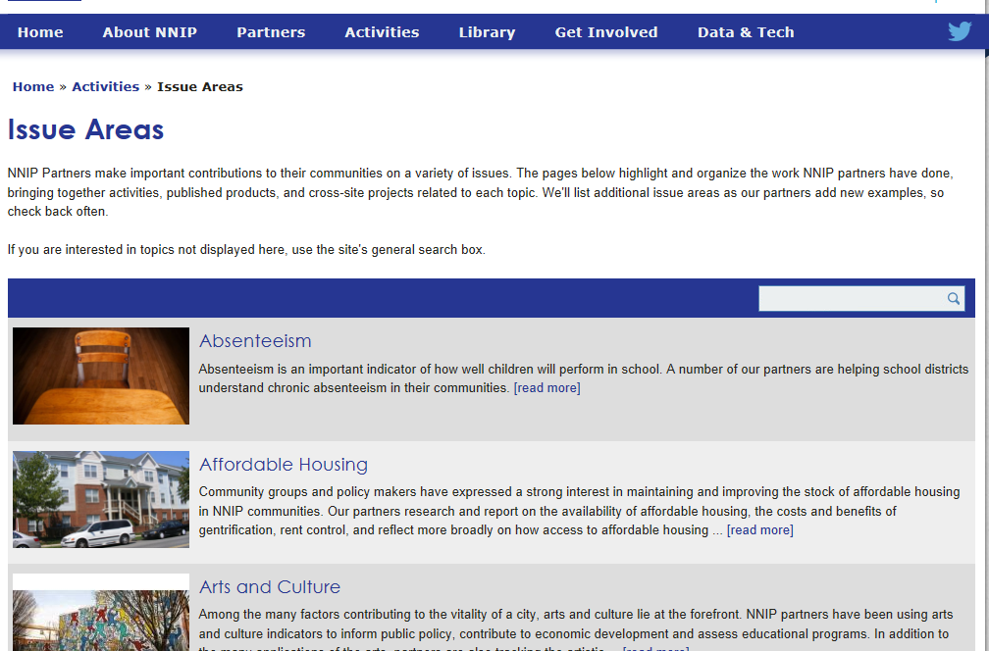
Notes:
Promise, choice neighborhood section

Slide 20
Follow us on Twitter @NNIPHQ
For more information about NNIP, visit www.neighborhoodindicators.org or
email Kathy Pettit at kpettit@urban.org

