Slide 1



Salt Lake City Carpe Datum Conference - April 25, 2013

Slide 2



Today’s Speakers
Chris Kingsley
Senior Associate for Data initiatives
Kathryn Pettit
Senior Research Associate
Metropolitan Housing & Communities Policy Center

Slide 3
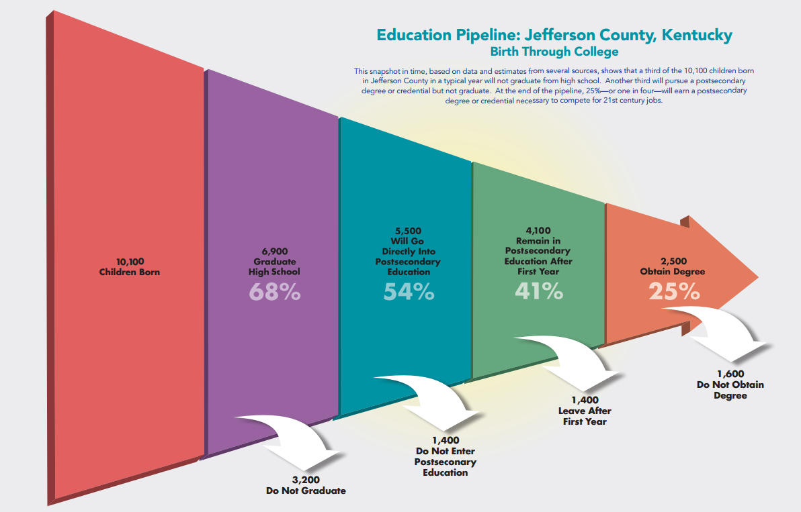

Catalyze Action

Slide 4
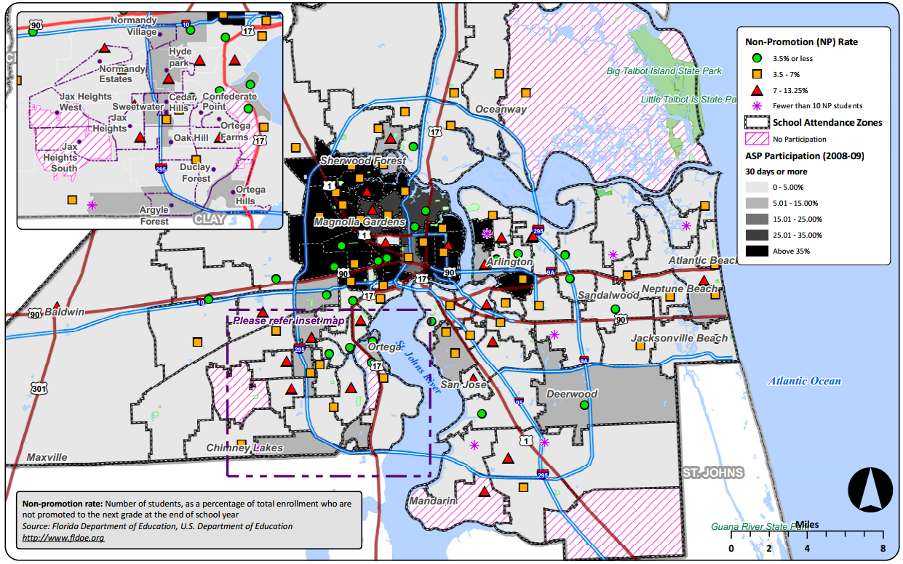

Guide Resource Allocation
High afterschool participation
Keeps non-promotion rates low,
even in disadvantaged areas.

Slide 5



3 Principles: Community Data Systems
multi-function, multi-purpose data infrastructure
neutral intermediary (“data Switzerland”)
locally owned and managed

Slide 6
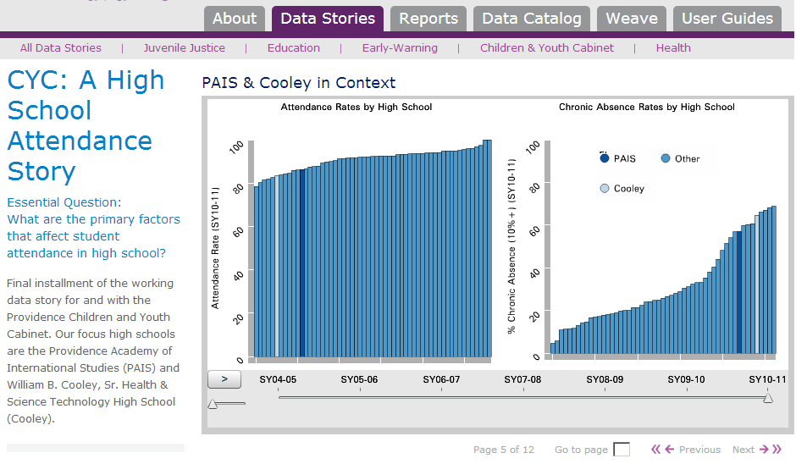
Providence Plan: RI Data Hub

Slide 7

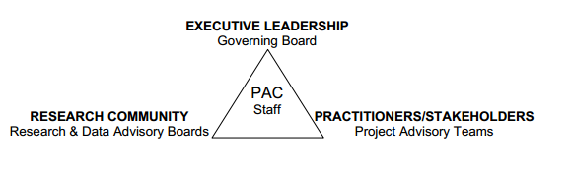
Philadelphia – Policy Analysis Center

Slide 8

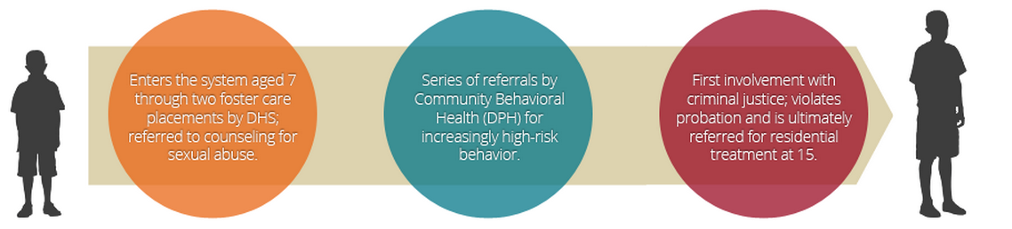
San Francisco: Shared Youth Database

Slide 9
Today’s Speakers
Chris Kingsley
Senior Associate for Data initiatives
Kathryn Pettit
Senior Research Associate
Metropolitan Housing & Communities Policy Center

Slide 10
From Information to Action: Lessons from NNIP
National Neighborhood Indicators Partnership
Better Data. Better Decisions. Better Communities.
Kathy Pettit
Salt Lake City Carpe Datum Conference
April 25, 2013
Notes:
Introduce myself, thanks for including us in the exciting day
About the network and our partners
Examples

Slide 11
National Neighborhood
Indicators Partnership (NNIP)
Collaborative effort since 1995
  Urban Institute & local partners; now 37 cities
  All partners build and operate neighborhood level information systems using local data
  Success based on:
    Trusted and engaged institutions
    Relevant and high-quality data
    Mission to support use of data for local action
Notes:
Collect administrative data from multiple sources

Slide 12
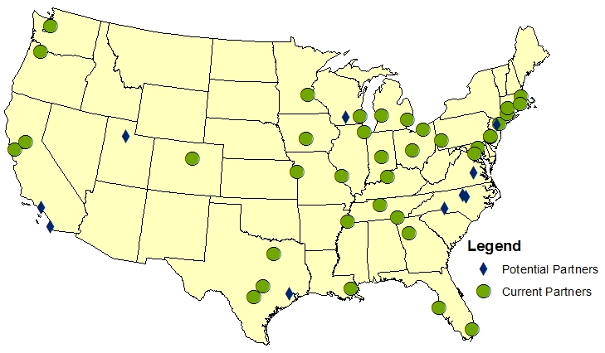
Trusted and Engaged Institutions
National Neighborhood Indicators Partners
Notes:
Many major cities and more on the way
Types of institutions – trusted, neutral,
Network of peer learning – allows new partners or existing partners tackling new issues to get a jump start from others’ past experiences

Slide 13
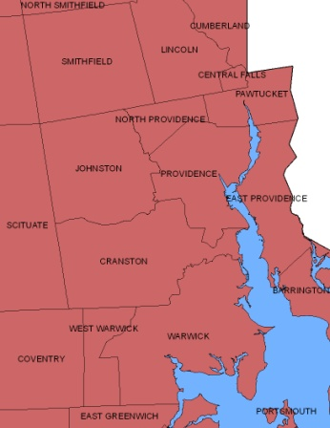
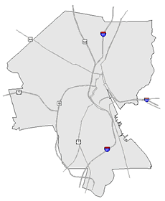
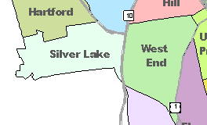
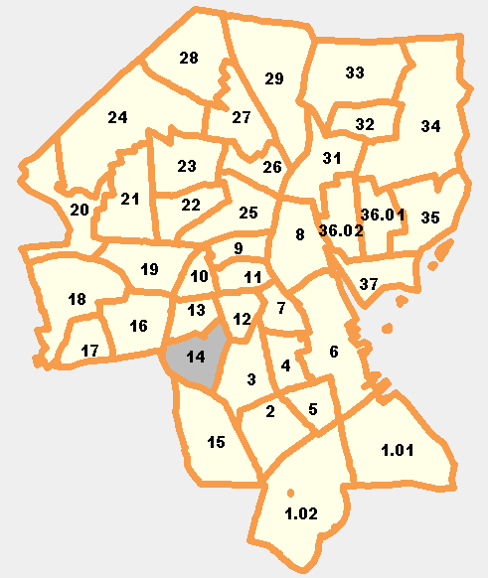
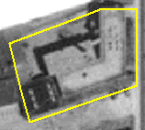
Relevant and High-Quality Data
Types of Data
  Education
  Child care
  Births, deaths
  TANF, Food Stamps
  Health
  Crime
  Property sales, prices
  Foreclosures
REGION
CITY
NEIGHBORHOOD
PARCEL
TRACTS
Notes:
Relevance – linking
Geography Matters - City-wide trends not helpful for action
Problems are not evenly distributed across cities.
Priority issues vary across neighborhoods.
People can relate to data analysis at the neighborhood level.
Partners cover many issues, recognizing residents don’t experience their community in silos (inventory summary available)
Partners generally receive information at the address level and aggregate to varying levels of geography depending on the audience and issue at hand. PARCEL AND NGH
Incremental, perspective of building infrastructure; not just one-time project, but formal agreements to get the data recurrently. Careful about confidentiality
One-stop shot

Slide 14
Mission: Data for Local Action
“Democratize Information”
  Facilitate the direct use of data by stakeholders
Serve multiple audiences and purposes
  But a central focus on strengthening and empowering low-income neighborhoods
Use information to promote collaboration
  Acts as a bridge among public agencies, nonprofits, businesses, resident groups
Notes:
Principles and values –
Not just research project extracting from the community, but long-term partnership
Importance of infrastructure is that data is re-used for many different purposes
Checking on low-income terminology
Breaks down silos, brings people to the table to develop a common understanding of the issues
Example of School Readiness project – health care system, day care providers, public school system, child advocates, family support services.

Slide 15
NNIP Partner Activities
Assemble, transform and disseminate data
Apply the data to achieve impact
  Assess and prioritize community needs
  Support federally-funded neighborhood initiatives
  Develop comprehensive community indicator projects
Use data to strengthen civic life and governance
  Enhance data capacity of local stakeholders
  Building a culture of data access and informed actions
Notes:
NNIP partners play multiple roles…
Assemble, etc.: New SLC system is great example
Getting the data out there is not enough, work with others in the community to learn how the data can be used.
Deliberate selection of key indicators to assess quality of life
Cross-sector recurrent review of indicators across topics
Federal initiatives =the application and implementation of

Slide 16
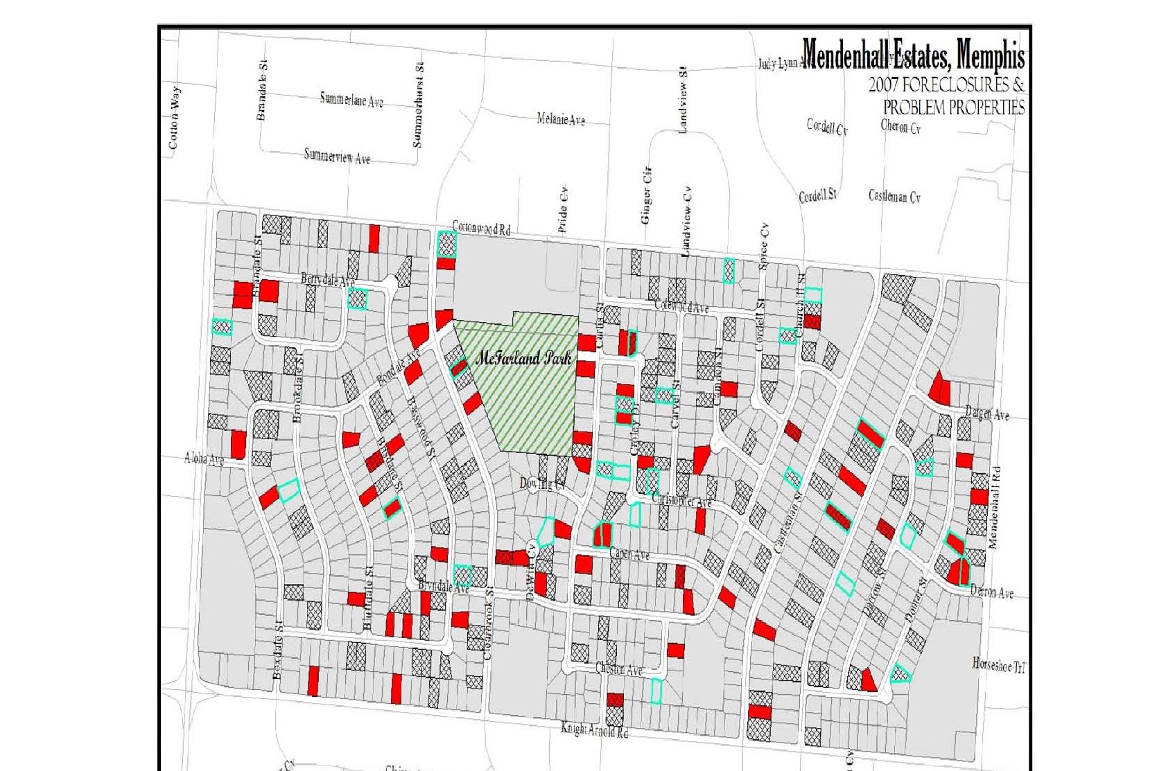
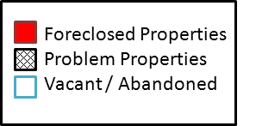
Combine Data Sources to Inform Policy
Source: Center for Community Building and Neighborhood Action, University of Memphis
Notes:
Don’t talk through in detail…
Here is a product of their work – able to tell where the homes were that were poorly maintained. They had initially thought most of the worst would be properties in foreclosures, but they found out that there were many problems with homes not in foreclosure –
Outcomes:
- Documentation for city-and private foundation-sponsored receivership actions against problem properties
- Selection of our new community development organization targeted neighborhood areas
- Background data for city acquisition strategies

Slide 17
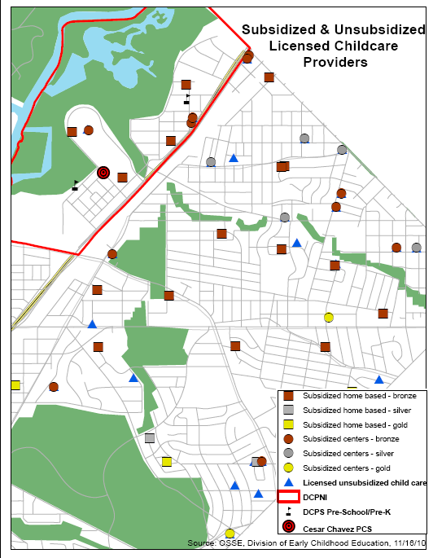
Map Resources & Analyze Gaps
Source: NeighborhoodInfo DC
Notes:
Current capacity as we know it: 3 center based centers and 4 home based centers – total capacity of 22 infants and 102 older children (what age is “older”?)
Questions: are these children from the neighborhood? We need access to individual level data to track those children and ensure they are from DCPNI
What is the rating/quality of these services? What is their curriculum? What do we know about these programs?
Also, there are 51 infants and 62 older children at 2 other center based care. Is this in our scope of work?
Needs assessment and segmentation analysis
Understanding the status of neighborhood residents
Government Performance Reporting Act (GPRA) indicators
Strategy development
Data systems
Longitudinal case management system (individual)
Aggregated data tracking system (school and neighborhood)
Performance monitoring and outcome evaluation
Process study
17

Slide 18

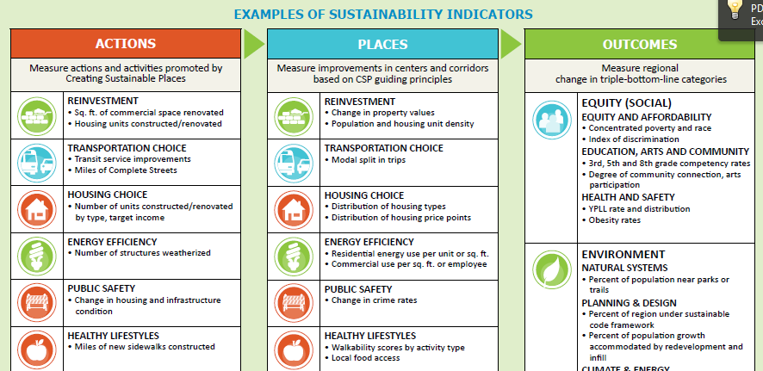
Identify & Measure Program Outcomes
Source: Mid-America Regional Council
Notes:
HUD-DoT Sustainable Communities - unusual in that the partner themselves are developing the program as well as the data/analysis in-house
Chose 6 commercial corridors; tied to transit improvements. Integrating regional and local perspective.
This is from Implementation Guidebook: for Sustainable Development in Greater Kansas City
detailed statement of principles, overarching goals, and steps for implementation
Trying to have a few key ones across 6 corridors, along with ngh-specific outcome goals, but getting some pushback from ngh stakeholders

Slide 19

Reducing chronic absenteeism in Oakland
Notes:
Give credit to Urban Strategies Council – Steve Spiker
Explain importance of absenteeism

Slide 20
Understanding the Problem
Notes:
Define Chronic Absence
Figure out who is affected
chronic absence (missing 10% or more of school days)
Poverty and Health
Family and Student Relationships with School
Reactive Attendance Policy

Slide 21
Understanding, continued
 | Number of Schools
Chronic Absence Rate | Elementary | Middle | High School
0 to 5% | 9 | 0 | 0
5.1 to 10% | 17 | 4 | 1
10.1 to 20% | 25 | 8 | 6
Greater than 20.1% | 9 | 4 | 9
Total # of Schools | 60 | 16 | 16
Notes:
Figure out

Slide 22
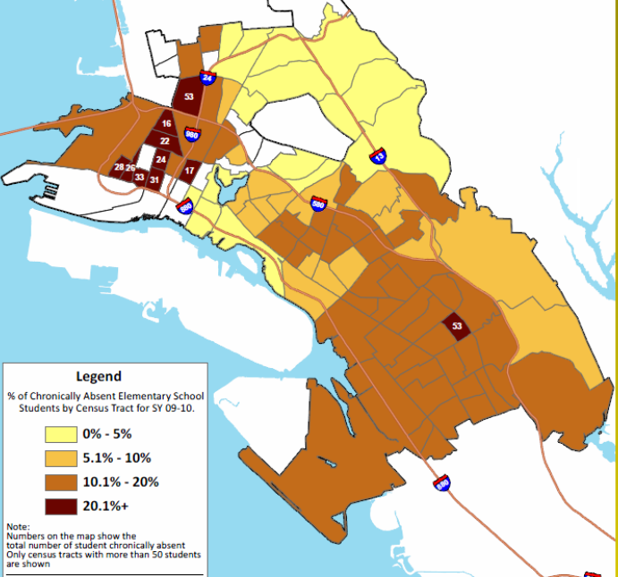
Percent of
Elementary Students
who are
Chronically Absent
Notes:
Note this is student level address, not by school alone o

Slide 23
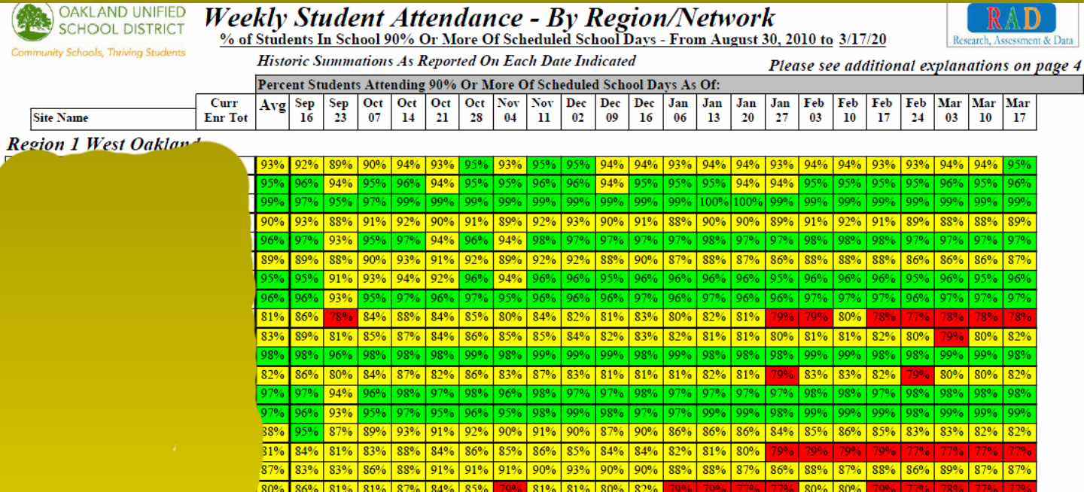
Example: Effective review of data

Slide 24
Collaborate on Action Steps
Improve data quality: take accurate attendance
Effective review and use of data – focus on prevention and early detection
Develop “culture” of attendance in school system
Engage and educate parents and students
Partner with nonprofits to address barriers
Notes:
Led to launch of African American Male Achievement Initiative (AAMAI)
Oakland Unified School District, Partners in School Innovation, and the East Bay Community Foundation in 2010

Slide 25
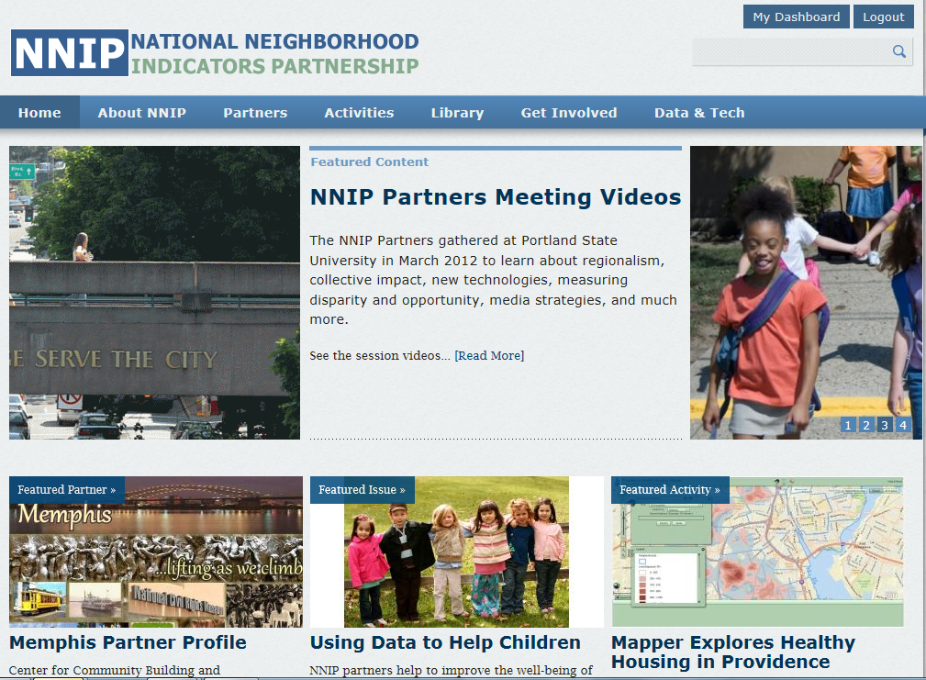

Slide 26
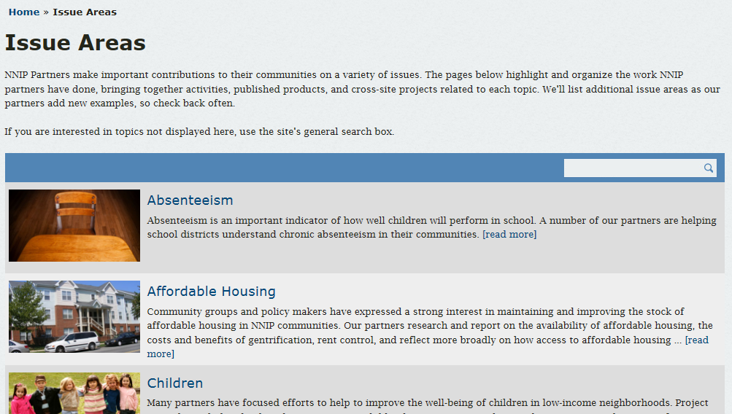

Slide 27
From Information to Action: Lessons from NNIP
National Neighborhood Indicators Partnership
Better Data. Better Decisions. Better Communities.
Kathy Pettit
Salt Lake City Carpe Datum Conference
April 25, 2013

