Slide 1

Using Information for Community Action
Kathryn Pettit, The Urban Institute
National Neighborhood Indicators Partnership
Notes:
Happy to be here
Introduce myself: urban researcher & Co-Director of the National Neighborhood Indicators Partnership (NNIP)
Today’s presentation: National trends around community use of data, a little about NNIP, and then examples of our how partners have used the data.
.

Slide 2
What’s Happening Nationally?
Great progress on Open Data
  Lots of energy from the private and the public sector
Federal place-based work surviving budget pressures
  Promise and Choice Neighborhoods Initiatives
  Sustainable Communities Initiatives
More critical than ever to target neighborhood efforts
  Stagnating economy increasing the need for public programs
  But local, state, and federal funding is being cut back
Notes:
First, there is much good news…
Increased availability of localized information from many sources (online property info, NCLB reporting, live crime stats, etc.)
More usable technology and broader personal use of information (Google maps)
- tools like Policymap, Census bureau site that you’ll hear about later today
2. Federal programs have encouraged communities to use data to plan and monitor programs. In the case of Promise Ngh, I’ve seen just the process of doing the proposal have an effect, even for those that did not win federal grant. You probably have examples of local programs too.
3. Need to be smarter about how we spend limited resources. Hard choices to be made.

Slide 3
What Needs to Be Done Locally?
Identifying the right data to answer questions
Transforming raw data into information
Communicating findings and insights
Advocating for effective & informed policies
Implementing the right programs to help residents and neighborhoods
Notes:
All of that momentum is not enough…. Data is only a tool to accomplish the goals of our organizations This is why all of you are needed....
From the flood of data, Still hard work to figure out how to get the data you need for the area you care about
Giant spreadsheet of numbers or data file difficult to absorb without interpretation, creating of meaningful indicators
What does it mean? What’s behind the trends?
Next need to share what you have learned and assemble the political will and resources for programs.
Finally, you move to the action and will need to track progress or setbacks.

Slide 4
National Neighborhood Indicators Partnership
Collaborative effort since 1995
Urban Institute and local partners in 35 cities
Success required three innovations
  Data and technology
  Institutions
  Using information for change
Notes:
Collaborative effort since 1995 of Urban Institute and local partners in 35 U.S. cities. And several more on the way.
All partners have built information systems with neighborhood level data on a variety of topics to support local advocacy and decisions.
From our years of experience, we now see that the NNIP models relies on advances in the data, the home institutions, and progressive missions.

Slide 5
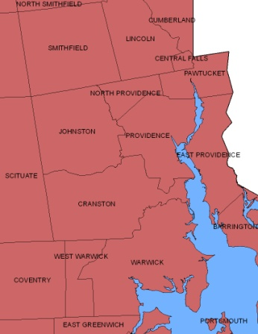
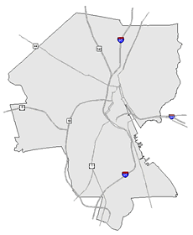
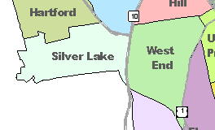
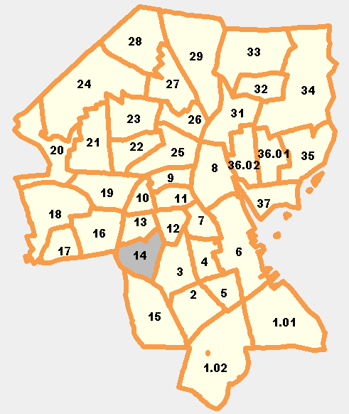
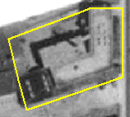
Data and Technology
Linking people information with place information
Types of Data
  Property sales, prices
  Foreclosures
  Births, deaths
  Crime
  Education
  TANF, Food Stamps
  Health
  Child care
REGION
CITY
NEIGHBORHOOD
PARCEL
TRACTS
Notes:
Geography Matters - City-wide trends not helpful for action
Problems are not evenly distributed across cities.
Priority issues vary across neighborhoods.
People can relate to data analysis at the neighborhood level.
Maps are powerful for engaging people. GIS has the power to show relationships – not necessarily statistical cause and effect, but co-existing conditions like vacant housing and crime, obesity and lack of grocery stores or exercise opportunities. Allows you to ask new questions.
Partners generally receive information at the address level and aggregate to varying levels of geography depending on the audience and issue at hand.
Partners cover many issues, recognizing residents don’t experience their community in silos (inventory summary available)
They obtain data incrementally – not all partners have everything, but they have in mind building infrastructure – formal agreements to get the data recurrently (so even if subsidized child care is not a hot topic right now, they still process the data to keep the longitudinal series intact.)

Slide 6
New Types of Institutions
All but one outside of government
  Nonprofits, university centers, alliances, funders
But partner with resident groups, nonprofits, government, and other stakeholders
Long-term and multifaceted interests
Positioned to maintain trust of data providers and users
Notes:
Home Matters - Most outside of govt
Institutions range from 1-person shop in donated office space to large university centers at Case Western or NYU
Not “winner takes all” - partner serves as the hub, but connects to other groups in the city
Partners act as “Intermediary” – Serve as Local Infrastructure
Long-term stake in community (versus out-of-town consultants)
Distance from political forces – not one mayor’s project
Handle data and analysis with integrity
Don’t mislead with maps
Pay attention to confidentiality issues
Newspaper article described our Providence partner as the “Switzerland of data”

Slide 7
Shared Mission: Information for Change
Democratizing Information
  Facilitate the direct use of data by stakeholders
Data serves many varied audiences and purposes
But a central focus on strengthening and empowering low-income neighborhoods
Information promotes collaboration
  Acts as a bridge among public agencies, nonprofits, businesses
Notes:
Partners are different in many ways, but we share a set of key principles
Importance of interacting with stakeholders around the data.
Agreed to take on the role of facilitating the direct practical use of data. Not only writing reports. Doesn’t make sense for each individual group to negotiate for, clean, and analyze crime data.
Systems on the shelf don’t sustain support. A colorful map will be admired, but will not be enough unless it leads to greater understanding or new conversations. Practically, need to convince funders of value
3rd item is key – . Giving emphasis to building the capacities of institutions and residents in distressed neighborhoods. Level the playing field by making sure everyone has access to the information
New information brings people to the table; starts people asking new questions, Terri Bailey (founding partner from Denver): “we could stop arguing over what the crime rate was and start talking about what to do about it”

Slide 8
Shared Mission: Types of Applications
Using indicators in local change initiatives
  Citywide analysis to change laws and policies
  Geographic targeting of resources for programs and investments
  Support individual neighborhood improvement initiatives
  Support program and policy evaluation
Comprehensive community indicator initiatives
  Review of indicators across topics to collectively track community quality of life
Notes:
In Milwaukee Boys and Girls club selecting a site for its new facility in a different location than they had expected, after they analyzed data from the NNIP partner on the spatial pattern of children living in the area
Memphis, data on foreclosure was paired with community-collected info on problem properties in 1 ngh to identify how foreclosures contributed to neighborhood blight. They then put pressure on owners of chronic problem properties and target limited city enforcement resources.
Indic projects: Boston most well-known, but several others
Mention Community Indicators Consortium as broader network

Slide 9
Joint Work Program of the NNIP Partnership
Advance the state of practice
    Informing local policy initiatives (cross-site projects)
    Developing tools and guides
Build/strengthen local capacity
    Developing capacity in new communities
    Services to an expanding network
Influence national context/partnering
    Leadership in building the field
Notes:
So far, described the local institutions & roles, but together across the cities we have set out goals and developed an agenda to accomplish them
Advance state of practice
1. cross-site projects: reentry, housing, school readiness
2. tools and guides on data sources, but also engagement strategies, etc.
Spread word to other cities
Develop ways for groups to tap experts in the field, share knowledge, and learn from each other’s experiences
Try to get our message out to national organizations – league of cities, federal government agencies, etc – about the importance of neighborhood information and the need to strengthen local institutions

Slide 10

Using Property-Level Data to Expand Services for Low-Income Elderly in Pittsburgh
INDICATORS IN ACTION:
Notes:
Credit the Pittsburgh Neighborhood and Community Information System
Alan Sisco at Rebuilding Together

Slide 11
Rebuilding Together Pittsburgh
60% of the homes in Pittsburgh
were built before 1940
Operation Urgent Care provides free repair services to qualifying homeowners in Allegheny County through the contracted and licensed professionals.
Notes:
Residents of Pittsburgh and Allegheny County are served by one of 200 chapters of Rebuilding Together nationwide (originally named Christmas in April)
Operation Urgent Care (OUC) provides free repair services twelve months a year to qualifying homeowners in Allegheny County through the contracted and licensed professionals.
The home can be a dangerous place. elderly and disabled individuals are constantly at risk for falls, exposure to carbon monoxide and other environmental agents in the home. Statistics indicate that most elderly homeowners who experience a fall within their home are never able to return to their home after the accident. OUC helps prevent the kind of accident or exposure that would cause injury, illness, or even death.
Homeowners served do not have the financial resources to maintain even the most common needs in their home. This program repairs the more critical things such as patching a roof, tuning up a furnace, building a ramp, upgrading the electrical system, or replacing damaged flooring.
http://www.rtpittsburgh.org/programs-initiatives/operation-urgent-care-2/

Slide 12
Community Block Build Model
Strategy to target specific neighborhoods and partner with local community groups
Challenges
  Identifying and selecting low-income neighborhoods
  Finding seniors in the target area
Notes:
Rebuilding Together had come to on of our partners’ training sessions for their online system. Our partner discussed their program needed and gave pointers to what data sets would help answering their questions.
Data-Savvy group – needed a little advice and access to the data

Slide 13
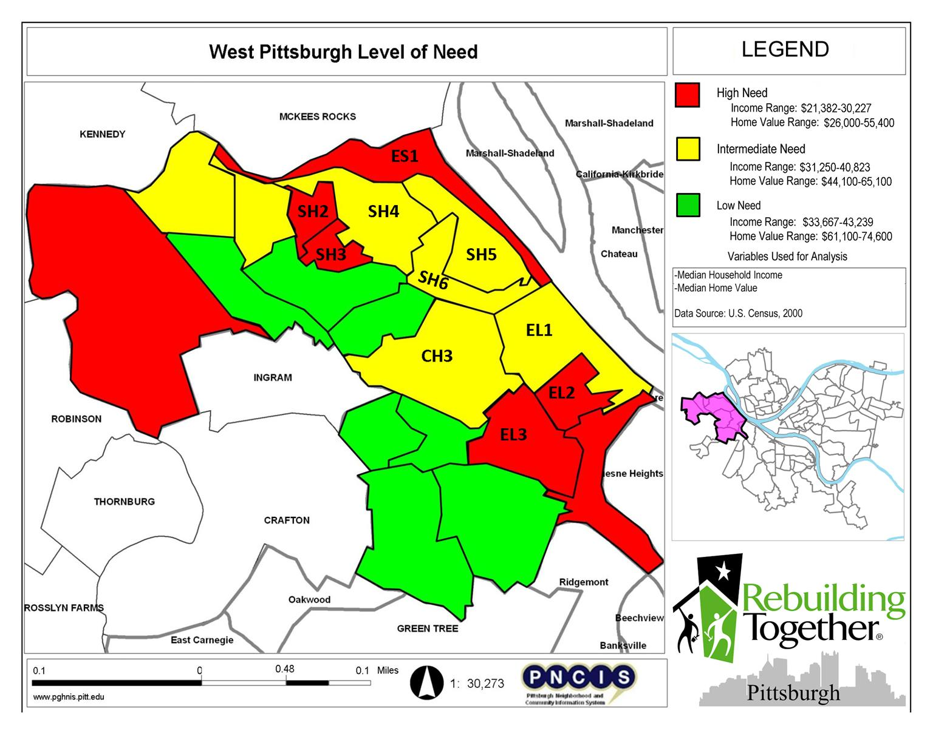
Notes:
Neighborhood and property data is online –allows users to pull their own data
1st task – selecting target ngh – used national data from the census
What areas have comparatively low median household incomes within the city/county?
What areas have comparatively low home values for the city/county?
CH – Chartire City
SH - sheridan

Slide 14
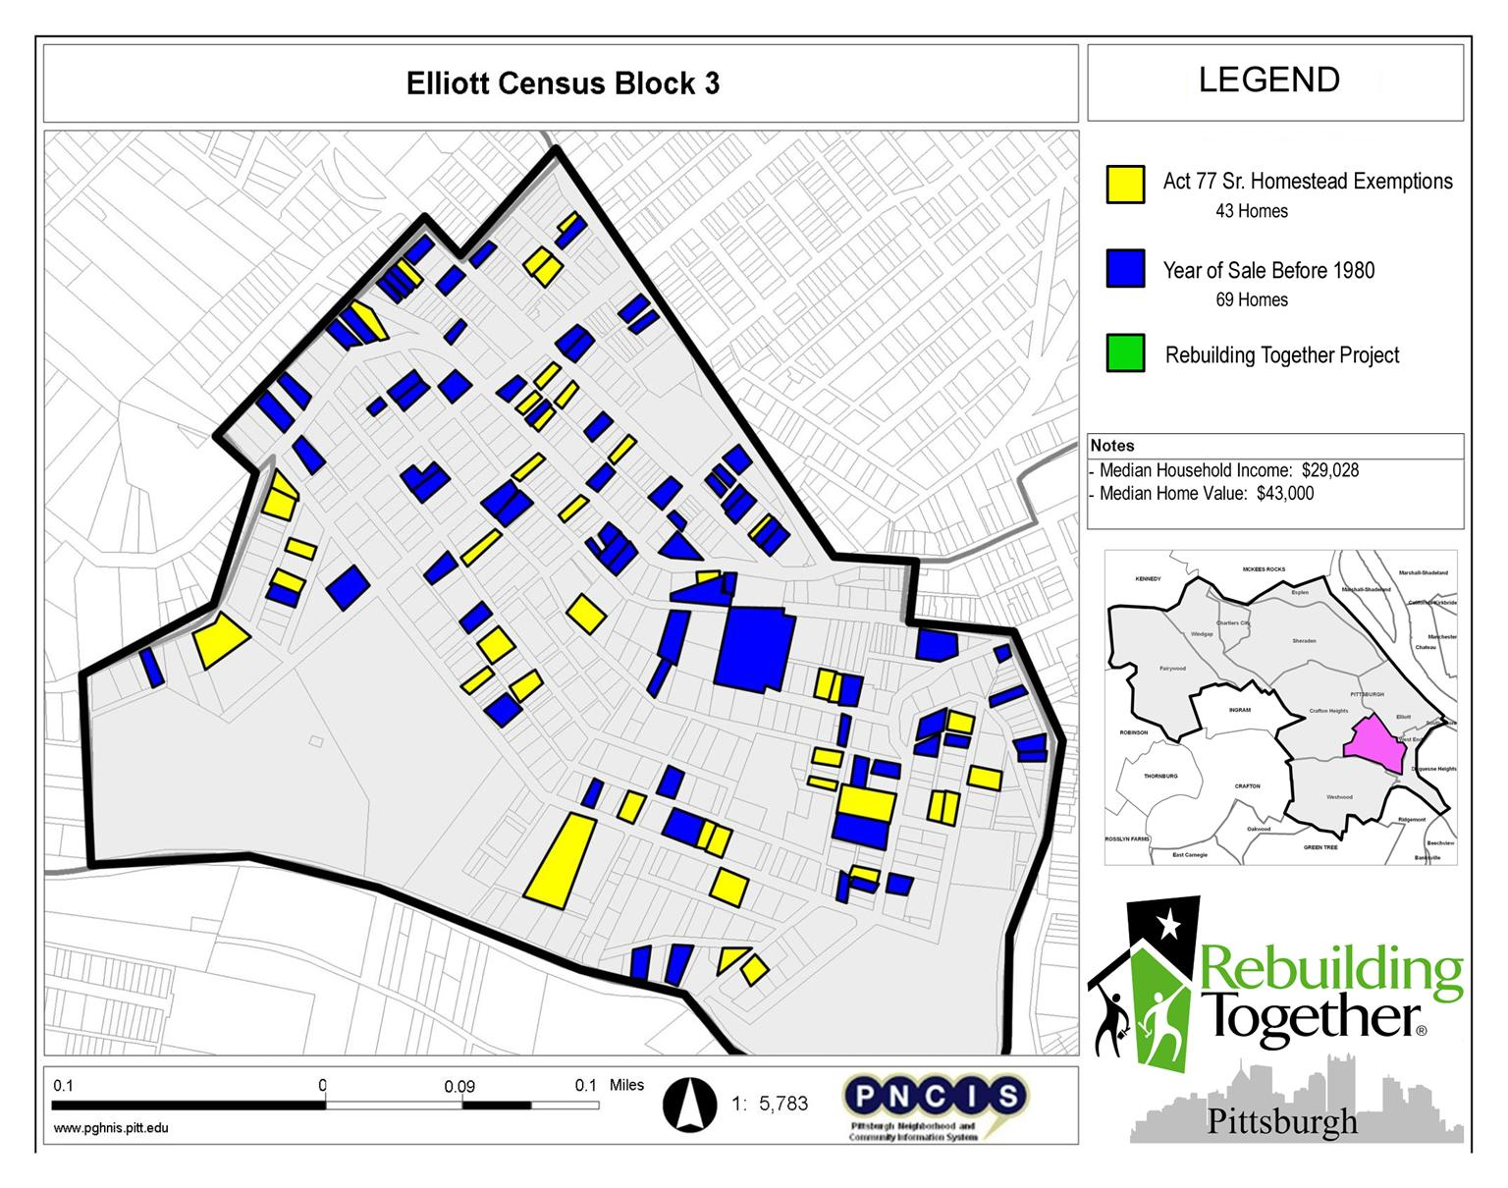
Notes:
Once target ngh was selected, they needed to reach out to individual homeowners
SECOND QUESTION
-Where are homeowners who take Senior tax exemptions?
-Where are homeowners who have owned their home for 30 years or more?
Year of Last Sale (A home last sold before 1980 indicates potential client.)
Act 77 Sr. Homestead Exempt (Eligibility for the exemption is similar to our eligibility guidelines. )
Owner’s Address (Tax Change Notice) (Indicates zoning type and possible homeowners.)
We have Map Reports indicating census blocks with high concentrations of seniors in our 3 target areas.
- spreadsheets listing names and addresses of potential clients.
- conducted targeted outreach in West Pittsburgh, sending out mailers to potential clients.

Slide 15
Early Results
Identified 10 Census Blocks With High Concentrations of Seniors.
Located 575 Potential Clients in West Pittsburgh.
Received 10 new applications in West Pittsburgh.
Completed 2 Block Builds in 2010 in The Hilltop and West Pittsburgh.
Notes:
Even at the early stages, the research they did has paid off for their program.

Slide 16
Bridging Education And Housing Policy Through Student Data in Washington, D.C.
INDICATORS IN ACTION:
Notes:
We at the Urban Institute are the DC partner. Worked with the school system since 1996. Going to describe 2 of the projects we are working on.
1. Highlight impact of foreclosure crisis on school-age children
2. Support planning for DC Promise Neighborhood

Slide 17
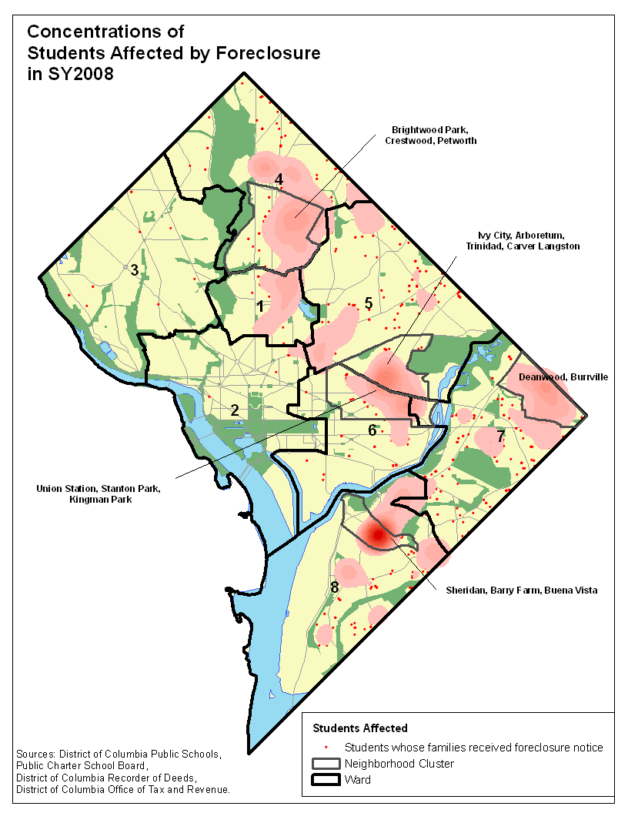
Highlight Effects of Foreclosure on Children
Forced mobility can put kids behind socially and academically
Foreclosure prevention counselors should connect families to student services
Schools need to understand the patterns and trends of students affected by foreclosure to design appropriate responses.
Notes:
DRAFT - DO NOT CITE
17
We are wrapping up a cross-site project on the impact of foreclosures on children and schools funded by Open Society Foundation. Here is a map from DC of the kids in foreclosed homes. (Hot spot is 2 apt complexes accounting for 151 of the students affected.)
Connecting school system staff, housing counselors, homelessness prevention - working with the same families and can do a better job by coordinating their efforts.
Implications for schools
Understand the patterns and trends of students affected by foreclosure to design appropriate responses.
Review school policy and practice for requiring children who move out-of-boundary mid-year to change schools.
Improve identification of children who become homeless and qualify for McKinney-Vento benefits and protections.
Implications for housing counselors
Inform families who are forced to move about potential impacts on education and available support services.
Connect displaced families with housing search and rapid re-housing assistance.
Partner with highly-affected schools to do financial education outreach.

Slide 18
Need to provide outreach and counseling for renters (most assistance programs focused on helping homeowners.)
Share of Renter Students in Foreclosure Households Is Increasing
Notes:
DRAFT - DO NOT CITE
18
One finding across sites was the growing share of children in renter families that are affected. The share of all public school students who lived in units that were rented has remained fairly constant in DC and Baltimore, but the share of students affected by foreclosure who were in renter households increased dramatically for Baltimore by 22 percentage points and for DC as well, 6 percentage points from the start of the period (but by 12 percentage points at the dip).
Many renters won’t even know their landlord is in foreclosure. Many counseling programs focused on helping homeowners, but this pointed to the need for outreach to affected tenants. In DC, every multifamily building entering foreclosure gets a visit with flyers about their rights from a housing nonprofit.

Slide 19
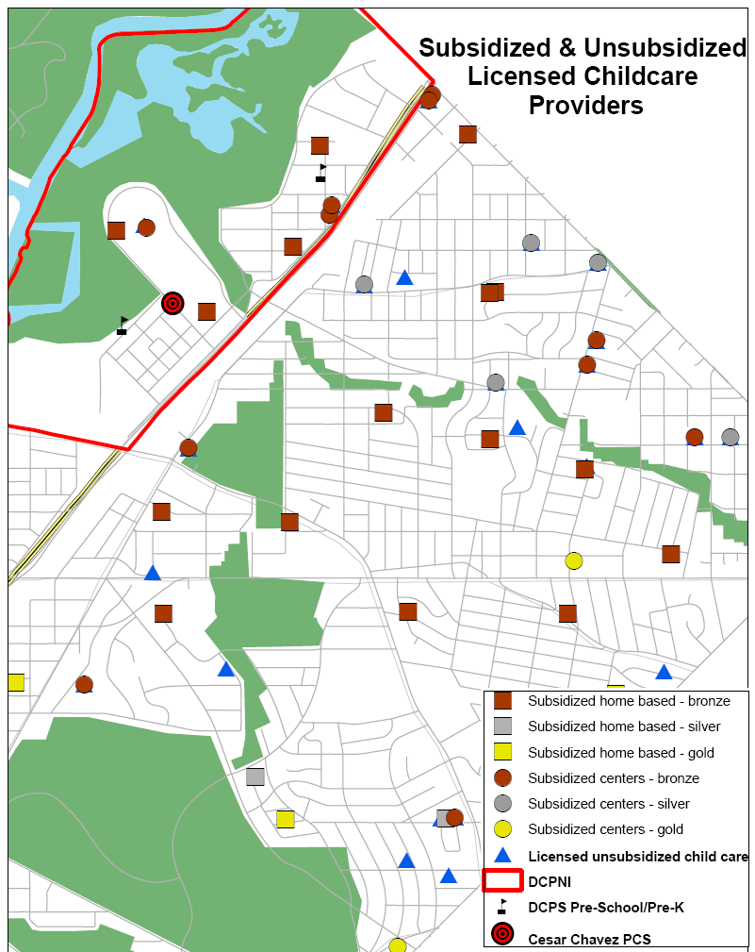
Kenilworth: DC Promise Neighborhood Initiative
Earlier investment now paying off in planning and fundraising.
Five Promises of
1. Caring adults;
2. Physical and emotional safety wherever they are;
3. A healthy start
4. An effective education;
5. Opportunities to help others
Notes:
Won planning grant for 2010-11, just submitted the implementation grant. Coalition of public, corporate, nonprofits. UI analyst staffs each committee for the data work is integrated into the program work from the start.

Slide 20

Using Neighborhood Indicators to Identify Need for Youth Services in Indianapolis
INDICATORS IN ACTION:
Notes:
Credit the Polis Center in Indianapolis for both the work and the slides.
Our partner in Indianapolis is working with county agencies and community groups using neighborhood-level data to support their county-wide early intervention and prevention initiative.

Slide 21

Marion County Commission on Youth
  EIP Goal:
  Reduce the number of children entering the county’s child welfare and juvenile justice systems by improving the coordination of youth services in Marion County.
  Co-location of Services:
  Organizations serving youth and families in Marion County will partner with community organizations, such as neighborhood centers, schools and churches, to offer various supportive services at common access points.
Notes:
This story started several years ago when their county council commissioned a study on reducing # of kids in juvenile. As part of the assessment and strategic plan (done by Ctr. for health policy), they recognized that families were having trouble accessing services – both due to transportation and because they would have to go to several different offices for various services. The report recommended an effort to co-locate services and Marion County Commission on Youth (MCCOY) took up the challenge about a year ago.

Slide 22
Vulnerability Index: Needs Indicators
Include
1
1
0
1
1
0
0
1
0
0
1
1
Weight
3
2
3
2
3
2
2
3
1
1
2
2
Single Parent Families
Economy - Unemployment
Economy - Poverty
Education – Less than HS Diploma
Education – Attendance
Health - Teen Births
Health - Births with no Prenatal Care
Health - Low Weight Births
Housing – Subsidized Housing
Public Assistance – Food Stamps
Public Safety – Adult Crimes
Public Safety – Juvenile Charges
Index
Value
Notes:
The question remained about where to locate the common facility.
First, they created a vulnerability index to identify areas most in need of services.
Our data partner worked with the commission to brainstorm about community risk indicators. Initial list really long and had to winnow them down.
Here is the final list. For those interested in the math, [hit clicker]
For each tract in Marion County, indicators were flagged 0 or 1 based on whether each neighborhood condition was substantially above the city avg. (1 standard deviation).
[hit clicker]
and they realized some factors were more important than others, so they assigned weights to reflect this.
[hit clicker]
rolled them into an index.
Also did second version where the indicator had to be even higher risk (2 STD)

Slide 23
Vulnerability Index
Least Vulnerable
(Lowest Need Areas)
Most Vulnerable (Greatest Need)
Notes:
The end result was a simple index 0 to 26 to indicate the most vulnerable areas.

Slide 24
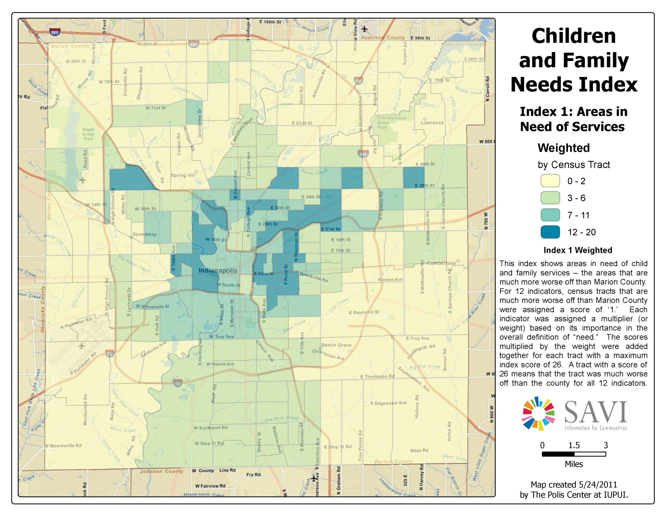
Notes:
From a lot of data, simple map. Here is the first index version – darker indicates more need. They found this didn’t narrow it down enough – still too many neighborhoods.

Slide 25
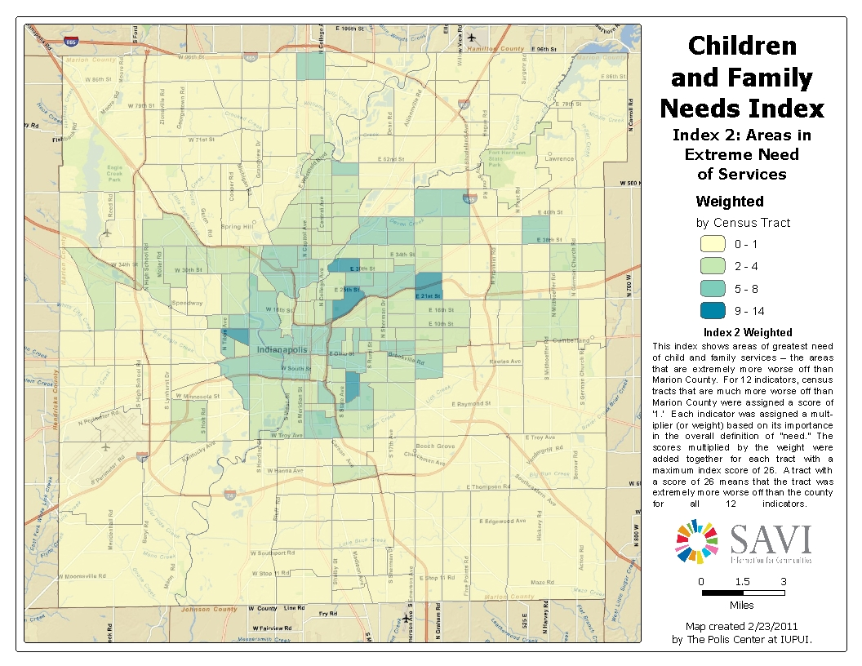
Notes:
The second version of the index flagging census tracts way above the city average did a better job of highlighting the neediest areas.
[hit clicker for outline]

Slide 26
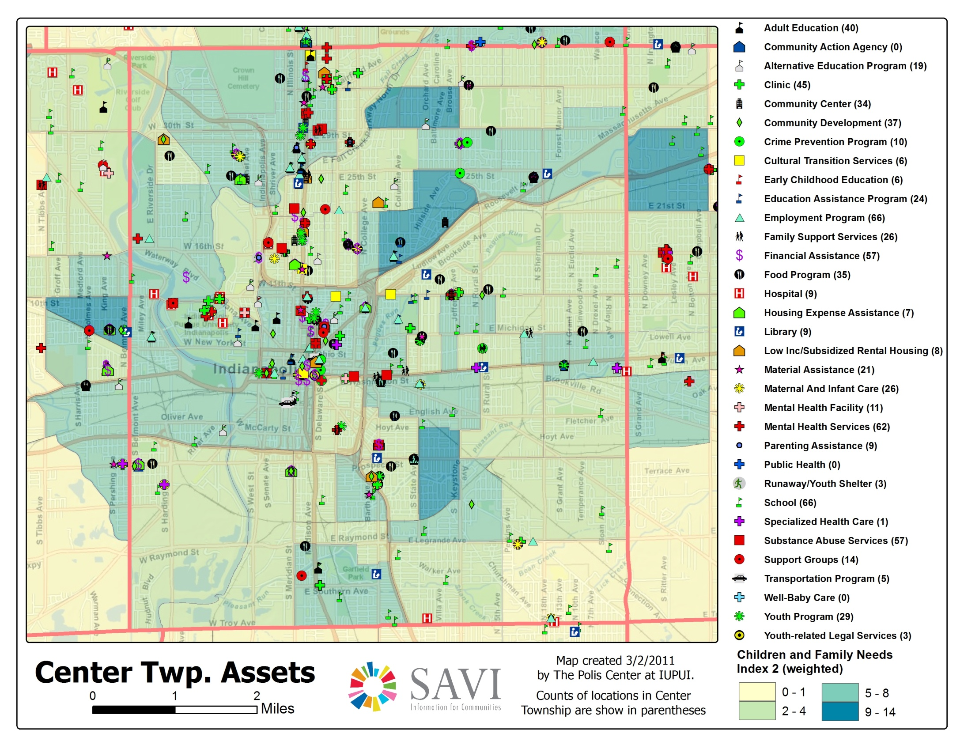
Notes:
Zooms into center township (about 5 miles across). The next step was to map existing human services related to the issues they are trying to address. Again worked with committee to narrowed down 100’s of asset categories to these couple dozen.
You can see that the assets clustered along Meridian street,

Slide 27
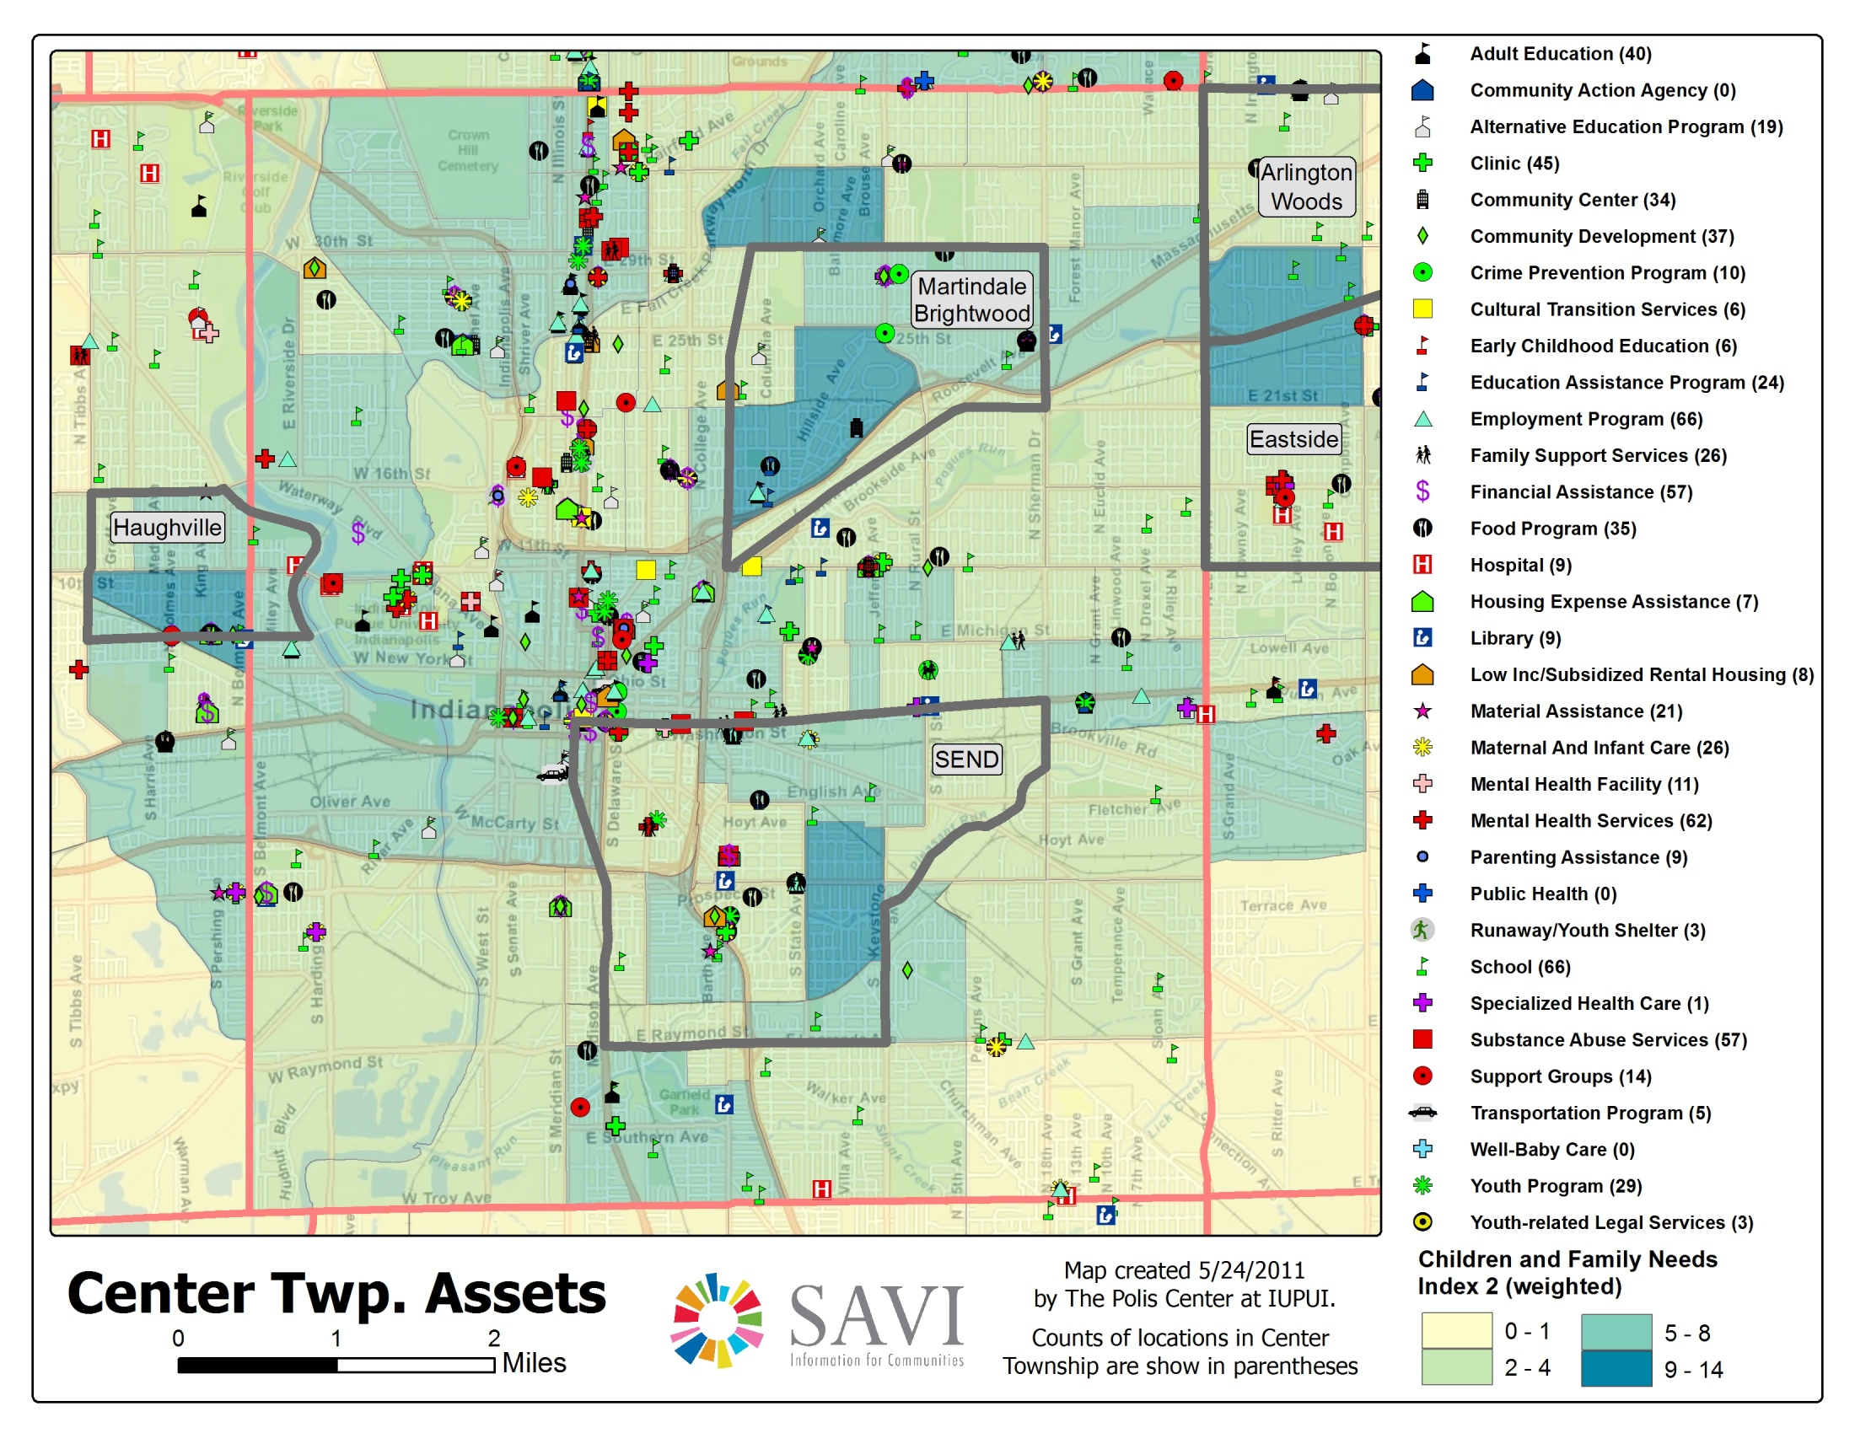
38th Street
Notes:
[hit clicker]
and that there are not a lot of assets in darkest blue areas.
Gathered community knowledge about what else is going on in each community – already in an initiative, or nothing going on and hard to get things going. They ruled out Martindale Brightwood because they had another big philanthropic initiative already in place. They also needed know that the neighborhoods that had some minimum base of community partners and organization to build upon.
Chose 2 ngh – Southeast and Haughville (HAWville)

Slide 28
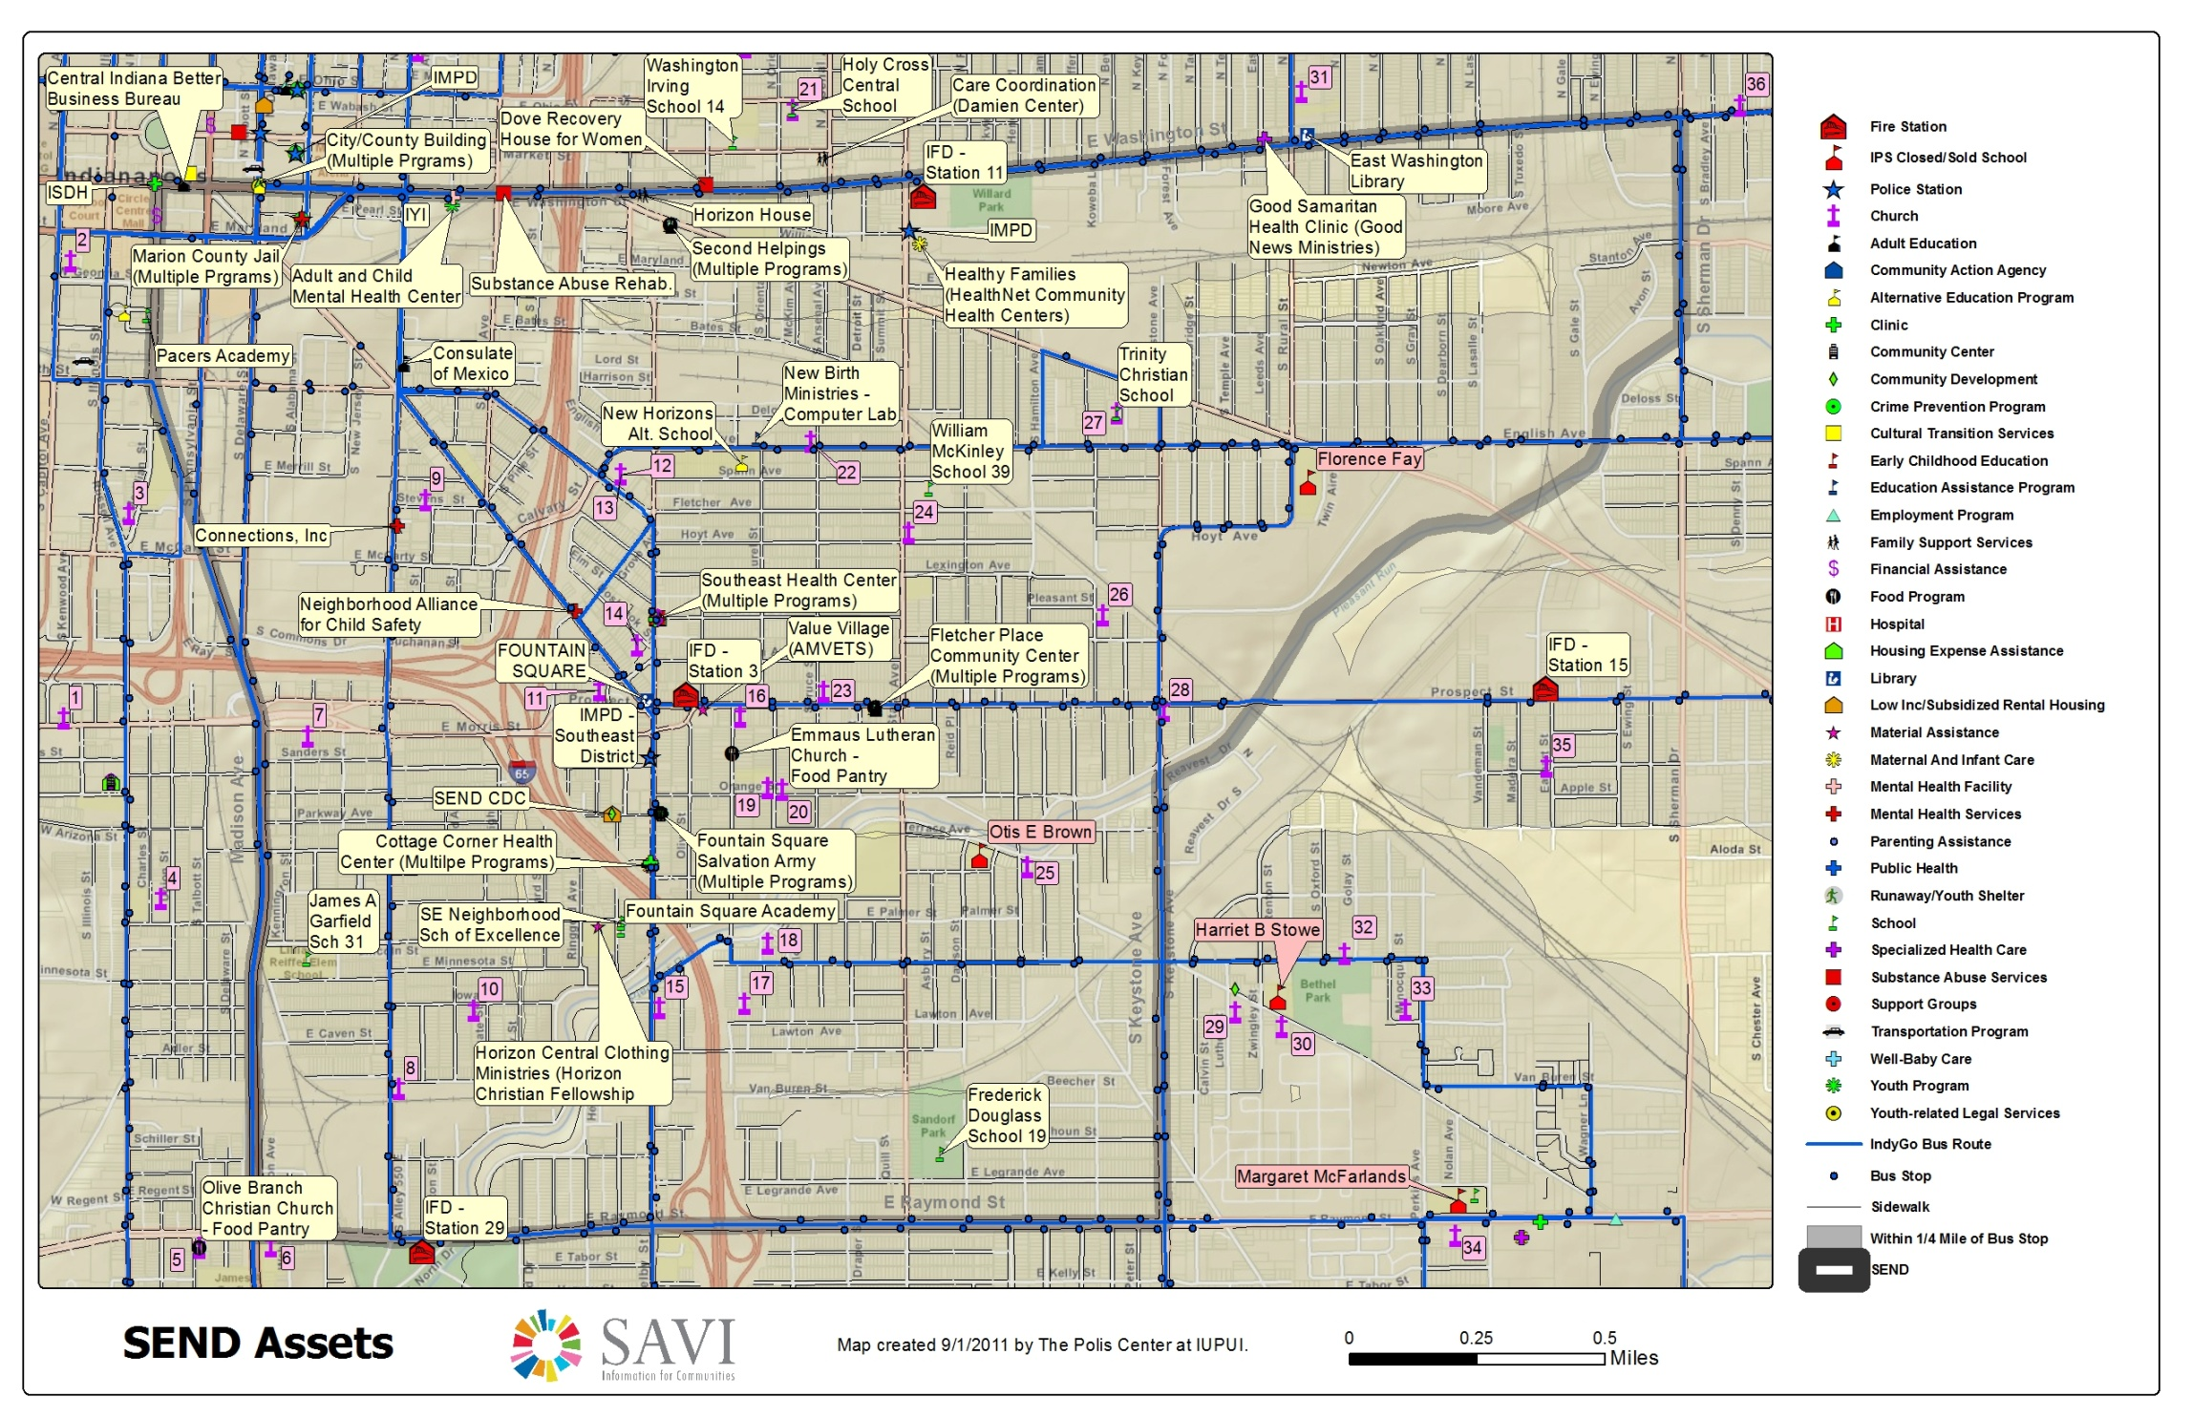
Notes:
They mapped all of the assets in the neighborhoods in detail and met with neighborhood and CDC leaders to engage them in the process - to ground truth the findings and identify any missing factors. This and more importantly to get involved with MCCOY as partners in this process to improve their neighborhood resources.
Now they are working on identifying an existing building for the center – promising location of Otis Brown which is an empty school.
Strategic planning process results:
We need access points that exist within communities, will eliminate some of the transportation barriers and increase immediate access to services
Need more partnerships and collaborations
Need opportunities to partner, share resources and apply for joint funding

Slide 29
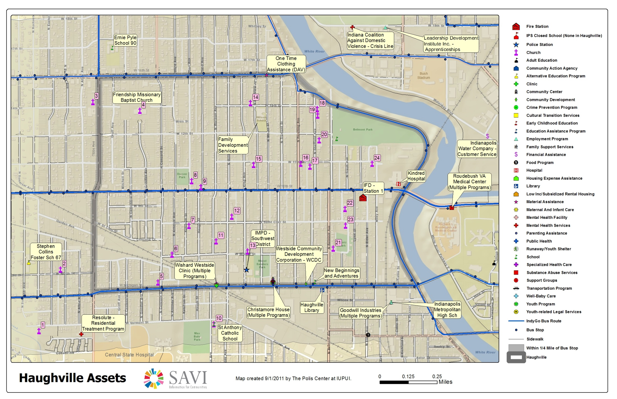
Notes:
HAWVILLE – this area expanded some after the community recognized some community assets just outside the initial community boundary
(Blue lines are bus lines in case anyone asks )
Inventoried list of all programs at each site – noted by “multiple programs” (1 dot paints a false picture).
Still researching possible locations for their center here, there’s still a lot of work to do, but the task force has shown a commitment to informed decisions and can implement their plans knowing they chose they are centered in the neediest communities and with the buy-in of the surrounding neighborhoods.

Slide 30
Suggestions for NHSDC Members
Think about how information might start new conversations and break down silos in your city.
  New audiences for your data
  External data that would help your work
Transform your program data into indicators for neighborhoods and cities to inform others’ work.
Connect with your NNIP partner (if you live in an NNIP city) or other local research groups.
Notes:
Conferences are great place to step away from everyday pressures
Urge you to think about how to break through silos
We believe that city and nonprofit agencies should focus on their missions, so supportive research organizations can do some of the heavy lifting on the data crunching. We help new cities develop similar capacities.
One thing not on the slide: Think long-term – support open data and build your local data infrastructure.
Finally, beyond your immediate needs, think about the data infrastructure in your community. Where are there resources you could tap? Where are their gaps that need to be filled? Can your local governments be more open about sharing their data?

Slide 31
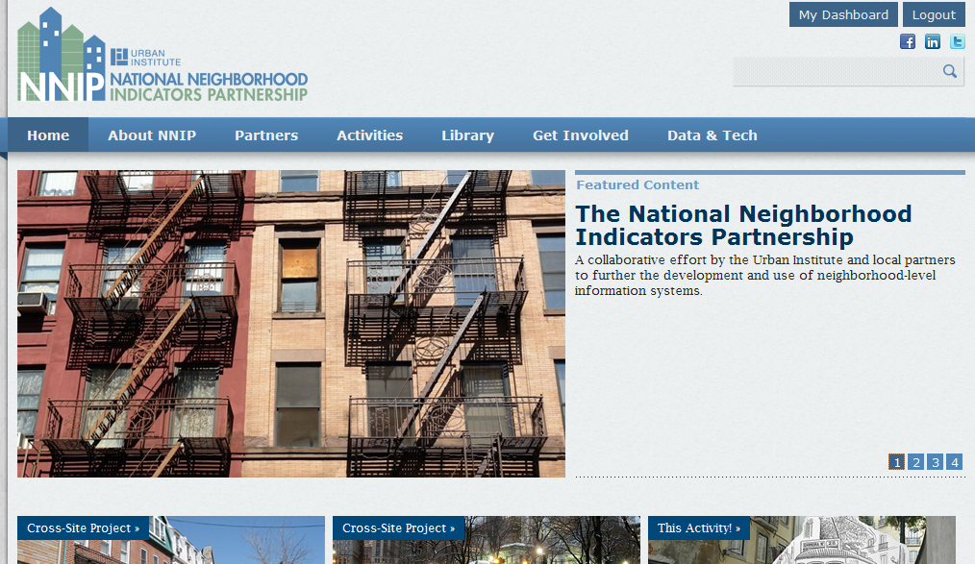
And visit our new website for ideas!
Notes:
Still working out some kinks but a great place to get ideas.

Slide 32
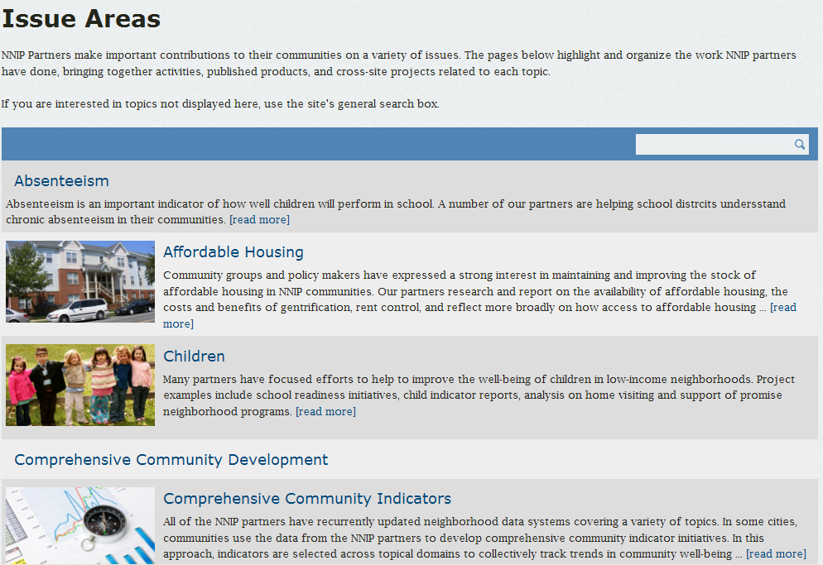

Slide 33
For more information
Kathy Pettit
NNIP/The Urban Institute
kpettit@urban.org
http://www.neighborhoodindicators.org

