Slide 1
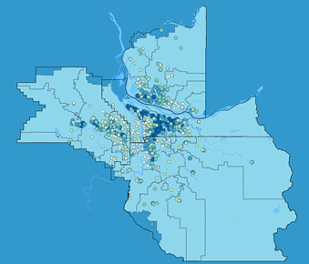
Decision making with Data: Using GPP Indicators in Public Policy Decision Making
Measuring Results, Inspiring Action

Slide 2
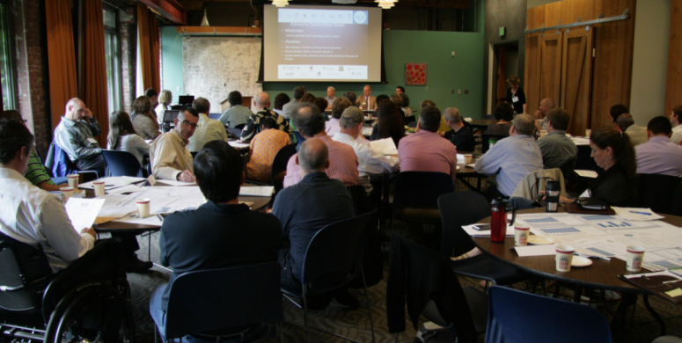
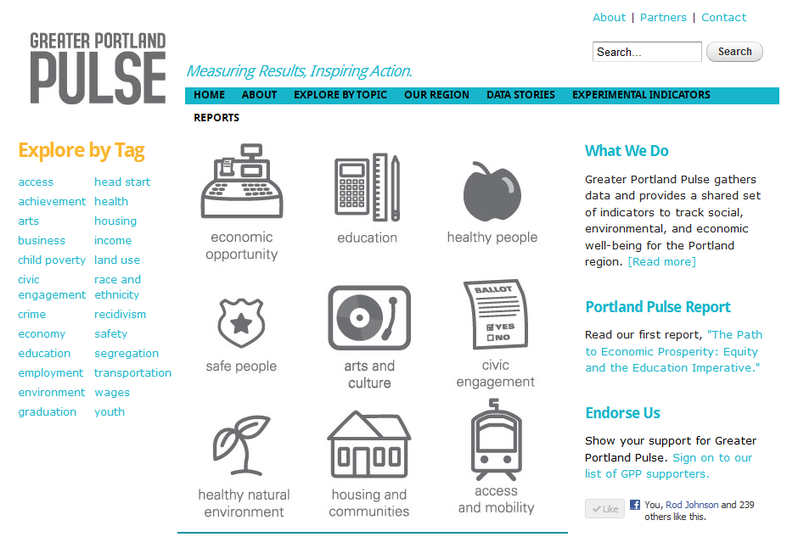
portlandpulse.org
Measuring Results, Inspiring Action

Slide 3
Project History and Timeline
Measuring Results, Inspiring Action
Notes:
Objectives of this slide
Address the ‘why are you here’ question:
You (or your organization) were part of the original advisory committee that launched GPP
PSU and Metro were identified as the stewards of the Pulse project
But GPP remains an indicator asset owned by the Portland community—community members, public officials, community organizations and, private enterprise
Also, objectives of this meeting include:
Providing an update of the project
Discuss and seek your input specific to project challenges
Big Event #1: Purpose: align nine Results Teams to the mission of the project and establish a community of learning within and across teams
Big Event #2: To move the first round of GPVI indicators from data and trends to actionable knowledge about how to advance the well-being of Greater Portland-Vancouver’s people, places and prosperity

Slide 4
Policy makers are confused
This data is great – but how do I use it to make public policy decisions?

Slide 5
Solution
Provide policy makers a guide and trainings that will help them use GPP data when making decisions
Measuring Results, Inspiring Action

Slide 6
Accessing Data
Measuring Results, Inspiring Action

Slide 7
New workshop structure
Visual representation of how the data is organized
Using GPP data as a stating point for disaggregation
Techniques or resources for finer-grained data
Measuring Results, Inspiring Action

Slide 8
Decision Support
Measuring Results, Inspiring Action

Slide 9
Utilizing GPP for policy, program and program decisions
Measuring Results, Inspiring Action

Slide 10
Aligning a project or program with GPP outcomes and indicators
Measuring Results, Inspiring Action
Notes:
Typically done early as part of project scoping
Example: how a trandportation project might help public safety through better lighting, landscaping, etc

Slide 11
Step by Step approach with examples
Unanticipated outcomes or meeting multiple objectives
How to focus a project; avoid scope creep
Measuring Results, Inspiring Action

Slide 12
Developing project/program evaluation criteria to best align GPP
Measuring Results, Inspiring Action

Slide 13
Step by step approach with examples
Data needs
Reporting; data displays; using tables/graphs
Prioritizing or weighting criteria
Other factors in decision-processes (public support, technical or legal feasibility, etc.)
Measuring Results, Inspiring Action

Slide 14
Next Steps
Measuring Results, Inspiring Action

Slide 15
Interview policy makers
Redesign and test new workshop structure
Write and advertise policy manual
Measuring Results, Inspiring Action

