Slide 1


Creating a Data Strategy:
Building Staff and Community Capacity
The Institute for Urban Policy Research
at The University of Texas at Dallas
Sara Mokuria and Anthony Galvan

Slide 2
Learning Objectives:
Participants will
Discuss how and why community-based organizations use data
Understand how a data strategy supports successful programs
Assess his/her originations capacity to access, analyze and use data
The Institute for Urban Policy Research

Slide 3
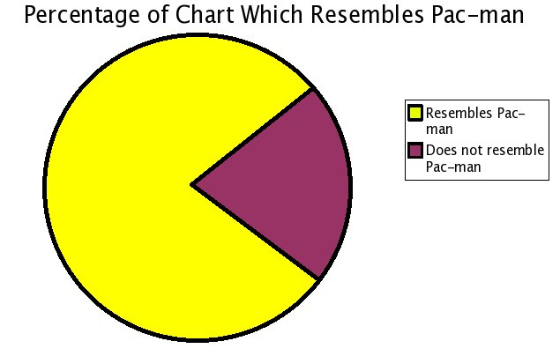
Why and how does your organization use data?

Slide 4
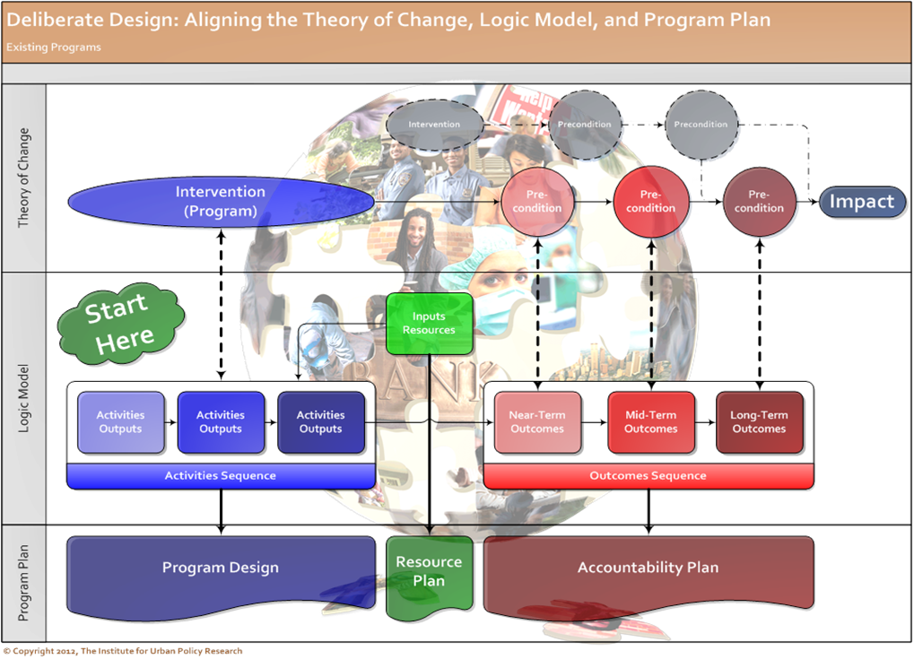
Transforming data into impact with Deliberate Design:
The goal is for agencies to use both qualitative and quantitative data to show impact and adjust strategies accordingly.

Slide 5
Three Considerations in the Deliberate Design Architecture
Access
Analysis
Use

Slide 6
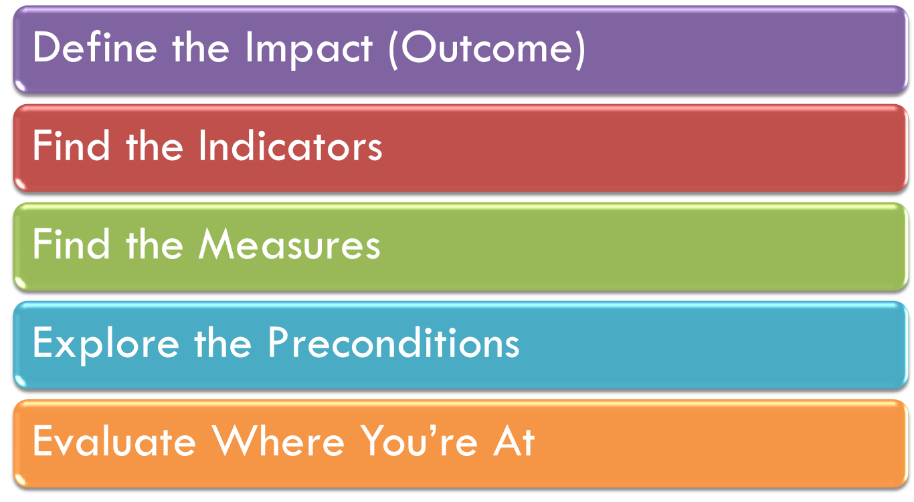
The Implications of Data Access for Data-Driven Decisions

Slide 7
First, Defining the word…
What result should occur because of your program’s impact? What needle do you want to move?
Programmatic results should be more than a crap shoot!
Deliberate Design is Essential!
Define the Impact

Slide 8
What is an indicator?
If the needle moved on your outcome, how would you know?
Important – the outcome and the indicator of the outcome are often not the same thing.
Outcome
Indicator
Indicator
Finding the Indicator

Slide 9
How will you measure the indicator you selected?
Things to think about…
  Definition
  Purpose
  Time
  Geography
Outcome
Impact
Impact
Measure
Measure
Finding the Measure(s)

Slide 10
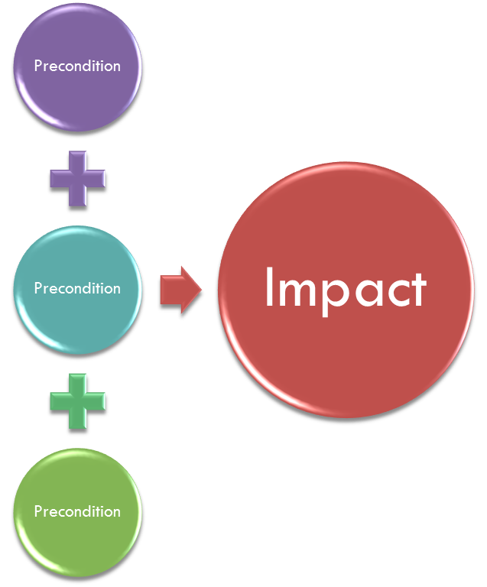
Defining preconditions…
Why do preconditions matter?
How much do changes in the measure reflect changes in the indicator, and how much does that indicate changes in the impact?
Exploring Preconditions

Slide 11
Does your measure measure what you think it measures?
Are there things that might move the needle you weren’t considering?
How will you “analyze” and “use” your measure?
“Does it mean what you think it means?”
Evaluating Where You’re At

Slide 12
Availability
Public
Public Use
Geographic Detail
National
State
Data Format
Tables
Excel Files
Proprietary
County
City
ZIP Code
Block Groups
Individual
Access Database
SQL Database
SAS / SPSS Data Files
A Guide to Using Data: Access
From Simple to Complex

Slide 13
Three Considerations in the Deliberate Design Architecture
Analysis
Use

Slide 14
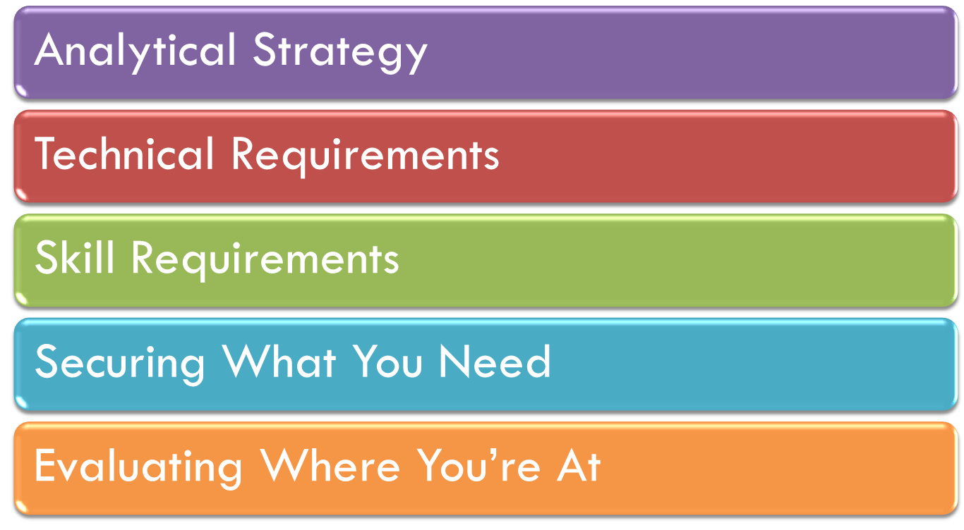
The Implications of Data Analysis for Data-Driven Decisions

Slide 15
How will you use the data now that you have it?
Key Decision Points:
  Time
  Relativity
  Level of Rigor
Analytical Strategy

Slide 16

What tools and technology will you need?
Technical Requirements

Slide 17
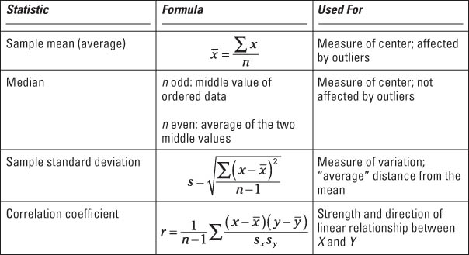
What skill sets do you need to complete the analytical strategy?
Can the analysis be done with a solid understanding of Excel?
Skill Requirements

Slide 18
Sizing the gap…do you have the assets on hand, or in short reach through development of existing staff?
Are there universities or organizations you can partner with for low to know cost?
Securing What You Need

Slide 19
How might your data strategy change given your work so far?
What are the implications for future projects?
Evaluating Where You’re At

Slide 20
Software Needs
Web-Based Search
MS Excel
Types of Data
Single Point in Time
Before and After
Levels of Rigor
Summary Statistics
Single Variable Change
MS Access
SQL Server or MySQL
SPSS / Stata / SAS
Time Series
Cross-Tabulation
Correlation
Inferential Statistics
A Guide to Using Data: Analysis
From Simple to Complex

Slide 21
Three Considerations in the Deliberate Design Architecture
Use

Slide 22
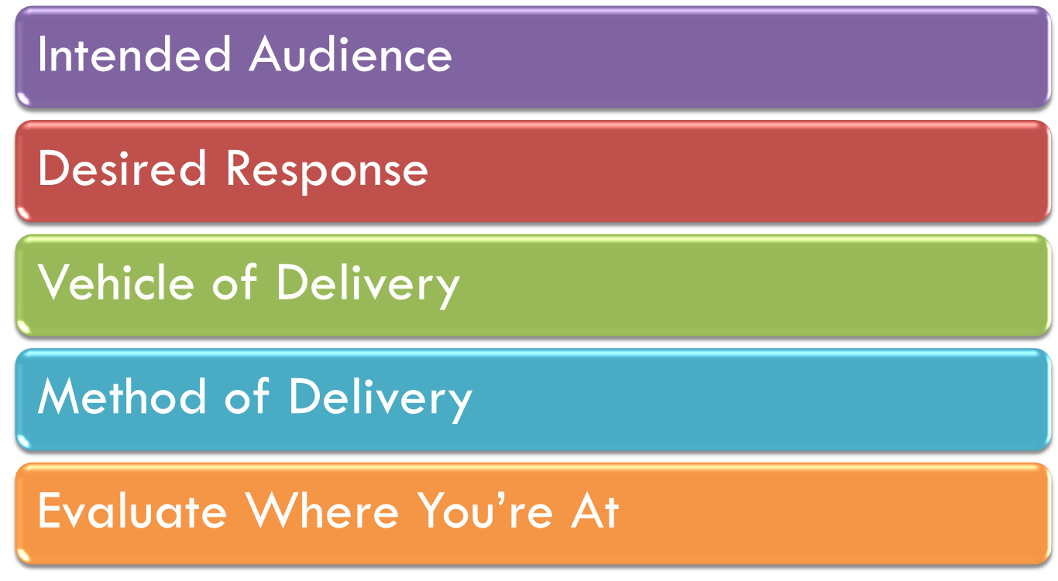
The Implications of Data Use for Data-Driven Decisions

Slide 23
How you tell the story heavily depends on who your telling the story to.
Key Considerations:
  Technical knowledge of intended audience
  What do they know, need to know and want to know?
Intended Audience

Slide 24
Do you want people to know, understand, or do something differently based on your findings?
Desired Response

Slide 25
“What good do your words do if they can’t understand you?” –Erykah Badu
What method of delivery best engages your audience? A flyer, tweet, short film, journal article, editorial, etc.
Vehicle of Delivery

Slide 26
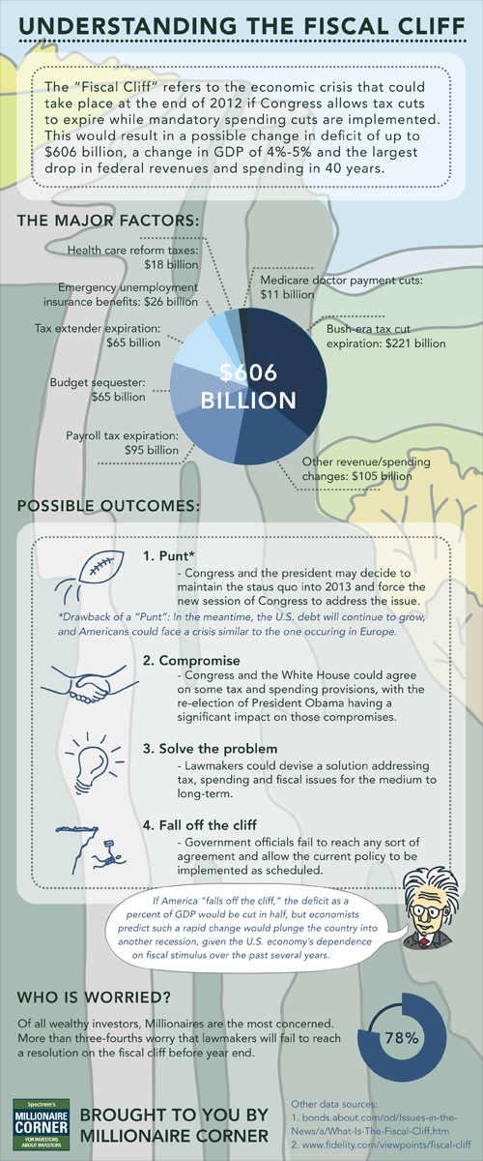
Remember your message should move people.
What is the best method for your audience? Tables, graphs, inforgraphics, and/or narrative.
Method of Delivery

Slide 27
"Cheshire Puss,...Would you tell me, please, which way I ought to go from here?"
"That depends a good deal on where you want to get to," said the Cat.
"I don't much care where--" said Alice.
"Then it doesn't matter which way you go," said the Cat.
"--so long as I get SOMEWHERE," Alice added as an explanation.
"Oh, you're sure to do that," said the Cat, "if you only walk long enough."
from Alice in Wonderland by Lewis Carroll
Evaluating Where You’re At

Slide 28
Audience
Community / Funder
Board / Program Staff
Vehicle for Delivery
Social Media
Method of Delivery
Narrative
Technical / Professional
Live Presentation
Written Report
Basic Graphs and Charts
Advanced Data Tables
Info Graphics
A Guide to Using Data: Use
From Simple to Complex

