Slide 1
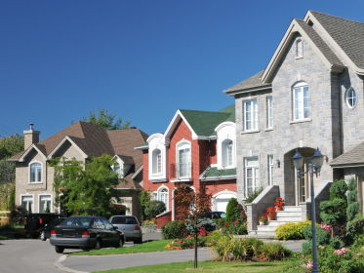
Region Neighborhood Delineation
Mingming Zhang
The Piton Foundation

Slide 2
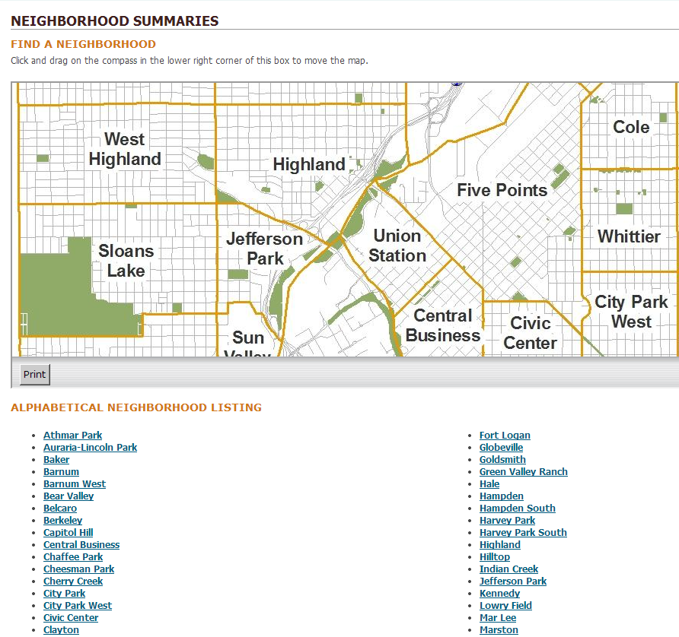
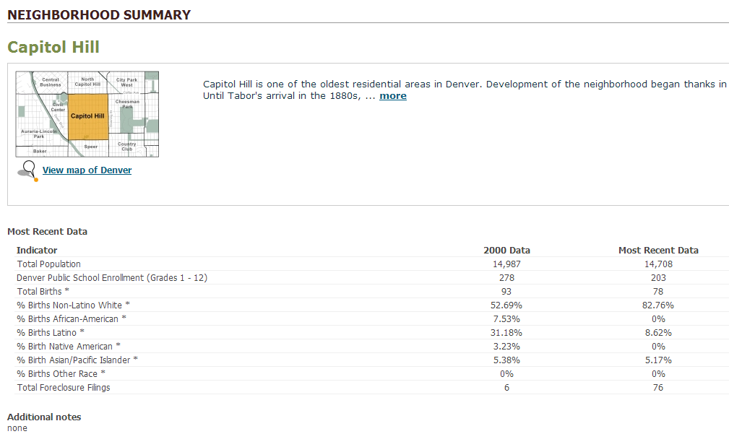
Introduction
Community Facts Tool
http://www.piton.org/CommunityFacts

Slide 3
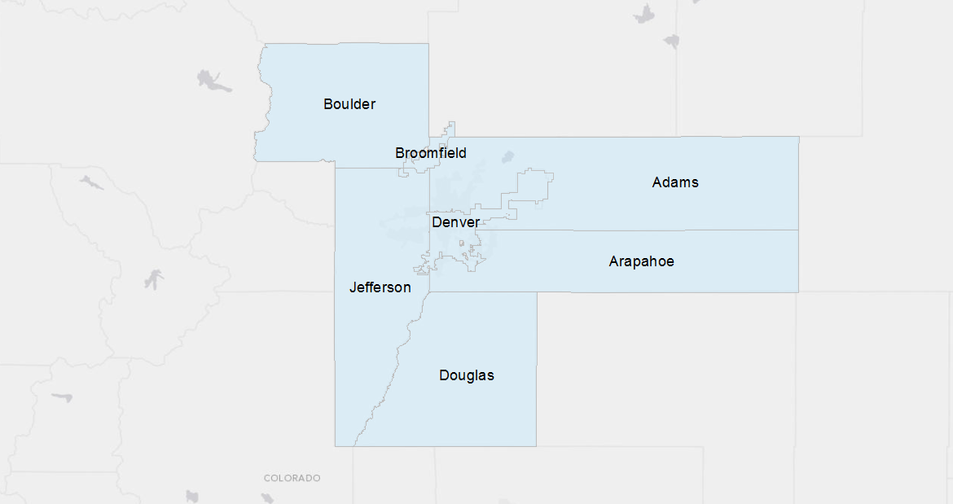
Introduction
Neighborhood Delineation

Slide 4
Methodology
Geographic unit
Census Tract
Important characteristics
Parcel Subdivisions
Physical Boundaries
Cluster Analysis(spatially constrained)
Demographic Status
Built Environment

Slide 5
Methodology – Demographic Status
Analysis Unit: Census Tract
Variables:
Group | Variables
Socioeconomic Status | Median Income %with College degree % without High School degree %Female Headed household %Professional Occupation %income Under 15000 households %income Over 45000 households
Racial Composition | %African American
Ethnic Diversity | %Hispanic %Other Race %Foreign Born
Population Density | Population Density (per acre)

Slide 6
Methodology – Built Environment
Group | Variables
Street Design | Intersections in ¼ radius
 | Street Length in ¼ radius
 | Perimeter of the block where the parcel is located in
 | Median Block Size in ¼ radius
 | Setback
Density | Parcel Lot Size
 | Median parcel Lot Size in ¼ radius
 | # parcel Lots
 | Single Family Floor Space in ¼ radius
 | Single Family Floor Space
 | Building Age
Mixed land uses | Commercial area in ¼ radius
 | # Stores in ¼ radius
 | Industrial
 | Acres of multi-family residential land use in ¼ radius
Accessibility | Distance from the lot to the nearest commercial land
 | Distance from the lot to the nearest bus stop
Alternative Transportation Modes | # Bus Stops in ¼ radius
Natural Environment | Acres of Open Area in ¼ radius
Analysis Unit:
¼ mile buffer parcel
Variables Group:
Street Design
Built Density
Mixed land uses
Accessibility
Natural Environment

Slide 7
Methodology
Parcel Subdivisions boundaries
Demographic Status Clusters
Built Environment Clusters
Level1
Level2
Level3

Slide 8
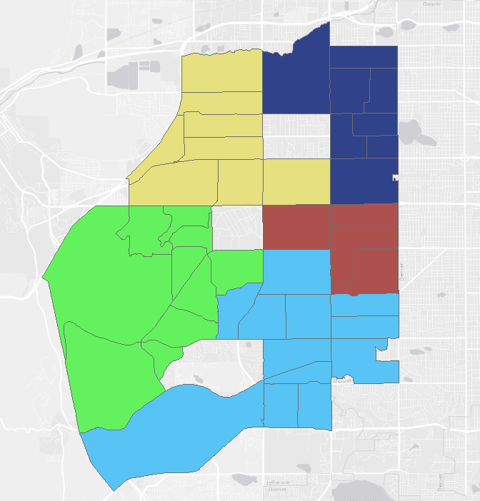
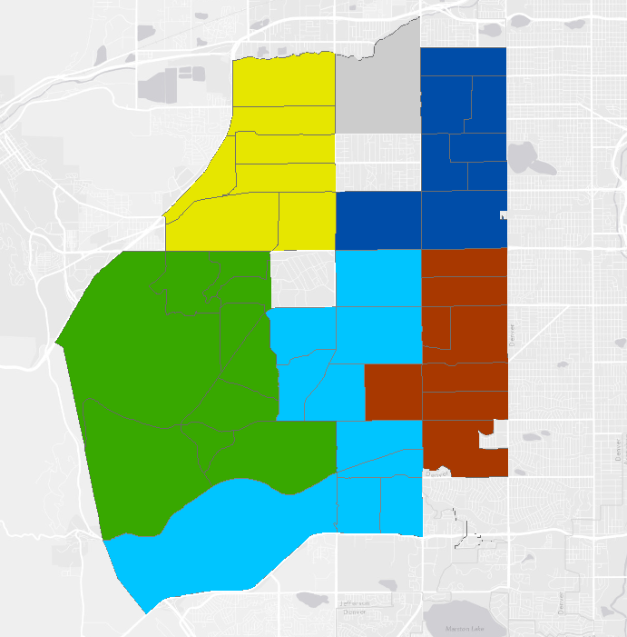
Verification
Compare with City Wards
Lakewood, Jefferson County
City Wards
Result

Slide 9
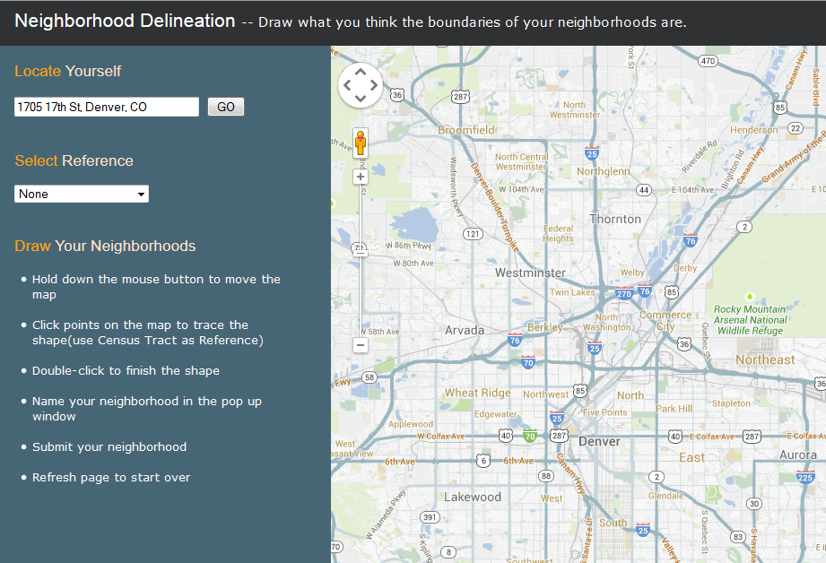
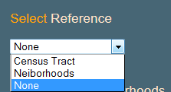
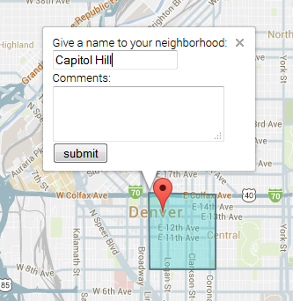
Verification
Feedback Tool
http://www.piton.org/
mzhang@piton.org

