Slide 1
Using Mapping to Promote Collective Community Impact
Visible changes for a healthy future
Susan Millea and Mohan Rao
Urban Institute
National Neighborhood Indicators Project
Portland, Oregon
March 1, 2012

Slide 2
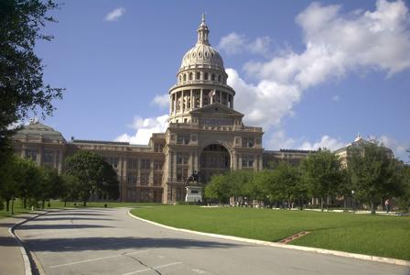
Welcome to Austin!
The Portland of the Southwest!

Slide 3
Welcome to Austin!

Slide 4
childrensoptimalhealth.org

Slide 5
Collective Leadership Initiative
Cross-sector Board
Competing Health Care Systems
City
County
School District
Chamber of Commerce
Housing Authority
Employment Agency
Social Service Providers
Universities

Slide 6
Board Member Organizations
Any Baby Can
Austin Independent School District
Central Health
E3 Alliance
Greater Austin Chamber of Commerce
HEB
Housing Authority of the City of Austin
Integrated Care Collaboration
Lifeworks
Lonestar Circle of Care
Workforce Solutions
Seton Family of Hospitals
St. David’s Community Foundation
University of Texas at Austin
University of Texas School of Public Health at Austin

Slide 7
COH Value Add
Children’s Optimal Health augments public data with protected/privately held data
We seek to
Engage the Community in action
Improve Practice
Impact Policy
Encourage Research
Building trusting relationships
Bridging trust with technology
Limit scope of work until there is trust
Locus of control: data owners

Slide 8
COH Approach/Process
Safe Harbor/Data Stewardship
Data Sharing Agreement
HIPAA, FERPA compliance, Addendum
Statement of Information Practices
Explains data ownership and use
Building partner trust
Technical Review Committee
Identify data limitations, first story line
Community Summits
Action Partners
Notes:
8

Slide 9
COH Projects Areas
Childhood Obesity
Prenatal Care
Access to Health Care
Child Injury
Mental/Behavioral Health
Preschool-aged Children
Student Housing and School Mobility
Chronic Absenteeism/Truancy
Child/Youth Behavioral Health
School Performance

Slide 10
Using Person-level Data
Focus is neighborhood of residence
Privacy/confidentiality concerns
De-identification
Aggregation
Removal of small data cells
Technical approach can be adjusted
Sensitive to constraints, purpose

Slide 11
Austin MSA Population History: 1900 - 2010
1,800,000
1,700,000
1,600,000
1,500,000
1,400,000
1,300,000
1,200,000
1,100,000
1,000,000
900,000
800,000
700,000
600,000
500,000
400,000
300,000
200,000
100,000
0%
1900
1905
1910
1915
1920
1925
1930
1935
1940
1945
1950
1955
1960
1965
1970
1975
1980
1985
1990
1995
2000
2005
2010
Chart produced by Ryan Robinson, City Demographer, Department of Planning, City of Austin. January 2011

Slide 12
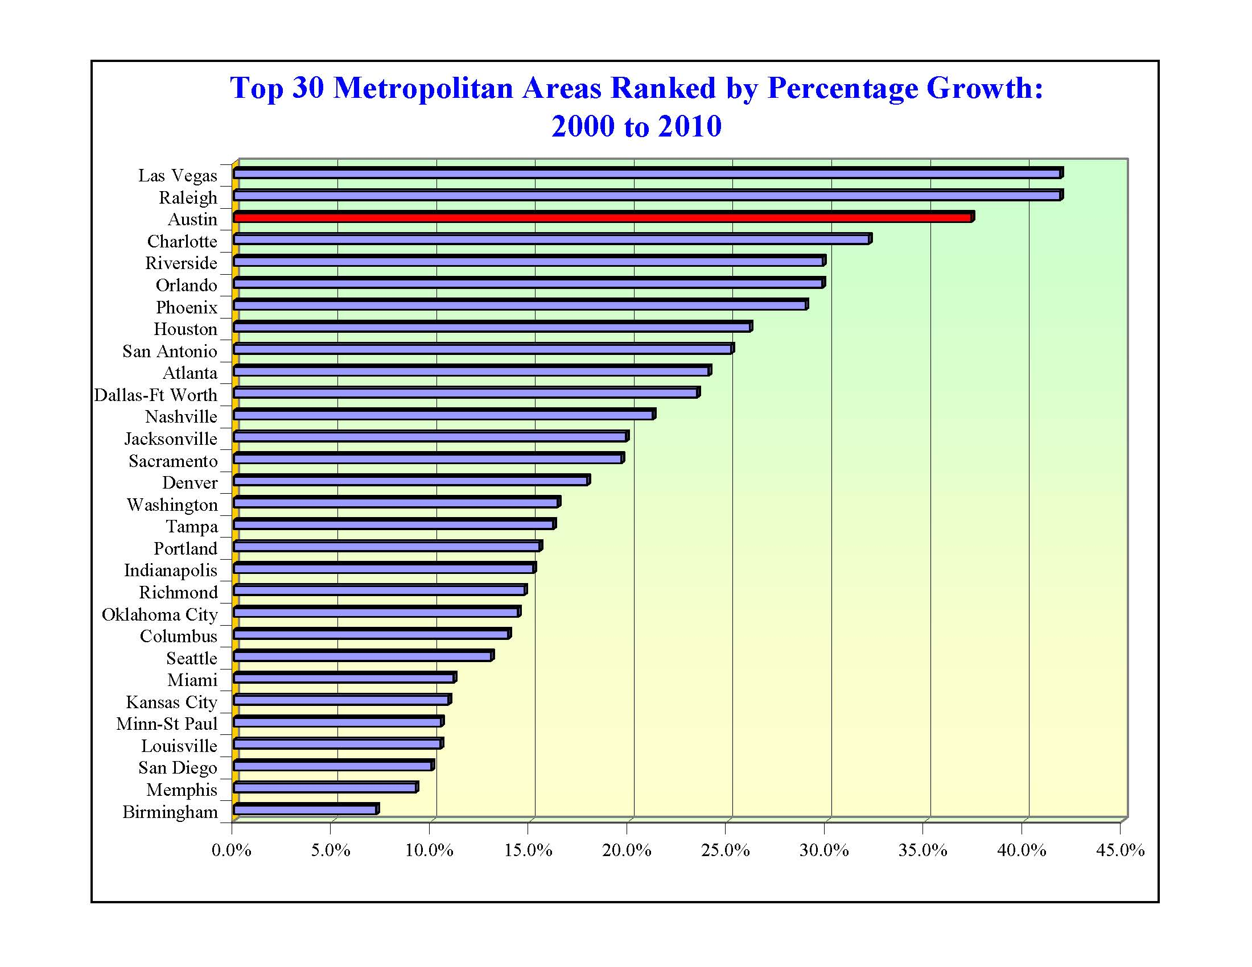
3rd

Slide 13
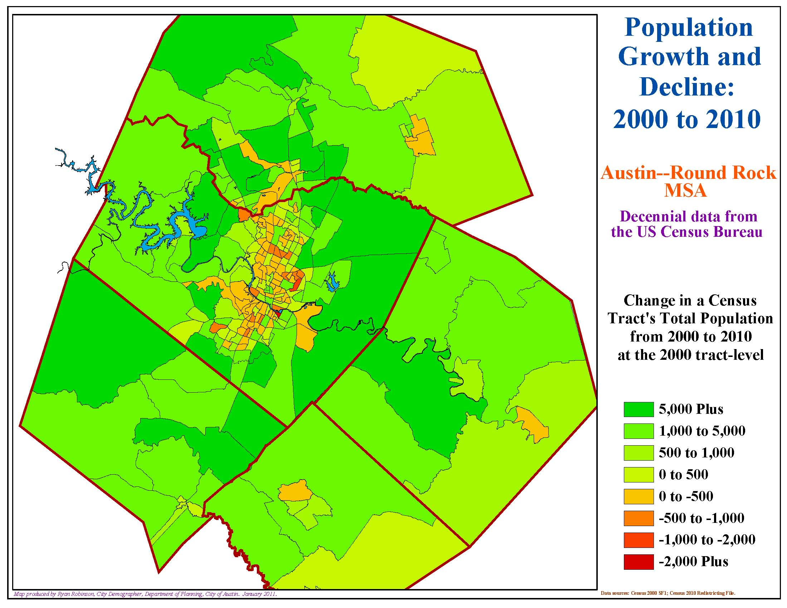

Slide 15
City of Austin Racial and Ethnicity Shares:
census 26
2010
50%
48.7 %
45%
White Non-Hispanic
40%
African American
Hispanic All Races
Asian
35%
Other
35.1 %
30%
25%
20%
15%
10%
5%
7.7 %
6.3 %
0%
2.2 %
White
African American
Hispanic
Asian
Other
Chart produced by Ryan Robinson, City Demographer, Department of Planning, City of Austin. January 2011

Slide 16
City of Austin, Change in Under 18 Population by Race and Ethnicity, 2000 - 2010
White
African American
Hispanic
Asian
Other
-5,000
0
5,000
10,000
15,000
20,000
25,000
65,000
75,000
85,000
Chart produced by Ryan Robinson, City Demographer, Department of Planning, City of Austin. January 2011

Slide 17
City of Austin Under 18 Race/Ethnicity Shares:
census 28
2010
60%
50%
White Non-Hispanic
50.9 %
African American
Hispanic All Races
Asian
40%
Other
30%
31.8 %
20%
10%
8.3 %
6.3 %
3.3 %
0%
White
African American
Hispanic
Asian
Other
Chart produced by Ryan Robinson, City Demographer, Department of Planning, City of Austin. January 2011

Slide 19
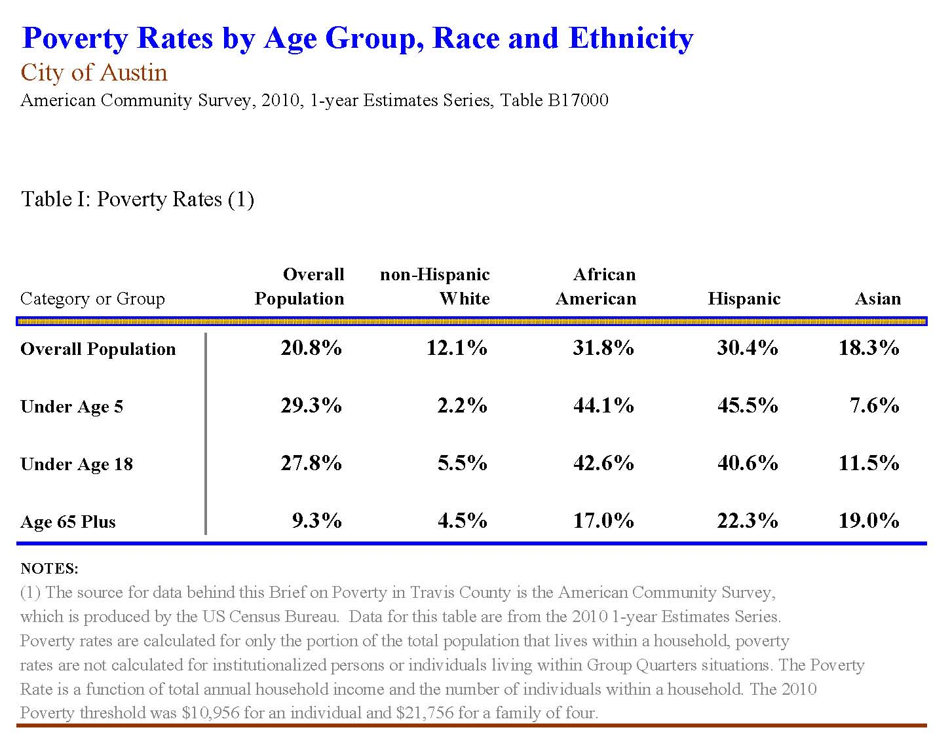

Slide 20
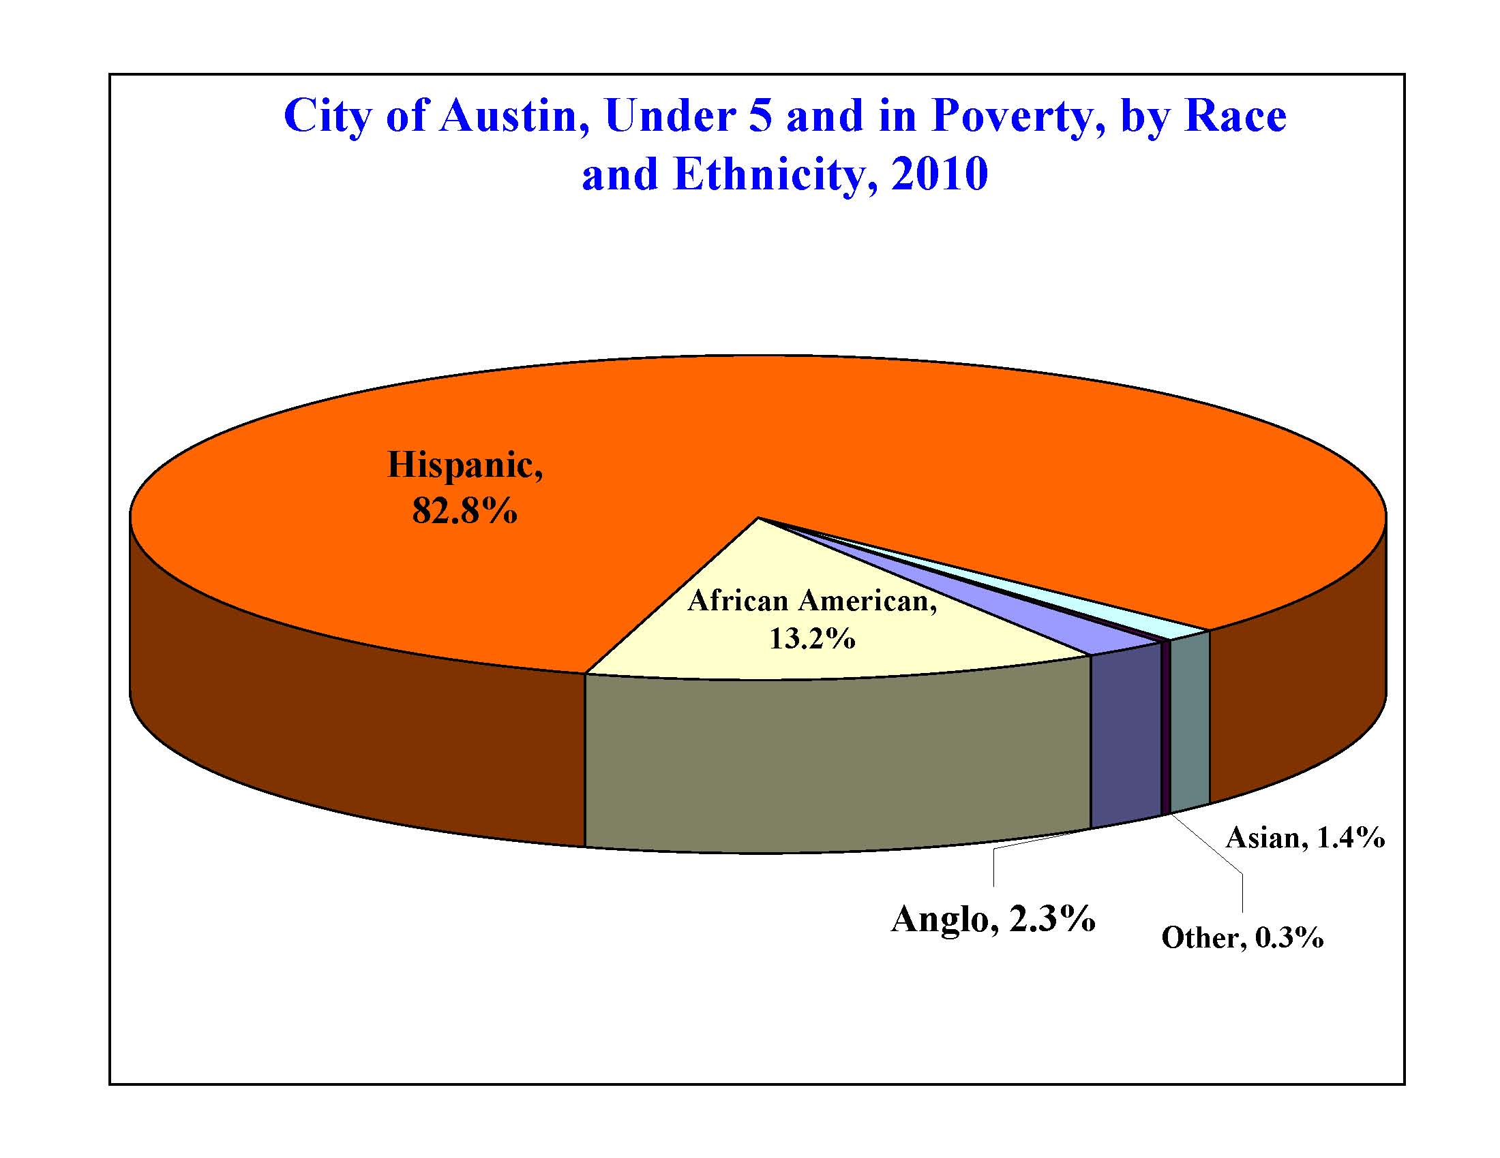
City of Austin, Under 5 and in Poverty, by Race and Ethnicity
2010
Chart produced by Ryan Robinson, City Demographer, Department of Planning, City of Austin. January 2011

Slide 21
Census 2010 Observations/Conclusions
Much of the overall population growth for metropolitan Austin was suburban during the past decade.
The total population continued to diversify in terms of racial and ethnic makeup.
One out of every two children within the City of Austin is now Hispanic.
Decrease in total number of African Americans within the City as the overall metropolitan African American community expanded and suburbanized.
Working-class Hispanic households continued to concentrate within Barrio-like neighborhoods while middle-class Hispanic households continued to disperse and suburbanize.
Continued rapid growth of the Asian community with a deconcentration of household clusters across the metropolitan region.

Slide 22
Mapping projects in context
Childhood Obesity
Young Children: A Case Study
Rapid demographic change served as backdrop for formation and focus of COH

Slide 23
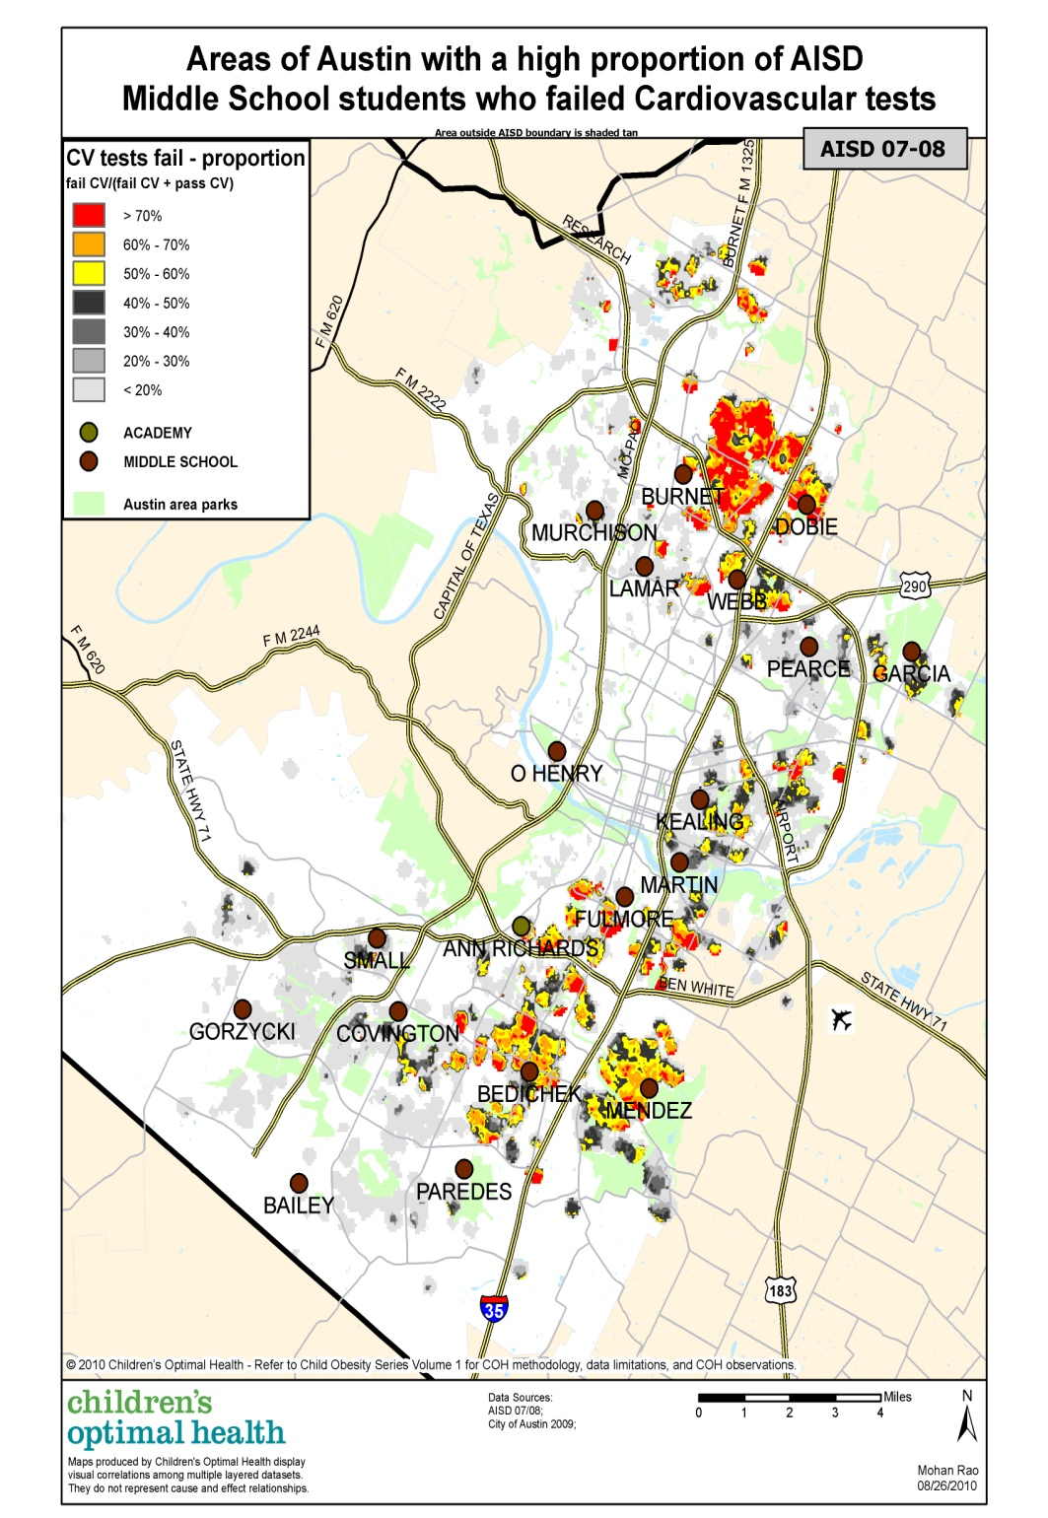
Childhood Obesity: Time Series
Austin ISD 2007-08
Middle School Students
Cardiovascular Health
Proportion Map

Slide 24
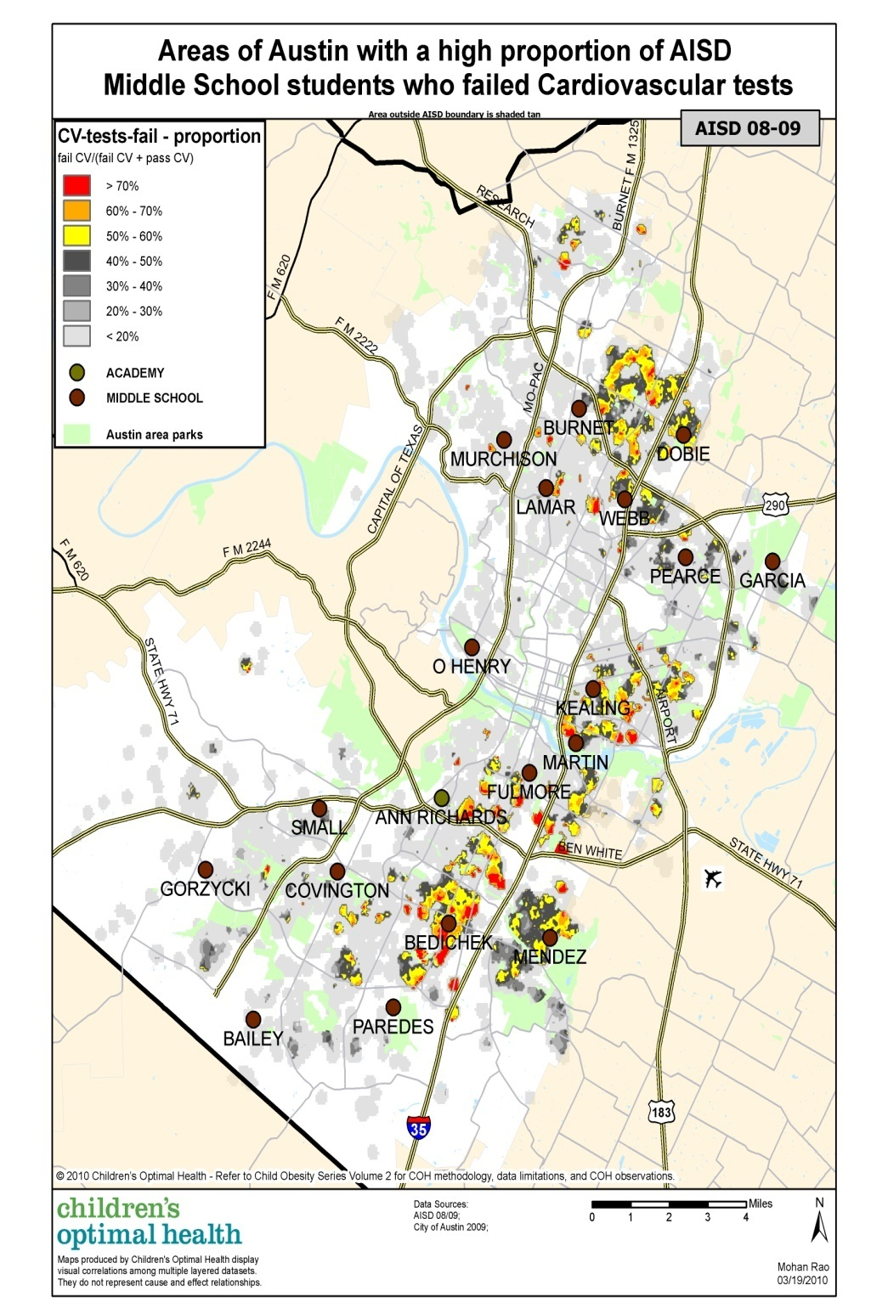
Childhood Obesity: Time Series
Austin ISD 2008-09
Middle School Students
Cardiovascular Health
Proportion Map

Slide 25
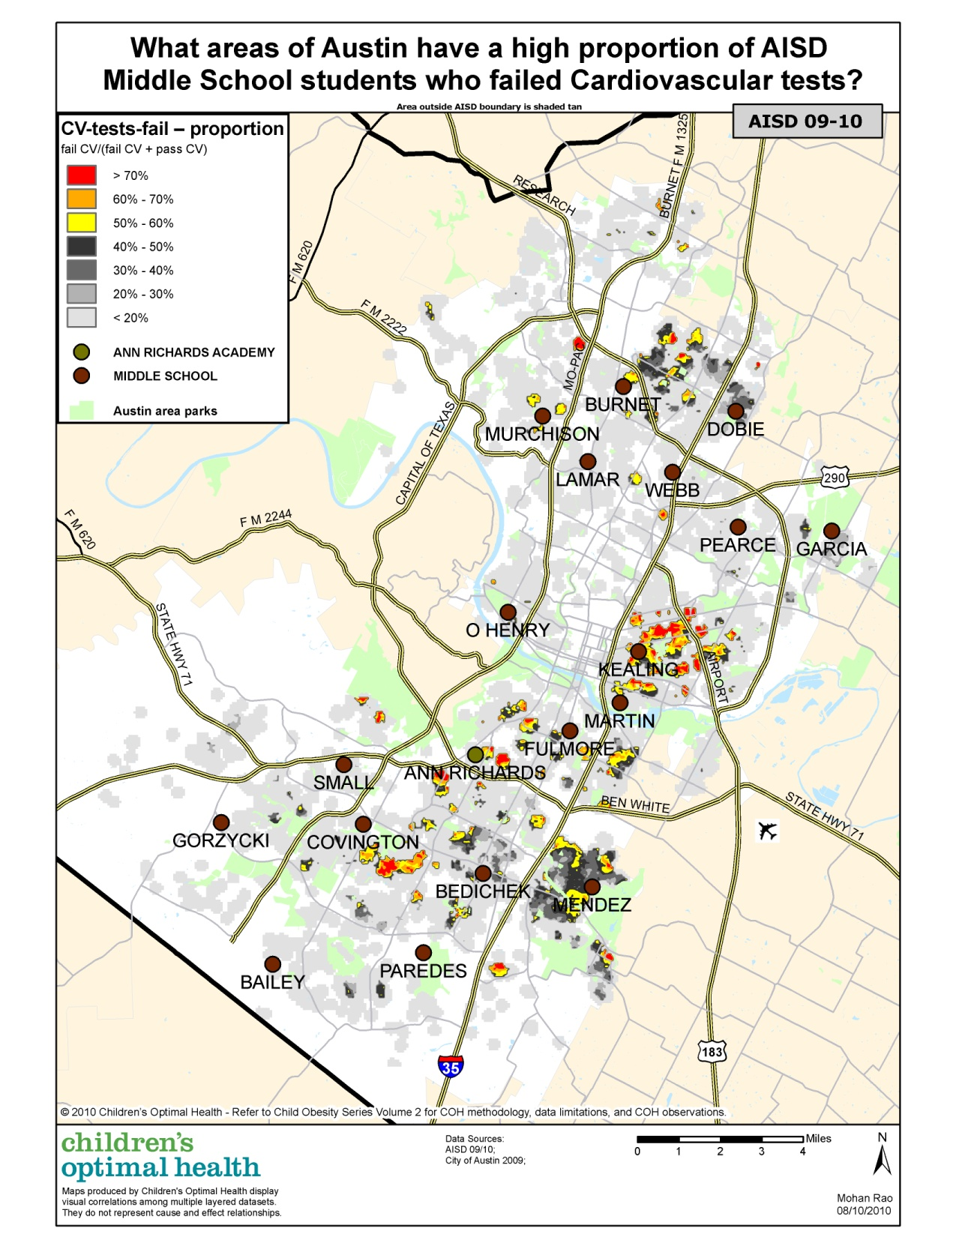
Childhood Obesity: Time Series
Austin ISD 2009-10
Middle School Students
Cardiovascular Health
Proportion Map

Slide 26
School Readiness: Austin Case Study
Starting with where you are
Building collaboration around data
Leveraging existing relationships
Promoting Collective Impact

Slide 27
All Hospital Births 2006
Competing Health Systems Sharing Data with COH
~ 97% births represented
Births across 3 Counties

Slide 28
All Hospital Births 2006
Cropped map to focus on hot spots
4 Hotspots identified
Density maps, decile analysis

Slide 29
ICC Births to Low Income Women
Integrated Care Collaboration
www.icc-centex.org
27 Safety Net Providers
Health Information Exchange (ICare)
2005

Slide 30
ICC Births to Low Income Women
Integrated Care Collaboration
2006
4 Hotspots identified
Density maps, decile analysis
Time series study

Slide 31
ICC Births to Low Income Women
Integrated Care Collaboration
2007
4 Hotspots identified
Density maps, decile analysis
Time series study

Slide 32
ICC Births to Low Income Women
Integrated Care Collaboration
2008
4 Hotspots identified
Density maps, decile analysis
Time series study

Slide 33
ICC Births to Low Income Women
Integrated Care Collaboration
2009
4 Hotspots identified
Density maps, decile analysis
Time series study

Slide 34
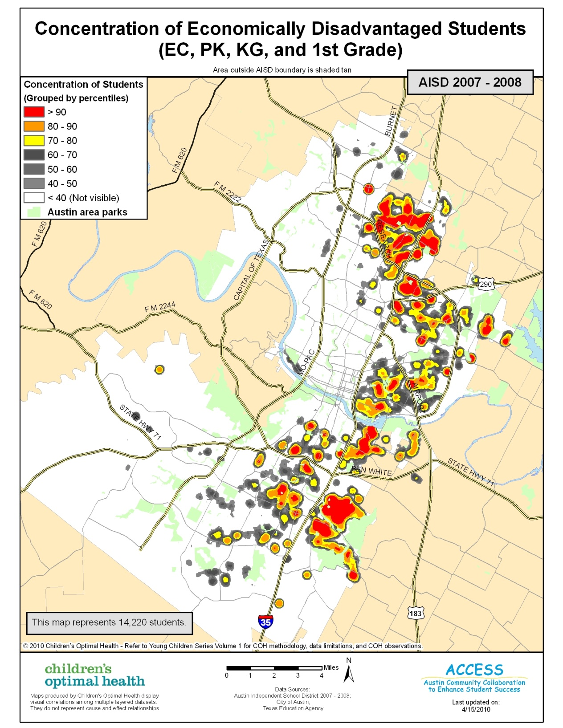
Proxy Data for Young Children
Austin ISD Data
86,000 Students
65% Econ Disad.
Map:
14,220 Economically Disadvantaged young students

Slide 35
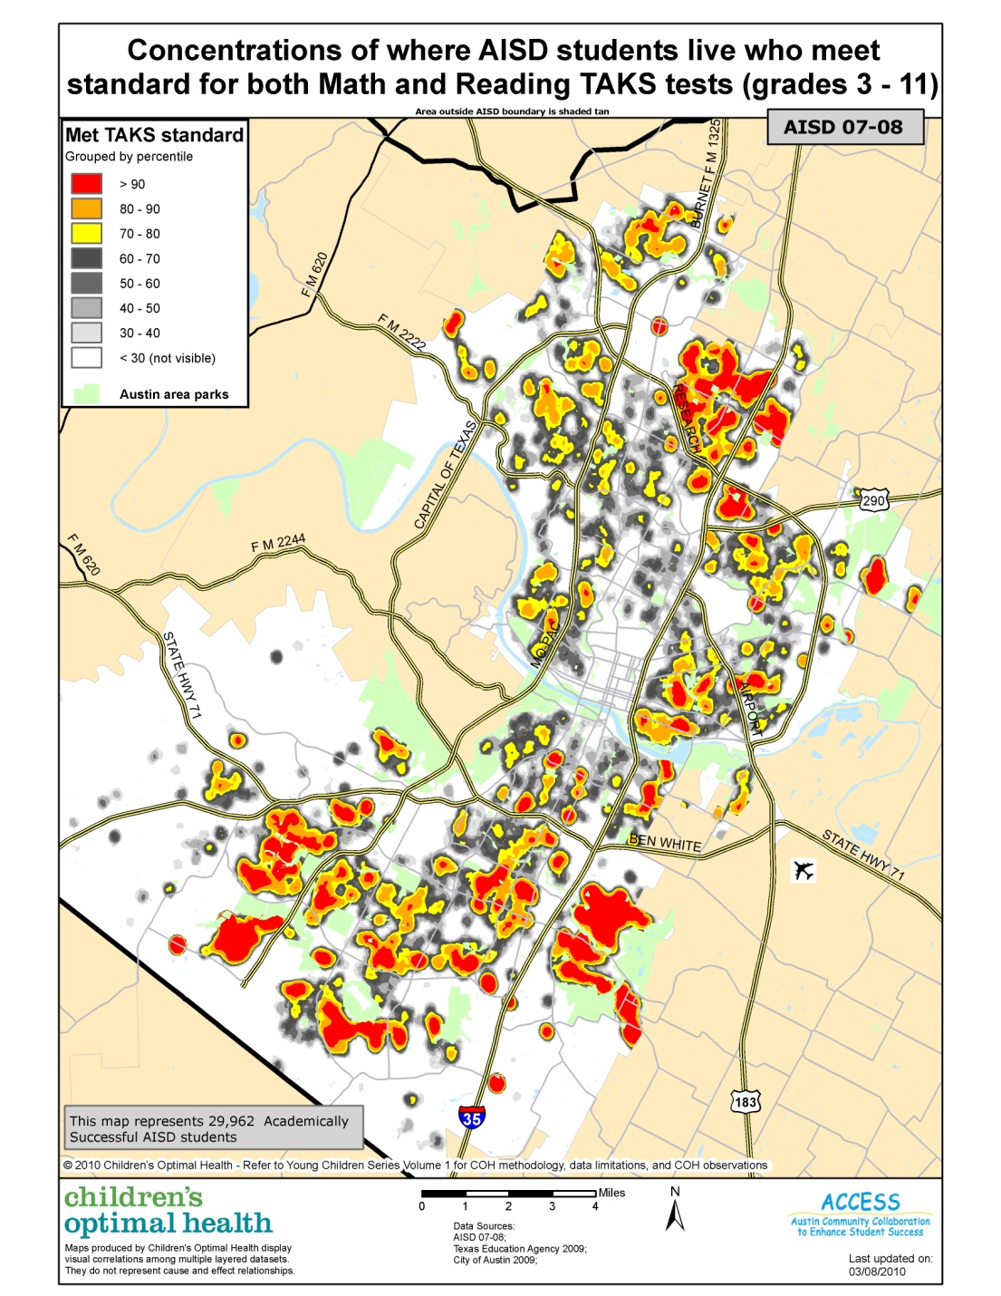
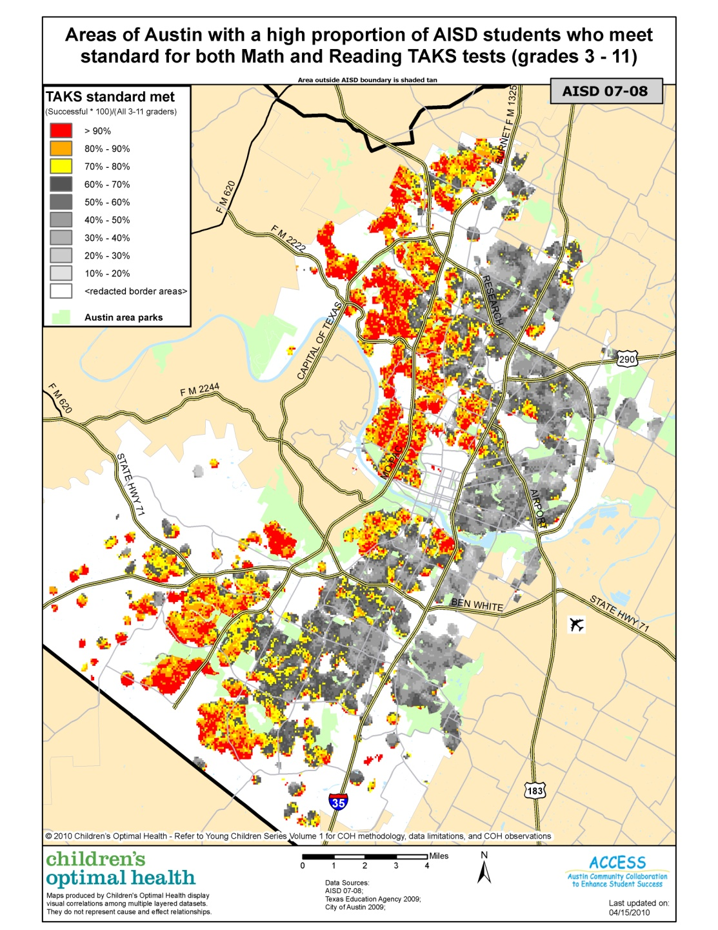
Proxy: School Success

Slide 36
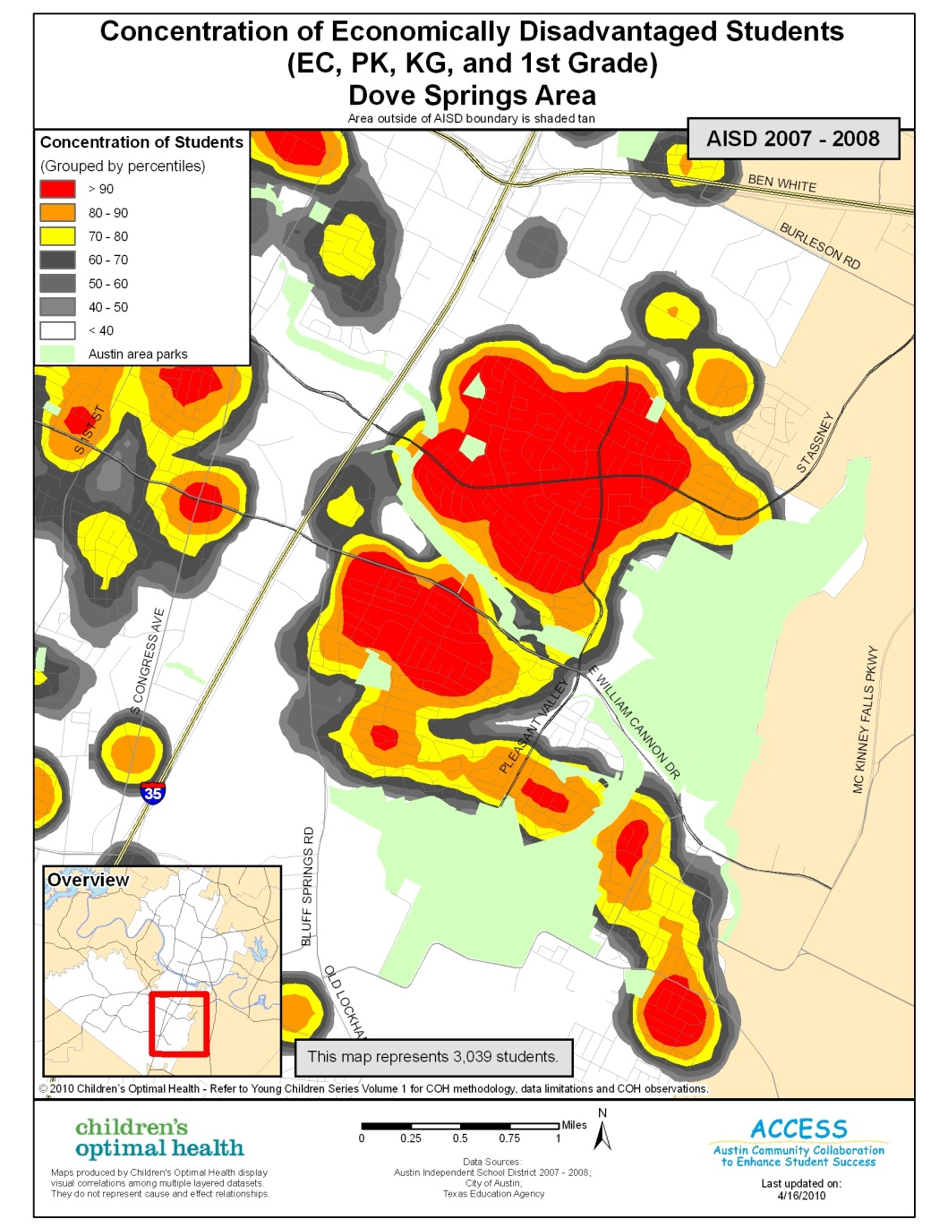
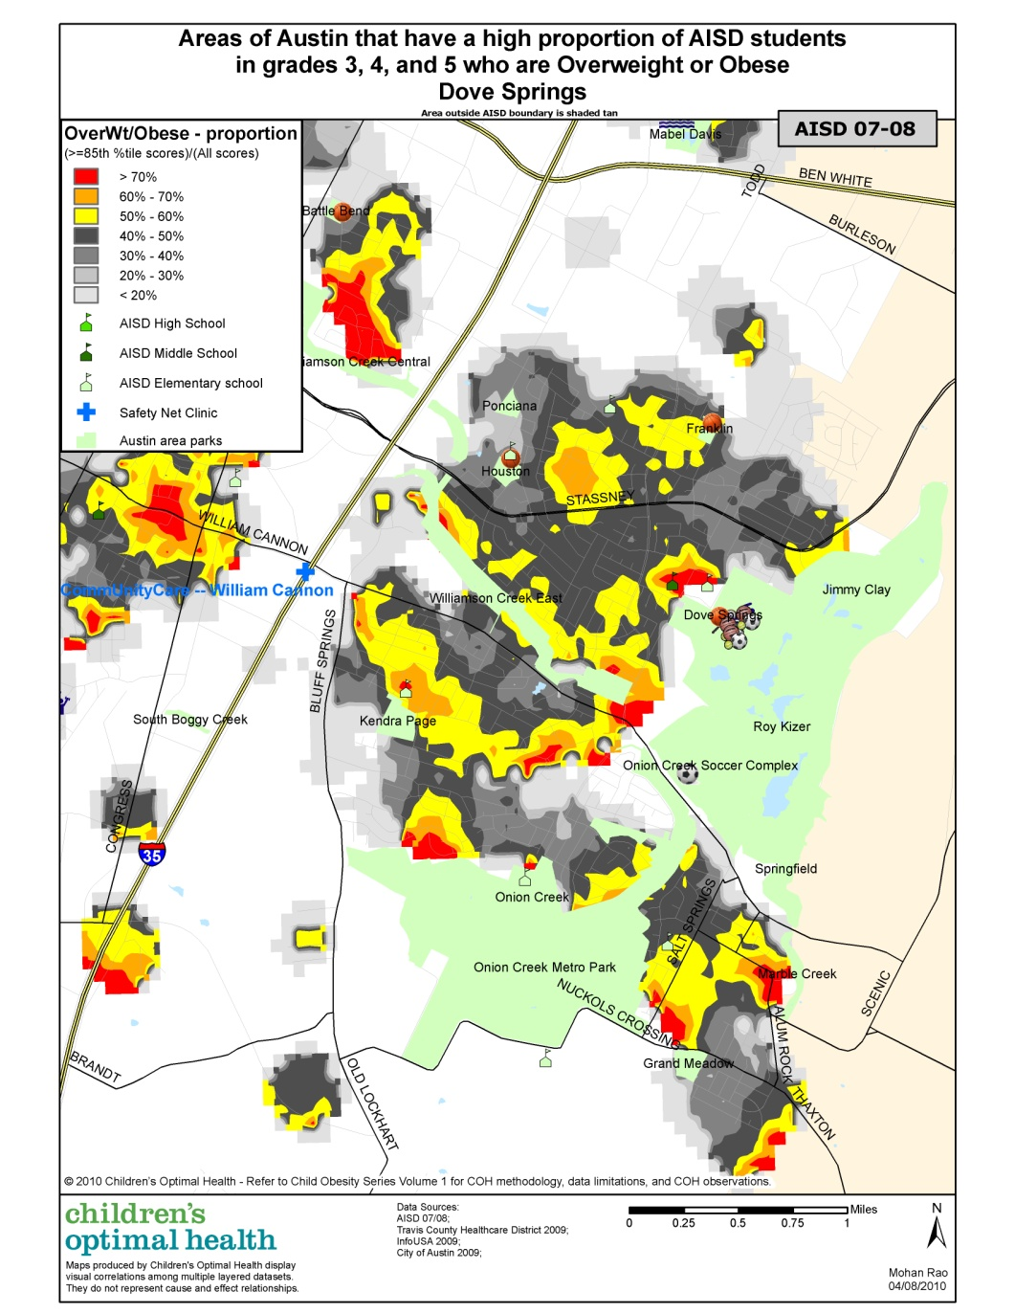
Proxy: Obesity

Slide 37
Community Assets
Access to health care: OB/GYN
Where do women from these target neighborhoods receive prenatal care?
Transportation

Slide 38
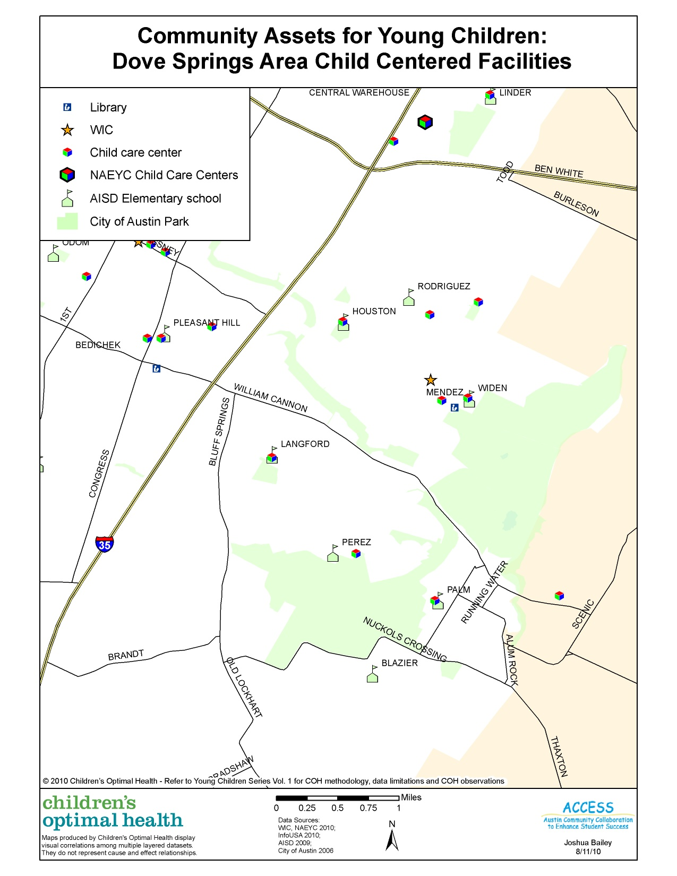
Community Assets
Neighborhood level
WIC
Child Care Centers
Elementary Schools
Playgrounds
Libraries
Food Landscape
Faith Communities
Health Care

Slide 39
School Readiness (Young Children Phase II)
Collaboration
United Way/Success by 6
Samsung Grant
UCLA Center for Healthier Children, Families and Communities
2 School Districts
WIC Clinics
Standardized Assessment Tools

Slide 40
School Readiness
UCLA Center for Healthier Children, Families, and Communities
Early Development Inventory (EDI)

Slide 41
February 4, 2012
Differences in early childhood experiences are evident by the age of 3
Developmental delays are more prevalent in certain neighborhoods
These delays are in specific skills sets including communication, problem solving and fine motor skills
Early delays persist and result in a school achievement gap
We can’t wait until a child starts school to begin their education . . .

Slide 42
Source: Greater Austin Chamber of Commerce

Slide 44
Thank You! www.childrensoptimalhealth.org smillea@childrensoptimalhealth.org
Lindsey Ripley
Project Manager
Maureen Britton
Executive Director
Mohan Rao
Spatial Analyst
Susan Millea
Community GIS Facilitator

