Slide 1
Clarendon and Portsmouth, North Portland Photovoice Project, 2008:
Exploring Challenges to Healthy Living
In partnership with the Multnomah County Health Department
Meg Merrick, Institute of Portland Metropolitan Studies
Portland State University

Slide 2
The “problem”:
What are the attributes of place that contribute to childhood obesity in low-income Hispanic youth in north Portland?
What are the barriers you face to healthy living in your community?

Slide 3
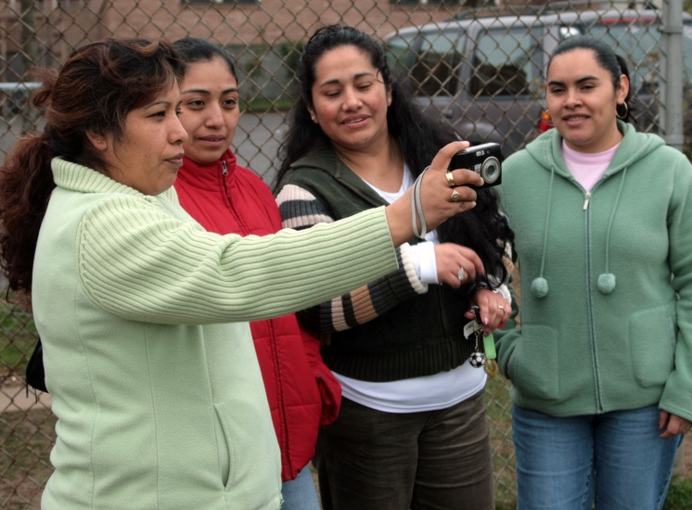
Photovoice Materials and Equipment
Cameras (film vs. digital)
Laptop computer & digital projector
Posters and easels, and Powerpoint

Slide 4
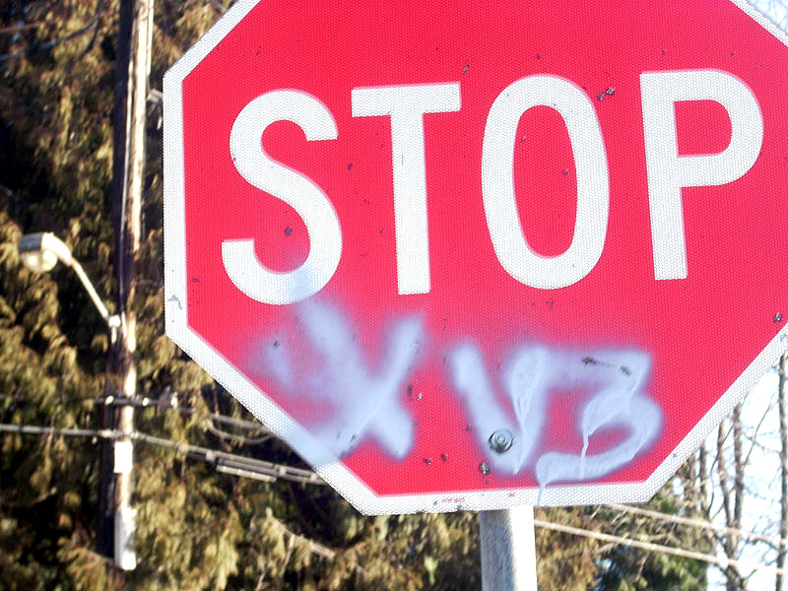
Señal de parar: Fessenden/Charleston St. con senal de gangas, “son gangas, se encuentran, hacen estas cosas, y nosotros no los vemos…”
Stop sign: Fessenden/Charleston St. with street gang sign, “…gangs, they meet [there], do these things, and we cannot see them…”

Slide 5
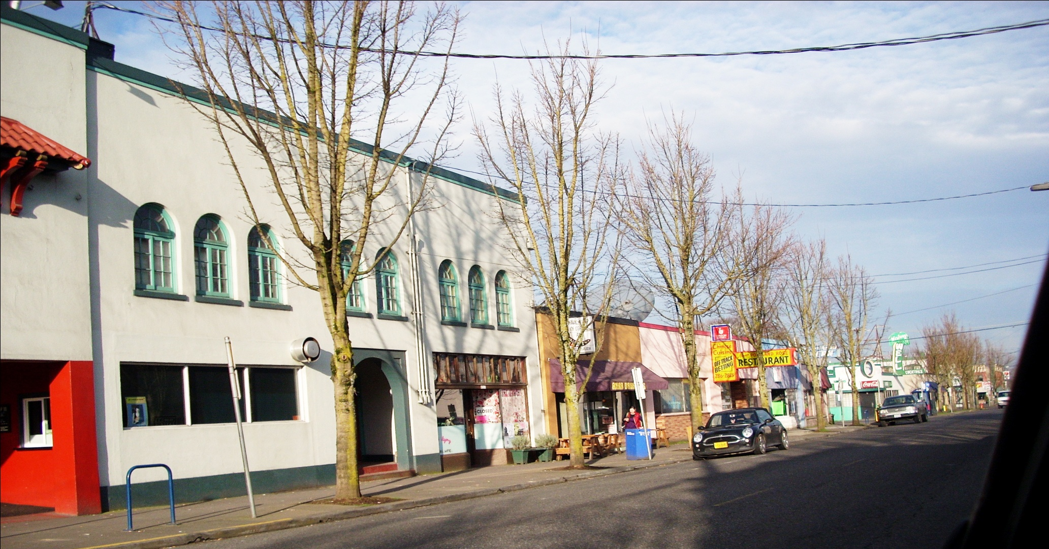
No me gusta por que hay muchas cantinas, hay cantinas y restaurantes en todo lo que es esta calle. Creo que por esto, St. Johns no le atrae a la gente, por que hay muchos bares. Cuando las personas salen de los bares… No es malo tener uno o dos bares, pero hay muchos en esta parte. Es un lugar histórico y una comunidad [St. Johns] familias no les gusta salir por que hay muchas cantinas.
Downtown St. Johns: “I don’t like the fact there are too many bars, it is restaurants and bars and bars all the way down the street. I think that is one of the reasons that [St Johns] it is not appealing, because there are too many bars, and when people come out of bars, its okay to have one or two but there are too many on this strip. It is a historical site and a community, families don’t go out and see it because of the bars.”

Slide 6
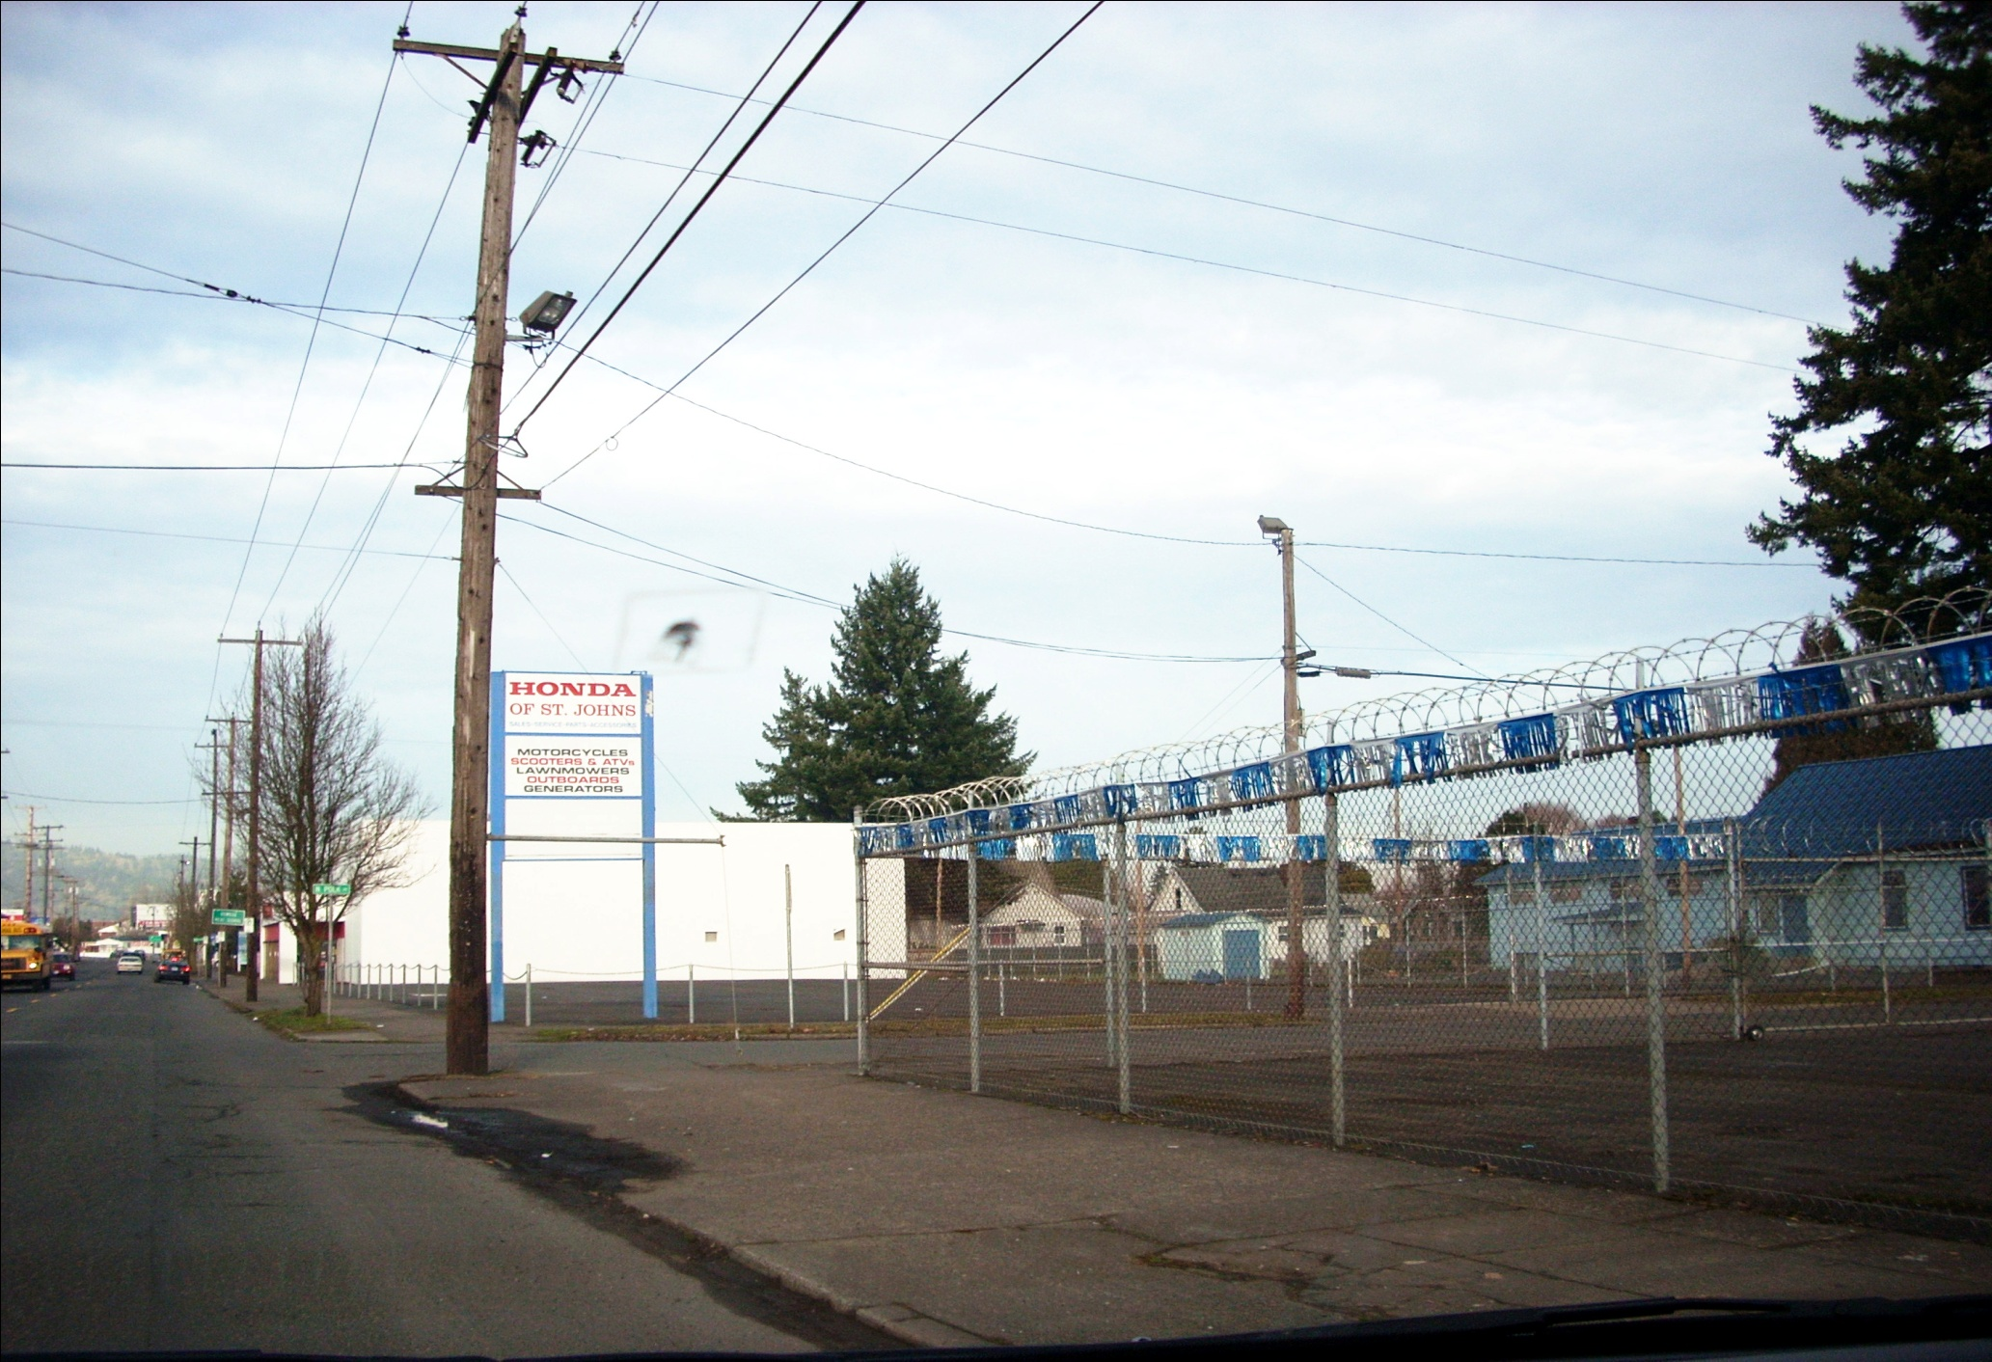
Aquí no hay negocios… muchos de estos negocios cierran, o los abandonan, y esto causa que personas no quieran poner negocios aquí en esta área. El alambre en la cerca parece una cárcel…
No businesses, too many are closing down or they are being abandoned, and this causes for less people to want to start a business. Wire on fences makes it looks like a jail.

Slide 7
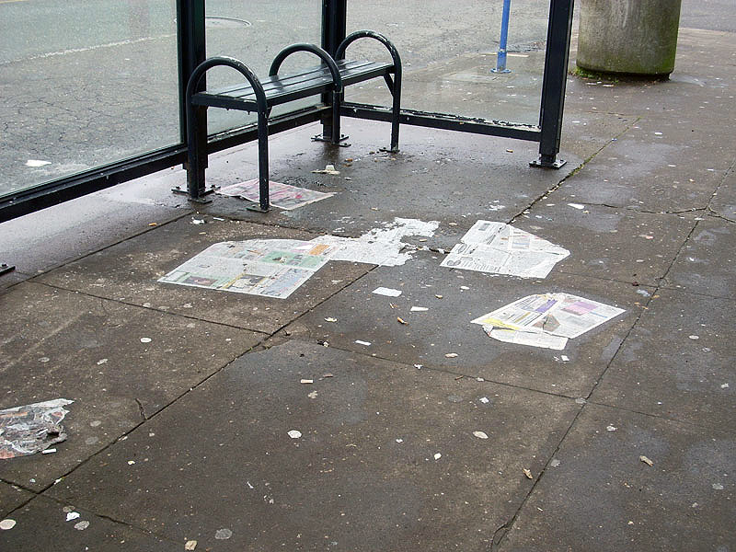
“Aquί esta una parada de bus y la gente tira la basura. Nos critican a los Mexicanos, que somos sucios, y yo veo que es Americanos. Los veo desde mi ventana que estan tirando la basura. Muchas veces cuando hacen eso me pongo a recoger para que vean que no todos los Mexicanos somos, “sucios”, y que ellos tambien tienen personas que son sucias.”
“Here is a bus stop where people throw garbage. They criticize us Mexicans, saying that we are dirty, and I see that it is Americans. I see them through my window that they throw trash. Many times when they do that I start picking up so they can see that not all Mexicans are like they say, “dirty”, and that they too have people that are dirty.”
“Here is a bus stop where people throw garbage. They criticize us Mexicans, saying that we are dirty, and I see that it is Americans. I see them thru my window that they throw trash. Many times when they do that I start picking up so they can see that not all Mexicans are like they say, “dirty”, and that they too have people that are dirty.”
“Aquί esta una parada de bus y la gente tira la basura. Nos critican a los Mexicanos, que somos sucios, y yo veo que es Americanos. Los veo desde mi ventana que estan tirando la basura. Muchas veces cuando hacen eso me pongo a recoger para que vean que no todos los Mexicanos somos, “sucios”, y que ellos tambien tienen personas que son sucias.”

Slide 8
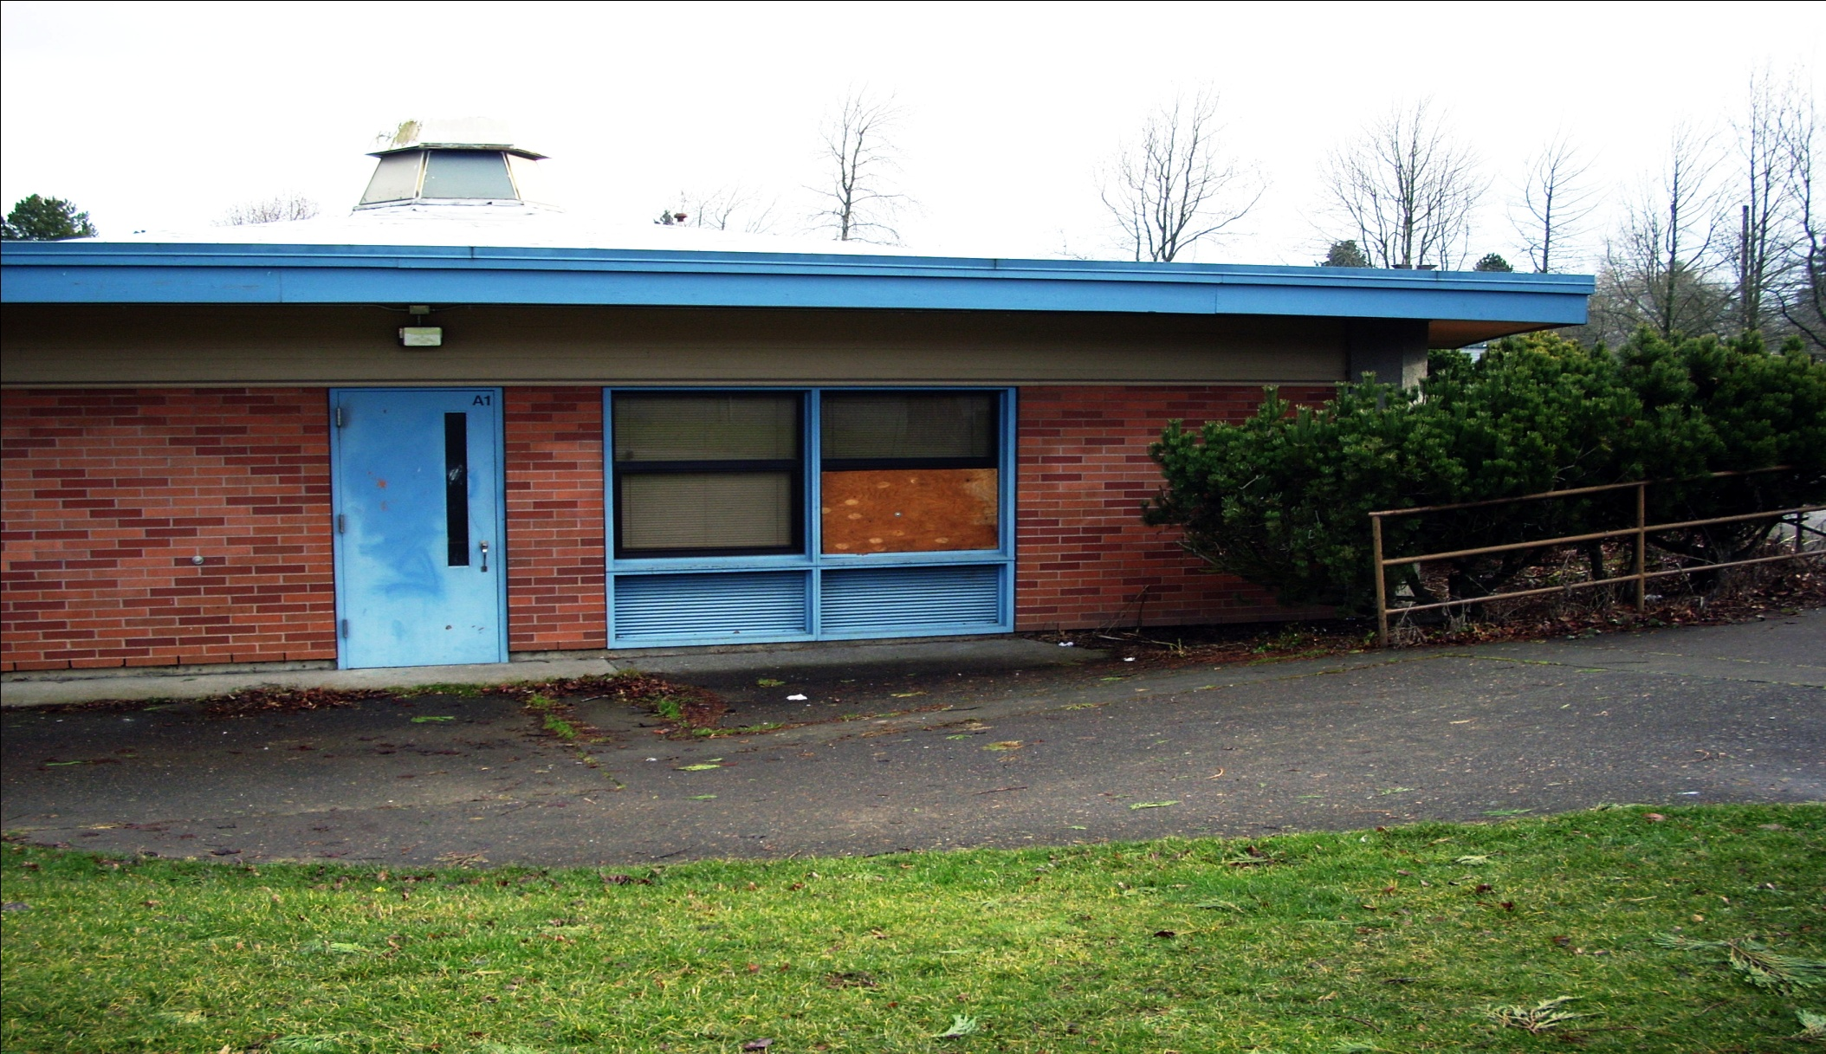
La escuela de Clarendon ha estada abandonada desde junio del 2007. Los padres tiene preocupaciones y no están de acuerdo con lo que esta pasando. A nosotros nos gustaría saber quien lo va arreglar? Queremos que la reparen y pongan un centro comunitario, un gimnasio, o otro uso para la comunidad.
“Clarendon Elementary School has been left
abandoned since July of 2007. Parents have
many concerns with what is happening and
want to know who is going to fix it? We want
this school to get repaired and use for a
community center or gym.”

Slide 9
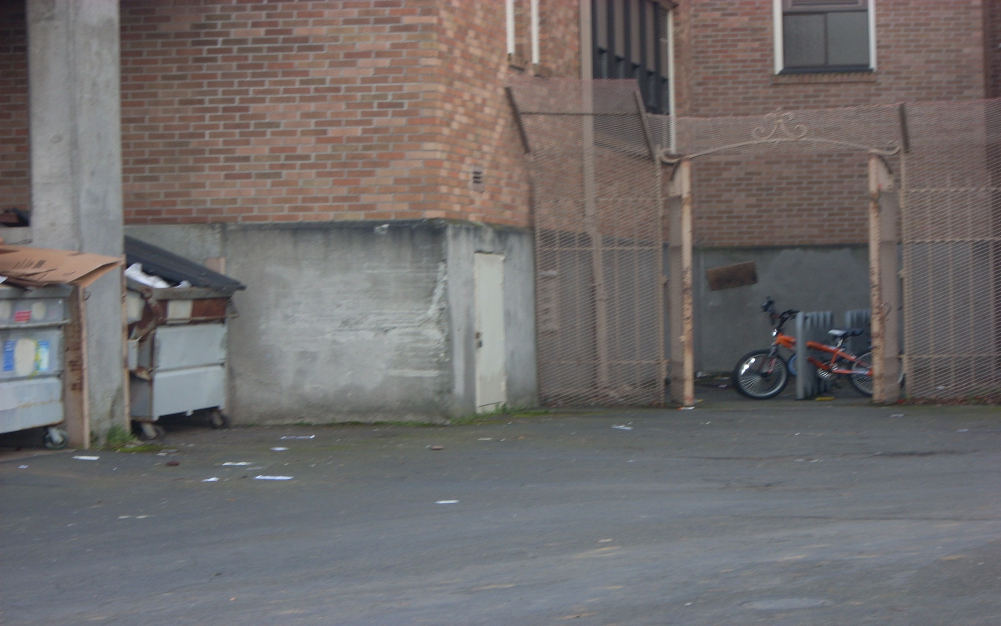
El estante para bicicletas esta atrás de la escuela, y bastantes bicicletas han sido robadas.
In back of school “…bike rack is on the back and too many bikes are being stolen.”

Slide 10
Barriers Revealed
Alcohol abuse and disorderly conduct
Gangs and vandalism
A lack of nutritious school breakfasts
Theft
Loss of school community
Acute anxiety
Helplessness and abandonment
Prejudice
A connection to place

Slide 11
Lessons Learned and Caveats
Advantages
The process can be transformative for the participants and revealing to the sponsor
Transcends language barriers
Connects participants to the political process
Connects issues to specific places
Caveats
Building trust beforehand
Time and resources
The quality of facilitation
Raising false expectations
Small, early successes are important

