Slide 1
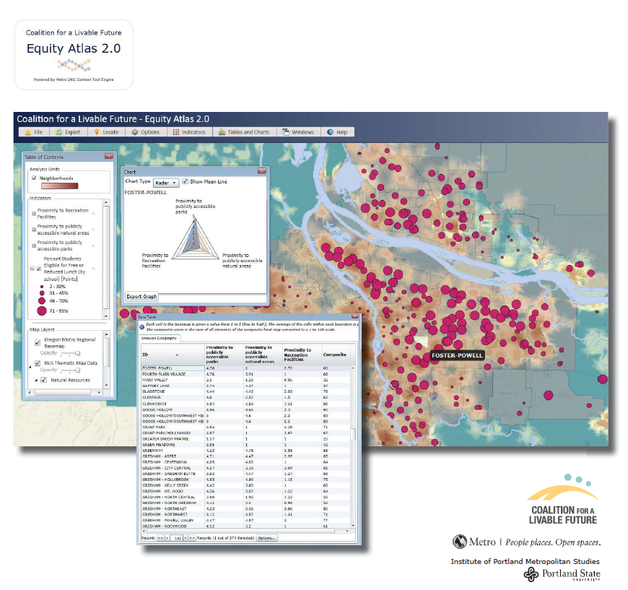
Challenges to Measuring Equity An Overview of the Regional Equity Atlas 2.0
Meg Merrick, Ph.D., Institute of Portland Metropolitan Studies, PSU
Key Funders:
Robert Wood Johnson Foundation
NW Health Foundation
Kaiser Community Fund

Slide 2
In an Equitable Region . . . - Coalition for a Livable Future
All people have access to the resources necessary for meeting their basic needs and advancing their health and well-being.
All people have the power to shape the future of their communities through public decision-making processes that are transparent, inclusive, and engage the community as full partners.
All communities experience the benefits and share the costs of growth and change.
All people are able and have the opportunity to achieve their full potential and realize their vision for success.
Notes:
The purpose of the Atlas project is to create a more equitable Portland-Vancouver metro region.
In an equitable region, everyone has access to essential resources, the ability to influence public decisions that affect them, and the ability to achieve their full potential.
The Atlas uses maps and data to measure the extent to which our region meets these criteria.

Slide 3
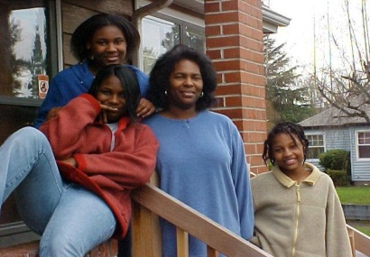
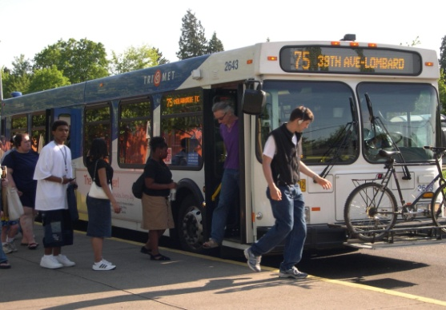
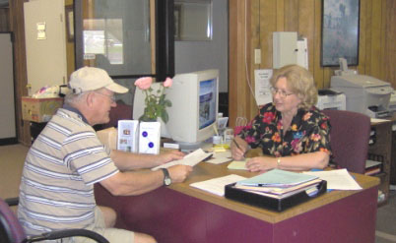
Housing • Education • Transportation • Health • Food • Clean Air • Nature • Services
What is the Regional Equity Atlas?
A tool to understand how well different neighborhoods
and populations across the region are able to access
essential resources & opportunities
Notes:
The Regional Equity Atlas is a tool that enables us to understand how well different neighborhoods and populations across the region are able to access the resources and opportunities necessary for meeting their basic needs and advancing their health and well-being.
Its purpose is to provide a visual depiction of disparities across the region to help inform strategies to promote greater equity through policy, planning, and strategic investments.

Slide 4
What is the Regional Equity Atlas? Equity Stories, White Papers, Mapping Tool www.equityatlas.org
Notes:
You can access the Atlas maps in two ways: The equityatlas.org website includes a Maps and Analysis section that includes more than a hundred key maps organized by theme, along with an explanation of each of the maps and an analysis of findings. The website also includes extensive background information, additional data, and other resources.

Slide 5
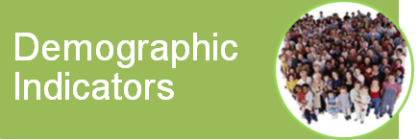
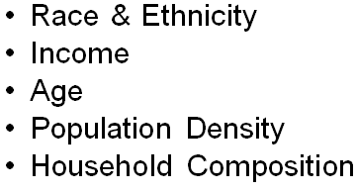
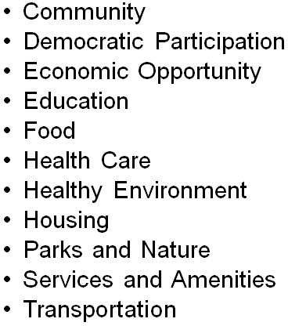
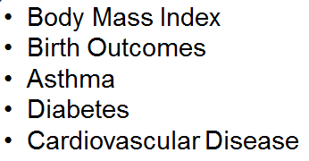
Identifying Which Issues to Map
Best Practices Research
Research on Data Sources
Selection of Priority Indicators
Stakeholder Engagement
Notes:
Atlas 2.0 is an update and expansion of the first Atlas.
We spent more than a year on a multi-step process to develop the list of indicators that are available in the Atlas 2.0 mapping tool. The process included extensive research on data sources and best practices as well as a robust stakeholder engagement process that gathered input from hundreds of leaders from non-profits, government agencies, and community organizations across the four-county region.

Slide 6
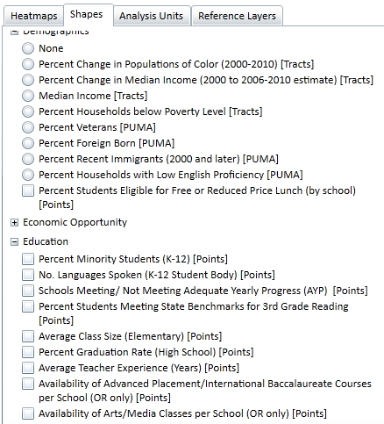
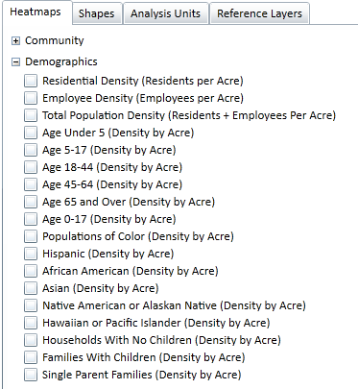
Equity Analysis Criteria
Trade-offs
Neighborhood level data
Disaggregated by race/ethnicity, age, household type

Slide 7
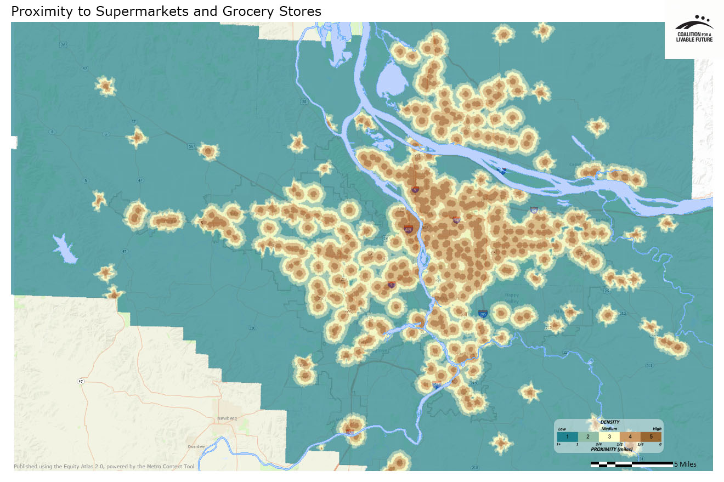
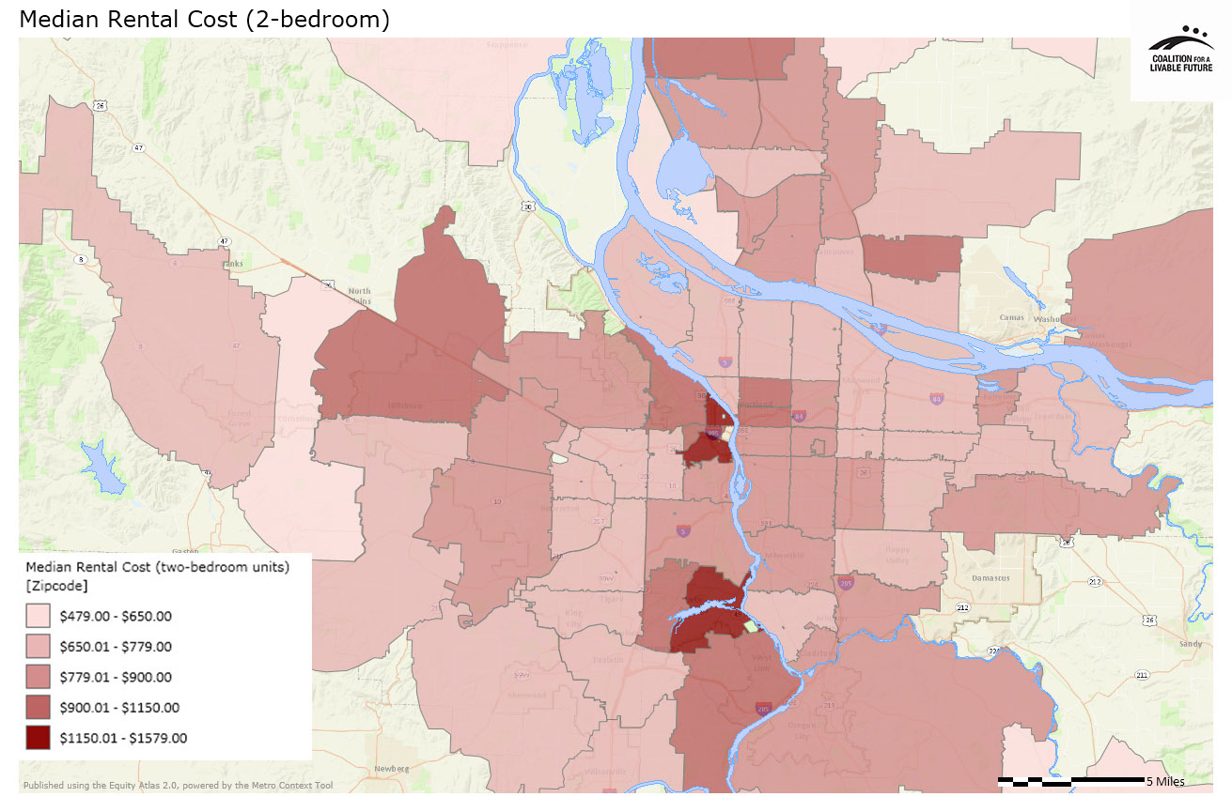
Equity Atlas 2.0 Mapping Tool Types of Data
Heatmaps (or raster)
Shapes
Notes:
For example [CLICK] this map shows median rental cost by zip code.

Slide 8
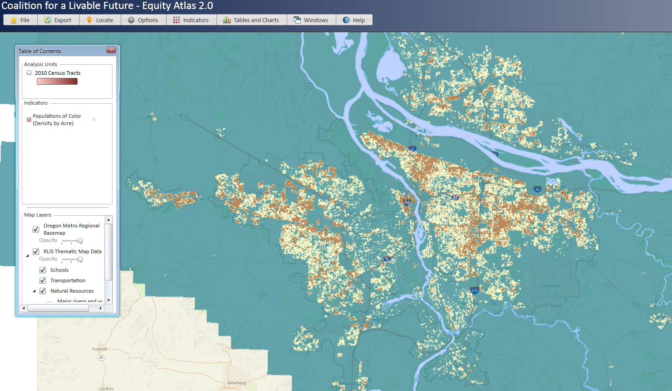
Populations of Color (2010)
264 ft grid

Slide 9
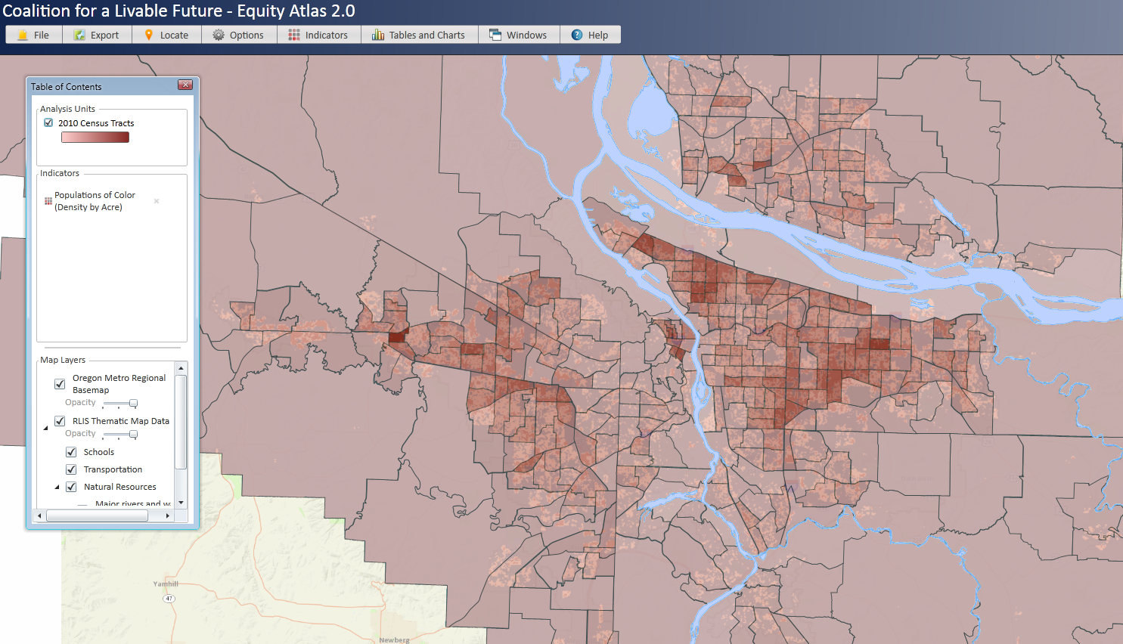
Heatmap Geographic Aggregation Capability
Populations of Color (2010)
Aggregated to 2010 Census Tracts, 1-5 density scale

Slide 10
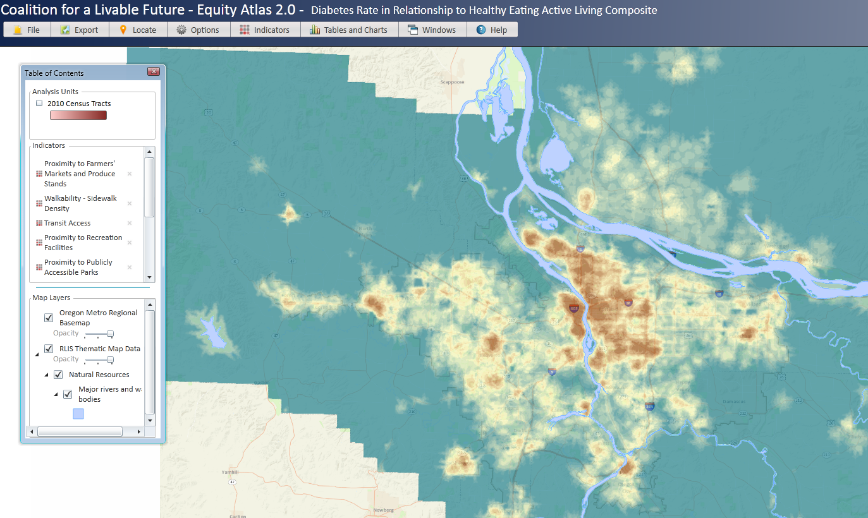
Heatmap Composite Indicator Capability
Healthy Eating Active Living Composite
264 ft grid

Slide 11
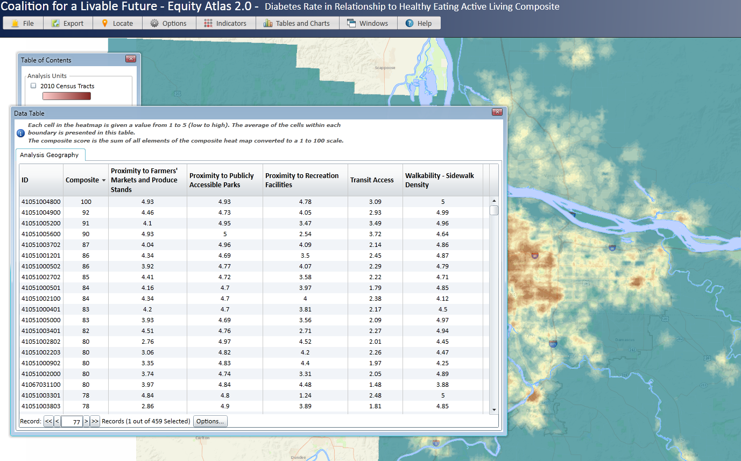
Interpreting the Composites/Table Exports
Healthy Eating Active Living Contributors by 2010 Census Tracts
Exportable table

Slide 12
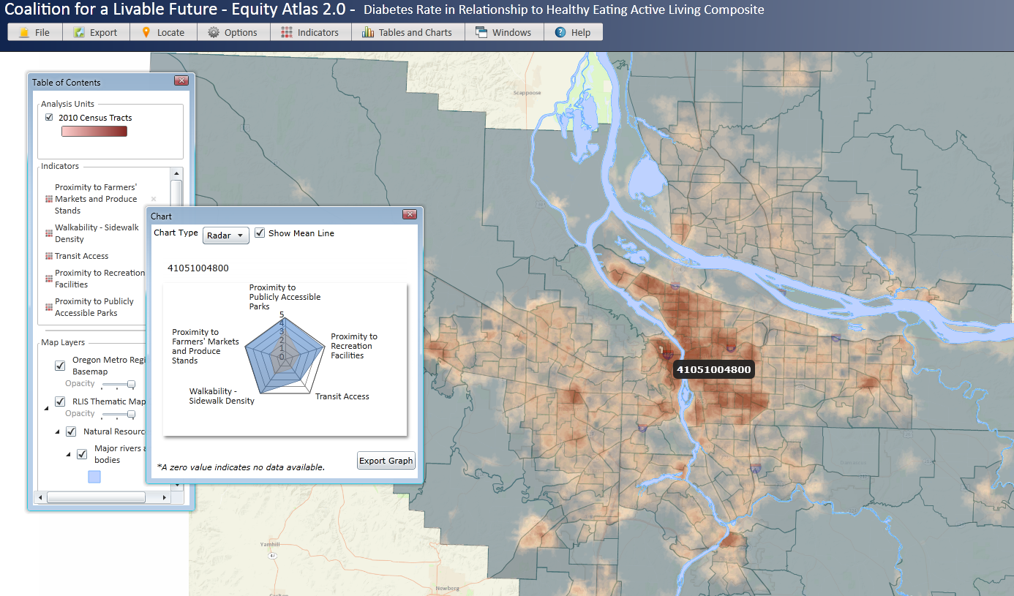
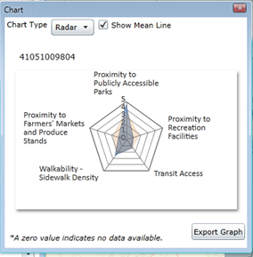
Interpreting the Heatmaps Against the Regional Mean Scores
Healthy Eating Active Living Contributors by 2010 Census Tracts
Radar charts: analysis unit compared to regional mean

Slide 13
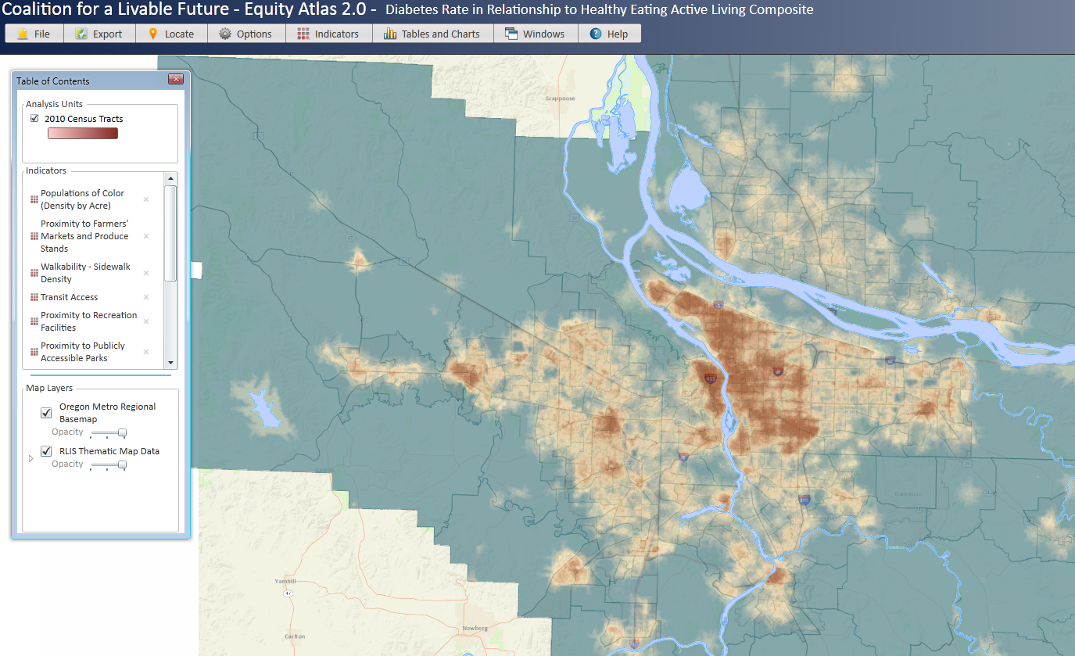
Demographics and Access?
Adding population density to other access heatmaps?

Slide 14
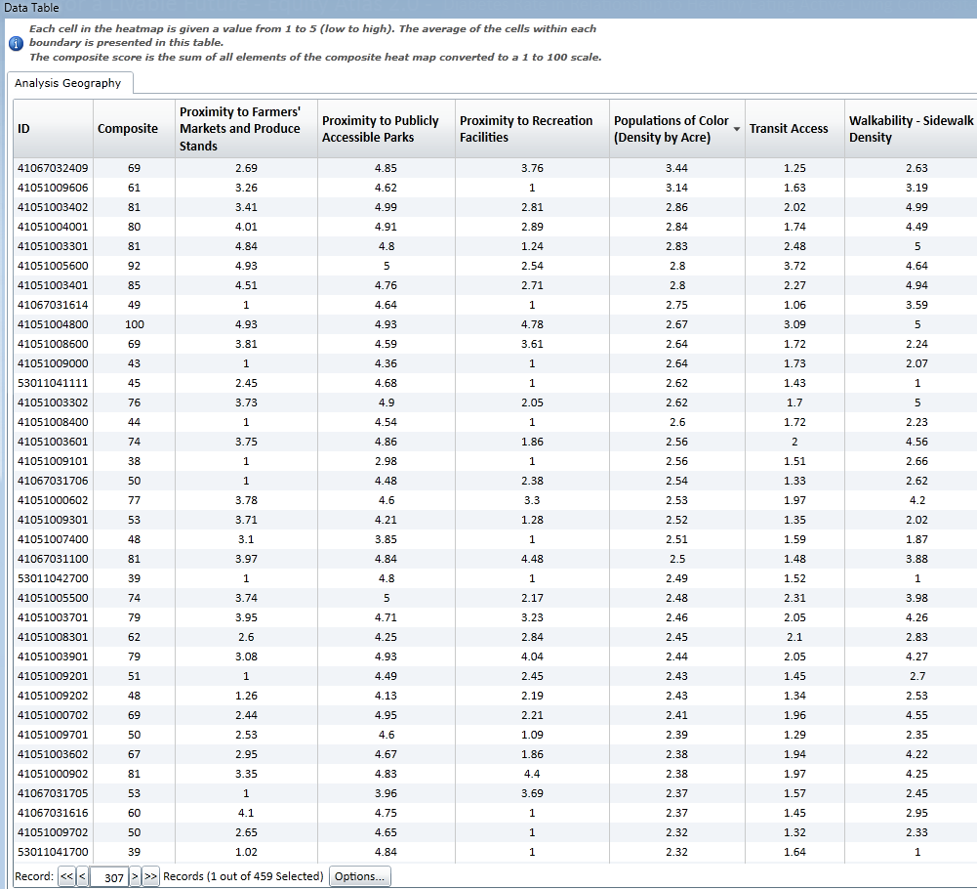
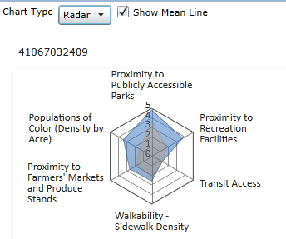
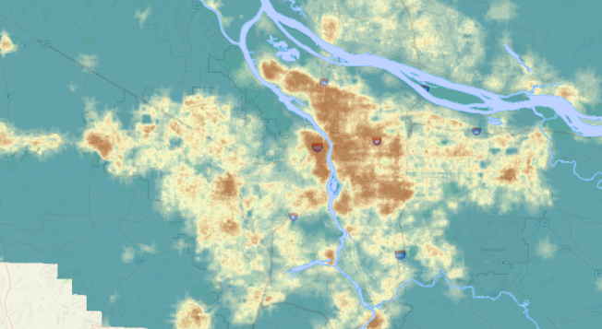
Demographic densities/geographic proximities
Adding population density to other access heatmaps? Meaningless map

Slide 15
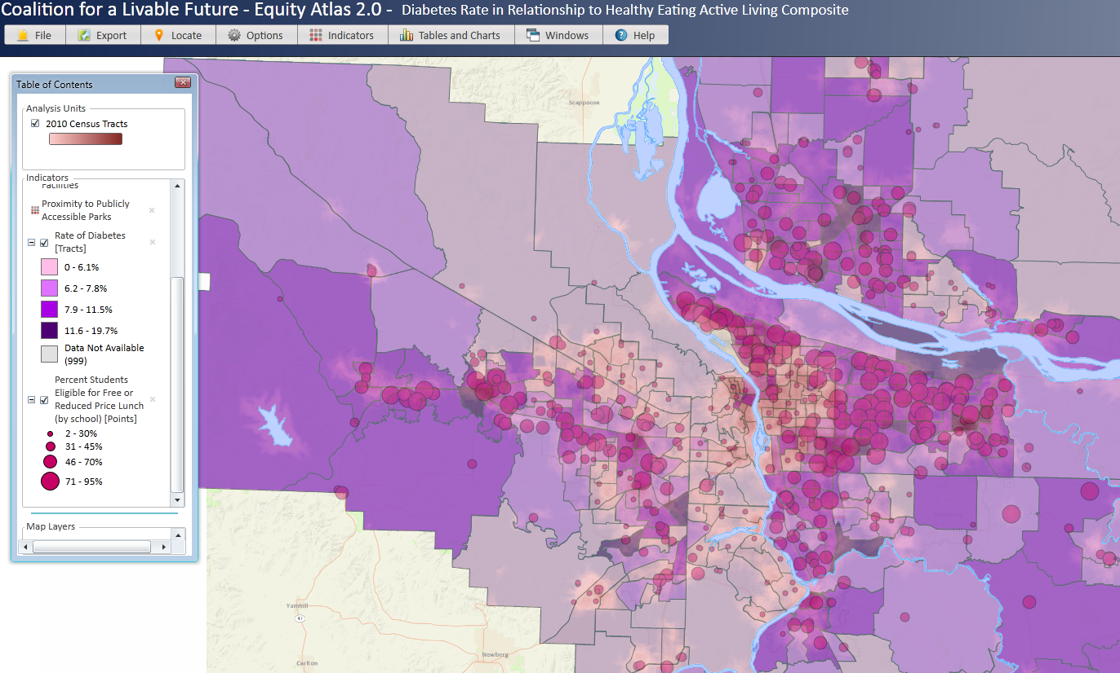
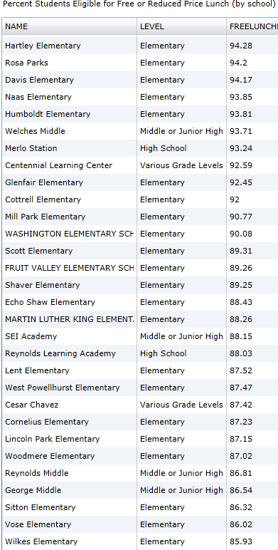
Adding “Shapes”/Triangulating Equity

