Slide 1
The Affordable Housing Debate (cont.)
Jeff Matson
jmatson@umn.edu
NNIP Idea Showcase
5/22/14

Slide 2
Outline
RCAPs / RCAWs
Mortgage Interest Deduction
Property Tax Revenue Sharing

Slide 3
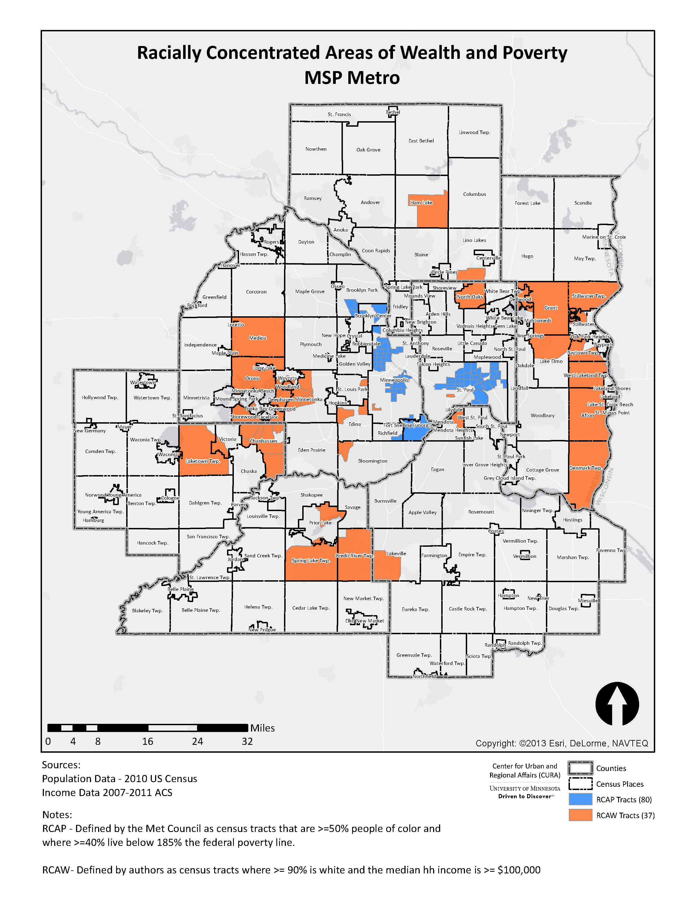

Slide 4
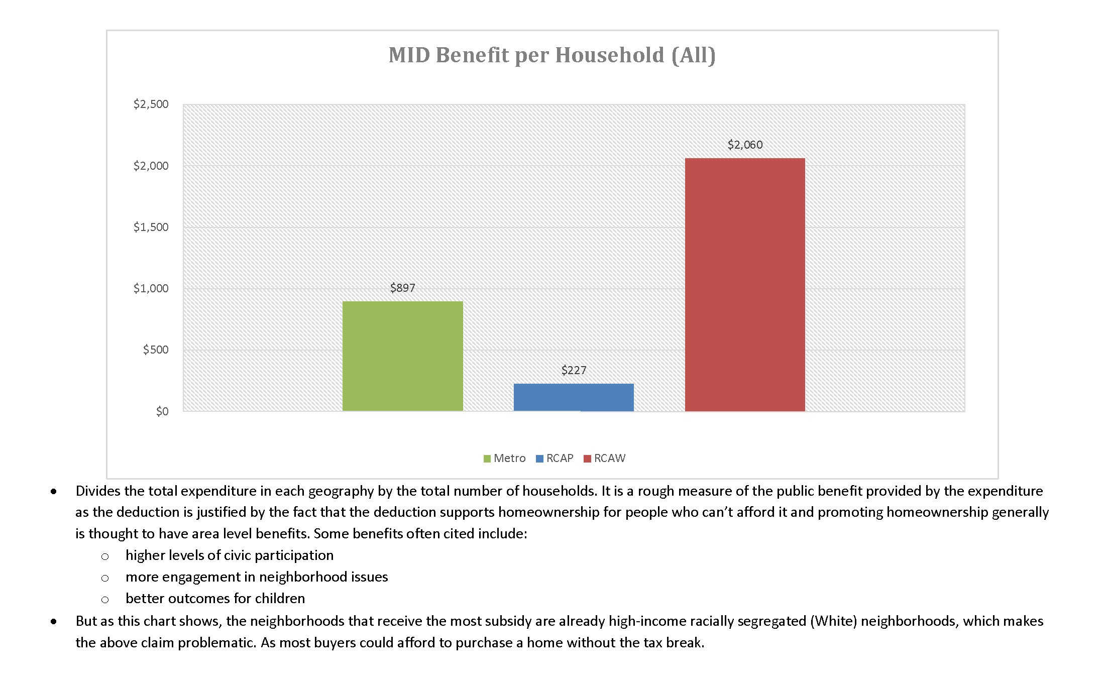

Slide 5
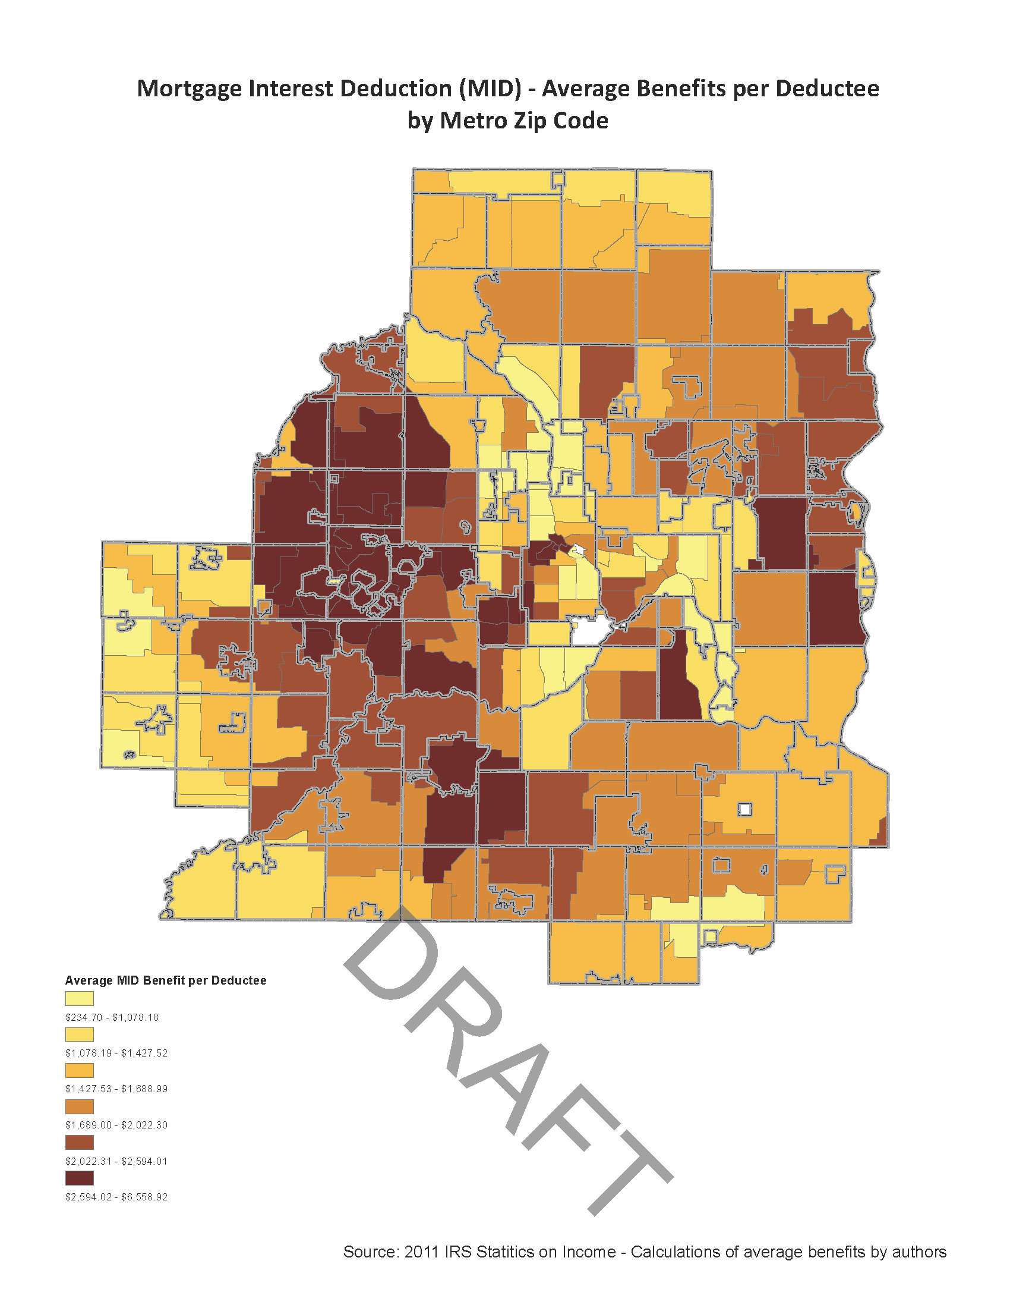

Slide 6
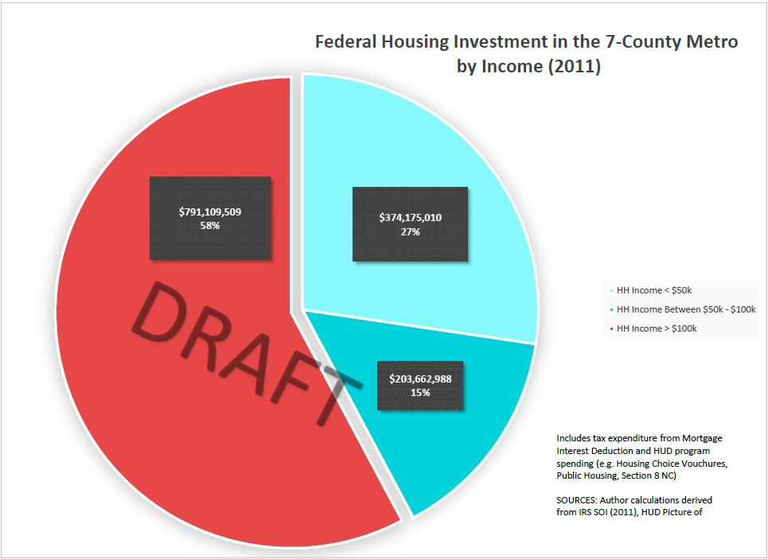

Slide 7
Property Tax Revenue Sharing
Current sharing of commercial / industrial tax
Use tax on high-value home to fund affordable housing
What numbers do we plug in?
$10M = (X)% of property tax on homes valued > (Y) thousand $
Notes:
What metro areas have the data we need to perform comparisons?

Slide 8
Thank you!
Jeff Matson
jmatson@umn.edu

