Slide 1
Defining Opportunity: Engagement, Equity and Analysis in the Twin Cities
  Jeff Matson
  Center for Urban and Regional Affairs
  University of Minnesota
  jmatson@umn.edu
  CIC Impact Summit, Chicago
  8/17/13

Slide 2
Center for Urban and Regional Affairs
45 years of community engagement
Community-based research
Faculty-led research
Technical assistance
  Community GIS

Slide 3

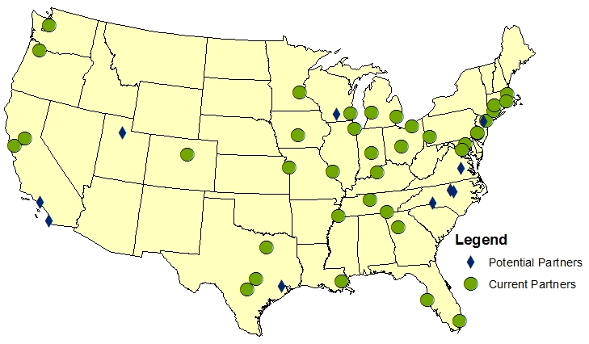
Better Data. Better Decisions. Better Communities.
National Neighborhood Indicators Partners

Slide 4
Outline
Fair Housing and Equity Assessment
Our role
Opportunity mapping
Remaining questions

Slide 5
What is the FHEA?
Data Analysis
Deliberation
Decision-Making
Notes:
Requirement of HUD SC Grants – Metropolitan Council
Data Analysis – RCAPs, Z-scores and Cluster Analysis
Deliberation – Community Engagement, Equity, Opportunity
Decision-Making – Integration with ThriveMSP 2040

Slide 6
Project Partners
Data Team
Wilder Research / MN Compass
MN Housing Finance Agency
Institute for Metropolitan Opportunity
CURA
HousingLink
Housing Preservation Project
Others
Notes:
We had just a small role to play in this process – led by Met Council.

Slide 7
Project Partners
Engagement Team
Alliance for Metro Stability
Nexus Community Partners
CURA
Notes:
We had just a small role to play in this process – led by Met Council.

Slide 8
Key Questions
What is opportunity?
How is opportunity distributed across the region?
How do we structure public investments?
Notes:
http://metrocouncil.org/Planning/Projects/Thrive-2040/Fair-Housing-Equity-Assessment-%28FHEA%29.aspx

Slide 9
CURA’s Role
Inside-Outside Strategy
Data
Engagement

Slide 10
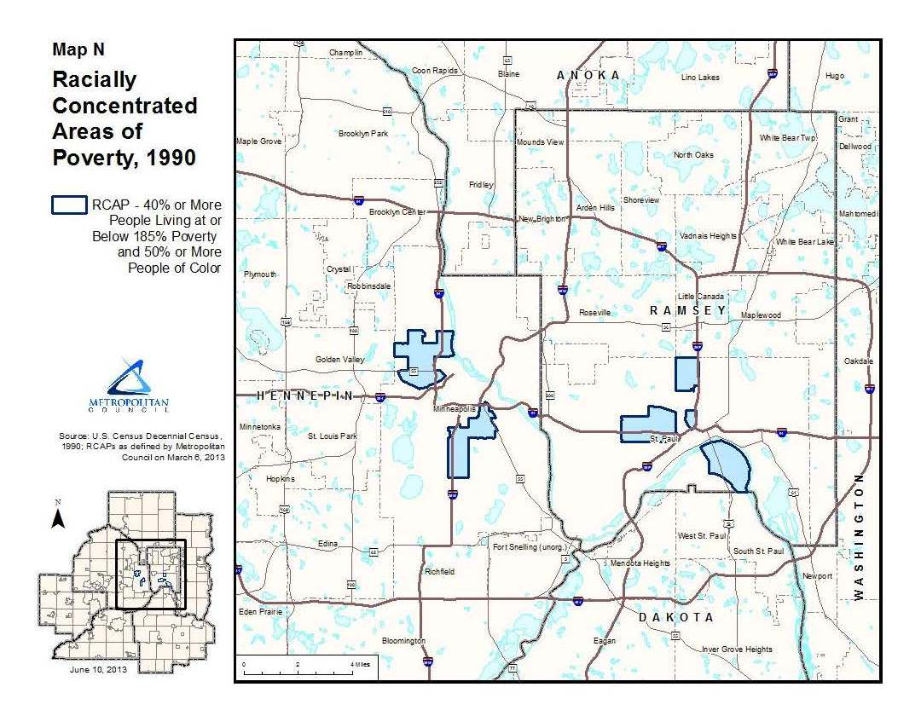
Identification and Assessment of RCAPs

Slide 11
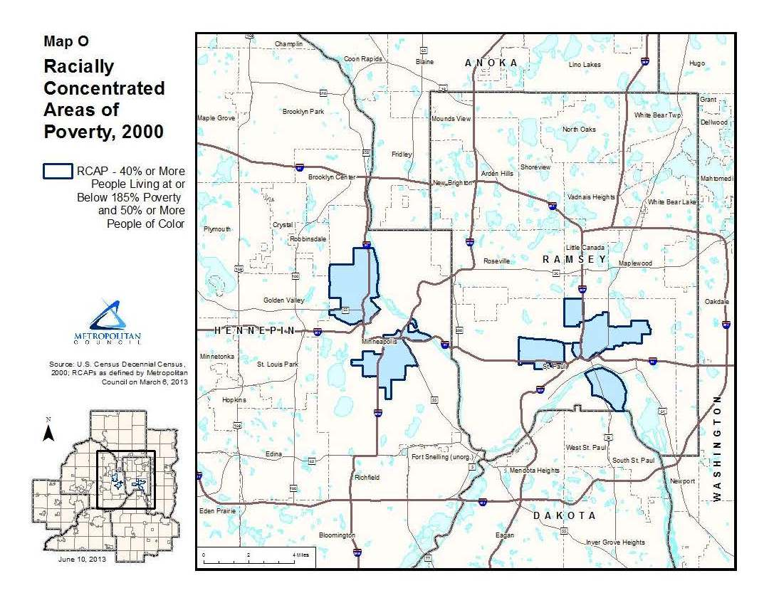

Slide 12
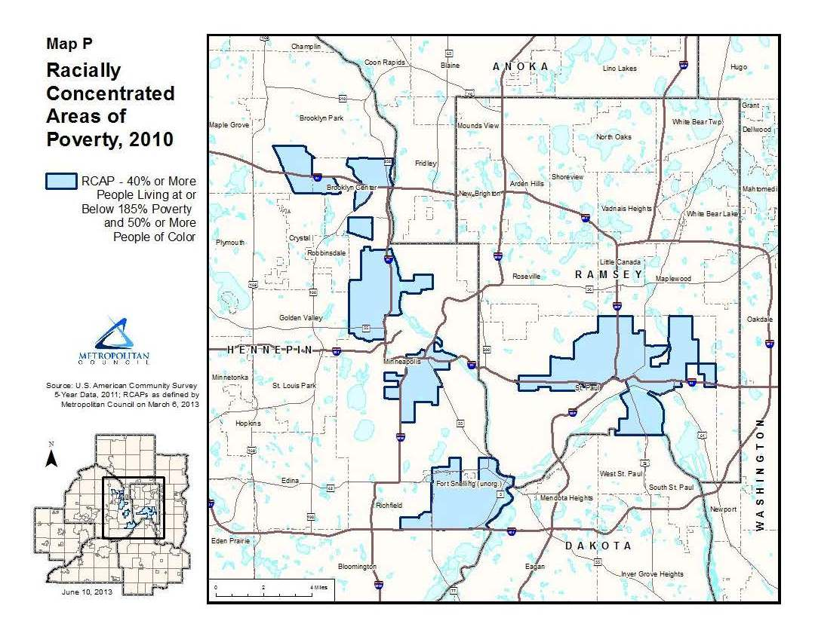

Slide 13
Opportunity Mapping
Good Schools
Low Crime
Low Rent
Proximity to Green Space
Proximity to Shopping & Services
Transit
Proximity to Friends / Family
Short Commute

Slide 14
FHEA Indicator Categories
Job Access
Access to Services and Necessities
Educational Outcomes
Public Safety
Environmental Hazards

Slide 15
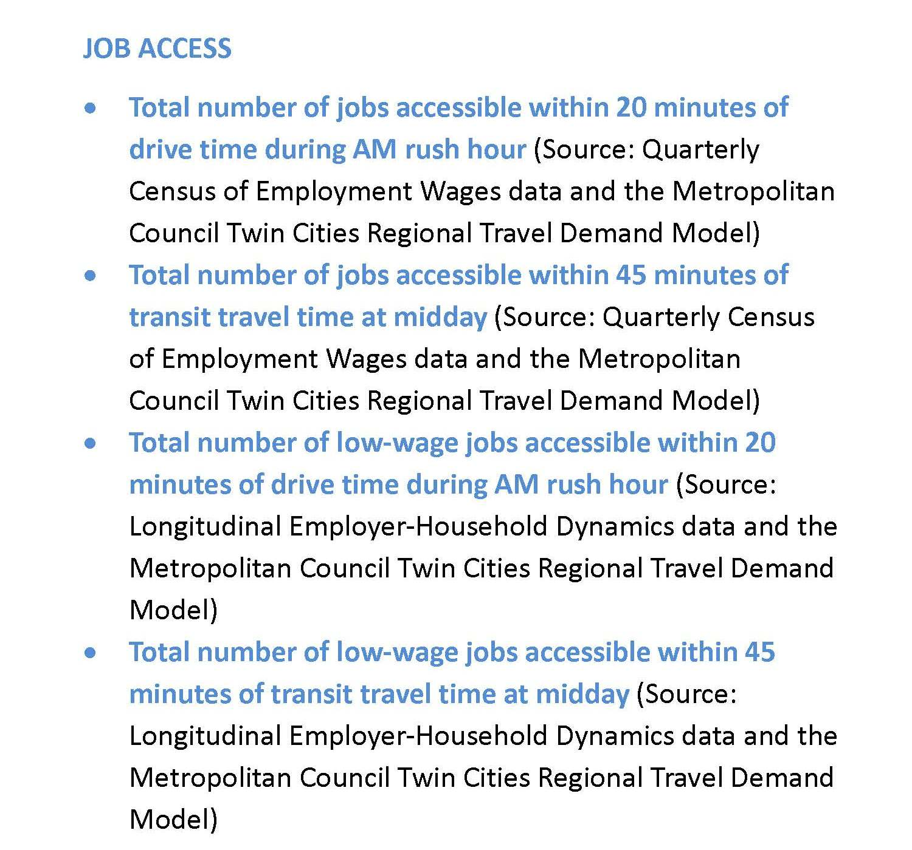
Notes:
Job Access – 4 variables
Access to Services, Amenities – 20 variables
Crime – 1 variable

Slide 16
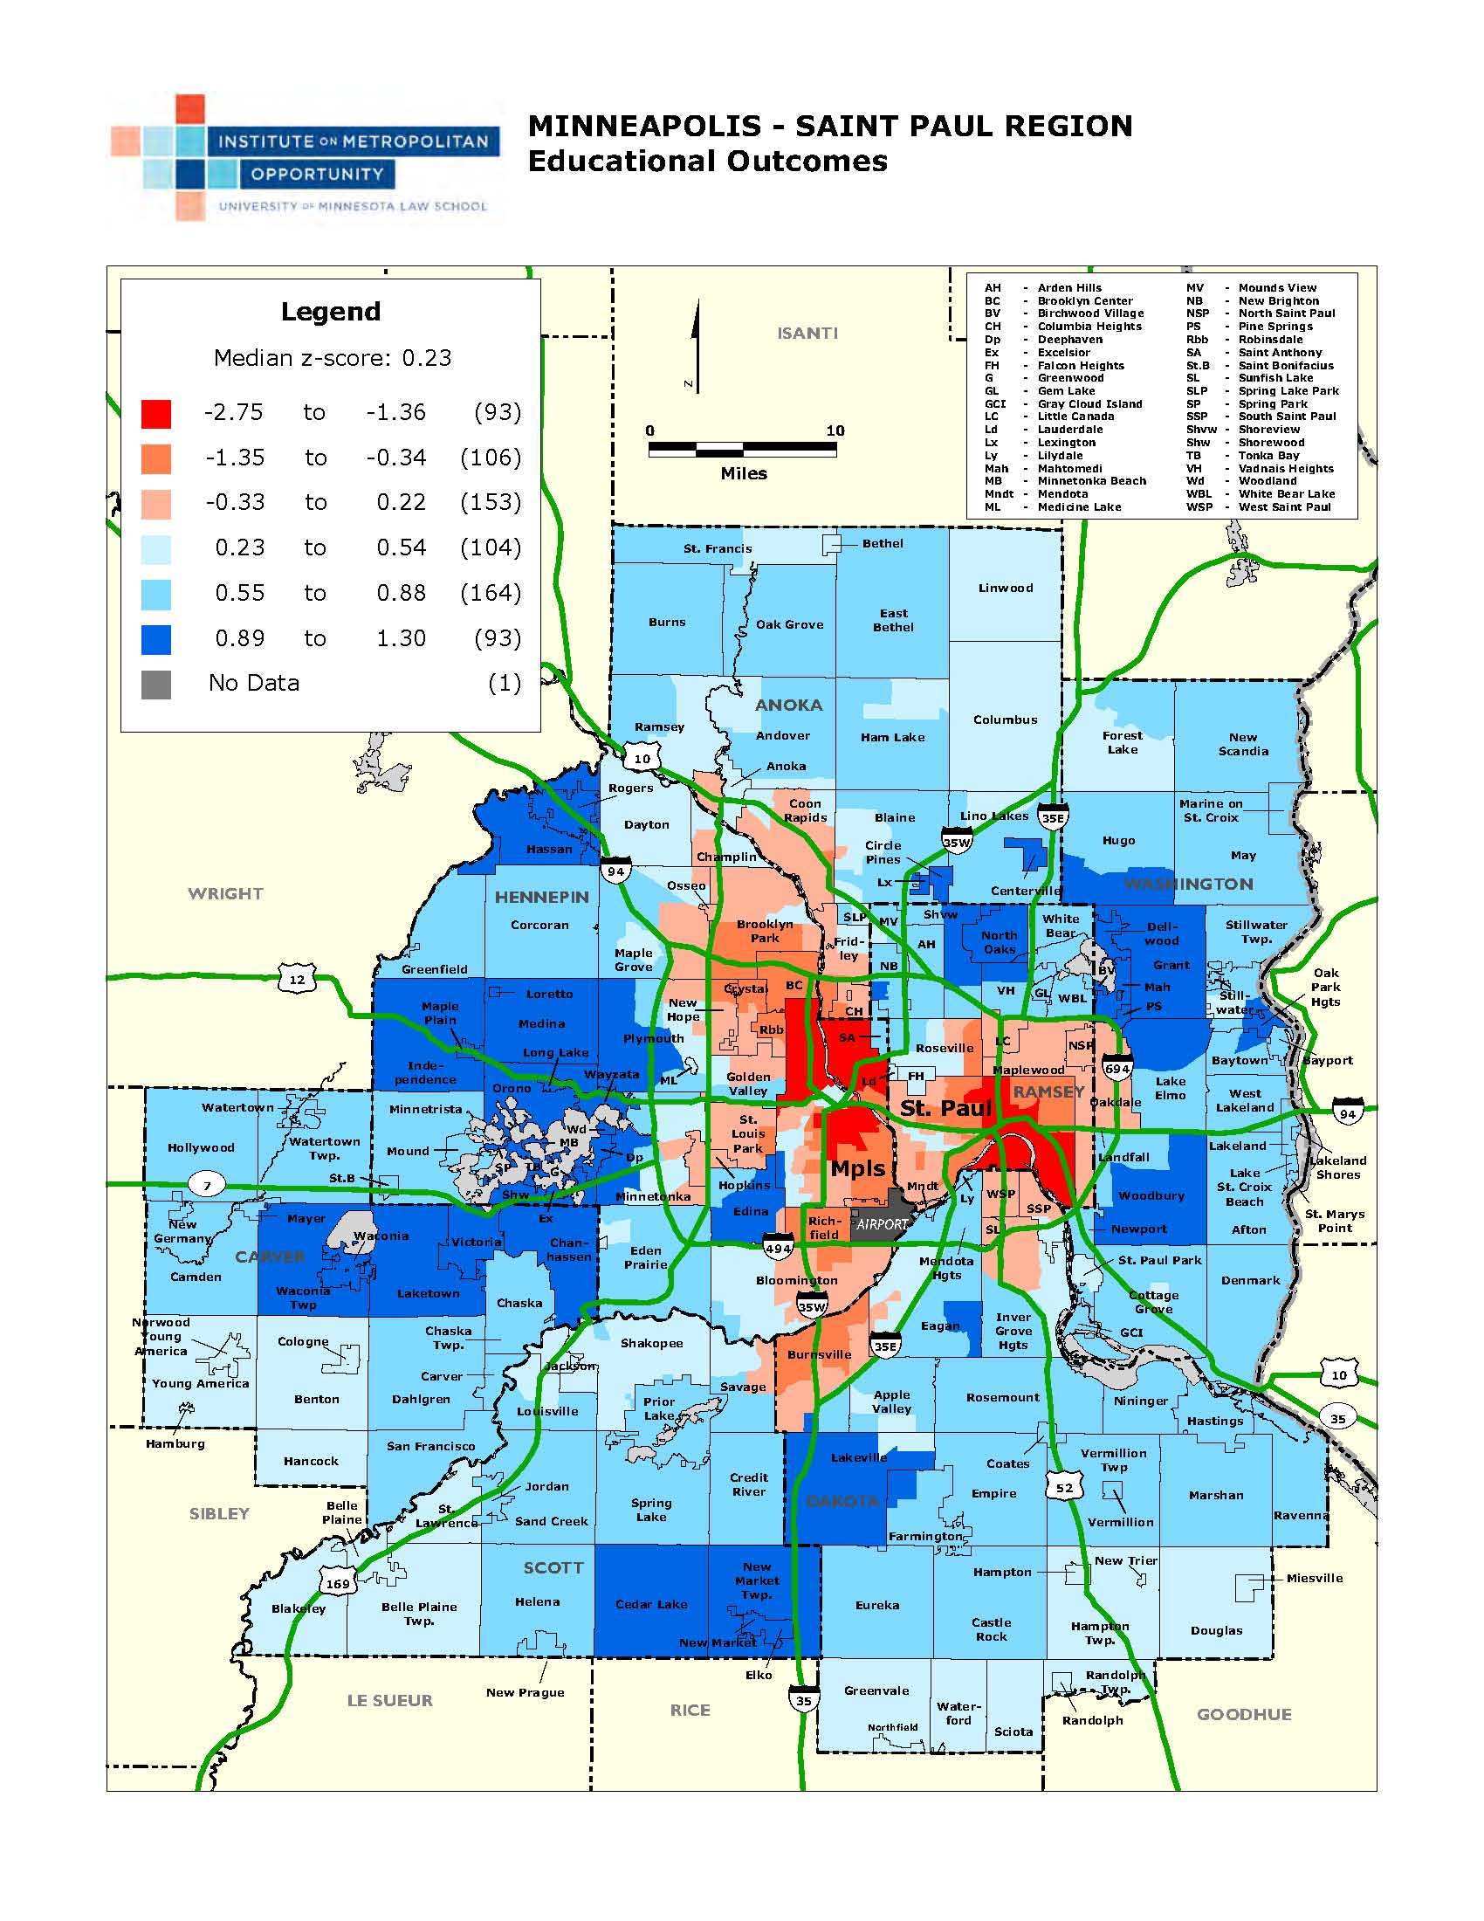

Slide 17
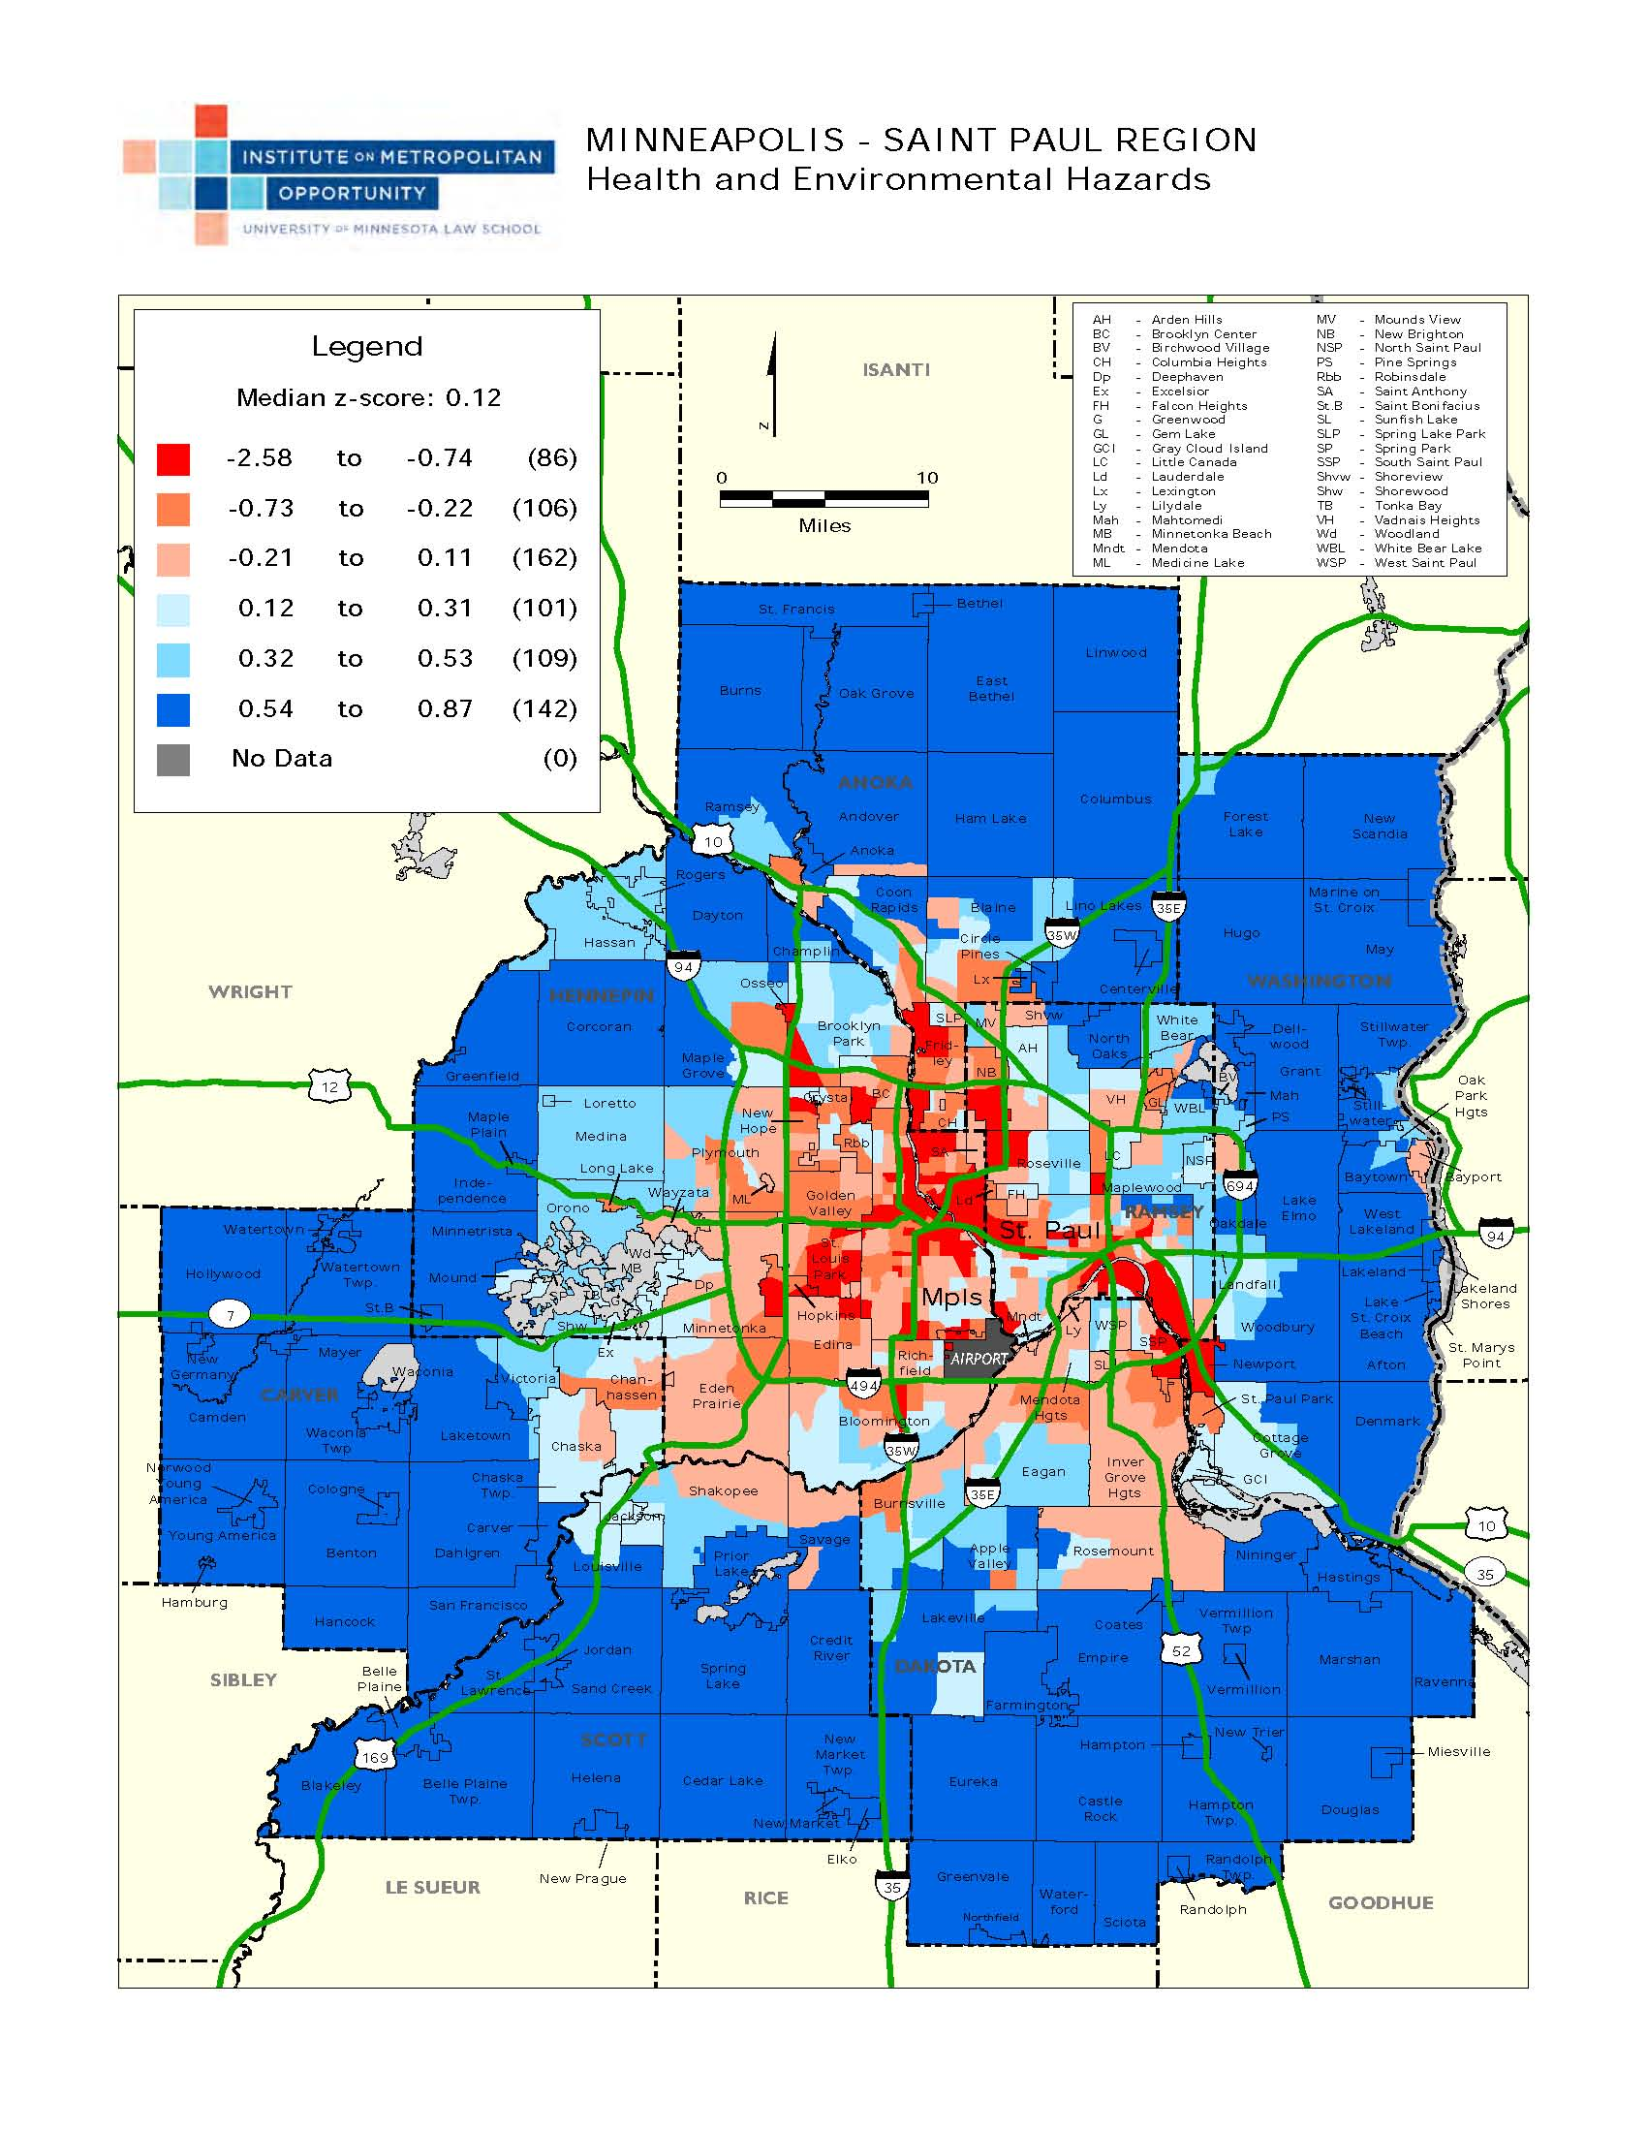

Slide 18
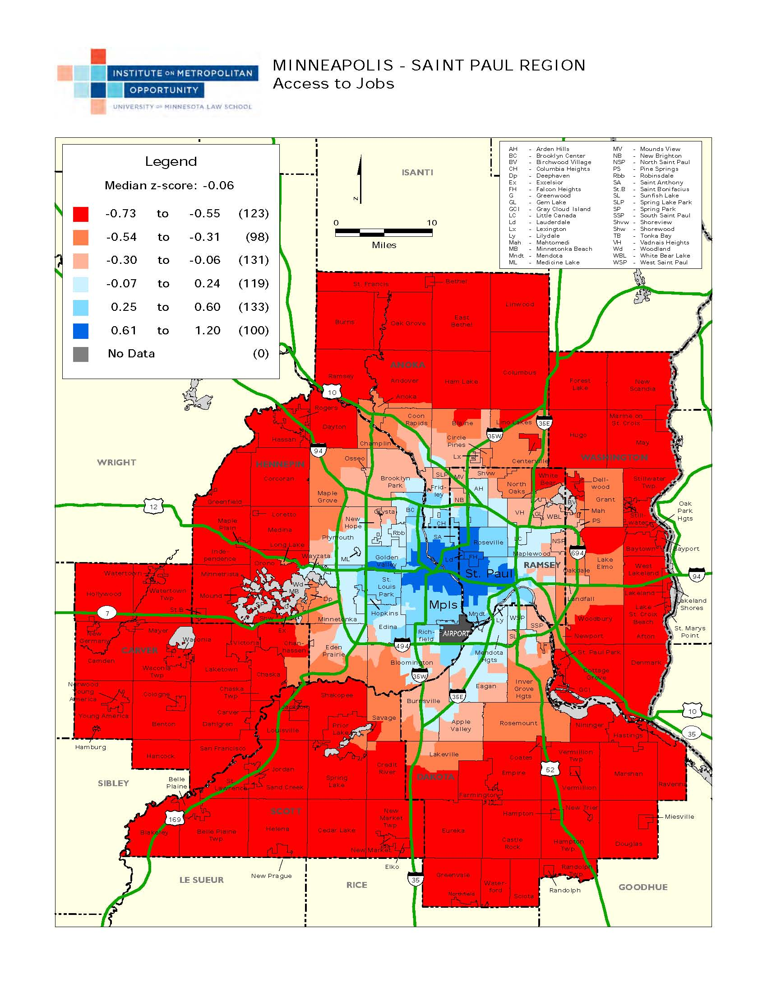

Slide 19
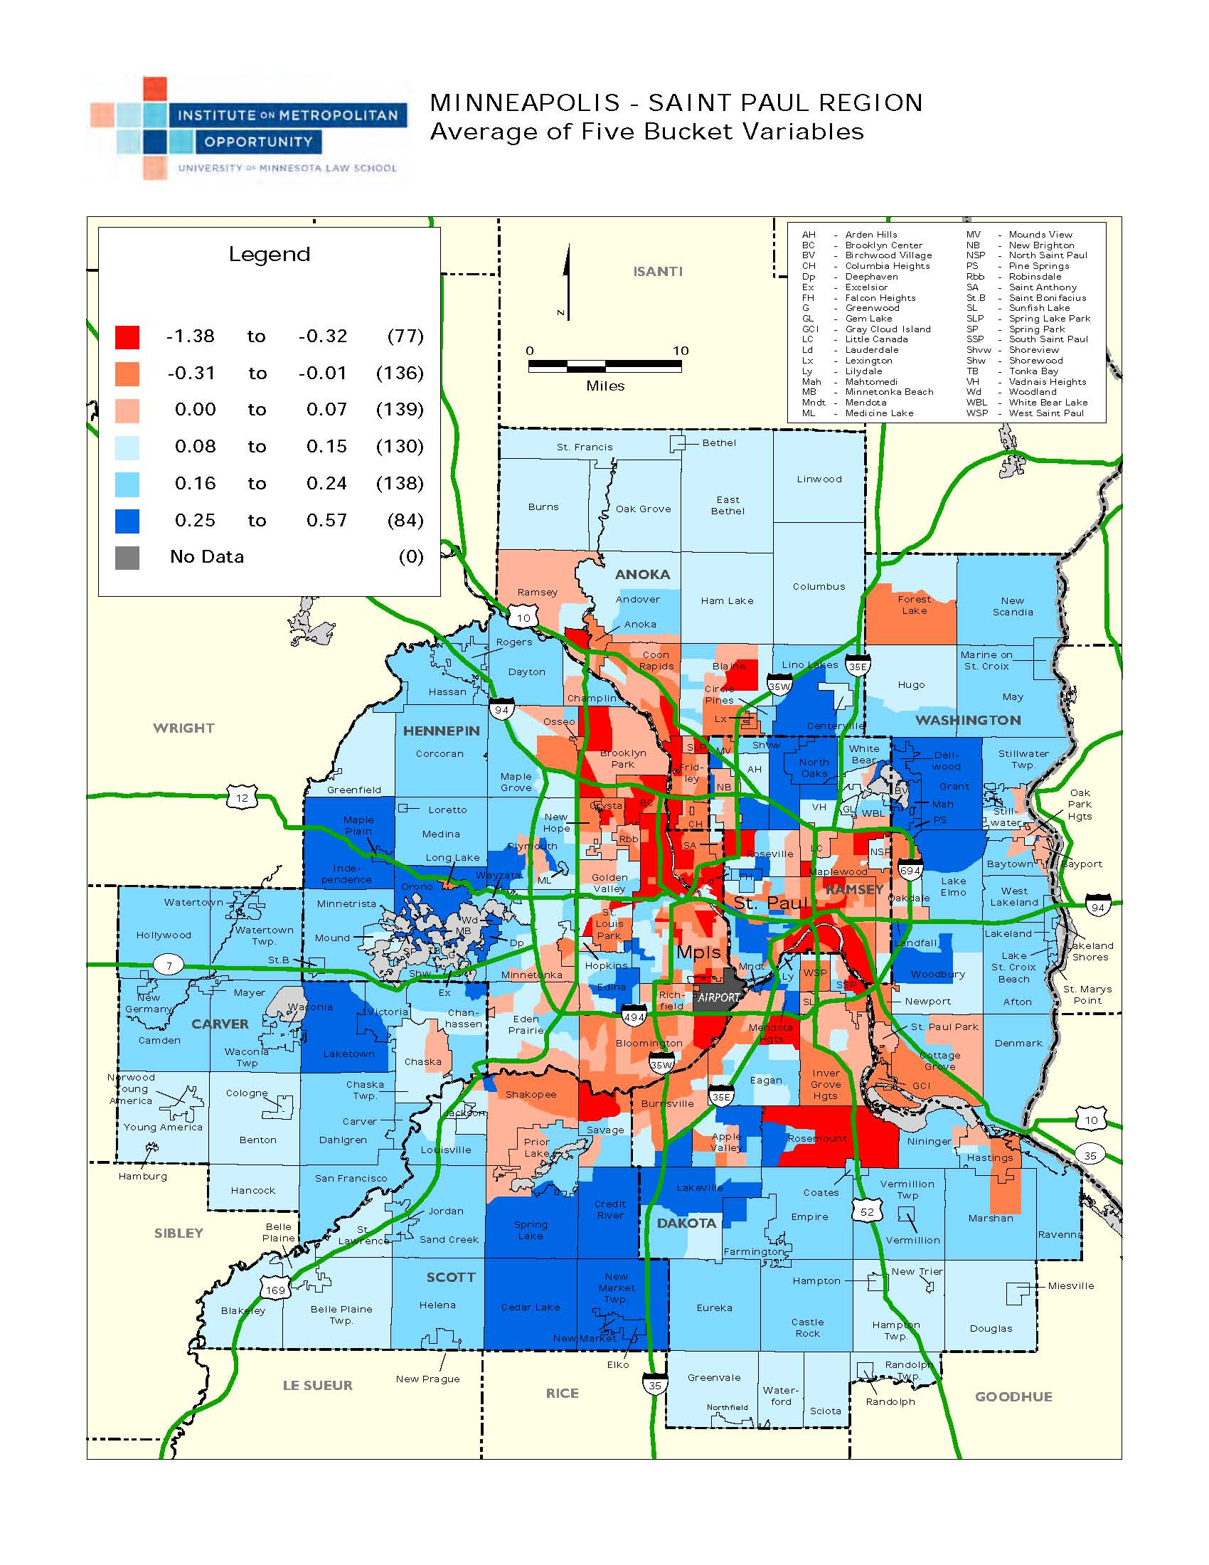

Slide 20
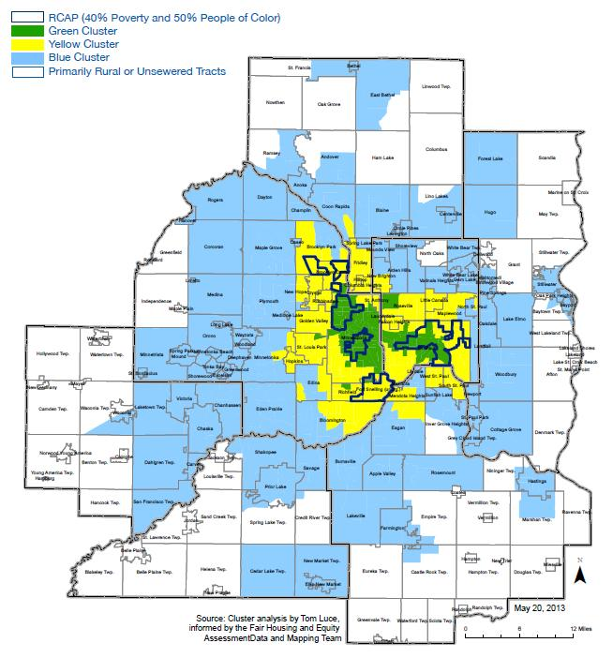
Notes:
Job growth taken out
Rural areas (no sewer) also removed
RCAPs shown (50% non-white, 40% at 185% poverty)

Slide 21
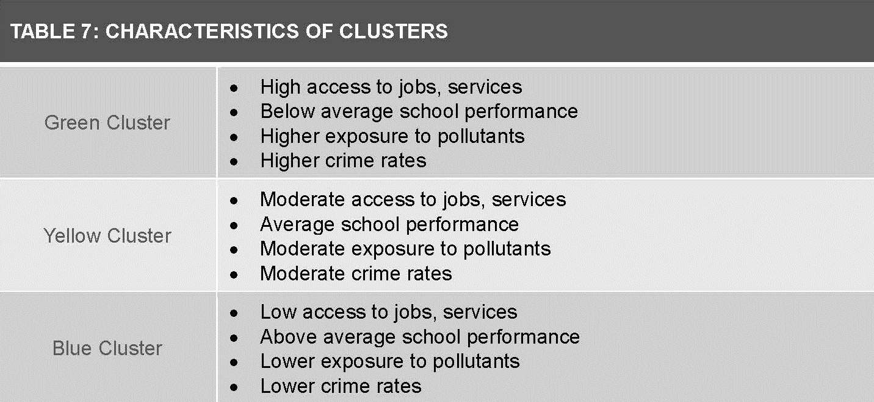
Cluster Definitions

Slide 22
Next Steps
Engagement
Deliberation
Decision-Making
Affordable Housing
Transit
Long Range Planning

Slide 23
Remaining Questions
Community Response
“So what”

Slide 24
Questions?
Thank you!
jmatson@umn.edu

