Slide 1
Open Data Twin Cities
Jeff Matson
jmatson@umn.edu
NNIP St. Louis
4/3/14

Slide 2
Outline
Open Data Policy
State
County / Regional
City
Open Data Practice
Visualizing Neighborhoods
McKnight / Open Data
CURA:Tech
Notes:
Happened in three ways:
State – rogue actor releasing data
County / Region – convinced by insiders and made the decisions unilaterally but in unison
City – drawn out formal process with committee of internal / external stakeholders

Slide 3
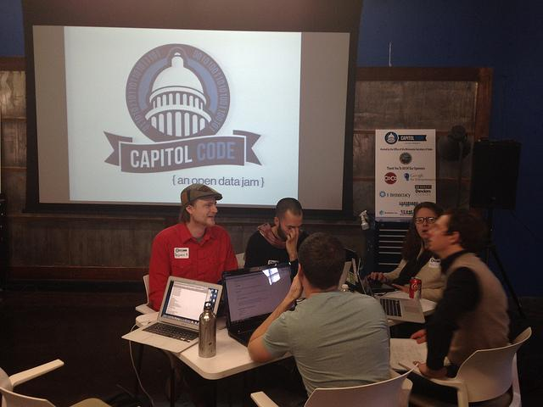
Capitol Code: An Open Data Jam
Notes:
Bill -- hackathons

Slide 5
MetroGIS
Open Data Champion
Biggest arguments are financial and liability
Data Producers & Elected officials
Approach from producers and users
Notes:
Came from the non-profit sector and realized the frustration with trying to get data
Show that you’re not making money, show that you won’t get sued
Start with data producers, then convince elected officials
Key retirements, non-profits ready to file lawsuits

Slide 7
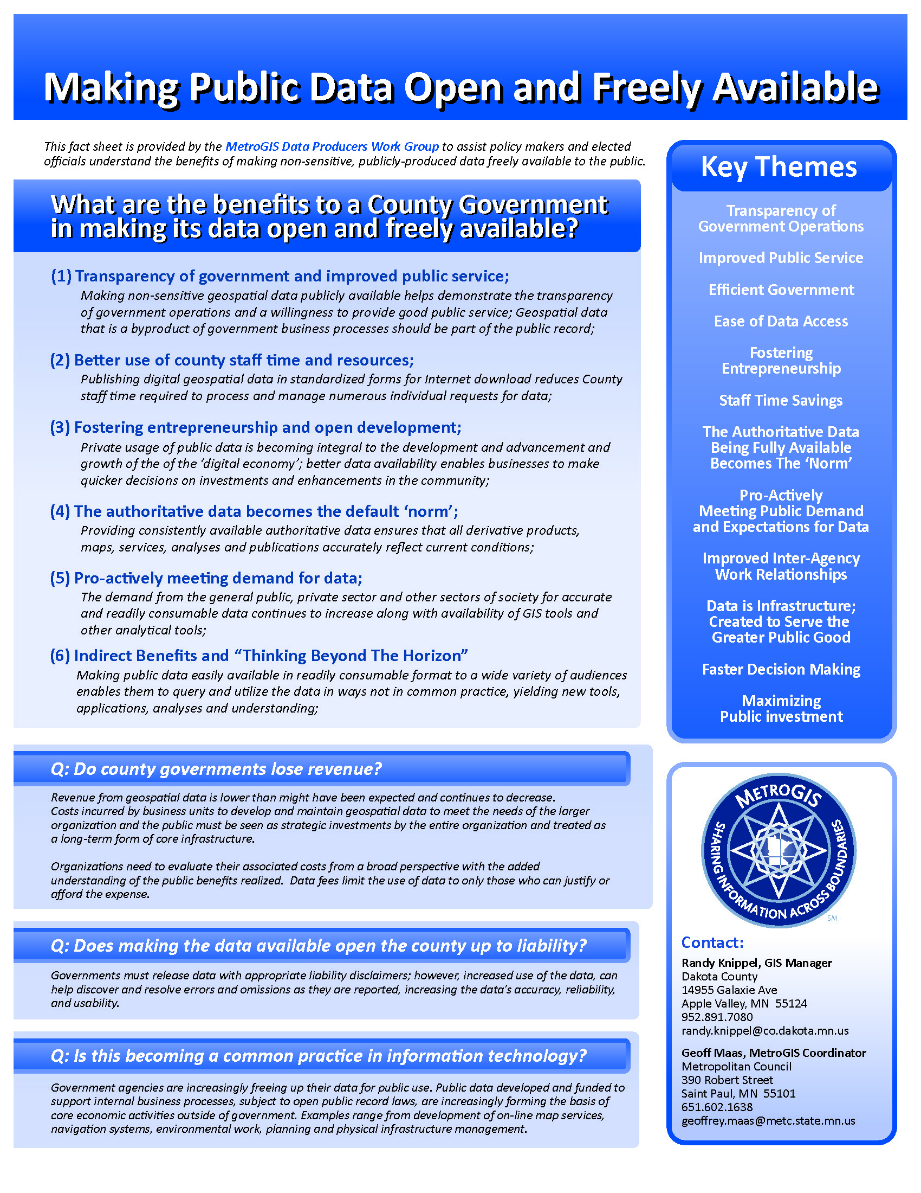

Slide 8
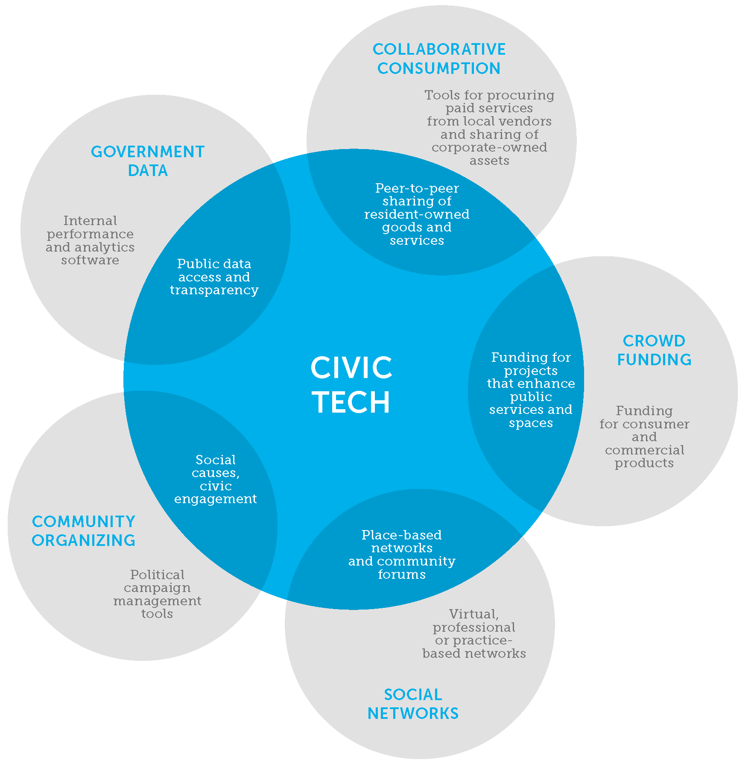
in Minneapolis
Knight Foundation, 2013
Notes:
Kristen

Slide 9
CURA:Tech supports collaborations among diverse communities in the Twin Cities to design, create and deploy civic technology tools and practices.
www.cura-tech.org
Notes:
Kristen (topic areas; goals; awarding $135k this year to collaborations to prototype and build civic tech tools; civic tech and equity… partnering with Open Twin Cities)

Slide 10
Why Civic Tech?
increase engagement and facilitate better decision-making
visualize data: the past, the present and possible futures
connect people to resources
increase effectiveness and efficiency of government
Notes:
Bill

Slide 11
Civic Tech is TOOLS
mobile apps
websites
text messaging systems
other phone-based systems
printed material
physical objects

Slide 12
Civic Tech is also PROCESS
community-building events
grass-roots development
technologists working with government
collaborations between technologists and non-profits
Notes:
Bill

Slide 13
Civic Tech and OPEN DATA
Real Time Access
Structured Access
Equitable Access
Legal Access
Notes:
Bill

Slide 14
Civic Tech and YOU
How could civic technology strengthen your community?
What issues would you like to see civic technology address?
What data would you like to have access to or want to collect?
What would you need to collaborate with technologists?
Notes:
Kristen

Slide 15
Thank you!
Jeff Matson
jmatson@umn.edu
NNIP St. Louis
4/3/14

