Slide 1
From .csv to web app in 300 seconds?
Jeff Matson
NNIP Providence, RI
September 13, 2012

Slide 2
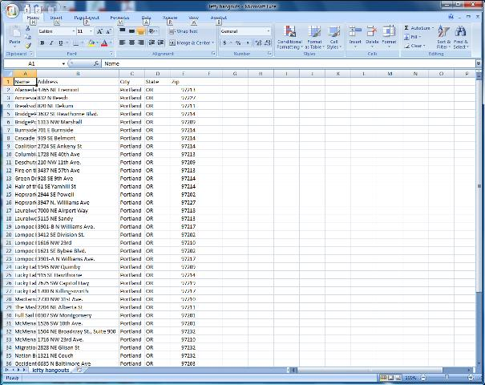
We’ll go from this…

Slide 3
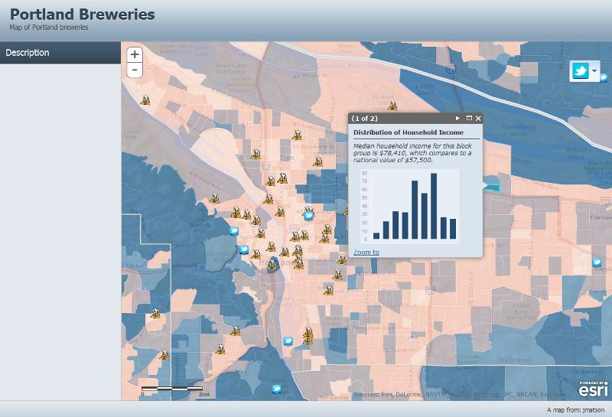
…to this

Slide 4
What You Need
ArcGIS.com or ESRI Global ID (free!)
a .csv file with addresses (optional)
Your own map layers (optional)
A website or blog (optional)

Slide 5
What You Don’t Need
Expensive GIS software
A web server
GIS or Programming skills

Slide 6
…and now for a prerecorded “Live” Demo

Slide 7
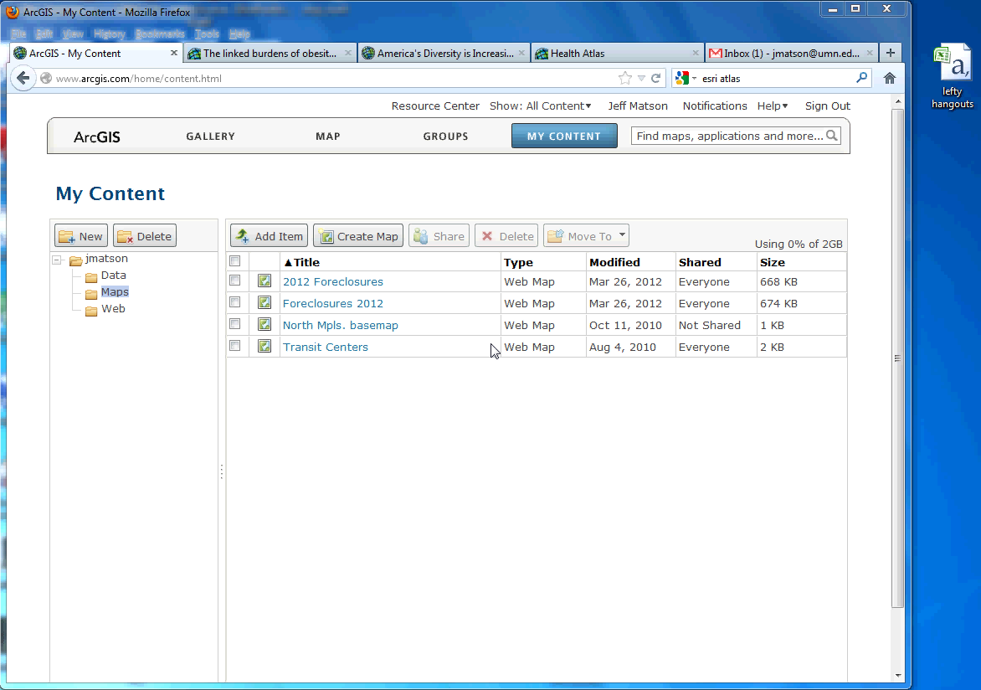

Slide 8
Web Links
www.arcgis.com
storymaps.esri.com
atlas.esri.com

