Slide 1
Private Market Rental Data: The Final Frontier?
Jeff Matson
Center for Urban and Regional Affairs
University of Minnesota
jmatson@umn.edu
NNIP Columbus
6/20/13

Slide 2
Elusive Data
Notes:
We all have data we’d like to have access to that for various reasons we don’t have a good handle on. In our case there have historically been three major categories of data we gets requests for but had (until recently) been unable to provide.

Slide 3
Crime
Notes:
Crime data is like travel to the moon. We’ve been there, we’ve touched it, we know we can get it if we really have to but we still don’t have that regularly scheduled shuttle we’ve all been promised

Slide 4
Business Listings
Notes:
Business data is like Mars. Again, we know can get there if we really need it but we haven’t stepped foot onto it ourselves. We might get it using proxies or robots if you will.

Slide 5
Rental Housing
Notes:
Final there’s data on rental housing and what it costs.
This to me was like Saturn. Never in my lifetime did I think it’d every see it up close.

Slide 6
Enter HousingLink!
Notes:
We’ll now we’re there thanks to a legislatively mandated agency we partner with often who tracks subsidized housing, foreclosures and voucher use in the metro.

Slide 7
What they collect
Type
# of BRs
Rent
Utilities
Application Fee
Pets?
Background Checks?
Shadow Market

Slide 8
Shadow Market?
Fewer than 10 units
Not in traditional apartment price/vacancy data
Notes:
You may be wondering what the shadow market is…
The stuff we see published in the paper (vacancy rate, avg rent) is only from the traditional apartment market

Slide 9
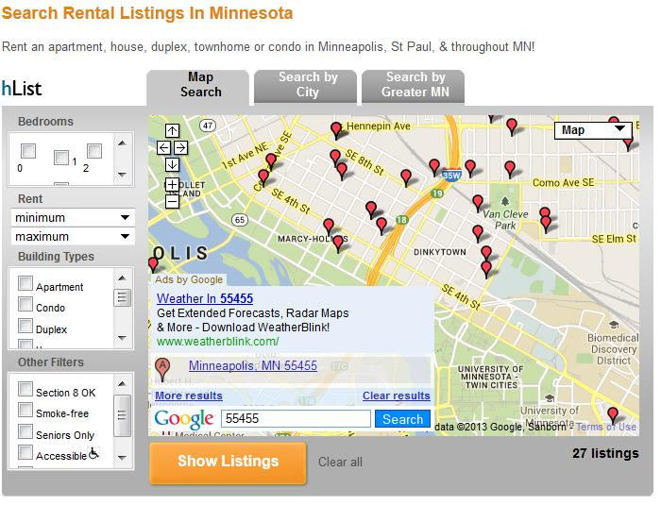
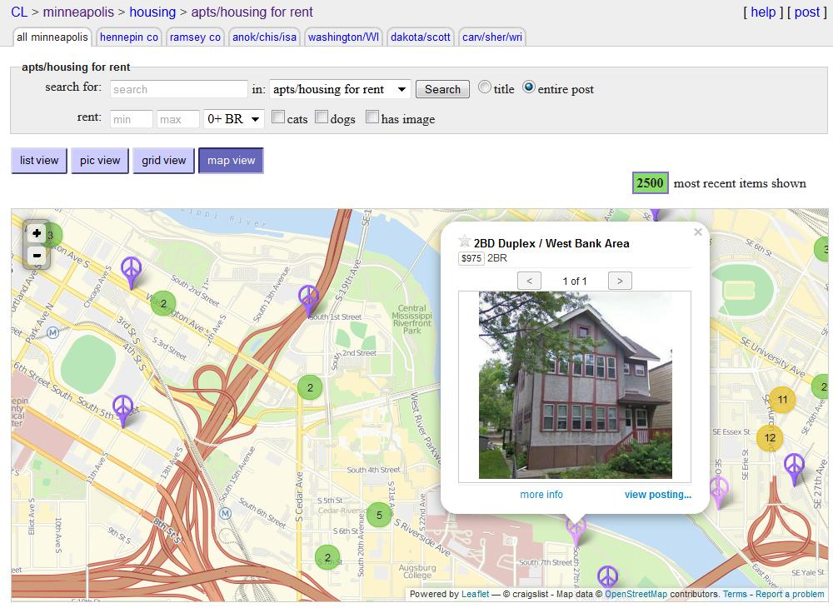
How they do it
Notes:
Mining their own listing and web scrapes from sites like Craigslist

Slide 10
Twin Cities Rental Revue
Notes:
Profiles of 65 cities and sub cities in our metro area
10 Minneapolis sub-area

Slide 11
Rental Revue
Notes:
Note the demand index (red) they build comparing searches v openings
Note the dominance of the shadow market in larger BR units.
Of 39,000 listing in 2012, 22K in shadow market. Over 56% and 2/3 of 2+BR listsings

Slide 12
What they give us
Notes:
~15,000 records per quarter (6 quarters worth of data)
X,Y coordinates
Shadow or Apt market
# of BR
rent

Slide 13
What we can do with it
Notes:
Maps showing the dominance of shadow market in some areas
Variation in rents asked in particular neighborhoods

Slide 14
What we can do with it
Notes:
Also create neighborhood profiles similar to Rental Revue
Track trends over time, gentrification along Central Corridor?
We can report it to the block group

