Slide 1
A Map App for Any Occasion
Implementation of ESRI ArcMap Server with Flex Viewer

Slide 2
Why ArcMap + Flexviewer?
Cheap for non-profits ($2k/year)
Rapid app deployment
Minimal programming (XML configuration, troubleshooting)
Lots of free Widgets available from the Code Gallery
Lots of REST map services out there, easy to integrate

Slide 3
Drawbacks
ESRI
Flex (iOS incompatible unless bundled as Air app)
Sometimes inflexible (no pun intended)
Map-centric, requires training for some users

Slide 4
Three Apps So Far

Slide 5
Implementation Steps
Install ArcGIS Server for your local map services
Download & unzip flexviewer into web server directory
Make map services in ArcMap (and identify external ones)
Mess with XML configuration files
Add Widgets
Test and tweak
A setup wizard is also available

Slide 6
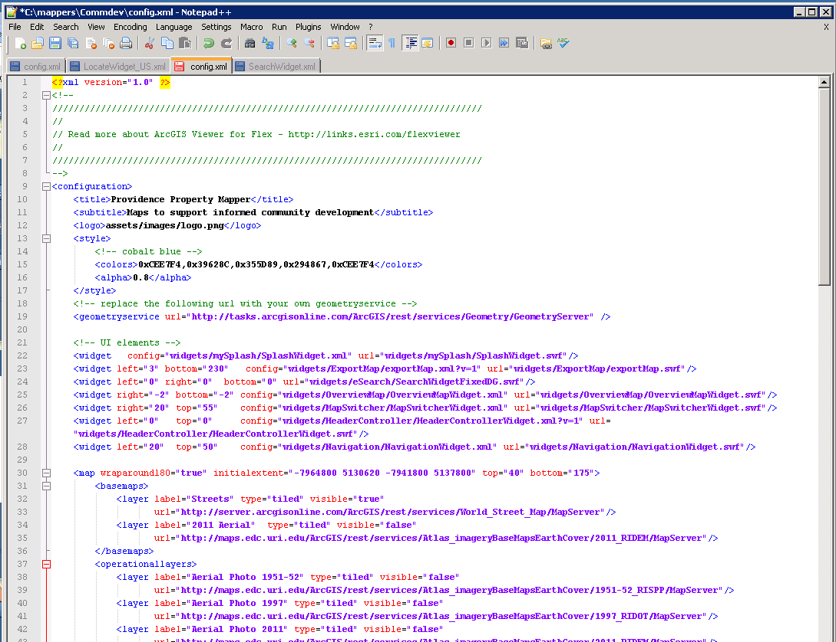
XML Config Example

Slide 7
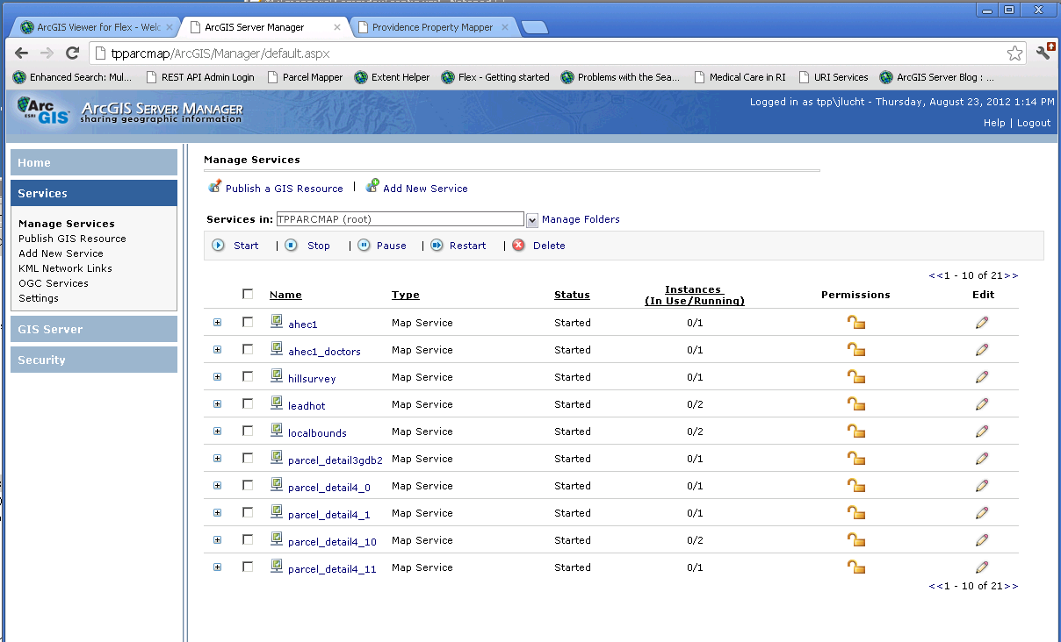
Map Service Administration
Or administer through ArcMap

Slide 8
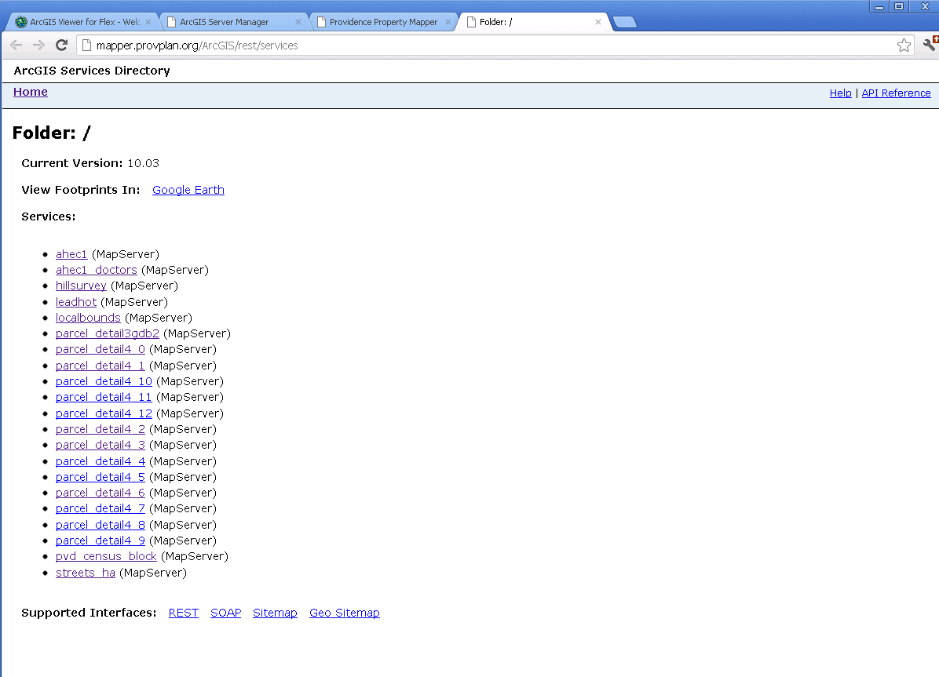
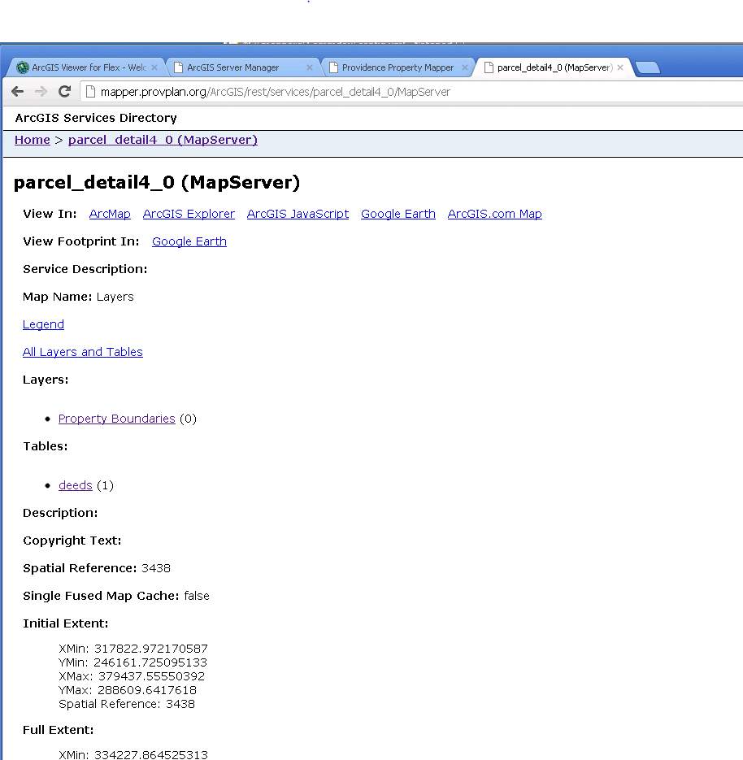
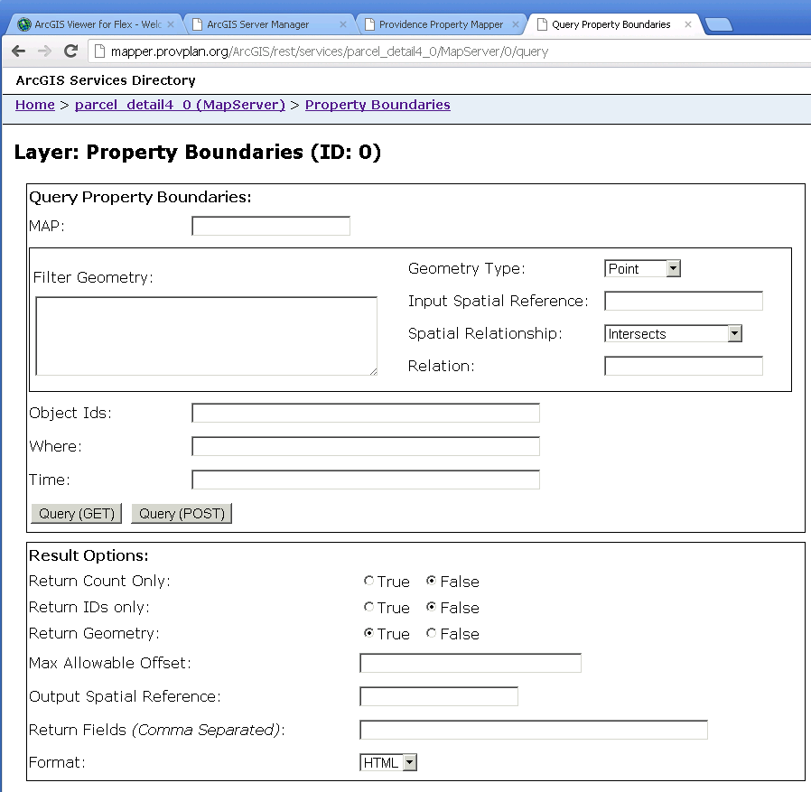
Map Service Directory

Slide 9
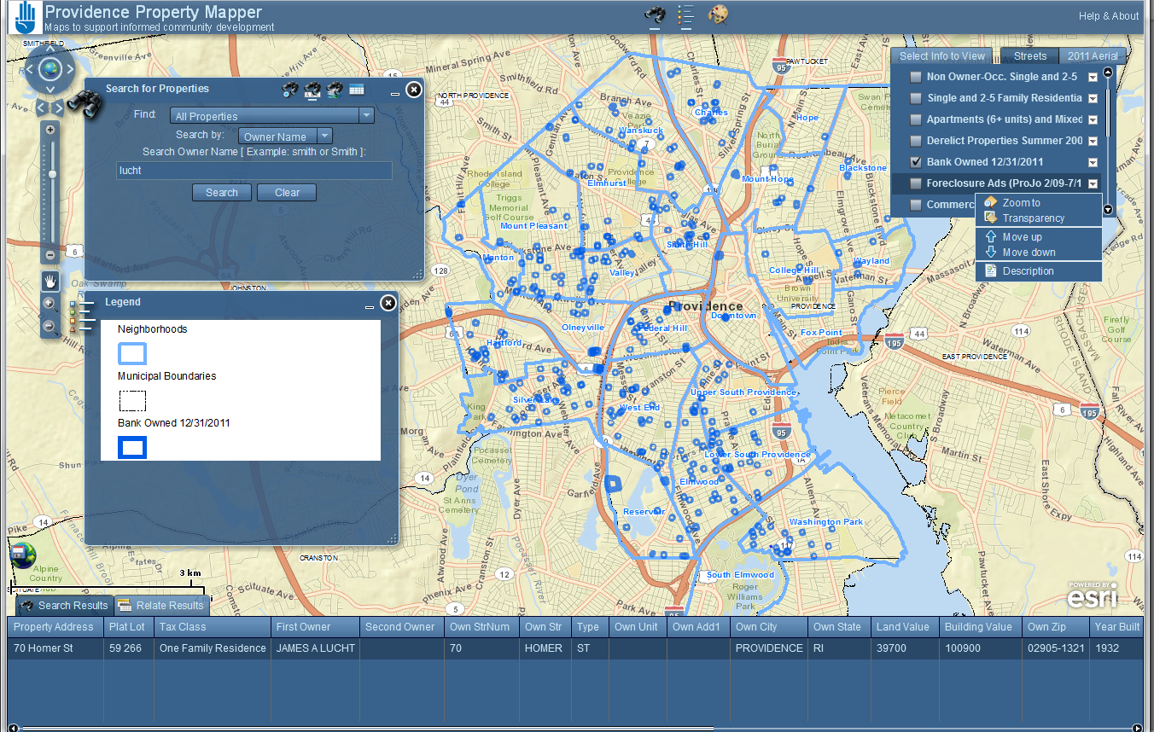
Parcel Mapper Dissected

Slide 10
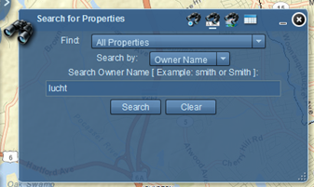
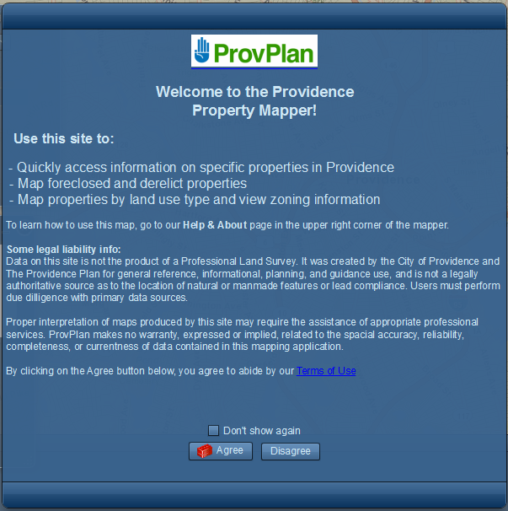
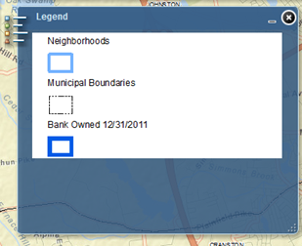
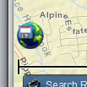
Widgets Used
Enhanced Search
Enhanced Splash
Dynamic Legend
Export Map

Slide 11
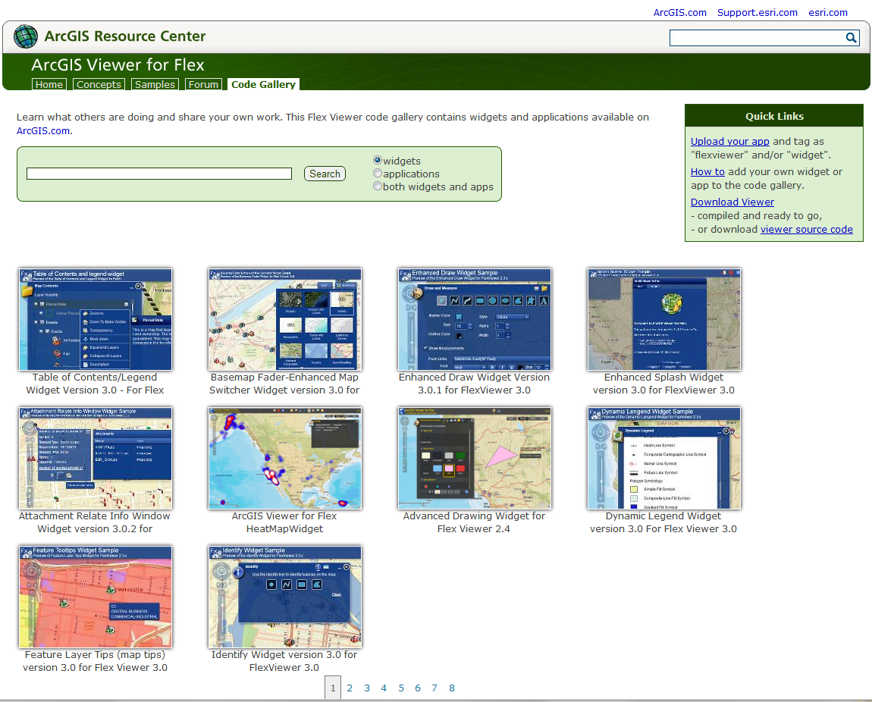
Where Widgets Come From
Anything by Robert Scheitlin is great!

Slide 12
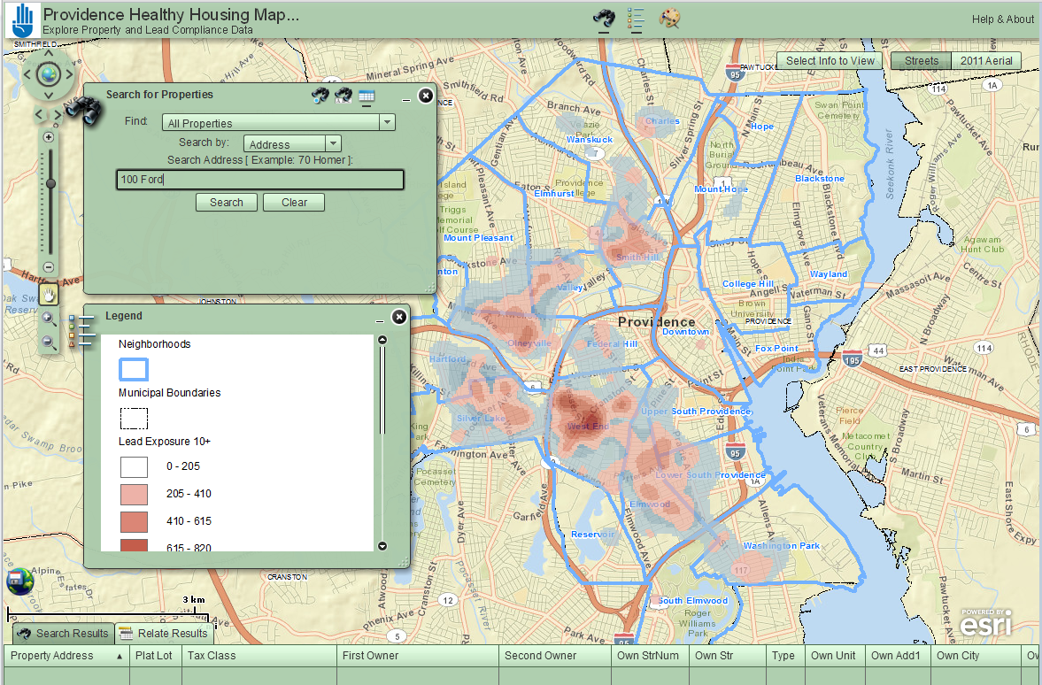
Healthy Housing Mapper Lead Exposure and Compliance with Property Data

Slide 13
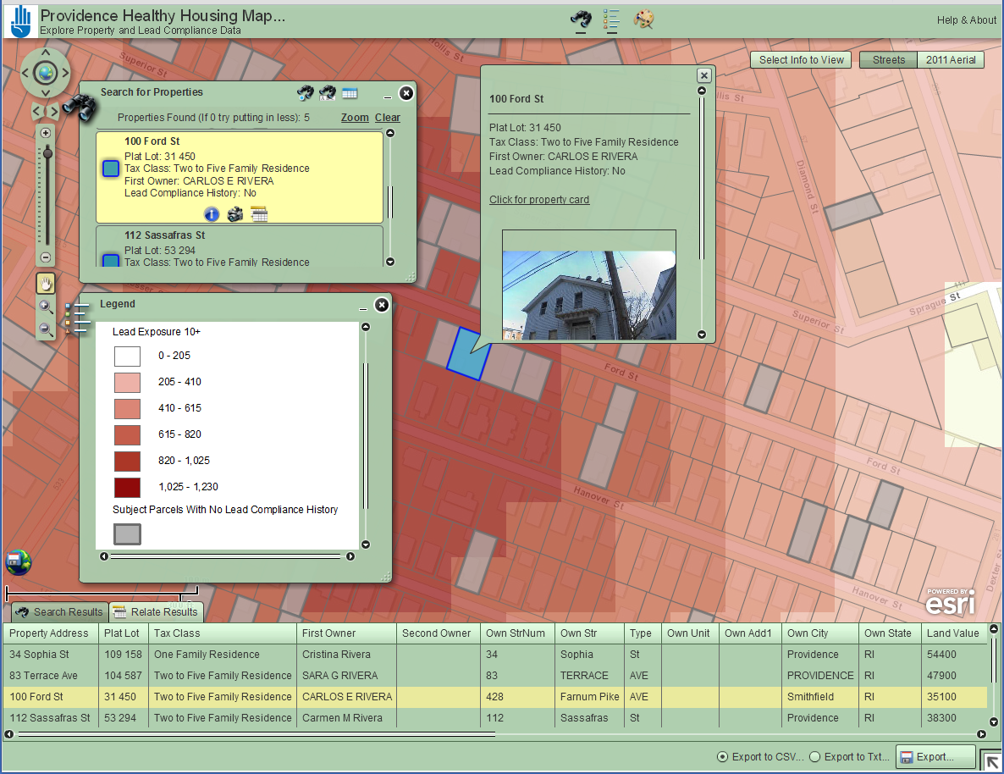

Slide 14
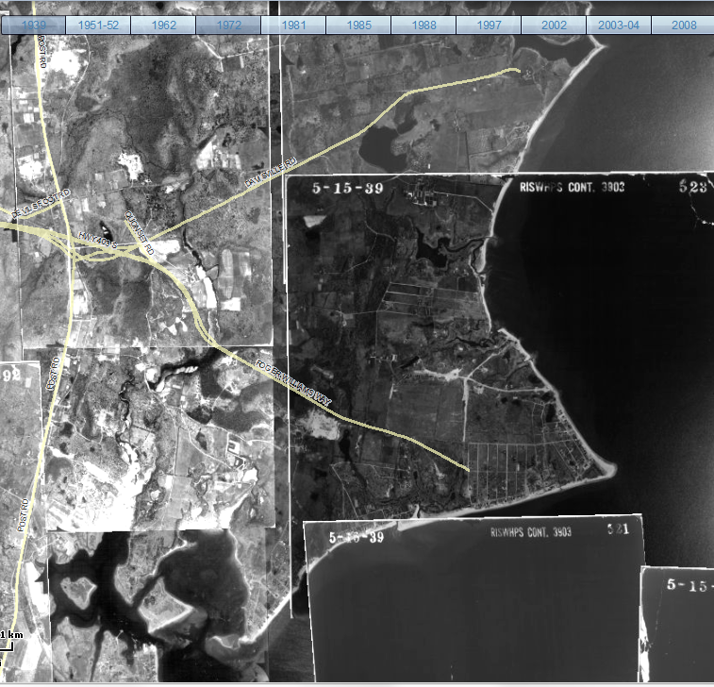
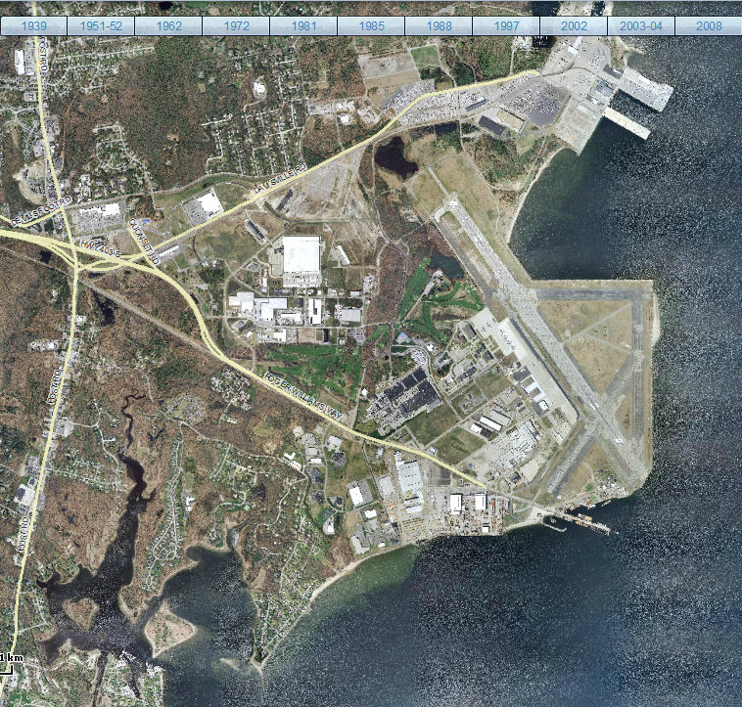
Historic Aerial: Quonset Point
1939
2011

Slide 15
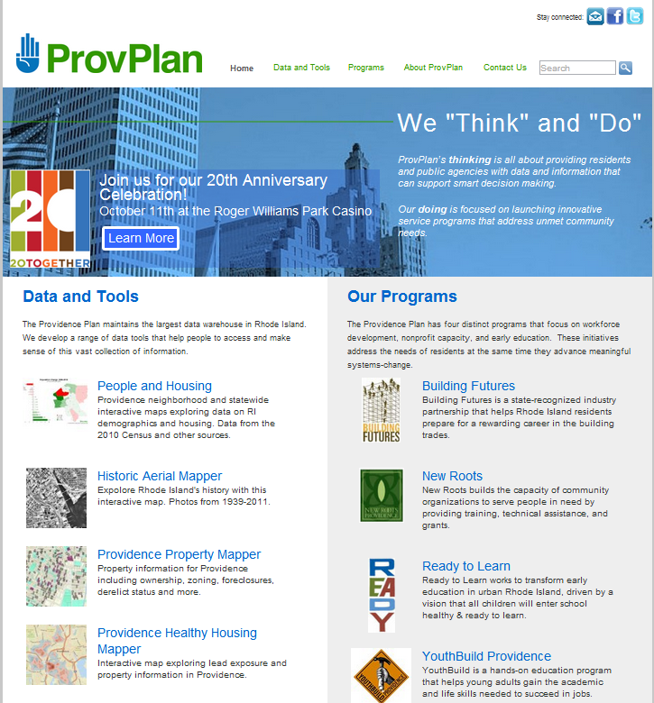
Mapper Links @ provplan.org

