Slide 1
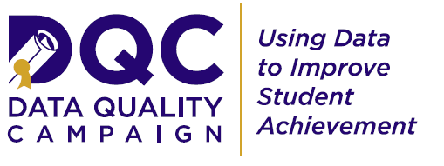
State Data for Local Action
Lisa Sparrow|Associate| State Policy and Advocacy
April 2014

Slide 2
Today’s Conversation
Introduction to DQC
Why state data?
SEAs: Compliance to service
What’s in my LDS, anyway?
Moving forward: IDS
Privacy considerations
@EdDataCampaign
#eddata

Slide 3
About Us
The Data Quality Campaign (DQC) is a nonprofit, nonpartisan, national advocacy organization committed to realizing an education system in which all stakeholders—from parents to policymakers— are empowered with high-quality data from the early childhood, K–12, postsecondary, and workforce systems.
To achieve this vision, DQC supports state policymakers and other key leaders to promote effective data use to ensure students graduate from high school prepared for success in college and the workplace.
@EdDataCampaign
#eddata

Slide 4
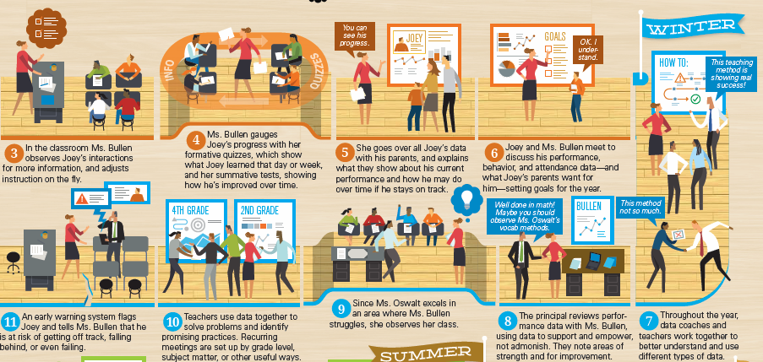
The Goal: Deliver Value to Educators & Families
Source: Ms. Bullen’s Data-Rich Year
@EdDataCampaign
#eddata

Slide 5
Why State Data?
Understand how our students move across school systems, and into postsecondary and the work force
Make comparisons between our schools and districts, and find pockets of success
Reduce the burden of duplicative data systems and out of date information on districts and communities
Ensure and equalize access to valuable information across high and low capacity districts
@EdDataCampaign
#eddata
Notes:
A few of you work with the states, but many of you don’t. We’re the state people, let me take 2 mins to tell you why the state matters.
Every state now has a robust statewide longitudinal data system with student-level data beyond test scores.

Slide 6
Longitudinal #EdData
Early Childhood
K-12
Postsecondary
Workforce
Avg. Number of Actions Achieved by States
What is the CCR graduation rate by high school?
Which early childhood programs best prepare students for kindergarten?
To what degree are high school math grades predictors of readiness for college math?
Is my state preparing students to successfully meet industry needs?
How successful are college graduates in the workforce by major or credential?
@EdDataCampaign
#eddata
Notes:
States are where cross-agency links are made – if we want to track and improve investments in early childhood and student postsecondary success, using the administrative data already collected and linked at the state only makes sense.

Slide 7
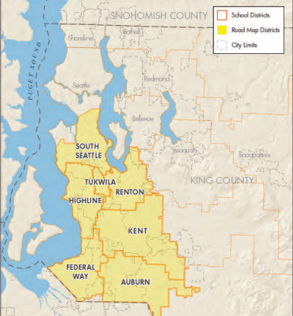
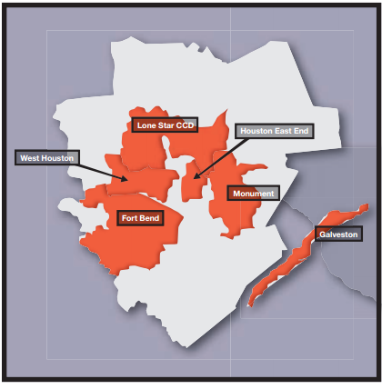
Regional #EdData
Road Map (King County, WA)
7 School Districts
All Kids Alliance (Houston, TX)
7 Regional Councils
Avg. Number of Actions Achieved by States
@EdDataCampaign
#eddata
Notes:
States are also where the REGIONAL and multi-district data lives: for those of you doing place-based work that spans multiple school districts, or in statewide afterschool networks that want to “roll up” outcomes to be able to communicate to governors what they’re getting for their dollars invested in youth services… again, a state system is your natural partner.

Slide 8
A Huge Investment
$650m
Avg. Number of Actions Achieved by States
@EdDataCampaign
#eddata
Notes:
Not to mention, there’s been a tremendous amount of money invested in these systems. Let’s get some value out of them!

Slide 9
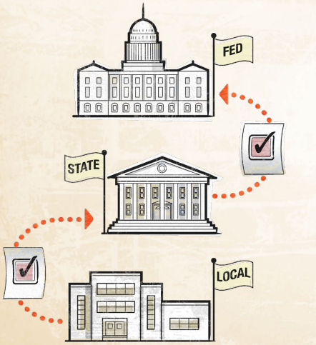
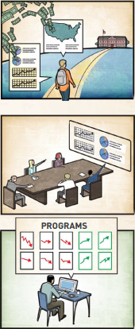
States are Changing
To Service
From Compliance…
Avg. Number of Actions Achieved by States
@EdDataCampaign
#eddata
Notes:
Now, we know what states have produced to date hasn’t been particularly useful—to anyone. States have been mostly compliance-oriented. We’re trying to change that.
States have this tremendous wealth of information, BUT… it’s worthless if it doesn’t provide value to those working to improve student achievement.
- Facilitating feedback loops through convos like Texas and Washington
Convening stakeholder groups to help provide recommendations to states on how to make their tools more useful to local audiences like PRTF
Quality pyramids to help states understand what good looks like (2013 HSFB, teacher access, K-12/PS linkages; 2014 public reporting, governance)

Slide 10
So, What’s in My LDS, Anyway?
@EdDataCampaign
#eddata
Notes:
So what IS in your LDS? What data do you have? Initially, DQC worked to define the core elements of a high quality SLDS and track states’ progress building this basic infrastructure.
DQC developed with our partners the 10 essential elements – the pieces that we knew were critical for states to collect and use in order to have robust education data. This isn’t the whole picture – this is what was agreed upon at the time as the essential, foundational pieces of an LDS. And note “ability” – states had created the plug, and the socket, but not necessarily put the plug into the socket to turn on the electricity. There was “can” and not “does.”

Slide 11
The Beginning: 10 Elements
2011: 36 have all 10 Elements, up from zero in 2005
@EdDataCampaign
#eddata
Notes:
By 2011, 36 states had all 10 elements – up from zero when DQC started in 2005 – and the rest were well on their way.

Slide 12
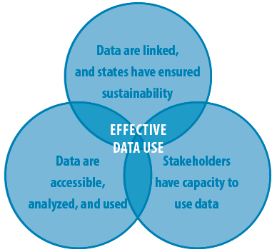
Now: Data for Action
LINKING P–20W Data
Link P–20W data systems
Create stable, sustained support
Develop governance structures
Build data repositories
ENSURING DATA ACCESS
Provide timely data access
Create individual student progress reports
Create longitudinal reports
BUILDING CAPACITY TO USE DATA
Develop research agenda
Build educator capacity
Raise awareness of available data
@EdDataCampaign
#eddata
Notes:
Briefly describe the “10 Actions”
Every year, DQC surveys the 50 states plus DC – “Data for Action”
Purpose of the survey: not scientific but sets a “north star” for policy makers
Every year we extend it to focus on priority areas (early warning systems, public reporting, data governance)

Slide 13
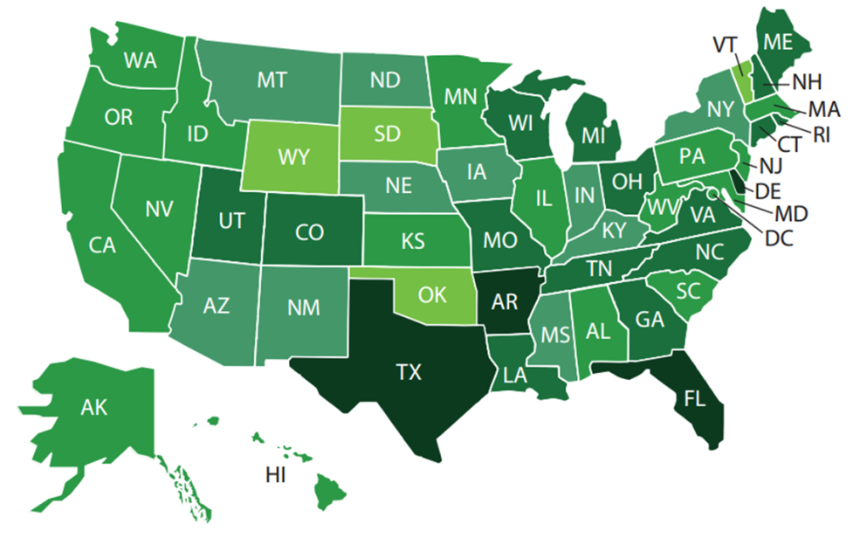
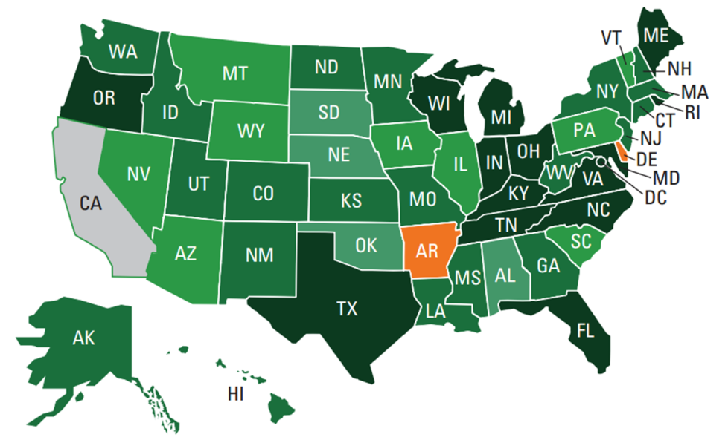
State Actions: Progress
2013: 2 states have all 10 Actions, up from zero in 2011
@EdDataCampaign
#eddata
Notes:
States have made tremendous progress.
If you’re interested in learning more about your state’s progress, visit our website. Each year, we publish state profiles detailing state progress toward the 10 Actions and sharing info on what tools and resources each state is making available to their local constituents. These profiles are a great way to learn more about your state’s capacity; they’re also great advocacy tools if you’re interested in pushing your state to do more. All profiles include the name and ocntact info of the survey respondent.

Slide 14
Moving Forward: IDS
In 2014, DQC will survey all 50 states and the District of Columbia on state IDS strategies.
We’ll use this as:
an initial “baseline” to chart growth of state IDS strategies; and
to identify leading states and practices for further engagement and support.
@EdDataCampaign
#eddata
Notes:
While most of DQC’s energy goes in to improving the capacity of state education data systems, this year we are including a section on “critical linkages” between state education data systems and other youth- and family-serving state agencies.
We’re working with the Annie E. Casey Foundation to get a baseline on cross-agency linkages at the state level and to identify a few promising initiatives. We pulled together a small working group and, on April 7th, we will define a set of questions to ask the 50 states and DC in 2014.
Nod to work NLC, folks at Penn, AISP w/ UI did surveying local folks—NLC w/ partners led this kind of effort not at state level, but at local level to find out what’s going on (e.g., Minneapolis)
Questions have been organized around four key areas: the data sharing policy framework, the scope and timeliness, use and impact, and challenges. The working group has some members of NNIP, UI is very much at the table, well represented, but this a really good time, if there are other things you want to know, tell me now.

Slide 15
IDS: Questions to Consider
Survey questions will be organized around four key themes:
Data Sharing Policy Framework
Scope and Timeliness
Use and Impact
Challenges
@EdDataCampaign
#eddata
Notes:
Questions have been organized around four key areas: the data sharing policy framework, the scope and timeliness, use and impact, and challenges. The working group has some members of NNIP, UI is very much at the table, well represented, but this a really good time, if there are other things you want to know, tell me now.
Data Sharing Policy Framework
How are sharing practices formalized?
Which are mandated (e.g. legislatively)?
What organization hosts and secures the data?
How is cross-agency data sharing funded? (Public/private, fee-for-service, etc.)
Is sharing federated or centralized?
How are legal constraints negotiated?
Scope & Timeliness
What state agencies and/or external data sources are included? (How does this group want to categorize those options?)
How frequently is data transferred or refreshed?
Use and Impact
What is/are the primary use(s) of multi-system data?
Program evaluation
Policy analysis
Decision support & case management
Who the most important clients or customers for these multi-system data?
What actual or anticipated impact have IDS strategies had on child and family welfare?
Challenges
How would states prioritize the major challenges to cross-system data sharing?
Technical
Legal
Political
Resources (money, human, time)
To whom do they look for support?

Slide 16
State Legislation in 2014
80 bills from 30 states
Many more are already being drafted
59 bills have taken a prohibitive approach
NH HB 1586: Prevents predictive analytics
MS SB 2737: Defunds the SLDS
33 bills have taken a governance/transparency/accountability approach
TN SB 1470: Requires a public data inventory and a comprehensive privacy policy
WV HB 4316: Describes state, district, and school privacy responsibilities and establishes data sharing governance
The approaches are not mutually exclusive
@EdDataCampaign
#eddata
Notes:
While this is all very exciting and we’re thrilled to start talking with states about integrated data for action, I would be remiss if I didn’t acknowledge the overwhelming amount of legislation introduced this year that threatens all of this great data work.
If you’re not alarmed, you should at least be aware; here’s why it matters to you; 59 bills taking the prohibitive approach and could absolutely shut down your access. We know you’re not necessarily the advocates in your state house, but this stuff will come up at your school board meetings, we have really good resources, if you want to know what’s going on, want help talking about it, please call us.
OKLAHOMA: OK HB 2911 would prohibit the linking of early childhood and K-12 PII or the linking of those data with postsecondary data, workforce data, or any other agency besides the Department of Education. The bill would also prohibit the storing of student data by any entity "independent of the State Department of Education" and would prohibit the funding of the SLDS. The bill would also require annual parental consent for any data disclosure not required by law and would prevent student data being collected through digital software or an app that could be shared with a third party.
Five states have passed privacy legislation through their House and Senate chambers. Notably, bills with a governance approach have been passed in Idaho, West Virginia, and Wyoming—states that have also seen the introduction of highly prohibitive legislation this session

Slide 17
Other State Actions
Executive Orders
Georgia: Affirmed prohibitions on sending PII to the federal government.
Maine: Affirmed commitment to student privacy rights.
Iowa: Confirmed the state DOE provides only aggregated student-level data to the federal government.
State Board Actions
Louisiana: Created a task force to validate data storage, security, and sharing practices at the district and state levels.
Alabama: Passed a policy to ensure that all state education data are collected, managed, and used in secure ways.
West Virginia: Submitted an amendment requiring transparency about data collection, governance, and parent compliant procedures.
@EdDataCampaign
#eddata

Slide 18
Key DQC Resources
@EdDataCampaign
#eddata

Slide 19
Why Data Matter
DQC’s Annual Report: information from the Data for Action survey on how states are using data and what they must do to improve
Communicating Data toolkit: language and tools to help you better talk to peers, press, and the public about data and meeting education goals
What Every Parent Should Be Asking about Education Data and Privacy: created with the National PTA, offers parents critical questions they should be asking their children's educators about the value of education data and how student privacy is ensured
Debunking Data Myths
Talking about the Facts of Education Data with Policymakers: addresses critical questions for policymakers on myths around the federal role in data, selling data, and what is collected
Protecting Data
Privacy, Security, and Confidentiality: DQC’s action issue page with information on how states can safeguard data and many additional resources
Supporting Data Use While Protecting the Privacy, Security and Confidentiality of Student Information: a primer for state policymakers
Complying with FERPA and Other Federal Privacy and Security Laws and Maximizing Appropriate Data Use
Interactive guide to data: a succinct infographic tool explaining what data are, how they help, and what various stakeholders (parents, teachers, etc.) can do with them
Myth Busters: Getting the Facts Straight about Education Data: addresses myths related to data and Common Core, vendors and corporations, and what the federal government collects
Safeguarding Data: Strategies state policymakers can pursue to support effective data use
Ms. Bullen's Data-Rich Year: an infographic that follows a teacher and student through the school year to see how data help teachers, parents, and others make sure students are meeting education goals.
EducationCounsel’s Key Elements for Strengthening State Laws and Policies Pertaining to Student Data Use, Privacy, and Security: Model language and privacy policy guidance from education law experts

Slide 20
Contact Information
Lisa Sparrow
Associate, State Policy and Advocacy
Lisa@DataQualityCampaign.org
DataQualityCampaign.org
@EdDataCampaign
#eddata

Slide 21
@EdDataCampaign
#eddata

