Slide 1
SAVI Marketing and Communications Plan
May 8, 2015
Notes:
HH

Slide 2
SAVI Community Information System
Processing, analyzing, publishing data
On-line data analysis and viz tools
Capacity Building – training, workshops, conference
Outreach and Marketing
Engagement with target audiences to use data to inform decision making
Notes:
Population 2010 = 905,000
Pop 2012 = 919,000
MSA = 1.8 million

Slide 3
2014-2015 Goals
Provide up-to-date reliable data and actionable information about Central Indiana Communities
Build capacity in organizations to use data effectively
Increase awareness about SAVI and its capabilities
Increase use of SAVI data for decision making (recruit new users and expand usage by current users)
Increase potential funding revenues to enhance SAVI and offset operational costs of SAVI.

Slide 4
Communications Plan
Grow awareness of SAVI in the community.
Position SAVI more effectively as a resource and expert in data for central Indiana.
Showcase the level of data SAVI provides and what it can do for users.
Recruit new users to SAVI.

Slide 5
Messaging
Reliable resource
Detailed and timely community information
Trends
Accessible
Capacity building
Location-based, Place-based
Informed decisions

Slide 6
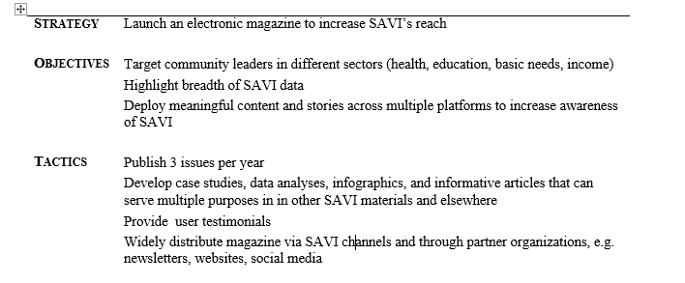
Strategies, Objectives, Tactics, Metrics
Metrics
Notes:
For each component

Slide 7
Components of Communications
Social Media
Increase followers by 250
Increase engagement (clicks, retweets, mentions, impressions)
Introduce SAVI and its capabilities to new organizations, groups, and/or associations
Summits, public conversations
Presentations and meetings

Slide 8
Components of Communications: E-Magazine
www.savi.org/savi-magazine

Slide 9
E-Mag Metrics
Launch an e-magazine
Target: 35% open rate
Mag 1 = 23%, Mag 2 = ?

Slide 10
E-Mag Metrics
Advertise the e-magazine on multiple platforms to drive traffic to SAVI’s website
E-newsletters
Social media
Personal outreach
Digital Advertising

Slide 11
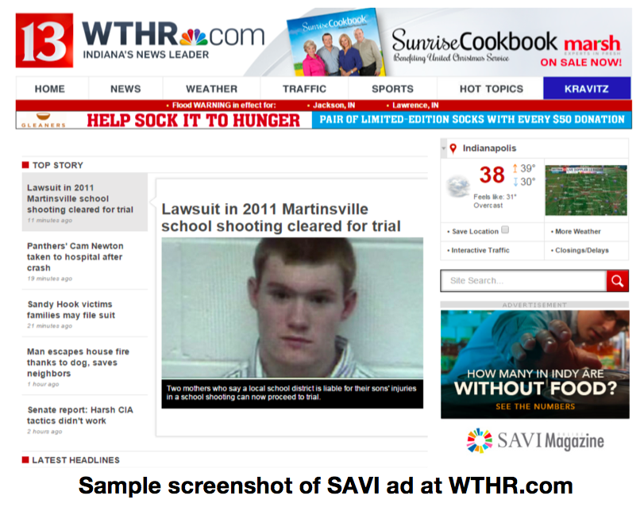
E-magazine Digital Advertising
Geo-targeted online advertisements

Slide 12
E-magazine Digital Advertising
Geo-targeted online advertisements (Mag 1)
AD TYPE | AD IMPRESSION | AD CLICKS | CTR (Click Through Rate)
Desktop sidebar/banner | 70,532 | 62 | 0.09%
Mobile phone banner | 49,909 | 488 | 1.0%
Mobile tablet banner | 34,530 | 152 | 0.44%
SOURCE: JOOMAG ANALYTICS An impression is the display of an ad to a user while viewing a web page. Click-through rate measures how many people clicked on the e-mag link after clicking on the ad.

Slide 13
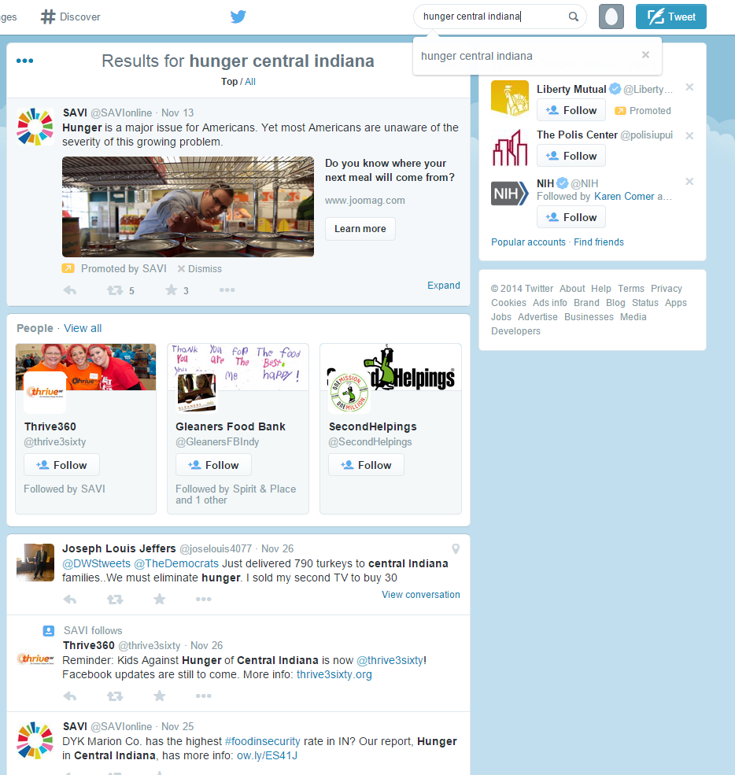
E-magazine Digital Advertising
Promoted Tweets

Slide 14
E-magazine Digital Advertising
Promoted Tweets (Mag 1)
Total impressions: 63.4K Engagements: 457 people
Of 457 overall engagements, 434 were direct clicks through to the E-magazine page at SAVI.org.

Slide 15
E-magazine Digital Advertising
Facebook advertisement
Google ad words campaign

Slide 16
Resources: PR Firm Partnership
High-quality, expert content (videos, case studies, etc.)
Guidance
Media reach – locally and nationally
Relationships
Leveraging audience
Social media

Slide 17
Better Annual Report
NOT a Washing Machine Instruction Manual

Slide 18
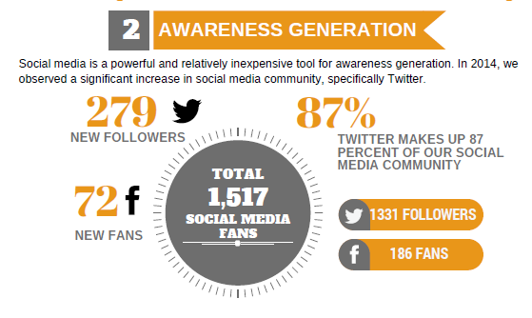
Annual Report

Slide 19
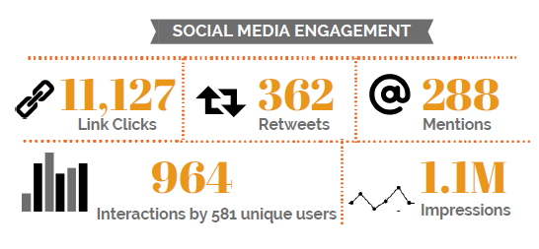
Annual Report

Slide 20
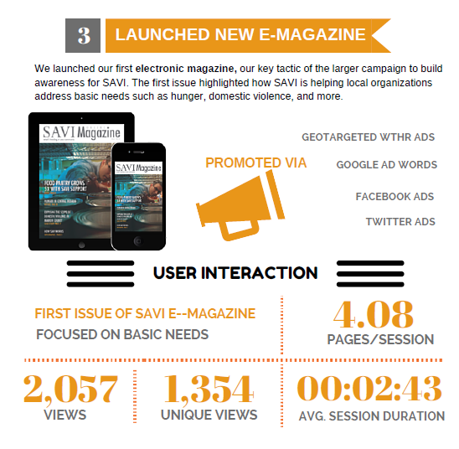
Annual Report

Slide 21
Contact Info
Sharon Kandris
Director of Community Informatics
The Polis Center
317.278.2944
skandris@iupui.edu

