Slide 1
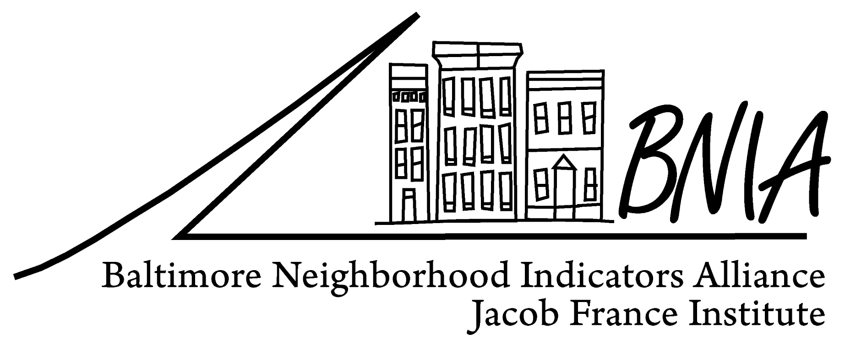
Vital Signs 11: Development and Results of Sustainability Indicators
Presentation to NNIP
Columbus, Ohio
June 21, 2013
Matthew Kachura
Research Associate
BNIA-JFI
University of Baltimore
mkachura@ubalt.edu

Slide 2
Strategic Directions
CSA (and below) data only
“Local” data sets
Convening role
Especially for sustainability indicators
Expert in neighborhood indicators
Neighborhood based sustainability indicators difficult to find/calculate
Expert in indicator sources
Few administrative data sources exist (many different partners collecting data)

Slide 3
BNIA-JFI: Vital Signs, 2000-2010
Project funded by the Annie E. Casey Foundation
Longitudinal database of 110 indicators
US Census & American Community Survey
Housing & Community Development
Children and Family Health & Wellbeing
Crime and Safety
Workforce & Economic Development
Sanitation
Urban Environment & Transit
Education & Youth
Neighborhood Action & Sense of Community
Notes:
Most persons know BNIA for producing Vital Signs. The continued support we have received from the Annie E. Casey Foundation allows for us to provide the Vital Signs data for Baltimore’s neighborhoods. We currently track 129 indicators of neighborhood vitality that we believe are important to understand and plan for the future of the City and its neighborhoods.
These indicators cut across subject areas – ranging from housing, to health, to education, to safety, to sanitation.
While we make these indicators available for free at the Community Statistical Area, most of the indicators are available for customized analyses at other geographies – including neighborhood, census tract, councilmanic district, and zip code.
And as you saw this morning, we are asking for your input and guidance in selecting from our current list of indicators that are most important and looking to add those that you have said are important to track that we currently do not collect. In fact at 1pm, we will be meeting in Room 143 to further discuss the Vital Signs indicators.

Slide 4
Project funded by the Annie E. Casey Foundation
Many NEW indicators in Vital Signs 11 (currently 150)
Available at the CSA data FREE on BNIA-JFI website
Notes:
Most persons know BNIA for producing Vital Signs. The continued support we have received from the Annie E. Casey Foundation allows for us to provide the Vital Signs data for Baltimore’s neighborhoods. We currently track 129 indicators of neighborhood vitality that we believe are important to understand and plan for the future of the City and its neighborhoods.
These indicators cut across subject areas – ranging from housing, to health, to education, to safety, to sanitation.
While we make these indicators available for free at the Community Statistical Area, most of the indicators are available for customized analyses at other geographies – including neighborhood, census tract, councilmanic district, and zip code.
And as you saw this morning, we are asking for your input and guidance in selecting from our current list of indicators that are most important and looking to add those that you have said are important to track that we currently do not collect. In fact at 1pm, we will be meeting in Room 143 to further discuss the Vital Signs indicators.

Slide 5
Development of Sustainability Section
2009 – Baltimore City adopted the Baltimore Sustainability Plan (29 goals across 7 topics)
Cleanliness, Pollution Prevention, Resource Conservation, Greening, Transportation, Education and Awareness, Green Economy
VS 11 Indicators included into the Annual Sustainability report
2011 – HUD Sustainable Communities Regional Planning Grant
6 federal principles of livability
Baltimore added 7th – protection of waters in the Chesapeake Bay
Movement by residents/communities to sustainable behaviors
Increase in public transit, tree plantings, use of public and private space, and reducing energy use

Slide 6
Development of Sustainability Section
Convened roundtables
Focus first on existing sources of data
Indicator can be updated at least annually
Community representation/variation
Discuss potential new indicators
New data sources available to track indicators
Indicators needed for plan monitoring
Indicator important at the regional level
Worked through list of identified indicators
(2011, 2012 and beyond)

Slide 7
Data Sources
311
New: Weatherized homes (DHCD)
New: Community Gardens (coordinated through Urban Waters)
New: Walk Score (purchased)

Slide 8
Sustainability
Existing Indicators
Neighborhood Associations and Block Clubs
Parks and Environmental Stewardship Groups
Community Gardens
% Population 18+ Who are Registered to Vote
% Population 18+ Who Voted in the General Election
Rate of Dirty Streets and Alleys Reports per 1,000 Residents
Rate of Clogged Storm Drain Reports per 1,000 Residents
Rate of Rat Incidents Reports per 1,000 Residents
% of Employed Population Using a Mode of Transportation Other Than A Car to get to Work*
% of Employed Population Using Public Transit to get to Work*
% of Employed Population Using Modes Other than Cars or Public Transit to get to Work*
Tree Canopy - % of Area Covered by Trees
Travel Time to Work for Working Population Not Working at Home*
Total Number of Residential Properties
New Indicators
Miles of Bike Lanes
Impervious Surface
Water Use
Energy Use
% of homes heated by Utility Gas
% of homes heated by Electricity
% of Households with no vehicles available
# of Photovoltaic/Solar Permits
% of homes weatherized (per 1,000 residential properties)
% of lead violations (per 1,000 residential properties)

Slide 9
Sustainability
Proposed Deletions
"Umbrella" Organizations
Community Development Corporations
Areas with a Healthy Neighborhood Initiative Program
Number of Designated Local Historic Buildings (CHAP)
Code Red days - # of days ozone levels exceeded EPA standards for 1-hour ozone exposure
Number of days with temperatures above 90 degrees
Air Quality Index
Number of potential hazardous waste sites
Particulate Matter (PM2.5)
Nitrogen Dioxide (NO2)
Carbon Monoxide (CO)
Sulfur Dioxide (SO2)
Ozone (O3) - Number of Days above the standard

Slide 10
Sustainability
Vital Signs 11
Percent of Population (Over the age of 18) Who are Registered to Vote
Percent Population (Over the age of 18) Who Voted in the General Election
Rate of Dirty Streets and Alleys Reports per 1,000 Residents
Rate of Clogged Storm Drain Reports per 1,000 Residents
Percent of Population that Drove Alone to Work
Percent of Population that Carpool to Work
Percent of Population that Uses Public Transportation to Get to Work
Percent of Population that Walks to Work
Percent of Employed Population with Travel Time to Work of 0-14 Minutes
Percent of Employed Population with Travel Time to Work of 15-29 Minutes
Percent of Employed Population with Travel Time to Work of 30-44 Minutes
Percent of Employed Population with Travel Time to Work of 45 Minutes and Over
Percent of Area Covered by Trees
Number of Community Managed Open Spaces
Median Daily Water Consumption
Percent of Residences Heated by Utility Gas
Percent of Residences Heated by Electricity
Percent of Households with No Vehicles Available
Percent of Homes Weatherized
Walk Score

Slide 11
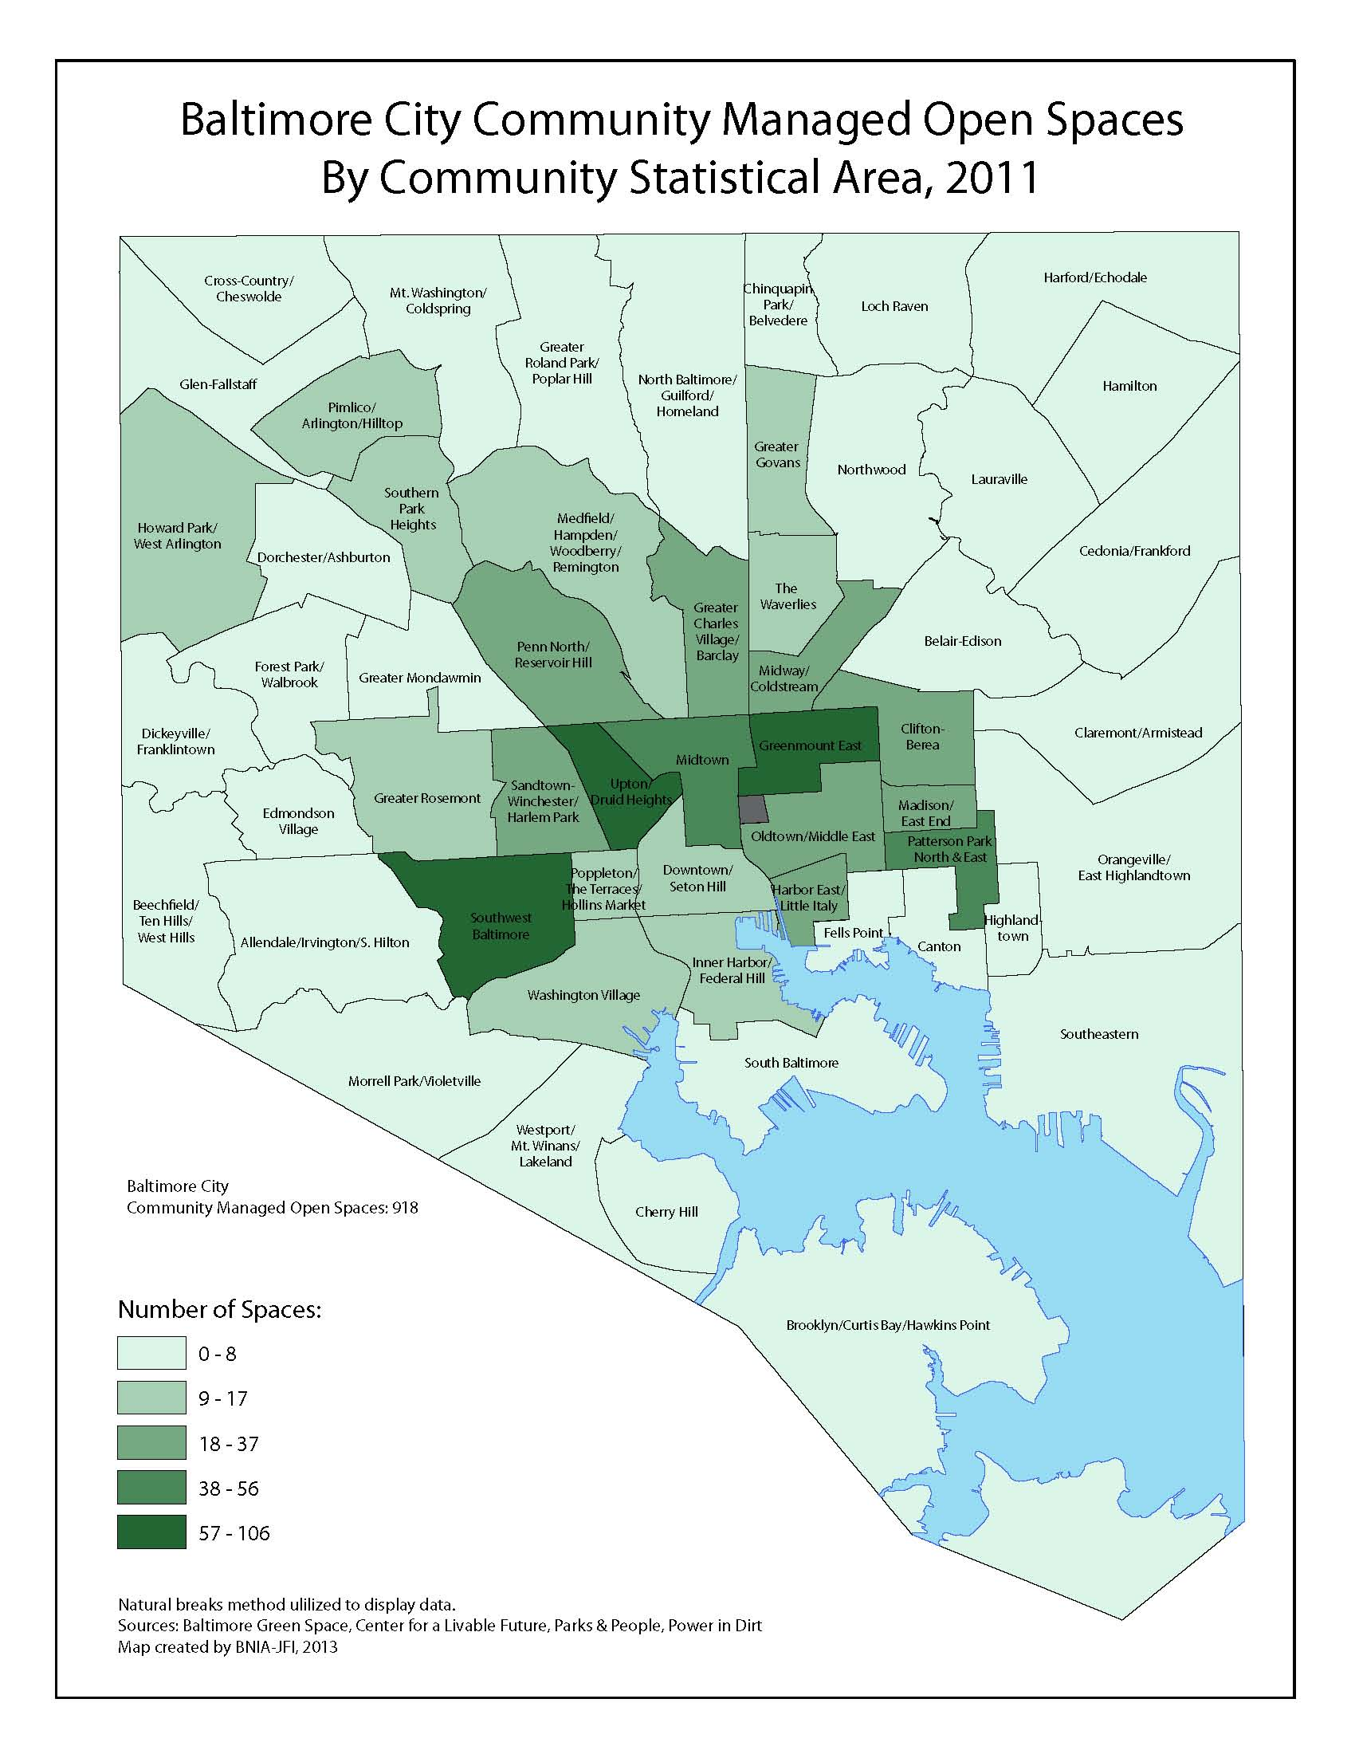
918 Community Managed Open Spaces
Aggregation and analysis of 5 different organizations
Interactive mapping feature built for more crowdsourced inputs in the future

Slide 12
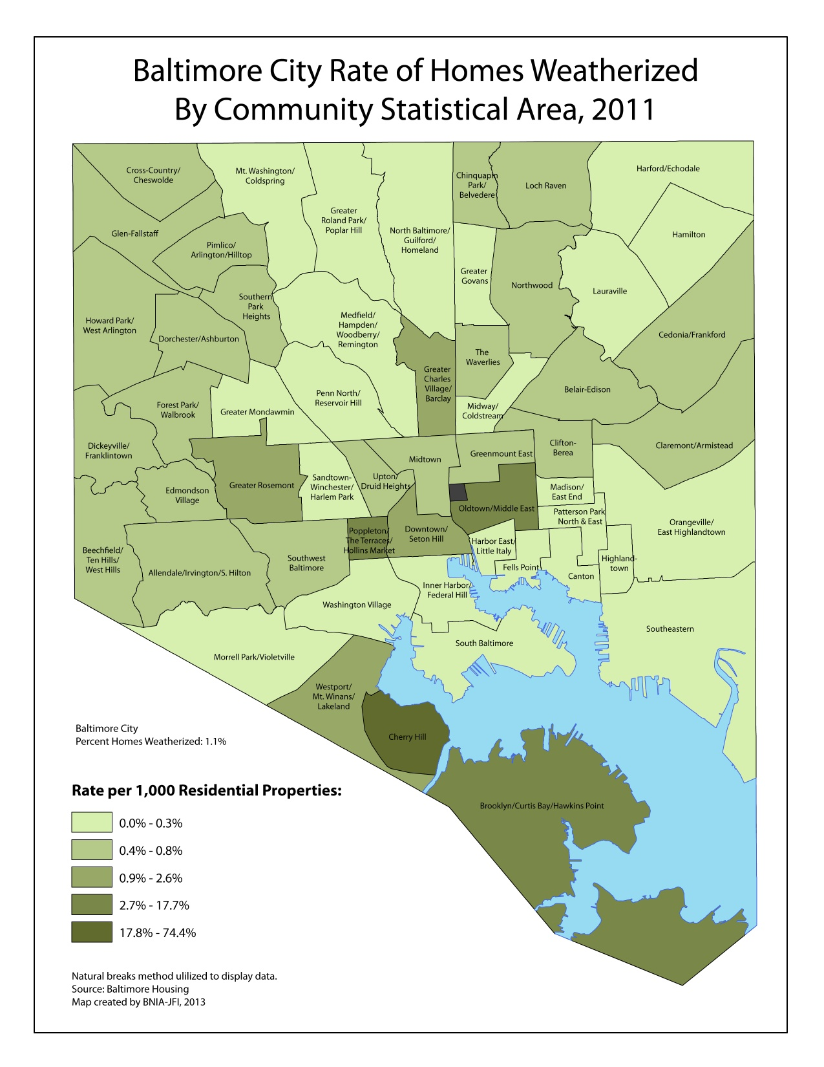
1.1% of all residences weatherized as of 2011
Increased 0.6 percentage points from 2010
This data can be used for housing policy analysis

Slide 13
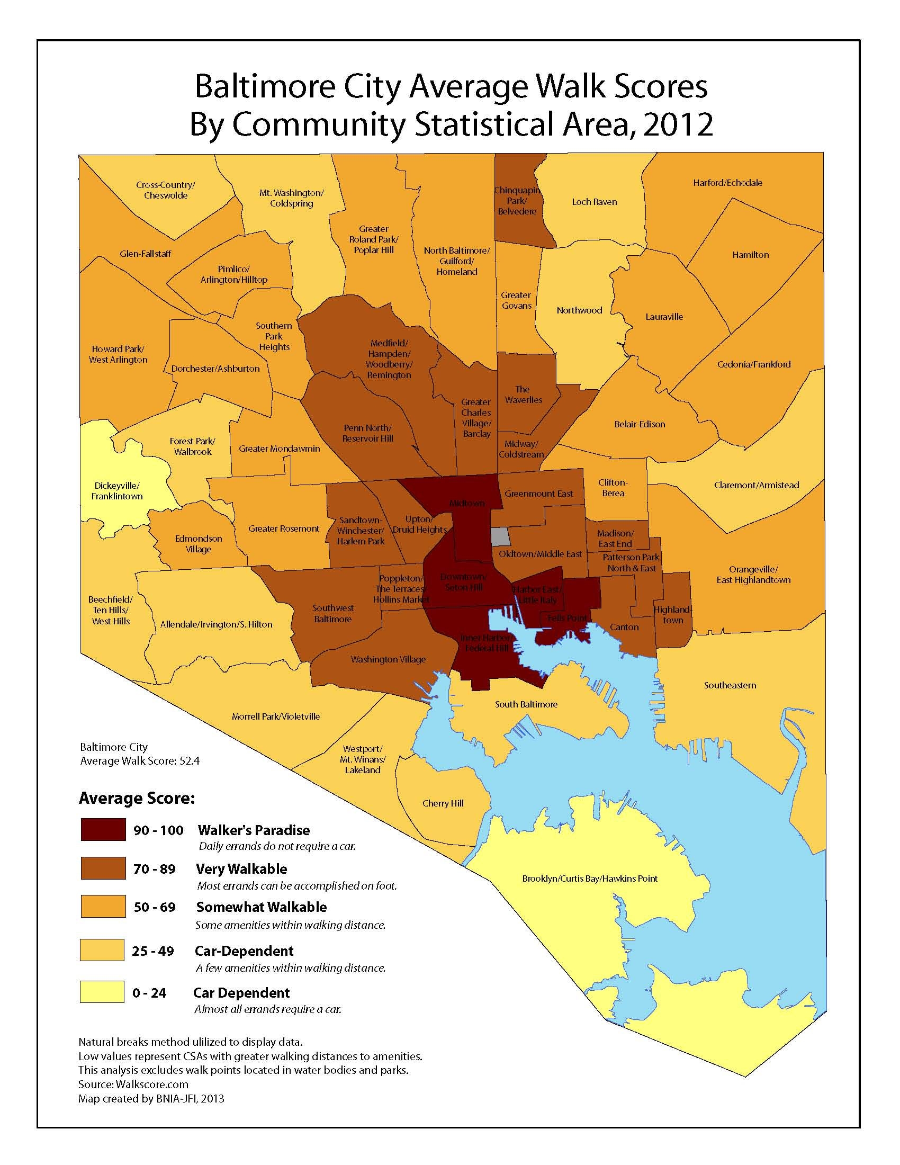
Baltimore City is “somewhat walkable” (score of 52.4)
Walkers Paradise – 5
Very Walkable – 17
Somewhat Walkable – 18
Car Dependent - 15

Slide 14
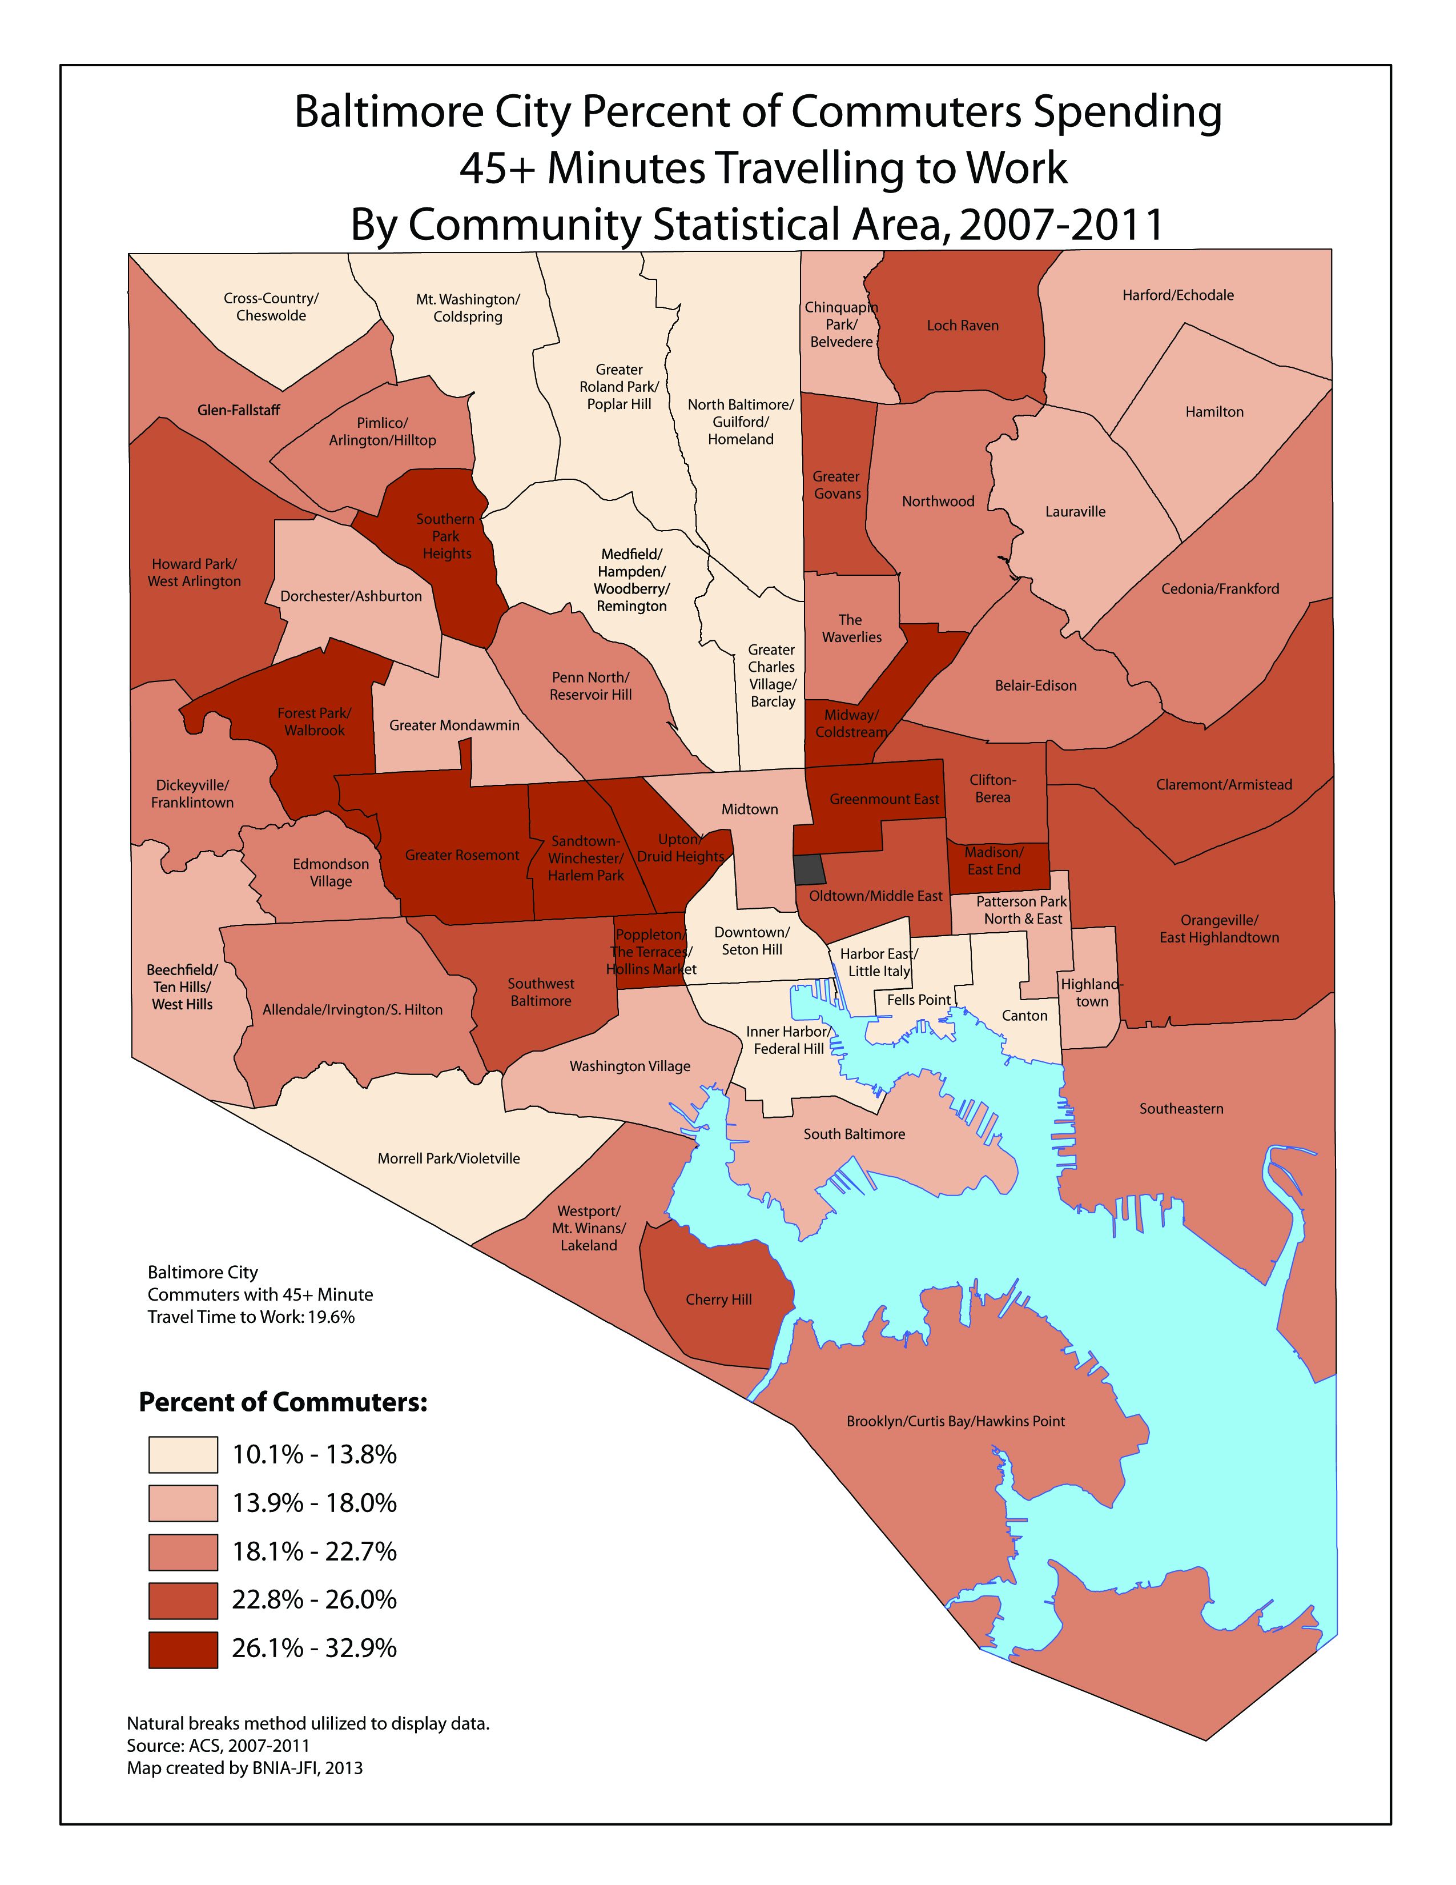
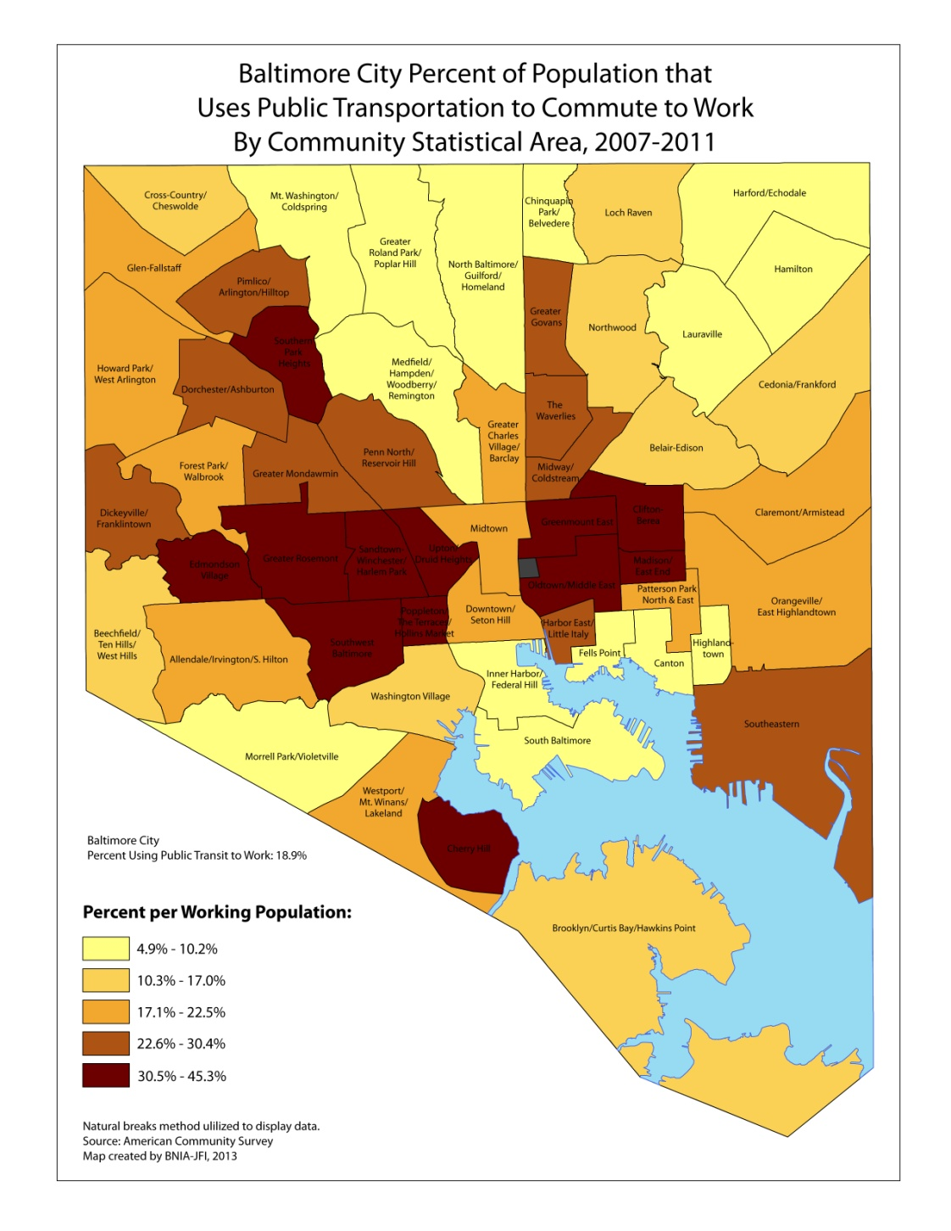

Slide 15
http://www.bniajfi.org/

