Slide 1
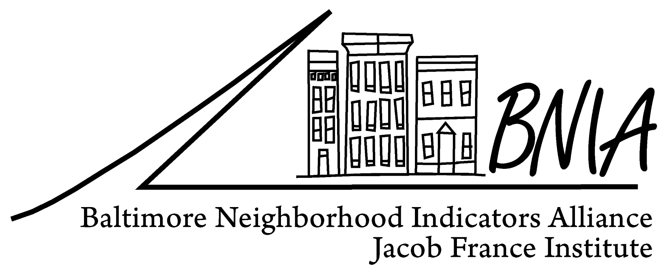
Baltimore City’s Interactive Foreclosure Map and Community Partnerships
Baltimore Neighborhood Indicators Alliance
Matthew Kachura.
Program Manager
Jacob France Institute
University of Baltimore
mkachura@ubalt.edu

Slide 2
BNIA-JFI: Vital Signs
Project funded by the Annie E. Casey Foundation
Longitudinal database of 110 indicators
US Census & American Community Survey
Housing & Community Development
Children and Family Health & Wellbeing
Crime and Safety
Workforce & Economic Development
Sanitation
Urban Environment & Transit
Education & Youth
Neighborhood Action & Sense of Community
Available at the CSA data FREE on BNIA-JFI website
Notes:
Most persons know BNIA for producing Vital Signs. The continued support we have received from the Annie E. Casey Foundation allows for us to provide the Vital Signs data for Baltimore’s neighborhoods. We currently track over 110 indicators of neighborhood vitality that we believe are important to understand and plan for the future of the City and its neighborhoods.
These indicators cut across subject areas – ranging from housing, to health, to education, to safety, to sanitation.
While we make these indicators available for free at the Community Statistical Area, most of the indicators are available for customized analyses at other geographies – including neighborhood, census tract, councilmanic district, and zip code.

Slide 3
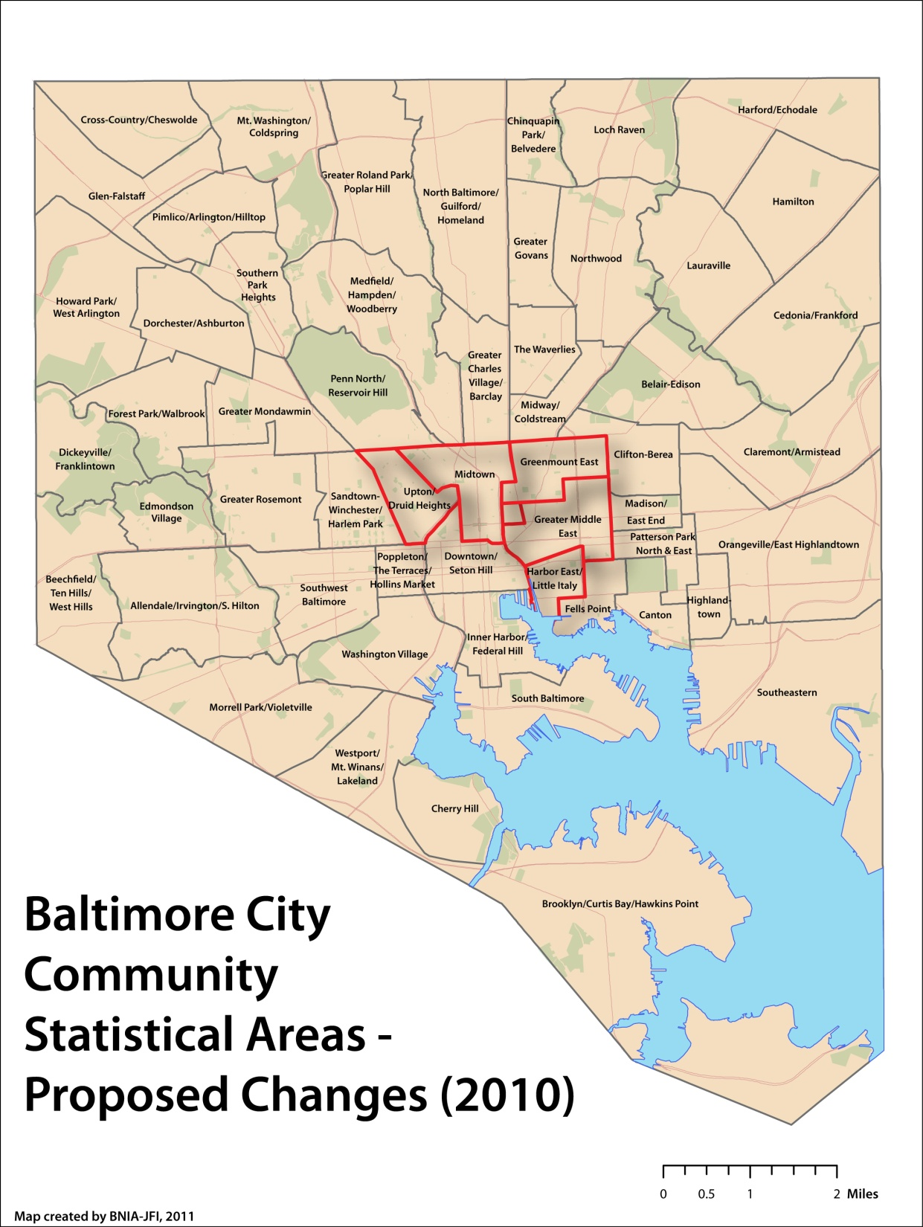
Baltimore City CSAs 2000 to 2009 - 55 2010 to .… - 55 Based on Census boundaries Aggregations of Census tracts (respectful of neighborhoods)
Notes:
Here are the boundaries of the CSAs moving from 2010 forward. While the number remains the same, 5 CSAs have changed due to Census changes – all around the central part of the City.

Slide 4
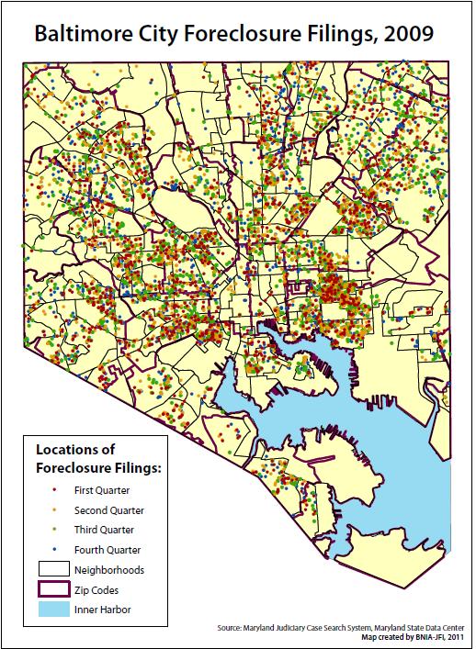
Baltimore City Foreclosures 2008 – 3,790 filings (1.9%) 2009 – 6,138 filings (3.0%) 2010 – 4,503 filings (2.2%) … 2012 – 2,336 Filings (through Nov 13)

Slide 5
Baltimore City Interactive Foreclosure Map http://foreclosures.bniajfi.org/

Slide 7
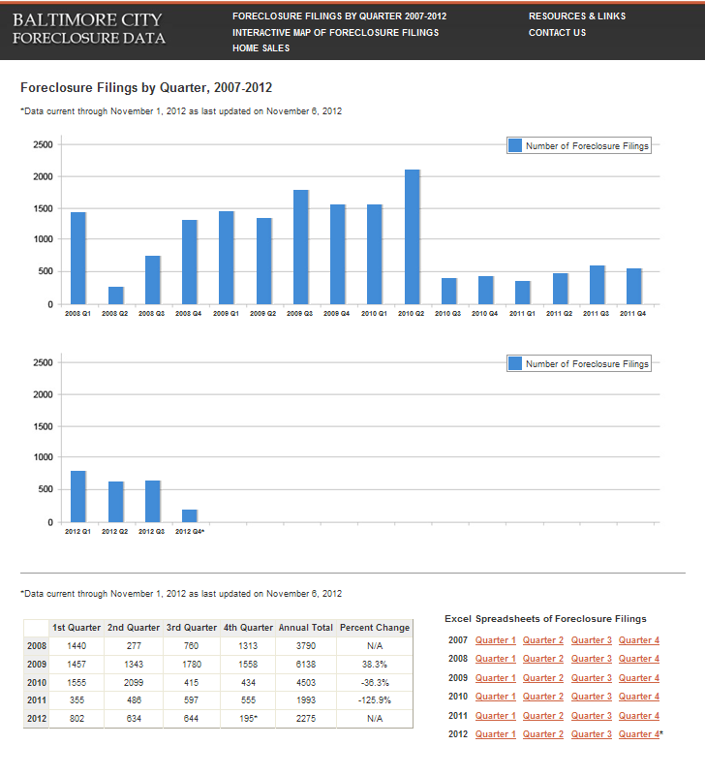

Slide 8
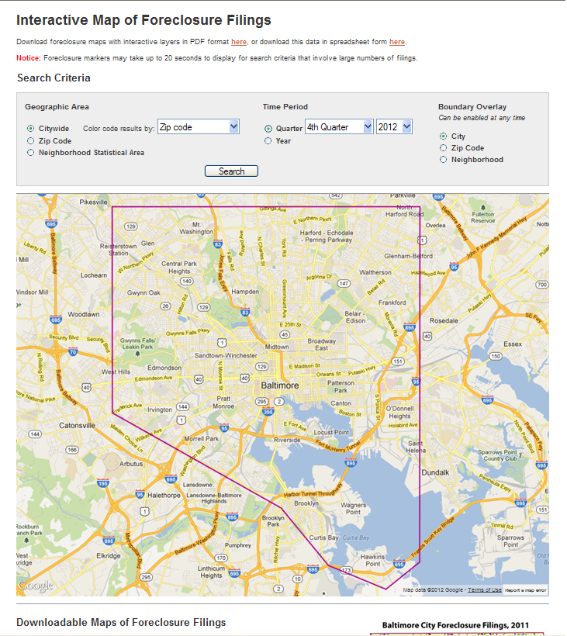

Slide 9
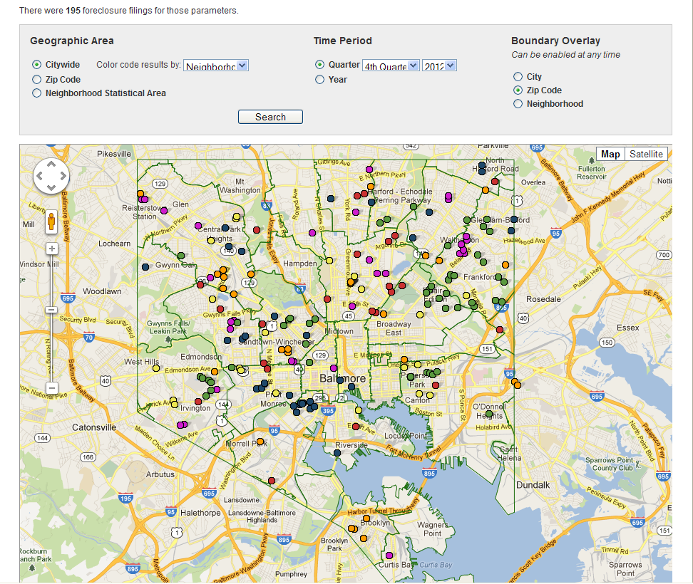

Slide 10
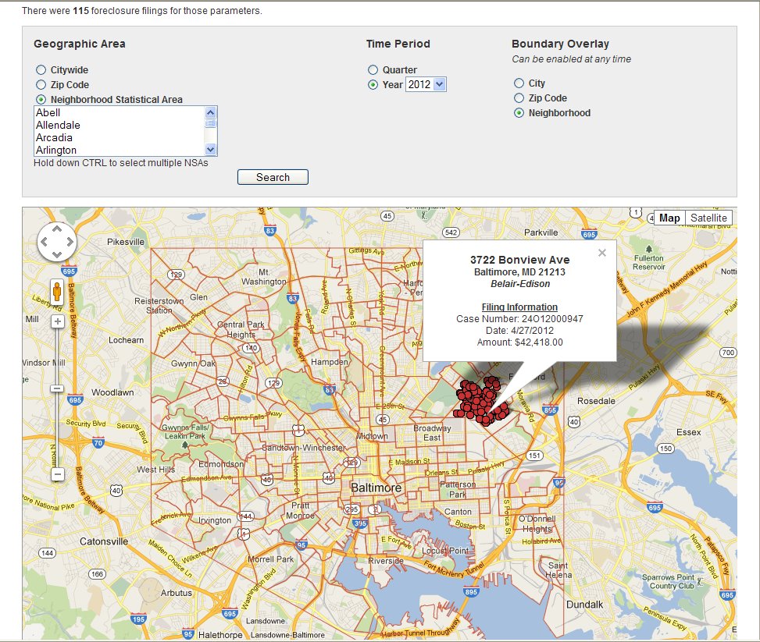

Slide 11
Foreclosure Data
Uses:
Program planning
Targeted intervention
Emails to service providers
Door knocking/hangers
Monitor trends
Community outreach
Research
Proposal writing
Newsletters
Users:
Community groups/orgs
Non-profits
Counseling agencies
Local government agencies
Housing
Neighborhoods
Planning
Schools
Sanitation
Police
Students/researchers
Media

Slide 12
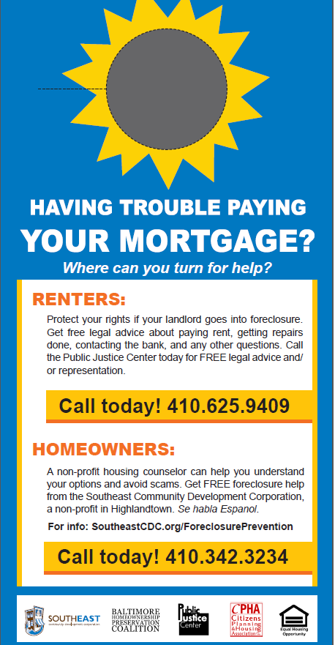
Example of a targeted area door hanger being used in Southeast Baltimore

Slide 13
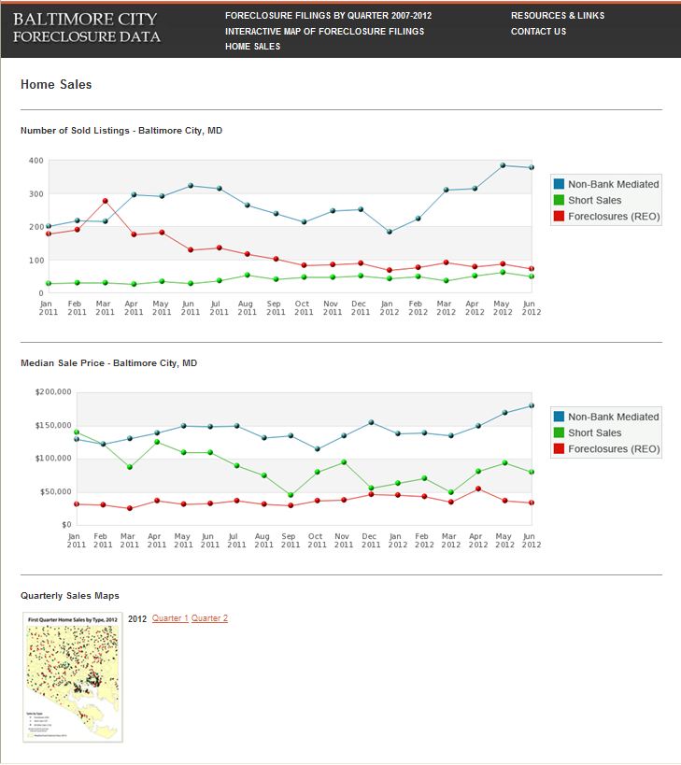

Slide 14
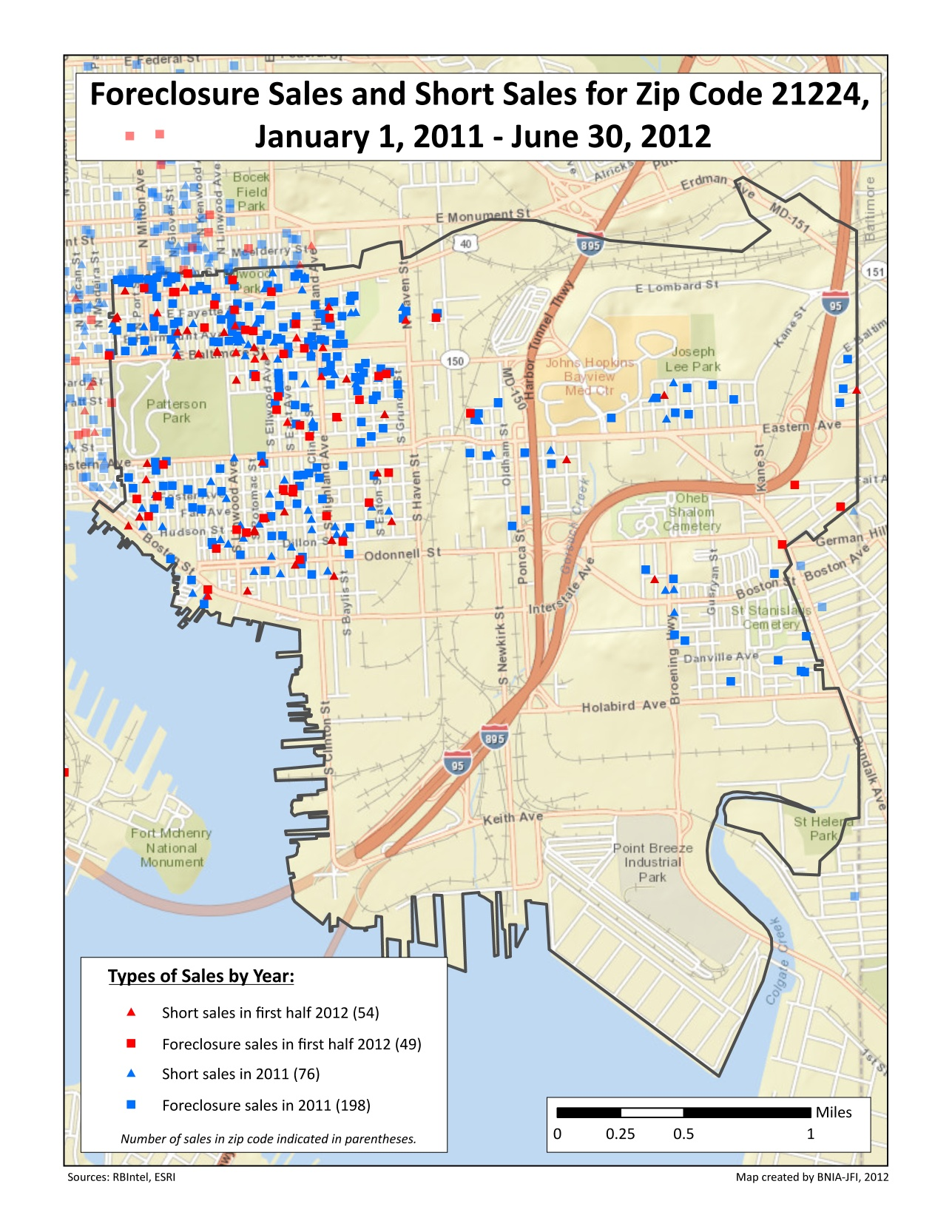

Slide 15
Home Sales Data –
Uses:
Aggregate (available on site):
Monitor trends
Research
Proposal writing
Often used in combination with foreclosure data
Point-level (provided to BHPC):
Targeted outreach
Monitor trends
Research
Often used in combination with foreclosure data.
Users:
Community groups/orgs
Non-profits
Local government agencies
Planning
Housing
Students/researchers
Media

Slide 16
Thank you

