Slide 1

Juvenile Welfare Board of Pinellas County
JWB IDS + PCS + PSRDC IDS= T⁴

Slide 2


T⁴
Trust
Turf
Time
Technology

Slide 3
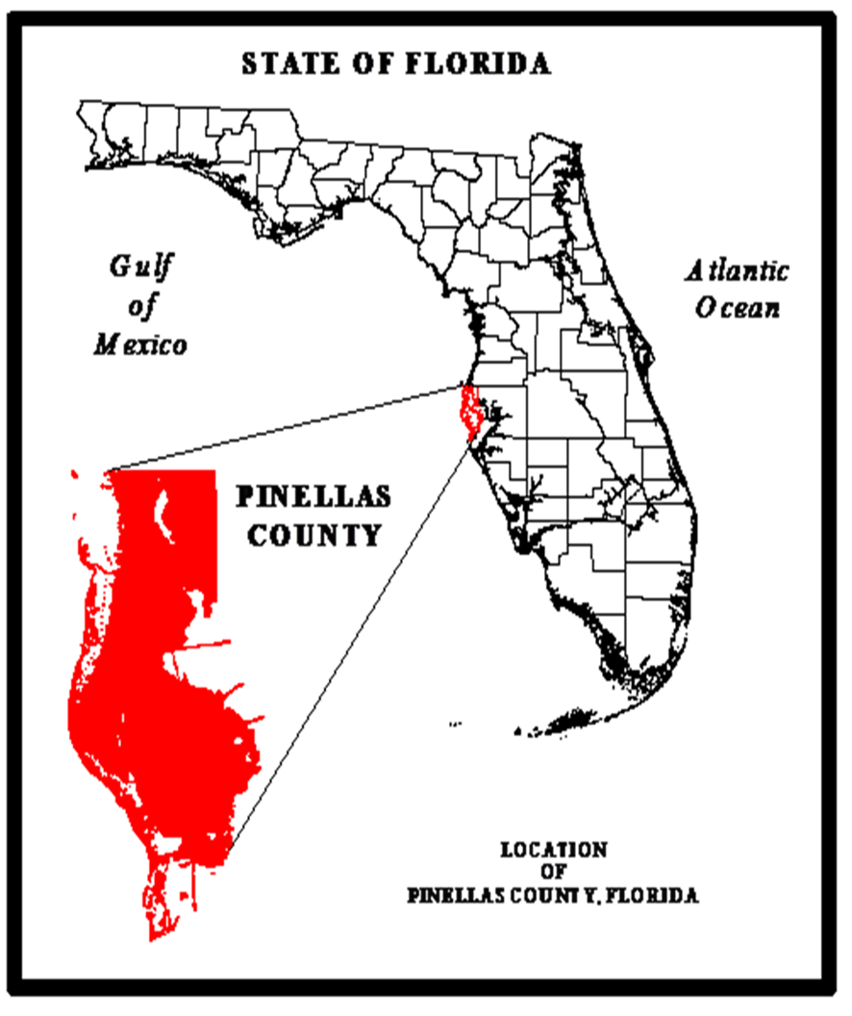

The Juvenile Welfare Board invests in partnerships, innovation and advocacy to strengthen Pinellas County children and families.

Slide 4
University of South Florida Policy
& Services Research Data Center
Juvenile Welfare Board
of Pinellas County
Integrated Data System
Integrated Data System
pinellasindicators.org
JWB Funded Program Client
Pinellas Juvenile Assessment Center
Pinellas County Schools
Tampa Bay Information Network
Eckerd Community Alternatives
Mental Health System IDS
Baker Act - Behavior/issues/concern resulting in the initiation
Criminal Justice Information Systems of Pinellas County
Florida Department of Law Enforcement.
Florida Department of Corrections
Florida Department of Juvenile Justice
Florida Health & Human Service
Florida Department of Children and Families Child Protective Services

Slide 5
Lealman: T⁴ Effect Minimized
PCS
JWB
PSRDC

Slide 6
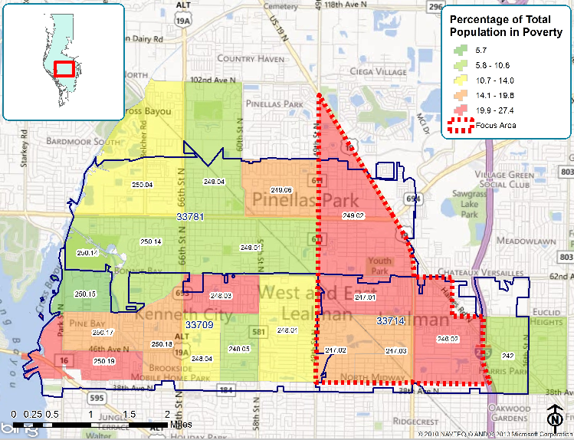
Lealman: T⁴ Impact Minimized

Slide 7
Nested Domains Impacting Student Absenteeism

Slide 8
A Priori Research Questions
Which domains have the greatest influence on absenteeism: child, home/family, school or community?
Which variables in each domain are the greatest contributors to absenteeism?
Is there a temporal relationship between factors that contribute to absenteeism and episodes of absenteeism?
Are there clusters of absentee students in at-risk neighborhoods? If so, why?

Slide 9
Absenteeism: T⁴ Impact Maximized
?
PCS
JWB
PSRSC

