Slide 1
A Journey Through the Boston Indicators Project
Data Day 2012
Northeastern University
Notes:
Good afternoon,
Thank you for coming to data day and welcome to this afternoon workshop, the purpose of which is to exhibit how the Boston Indicators Project can be a useful tool for accessing data and information about Boston and the region in a way that can support all of your work. My name is Jessica Martin and I and the research manager for the Boston Indicators Project.

Slide 2
Workshop Overview
Introductions: What brings you here today?
Presentation: Boston Indicators Project as a resource for information
Exercise: How you use data
Notes:
Just a brief overview of today’s workshop:
Of course, I would like to start by getting to know each of you and what brings you to data day and this workshop today
I’ll follow up with a primer on the Boston Indicators Project, the trends we are tracking in Boston and the region, and how the project can be a resource for data and information as well as community engagement
We’ll also spend some time working through how to answer questions and address issues using community and neighborhood data, talk about barriers to using data and, hopefully, identify some solutions
It would be great to start by turning to your immediate neighbor, introduce yourself and talk for a moment about how you currently use data and what brings you to data day and this session
Now, as we go around the room, rather than reporting your own answers I would like you to introduce your partner to the group and share what brings him or her here today.

Slide 3
What is the Boston Indicators Project?
Its goals are to:
Democratize access to data & information;
Foster informed public discourse; and
Track progress on shared civic goals.
Notes:
How many of you are familiar with the Project?
We will get into the details in a moment, but just as a primer to get us all up to speed, the Boston Indicators Project is jointly supported by the Boston Foundation, the Metropolitan Area Planning Council and the City of Boston to a collaborative project of Boston’s civic community
The primary goals are to : democratize access to data, foster informed public discourse and track progress on shared civic goals through the year 2030, Boston’s 400th anniversary as a city.

Slide 4
What is an Indicator?
“In the ‘information society’, access to data, including statistical data, is much easier. More and more people look at statistics to be better informed or to make decisions.”
BUT
“If we have the wrong metrics, we will strive for the wrong things”
Stiglitz, Sen & Fitoussi, Mismeasuring Our Lives: Why GDP Doesn’t Add Up
Notes:
These are two quotes from the landmark report often referred to as the “stiglitz” report which called for more comprehensive economic measures of quality of life in addition to growth.
Indeed, the information society is around us. We have access to a profound amount of data and now have the tools to analyze it for decision making in all sectors of life. But as the report warns, if we have the wrong metrics, we will strive for the wrong things.
So while data
Indicators are measures selected for their special meaning in that they:
Reflect and express community values, interests, goals
Create common ground for dialogue and discourse
Provide a shared “container” for community information, research and knowledge
Foster systemic thinking and strategies

Slide 5
Data: Boston’s Child Population: 2000
2000
2010
Notes:
An example of this is Boston’s Child Population.
Here, we are looking at a bar chart of a single data point: boston’s child population in the year 2000

Slide 6
Data: Boston’s Child Population: 2010
Notes:
And in 2010. We can see that the number of 15 to 19 year olds has increased while the numbers of younger children have declined over the decade.
But what does this data point tell us about how Boston is doing? While data can show a snapshot or a trend, or lead to further questions, indicators help to provide the context in which the data exist

Slide 7
Data: Boston’s Child Population
by Census Tract
Notes:
To get further information, we may start by looking at the child population where they live. Here’s a map of Boston and the immediate surrounding communities by census tract. The darker blue ones have the largest number of children—in Boston, these tracts are largely in the neighborhoods of Roxbury, Dorchester and Mattapan.
But even this does little to highlight the conditions of the neighborhoods where children live. This is, again, where the use of Indicators can drive deeper understanding.

Slide 8
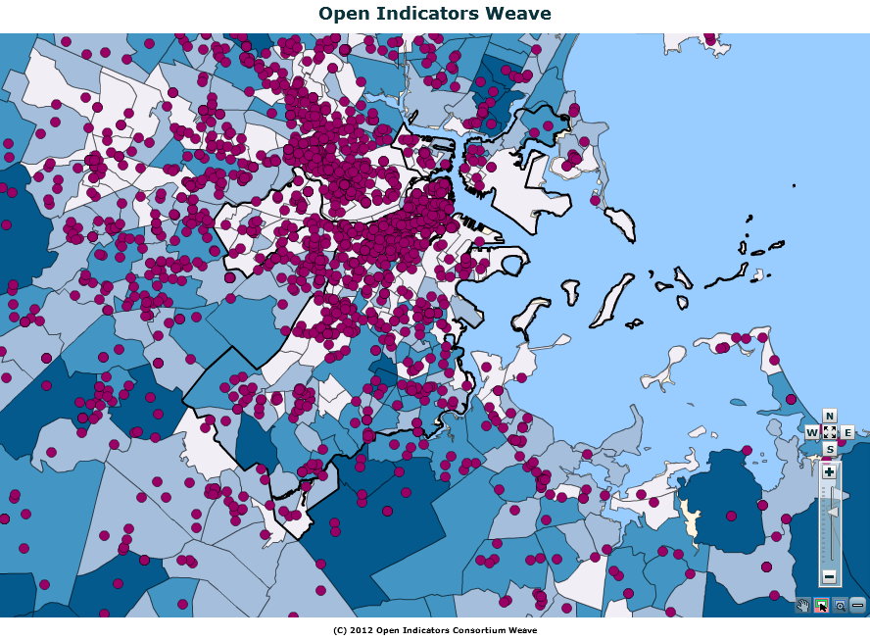
GOAL: All children have access to arts facilities INDICATOR: share of Boston’s children & cultural facilities by neighborhood
Notes:
Indicators are designed to be asset-oriented, such as access to arts facilities, which are represented as the purple points on the map. This allows us to see the general accessibility of arts facilities for Boston’s children. While Boston is clearly not lacking in this area, we can see that a majority of facilities are located outside of the areas with a high number of children.

Slide 9
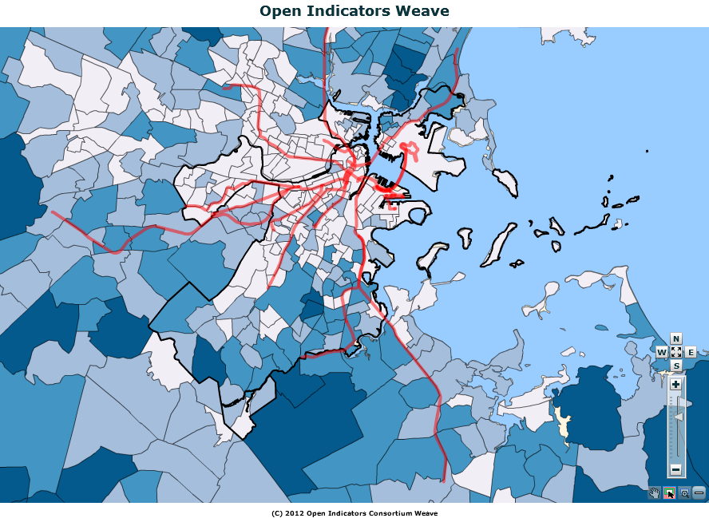
GOAL: All children have access to transportation INDICATOR: Children within a ¼ mile of MBTA station
Notes:
Which may lead us toward wanting to know how Boston’s children might access the full menu of arts and culture. Another indicators, access to Here we see a map of the T, which converges in the center of Boston that is dense with arts facilities. However, we can see that the swathe of the city with the most children has virtually no access to high-speed transit

Slide 10
Progress on this indicator
Notes:
The fairmount line currently runs through but does not stop in these neighborhoods, but with the coming development of the new transit stops along the Fairmount line

Slide 11
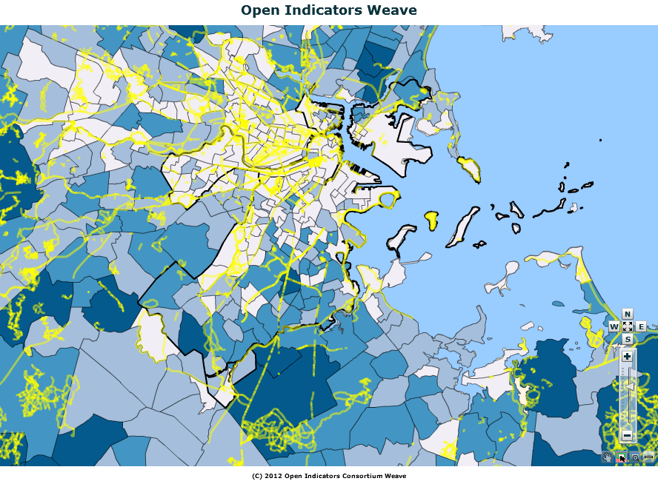
GOAL: All children have access to safe pedestrian walkways and bikeways INDICATOR: Children within a ¼ mile of a bike lane
Notes:
Other modes of transit for health and access
I’m just going to PAUSE for a moment to see if you have any thoughts of questions about data and indiators?
OK, so mow I’m going to talk about the Boston indicators Project framework and how we use and make sense of all of this data.

Slide 12
The Project has a long time frame—through 2030—and two tracks:
1) Data 2) Civic Agenda
Civic Agenda
civic leadership, deliberation, and action on a high-leverage civic agenda
2002
2004
2006
Benchmarks aligned to vision for 2030
2030
Long Term Vision
1997
2000
Project Launch
Identifying indicators framework
1st Report
The Wisdom of Our Choices
2002
2004
2006
Indicators Data & Reports
…updated website, report every two years to measure progress towards a vision for 2030
---deepening data, creating tools for access to data, training and education
Notes:
The Framework of the Boston Indicators Project is

Slide 13
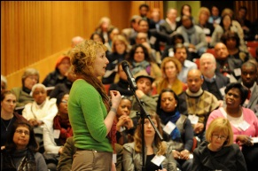
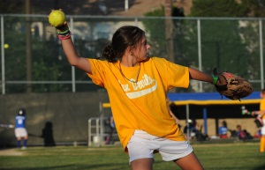
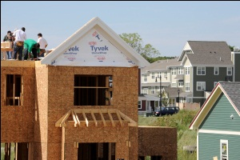
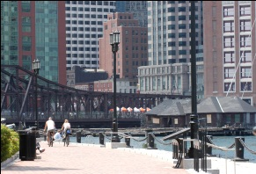
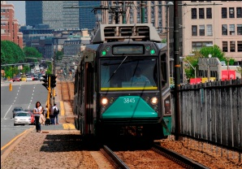
Measures progress across 10 sectors
Civic Vitality
Health
Cultural Life & the Arts
Housing
Economy
Public Safety
Education
Technology
Environment & Energy
Transportation
Notes:
These are the usual suspects as well as unusual ones
The reason why we have some unusual ones is because of the hundreds of people who canem to convenings to inform the proces
First to include arts
Civic vitality as a comprehensive of measure so race/ethnicity, the strength of the nonprofit sector,

Slide 14
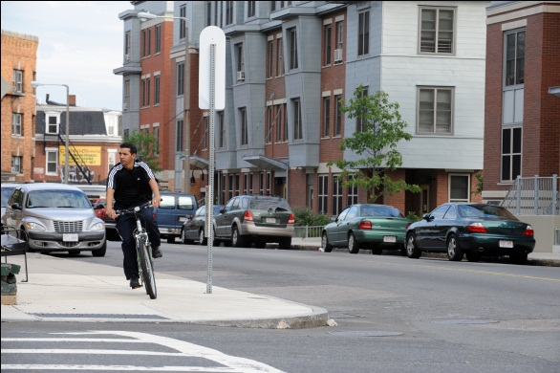
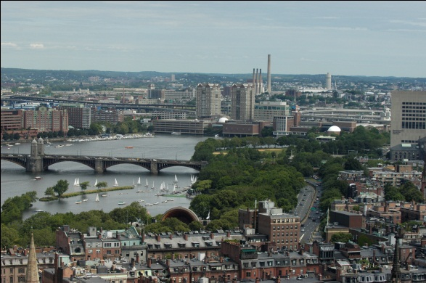
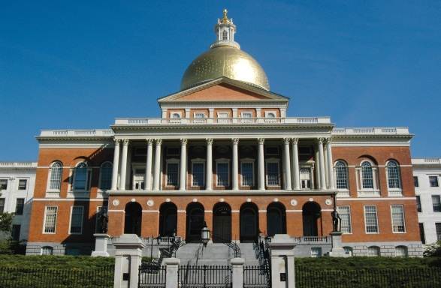
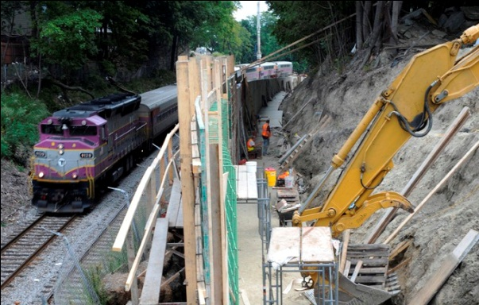
Topics that “cross-cut” all of the sectors
Boston Neighborhoods
Children & Youth
Competitive Edge
Sustainable Development
Fiscal Health
Race & Ethnicity
Notes:
Before we move on PAUSE FOR QUESTIONS

Slide 15
2000: The Wisdom of Our Choices
Baseline Report
Warned of vulnerability to a down-turn
Impact of a two-tiered knowledge economy
2001 |  | 2003 |  | 2005 |  | 2007 | 2008 | 2009 |  | 2011 | 2012
Notes:
The 2000 report, released at the height of the dot.com boom, warned of our vulnerability to a downturn and of the effects of the two-tiered knowledge economy on those without a good education.
Set the stage for measuring Boston’s progress through 2030
Identified city and regional strengths and challenges
Diversity of people and economy
Vibrant cultural institutions and neighborhoods
World-class built and natural environment
Growing income inequality
Vulnerability of “new economy” jobs
High cost of living

Slide 16
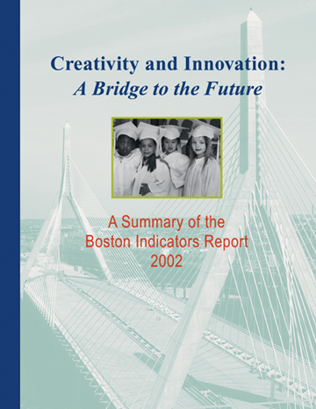
2001-2002: Creativity & Innovation: A Bridge to the Future
Followed dot.com bust
Challenge of talent retention in a cold, high-cost city
Identified Boston’s Competitive Advantage
2001 |  | 2003 |  | 2005 |  | 2007 | 2008 | 2009 |  | 2011 | 2012
Notes:
Two years later, after the high tech bust, we pointed to talent retention as a major challenge in a cold region with a high cost of living and declining jobs.
Found Boston’s competitive advantage lies in three areas:
A strong physical and institutional infrastructure
A Culture of Practice and innovation
Human capital: skills, talents and aspriations

Slide 17
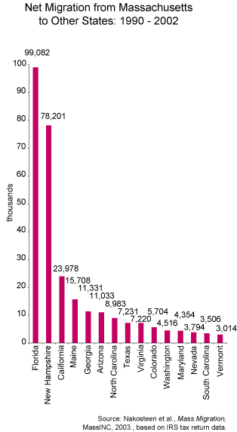
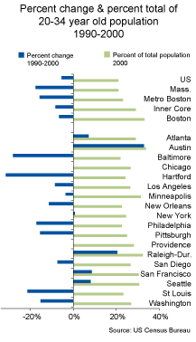
Challenge: Talent Retention
Notes:
Found that Boston was losing younger residents faster than many other cities

Slide 18
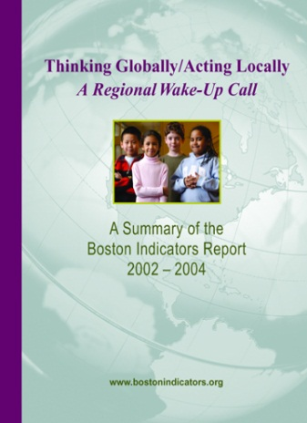
2003-2004: Thinking Globally/Acting Locally: A Regional Wake Up Call
Growing global competition as well as other US regions
Regionalism as a solution to challenges
Greater Boston’s Emerging Civic Agenda
2001 |  | 2003 |  | 2005 |  | 2007 | 2008 | 2009 |  | 2011 | 2012
Notes:
The 3rd report centered on the growing competition for jobs and talent from other US regions and globally, as well as on unmet local challenges.

Slide 19
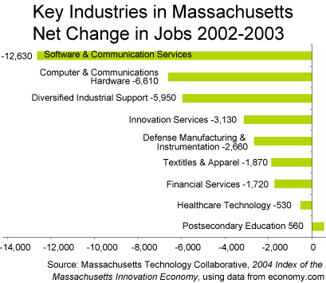
Risk of job loss & competition, Education: the greatest asset

Slide 20
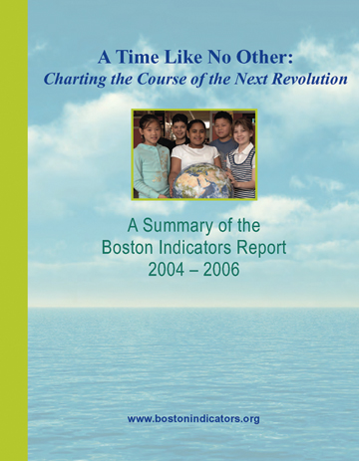
2005-2007: A Time Like No Other: Charting the Course of the Next Revolution
Bottleneck for Humanity: Boston at the center of global, historical change
Points of crisis and opportunity for the region
2001 |  | 2003 |  | 2005 |  | 2007 | 2008 | 2009 |  | 2011 | 2012
Notes:
Our 4th report named this as a period of great crisis and opportunity, with emphasis on intensifying global forces buffeting the region and city, and proposed 7 areas for focus and action.

Slide 21
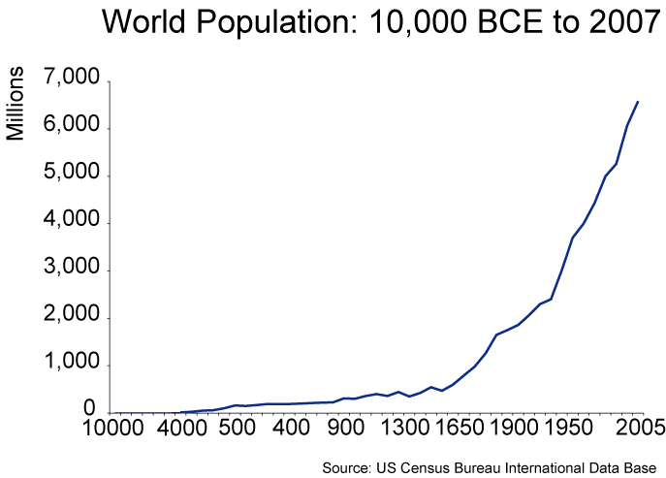
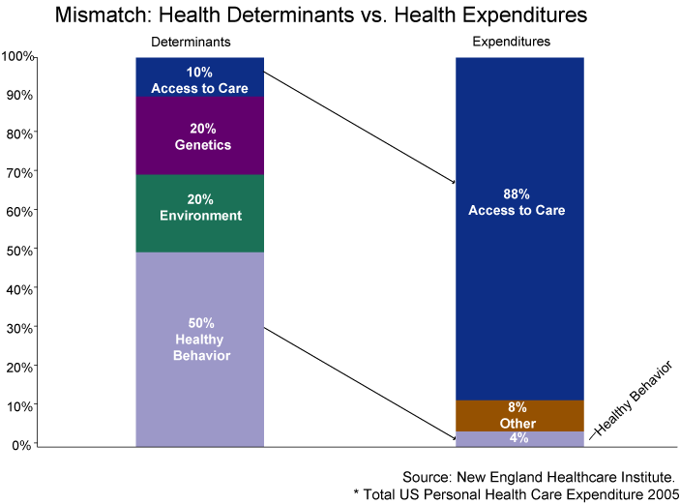
Bottleneck for Humanity

Slide 22
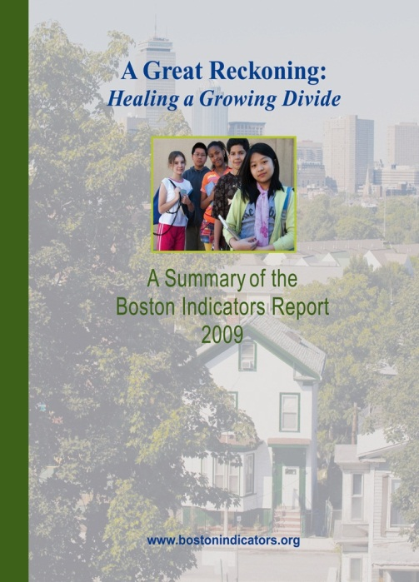
2008-2009: A Great Reckoning: Healing a Growing Divide
Foretold the growing challenge of income inequality
Highlight the region’s “trickle down demographics”
Detailed profiles of Boston’s sub-city regions
2001 |  | 2003 |  | 2005 |  | 2007 | 2008 | 2009 |  | 2011 | 2012
Notes:
Risks of growing income inequality

Slide 23
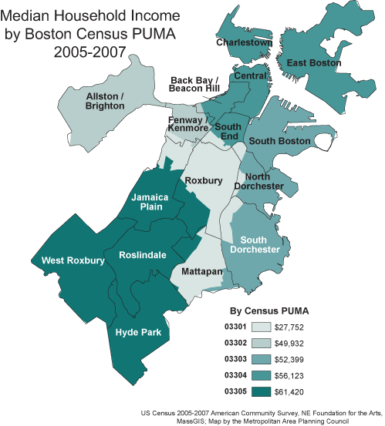
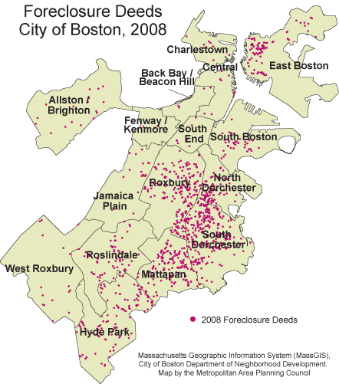
Inequality at the breaking point

Slide 24
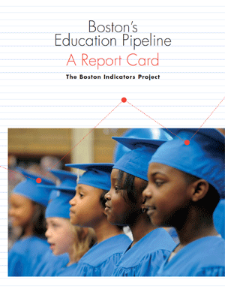
2008: Boston’s Education Pipeline: A Report Card
Baseline measures of opportunity & preparedness from cradle to career
Inputs as well as outcomes
Reprised as a 2.0 presentation in 2011
2001 |  | 2003 |  | 2005 |  | 2007 | 2008 | 2009 |  | 2011 | 2012
Notes:
Baseline measures of opportunity and preparedness from cradle to career with a focus in input measures—quality of schools, teachers, curriculum, facilities—as well as the typical output measures of proficiency, graduation

Slide 25
Outcomes are not binary, most kids are “side-tracked”

Slide 26
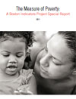
2011: The Measure of Poverty
The profile of poverty in Boston has changed little in the last twenty years
Great “hidden poverty” from high costs and cliff effect
Cuts to programs that mitigate the effects of poverty
2001 |  | 2003 |  | 2005 |  | 2007 | 2008 | 2009 |  | 2011 | 2012

Slide 27
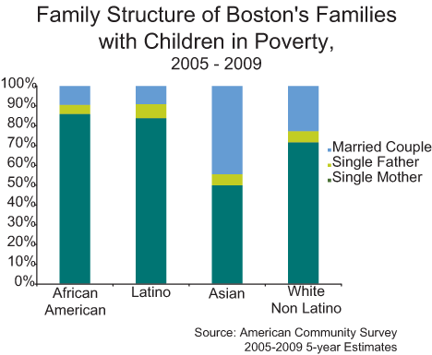
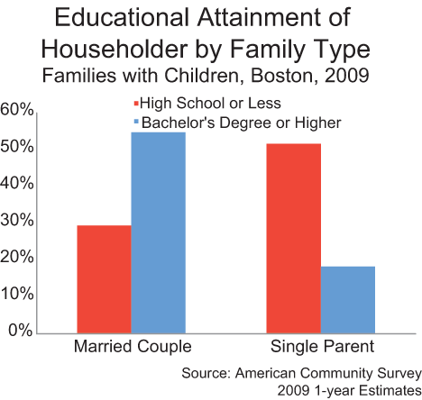
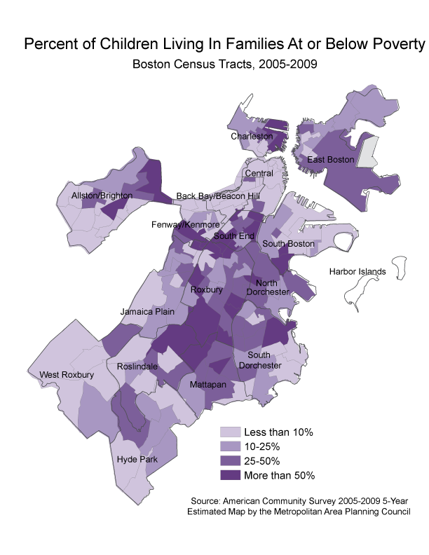
Poverty is linked to family structure, educational attainment and is highly concentrated

Slide 28
2010-2011: Where are we now?
City of Ideas: Reinventing Boston’s Innovation Economy
Nothing will ever be the same
Boston is a resilient, 21st century city & economy
“Under the hood” of the Innovation Economy
Standard measures don’t tell us everything
It is not working for everyone
It is more vulnerable than we think
New Paradigm: Innovate Locally, Exchange Regionally, Export Globally
2001 |  | 2003 |  | 2005 |  | 2007 | 2008 | 2009 |  | 2011 | 2012
Notes:
We have been tracking change through one of the most volatile decades in history
What we saw in each of the last reports was the rapid [ace of change, but in this report it all kind of comes together
Following thirty years of stagnation

Slide 29
Putting Indicators to Action
Data
Indicators
Goals
Milestones
Analysis & reports that “tell a story”
Strategies/Agenda
Alignment
Action
Impact
Notes:
What Needs to Be Done Locally? Identifying the right data to answer questions
Transforming raw data into information
Communicating findings and insights
Advocating for effective & informed policies
Implementing the right programs to help residents and neighborhoods
All of that momentum is not enough…. LOTS OF WORK TO BE DONE LOCALLY
This is why all of you are needed....

Slide 30
Greater Boston’s Emerging Civic Agenda
World Class
Human Capital
21st Century Infrastructure
& Sustainability
21st Century
Economic Strategies
Open, Dynamic &
Effective Civic Culture
Notes:
The bottom line is that our indicators and the data behind them have given us the confidence to develop and track progress on a shared civic agenda in the following 4 categories:
This agenda creates a shared frame of reference and focus on key challenges and opportunities
And it uses data to create “civic common ground” -- greater collaboration, data-driven policies, informed action and aligned resources
Direct and Indirect Impacts (for which we can take partial credit)
Smart growth housing legislation passed
A comprehensive Healthy People/Healthy Economy Initiative
A new “Food and Fuel Fund” at the Boston Foundation
A seamless “pipeline” or life course, approach to education reform
Better understanding and greater strategic traction on ways to address racial/ethnic disparities
THE BOTTOM LINE:
Shared understanding, a shared civic agenda and one conversation about the key challenges and opportunities facing Boston and the Greater Boston region

Slide 31
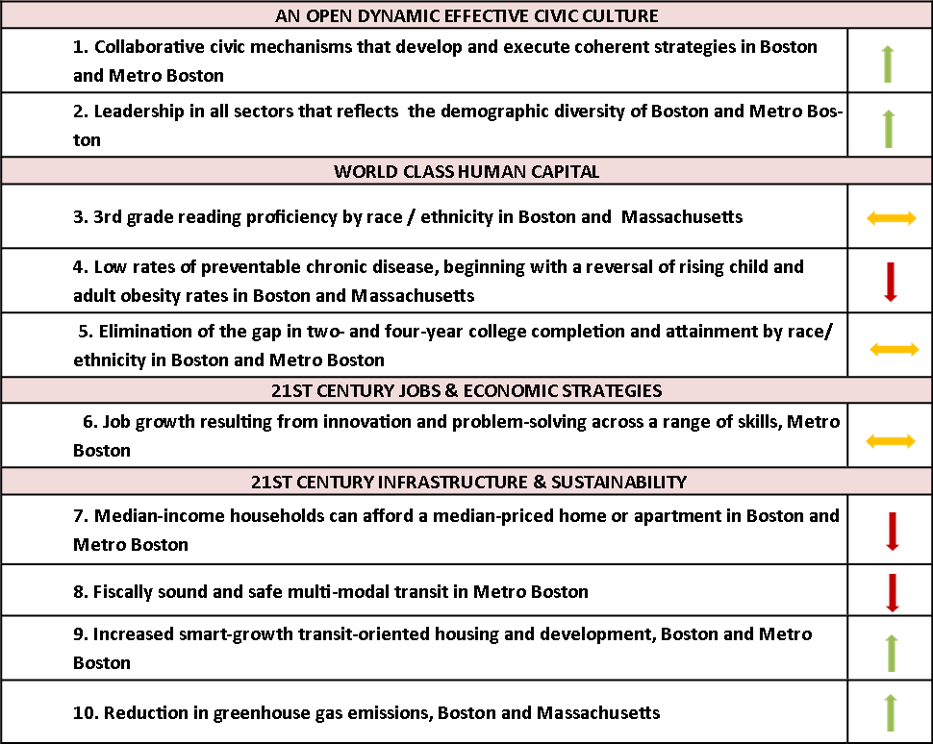
Civic Agenda progress through 2011

Slide 32
Boston Indicators Project Website: Tool for Accessing Data & Information
Notes:
Here’s a shot of our current website where provide access to each of the 10 sectors, 6 cross cut filters and data profiles of Boston and its 16 neighborhoods. We also provide access to our latest reports as well as new research that helps to inform the project
But we have been working on a new website design over the last year and I would like to give you a quick preview into some of the design changes and new features that will, hopefully, make it easier for you to find the data and information that you need.

Slide 33
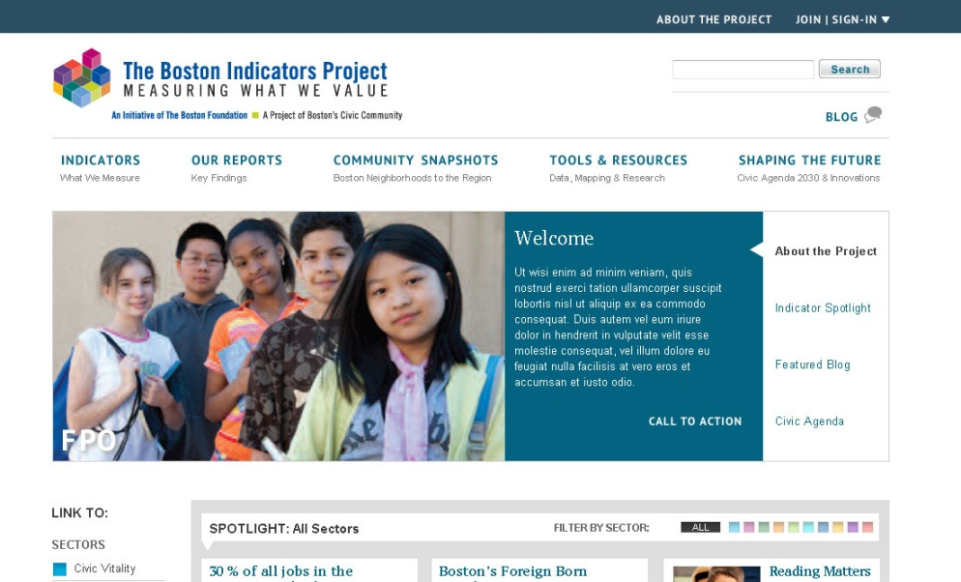
PREVIEW: The new Boston Indicators Project Website

Slide 34
PREVIEW: The new Boston Indicators Project Website

Slide 35
PREVIEW: The new Boston Indicators Project Website

Slide 36
PREVIEW: The new Boston Indicators Project Website

Slide 37
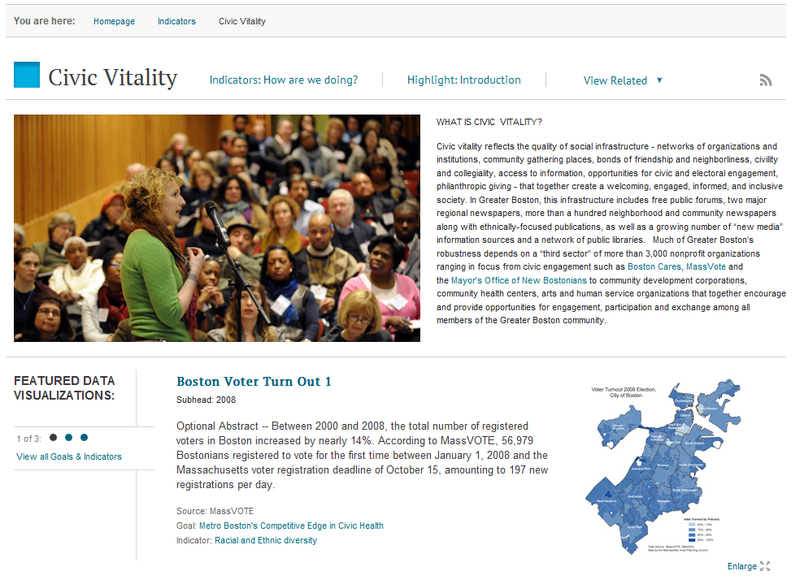
PREVIEW: The new Boston Indicators Project Website

Slide 38
Group Discussion
How do you use data?
What are your biggest needs when it comes to data?
How can you envision using the Boston Indicators Project as a tool in your work?

