Slide 1
National Neighborhood
Indicators Partnership (NNIP)
Collaborative effort between the Urban Institute & local partners in 32 cities
NNIP partners help residents and institutions use data to improve neighborhoods in advocacy, planning, and policymaking.
Notes:
[LEAH] welcome
Purpose of session – 1) NNIP close-knit network, give folks new to the meeting an opportunity to meeting other new people ahead of time. 2) mix of staff at partner organizations, potential partner organizations, and other invited national and local guests – develop shared language about NNIP, 3) give a little bit of background on how the meeting will run.
[Let’s first do introductions]
NNIP is a peer-learning network that has been operating for more than 20 years, it’s a collaborative effort between the Urban Institute, where I’m at and independent local partner in 32 cities,
What we all have in common is…to help residents and institutions use data to improve neighborhoods in advocacy, planning and policy making.
The Urban Institute is a nonprofit and nonpartisan social and economic policy research organization, our mission is to elevate policy debates through rigorous research, evidence, and engagement.

Slide 2
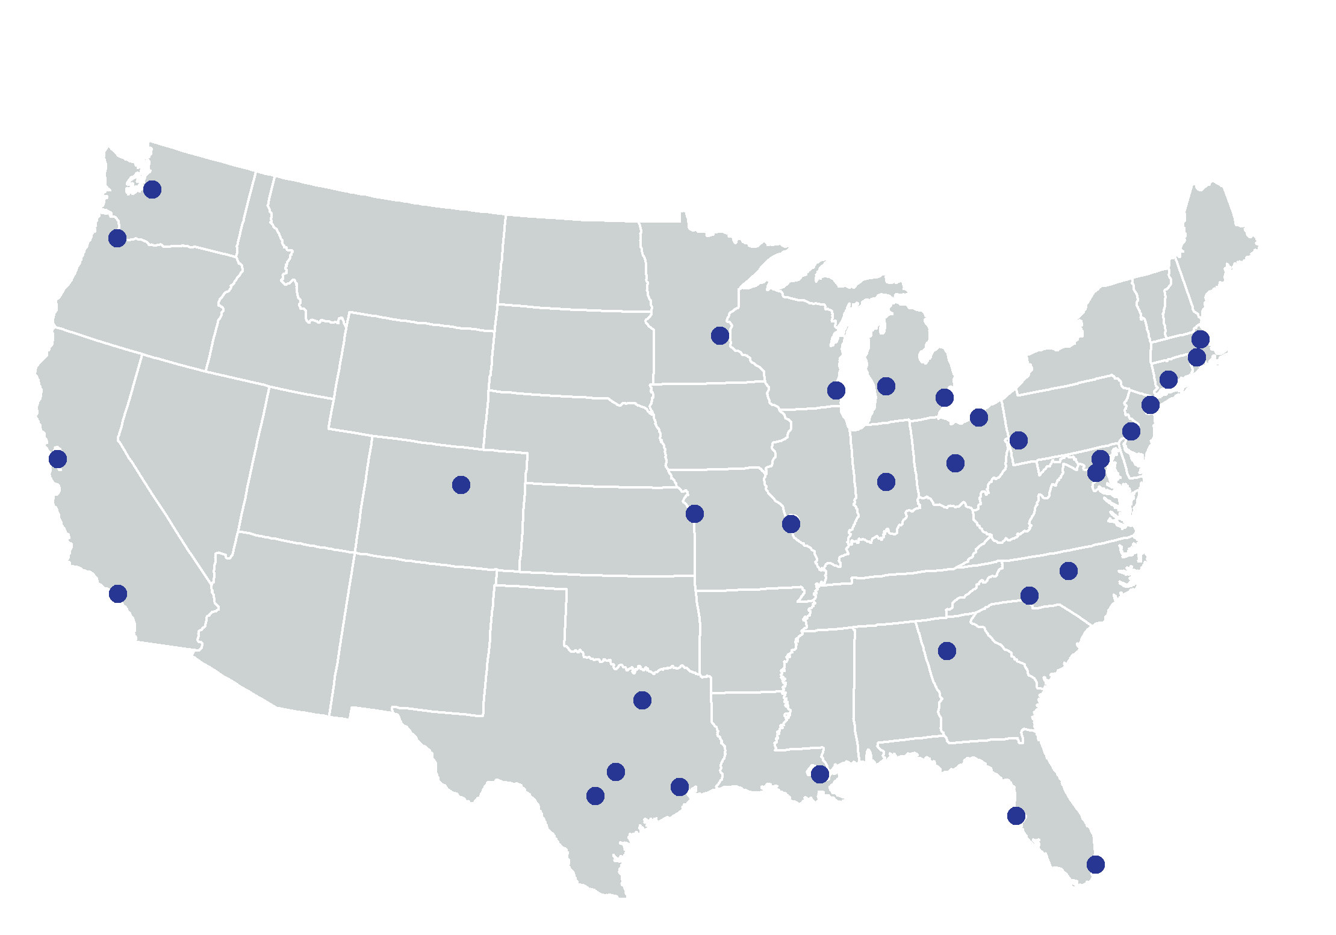
Better Data. Better Decisions.
Better Communities.
Notes:
Grown from 6 founding partners to 32 and more on the way. The partners are housed in various types of institutions –universities, independent nonprofits, local funders –5 of them have more than 1 organization, so there are 38 institutions for our 32 partner cities. (38% universities, 31% nonprofits, one-third other). What we found that is more important than the type of institution is that the are respected by all sectors and have a long-term stake in their community.

Slide 3
The NNIP Model of a Local Data Intermediary
Build and operate an information system with recurrently updated data on neighborhood conditions across topics in its local area;
Facilitate and promote the practical use of data by community and government leaders in community building and local policymaking; and
Giving emphasis to using information to build the capacities of institutions and residents in low-income neighborhoods.
Notes:
We characterize NNIP partners as local data intermediaries –organizations that help people understand and use data. When partners join NNIP, they agree to maintain three functions.
[go over]
To give a few examples of what this looks like – I’m going to have Noah and Laura share an example.

Slide 4
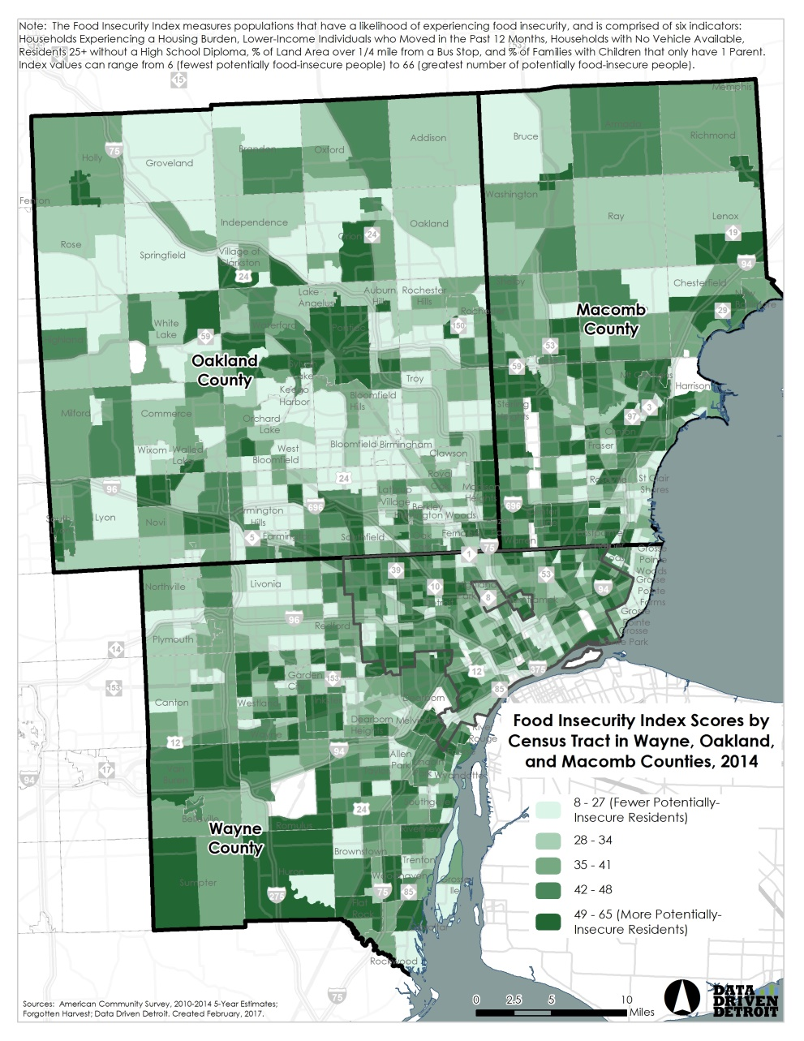
Inform community decisions in Detroit
Notes:
[NOAH]
Here’s an example of how partners use neighborhood-level data – D3 analyzed a number of different indicators and compiled a food insecurity index, which identifies where people are at greatest risk of potentially facing food insecurity in Southeast Michigan. You can see that a lot of patterns come out, both in the central city, as well as in some of the outlying regions that are often considered to be more affluent.
CAN WE SAY THESE THINGS IN THE EXAMPLES?
Democratize Information
Facilitate the direct use of data by stakeholders
Serve multiple audiences and purposes
But a central focus on strengthening and empowering low-income neighborhoods and communities of color
Use information to promote collaboration
Acts as a bridge among public agencies, nonprofits, businesses, resident groups
Success due to: trusted and engaged institutions; relevant high quality data and analysis, mission to support use of data for action

Slide 5
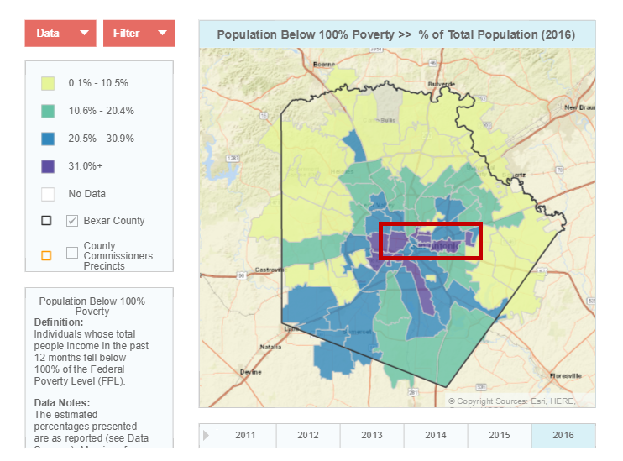
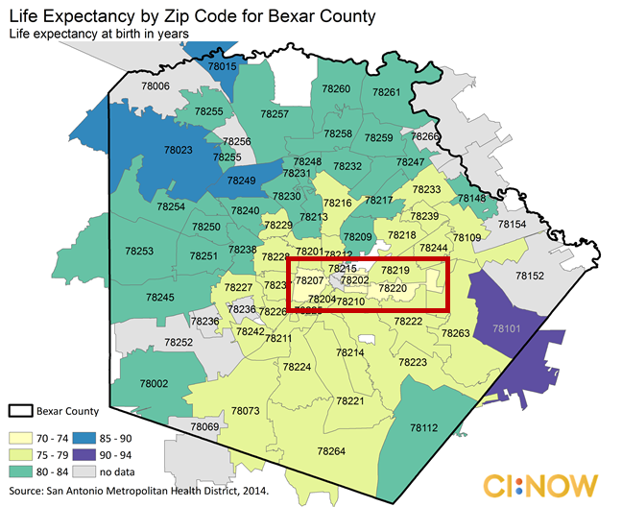
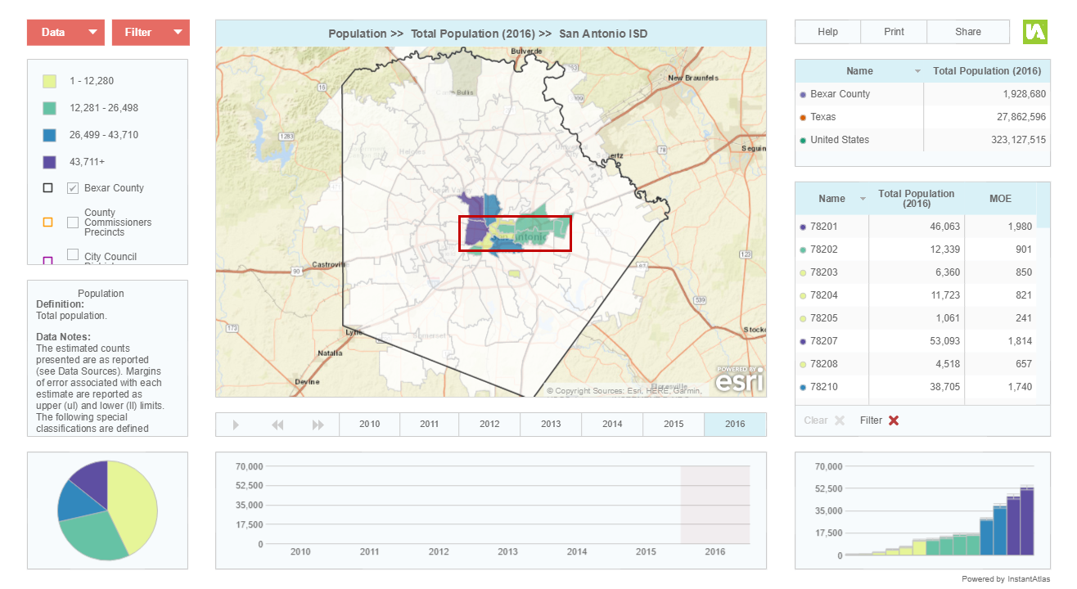



Life expectancy
and poverty
San Antonio ISD
Notes:
[Laura]
Reference if possible:
Democratize Information
Facilitate the direct use of data by stakeholders
Serve multiple audiences and purposes
But a central focus on strengthening and empowering low-income neighborhoods and communities of color
Use information to promote collaboration
Acts as a bridge among public agencies, nonprofits, businesses, resident groups
Success due to: trusted and engaged institutions; relevant high quality data and analysis, mission to support use of data for action

Slide 6
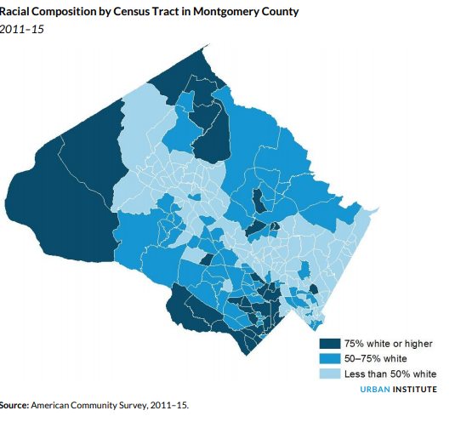

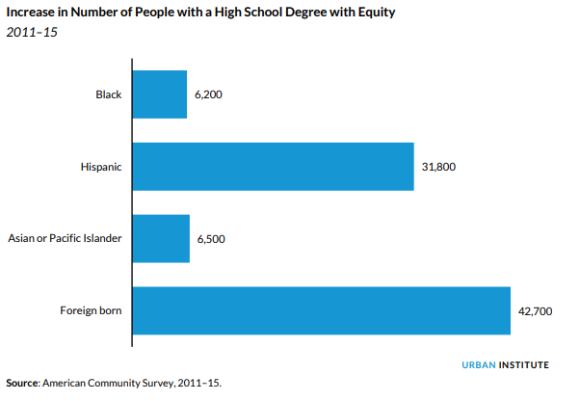
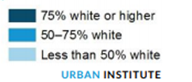
Promote racial equity in
Montgomery County
Notes:
[Leah]
Urban Institute also serves as the NNIP partner for the Washington, DC area, and I play a role in that. Local philanthropies in the area have been really interested in bring the racial inequities that exist in our prosperous region to the forefront.
In addition to the administrative data we organize for DC, we used the ACS data to calculate what equity would look like if you saw no differences by race and ethnicity. This map is of Montgomery County, a suburban jurisdiction northwest of DC that is relatively affluent. You can see those that is still quite segregated – That strip of less than 50% white follows the route of a major freeway.
We found that despite affluence large inequities existed in education, income, and homeownership. For example, in an equitable Montgomery County we’d expect to see 6200 additional black residents and almost 32000 Latino residents with a high school degree.
The local foundations shared this data with the County Council - who in April passed a resolution that referenced the report and will take a look at equity as a step towards requiring a racial equity impact assessment on new legislation. [review smartsheet]

Slide 7
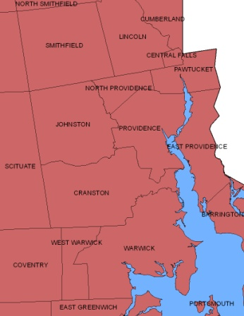
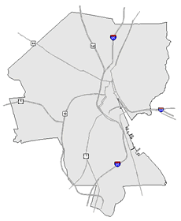
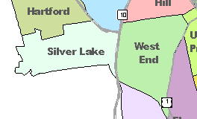
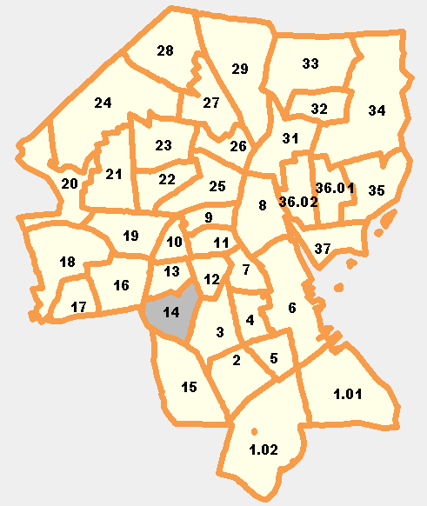
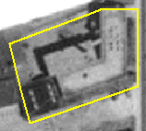
What Activities Do NNIP Partners Perform?
Assemble, Transform and Maintain Data
Types of Data
  Education
  Child care
  Births, deaths
  TANF, Food Stamps
  Health
  Crime
  Property sales, prices
  Foreclosures
REGION
CITY
NEIGHBORHOOD
PARCEL
TRACTS
Notes:
To move from these specific examples to more general activities = One of the major categories of activities that NNIP Partners perform is to - Assemble, transform and maintain data. What is more unique about NNIP partners is that they focus on collecting administrative data.
The partners collect data once from police, schools, health department; and add value by cleaning the data; and develop ngh-level indicators.
The 3 key aspects of the data that partners maintain as we described in the NNIP model earlier – are:
Neighborhood-level is key since problems are not evenly distributed across cities and priority issues vary across neighborhoods.
Multiple topics: the ability to cover many issues is critical: residents don’t experience their community in silos and the solutions aren’t siloed either. I think you’ll see examples of this through out the meeting.
Recurrent: Not just one-time project, but formal agreements to get the data every year or sometimes every day to be ready when need for data arise
Result is a one-stop shop that is a flexible resource for the whole community – much more cost-effective than each nonprofit group trying to do it themselves. There is an economy of scale.
This part is hard work and the systems are built incrementally. Perspective of investment in infrastructure – which requires commitment from partner org and their funders to grow and support the systems over time.

Slide 8
What Activities Do NNIP Partners Perform?
Disseminate information and apply the data to achieve impact
  Maintain website (neighborhood profiles, etc.)
  Analyze local conditions, programs, and policies
  Work 1-on-1 with groups on using data for planning
Use data to strengthen civic capacity and governance
  Provide training on how to use data
  Educate on issues related to local capacity to use data
Notes:
Though the data is necessary and hard work to accomplish, the most important set of activities that partners take on are to disseminate information and apply the data to achieve impact as you heard in the earlier examples. These activities take on a variety of forms – from the more passive dissemination of data in neighborhood profiles on a website to conducting in-depth analyses of local conditions and programs. To truly get the data out there and used NNIP Partners need to be actively engaging will local stakeholders..
The other set of activities is about increasing the capacity of the community to use data through training and education and to advocate for or collaborate in ways the strengthen local data capacity and use of data. You’ll hear from our partners on how they’ve done some of this tomorrow through their involvement with the open data efforts in their cities.
***Reference*****************************
Disseminate information and apply the data to achieve impact.
Maintain a website with static neighborhood data and/or interactive tools
Prepare data products for local clients (maps, fact sheets, data excerpts)
Conduct analyses of local conditions, programs, and policies
Present data and results of local analyses at public forums
Provide ad hoc help and technical assistance to local groups on how to access/use data
Work one-on-one with organizations or foundations on using data for program planning and design
Use data to strengthen civic capacity and governance.
Provide training to local groups on how to access and use data
Conduct public education on issues related to strengthening local data capacity
Collaborate with others to strengthen local data capacity (serving on civic committees, encouraging open data, etc.)

Slide 9
Network Roles
Partners: Commit to carrying out the NNIP model at home, share knowledge, and participate in network activities.
Urban: facilitates peer learning, launches cross-site projects, creates products to inform policy and practice, and builds support for community information field.
Executive Committee: Six elected staff members from partner organizations help govern NNIP.
Notes:
[pause – questions for discussion]
Does any one want to share an example of how their organization demonstrates the NNIP model and activities? For those not at partner organizations – how do these activities align with where you see needs in your community related to data and information?
I wanted to just give you a bit more info about how the NNIP network operates, and you’ll here more about some of our work in the opening presentation that Kathy Pettit will do.
Cover network roles.
Strategic Goals
Build and strengthen local capacity
Support current partners
Support potential partners
Inform local and national policy
Build support for community information field
Deleted:
organizes and plans meetings,

Slide 10
Stay in Touch! http://www.neighborhoodindicators.org/get-involved/listservs or Follow Us @NNIPHQ
Kathy Pettit: kpettit@urban.org; 202-261-5670
Leah Hendey: lhendey@urban.org; 202-261-5856
Notes:
Visit our website to sign up for our NNIPNews – and get updates from NNIP on our quarterly newsletter. There are also Twitter lists to follow our partners and you can follow the Network on Twitter @NNIPHQ
You have your packets which has the agenda for the next three days. Note code of conduct. Working meeting The sessions are a mix of topical and technical. We encourage active participation – that’s what makes it such a great peer learning network.
Explain camp - So don’t be afraid to jump in. Or propose an NNIP Camp session!
Mention buddies / Executive committee- people to go to ask questions.
Feel free to ask any questions.

Slide 11
Discard

Slide 12
An Introduction to the
National Neighborhood Indicators Partnership
(NNIP)
ATLANTA, GA
MAY 9, 2018
Notes:
Welcome – this is just to get you oriented before the full meeting starts and have you know some friendly faces.
As this is a working meeting for the partners we don’t do a lot of explaining about NNIP or our partners – we have this session to give you a chance to learn more about the network and ask questions. Much of this will sound familiar to those of you who are staff in NNIP partner organizations since this is your day-to-day work.
Introductions

Slide 13

Urban Institute
Urban is dedicated to elevating the debate
on social and economic policy through
rigorous research and engagement.
We believe in the power of evidence to improve lives by
  Reducing hardship amongst the most vulnerable
  Expanding opportunities for all people
  Strengthening the effectiveness of the public sector
Notes:
Urban was started in 1968 to be an outside evaluator for War on Poverty programs. Today, we do a broader array of research for governments and foundations - our work is grounded in our original research.

Slide 14
Why Are Local Data Intermediaries Important?
Democratize Information
  Facilitate the direct use of data by stakeholders
Serve multiple audiences and purposes
  But a central focus on strengthening and empowering low-income neighborhoods
Use information to promote collaboration
  Acts as a bridge among public agencies, nonprofits, businesses, resident groups
Notes:
The founding NNIP partners recognized that not everyone had equal access to information and believed their was a need to democratize information.
Focus started on and still in on low-income nghs that have traditionally not had access to data or skills to use it.
We found NNIP partners are a central resource and can serve multiple audiences and purposes at the same time – such as working with citywide nonprofits and even gov’t agencies find and use the data in their work.
Some of the most compelling stories are where data has been used to break down silos – among agencies, sectors, geographies.
Data brings people to the table to develop a common understanding of the issues, and new solutions emerge.
Example: School Readiness project – documented all the systems that work with young kids: health care providers , day care and early education providers, public school system, child advocates, family support services. Gather data and indicators about young children in the community and bring everyone to the same table to help improve outcomes for the kids.

Slide 15
What Makes NNIP Partners Successful?
Trusted and engaged institutions
Relevant and high-quality data and analysis
Collaborative working relationships with a wide range of local institutions
Mission to support use of data for action
Notes:
Because it is easy to get wrapped up in the numbers and colorful maps, we always emphasize that all of these qualities we’ve talked about are needed for NNIP’s success
To recap some of the things I’ve just shared, to be successful as local data intermediaries NNIP partners need to:
I have just a few brief examples to share with you.

Slide 16
NNIP Cross-site Projects
Topic | Years | Funder
Neighborhood Change | 2015-18 | Kresge Foundation and local funders
Data and Tech Training | 2016-17 | Microsoft
Civic Tech and Data | 2015-18 | John D. and Catherine T. MacArthur Foundation
Integrated Data Systems | 2013-17 | Annie E. Casey Foundation
NNIP and Open Data | 2012-14 | John D. and Catherine T. MacArthur Foundation
Kids and Foreclosure | 2009-12 | Open Society Foundation Annie E. Casey Foundation
School Readiness | 2007-10 | Annie E. Casey Foundation
Foreclosure Crisis | 2008-09 | Fannie Mae
Older: Guiding Land Markets, Reentry Mapping Network, Neighborhoods and Health, Welfare-to-Work
Notes:
Don’t talk through individual....
One of the ways we hope to influence local policy is through cross-site projects
Note – OMH not mentioned… I extended the IDS years to 2017.

Slide 17
Current General Network Funding
Annie E. Casey Foundation
John D. and Catherine T. MacArthur Foundation
Notes:
Casey has been our funder since the beginning. Both of these funders also fund cross site projects… turn to next page.

Slide 18
NNIP History
  1980s/1990s: local organizations funded by Jim Gibson through Rockefeller Foundation begin to use data in community organizing
June 1995
  First meeting of Urban and first six local intermediaries to discuss partnership
  Atlanta, Boston, Cleveland, Denver, Oakland, Providence
June 1996: Urban assessment completed, report published, partnership funded
Notes:
NNIP was not conceived of by Urban, but by local partners.
Started with.. Community Planning and Action Program (CPAP)_ - local groups funded by the Rockefeller Foundation to develop local solutions to emerging concerns about concentrated urban poverty in several US cities
NNIP model created by Claudia Coulton in 1992 in Cleveland

Slide 19
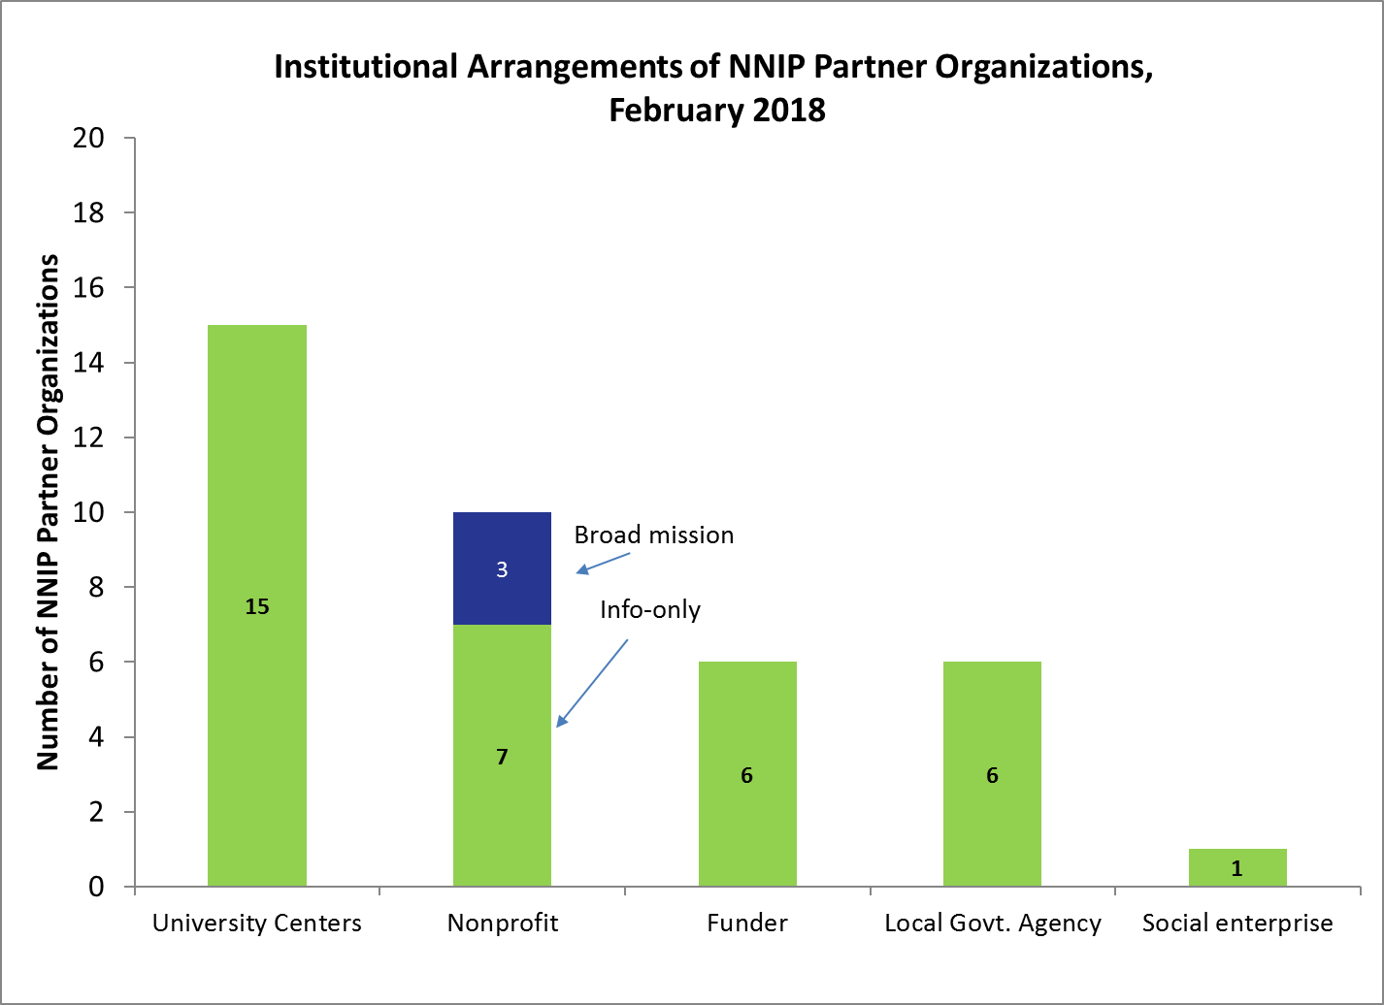
Who Are NNIP Partners?
Notes:
The partners are housed in various types of institutions –universities, independent nonprofits, local funders –5 of them have more than 1 organization, so there are 38 institutions for our 32 partner cities. (38% universities, 31% nonprofits, one-third other).
What we’ve found is that more important than the time of institution is that they are all respected organizations with a long-term stake in their community.
They are viewed as neutral - not tied to any one political agenda or issue area. Meant to last beyond any particular mayor’s term.
Data providers are confident that confidential data will be handled properly, and audiences are confident of the rigor of the analysis.
They display flexibility -Since they are on the ground, they can be responsive to community needs and emerging issues [give example] [when the foreclosure crisis hit many partners, including here in Cleveland, had already been tracking the data.
Together, the partners are an amazing network for peer learning. Rich base of knowledge to draw from - allows new partners or existing partners tackling new issues to get a jump start from others’ past experiences.

Slide 20
The NNIP Network

Slide 21
NNIP Work Plan Components
Build and strengthen local capacity
  Support current partners
  Support potential partners
Inform local and national policy
Build support for community information field
Notes:
Our network’s strategic goals are to…

