Slide 1
An Introduction to the
National Neighborhood Indicators Partnership
(NNIP)
SAN ANTONIO, TX
APRIL 6, 2016
Notes:
Welcome – this is just to get you oriented before the full meeting starts and have you know some friendly faces.
Introductions
Much of this will sound familiar to those of you who are staff in NNIP partner organizations since this is your day-to-day work.

Slide 2
National Neighborhood
Indicators Partnership (NNIP)
Collaborative effort between the Urban Institute & local partners in 30 cities
NNIP partners help residents and institutions use data to improve neighborhoods in advocacy, planning, and policymaking.
Notes:
We have a long history and have grown over time, but what we all have in common is… walk through slide.

Slide 3

Urban Institute
Urban is dedicated to elevating the debate
on social and economic policy through
rigorous research and engagement.
We believe in the power of evidence to improve lives by
  Reducing hardship amongst the most vulnerable
  Expanding opportunities for all people
  Strengthening the effectiveness of the public sector
Notes:
Urban was started in 1968 to be an outside evaluator for War on Poverty programs. Today, we do a broader array of research for governments and foundations - our work is grounded in our original research.

Slide 4
NNIP History
  1980s/1990s: local organizations funded by Jim Gibson through Rockefeller Foundation begin to use data in community organizing
June 1995
  First meeting of Urban and first six local intermediaries to discuss partnership
  Atlanta, Boston, Cleveland, Denver, Oakland, Providence
June 1996: Urban assessment completed, report published, partnership funded
Notes:
NNIP was not conceived of by Urban, but by local partners.
Started with.. Community Planning and Action Program (CPAP)_ - local groups funded by the Rockefeller Foundation to develop local solutions to emerging concerns about concentrated urban poverty in several US cities
NNIP model created by Claudia Coulton in 1992 in Cleveland

Slide 5
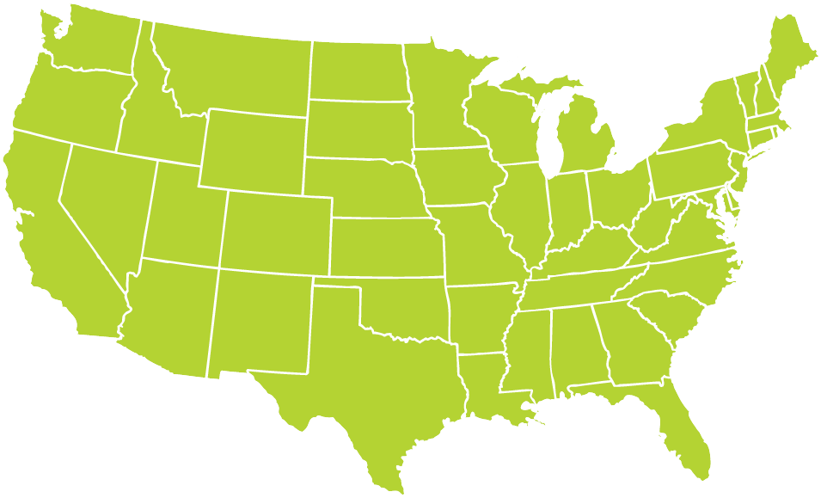
Better Data. Better Decisions. Better Communities.
Notes:
Grown from 6 founding partners to 31, and more on the way.
San Antonio joined in 2010

Slide 6
The NNIP Model of a Local Data Intermediary
Build and operate an information system with recurrently updated data on neighborhood conditions across topics in its local area;
Facilitate and promote the direct practical use of data by community and government leaders in community building and local policymaking; and
Giving emphasis to using information to build the capacities of institutions and residents in distressed neighborhoods.
Notes:
Note we’ll come back to these three ideas in more detail

Slide 7
Who Are NNIP Partners?
Notes:
The partners are housed in various types of institutions –universities, independent nonprofits, local funders. (29% universities, 24% broader mission NFP, 21% partnerships, 15% Info only NFP, 9% funder, 3% local govt)
But whatever the home, they are all respected organizations with a long-term stake in their community.
They are viewed as neutral - not tied to any one political agenda or issue area. Meant to last beyond any particular mayor’s term.
Data providers are confident that confidential data will be handled properly, and audiences are confident of the rigor of the analysis.
Since they are on the ground, they can be responsive to community needs and emerging issues [give example]
Together, the partners are an amazing network for peer learning. Rich base of knowledge to draw from - allows new partners or existing partners tackling new issues to get a jump start from others’ past experiences.

Slide 8
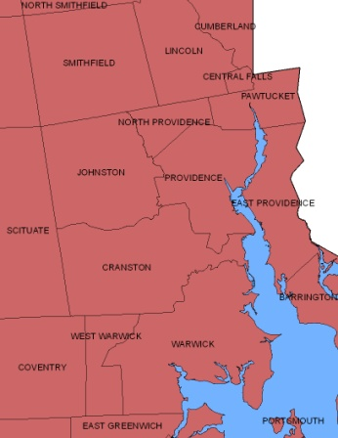
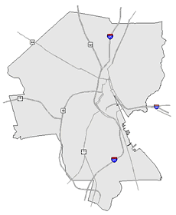
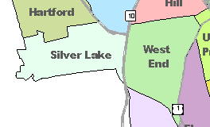
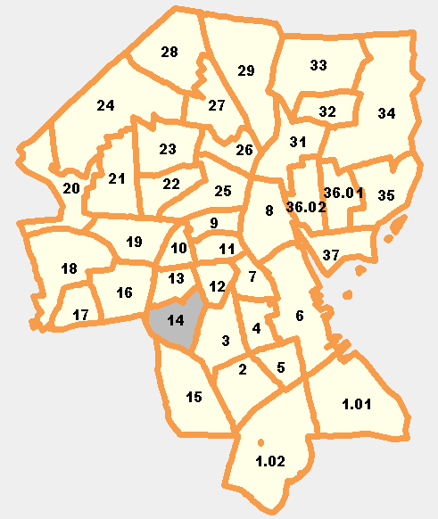
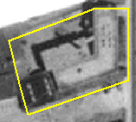
What Activities Do NNIP Partners Perform?
Assemble, Transform and Maintain Data
Types of Data
  Education
  Child care
  Births, deaths
  TANF, Food Stamps
  Health
  Crime
  Property sales, prices
  Foreclosures
REGION
CITY
NEIGHBORHOOD
PARCEL
TRACTS
Notes:
Basic requirement for partners - Assemble, transform and maintain data
The partners collect data once from police, schools, health department; and add value by clean the data; and develop ngh-level indicators.
Neighborhood-level is key since problems are not evenly distributed across cities and priority issues vary across neighborhoods.
Multiple topics: the ability to cover many issues is critical: residents don’t experience their community in silos and the solutions aren’t siloed either. (obesity example?)
Recurrent: Not just one-time project, but formal agreements to get the data every year or sometimes every day to be ready when need for data arise
Result is a one-stop shop that is a flexible resource for the whole community – much more cost-effective than each nonprofit group trying to do it themselves. There is an economy of scale.
This part is hard work and the systems are built incrementally. Perspective of investment in infrastructure – which requires commitment from partner org and their funders to grow and support the systems over time.
End with: Building and operating information systems with integrated and recurrently updated data on neighborhood conditions

Slide 9
What Activities Do NNIP Partners Perform?
Disseminate information and apply the data to achieve impact
  Maintain website (neighborhood profiles, etc.)
  Analyze local conditions, programs, and policies
  Work 1-on-1 with groups on using data for program planning and design
Use data to strengthen civic capacity and governance
  Provide training on how to use data
  Conduct public education on issues related to local capacity to use data
Notes:
Disseminate information and apply the data to achieve impact.
Maintain a website with static neighborhood data and/or interactive tools
Prepare data products for local clients (maps, fact sheets, data excerpts)
Conduct analyses of local conditions, programs, and policies
Present data and results of local analyses at public forums
Provide ad hoc help and technical assistance to local groups on how to access/use data
Work one-on-one with organizations or foundations on using data for program planning and design
Use data to strengthen civic capacity and governance.
Provide training to local groups on how to access and use data
Conduct public education on issues related to strengthening local data capacity
Collaborate with others to strengthen local data capacity (serving on civic committees, encouraging open data, etc.)

Slide 10
Why Are Local Data Intermediaries Important?
Democratize Information
  Facilitate the direct use of data by stakeholders
Serve multiple audiences and purposes
  But a central focus on strengthening and empowering low-income neighborhoods
Use information to promote collaboration
  Acts as a bridge among public agencies, nonprofits, businesses, resident groups
Notes:
Mission is about data for local action.
Disseminate passively, but most imptly in partnership with local groups.
Principles and values: The motivation for all the hard work of compiling the data is to get it used - whether for policymaking, community building, program planning.
The founding NNIP partners recognized that not everyone had equal access to information.
Focus started on and still in on low-income nghs that have traditionally not had access to data or skills to use it.
but we found that as NNIP partners matured they were also needed to help citywide nonprofits and even gov’t agencies find and use the data in their work.
Some of the most compelling stories are where data has been used to break down silos – among agencies, sectors, geographies.
Data brings people to the table to develop a common understanding of the issues, and new solutions emerge.
Example: School Readiness project – documented all the systems that work with young kids: health care providers , day care and early education providers, public school system, child advocates, family support services. Gather data and indicators about young children in the community and bring everyone to the same table to help improve outcomes for the kids.
Civic capacity = raising the interest in using data among many types of groups

Slide 11
What Makes NNIP Partners Successful?
Trusted and engaged institutions
Relevant and high-quality data and analysis
Collaborative working relationships with a wide range of local institutions
Mission to support use of data for action
Notes:
Because it is easy to get wrapped up in the numbers and colorful maps, we always emphasize that all of these qualities we’ve talked about are needed for NNIP’s success
[Fix notes]

Slide 12
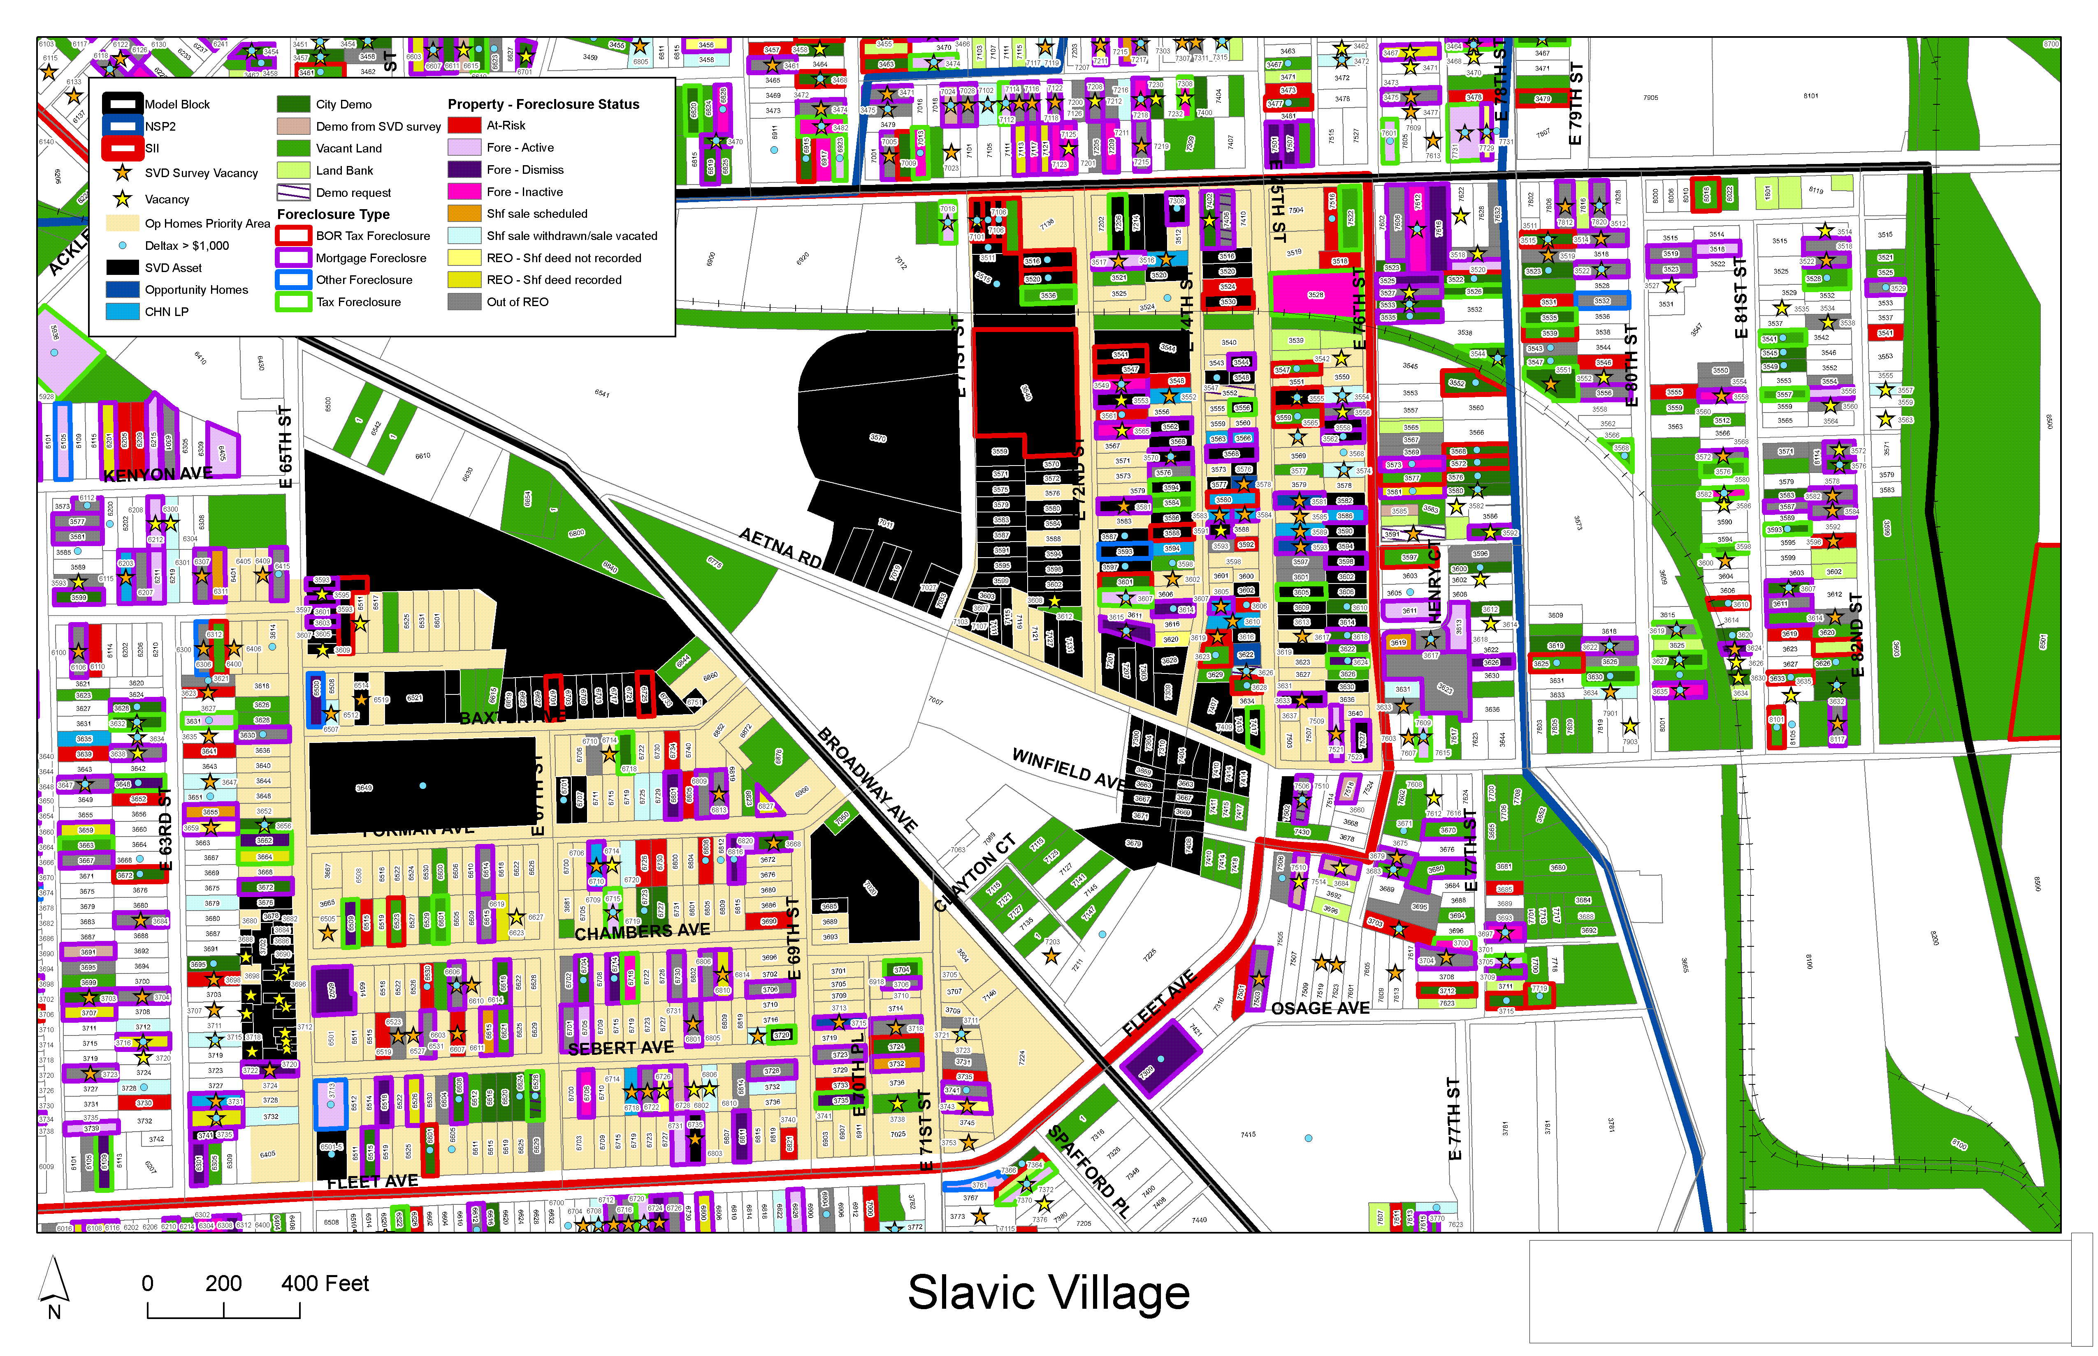
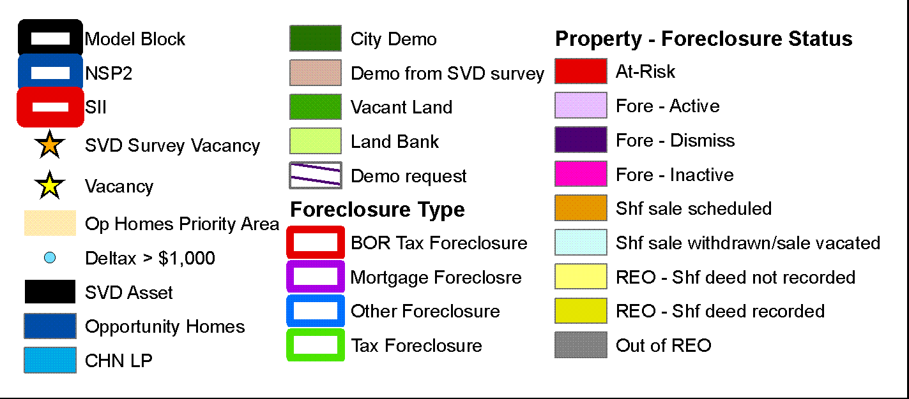
Inform community development decisions
Source: Center on Urban Poverty and Community Development, Case Western Reserve University
Notes:
This example is from one of our founding partners in Cleveland, the Center on Urban Poverty and Community Development at Case Western Reserve University.
The Neighborhood Stabilization Team in Cleveland makes use of data from Case Western’s NEO CANDO – North East Ohio Community and Neighborhood Data for Organizing – System.
Pull together parcel level data from many different sources from the assessors office, the court system, vacancy data and blight surveys, neighborhood amenities, etc.
This data can zoom down to the block and to the parcel and zoom up to look at trends and the bigger picture.
It helps the team figure out which properties make for strategic interventions with their limited resources– whether helping homeowners to find foreclosure counseling or making sure vacant properties are maintained and boarded up to fight blight and cut down on spillover effects to other properties.

Slide 13
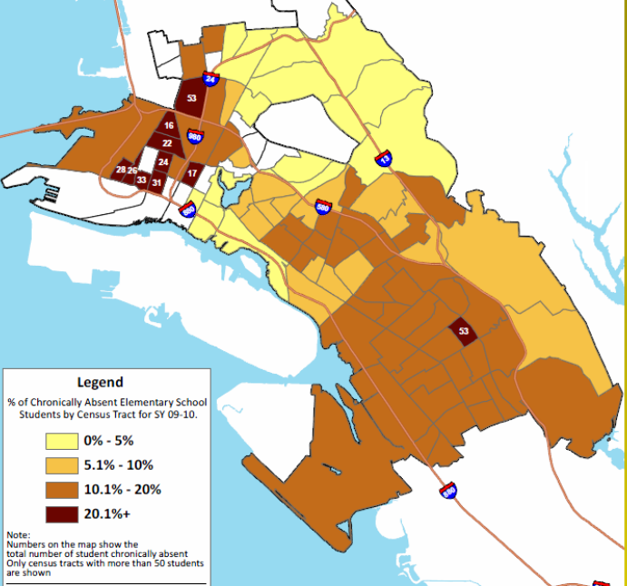

Share of Elementary Students who Were Chronically Absent
Highlight Effects of Foreclosure on Children
Forced mobility can put kids behind academically and socially.
Foreclosure prevention counselors should connect families to student services.
Schools need to understand the how their students are affected by foreclosure to design appropriate responses.
Assist school district with analysis
and operations
Source: NeighborhoodInfo DC
Notes:
13
Map of the share of chronically absent elementary school students by census tract of where the student lived – not by school location.
Darkest shade had 20% of more of their children chronically absent in this school year.
Impt b/c Root of the problem may differ ngh by ngh. By understanding the patterns, interventions can be tailored to fit the neighborhood context (transportation, childcare health)
Developed weekly tools
Action plan – parents, teachers, comm groups, service agencies

Slide 14
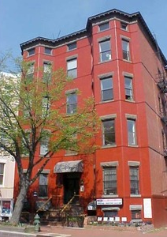
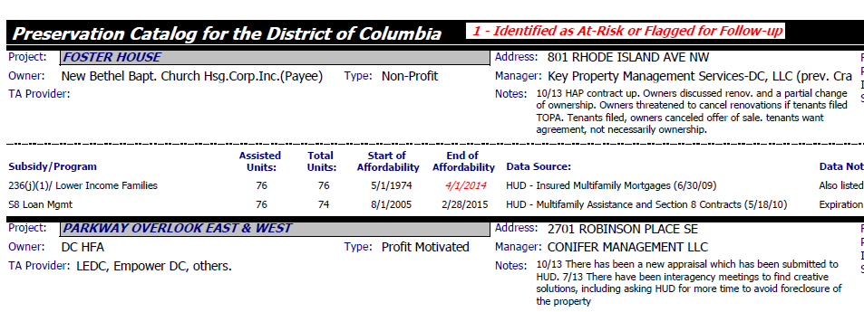
Coordinate Collective Planning and Action

Slide 15
The NNIP Network

Slide 16
Network Roles
Partners: Commit to carrying out the NNIP model at home, share knowledge, and participate in network activities.
Urban: coordinates the network, organizes and plans meetings, raises funding for and manage cross-site projects, broader outreach and communication.
Executive Committee: Elected staff members from partner organizations helps govern NNIP.
Notes:
You’ll see Rob’s Ignite on participation

Slide 17
Current Network Funding
Annie E. Casey Foundation
  General Support/Meeting Costs
  Cross-site project on Integrated Data Systems
John D. and Catherine T. MacArthur Foundation
  General Support/Meeting Costs
  Civic Tech and Data Collaborative
Notes:
[ADD SLIDE ON HOW TO STAY IN TOUCH – NNIPNews – other CIC, APDU, etc.)

Slide 18
NNIP Work Plan Components
Build and strengthen local capacity
  Support current partners
  Support potential partners
Inform local and national policy
Build support for community information field
Notes:
Go through these 1 by 1 - all interconnected.
Tom will go through an update of these on Thursday

Slide 19
NNIP Cross-site Projects
Topic | Years | Funder
Neighborhood Change | 2015-17 | Kresge Foundation and local funders
Civic Tech and Data | 2015-17 | John D. and Catherine T. MacArthur Foundation
Integrated Data Systems | 2013-15 | Annie E. Casey Foundation
NNIP and Open Data | 2012-14 | John D. and Catherine T. MacArthur Foundation
Kids and Foreclosure | 2009-12 | Open Society Foundation Annie E. Casey Foundation
School Readiness | 2007-10 | Annie E. Casey Foundation
Foreclosure Crisis | 2008-09 | Fannie Mae
Guiding Land Markets | 2004-08 | Brookings Institution
Older: Reentry Mapping Network, Neighborhoods and Health, Welfare-to-Work
Notes:
Don’t talk through individual....
One of the ways we hope to influence local policy is through cross-site projects
Note IDS session – often selected through competitive process

Slide 20
Stay in Touch! http://www.neighborhoodindicators.org/get-involved/listservs or Follow Us @NNIPHQ
Kathy Pettit: kpettit@urban.org; 202-261-5670
Leah Hendey: lhendey@urban.org; 202-261-5856
Notes:
Visit our website to sign up for our NNIPNews – which will be converted to a google group next week. There are also Twitter lists to follow our partners and you can follow the Network on Twitter @NNIPHQ
You have your packets which has the agenda for the next three days. Note code of conduct.
Feel free to ask any questions.

