Slide 1
An Introduction to the National Neighborhood Indicators Partnership (NNIP)
DALLAS, TX
OCTOBER 21, 2015
Notes:
Welcome – this is just to get you oriented before the full meeting starts and have you know some friendly faces.
Introductions
Much of this will sound familiar to those of you who are staff in NNIP partner organizations since this is your day-to-day.

Slide 2
National Neighborhood Indicators Partnership (NNIP)
Collaborative effort between the Urban Institute & local partners in 31 cities
NNIP partners help residents and institutions use data to improve neighborhoods in advocacy, planning, and policymaking.
Notes:
We have a long history and have grown over time, but what we all have in common is… walk through slide.

Slide 3
Urban Institute
Urban is dedicated to elevating the debate
on social and economic policy through
rigorous research and engagement.
We believe in the power of evidence to improve lives by
Reducing hardship amongst the most vulnerable
Expanding opportunities for all people
Strengthening the effectiveness of the public sector
Notes:
Urban was started in 1968 to be an outside evaluator for War on Poverty programs. Today, we do a broader array of research for governments and foundations - our work is grounded in our original research.

Slide 4
NNIP History
1980s/1990s: local organizations funded by Jim Gibson through Rockefeller Foundation begin to use data in community organizing
June 1995
First meeting of Urban and first six local intermediaries to discuss partnership
Atlanta, Boston, Cleveland, Denver, Oakland, Providence
June 1996: Urban assessment completed, report published, partnership funded
Notes:
NNIP was not conceived of by Urban, but by local partners.
Started with.. Community Planning and Action Program (CPAP)_ - local groups funded by the Rockefeller Foundation to develop local solutions to emerging concerns about concentrated urban poverty in several US cities
NNIP model created by Claudia Coulton in 1992 in Cleveland

Slide 5
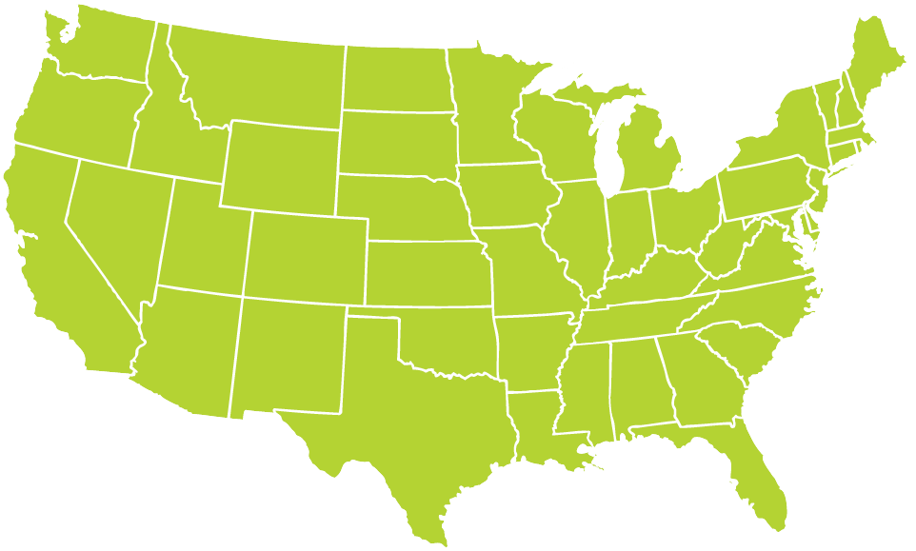
Better Data. Better Decisions. Better Communities.
Notes:
Grown from 6 founding partners to 31, and more on the way.
Dallas joined in 2005.

Slide 6
Success Factors
Trusted and engaged institutions
Relevant and high-quality data
Mission to support use of data for action
Notes:
Because it is easy to get wrapped up in the numbers and colorful maps, we always emphasize that there are three necessary components to NNIP’s success

Slide 7
Trusted and Connected Institutions
Notes:
The partners are housed in various types of institutions –universities, independent nonprofits, local funders. (29% universities, 24% broader mission NFP, 21% partnerships, 15% Info only NFP, 9% funder, 3% local govt)
But whatever the home, they are all respected organizations with a long-term stake in their community.
They are viewed as neutral - not tied to any one political agenda or issue area. Meant to last beyond any particular mayor’s term.
Data providers are confident that confidential data will be handled properly, and audiences are confident of the rigor of the analysis.
Since they are on the ground, they can be responsive to community needs and emerging issues [give example]
Together, the partners are an amazing network for peer learning. Rich base of knowledge to draw from - allows new partners or existing partners tackling new issues to get a jump start from others’ past experiences.

Slide 8
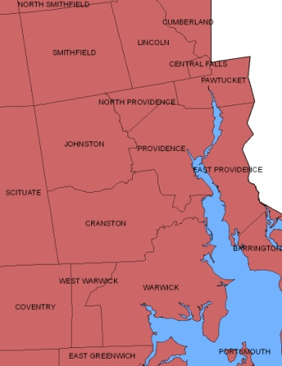
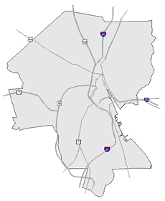
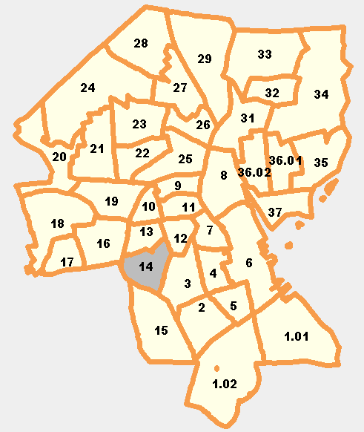
Relevant and High Quality Data
Types of Data
Education
Child care
Births, deaths
TANF, Food Stamps
Health
Crime
Property sales, prices
Foreclosures
REGION
CITY
NEIGHBORHOOD
PARCEL
TRACTS
Notes:
Basic requirement for partners - Assemble, transform and disseminate data
The partners collect data once from police, schools, health department; and add value by clean the data; and develop ngh-level indicators.
Neighborhood-level is key since problems are not evenly distributed across cities and priority issues vary across neighborhoods.
Multiple topics: the ability to cover many issues is critical: residents don’t experience their community in silos and the solutions aren’t siloed either. (obesity example?)
Recurrent: Not just one-time project, but formal agreements to get the data every year or sometimes every day to be ready when need for data arise
Result is a one-stop shop that is a flexible resource for the whole community – much more cost-effective than each nonprofit group trying to do it themselves. There is an economy of scale.
This part is hard work and the systems are built incrementally. Perspective of investment in infrastructure – which requires commitment from partner org and their funders to grow and support the systems over time.
End with: Building and operating information systems with integrated and recurrently updated data on neighborhood conditions

Slide 9
Mission: Data for Local Action
Democratize Information
Facilitate the direct use of data by stakeholders
Serve multiple audiences and purposes
But a central focus on strengthening and empowering low-income neighborhoods
Use information to promote collaboration
Acts as a bridge among public agencies, nonprofits, businesses, resident groups
Notes:
Disseminate passively, but most imptly in partnership with local groups.
Principles and values: The motivation for all the hard work of compiling the data is to get it used - whether for policymaking, community building, program planning.
The founding NNIP partners recognized that not everyone had equal access to information.
Focus started on and still in on low-income nghs that have traditionally not had access to data or skills to use it.
but we found that as NNIP partners matured they were also needed to help citywide nonprofits and even gov’t agencies find and use the data in their work.
Some of the most compelling stories are where data has been used to break down silos – among agencies, sectors, geographies.
Data brings people to the table to develop a common understanding of the issues, and new solutions emerge.
Example: School Readiness project – documented all the systems that work with young kids: health care providers , day care and early education providers, public school system, child advocates, family support services. Gather data and indicators about young children in the community and bring everyone to the same table to help improve outcomes for the kids.
Civic capacity = raising the interest in using data among many types of groups

Slide 10
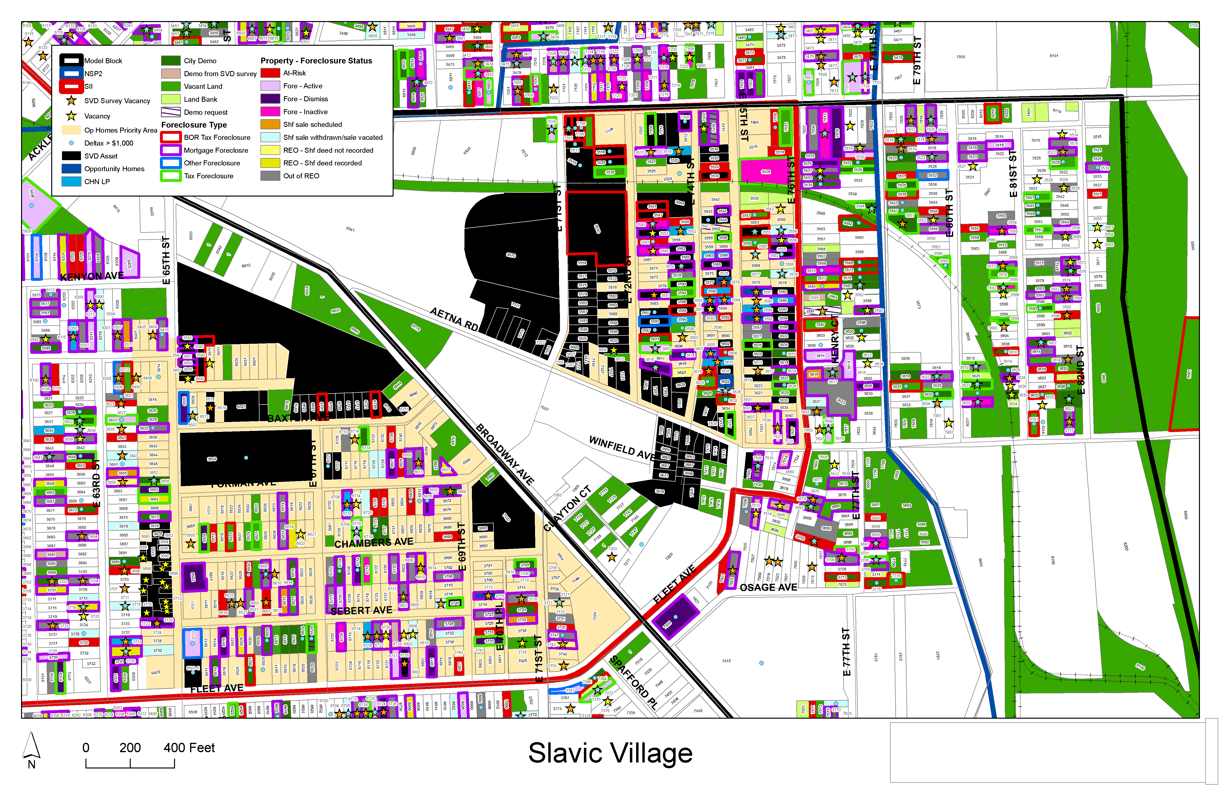
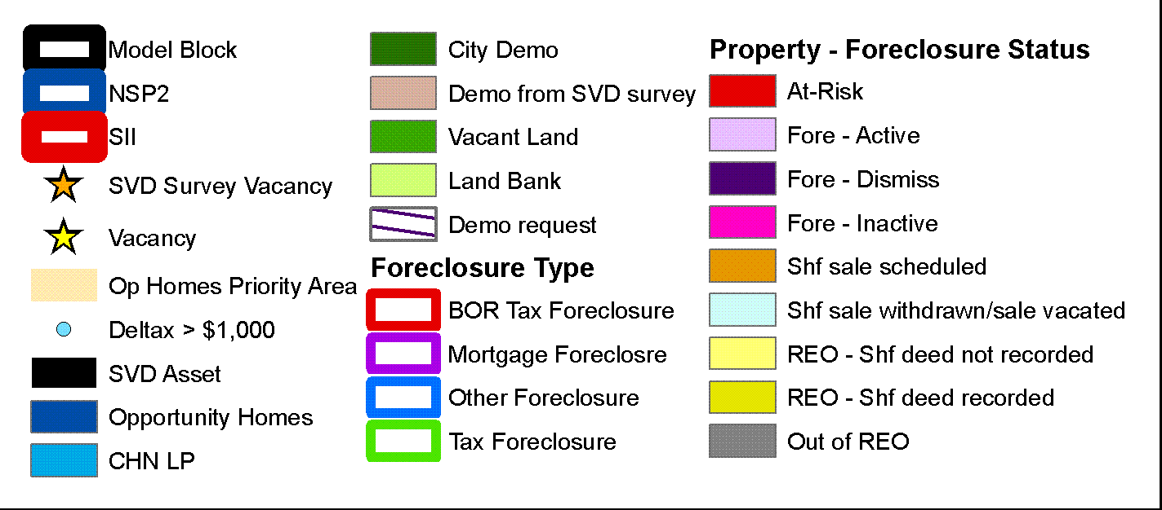
Inform community development decisions
Source: Center on Urban Poverty and Community Development, Case Western Reserve University
Notes:
This example is from one of our founding partners in Cleveland, the Center on Urban Poverty and Community Development at Case Western Reserve University.
The Neighborhood Stabilization Team in Cleveland makes use of data from Case Western’s NEO CANDO – North East Ohio Community and Neighborhood Data for Organizing – System.
Pull together parcel level data from many different sources from the assessors office, the court system, vacancy data and blight surveys, neighborhood amenities, etc.
This data can zoom down to the block and to the parcel and zoom up to look at trends and the bigger picture.
It helps the team figure out which properties make for strategic interventions with their limited resources– whether helping homeowners to find foreclosure counseling or making sure vacant properties are maintained and boarded up to fight blight and cut down on spillover effects to other properties.

Slide 11
Share of Elementary Students who Were Chronically Absent
Highlight Effects of Foreclosure on Children
Forced mobility can put kids behind academically and socially.
Foreclosure prevention counselors should connect families to student services.
Schools need to understand the how their students are affected by foreclosure to design appropriate responses.
Assist school district with analysis
and operations
Source: NeighborhoodInfo DC
Notes:
11
Map of the share of chronically absent elementary school students by census tract of where the student lived – not by school location.
Darkest shade had 20% of more of their children chronically absent in this school year.
Impt b/c Root of the problem may differ ngh by ngh. By understanding the patterns, interventions can be tailored to fit the neighborhood context (transportation, childcare health)
Developed weekly tools
Action plan – parents, teachers, comm groups, service agencies

Slide 12
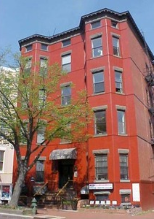
Coordinate Collective Planning and Action

Slide 13
The NNIP Network

Slide 14
Network Roles
Partners: Commit to carrying out the NNIP model at home, share knowledge, and participate in network activities.
Urban: coordinates the network, organizes and plans meetings, raises funding for and manage cross-site projects, broader outreach and communication.
Executive Committee: Elected staff members from partner organizations helps govern NNIP.

Slide 15
Current Network Funding
Annie E. Casey Foundation
General Support/Meeting Costs
Cross-site project on Integrated Data Systems
John D. and Catherine T. MacArthur Foundation
General Support/Meeting Costs
New project on civic data/tech
Notes:
[ADD SLIDE ON HOW TO STAY IN TOUCH – NNIPNews – other CIC, APDU, etc.)

Slide 16
NNIP Work Plan Components
Build and strengthen local capacity
Support current partners
Provide capacity-building opportunities & materials
Increase network participation
Increase partner and network accountability
Support potential partners
Inform local and national policy
Build support for community information field
Notes:
Go through these 1 by 1 - all interconnected.
A lot of material here – but we wanted to include it for your reference and it will (is ) posted on the website.

Slide 17
NNIP Cross-site Projects
Topic | Years | Funder
Civic Data & Tech | 2015-17 | John D. and Catherine T. MacArthur Foundation
Integrated Data Systems | 2013-15 | Annie E. Casey Foundation
NNIP and Open Data | 2012-14 | John D. and Catherine T. MacArthur Foundation
Kids and Foreclosure | 2009-12 | Open Society Foundation Annie E. Casey Foundation
School Readiness | 2007-10 | Annie E. Casey Foundation
Foreclosure Crisis | 2008-09 | Fannie Mae
Guiding Land Markets | 2004-08 | Brookings Institution
Reentry Mapping Network | 2001-04 | Annie E. Casey Foundation National Institute of Justice
Older: Neighborhoods and Health, Welfare-to-Work
Notes:
Don’t talk through individual....
One of the ways we hope to influence local policy is through cross-site projects
Note IDS session – often selected through competitive process

Slide 18
Connect at www.NeighborhoodIndicators.org or @NNIPHQ
Kathy Pettit: kpettit@urban.org; 202-261-5670
Leah Hendey: lhendey@urban.org; 202-261-5856
Notes:
You have your packets which has the agenda for the next three days.
Feel free to ask any questions.

